Slide 1
Understanding the Convention on Biological Diversity
The Convention on Biological Diversity (CBD), created under the United Nations Environment Programme (UNEP), was introduced at the Earth Summit in Rio de Janeiro in June 1992 and came into effect on December 29, 1993. With 191 Parties by August 2008, the CBD is a legally binding framework that promotes the conservation of biological diversity, the sustainable use of its components, and the fair and equitable sharing of benefits from genetic resources.
It is a milestone in international law, affirming national sovereignty over natural resources and recognizing the conservation of biological diversity as a common concern of humankind and an integral part of the development process.
The CBD encompasses all ecosystems, species, and genetic resources, and addresses biotechnology, technology transfer and development, benefit-sharing, and biosafety, setting policies and obligations and organizing technical and financial cooperation.
However, implementation is at the national level, with responsibility resting on national governments.

Slide 2
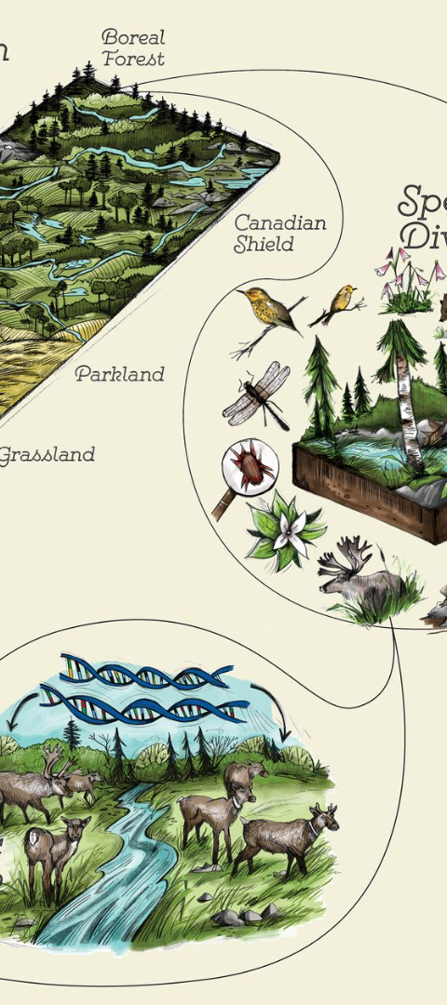
Main Objectives of the CBD
1
Conservation
2
Sustainable Use
The CBD aims to promote the conservation of biological diversity, ensuring the protection and sustainability of ecosystems, species, and genetic resources.
It encourages the sustainable use of biological diversity's components, balancing current needs with those of future generations.
3
Equitable Sharing
The CBD seeks the fair and equitable sharing of benefits arising from the utilization of genetic resources, especially with developing countries.

Slide 3
Support for Developing Countries
Preamble
Article 20.5
Parties acknowledge the need for special provisions to meet the needs of developing countries, including financial resources and access to technologies, noting the special conditions of LDCs and small island States.
Parties commit to considering the specific needs and situations of least developed countries in actions related to funding and technology transfer.

Slide 4
Protocols Under the CBD
1
Nagoya Protocol
2
Cartagena Protocol
Focuses on access to genetic resources and fair benefit-sharing, with a commitment to considering the needs of developing countries, LDCs, SIDS, and economies in transition.
Addresses biosafety of living modified organisms (LMOs), assisting Parties to implement the Protocol, with special attention to developing countries, LDCs, SIDS, and economies in transition.

Slide 5
From Concern to Action: The CBD's Genesis
1
20th Century Concerns
Scientific communities and environmental organizations increasingly raised concerns about the decline of species and ecosystems throughout the 20th century.
2
Policy and Scientific Dialogues
This awareness spurred policy and scientific dialogues aimed at creating a framework for international action on biodiversity loss.

Slide 6
The Road to the CBD
IUCN's Role
The International Union for the Conservation of Nature (IUCN) drafted initial recommendations for a comprehensive biodiversity treaty in the late 1980s.
UNEP's Draft
The United Nations Environment Programme (UNEP) prepared the first formal draft in 1991, which was considered by an Intergovernmental Negotiating Committee (INC) formed that year.
Nairobi Conference
The INC held five sessions over two years, culminating in the Nairobi Conference on May 22nd, 1992, where the final text of the CBD was adopted.

Slide 7
Rio Earth Summit: A Historic Moment
The CBD was officially opened for signature at the United Nations Conference on Environment and Development in Rio de Janeiro in June 1992. This event, also known as the Rio Earth Summit, saw a record number of nations signing the convention, reflecting a global commitment to addressing biodiversity loss.

Slide 8
Core Objectives of the CBD
Conservation
Sustainable Use
Benefit Sharing
Protection of ecosystems, species, and genetic variation across all life forms.
Utilization of biodiversity in ways that meet present needs without compromising future generations.
Sharing of benefits derived from genetic resources, particularly with developing countries, to ensure fairness and promote sustainable development.

Slide 9
Conservation of Biological Diversity
The CBD's first objective is the conservation of biological diversity, encompassing the protection of ecosystems, species, and genetic variation. This objective is fundamental to the overall mission of the CBD, aiming to safeguard the natural world for present and future generations.

Slide 10
Sustainable Use of Biodiversity
The second objective of the CBD is the sustainable use of the components of biological diversity. This involves the responsible management and utilization of natural resources, ensuring that biodiversity continues to provide the necessary services and value to humanity without being depleted.

Slide 11
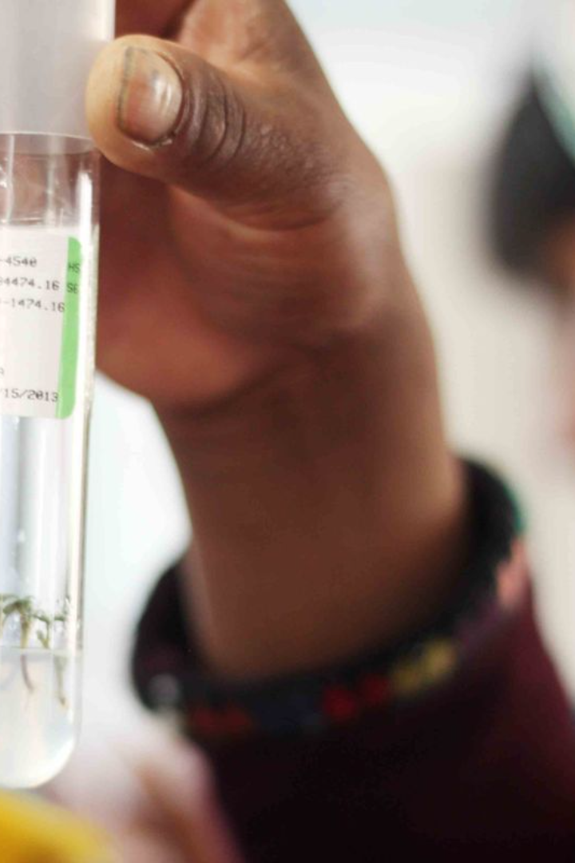
Sharing of Benefits from Genetic Resources
The third objective of the CBD is the fair and equitable sharing of benefits arising from the utilization of genetic resources. This principle is crucial for fostering international cooperation and ensuring that all parties, especially those in developing countries, benefit from the use of genetic resources.

Slide 12
Major Milestones of the CBD
2000
1
Adoption of the Cartagena Protocol on Biosafety, establishing procedures for the safe transfer and use of genetically modified organisms. Over 170 countries have ratified it.
2
2010
Nagoya Protocol on Access to Genetic Resources enters into force, aiming to equitably share benefits from commercial use and deter unauthorized access.
2010
3
Aichi Targets adopted at COP10, setting 20 measurable biodiversity reduction targets for 2020, most of which were missed by the target year.
4
2021
Glasgow Leaders' Declaration where most countries recommitted to the CBD’s goals and negotiating a strong Global Biodiversity Framework deal by COP15 in 2022.

Slide 13
Key Takeaways and Impact
Global Consensus
Sovereign Rights
The CBD has been signed by 193 countries, reflecting a nearly universal consensus on the importance of cooperation to reduce biodiversity loss.
By affirming sovereign rights over biological resources, developing countries have gained greater control over the commercial uses of genetic material and traditional knowledge.
Protocols and Safety
National Strategies
Protocols under the CBD have facilitated containment, monitoring, and awareness of risks from emerging biotechnologies.
National Biodiversity Strategies and Action Plans have mainstreamed conservation planning and commitments into country-level decision making.

Slide 14
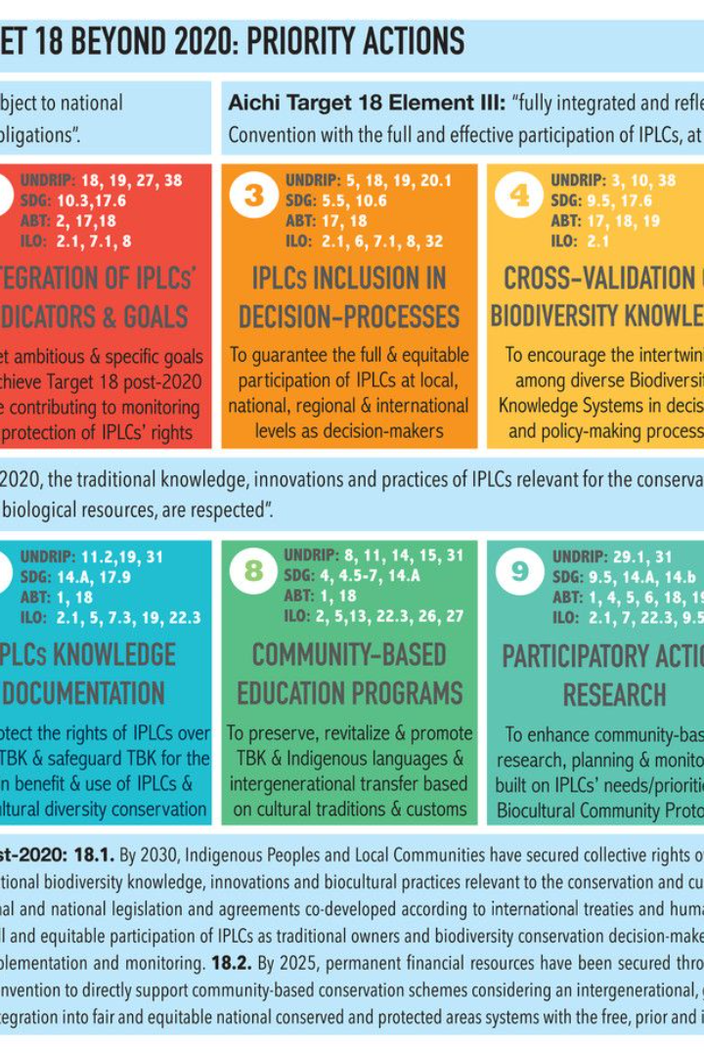
Challenges and Progress
Despite frameworks like the Aichi Targets, measurable reductions in global biodiversity loss have not been achieved. Significant barriers around conservation funding and political will remain. The CBD has been crucial for getting world governments to recognize the critical situation of declining ecosystems and unify behind frameworks intended to reverse this. Though effectiveness has been mixed, the CBD remains the central mechanism for multilateral cooperation on this existential issue facing humanity.

