Slide 1
CCP-LAW
Curricula development on Climate Change Policy and Law
Subject title: CLIMATE CHANGE DISPUTE LITIGATION
Instructor Name: Nguyễn Thị Hồng Trinh
Project No of Reference: 618874-EPP-1-2020-1-VN-EPPKA2-CBHE-JP:
The European Commission's support for the production of this publication does not constitute an endorsement of the contents, which reflect the views only of the authors, and the Commission cannot be held responsible for any use which may be made of the information contained therein.

Slide 2
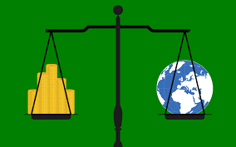
3.1. Tort-based Claims
3. TYPES OF CLAIMS AND LEGAL THEORIES
Introduction to Tort-based Claims in Climate Litigation
Definition of tort law and its relevance to climate litigation.
The role of tort claims in addressing environmental harm and climate change.
Common types of tort-based claims used in climate litigation.
The significance of tort law in holding corporations and governments accountable.

Slide 3
3.1. Tort-based Claims
3. TYPES OF CLAIMS AND LEGAL THEORIES
Negligence Claims
Explanation of negligence claims in the context of climate change.
The requirement to prove a duty of care owed by the defendant to the plaintiff.
Challenges in establishing breach and causation related to climate harm.
Notable cases where negligence claims have been made against major polluters.

Slide 4
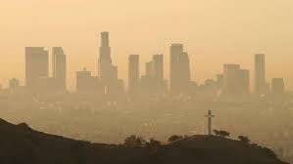
3.1. Tort-based Claims
3. TYPES OF CLAIMS AND LEGAL THEORIES
Nuisance Claims
Definition of public and private nuisance in environmental litigation.
Use of nuisance claims to address harm from pollution and environmental degradation.
Examples of successful nuisance claims in climate change litigation.
The impact of nuisance claims on regulatory practices and policies.

Slide 5
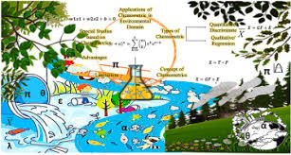
3.1. Tort-based Claims
3. TYPES OF CLAIMS AND LEGAL THEORIES
Trespass Claims
Trespass in the context of environmental harm and unauthorized use of property.
The challenge of applying traditional trespass claims to climate change impacts.
Cases where environmental contamination has led to successful trespass claims.
The role of trespass claims in highlighting the physical invasion caused by pollution.

Slide 6
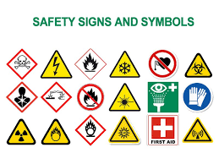
3.1. Tort-based Claims
3. TYPES OF CLAIMS AND LEGAL THEORIES
Strict Liability Claims
Overview of strict liability and its application to inherently dangerous activities.
The argument for strict liability in cases of significant environmental harm.
Examples where strict liability has been applied to pollution and environmental damage.
The potential for expanding strict liability in the context of climate change.

Slide 7
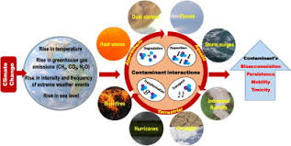
3.1. Tort-based Claims
3. TYPES OF CLAIMS AND LEGAL THEORIES
Challenges in Tort-based Climate Litigation
Scientific complexity in attributing specific harms to climate change.
The difficulty in proving causation between defendants' actions and climate impacts.
Jurisdictional and standing issues faced by plaintiffs.
Defense strategies employed by corporations and governments in tort-based cases.

Slide 8
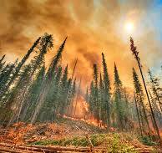
3.2. Public nuisance, negligence, and trespass
3. TYPES OF CLAIMS AND LEGAL THEORIES
Public Nuisance in Climate Litigation
Definition of public nuisance as an unreasonable interference with a right common to the general public.
Use in climate litigation to address activities contributing to global warming.
Examples of cases targeting large-scale polluters for their contributions to climate change.

Slide 9
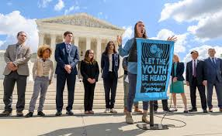
3.2. Public nuisance, negligence, and trespass
3. TYPES OF CLAIMS AND LEGAL THEORIES
Key Cases of Public Nuisance
Summaries of landmark public nuisance climate cases, such as the various state vs. oil company lawsuits.
The role of these cases in setting precedents for future litigation.
Challenges faced in proving public nuisance claims in court.

Slide 10
3.2. Public nuisance, negligence, and trespass
3. TYPES OF CLAIMS AND LEGAL THEORIES
Negligence Claims in Climate Litigation
Definition of negligence as failure to take proper care in doing something, leading to damage or injury.
Application in climate litigation to hold entities accountable for harm caused by GHG emissions.
The difficulty in establishing a duty of care and direct causation.

Slide 11
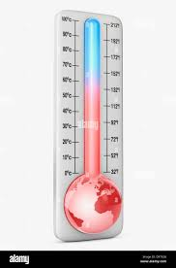
3.2. Public nuisance, negligence, and trespass
3. TYPES OF CLAIMS AND LEGAL THEORIES
Prominent Negligence Cases
Overview of significant negligence cases in climate litigation, focusing on breaches of duty of care related to climate change.
Impacts of these cases on regulatory and corporate practices.

Slide 12
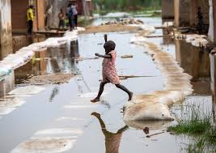
3.2. Public nuisance, negligence, and trespass
3. TYPES OF CLAIMS AND LEGAL THEORIES
Trespass in Climate Litigation
Explaining trespass as unauthorized entry onto land resulting in direct harm.
Use of trespass claims in climate litigation, particularly when property damage is caused by climate-related events.
Unique challenges in applying traditional trespass concepts to climate change effects.

Slide 13
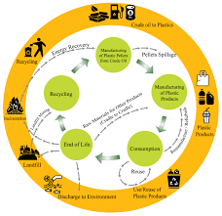
3.2. Public nuisance, negligence, and trespass
3. TYPES OF CLAIMS AND LEGAL THEORIES
Case Studies on Trespass
Detailed examples of how trespass has been argued in climate litigation cases.
Discussion on the outcomes and legal reasoning in these cases.
The evolving interpretation of trespass in the context of environmental harm.

Slide 14
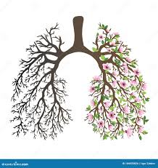
3.4. Right to life, health, property, and a healthy environment
3. TYPES OF CLAIMS AND LEGAL THEORIES
Right to Life in Climate Litigation
Definition of the right to life in the context of environmental harm.
Examples of cases where environmental degradation threatened the right to life.
The role of courts in protecting individuals against climate-related threats.

Slide 15
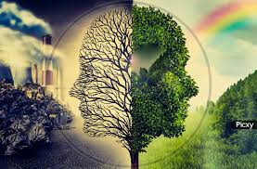
3.4. Right to life, health, property, and a healthy environment
3. TYPES OF CLAIMS AND LEGAL THEORIES
Health Rights and Climate Change
How climate change poses a significant threat to public health.
Legal actions taken to address health issues stemming from pollution and environmental degradation.
Cases linking air quality and climate change to health rights.

Slide 16
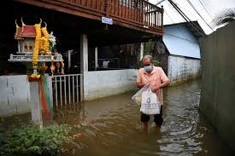
3.4. Right to life, health, property, and a healthy environment
3. TYPES OF CLAIMS AND LEGAL THEORIES
Property Rights Affected by Climate Change
The impact of climate change on property rights through natural disasters and sea-level rise.
Legal cases where property damage from climate-related events led to litigation.
The evolving concept of property rights in the face of climate change.

Slide 17
3.4. Right to life, health, property, and a healthy environment
3. TYPES OF CLAIMS AND LEGAL THEORIES
The Right to a Healthy Environment
Introduction of the right to a healthy environment as a basis for climate litigation.
Notable cases where this right has been invoked to protect natural resources and public health.
The growing recognition of environmental rights globally.

Slide 18
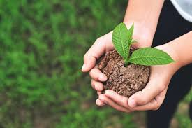
3.4. Right to life, health, property, and a healthy environment
3. TYPES OF CLAIMS AND LEGAL THEORIES
Children and Future Generations' Rights
The specific impact of climate change on children and future generations.
Legal strategies involving the rights of future generations to a livable planet.
Highlighting landmark cases like Juliana v. United States.

Slide 19
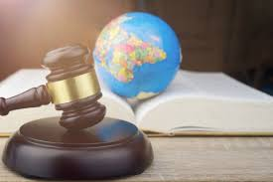
3.4. Right to life, health, property, and a healthy environment
3. TYPES OF CLAIMS AND LEGAL THEORIES
Challenges in Litigating Human Rights Claims
The complexity of linking specific climate harms to the infringement of human rights.
Jurisdictional and standing issues in bringing forward these claims.
The role of science and evidence in substantiating rights-based claims.

Slide 20
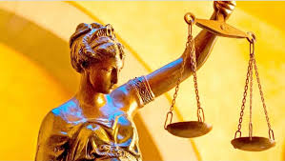
3.5. Constitutional and Statutory Claims
3. TYPES OF CLAIMS AND LEGAL THEORIES
Introduction to Constitutional and Statutory Claims
Overview of constitutional and statutory claims in the context of climate litigation.
Distinction between constitutional rights and statutory rights.
The role of these claims in advancing climate justice and environmental protection.

Slide 21
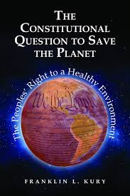
3.5. Constitutional and Statutory Claims
3. TYPES OF CLAIMS AND LEGAL THEORIES
Constitutional Claims in Climate Litigation
Explanation of how constitutional claims are used to argue for government action on climate change.
Highlighting the role of constitutional rights to life, health, and a clean environment.
Examples of successful constitutional claims in various jurisdictions.

Slide 22
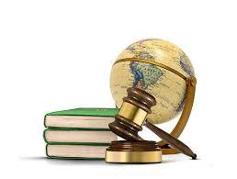
3.5. Constitutional and Statutory Claims
3. TYPES OF CLAIMS AND LEGAL THEORIES
Statutory Claims in Climate Litigation
Overview of statutory claims based on specific environmental laws and regulations.
The importance of statutory duties in regulating emissions and environmental protection.
Case studies where statutory claims have led to significant environmental rulings.

Slide 23
3.5. Constitutional and Statutory Claims
3. TYPES OF CLAIMS AND LEGAL THEORIES
The Public Trust Doctrine
Explanation of the public trust doctrine as a foundation for constitutional and statutory claims.
Its use in protecting communal resources like air, water, and land for public use.
Notable cases where the public trust doctrine has been invoked in climate litigation.

