Slide 1
CCP-LAW
Curricula development on Climate Change Policy and Law
Subject title: CLIMATE CHANGE DISPUTE RESOLUTION
Instructor Name: Tran Anh Tuan
Project No of Reference: 618874-EPP-1-2020-1-VN-EPPKA2-CBHE-JP:
The European Commission's support for the production of this publication does not constitute an endorsement of the contents, which reflect the views only of the authors, and the Commission cannot be held responsible for any use which may be made of the information contained therein.

Slide 2
4.1. Features of Online Dispute Resolution
4. Online Dispute Resolution (ODR)
Key features:
Online Dispute Resolution (ODR) refers to the use of internet and communications technology to facilitate the resolution of disputes.
It offers an alternative to in-person litigation, providing a more accessible, efficient, and often less expensive way to resolve disputes.
ODR offers unique features that can address specific needs in dispute resolution. However, it's crucial to evaluate its suitability for each situation considering its limitations and potential challenges.

Slide 3
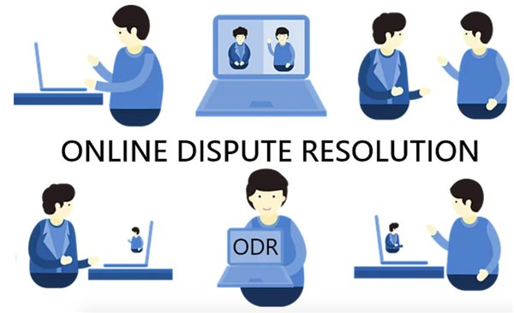
4.1. Features of Online Dispute Resolution
4. Online Dispute Resolution (ODR)
Examples of ODR applications:
Contractual disputes between businesses
Intellectual property disputes
Neighborhood conflicts
Workplace disagreements
Compensation for localized damages.
Addressing access to resources.
Resolving intellectual property disputes related to green technologies.

Slide 4
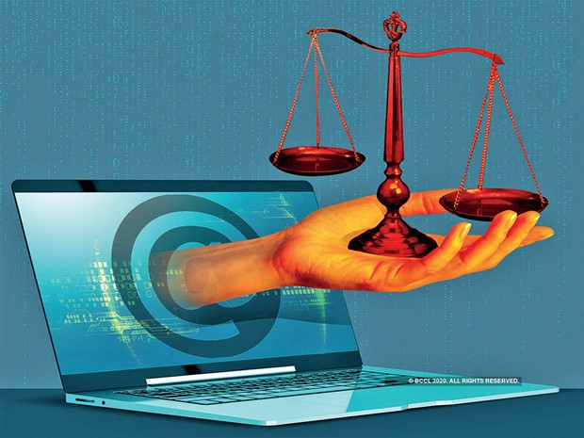
4.1. Features of Online Dispute Resolution
4. Online Dispute Resolution (ODR)
Examples of online dispute resolution mechanisms being applied in the climate change context:
UNFCCC Climate Neutral Now - This initiative by the UNFCCC includes an ODR mechanism for resolving disputes related to their carbon offsetting program. It utilizes online negotiation, mediation, and arbitration.
International Chamber of Commerce - The ICC has ODR procedures for disputes in areas like carbon trading, emissions regulation, and climate finance. Arbitrators with climate expertise facilitate resolution.

Slide 5
4.1. Features of Online Dispute Resolution
4. Online Dispute Resolution (ODR)
Examples of online dispute resolution mechanisms being applied in the climate change context:
Stockholm Chamber of Commerce - They administer a Green Claims ODR platform for resolving false/misleading environmental claims disputes in advertising and marketing. Relevant for carbon claims.
Sustainability Standards ODR - Organizations like the Rainforest Alliance provide ODR for disputes related to sustainability certification standards and climate commitments.

Slide 6
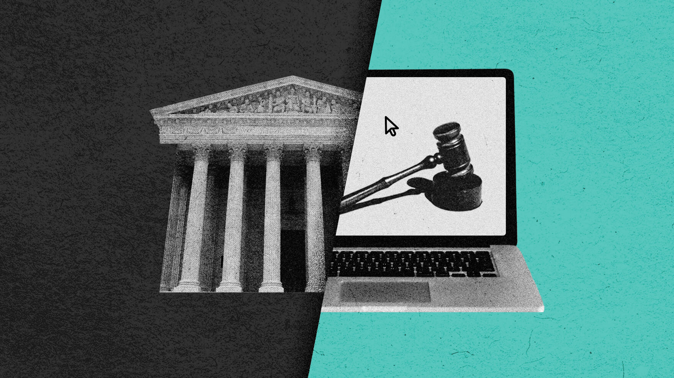
4.1. Features of Online Dispute Resolution
4. Online Dispute Resolution (ODR)
Examples of online dispute resolution mechanisms being applied in the climate change context:
Georgetown Environmental Law Program - Runs an ODR simulation for negotiating a global climate agreement involving climate modeling, online facilitation, and document sharing.
Investor-State disputes - There are examples of investor-state climate disputes handled through online arbitration platforms like that of the Permanent Court of Arbitration.

Slide 7
4.2. Types of Online Dispute Resolution
4. Online Dispute Resolution (ODR)
Some of the main types of ODR:
Automated Negotiation: This involves the use of software and algorithms to facilitate negotiation and settlement between parties without third party intervention. The software can help parties calculate settlement options.
Online Mediation: A neutral third-party mediator facilitates negotiations between parties remotely through videoconferencing, chat, or messaging. The mediator helps parties communicate and find common ground.

Slide 8
4.2. Types of Online Dispute Resolution
4. Online Dispute Resolution (ODR)
Some of the main types of ODR:
Online Arbitration: Parties present their case before an arbitrator online who then makes a final and binding decision to resolve the dispute. It is typically faster and less expensive than traditional arbitration.
Online Judging: A qualified neutral third-party with judicial training makes a decision on the dispute after reviewing arguments and evidence submitted by the parties online. The judge's decision is legally binding.

Slide 9
4.2. Types of Online Dispute Resolution
4. Online Dispute Resolution (ODR)
Some of the main types of ODR:
Peer Review Panels: A dispute is presented online to a panel of peers, experts, or stakeholders selected by the parties, who review the information and make a determination. The panel could be voting-based.
Crowdsourced Dispute Resolution: The dispute is opened up to a larger crowd-based online community to gather opinions and input, which the parties then use to reach a resolution.

Slide 10
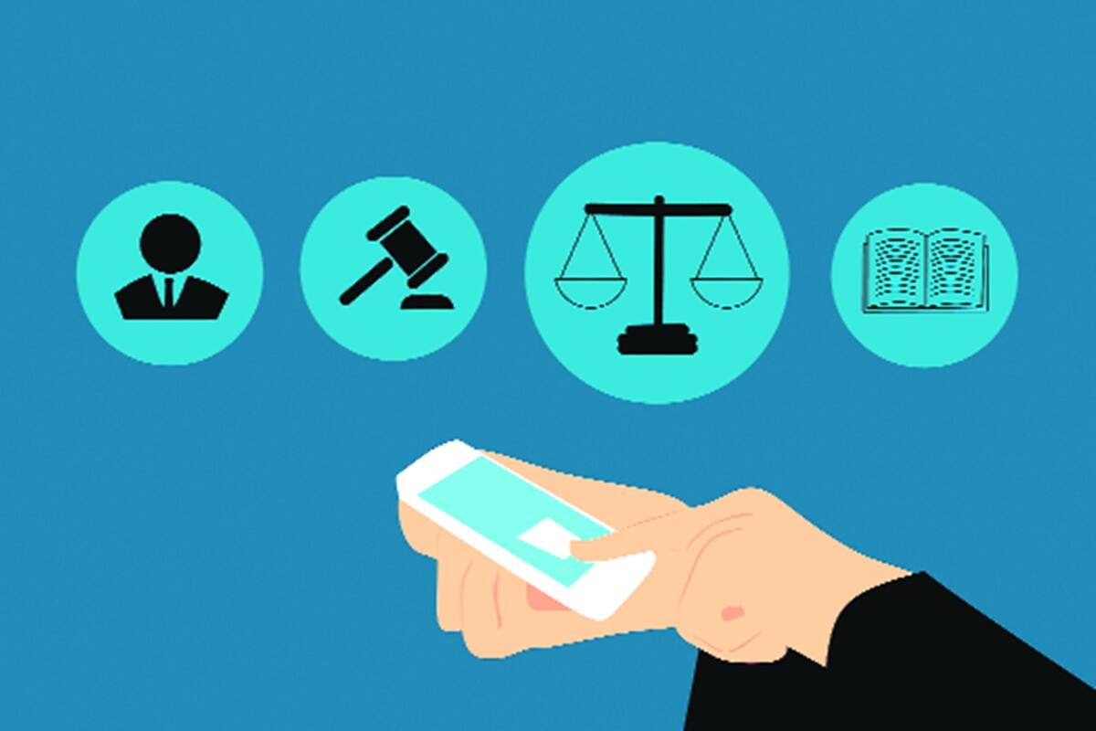
4.2. Types of Online Dispute Resolution
4. Online Dispute Resolution (ODR)
Some of the main types of ODR:
Consensus-Based Approaches: Including collaborative problem-solving, facilitated communication, and group decision-making
Hybrid Models: Combining elements of multiple ODR techniques, such as automated negotiation followed by human intervention

Slide 11
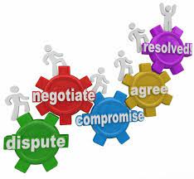
4.3. Infrastructure of Online Dispute Resolution
4. Online Dispute Resolution (ODR)
Some of the main types of ODR:
Legal framework: Relevant laws and regulations must permit ODR use for the jurisdiction, types of disputes, enforcement of resolution, limitations etc.
Internet connectivity and access: For effective Online Dispute Resolution (ODR), participants must have dependable high-speed internet for digital interactions and sharing files.

Slide 12
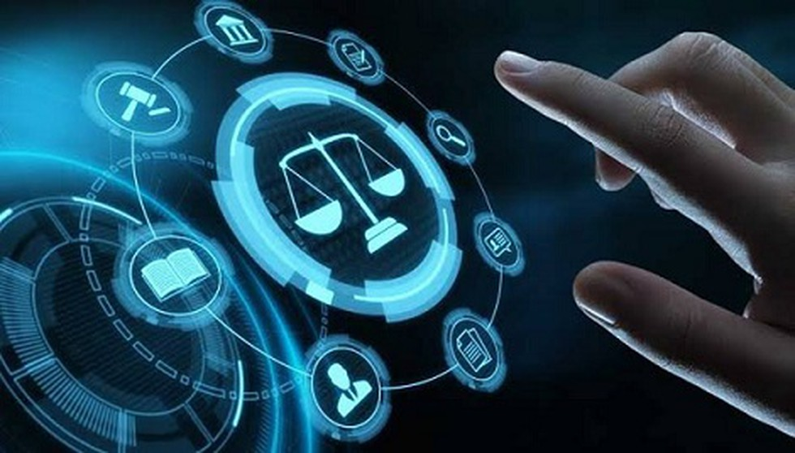
4.3. Infrastructure of Online Dispute Resolution
4. Online Dispute Resolution (ODR)
Some of the main types of ODR:
ODR platform software: A dedicated ODR platform is needed to host the end-to-end dispute resolution process online. This includes case management, scheduling, document sharing, video and messaging capabilities, mobile access etc.
Artificial intelligence: AI could be used to automate certain parts of the process like drafting agreements, predicting outcomes, reviewing documents, etc. This improves efficiency and consistency.

Slide 13
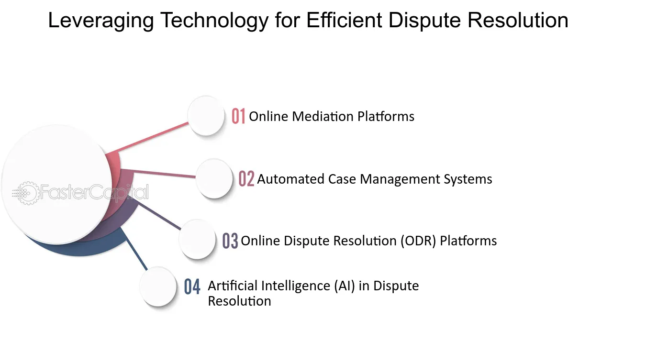
4.3. Infrastructure of Online Dispute Resolution
4. Online Dispute Resolution (ODR)
Some of the main types of ODR:
Digital signatures - Legally valid digital signatures are essential for signing binding agreements and approvals reached online. Compatible software and legal framework must support this.
Payment systems - Integrated electronic payment systems enable online payment transfers as required as part of the dispute resolution. This could include settlements, arbitration fees, etc.

Slide 14
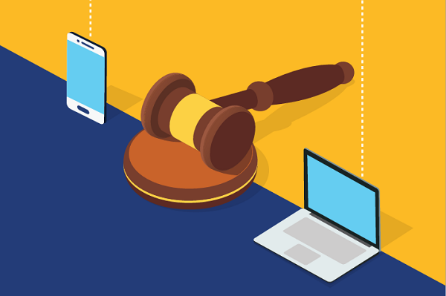
4.3. Infrastructure of Online Dispute Resolution
4. Online Dispute Resolution (ODR)
Some of the main types of ODR:
Data security and privacy: The ODR platform and associated data storage must be secure with encryption, cybersecurity protections, access controls and privacy safeguards.
Training and support: Users of the system need training on how to use the ODR platform effectively. Technical support must be available in case users face any issues.

Slide 15
4.4. Applications of ODR for resolving climate change disputes
4. Online Dispute Resolution (ODR)
A few ways ODR could be applied to help resolve climate change disputes:
Facilitating negotiations between countries on climate agreements and emission targets. ODR systems could allow asynchronous negotiations and mediate between different parties.
Resolving disputes over climate adaptation and mitigation projects. ODR could provide a faster and cheaper way to settle disputes compared to traditional litigation.

Slide 16
4.4. Applications of ODR for resolving climate change disputes
4. Online Dispute Resolution (ODR)
A few ways ODR could be applied to help resolve climate change disputes:
Facilitating negotiations between countries on climate agreements and emission targets. ODR systems could allow asynchronous negotiations and mediate between different parties.
Resolving disputes over climate adaptation and mitigation projects. ODR could provide a faster and cheaper way to settle disputes compared to traditional litigation.

Slide 17
4.4. Applications of ODR for resolving climate change disputes
4. Online Dispute Resolution (ODR)
A few ways ODR could be applied to help resolve climate change disputes:
Handling disputes over carbon credits and emissions trading. ODR systems could help verify carbon credits and handle transaction disputes in carbon markets.
Settling disputes over climate refugees and migration. As climate change displacement increases, ODR may help mediate cross-border resettlement and compensation issues.

Slide 18
4.4. Applications of ODR for resolving climate change disputes
4. Online Dispute Resolution (ODR)
A few ways ODR could be applied to help resolve climate change disputes:
Managing disputes over climate responsibility and liability. ODR could facilitate arbitration and restorative justice processes to determine liability for climate damage.
Resolving local community disputes related to renewable energy projects, geoengineering proposals, etc. ODR can help give voice to local concerns and broker agreements.

Slide 19
4.4. Applications of ODR for resolving climate change disputes
4. Online Dispute Resolution (ODR)
A few ways ODR could be applied to help resolve climate change disputes:
Providing access to climate justice for vulnerable groups and future generations. ODR can enable forms of litigation and advocacy not possible solely through in-person processes.
Supporting dialogues and agreements within communities affected by climate change impacts, fostering local solutions and reducing reliance on traditional legal systems.

Slide 20
4.5. Advantages and chalenges
4. Online Dispute Resolution (ODR)
Some key advantages and challenges of using ODR:
Advantages:
Cost-effectiveness: ODR eliminates travel and venue costs, making it cheaper than traditional in-person methods.
Accessibility: ODR platforms are accessible 24/7, allowing for dispute resolution at any time and from anywhere with internet access.
Flexibility: ODR processes often offer asynchronous communication, allowing parties to participate at their own pace and convenience.

Slide 21
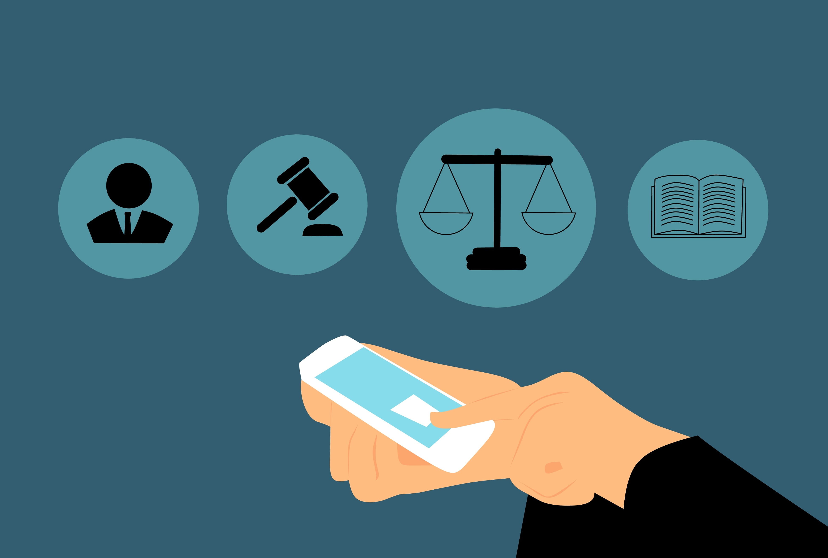
4.5. Advantages and chalenges
4. Online Dispute Resolution (ODR)
Some key advantages and challenges of using ODR:
Advantages:
Efficiency: Streamlined processes and automated features can expedite dispute resolution compared to traditional methods.
Confidentiality: Online platforms can offer greater privacy and confidentiality than public court proceedings.
Informal and less intimidating: ODR can create a less stressful and confrontational environment for parties compared to court.

Slide 22
4.5. Advantages and chalenges
4. Online Dispute Resolution (ODR)
Some key advantages and challenges of using ODR:
Advantages:
Speed: ODR systems can facilitate faster resolutions than traditional court litigation or in-person mediation. Automation like document filing speeds the process.
Data preservation: Online platforms provide a digital record of the entire process, facilitating future reference and transparency.
Wider reach: ODR can connect parties across geographical boundaries, making it suitable for international disputes.

Slide 23
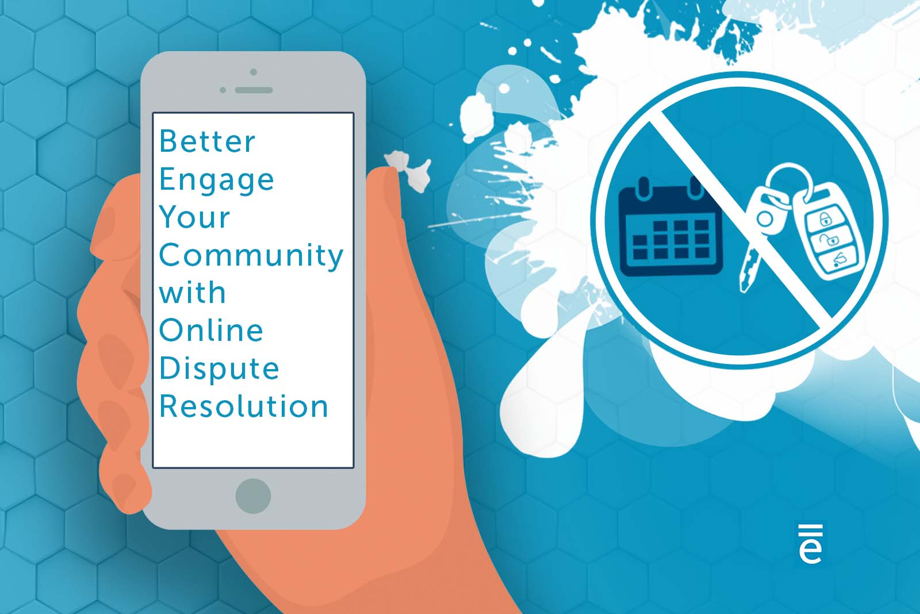
4.5. Advantages and chalenges
4. Online Dispute Resolution (ODR)
Some key advantages and challenges of using ODR:
Challenges:
Technical barriers: Unequal access to technology and digital literacy can exclude certain parties from participating.
Lack of human interaction: The absence of face-to-face interaction can hinder building trust and rapport between parties.
Limited scope: ODR may not be suitable for complex legal disputes requiring extensive evidence presentation or nuanced judgment.

Slide 24
4.5. Advantages and chalenges
4. Online Dispute Resolution (ODR)
Some key advantages and challenges of using ODR:
Challenges:
Enforcement of agreements: ODR agreements may lack the same enforceability as court judgments, requiring alternative mechanisms.
Security and privacy concerns: Data security breaches and privacy violations can be risks associated with online platforms.
Potential for bias: Algorithms used in ODR platforms could introduce biases that disadvantage certain parties.

Slide 25
4.5. Advantages and chalenges
4. Online Dispute Resolution (ODR)
Some key advantages and challenges of using ODR:
Challenges:
Limited legal expertise: ODR platforms typically don't offer legal representation, which may disadvantage some users.
Cultural differences: Cultural norms and expectations around communication and dispute resolution can pose challenges in online settings.
Unequal power: Potential for stronger parties to dominate weaker parties remains without facilitator oversight.

Slide 26
4.5. Advantages and challenges
4. Online Dispute Resolution (ODR)
Key takeaways
ODR offers several advantages over traditional dispute resolution methods, particularly in terms of cost, accessibility, and flexibility.
ODR offers a valuable alternative for resolving disputes online, but its suitability depends on the specific context and challenges.

Slide 27
4.5. Advantages and challenges
4. Online Dispute Resolution (ODR)
Key takeaways
It's crucial to consider its limitations and ensure its implementation is fair, transparent, and inclusive.
ODR should be seen as a complementary tool alongside other approaches, not a replacement for traditional dispute resolution in complex cases.

