Slide 1
CCP-LAW
Curricula development on Climate Change Policy and Law
Module: Environmental Risk Prevention and Management
Topic: Regulatory frameworks for understanding Natural Hazards and Environmental Risk: Sendai Framework, Paris Climate Agreement and Sustainable Development Goals
Instructor Name:
Project No of Reference: 618874-EPP-1-2020-1-VN-EPPKA2-CBHE-JP:
The European Commission's support for the production of this publication does not constitute an endorsement of the contents, which reflect the views only of the authors, and the Commission cannot be held responsible for any use which may be made of the information contained therein.

Slide 2
Aims of the Session
Consider the role of Frameworks in addressing Climate related, environmental and natural hazard-based risks.
Introduce the Hyogo Framework, Sendai Framework, Sustainable Development Goals and Paris Agreement as frameworks for understanding and reducing climate risk, hazards and development challenges.

Slide 3
Frameworks
Which international frameworks relating to climate change, and hazards have you heard of?
In the session, we will discuss the following:
Hyogo Framework
Sendai Framework
Sustainable Development Agenda
Paris Agreement

Slide 4
Background to Disaster Risk Reduction Policy

Slide 5
Background to Disaster Risk Reduction Policy

Slide 6
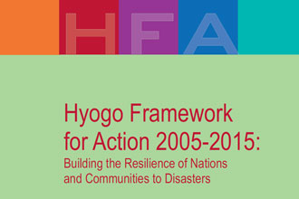
The Hyogo Framework for Action
The Hyogo Framework was agreed to reduce vulnerability and risks to natural hazards
Decrease losses (social, economic and environmental) over a 10-year period
The framework adopted strategic objectives and priority areas to reduce disaster risk
Strategic goals/objectives:
Integrate disaster risk into sustainable development policies and planning
Build resilience to hazards
Integrate risk reduction into preparedness, response and recovery

Slide 7
Priorities for Action

Slide 8
What is being done?
Exposure and vulnerability to hazards has been assessed
Existing capacities and needs have been reviewed
Increased data availability has been encouraged informing implementation
Increased incentives and encouragement of knowledge transfer
Identified essential investment for risk assessment and early warning systems

Slide 9
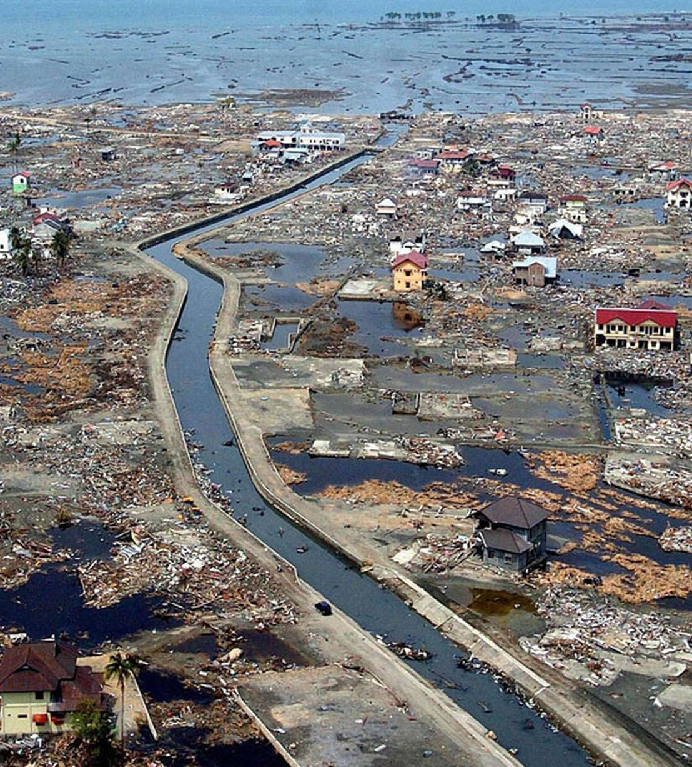
Examples
Disaster-prone countries targeted and assessed
Establishment of a tsunami early warning system in the Indian Ocean
Activities that encompass all hazards – storms, floods, droughts, landslides, heat waves and volcanic eruptions
Increased international co-operation to disaster preparedness at regional and global scales
Disaster risk reduction efforts considered as part of development funds

Slide 10
Examples
Education
Early warning systems
Land use planning
Amended and implementing policies and laws
Build capacity
Implement risk reduction measures
Preparedness
Pre-disaster recovery planning
Post-disaster needs assessment

Slide 11
What is the Sendai Framework?
The Sendai Framework is a voluntary non-binding agreement which recognises that the state has the primary role to reduce disaster risk, but that responsibility should be shared with other stakeholders including local government, the private sector and other stakeholders.
“The substantial reduction of disaster risk and losses in lives, livelihoods and health and in the economic, physical, social, cultural and environmental assets of persons, businesses, communities and countries.”

Slide 12
Hyogo to Sendai Framework
There were some improvements made from the structure and content in the Hyogo Framework to the structure and content of the Sendai Framework:
Stronger focus on Disaster Risk Prevention rather than Disaster Risk Management
The scope is clearer as there are guidelines for addressing the ‘Priorities for Action’
The role of stakeholders are taken into consideration
Local, national, regional and global levels are addressed within the Priorities for Action.
Climate Change and Sustainable Development is given more precedence.

Slide 13
Hyogo to Sendai Framework continued…
Focus on stakeholders and the importance of an inclusive approach to disaster risk management, with a clear articulation of responsibilities across public and private stakeholders.
Importance of Health – very important in terms of women and children’s specific needs.
Role of science and technology in disaster risk reduction.
Prevention of NEW disaster risks….link this back to the lectures on vulnerability. Consider what vulnerabilities are already in place within a location.

Slide 15
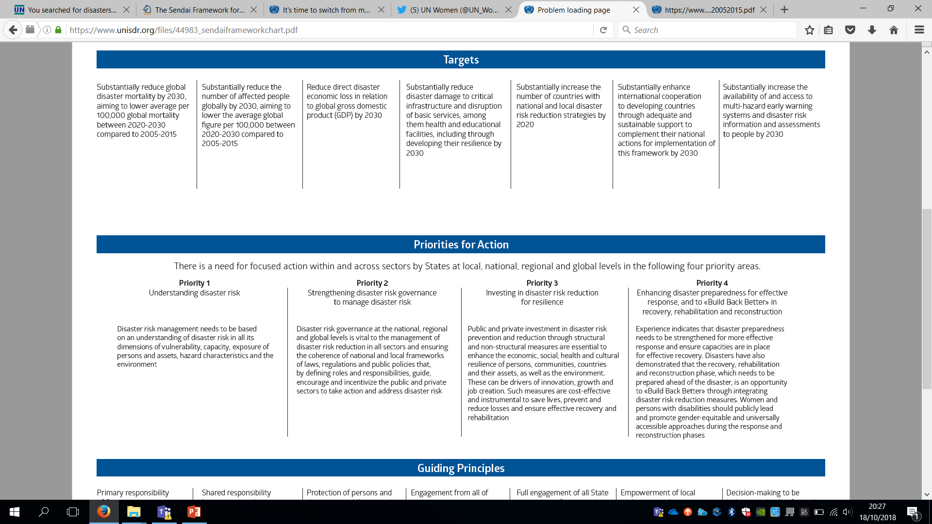

Slide 18
Priority 1: Understanding Disaster ‘Risk’
We now know that disaster risk and disasters are not only composed of natural hazards but are socially constructed.
The need to assess why certain groups in society and particular places are at greater risk, what can be done to reduce this in ‘normal’ life and then how can a plan be developed in order to manage and reduce this risk further in a disaster event.
The need to gather data and create disaster risk maps to assess the level and patterns of vulnerability and risk.
More communication is required between scientists, social scientists and policy makers. People need t understand how to manage their spaces better.

Slide 19
Priority 2: Strengthening Disaster Risk Governance to manage Disaster Risk
There is a need to invest in governance. Why? What role does it have in Disaster Risk Governance? Link back to the Legal Reviews for Disaster Risk Reduction and Management in the Political Vulnerability Lecture.
It can address any policy gaps and ensure that there is accountability and transparency which should prevent the generation of any new risks and manage the current risks.
It should provide a strategic vision for reducing disaster risks.
Assists in the communication at various different levels of society.

Slide 20
Priority 3: Investing in Disaster Risk Reduction for Resilience
Abandon traditional reactive approaches to disaster risk in favour of a proactive approach.
Disaster Risk Reduction preventative strategies is recognised to cost less than disaster response strategies. Why do you think that governments may choose a reactive approach?
Engagement with scientists to offer cost-effective disaster risk reduction strategies. This requires investment.

Slide 21
Priority 4: Enhancing Disaster Preparedness for Effective Response and to ‘Build Back Better’
Build back better for longer term risk reduction and sustainability for the people within a place and the environment.
Engage with all groups for a more inclusive, tailored and practical approach that local community members will adopt and that will work for them. EQUALITY!!
Investing properly should ensure that disaster costs (human and economic) will reduce in time.

Slide 22
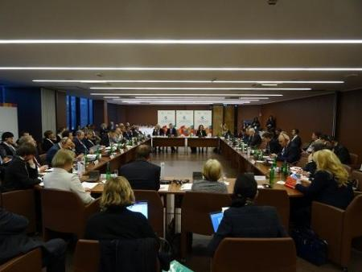
Governance
The concept of governance includes three main components: “authority; decision-making and accountability”.
“Governance determines who has power, who makes decisions, how other players make their voice heard and how account is rendered.”
Again – consider context here….which groups or communities are most vulnerable?

Slide 23
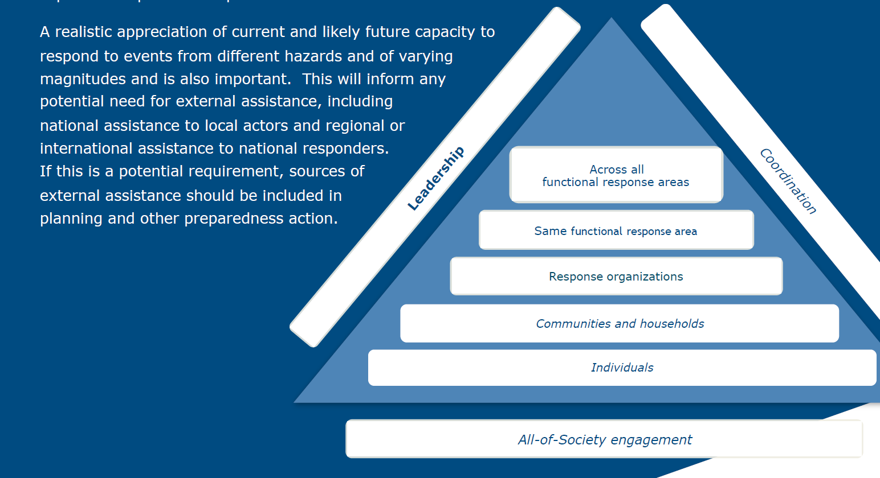

Slide 24
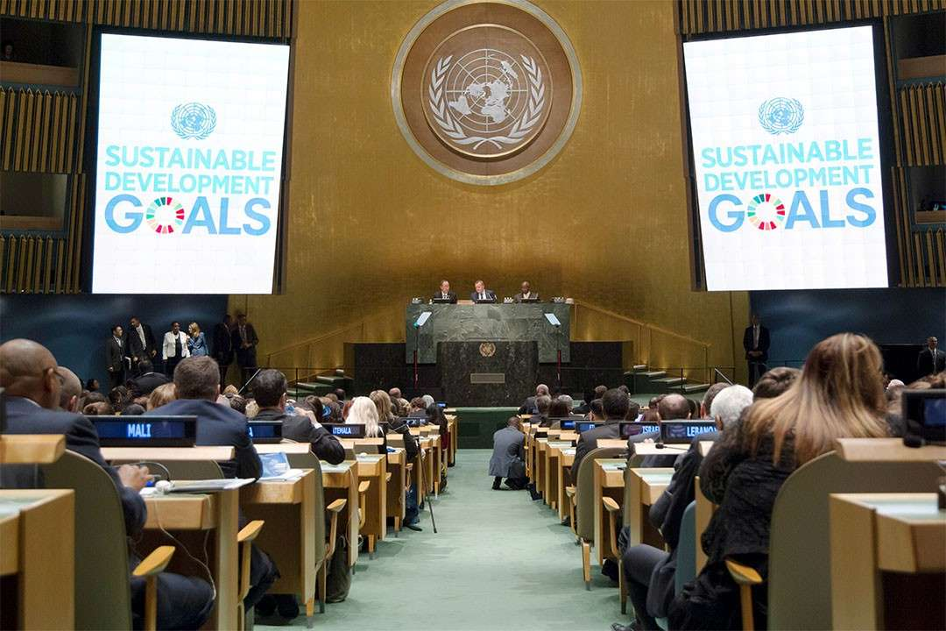
2030 agenda FOR sustainable DEVELOPMENT
In September 2015, more than 190 world leaders committed to the 17 Sustainable Development Goals to help end extreme poverty, fight inequality, combat climate change, and build resilience to disasters.
While all the Sustainable Development Goals are relevant for building a sustainable and resilient world, a number of them have targets directly or indirectly related to disaster risk reduction.
Implementing the Sustainable Development Goals also contributes to achieving the goal of the Sendai Framework to prevent new and reduce existing disaster risk and strengthen resilience.

Slide 25
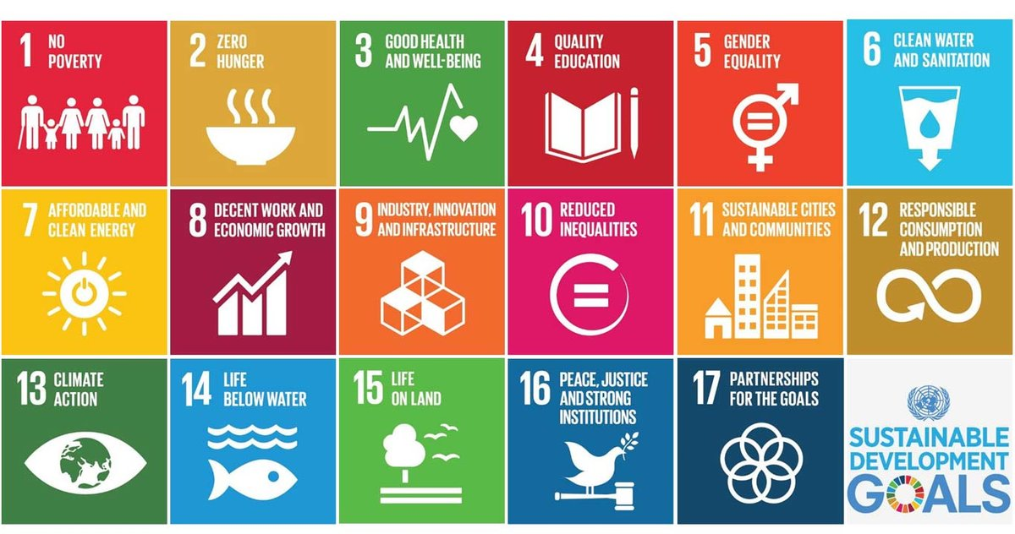

Slide 26
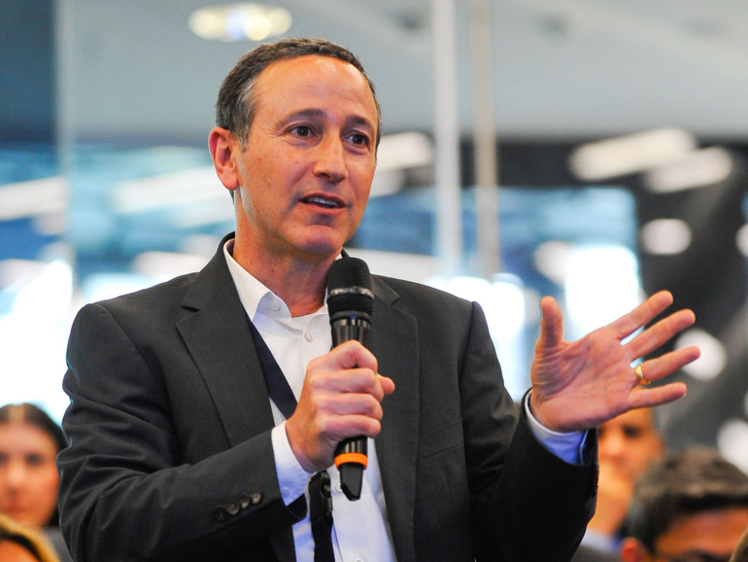
“Disaster risk reduction is at the heart of the 2030 Agenda. Development that is not risk informed cannot be sustainable. Recurring disaster losses are a significant brake on poverty eradication. The implementation of the Sendai Framework for Disaster Risk Reduction is essential for the achievement of the Sustainable Development Goals”
(Robert Glasser – Special Representative of the Secretary-General for DRR)

Slide 27
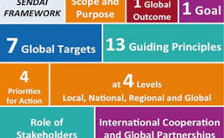
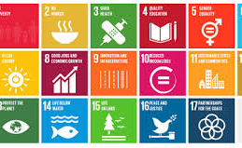
Sendai Framework and SDGS
Here is a short video on the SDGs and Sendai Framework:
https://www.youtube.com/watch?v=N6soXnTsgZg
How do the 7 targets outlined in the SFDRR help to meet some of the SDGs?

Slide 28
Country Profiles - SDG Case Studies
Explore the status of your country profile in achieving the SDGs:
Bangladesh
Chad
United Kingdom
Spain
Japan
Vietnam
Malaysia
Haiti
India
Mozambique
Identify areas for improvement
How do hazards influence the achievement of the SDGs for each country?
How do hazards relate to the achievement of other development challenges?

Slide 29
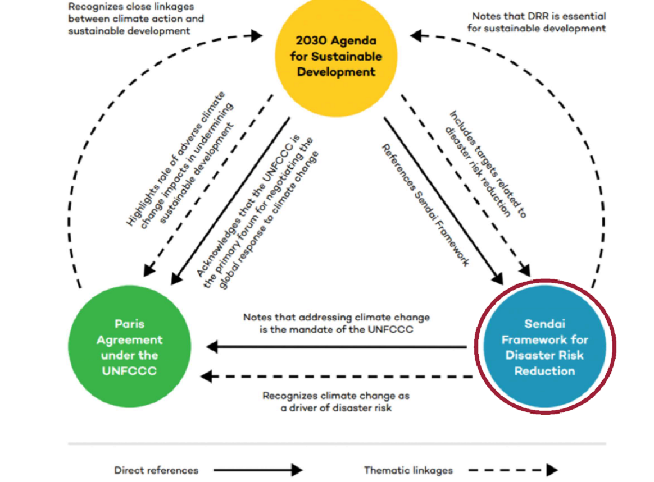
Integration of frameworks
A rare but significant opportunity to build coherence across different but overlapping policy areas and science. Taken together these framework and agreements provide a more complete resilience agenda:
• Addressing fragmentation – policy, practice and science
• Strengthening resilience framing for multi-hazard assessments and action

Slide 30
Paris Agreement
The Paris Agreement is a legally binding international treaty on climate change. It was adopted by 196 Parties at the UN Climate Change Conference (COP21) in Paris, France, on 12 December 2015. It entered into force on 4 November 2016. Its overarching goal is to hold “the increase in the global average temperature to well below 2°C above pre-industrial levels” and pursue efforts “to limit the temperature increase to 1.5°C above pre-industrial levels.” However, in recent years, world leaders have stressed the need to limit global warming to 1.5°C by the end of this century. That’s because the UN’s Intergovernmental Panel on Climate Change indicates that crossing the 1.5°C threshold risks unleashing far more severe climate change impacts, including more frequent and severe droughts, heatwaves and rainfall. To limit global warming to 1.5°C, greenhouse gas emissions must peak before 2025 at the latest and decline 43% by 2030. The Paris Agreement is a landmark in the multilateral climate change process because, for the first time, a binding agreement brings all nations together to combat climate change and adapt to its effects.

Slide 31
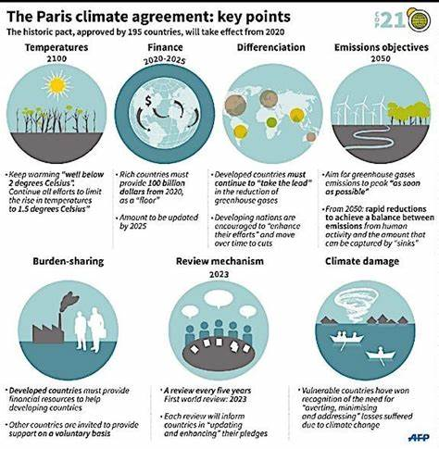
Key Priorities of the Climate Agreement

Slide 32
Accountability
This will be discussed in more detail in Session 4.

Slide 33
Conclusion
Frameworks have been put in place to better understand the impacts that a changing climate, unsustainable development and subsequently increased hazard risk are having in the time of the Anthropocene.
Frameworks such as the Sendai Framework, Sustainable Development Goals and Paris Agreement have all been established to set goals and time related targets to achieving these and there are guidelines within each to assist nations with doing so.
The three key international frameworks are all intertwined and work towards supporting each other in achieving their respective goals.
There are key challenges and setbacks for achieving all goals and there are criticisms in how the frameworks have been designed, whether they should be more tailored, the level of accountability and the feasibility of the targets set.

Slide 34
References
Averchenkova, A., Higham, C., Chan, T., Keuschnigg, I., Mercer, L., Taylor, P., Turner, S., Setzer, J., Hope, E., Billingham, C., Samarasinha, N., Fhearraigh, D. mac, & Kosubek, Z. M. (2024). Impacts of climate framework laws Lessons from Germany, Ireland and New Zealand. www.lse.ac.uk/granthaminstitute/
Leal Filho, W., Wolf, F., Lange Salvia, A., Beynaghi, A., Shulla, K., Kovaleva, M., & Vasconcelos, C. R. P. (2020). Heading towards an unsustainable world: some of the implications of not achieving the SDGs. In Discover Sustainability (Vol. 1, Issue 1). Springer Nature. https://doi.org/10.1007/s43621-020-00002-x
Kleespies, M. W., & Dierkes, P. W. (2022). The importance of the Sustainable Development Goals to students of environmental and sustainability studies—a global survey in 41 countries. Humanities and Social Sciences Communications, 9(1). https://doi.org/10.1057/s41599-022-01242-0
Mosneaga, A. (2022). Unsustainable development, disasters and displacement: Revisiting the governance challenge. International Journal of Disaster Risk Reduction, 79. https://doi.org/10.1016/j.ijdrr.2022.103172
Nations Office for Disaster Risk Reduction, U. (2015). Sendai Framework for Disaster Risk Reduction 2015 - 2030.
UNFCC. (2015). Adoption of the Paris Climate Agreement - Paris Agreement text.

