Slide 1
The Ramsar convention
Convention on Wetlands of International Importance Especially as Waterfowl Habitat, 1971

Slide 2
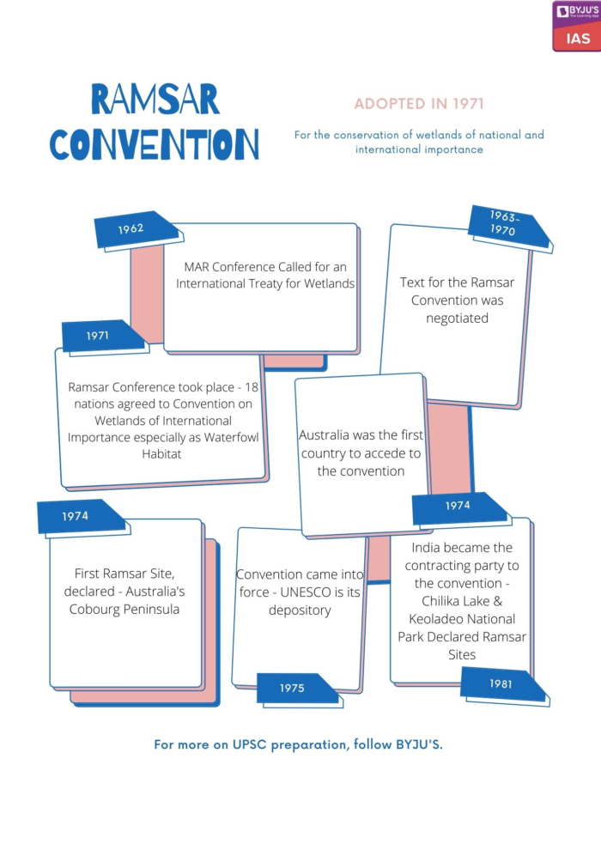
Introduction
The Ramsar Convention’s primary aim is the conservation of wetlands across the globe, especially those serving as habitat for waterfowls.
One of the major reasons for wetlands’ significance is their role as carbon sinks in climate change mitigation.
It was concluded in Ramsar, Iran on 2nd February 1971, coming into force on 21st December 1975.
As of 2023, there are 172 States party to the Ramsar Convention and 2500 wetlands designated as being of international importance. These are also known as ‘Ramsar Sites.’
The Convention is administered and reviewed on a triennial basis, at the Conference of the Contracting Parties (COP).

Slide 3
Key Provisions
Article 2:
This Article requires all Contracting Parties to designate suitable areas within their territory (that fulfil the definition of wetlands as given in Article 1) for inclusion in the List of Wetlands of International Importance (“List”), particularly those areas that serve as habitat for waterfowls.
At least one such designation must be made at time of acceding to the Convention and Parties may add or subtract from the List, though they must consider their international obligations for conservation and management of migratory stocks of waterfowl when doing so.
The designated wetland should be internationally significant in terms of ecology, zoology, botany, hydrology, limnology.
Designations do not affect sovereign rights of the Party over its territory.

Slide 4
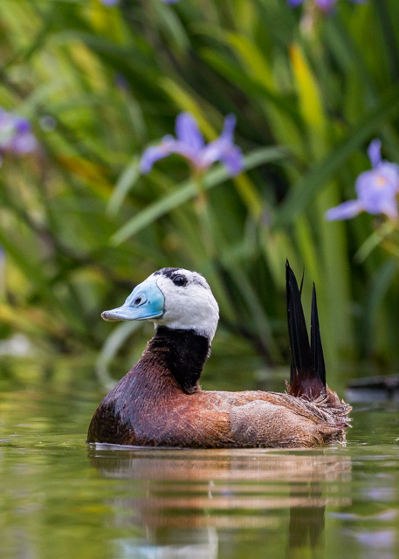
Article 3(2):
Parties should arrange to be informed if the ecological character of a designated wetland changes/is changing/is likely to change due to pollution, technological development, or human interference. Such information should be provided immediately to the International Union for the Conservation of Nature and Natural Resources.
Article 4:
Parties shall promote wetlands and waterfowl conservation by establishing nature reserves on wetlands (designated or not). If a wetland is deleted from the List or its boundaries are restricted, the resource loss may be compensated through additional nature reserves for waterfowl.
Parties shall encourage research and information exchange on wetlands and endeavour to increase waterfowl population through management.

Slide 5
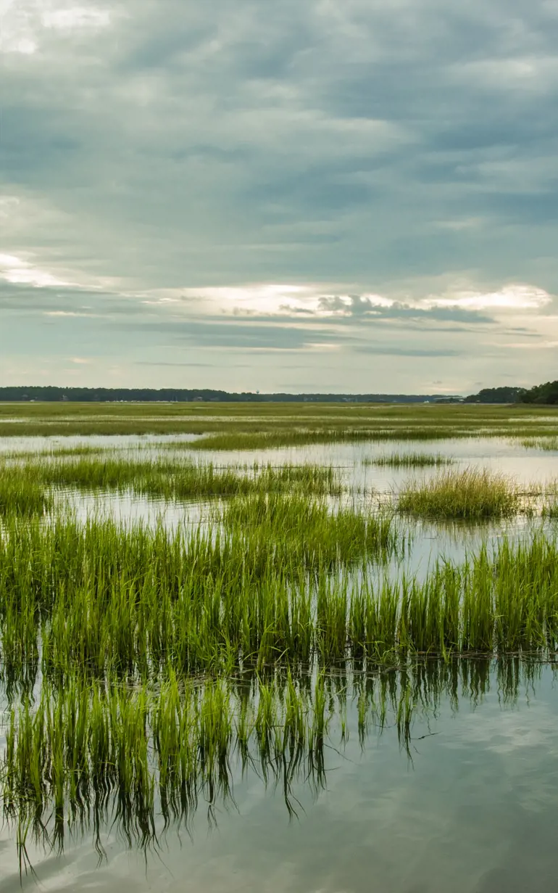
Article 5:
Parties shall consult with each other regarding Convention obligations where a wetland extends over more than one territory or they share a water system. They shall coordinate and support conservation policies for the wetlands, flora and fauna.
Article 6:
Parties shall convene advisory Conferences on the Conservation of Wetlands and Waterfowl to discuss: implementation of the Convention; changes to the List; consideration of information regarding ecological changes; formulate recommendations for conservation and management of wetlands, flora and fauna; request international bodies for reports and statistics for international matters.
The recommendations made should be utilized by those engaged in wetlands management at all levels.

Slide 6
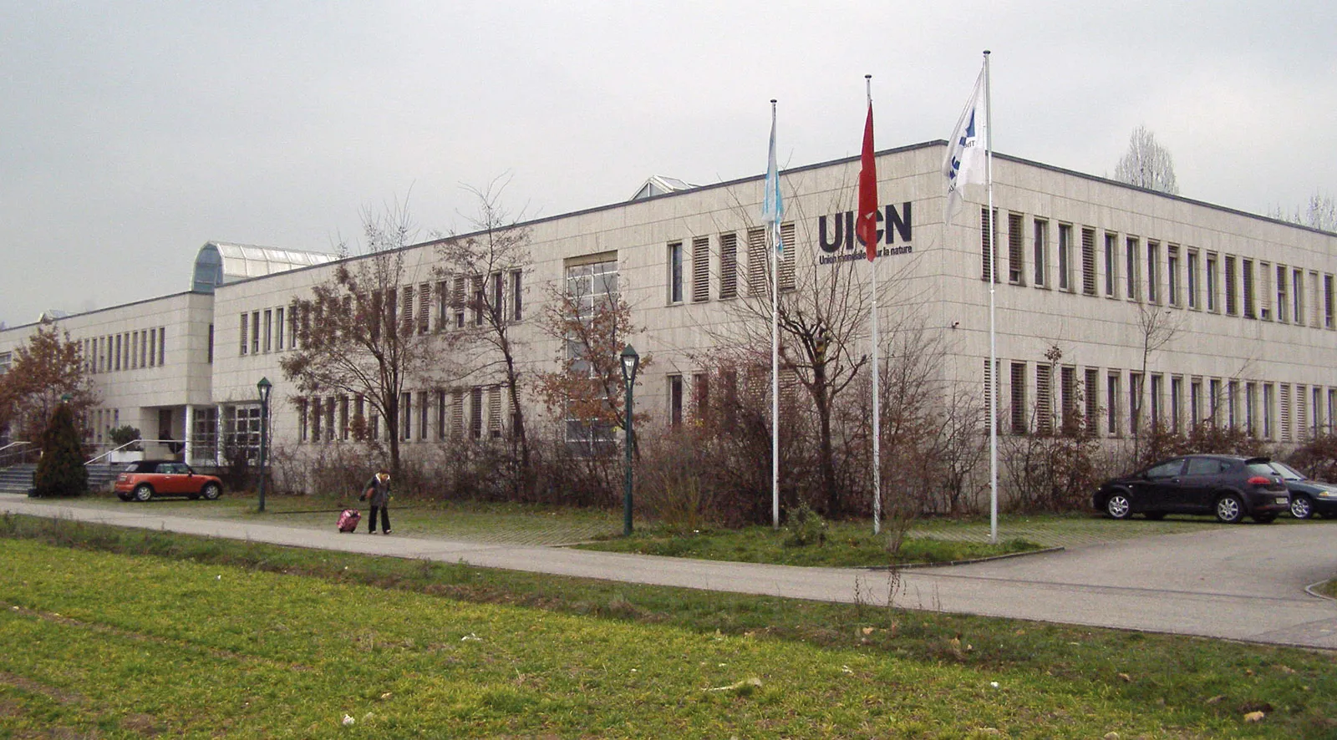
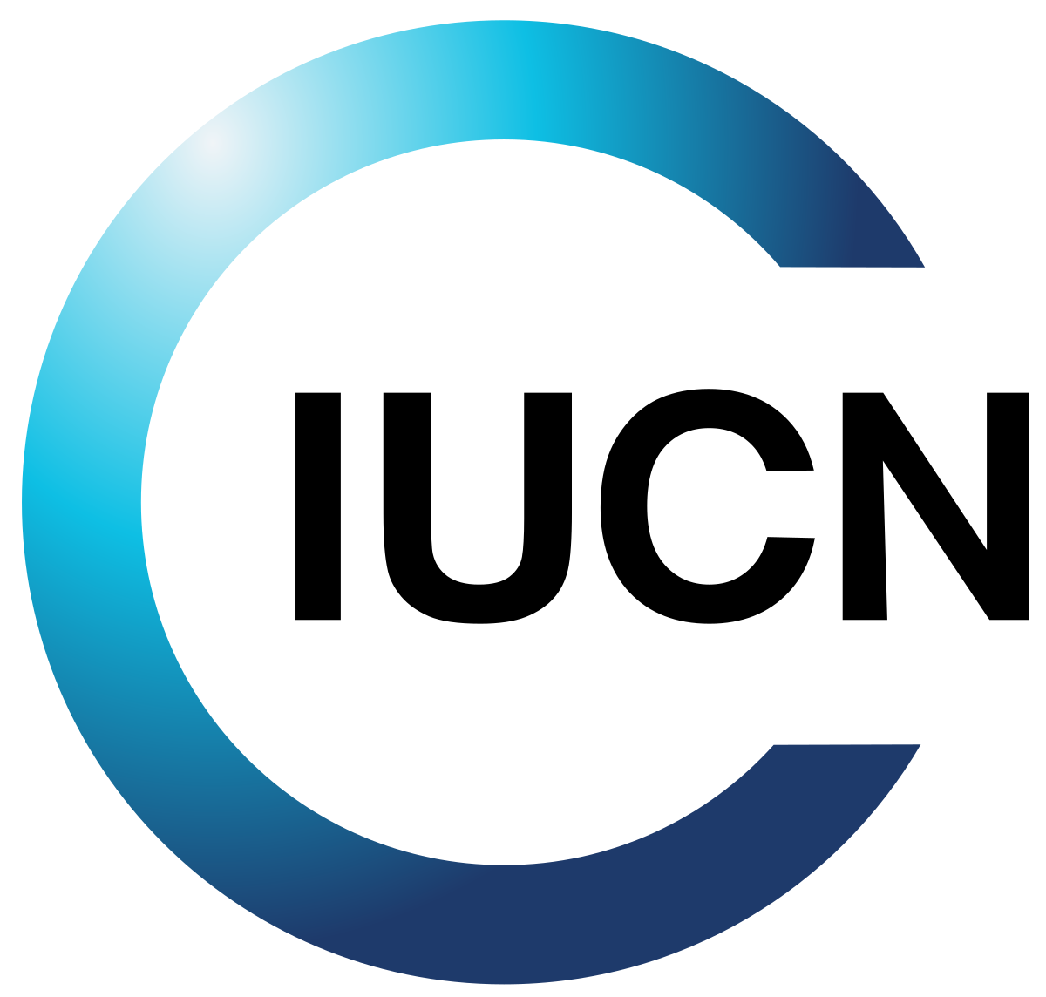
Article 8:
The continuing bureau duties – maintaining the List, receiving information regarding ecological changes – shall be carried out by the International Union for the Conservation of Nature and Natural Resources, until a different organization or government is appointed by a majority of two-thirds of all Contracting Parties.
The duties include: to assist in organization of the advisory Conferences; to maintain the List; to receive information of ecological changes to designated wetlands; to communicate information regarding changes in the List and ecology of wetlands to other Parties; convey Conference recommendations to specific States.

Slide 7
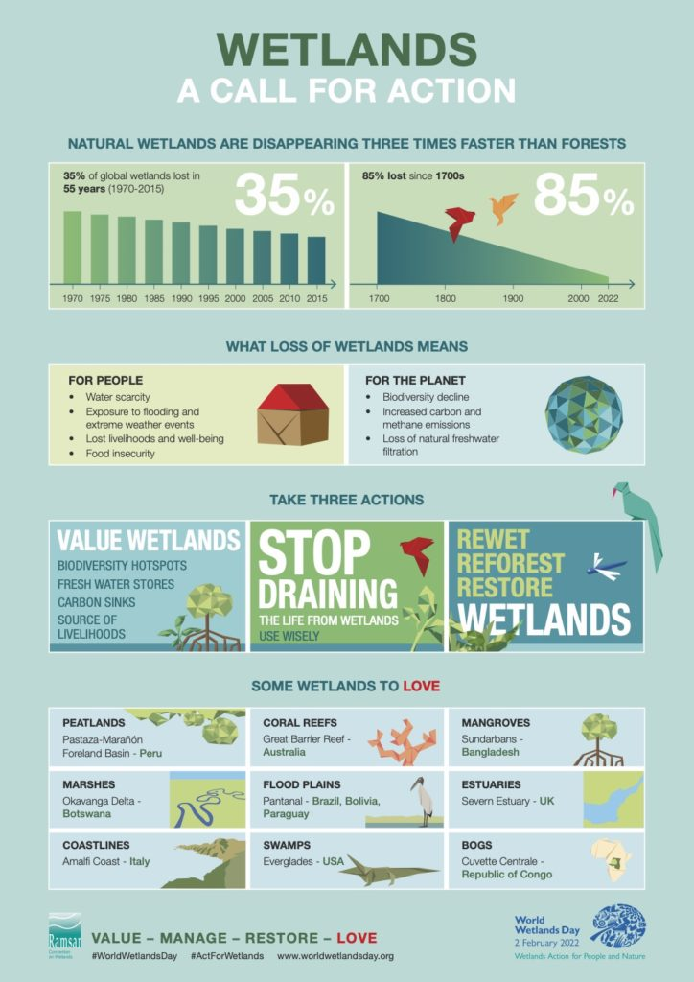
Impact
Research has found that the Ramsar Convention has not been effective in the conservation of wetlands and waterfowl.
The Global Wetland Outlook, published by the Secretariat for the Ramsar Convention, found wetlands to be under serious decline in terms of area and quality. Between 1970 and 2015, both inland and marine coastal wetlands declined by around 35 percent.
The Global Assessment of the Intergovernmental Platform on Biodiversity and Ecosystem Services found in 2019 that “over 85 percent of wetlands area has been lost.”

Slide 8
Binding Commitment – The Convention is legally binding on ratifying States, thereby making wetland conservation a legal obligation with consequences for non-compliance.
Increased international support – The Convention has increased the attention and support for wetland and waterfowl conservation globally.
Recovery Assistance – Recommendations for the recovery of threatened Ramsar Sites – experiencing/likely to experience ecological changes – are provided through an Advisory Mission.
Waterfowl as an International Resource – The Convention calls for waterfowl to be treated as an international resource as they transcend borders during seasonal migration.

Slide 9
Criticism of the Convention
Lack of Enforcement – The Convention lacks enforcement mechanisms for the obligations it imposes on States. There are no substantial methods of imposing accountability for violations.
No Direct Compensation – The Convention does not provide for financial or other types of compensation for individuals or communities affected by wetland degradation. The only form of compensation is the addition of natural reserves for waterfowl.
Indirect Impact – The Convention only sets general guidelines and leaves it up to national systems to determine what actions/treatment of resources are unlawful.
Highly Dependant on National Will – The Convention depends entirely on States to implement its provisions adequately. Combined with the lack of enforcement, States may neglect their obligations with little repercussions. For eg: in 2022, the COP14 report found that data for over 75% of wetlands was outdated despite State commitments to transfer information to the IUCN every 6 years.
Notes:
N

Slide 10
Case Study: Natura 2000 Network
What is it?
Natura 2000 is a network of threatened areas designated for protection under the EU’s Birds and Habitats Directives (Nature Directives).
The network extends across all 27 EU Member States and is made up of SPA’s, SCI’s and SAC’s.
It is a result of the EU’s obligations under the Bern Convention on the Conservation of European Wildlife and Natural Habitats and contributes to the Pan-European Emerald Network of the Bern Convention.
It also contributes significantly to the EU’s 2030 Biodiversity Strategy.

Slide 11
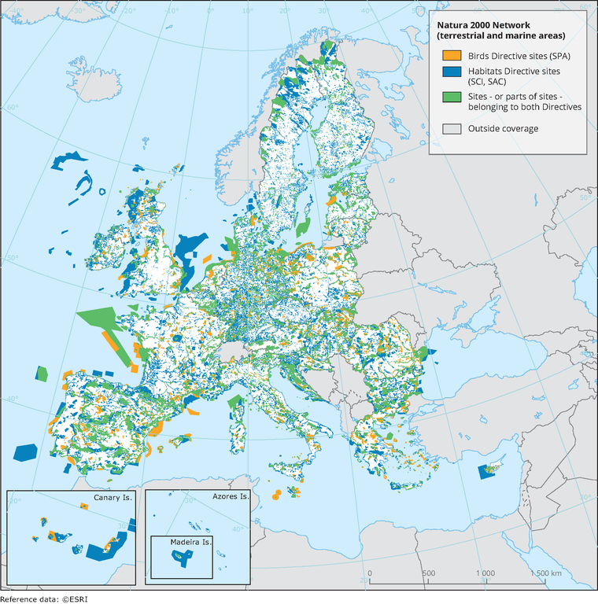
Key Facts
In 1979, the Birds Directive established an EU-wide protection regime for birds. States of Special Protection Areas (SPA) were designated for threatened species.
In 1992, the Habitats Directive established legally-protected areas called Sites of Community Importance (SCI) across the EU to protect specified habitats and species.
Additionally, SCI’s are to be designated Special Areas of Conservation (SAC) within 6 years.
State obligations under the Network include reports on conservation status of species and habitats and compensation measures for activities harmful to Natura 2000 sites.
Assessments for impact on Natura 2000 sites are mandatory prior to new projects.

Slide 12
Natura 2000 and the Ramsar Convention
The Natura 2000 Network and Ramsar Sites are linked insofar as they both protect bird species and their habitats. Numerous Ramsar Sites are also part of the Natura 2000 Network, a matter of significance given the Convention’s enforcement issues.
Examples: all Ramsar Sites in Scotland; Voordelta in the Netherlands; L-Ghadira and is-Simar in the Maltese Islands.
While the EU’s Nature Directives are broad frameworks for the protection and conservation of bird species and habitats, the Ramsar Convention can be viewed as a subset, focusing specifically on waterfowl and wetlands.
Key similarities include designation of sites, promotion of conservation, compensation requirements, status report mandates and a focus on proper management.
Natura 2000 is one of the most successful programs in wetland and waterfowl conservation given that ignoring an EU Directive leads to formal procedures against the country in question, including reference to the Court of Justice as a last resort.

Slide 13
The Way Forward
Enforcement Measures: A major criticism of the Ramsar Convention is its lack of enforcement mechanisms. One possible method is found under the UNFCCC – compliance is ensured by the Compliance Committee, which investigates violations, allows parties to present their case and depending on its finding, imposes penalties.
For instance, Ukraine was barred from participating in the emissions trading program and could not sell, transfer, or acquire new emissions credits. Additionally, the State had to submit a plan of action to address non-compliance within 3 months, at risk of steeper penalties.
Ambiguity – The Convention leaves it up to national systems to define what actions relating to wetlands would be illegal. At the very least, critical actions contributing to deterioration of wetlands could be addressed, leading to a more harmonized implementation of the Convention.

Slide 14
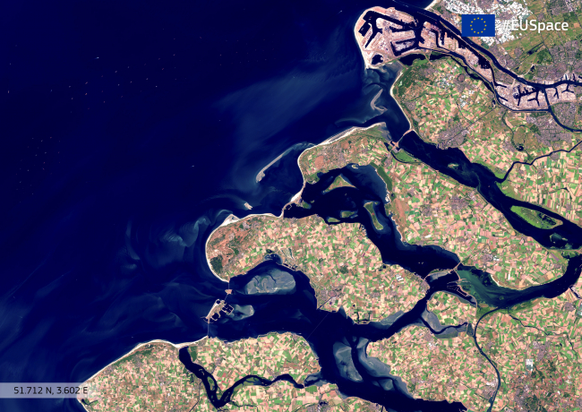
Impact Assessment – Drawing from the EU’s Natura 2000 plan, a requirement for development projects to undertake assessments for impact on wetlands would be useful in better implementation of Article 4(2), which allows parties to delete wetlands from the List for ‘urgent national interests.’
Raising Awareness – The Convention is largely unknown, particularly as it is not under the UN’s ambit. Social support has a strong impact on political processes and government action and so raising awareness regarding the Convention and its importance is key in fostering tangible government action. For instance, public discourse around climate change has placed immense pressure on governments for action, brought the Paris Agreement into the spotlight and made climate change a significant aspect of election manifestos.

