Slide 1
Science of Climate Change

Slide 2
Science of Climate Change
Learning objectives:
To understand the evidence for, and causes of, climate change and how human activity has, and is, driving it
To assess the effect of climate change on the natural and human environment

Slide 3
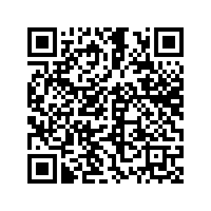
Science of Climate Change
Review of your perspectives on the pre-class reading and video

Slide 4
Science of Climate Change

Slide 5
Science of Climate Change
Let’s test your basic understanding after the video

Slide 6
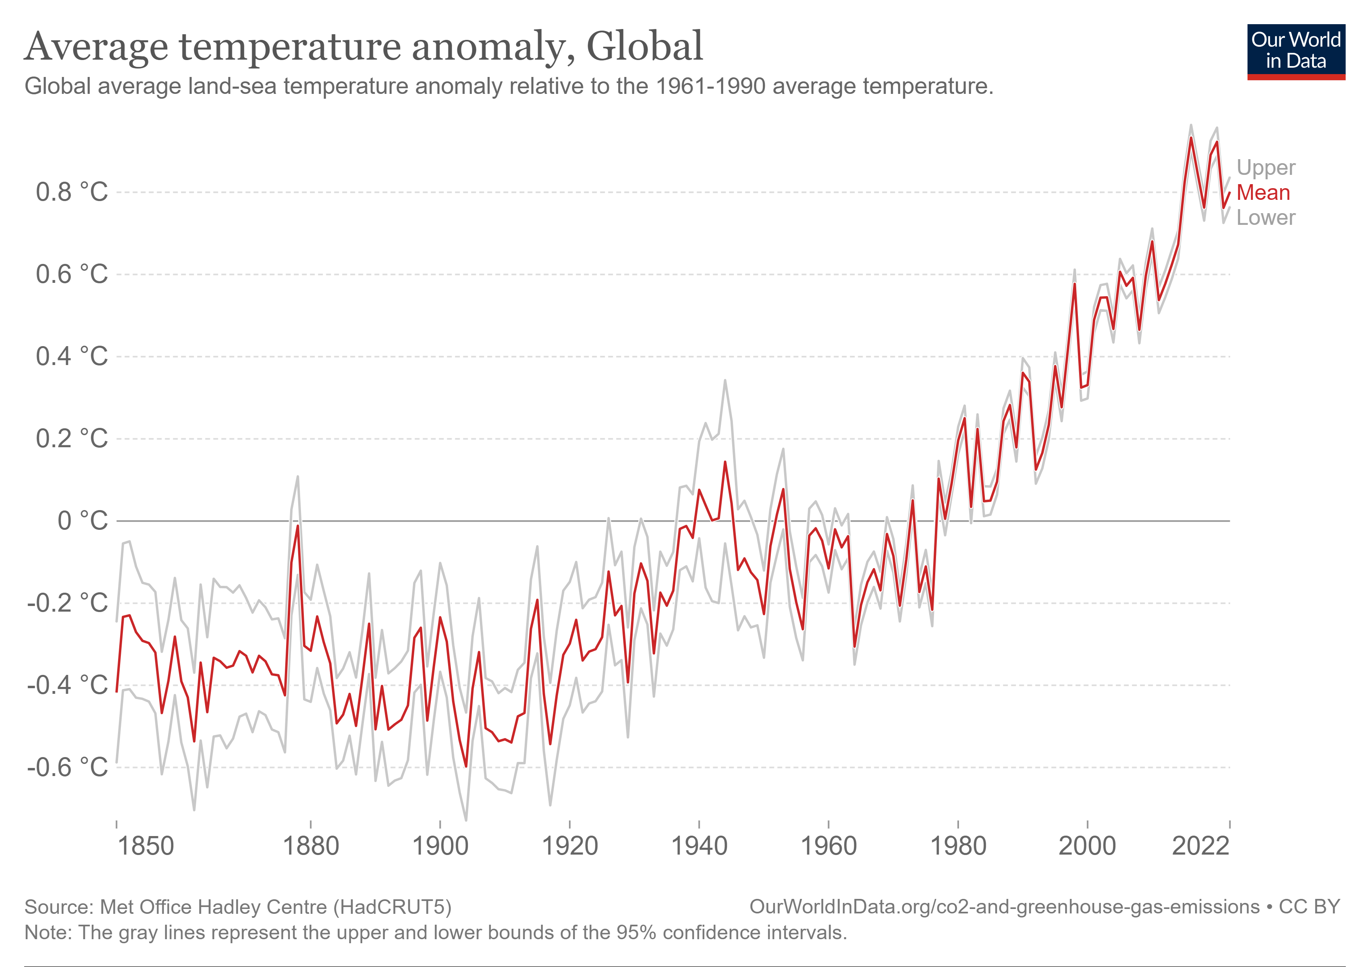
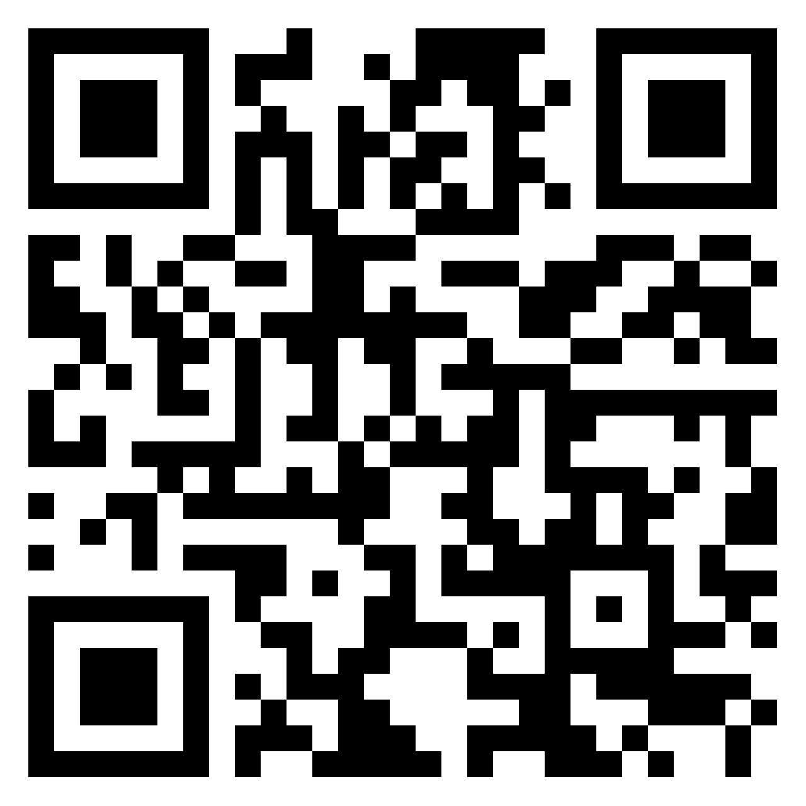
Science of Climate Change
To understand the evidence for, and causes of, climate change and how human activity has, and is, driving it
In 1970s, scientists began to note a warming global temperature, coining the term “global warming”
The trend has continued and indeed, warming has accelerated more recently
How do we know this?

Slide 7
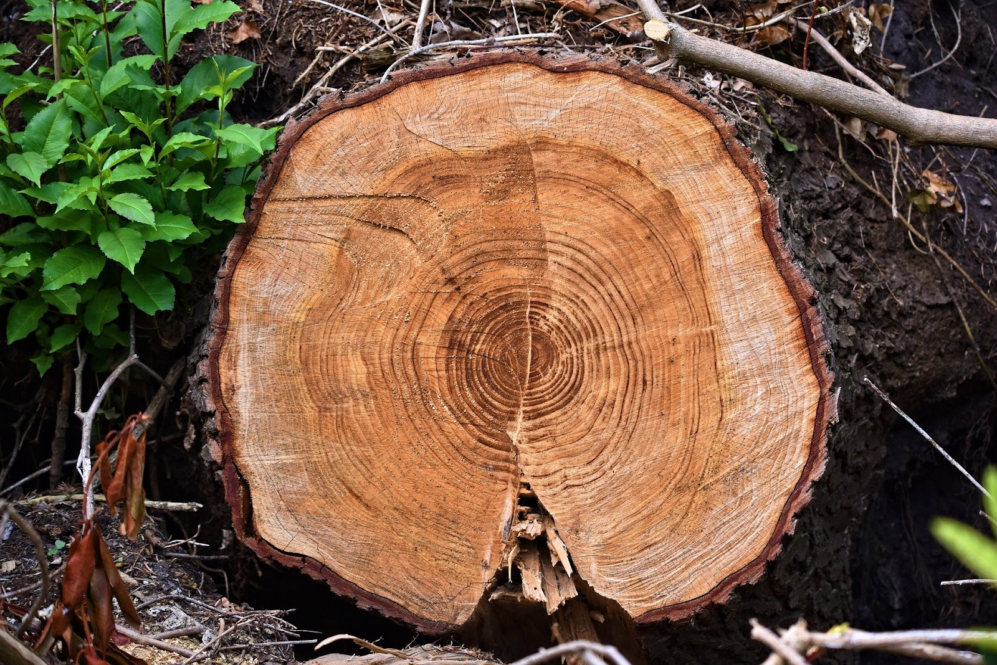
Science of Climate Change
To understand the evidence for, and causes of, climate change and how human activity has, and is, driving it
Dendrochronology
Thermometers became reliable from 1850s

Slide 8
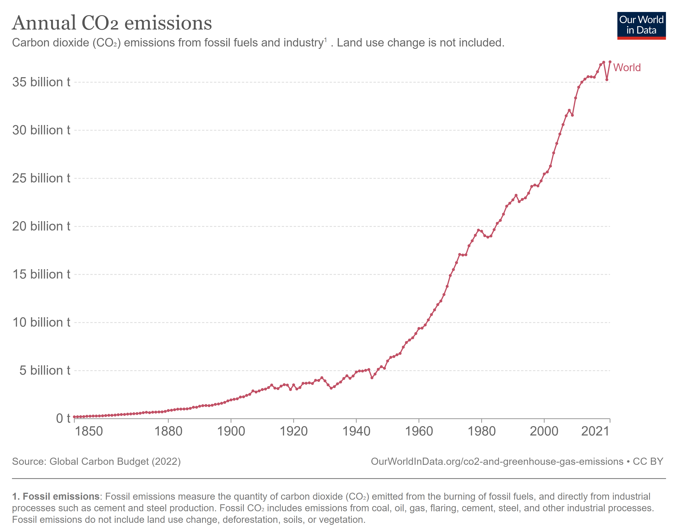
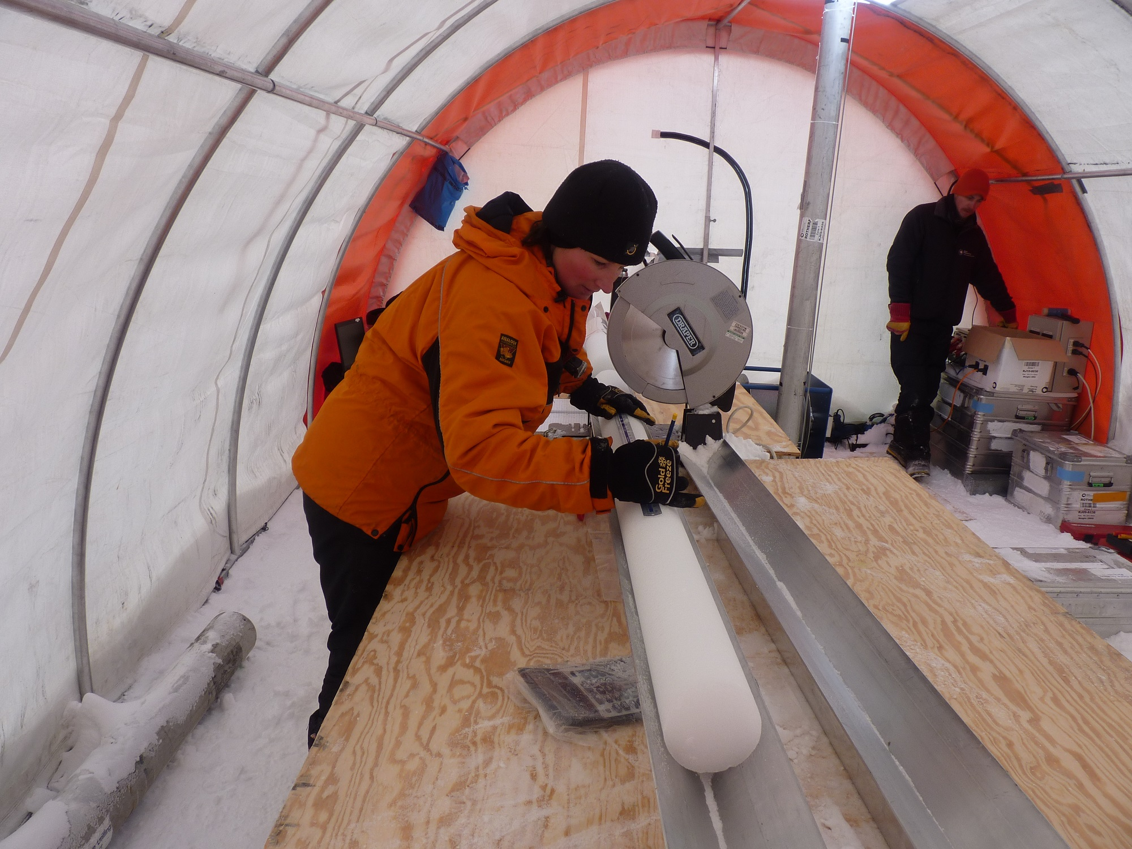
Science of Climate Change
To understand the evidence for, and causes of, climate change and how human activity has, and is, driving it
Coincident with increasing temperatures, CO2 emissions have increased
These increases have been directly associated via the greenhouse effect
How do we know this?

Slide 9
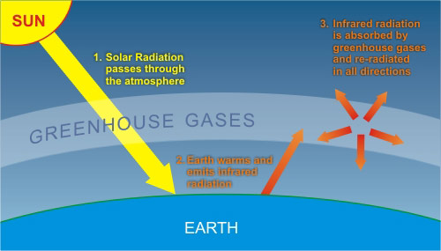
Science of Climate Change
To understand the evidence for, and causes of, climate change and how human activity has, and is, driving it

Slide 10
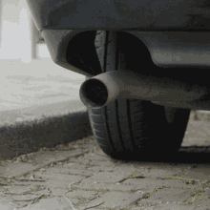
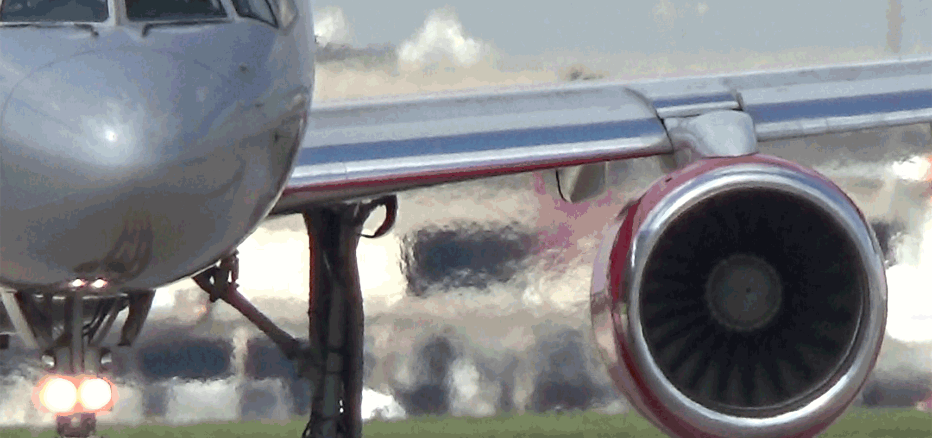
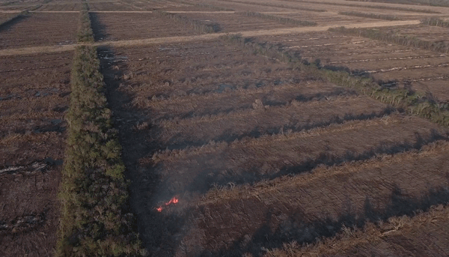
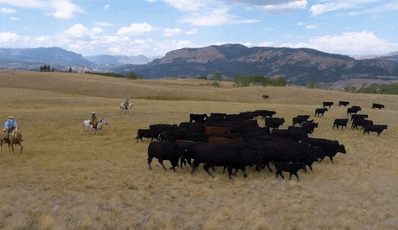
Science of Climate Change
To understand the evidence for, and causes of, climate change and how human activity has, and is, driving it

Slide 11
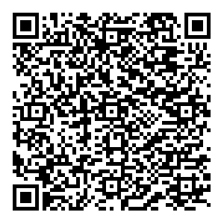
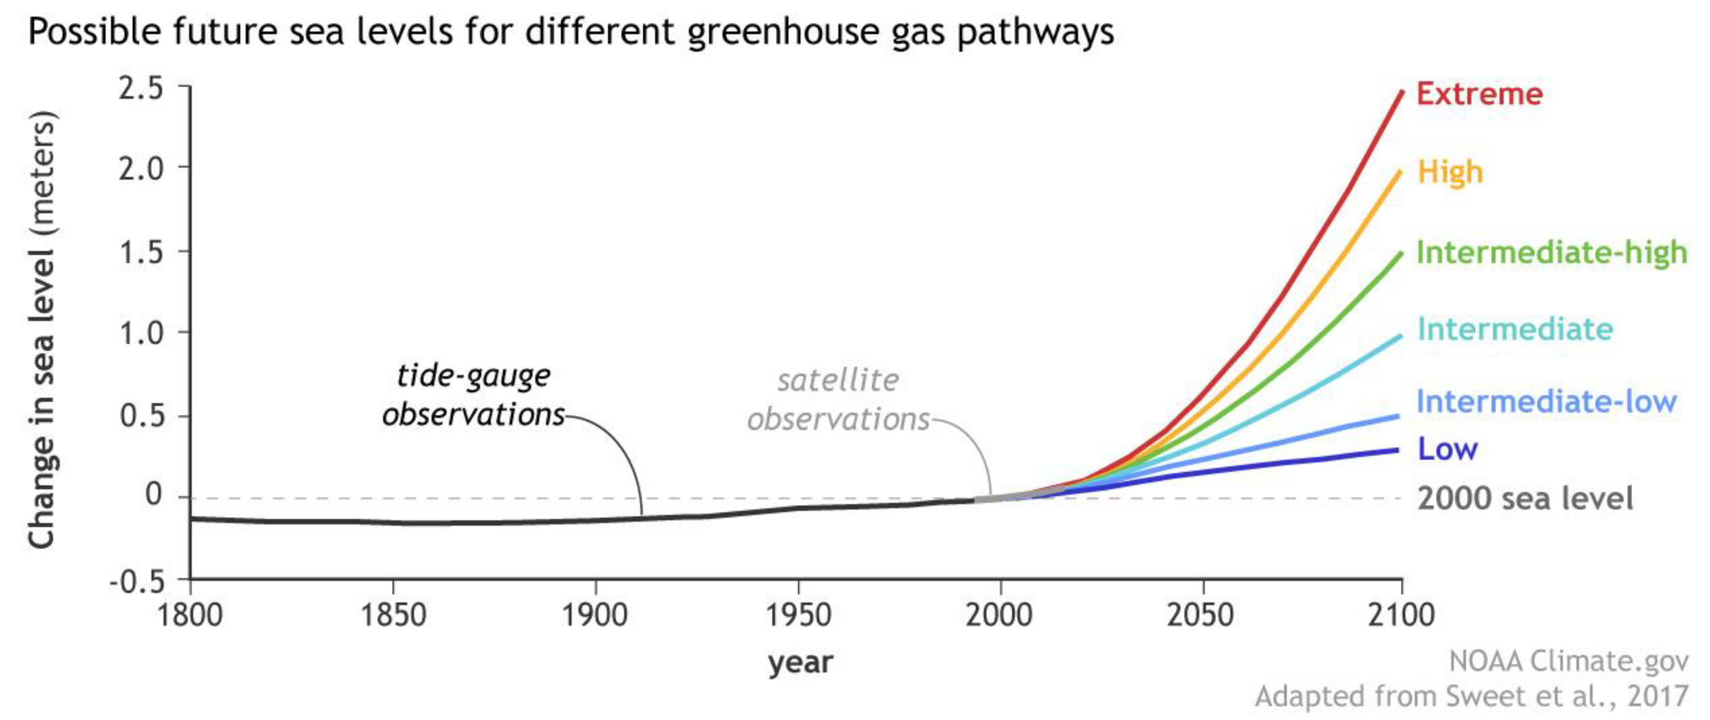
Science of Climate Change
To assess the effect of climate change on the natural and human environment
Choose a scenario (QR code)
Mark on this map a city/region that will be affected
https://tinyurl.com/2p9h2wnf
3. Research the potential impact this will have
Various scenarios exist which predict the changes in sea-level based on how much greenhouse gases continue to be emitted

Slide 12
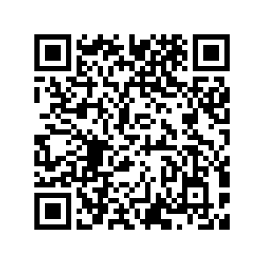
Science of Climate Change
Assessment
Examination: evidence for climate change (50%)
Project: a literature review on one of the effects of climate change
To start this process, read your assigned abstract and critically summarise your findings in this shared document by next class

Slide 13
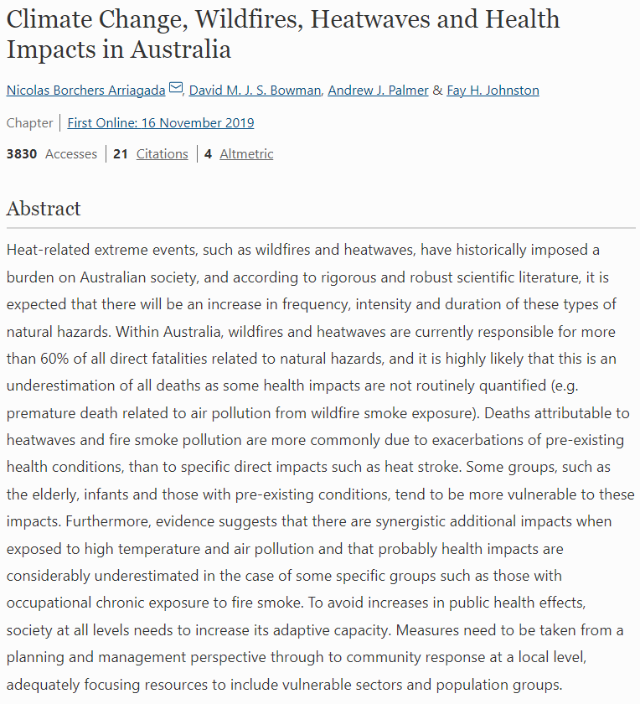
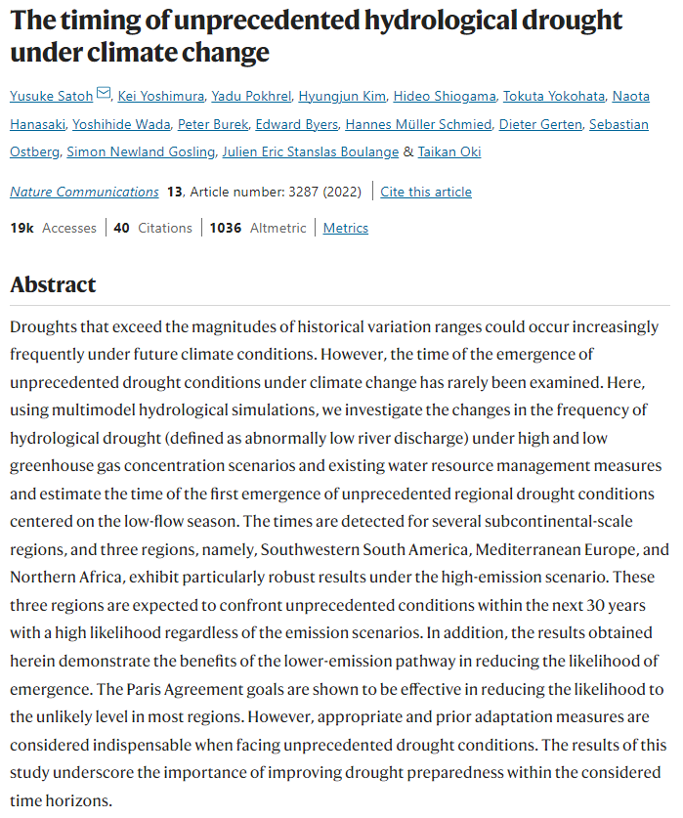
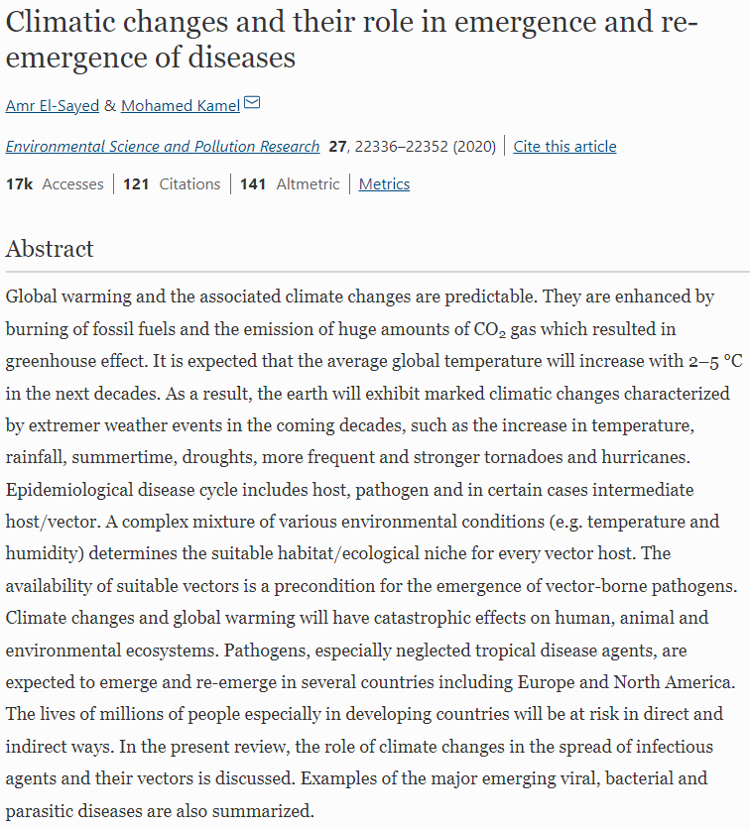
Science of Climate Change

Slide 14
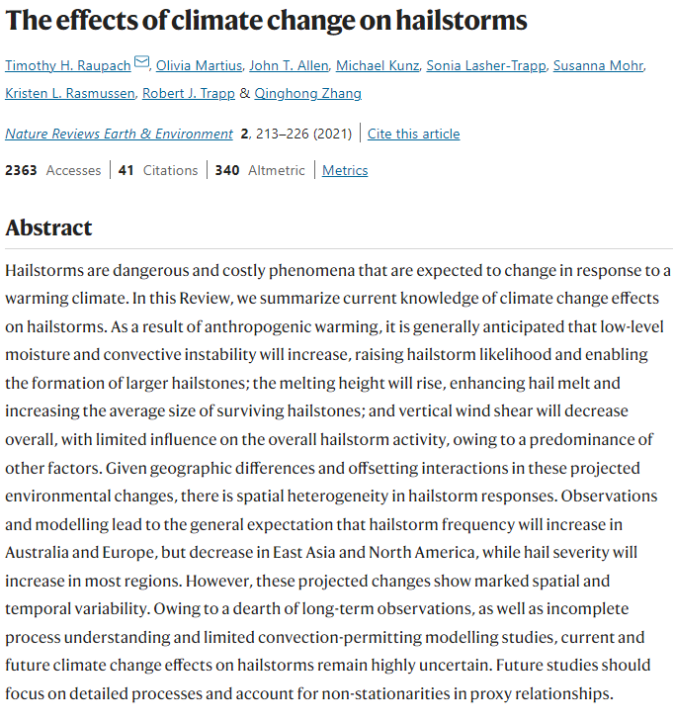
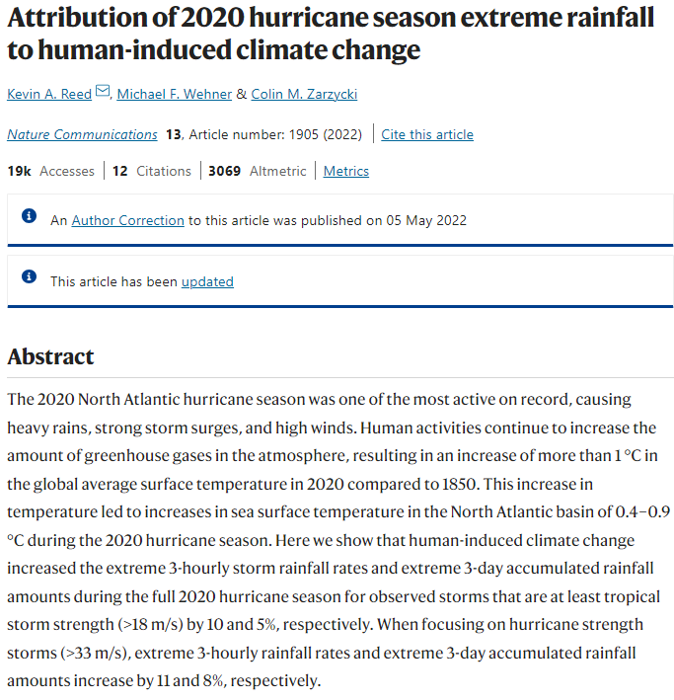
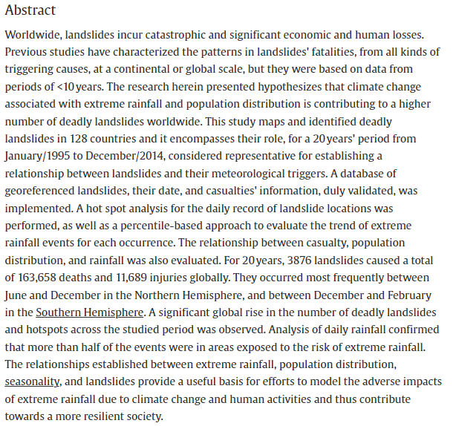
Science of Climate Change
Haque et al. (2019)

