Slide 1
CCP-LAW
Curricula development on Climate Change Policy and Law
Module: Environmental Risk Prevention and Management
Topic: Responding to Environmental Risk: Demonstrating Resilience
Instructor Name:
Project No of Reference: 618874-EPP-1-2020-1-VN-EPPKA2-CBHE-JP:
The European Commission's support for the production of this publication does not constitute an endorsement of the contents, which reflect the views only of the authors, and the Commission cannot be held responsible for any use which may be made of the information contained therein.

Slide 2
Aims of the Session
To offer an introduction to the term ‘resilience’ and acknowledge its relevance within the context of disasters
To be aware of the continuing change in the term, temporally and spatially for different groups and in different contexts
Recap to the sustainable livelihood's theory and the importance of social capital within that

Slide 3
Resilience Defined
Resilience is a complex, multi-faceted term which can be understood and interpreted in different ways.
Resilience...what are your first thoughts.
Respond to the Answer Garden Word Cloud on the next slide....

Slide 4
Conceptualising Resilience – what do you think?
Take a moment to add your thoughts to the link below:
AnswerGarden » What comes to mind when you think of the term resilience?...- Plant a Question, Grow Answers! Generate a live word cloud with your audience.

Slide 5
RESILIENCE
"The capacity of a system, community or society potentially exposed to hazards to adapt, by resisting or changing in order to reach and maintain an acceptable level of functioning and structure. This is determined by the degree to which the social system is capable of organising itself to increase its capacity for learning from past disasters for better future protection."
(UNISDR)

Slide 6
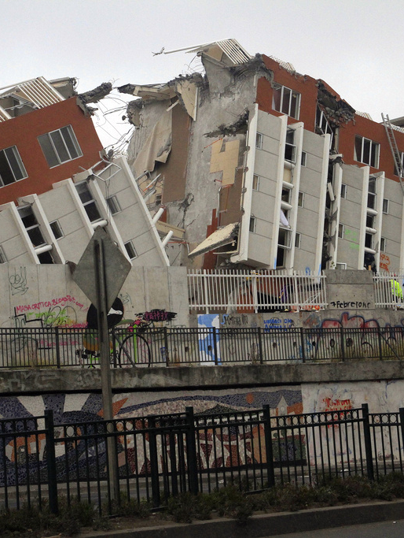
'Soft' and 'Hard' Resilience
The concepts of resilience (Moench 2009) take two broad forms:
(a) hard resilience: the direct strength of structures or institutions when placed under pressure, such as increasing the resilience of a structure through specific strengthening measures to reduce their probability of collapse.
(b) soft resilience: the ability of systems to absorb and recover from the impact of disruptive events without fundamental changes in function or structure, which depend on the flexibility and adaptive capacity of the whole system, rather than simply strengthening structures or institutions in relation to specific stresses, as in the hard resilience approach.

Slide 7
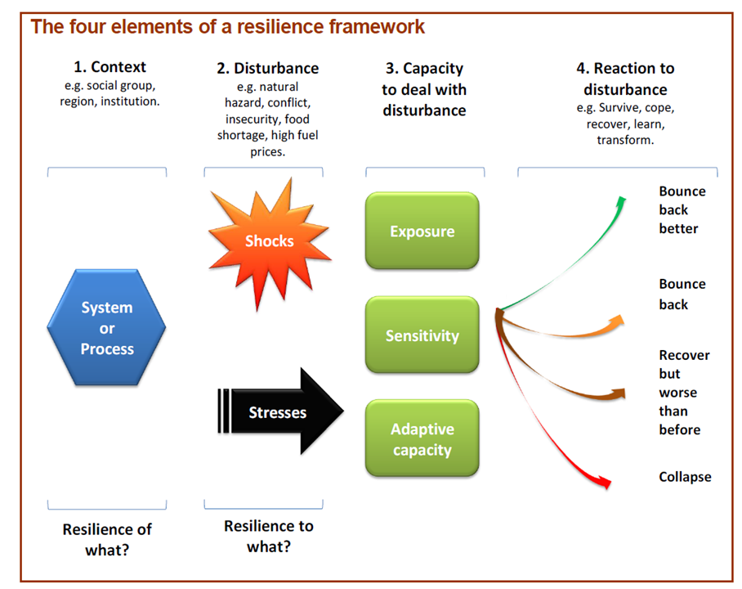
RESILIENCE FRAMEWORK
Taken from ‘Defining Disaster Resilience’ - DFID (2009)
Notes:
Spend some time within the session discussing how different case study communities have reacted to the disturbance.

Slide 8
A Resilient Individual/Community
Can an individual or a person be seen as resilient?
Often this term is attributed to a person, but can a resilient person be vulnerable?
Why is it problematic to assign the term 'vulnerable' or 'resilient' to someone?

Slide 9
Ann Masten's work
Masten (2014:10): “disasters underscore the interdependence of individual, family, and community systems.”
Resilience is dynamic
Capacity for adaptation to adversity is distributed across systems
Individual resilience depends on resilience of other systems
Resilience is not a trait

Slide 10
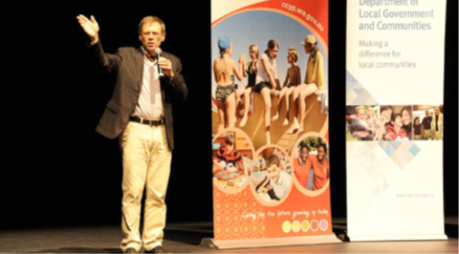
Michael Ungar's work on Resilience and Context
Ungar (2013) urges researchers to understand and interpret risk and protective factors in local and social contexts. Risk and Vulnerability cannot be fully addressed unless we take into consideration the cultural, political and economic situation of the place in which it is happening.
“In the context of exposure to significant adversity, resilience is both the capacity of individuals to navigate their way to the psychological, social, cultural, and physical resources that sustain their wellbeing, and their capacity individually and collectively to negotiate for these resources to be provided in culturally meaningful ways” (2013:253-265)

Slide 11
ADAPTIVE CAPACITY
Adaptive capacities are the social and technical skills and strategies of individuals and groups that support them in responding to environmental and socioeconomic changes like natural hazards.
•Processes communication and information; learning, education and knowledge; risk awareness; adaptation, including acceptance of uncertainty and change; adequate planning and preparation.
•Community, such as community involvement, organisation and cohesion (e.g.: trust).
•Underlying social, economic and political conditions, including high equity, good governance, political stability, economic strength and diversification, the population’s physical and mental health.
•Ecological systems and human systems (e.g.: emergency health systems). Characteristic drivers of resilience in systems include high diversity, redundancy, links between capacities at different geographic levels, and the ability of systems to continue working while evolving (as opposed to merely being stable).

Slide 12
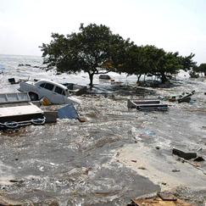
Resettlement after adversity: 2004 SOUTHEASTERN India Tsunami
•After the 2004 South-eastern India, it was found that most of the residents were placed at random in resettlement communities which severed close connections to family and friends.
•This made the long-term recovery difficult as support such as childcare and informal job assistance was no longer available. As a result, people could not resume their normal lives.

Slide 13
India, Resettlement and the Tsunami
Activists in India have campaigned against the actions of the Government for allowing commercial businesses such as tourist hotels to be erected soon after the disaster but preventing local fishing communities from accessing, working or living in the area.
Some believe they used this opportunity to remove the fishermen and make and move business away from traditional practices to commercial money -making enterprises.

Slide 14
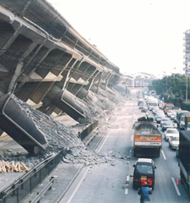
Kodokushi – Lonely Deaths and Resettlement in Japan
Lonely unnoticed deaths have become more common in Japan, particularly among the elderly in an ageing society. This is hugely exacerbated when people live in separate lives with a lack of social engagement and interaction.
Following the Kobe earthquake in 1995, many elderly people were evacuated and placed in Soviet Style Tower blocks with no attempt made to settle people near friends or family.
It resulted in many people going unnoticed when they died as they did not have immediate support networks (i.e.: neighbours etc. to check on them). Much of this was preventable.

Slide 15
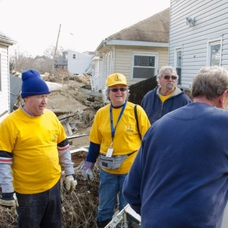
Community Resilience
Community resilience describes the collective ability of a neighbourhood or geographically defined area to deal with stressors and efficiently resume the rhythms of daily life through cooperation following shocks (Aldrich, 2012c).
Following the 1995 Kobe earthquake, for example, most individuals pulled from the rubble of their collapsed homes were saved by neighbours, not firefighters or rescue workers.
Individual and community social capital networks provide access to various resources in disaster situations, including information, aid, financial resources, and child-care along with emotional and psychological support.

Slide 16
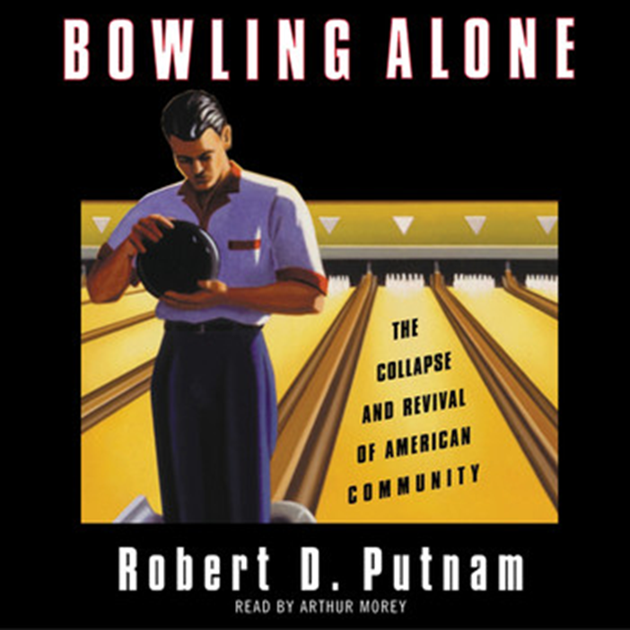
“Trust, norms and networks that can improve the efficiency of society by facilitating coordinated actions”
(Putnam 1993: 167)
Notes:
Putnam's work is based

Slide 17
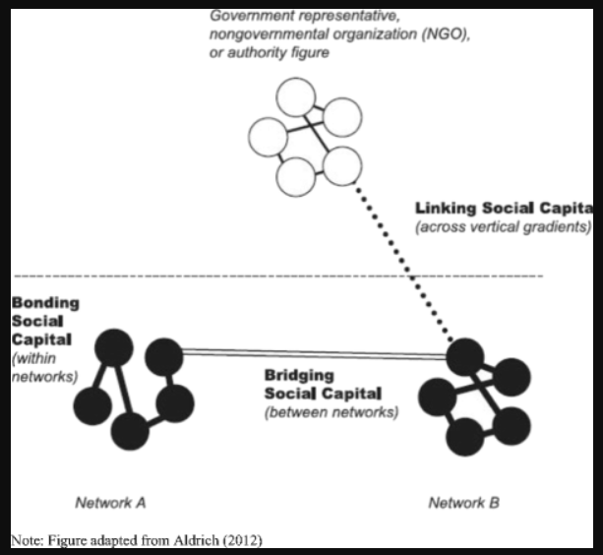
Activity (15 mins) - Social Connections
Consider who your social ties are?
Who is part of your community?
Who could you turn to in times of need?
What connections do you have personally or within your household to people of authority?
Are you responsible for supporting other people in your locality?
Are some of your close ties geographically far?
Have you or are you exposed to any environmental risks?
How high would you suggest your social capital is?

Slide 18
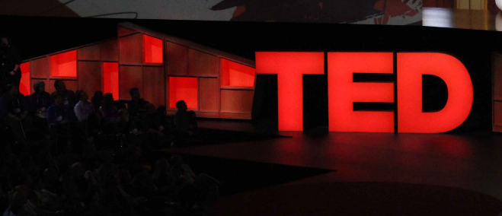
Ted Talk – Daniel Aldrich (27 mins)
Watch the following Ted Talk video:
PrepTalks: Dr. Daniel Aldrich "Social Capital in Disaster Mitigation and Recovery" - YouTube
Please make notes on the key points made by Aldrich in his talk.
How does Aldrich conceptualise social capital?
What are some of the popular theories that he is dispelling in terms of recovery?
What are the different social ties/social capital?
How does Aldrich define collective action?
What limitations are there with social capital?

Slide 19
Discussion (15 mins) Are there any limitations to the concept of social capital?

Slide 20
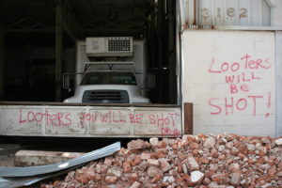
Social Capital Limitations
“The Social ties that bind catastrophe survivors to each other can also be the barriers that exclude lawbreakers and norm violators from the recovery or punish nonconforming outsiders”
(Aldrich 2012: 25).
Notes:
This was noted in Haiti following the supposed death of a man in one community accused of looting from his neighbours.
It can also be the case where marginalised groups have been excluded.

Slide 21
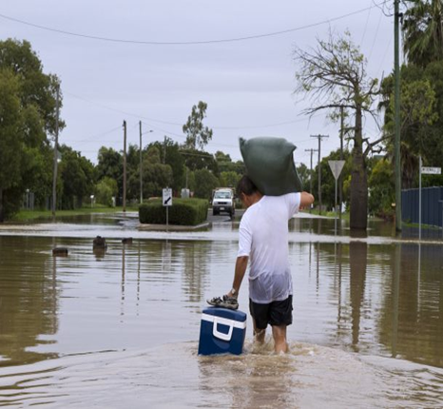
Are there limitations with Resilience?
Sometimes resilience can be romanticised.
What limitations can there be with using a concept like this when addressing disaster risk and management?
Jonathan Pugh (2014) and David Chandler (2013) argued that the rise of resilience indicates the fall from grace of the liberal state-building project, as Western powers promoted individual resilience rather than democratic institutions on their own model.
The theme in this literature is clear: resilience represents the triumph of a neoliberal world, where ‘resilient subjects’ are encouraged to accept and adapt to a world of endless risk (Evans and Reid, 2013).
Resilience might serve as a strategy for helping communities to cope with adversity but does not represent a means of overturning structural inequalities (Platts-Fowler 2016:26).

Slide 22
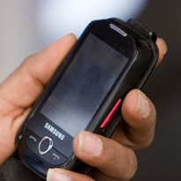
Technology in building Social Capital
The importance of having access to communication technology like mobile phones in rural or spatially marginalised communities:
Decentralisation of communication networks through access to technology can assist in times of environmental disasters.
Toya and Skidmore (2015) found that ICT communication particularly in the form of mobile phones was able to reduce disaster risk significantly in communities which had higher social capital. Cell phone and the internet enable communication prior to and during crises. Communications are enhanced when authorities develop warning systems that are integrated with ICT.

Slide 23
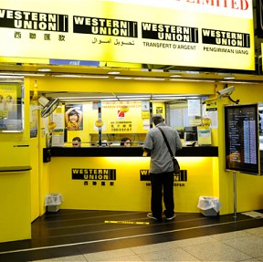
Remittances
What are remittances?
Transfer of money or gifts. ‘Everydayness’ or in ‘Disasters’
De le et al. (2013) found in their work that some of the remittances were received more quickly than international donor support.
What impact does a reliance on remittances have on the country?
Consider the challenges that a breakdown in banking services during a disaster may have?

Slide 24
Conclusion
Resilience is a term adopted by a wide range of academics across several disciplines. It is important to understand it within the context of where it is taking place and for who.
Vulnerable and marginalised groups such as children are recognised to be resilient in many cases to the impact of adversity.
Resilience is not a trait but an ongoing process….it is a fluid concept. It should not be looked at in opposition to vulnerability but rather people can move in and out of vulnerability and resilience periods over time and in the presence of ‘shocks’ or ‘trauma.’
Social capital can be an important way for people overcoming adversity to environmental shocks and stresses and has been theorised by
There are several factors that influence how people and societies cope with disasters and the presence of social capital is recognised as being highly conducive to community resilience, however, governments may use this as a way of shirking responsibility.

Slide 25
Additional Reading
Adger, N (2006) Vulnerability, Global Environmental Change 16 pp 268-281
Aldrich, D.P (2015) Building Resilience: Social Capital in Post Disaster Recovery, Chicago: University of Chicago Press
Aldrich, D.P. & Meyer, M.A., (2014). Social Capital and Community. American Behavioural Scientist, pp.1–16.
Cutter, S. L. (1996) Vulnerability to Environmental Hazards. Progress in Human Geography 20 (4) pp 529-539
Le De, L., Gaillard, J.C. & Friesen, W., (2013). Remittances and disaster: A review. International Journal of Disaster Risk Reduction, 4, pp.34–43.
Masten, A.S., (2014). Ordinary Magic: Resilience in Development, New York: The Guildford Press.
Ungar, M., (2011) The social ecology of resilience: Addressing contextual and cultural ambiguity of a nascent construct. American Journal of Orthopsychiatry, 81, pp.1–17.

