Slide 1
CCP-LAW
Curricula development on Climate Change Policy and Law
Subject: Corporate Governance and Climate Change
Topic 3:Governance, Risk Management and Internal Controls Instructor Name: …
Project No of Reference: 618874-EPP-1-2020-1-VN-EPPKA2-CBHE-JP:
The European Commission's support for the production of this publication does not constitute an endorsement of the contents, which reflect the views only of the authors, and the Commission cannot be held responsible for any use which may be made of the information contained therein.

Slide 2
Risk management and internal control process

Slide 3
Risk Management Process
Risk Identification
Risk Assessment
Risk Mitigation
Risk Monitoring
Risk Reporting

Slide 4
RISK IDENTIFICATION
Objective: To identify potential risks that could affect the organization’s objectives.
Methods: Brainstorming sessions, SWOT Analysis (Strengths, Weaknesses, Opportunities, Threats),Scenario Analysis, Expert Interviews
Tools: Risk Registers, Risk Checklists.

Slide 5
RISK ASSESSMENT
Objective: To evaluate the likelihood and impact of identified risks.
Methods:
Qualitative Assessment: Risk matrices, risk maps
Quantitative Assessment: Statistical analysis, simulations
Criteria:
Likelihood: Probability of occurrence
Impact: Potential consequences on the organization

Slide 6
RISK MITIGATION
Objective: To develop strategies to manage risks.
Strategies:
Avoidance: Eliminating the risk
Reduction: Minimizing the impact or likelihood
Sharing: Transferring the risk to another party (e.g., insurance)
Acceptance: Acknowledging the risk and preparing to manage its impact
Implementation:
Developing action plans
Allocating resources
Setting timelines

Slide 7
RISK MONITORING
Objective: To continuously oversee the risk environment and the effectiveness of risk management strategies.
Methods:
Regular Risk Reviews
Audits and Inspections
Key Risk Indicators (KRIs)
Reporting:
Risk Reports to Management
Risk Dashboards

Slide 8
RISK REPORTING
Objective: To communicate risk information to stakeholders.
Types:
Internal Reporting: Reports to management and the board
External Reporting: Reports to investors, regulators, and other stakeholders
Components:
Risk Profile: Overview of key risks
Risk Appetite: Level of risk the organization is willing to accept
Risk Treatment: Actions taken to manage risks

Slide 9
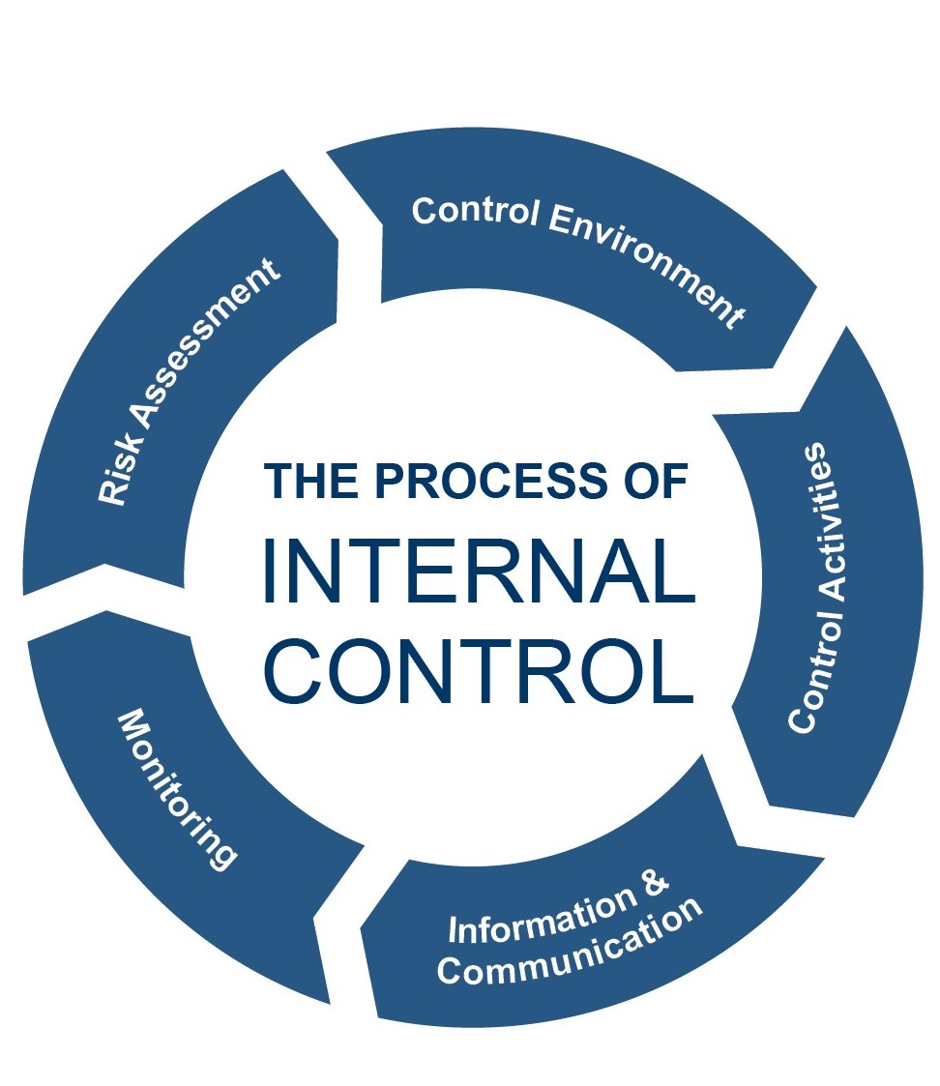
Internal Control Process

Slide 10
CONTROL ENVIRONMENT
Foundation of the internal control system, influencing the control consciousness of its people.
Elements:
Ethical Values and Integrity
Management’s Philosophy and Operating Style
Organizational Structure
Assignment of Authority and Responsibility.

Slide 11
CONTROL ACTIVITIES
Actions taken to address risks and achieve objectives.
Types:
Segregation of Duties: Ensuring no single individual has control over all aspects of a transaction.
Physical Controls: Safeguarding assets with physical measures.
Authorization and Approval: Requiring appropriate approvals for transactions.
Documentation and Record Keeping: Maintaining proper records to ensure accountability.

Slide 12
RISK ASSESSMENT
Identifying and analyzing risks to achieving the organization’s objectives.
Steps:
Identify relevant risks
Estimate the significance of risks
Assess the likelihood of occurrence
Develop actions to manage risks

Slide 13
INFORMATION AND COMMUNICATION
Ensuring relevant information is identified, captured, and communicated in a timely manner.
Components:
Information Systems: Reliable systems to process and report data.
Internal Communication: Clear communication of roles and responsibilities.
External Communication: Effective communication with stakeholders.

Slide 14
MONITORING
Regularly assessing the effectiveness of internal controls.
Methods:
Ongoing Monitoring: Continuous review of processes.
Separate Evaluations: Periodic evaluations by internal or external auditors.
Reporting Deficiencies: Communicating identified deficiencies to those responsible for corrective actions.

