Slide 1
CCP-LAW
Curricula development on Climate Change Policy and Law
Subject title: Climate Change Policy
Instructor Name: Dr. Rahul Nikam
Project No of Reference: 618874-EPP-1-2020-1-VN-EPPKA2-CBHE-JP:
The European Commission's support for the production of this publication does not constitute an endorsement of the contents, which reflect the views only of the authors, and the Commission cannot be held responsible for any use which may be made of the information contained therein.

Slide 2
Beyond the Kyoto Protocol, The Paris Agreement and Next Steps
Three areas where analysts can help articulate pitfalls and identify opportunities to avoid them:
Incentives for ambition
The role of non-UNFCCC institutions
Preserving global consensus
Differentiation and Equity in the Post- Paris Negotiations
The nature & extent of differentiation in the Paris Agreement, however, is distinct from that in the 1992 Framework Convention on Climate Change (FCCC) & its Kyoto Protocol.
Illustrative Crosscutting Issues
Applying the terms “developed” and “developing”
Operationalizing Developed Country Leadership
Identifying countries with “special circumstances”

Slide 3
Beyond the Kyoto Protocol, The Paris Agreement and Next Steps
Illustrative Thematic Issues
Support and conditional NDCs
Long-term GHG emission development strategies
Balancing flexibility and rigor in the transparency frameworks
Building equity into the global stocktake.

Slide 4
Enhancing Mitigation Ambition in the Paris Agreement
There are 2 important new features, about mitigation ambition, in the Paris Agreement: much broader participation, and provisions to enhance ambition over time under UNFCCC.
The drivers of enhanced mitigation ambition (as the context of the Paris Agreement) provide cause for optimism that the Agreement may be successful.
The design and implementation of an international agreement on mitigating climate change (a global public good) must be consistent with countries’ strategic interests.
It is important to connect the Paris Agreement process with dynamic & real content of global trends, international interactions, multilateral and bilateral agendas, and major Parties’ expectations about their development level and dynamic interests in the future.

Slide 5
Enhancing Mitigation Ambition in the Paris Agreement
Making Paris Sustainable
Advantage of the Paris Agreement
Conditional offers
Pledge & review
Challenges
5 years is too brief
Offers are not comparable
Solutions
Pledging to a path
Using formulas
Trade measures
Include forests
Keeping fossil fuels in the ground.

Slide 6
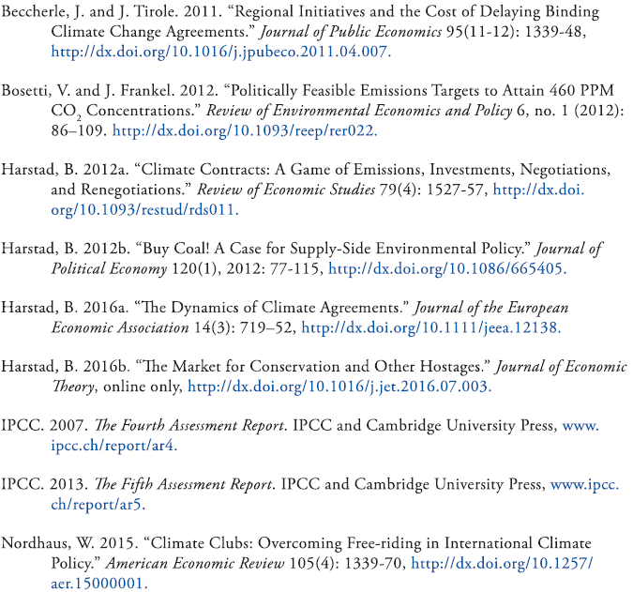
Further Reading

Slide 7
Elaborating the Paris Agreement’s-Transparency Mechanism
Transparency Framework and Strategic Choice of NDC Metrics
In theory, NDCs can be translated into any metric without affecting ambition, if detailed information is known and provided. However despite theoretical equivalence, in practice, the degree of transparency is associated with the target type.
It seems important to distinguish between “narrow” & “broad” transparency. The first concept refers to how information under the GHG target is provided and the second has to do with possible problems associated with asymmetric information.

Slide 8
Elaborating the Paris Agreement’s-Transparency Mechanism
We might assume that diversity in INDC types is due only to strategic choice (i.e., choice based on hidden criteria other than emissions reduction )- & that if all governments acted transparently, they would use a common metric (ideally, the simplest- a quantified amount relative to a base year). However, countries may choose more flexible metrics for other reasons.

Slide 9
Further Reading

Slide 10
Elaborating the Paris Agreement’s-Transparency Mechanism
The Role of Domestic Policy Surveillance in the Multilateral Climate Transparency Regime
Well-designed domestic policy surveillance can inform and enhance the effectiveness of multilateral climate policy transparency.
Effective, rigorous ex-post review of policies & regulations requires careful planning- including provisions for effectively collecting data about implementation & impacts.
Domestic policy surveillance can promote policy learning and identify best policy practices.
A robust domestic policy review framework can demonstrate a country’s good-faith effort in delivering on its mitigation pledge, which can build trust in international climate policy.

Slide 11
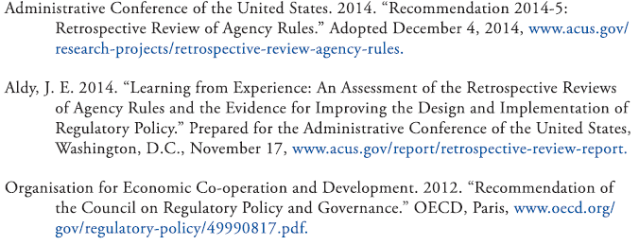
Further Reading

Slide 12
Market Mechanisms in and out of the Paris Agreement
Governance of Carbon Markets under Article 6 of the Paris Agreement
Art. 6 provides parties with alternative governance models for transferring mitigation outcomes internationally. Internationally transferred mitigation outcomes (ITMOs) can be used towards countries' NDCs.
Arts. 6.2-6.7 could be seen as competitive options, offering different products. They present different levels of intrusion and intervention by the CMA in providing a framework for the use of mitigation outcomes by parties other than the ones where the mitigation outcomes were created, towards their NDCs.

Slide 13
Market Mechanisms in and out of the Paris Agreement
While they present different governance models, the alternatives offered by Art.6.2 & 6.4 need to be, and can only be, complementary and synergetic, and eventually converge. This is especially true for the metrics of quality and quantity of the mitigation outcomes being transferred between parties. It also has a significant impact on the fungibility of the mitigation outcome being transferred.
To ensure complementarity & synergy, a process needs to be put in place to ensure that the different technical standards that emerge under 6.2, as well as the difference between what emerges under 6.2 & 6.4, are well understood, analyzed, and can be transmitted between the two options.
This will be especially important for the modalities and procedures (M&P) to be defined under Art. 6.4, which will be scrutinized by international stakeholders.

Slide 14
Market Mechanisms in and out of the Paris Agreement
Market Mechanisms in the Paris Climate Agreement: International Linkage under Article 6.2
A key question on the Paris Agreement, with its NDCs anchored as they are in domestic political realities, is whether it can progressively lead to mitigation commitments with sufficient ambition.
Linkage of regional, national & sub-national policies can be part of the answer, & Art. 6.2 of the Paris Agreement provides the needed foundation.
Linkage among mitigation systems that are heterogeneous about policy instruments, level of jurisdiction, and type of target- heterogeneity that will be prevalent under the global Paris- Agreement regime will be feasible &wise in some cases, but not in others.
Negotiators must now develop sound accounting mechanisms to fully enable Art. 6.2 and “bottom-up” linkage. They must also determine the degree & types of oversight that might be required.

Slide 15
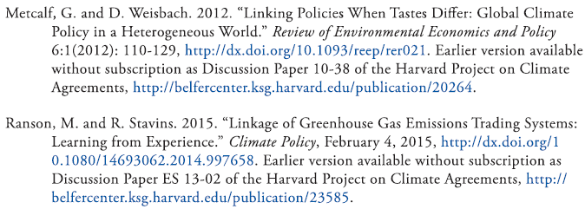
Further Reading

Slide 16
Market Mechanisms in and out of the Paris Agreement
Government-to-Government Carbon Trading
Emissions trading between two jurisdictions can lower costs for both, making it easier to achieve current mitigation targets and enhance future action.
Yet, harmonizing and linking domestic carbon policies to enable international trading in a fully decentralized can be challenging and impractical in the near term.
Government-to-government trading between jurisdictions with existing domestic emissions markets requires no such harmonization, yet achieves much of the same benefits and could encourage full policy linking in the future.

Slide 17
Market Mechanisms in and out of the Paris Agreement
Such trades might also occur between a jurisdiction with a carbon tax in place & a jurisdiction with a lower-price emission trading program, leading to reduced emissions.
The next steps to facilitate government-to-government trades include creating a forum for discussion, developing a template for transactions, and piloting actual trades.

Slide 18
Further Reading

Slide 19
Market Mechanisms in and out of the Paris Agreement
Building a Coalition of Carbon Markets to Spur Faster, Deeper Cuts in Climate Pollution
Emission trading programs, or carbon markets, can play a critical role in enabling countries to meet their nationally determined contributions (NDCs) and undertake more ambitious reductions in climate pollution over time.
Art.6 of the Paris Agreement affirms the role of voluntary, bilateral transactions among sovereigns in meeting their NDCs.
By developing common standards or guidelines to ensure the integrity of international emission trading, a coalition of carbon market jurisdictions (CCM) could promote coordination among carbon markets, ensure environmental integrity, and ultimately spur greater ambition in climate action.

Slide 20
Market Mechanisms in and out of the Paris Agreement
Coordinated CO2 Prices and Strategic Transfers
Mutual obligations with effective sanctions are needed in international climate policy.
At the national level, a carbon price that increased over the long term would be a meaningful climate policy instrument.
More effective forums are needed to negotiate ambitious carbon prices.
Transfer payments should be made to developing countries, on the condition that they accept a minimum carbon price.
The G20 could provide a meaningful forum to further coordinate climate policy discussions.

Slide 21
Further Reading

