Slide 1
CCP-LAW
Curricula development on Climate Change Policy and Law
Subject title: Climate Change Policy
Instructor Name: Dr. Rahul Nikam
Project No of Reference: 618874-EPP-1-2020-1-VN-EPPKA2-CBHE-JP:
The European Commission's support for the production of this publication does not constitute an endorsement of the contents, which reflect the views only of the authors, and the Commission cannot be held responsible for any use which may be made of the information contained therein.

Slide 2
Geoengineering: Intervention in the Earth System
The Geopolitical Challenges of Geoengineering and its challenge to Geopolitics
A (Political) Science Experiment
Invidious Intervention?
A New Geopolitical Phenomenon
Without Attention, Geoengineering could upend Foreign Policy
Geoengineering potential to heighten tension
Geopolitical divide between the Have and Have nots
The Military Factor
Designing Geoengineering Governance frameworks

Slide 3
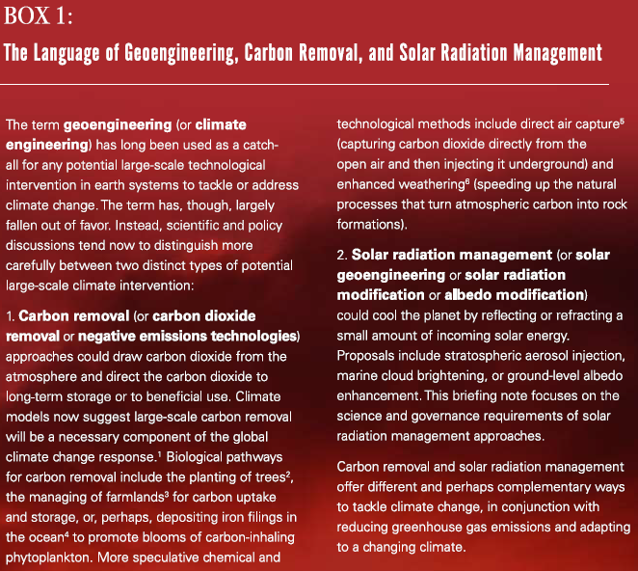
Geoengineering: Intervention in the Earth System
Solar Radiation Management

Slide 4
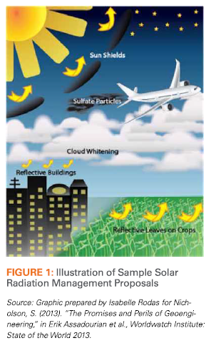
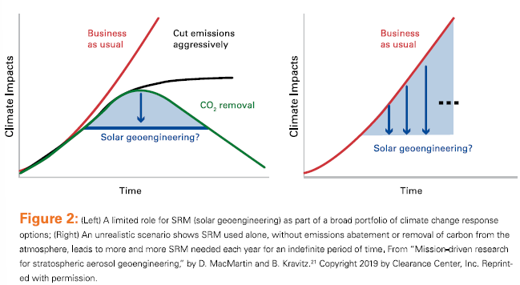
Geoengineering: Intervention in the Earth System
What is Solar radiation management on the table?
SRM should only considered a supplement to emissions abatement, never a substitute.

Slide 5
Geoengineering: Intervention in the Earth System
Governing Solar Radiation Management
The Convention on Biological Diversity (CBD) 2012
The London Convention and London Protocol (LC/LP)
The Vienna Convention and Montreal Protocol

Slide 6
Further Reading
21st Century Diplomacy: Foreign Policy is Climate Policy Full Report https://www.wilsoncenter.org/publication/21st-century-diplomacy-foreign-policy-climate-policy-full-report

