Slide 1
CCP-LAW
Curricula development on Climate Change Policy and Law
Subject title: Climate Change and Migration
Instructor Name: Dr. Shashikala Gurpur
Project No of Reference: 618874-EPP-1-2020-1-VN-EPPKA2-CBHE-JP:
The European Commission's support for the production of this publication does not constitute an endorsement of the contents, which reflect the views only of the authors, and the Commission cannot be held responsible for any use which may be made of the information contained therein.

Slide 2
TOPIC 3:Economic and environmental impacts of climate migration
Total Allocated Hours: 25 hrs
Number of Sessions: 5

Slide 3
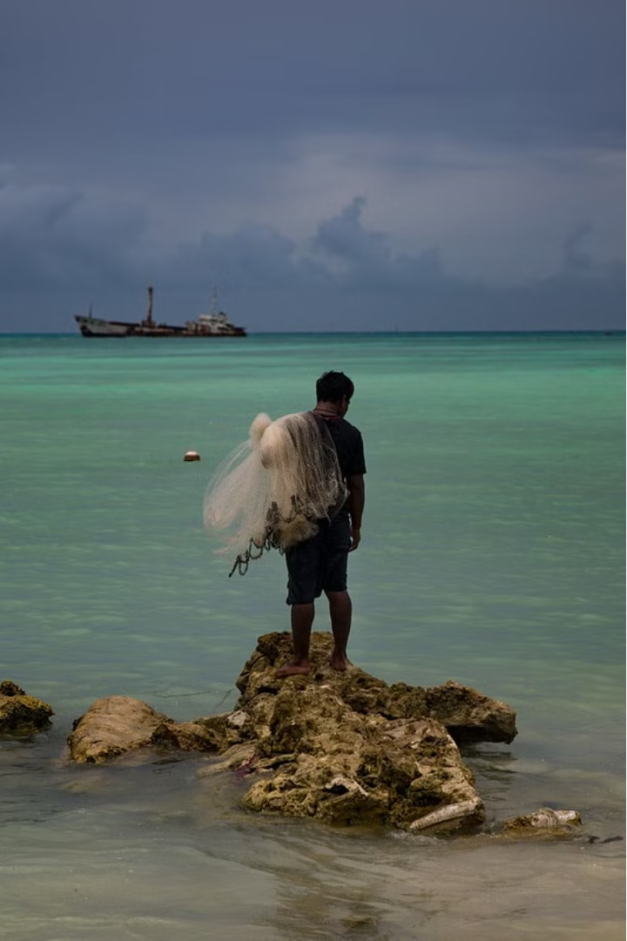
The Multifaceted Impacts of Climate Migration
Climate change is driving mass migration around the world, with profound economic and environmental consequences. These complex issues require a nuanced understanding to develop effective solutions.

Slide 4
Macro and Micro Economic Effects
Macro Impacts
Micro Impacts
Remittances
Climate migration can strain national economies, disrupt labor markets, and burden public services. Governments must adapt infrastructure and social safety nets.
Displaced individuals often lose assets, access to jobs, and social networks, leading to income shocks and increased poverty at the household level.
Migrants may send money back to communities of origin, providing a crucial economic lifeline but also potentially creating dependence.

Slide 5
Social Impacts
1
Cultural Disruption
2
Mental Health Challenges
Resettlement can erode traditional ways of life, leading to loss of identity and conflict with host communities.
Displacement and uncertainty take a heavy psychological toll, increasing anxiety, depression, and trauma.
3
Gender Dynamics
4
Strained Social Cohesion
Women and children are disproportionately vulnerable, facing heightened risks of exploitation and violence.
Influxes of migrants can strain resources and public services, fueling social tensions and xenophobia.

Slide 6
Rapid and Slow-Onset Climate Impacts
Rapid-Onset
Compounding Crises
Extreme weather events like hurricanes, floods, and wildfires that force immediate displacement.
The interplay of rapid and slow-onset changes creates a perfect storm, exacerbating vulnerability and displacement.
1
2
3
Slow-Onset
Gradual environmental degradation like sea level rise, drought, and desertification that erode livelihoods over time.

Slide 7
Environmental Impacts
Ecosystem Damage
Resource Depletion
Influxes of migrants can strain natural resources and lead to unsustainable land use, habitat destruction, and biodiversity loss.
Overcrowding and overexploitation of water, food, and energy sources in destination areas can exacerbate scarcity.
Carbon Emissions
Waste Management
Increased transportation, construction, and energy demands from migration patterns can raise greenhouse gas emissions.
Inadequate waste disposal systems in host communities can lead to pollution and environmental degradation.

Slide 8
Climate Change and Poverty in the Sundarbans
Cyclones
Sea Level Rise
Ecosystem Degradation
Livelihood Loss
Intensifying storms destroy homes, farms, and infrastructure, pushing the already impoverished to the brink.
Encroaching waters submerge islands, displace communities, and contaminate freshwater sources.
Disruption to agriculture, fishing, and other traditional livelihoods traps residents in a cycle of poverty.
Declining mangrove forests erode natural coastal defenses, exacerbating the impacts of climate change.

Slide 9
Climate Change and Poverty in Bundelkhand
Water Scarcity
Crop Failure
Livestock Loss
Impoverishment
Prolonged droughts deplete groundwater supplies, forcing residents to travel further for dwindling resources.
Unreliable rainfall and extreme temperatures decimate agricultural yields, jeopardizing food security.
Lack of water and grazing land leads to high mortality rates among cattle, a crucial livelihood asset.
The compounding effects trap residents in a vicious cycle of poverty, driving out-migration and further environmental degradation.

Slide 10
NRC Study on Climate Migration
Vulnerable Populations
Women, children, the elderly, and Indigenous communities face disproportionate risks.
Conflict and Instability
Climate-induced migration can exacerbate social tensions and political unrest in host regions.
Barriers to Assistance
Lack of legal recognition and resources hinders the ability of displaced people to access aid and support.
International Cooperation
Coordinated global efforts are needed to address the complex, cross-border nature of climate migration.

Slide 11
Policy Responses and Solutions
Adaptive Strategies
Mitigation Efforts
Comprehensive Policies
Investing in resilient infrastructure, sustainable resource management, and social safety nets can help communities adapt to climate impacts.
Reducing greenhouse gas emissions and protecting natural ecosystems are crucial to mitigate the root causes of climate change.
Integrated policies that address the economic, social, and environmental dimensions of climate migration are needed to develop holistic solutions.

