Slide 1
CCP-LAW
Curricula development on Climate Change Policy and Law
Subject title: The Science of Climate Change: Mitigation and Adaptation
Instructor Name: Dr. Abhishek Gupta
Project No of Reference: 618874-EPP-1-2020-1-VN-EPPKA2-CBHE-JP:
The European Commission's support for the production of this publication does not constitute an endorsement of the contents, which reflect the views only of the authors, and the Commission cannot be held responsible for any use which may be made of the information contained therein.

Slide 2
Climate Change Adaptation

Slide 3
Impact of Climate Change on Human Health
Text……

Slide 4
Introduction to Climate Change Adaptation
According to the United Nations Framework Convention on Climate Change, adaptation refers to adjustments in ecological, social or economic systems in response to real or anticipated climatic stimuli and their effects or impacts.
Climate change adaptation involves adjusting natural or human systems in response to actual or expected climatic stimuli or their effects, to moderate harm or exploit beneficial opportunities.
As climate change impacts become more pronounced, adaptation is crucial for minimizing vulnerabilities and enhancing resilience of ecosystems and human communities.

Slide 5
Key Terminologies
Climate Change Adaptation:
Definition: Adjusting natural or human systems in response to actual or expected climatic changes and their impacts to minimize harm and exploit beneficial opportunities.
Example: Building seawalls to protect coastal communities from rising sea levels.
Mitigation:
Definition: Efforts to reduce or prevent the emission of greenhouse gases to slow down global warming.
Example: Increasing the use of renewable energy sources like wind and solar power.
Resilience:
Definition: The capacity of a system, community, or society to withstand and recover quickly from climate-related shocks and stresses.
Example: Developing drought-resistant crops to maintain agricultural productivity during prolonged dry periods.

Slide 6
Key Terminologies
Vulnerability:
Definition: The degree to which a system or population is susceptible to and unable to cope with the adverse effects of climate change.
Example: Low-lying coastal areas are highly vulnerable to sea-level rise and storm surges.
Exposure:
Definition: The presence of people, livelihoods, environmental services and resources, infrastructure, or economic, social, or cultural assets in places that could be adversely affected by climate change.
Example: Coastal cities exposed to sea-level rise and hurricanes.

Slide 7
Key Terminologies
Sensitivity:
Definition: The degree to which a system is affected, either adversely or beneficially, by climate variability or change.
Example: Agricultural yields that are highly sensitive to temperature and precipitation changes.
Adaptive Capacity:
Definition: The ability of systems, institutions, humans, and other organisms to adjust to potential damage, to take advantage of opportunities, or to respond to consequences.
Example: Communities with robust disaster response plans and resources have high adaptive capacity.

Slide 8
Why Adaptation Is Necessary
Increasing Frequency of Extreme Weather Events: Climate change is leading to more frequent and severe weather events such as hurricanes, heatwaves, floods, and droughts, posing significant risks to communities and ecosystems.
Long-term Climatic Changes: Gradual changes in temperature, precipitation patterns, and sea level rise are affecting agricultural productivity, water resources, and biodiversity, necessitating proactive adaptation measures.
Economic Impacts: Without adaptation, the economic costs of climate change impacts, including damage to infrastructure, loss of productivity, and healthcare costs, can be substantial. Investing in adaptation can reduce these long-term costs.
Social and Health Impacts: Vulnerable populations, such as the elderly, children, and low-income communities, are disproportionately affected by climate change. Adaptation can help protect public health and ensure social equity.
Preserving Ecosystems and Biodiversity: Adaptation strategies are essential for conserving natural habitats and species, maintaining ecosystem services, and ensuring biodiversity resilience in the face of climate change.

Slide 10
Why Adaptive planning?
To make “Climate Resilient” society.
Todays choice will shape tomorrow’s vulnerabilities
Significant time is required to motivate and develop adaptive capacity, and to implement changes
Proactive planning is often more effective and less costly than reactive planning

Slide 11
Concept of Vulnerability Assessment
Definition: Vulnerability assessment involves evaluating the extent to which a system, community, or individual is susceptible to, or unable to cope with, adverse effects of climate change, including variability and extremes.
Purpose:
To identify and prioritize areas, sectors, and populations at greatest risk.
To inform the development of targeted adaptation strategies and policies.
Components of Vulnerability:
Exposure: The presence of people, infrastructure, and ecosystems at risk.
Sensitivity: The degree to which these elements can be affected by climate hazards.
Adaptive Capacity: The ability to adjust, mitigate potential damage, or cope with consequences.

Slide 12
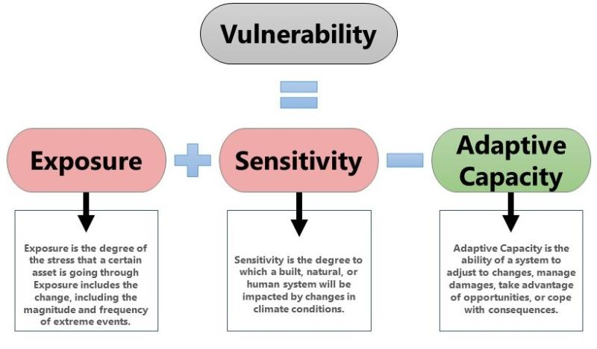

Slide 13
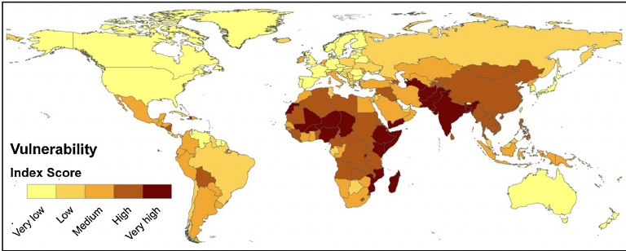
Source: https://www.sciencedirect.com/science/article/abs/pii/S0959378013001969

Slide 14
Concept of Vulnerability Assessment
Steps in Conducting a Vulnerability Assessment:
Identifying Hazards: Determining climate-related hazards relevant to the area or sector being studied.
Assessing Exposure: Mapping and quantifying the elements at risk.
Evaluating Sensitivity: Understanding how susceptible these elements are to climate impacts.
Analyzing Adaptive Capacity: Examining the resources and strategies available to respond to climate risks.
Benefits of Vulnerability Assessment:
Enhanced Decision-Making: Provides data-driven insights for policymakers and planners.
Resource Allocation: Helps prioritize investments and interventions in the most vulnerable areas.
Community Preparedness: Increases awareness and preparedness among vulnerable populations.

Slide 15
Vulnerability Assessment Methodology

Slide 16
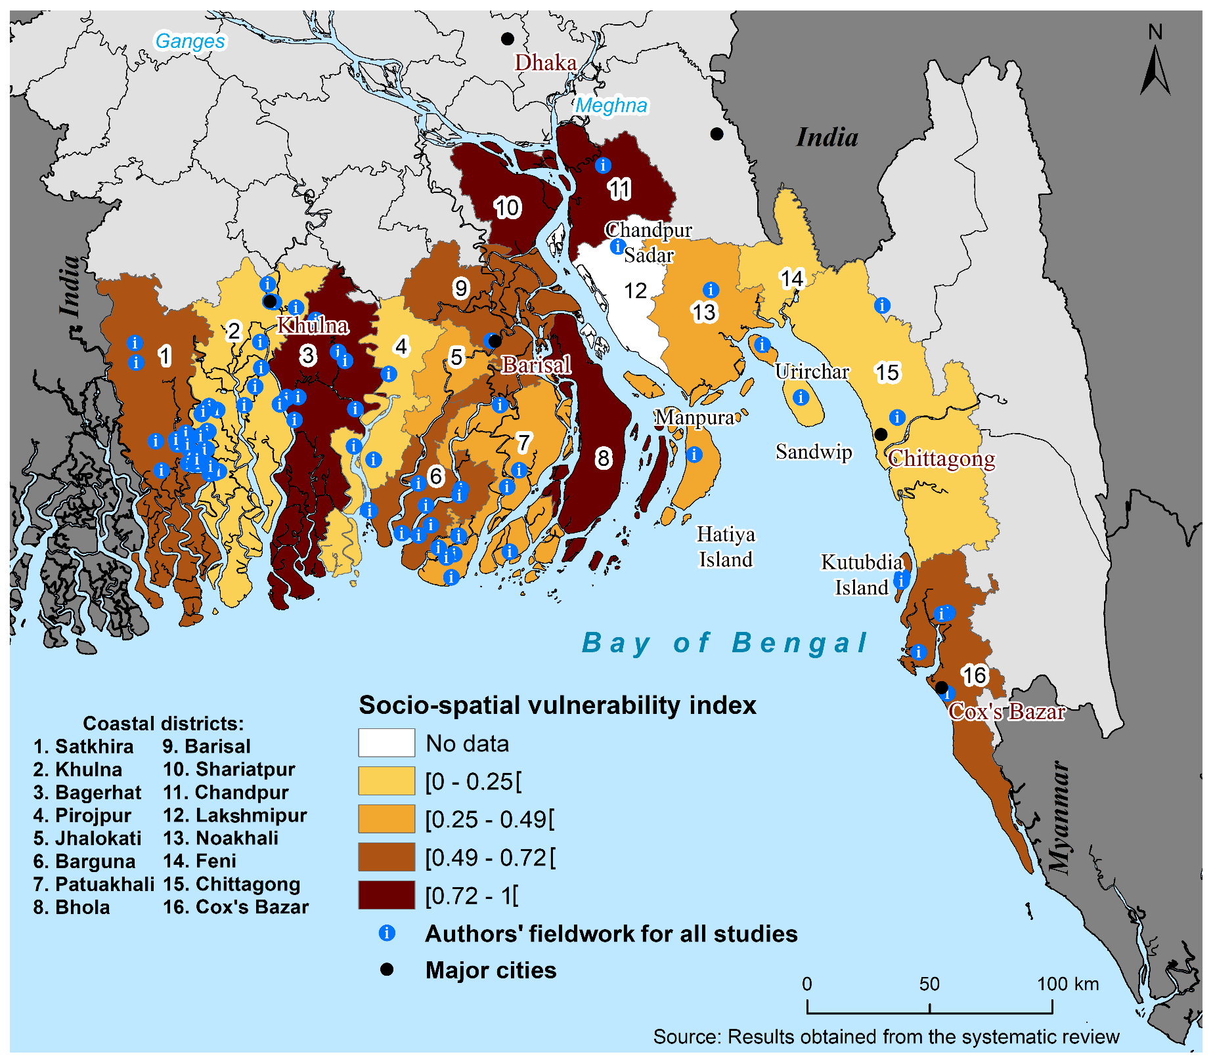
Case Study - Bangladesh
Location: Coastal areas of Bangladesh, focusing on regions like the Sundarbans and low-lying coastal zones.
Context: Bangladesh is one of the most vulnerable countries to climate change due to its low elevation, high population density, and exposure to extreme weather events like cyclones and flooding.
Assessment of Exposure:
Details: The coastal regions of Bangladesh are highly exposed to sea-level rise, storm surges, and river flooding.
Examples: In 2009, Cyclone Aila caused widespread flooding and damage, displacing thousands of people.

Slide 17
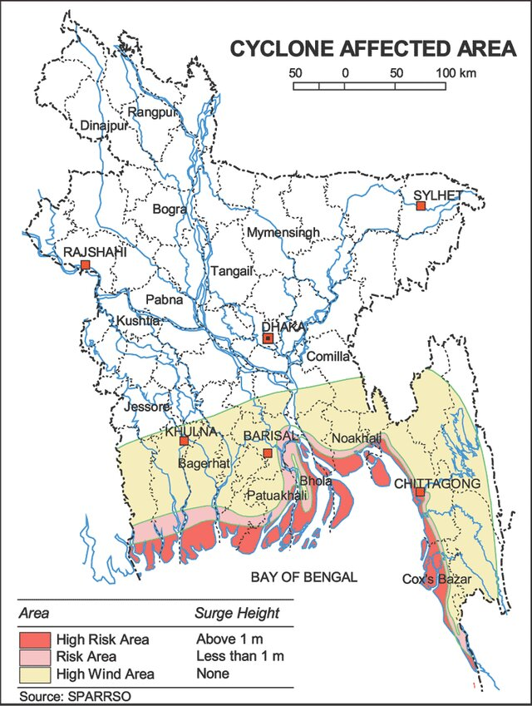
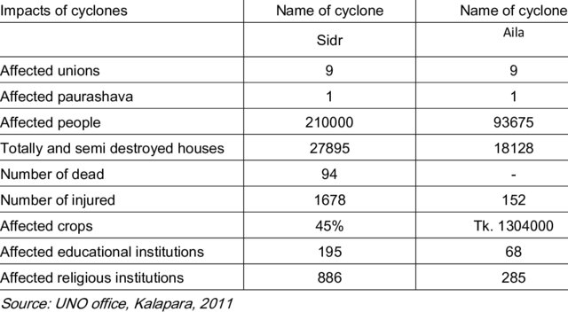
Case Study - Bangladesh

Slide 18
Case Study - Bangladesh
Evaluation of Sensitivity:
Details: The sensitivity of Bangladesh’s coastal regions is high due to the dependence on agriculture and fisheries, poor infrastructure, and limited access to healthcare.
Examples: Saltwater intrusion from sea-level rise affects agricultural productivity, impacting food security.
Analysis of Adaptive Capacity:
Details: The adaptive capacity in these regions is constrained by poverty, lack of resources, and inadequate infrastructure.
Examples: Limited financial resources for rebuilding, inadequate disaster response mechanisms, and lack of education on adaptation strategies.
Findings and Recommendations:
The vulnerability assessment indicates high exposure and sensitivity with low adaptive capacity, making the coastal areas of Bangladesh extremely vulnerable to climate change.
Recommendations: Implementing better early warning systems, constructing cyclone shelters, improving infrastructure, and enhancing community education and engagement in adaptation planning.

Slide 19
Resilience
Definition: Resilience is the capacity of a system, community, or individual to withstand, recover, and adapt in the face of stressors and shocks, such as climate-related hazards.
Example: A coastal community that can rebuild quickly after a hurricane demonstrates resilience.
Importance of Resilience:
Explanation: Building resilience is crucial for reducing long-term vulnerability and ensuring sustainable development in the face of climate change.
Benefits: Enhances the ability to cope with unexpected events, reduces economic losses, and protects lives and livelihoods.

Slide 20
Resilience
Components of Resilience:
Robustness: Strength and durability of infrastructure and systems to withstand impacts.
Redundancy: Availability of backup systems and resources to maintain functionality during disruptions.
Resourcefulness: Ability to effectively manage resources, including emergency response and recovery efforts.
Recovery: Capacity to restore and improve systems and services after an event.
Adaptive Capacity: Ability to learn, adjust, and transform in response to changing conditions.

Slide 21
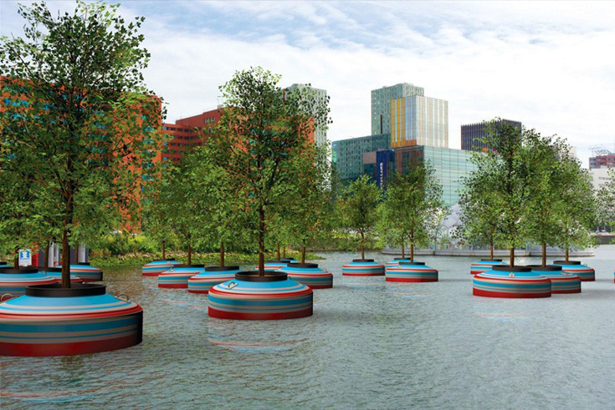
Resilience
Strategies for Building Resilience:
Community Engagement: Involving local communities in planning and decision-making to ensure tailored and effective resilience strategies.
Diversification: Diversifying livelihoods and economic activities to reduce dependency on a single source of income.
Infrastructure Improvement: Strengthening buildings, transportation networks, and utilities to withstand climate impacts.
Ecosystem-Based Approaches: Using natural systems, like mangroves and wetlands, to provide protective barriers and enhance resilience.
Case Study Example:
Example: The city of Rotterdam, Netherlands, has implemented a comprehensive resilience strategy that includes innovative water management, green infrastructure, and community engagement.
Floating Forest, Rotterdam

Slide 22
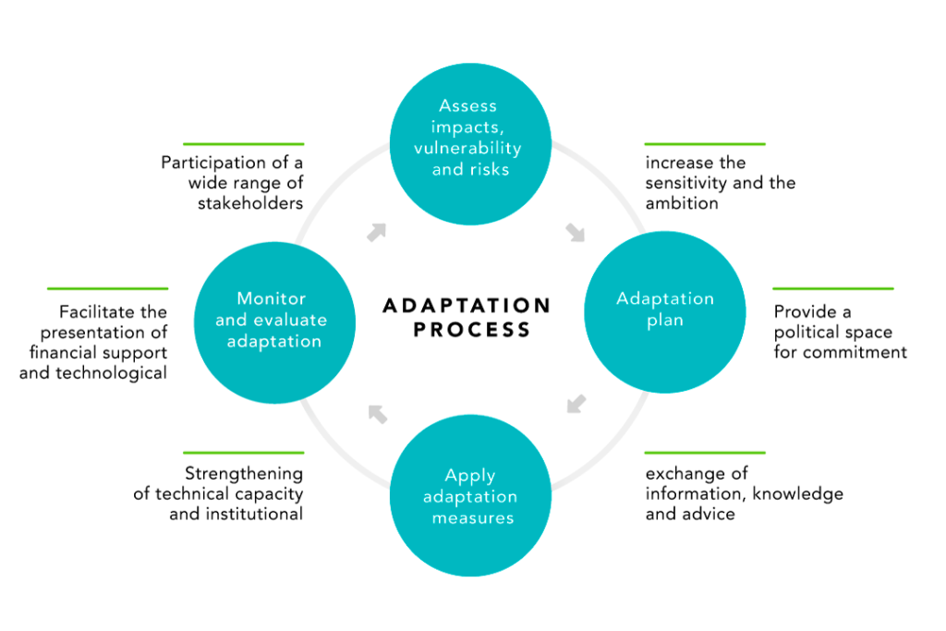
How we can Adapt

Slide 23
Adaptive Capacity
Adaptive capacity is the ability of systems, institutions, humans, and other organisms to adjust to potential damage, take advantage of opportunities, or respond to consequences related to climate change.
Examples: Communities with strong social networks and access to resources can better respond to climate threats.
Components of Adaptive Capacity:
Human Resources: Education, skills, and knowledge that enable individuals and communities to adapt.
Economic Resources: Availability of financial resources to invest in adaptation measures.
Institutional Resources: Governance structures, policies, and institutions that support adaptation planning and implementation.
Technological Resources: Access to technology and infrastructure that facilitate adaptation.

Slide 24
Adaptive Capacity
Factors Influencing Adaptive Capacity:
Social Factors: Community cohesion, social networks, and equitable access to resources.
Economic Factors: Wealth distribution, employment opportunities, and economic diversification.
Institutional Factors: Effective governance, institutional support, and political stability.
Environmental Factors: Availability and management of natural resources, ecosystem health.
Enhancing Adaptive Capacity:
Education and Awareness: Promoting education and awareness about climate risks and adaptation strategies.
Strengthening Institutions: Developing robust governance structures and policies that support adaptive measures.
Building Financial Resilience: Ensuring access to financial resources through insurance, microfinance, and investment in resilient infrastructure.
Technology and Innovation: Investing in and promoting the use of technology and innovative solutions to enhance adaptive capacity.

Slide 25
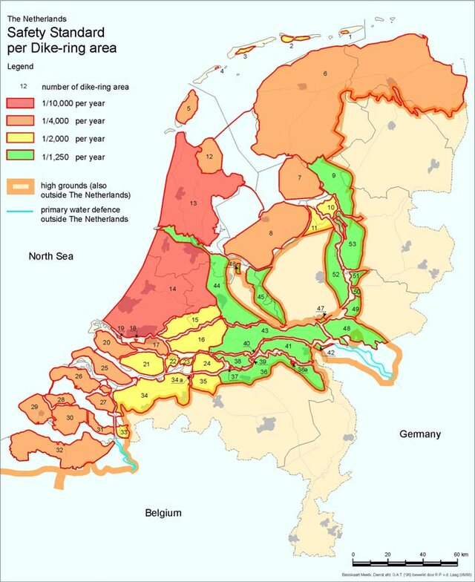
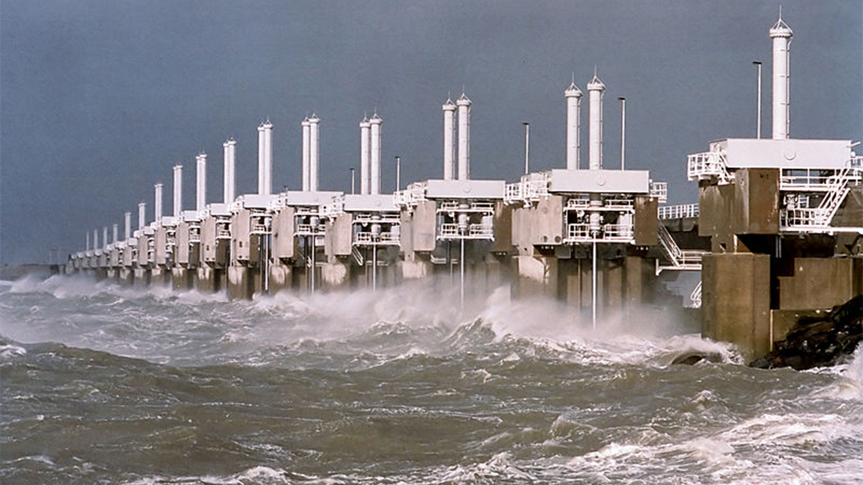
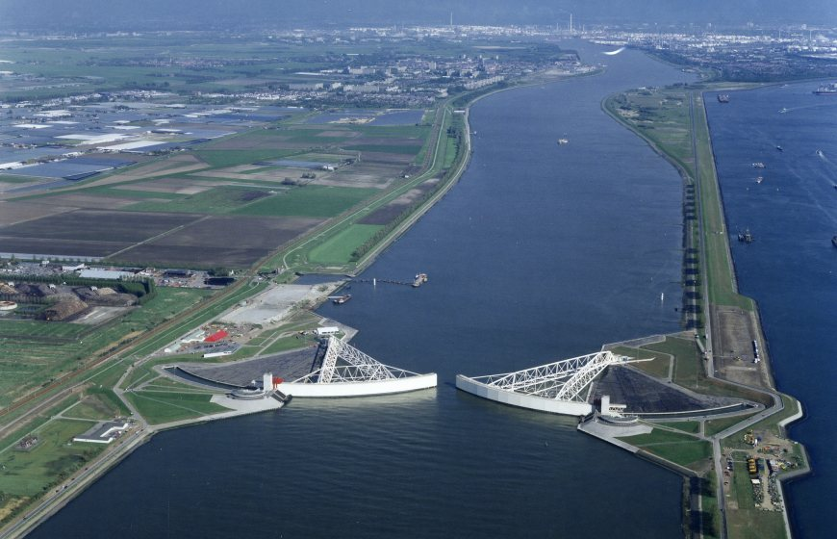
Adaptive Capacity
Case Study Example:
Country/Region: The Netherlands
Details: The Netherlands has developed advanced water management systems and policies to address the risk of sea-level rise and flooding.

Slide 26
Adaptation Pathways
Adaptation pathways are flexible, long-term strategies that outline a series of actions to manage climate risks over time. They allow for adjustments as new information becomes available or as conditions change.
Example: A coastal city developing a sequence of flood defense measures that can be implemented over decades as sea levels rise.
Importance of Adaptation Pathways:
Long-term Planning: They provide a structured approach to anticipate and address future climate impacts.
Flexibility: Adaptation pathways accommodate uncertainty and allow for course corrections based on new data and changing conditions.
Developing Adaptation Pathways:
Identify Objectives: Define the goals and desired outcomes of the adaptation plan.
Assess Risks and Opportunities: Evaluate potential climate risks and opportunities for adaptation.
Sequence Actions: Develop a timeline of actions, starting with low-regret measures and progressing to more significant investments as needed.
Monitor and Review: Continuously monitor outcomes and review the plan to incorporate new information and adjust actions accordingly.

Slide 27
Adaptation Pathways
Examples of Adaptation Pathways:
Urban Areas: Developing green infrastructure, such as parks and green roofs, to manage heatwaves and stormwater, with the option to scale up to more extensive flood defenses if needed.
Agricultural Systems: Starting with crop diversification and soil management practices, with the potential to shift to more resilient crop varieties and irrigation systems as climate impacts intensify.
Case Study: Thames Estuary 2100 Project:
Details: The Thames Estuary 2100 Project in the UK is a comprehensive plan to protect London from future tidal flooding. It outlines a series of adaptive measures to be implemented over the next century, including strengthening existing defenses and eventually constructing new barriers.

Slide 28
International Initiatives in Climate Change Adaptation
United Nations Framework Convention on Climate Change (UNFCCC): The UNFCCC is an international environmental treaty aimed at addressing climate change. It plays a key role in coordinating global efforts for adaptation and mitigation.
Adaptation Initiatives: Establishment of the Adaptation Committee and the Nairobi Work Program to support adaptation actions and knowledge sharing.
Intergovernmental Panel on Climate Change (IPCC): The IPCC assesses scientific information related to climate change and provides policymakers with regular reports on climate impacts, vulnerabilities, and adaptation.
Contribution: IPCC reports serve as critical resources for understanding adaptation needs and guiding policy development.

Slide 29
International Initiatives in Climate Change Adaptation
Global Environment Facility (GEF): The GEF provides funding for projects and programs in developing countries to address environmental issues, including climate change adaptation.
Projects: Funding for community-based adaptation projects, capacity building, and technology transfer.
Green Climate Fund (GCF): The GCF is a financial mechanism under the UNFCCC, dedicated to supporting developing countries in adapting to and mitigating climate change.
Focus Areas: Providing grants and loans for adaptation projects in areas such as water management, agriculture, and coastal protection.
International Climate Change Adaptation Frameworks:
Paris Agreement: Includes a global goal on adaptation to enhance adaptive capacity, strengthen resilience, and reduce vulnerability to climate change.
Sendai Framework for Disaster Risk Reduction: Aims to reduce disaster risk and losses, emphasizing the importance of integrating climate change adaptation into disaster risk reduction strategies.

Slide 30
Overview of the Paris Agreement
Adopted in December 2015 at COP21 in Paris, France, under the United Nations Framework Convention on Climate Change (UNFCCC).
Objective was to aim to strengthen the global response to climate change by keeping global temperature rise well below 2 degrees Celsius above pre-industrial levels and pursuing efforts to limit it to 1.5 degrees Celsius.
Key Points:
Nationally Determined Contributions (NDCs): Each country sets its own targets for reducing greenhouse gas emissions and adapting to climate change, with regular updates.
Global Goals: Enhances adaptive capacity, strengthen resilience, and reduce vulnerability to climate change, with a focus on safeguarding food security and ending hunger.

Slide 31
Overview of the Paris Agreement
Relevance to Adaptation:
Adaptation Goal: Includes a global goal on adaptation to enhance adaptive capacity, strengthen resilience, and reduce vulnerability to climate change.
Support for Developing Countries: Provides financial and technical support to developing countries for adaptation actions through the Green Climate Fund and other mechanisms.
Implementation Challenges:
Funding: Mobilizing sufficient financial resources for adaptation projects in developing countries.
Coordination: Ensuring effective coordination between countries and international organizations to implement adaptation measures.
Monitoring and Reporting: Establishing robust mechanisms for monitoring progress on adaptation commitments and reporting on actions taken.

Slide 32
National Adaptation Plans (NAP)
Many countries develop NAPs to identify medium- and long-term adaptation needs and outline strategies to address them.
United States: National Climate Assessment (NCA):
Overview: The NCA provides a comprehensive assessment of climate change impacts, vulnerabilities, and adaptation efforts across the United States.
Key Actions: Identifies adaptation strategies for different sectors and regions, supports local adaptation planning, and promotes public awareness.
Australia: National Climate Resilience and Adaptation Strategy:
Overview: Australia's strategy focuses on enhancing the resilience of communities, economies, and ecosystems to climate change.
Key Actions: Implementing risk assessments, supporting community-based adaptation, and investing in resilient infrastructure.

Slide 33
National Adaptation Plans (NAP)
India: National Action Plan on Climate Change (NAPCC):
Overview: The NAPCC outlines India's approach to addressing climate change through eight national missions, including one focused on adaptation.
Key Actions: Promotes sustainable agriculture, water conservation, and ecosystem protection, with a focus on vulnerable communities.
Bangladesh: Climate Change Strategy and Action Plan (BCCSAP):
Overview: The BCCSAP is a comprehensive plan to enhance the country's resilience to climate change impacts.
Key Actions: Focuses on disaster management, infrastructure development, and community-based adaptation initiatives.

Slide 34
Success Stories
Social safety nets in Ethiopia
In 2006, the Ethiopian government and international partners established the Productive Safety Net Program.
The program provides cash and food to families that are unable to feed themselves due to droughts, delayed rains, and flooding that threaten food security.
The aid is contingent on participation in local productivity-enhancing or environmental programs—for example, land rehabilitation, improvement of water sources, and construction of infrastructure such as roads and hospitals.
Program beneficiaries experience a 25 percent smaller drop in consumption after droughts relative to those not in the program.
The program has also reduced soil loss by more than 40 percent, improved availability of water, and increased land productivity.

Slide 35
Success Stories
Climate-smart infrastructure in Malaysia
The Stormwater Management and Road Tunnel (SMART Tunnel) in Kuala Lumpur, Malaysia, serves a dual purpose: it carries traffic and helps combat flash floods.
The tunnel consists of three levels. Normally, the top two levels carry road traffic.
However, they can be temporarily used as storm drains.
At a cost of about $500 million, the SMART Tunnel is expected to prevent more than $1.5 billion in flood damage and reduce the costs of traffic congestion by more than $1 billion over the next 30 years.

Slide 36
Success Stories
Centralized air conditioning in India
High temperatures reduce labor productivity and can also harm health. Air-conditioning is the most common solution to deal with excessive heat. However, the negative effects of air-conditioning, such as increased energy consumption and pollution, cannot be ignored.
Moreover, high up-front costs and infrastructure requirements push air conditioning out of reach for poor and vulnerable populations, especially in low-income countries.
District cooling, a centralized air-conditioning system where centrally chilled water is distributed to consumers through underground pipes, can reduce these negative effects.
It is in use in several major cities in advanced economies and is currently under construction by the Government of Gujarat, India, in the Gujarat International Finance Tec-City.
Centralized cooling systems reduce cost and pollution by consuming 35 to 50 percent less energy than individual air cooling units. These systems unburden the electricity sector and make indoor climate control more accessible by eliminating the up-front cost for its users.

Slide 37
Community-Based Adaptation
Importance of Community-Based Adaptation:
Local Context: Tailors adaptation strategies to the specific needs, priorities, and vulnerabilities of local communities.
Ownership and Engagement: Promotes community ownership, participation, and resilience-building, enhancing the sustainability of adaptation efforts.
Traditional Knowledge: Integrates indigenous and local knowledge systems, contributing to effective adaptation planning and implementation.
Key Components:
Community Engagement: Involving local residents, community leaders, and stakeholders in decision-making processes and project implementation.
Capacity Building: Strengthening local skills, knowledge, and institutions to effectively respond to climate impacts and sustain adaptation measures.
Ecosystem-Based Approaches: Using natural ecosystems and biodiversity to enhance resilience and provide ecosystem services crucial for community well-being.

Slide 38
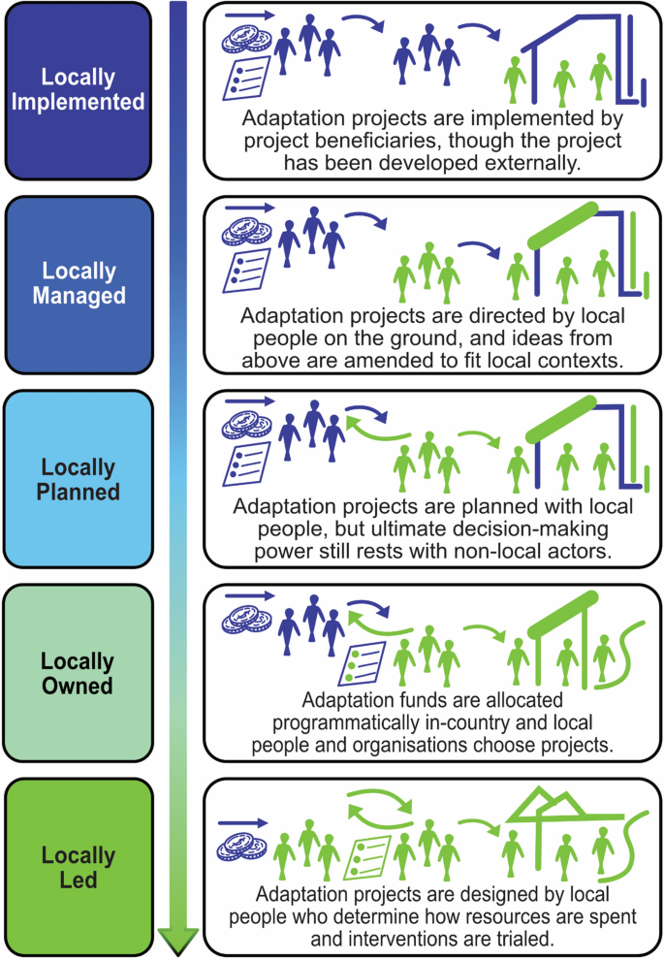
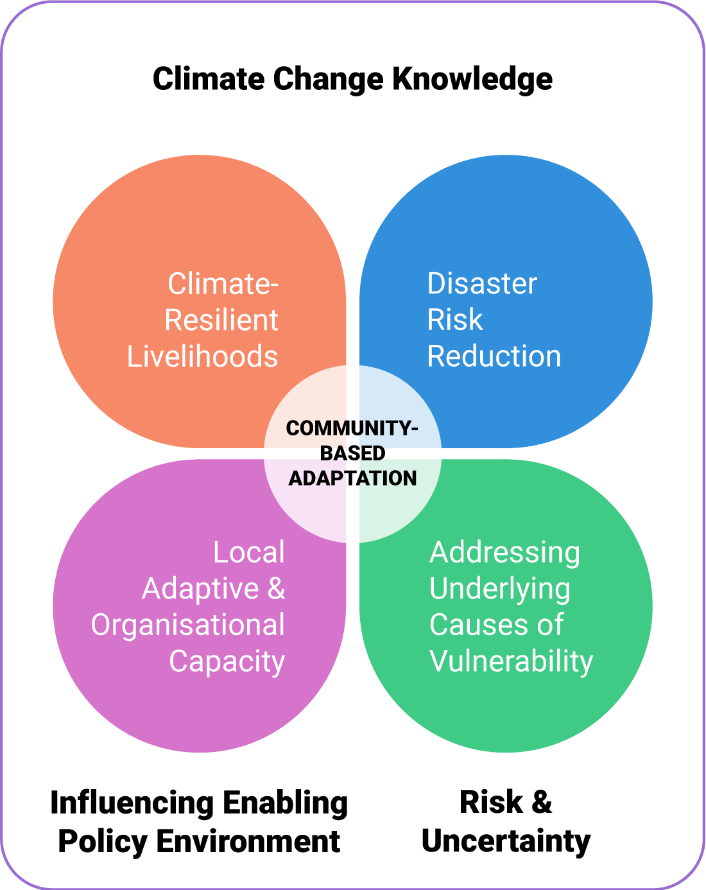

Slide 39
Community-Based Adaptation
Examples of Community-Based Adaptation:
Coastal Communities: Building cyclone-resistant shelters and early warning systems in vulnerable coastal areas.
Agricultural Communities: Introducing climate-resilient crop varieties and sustainable farming practices to mitigate the impacts of changing weather patterns.
Urban Neighborhoods: Establishing community gardens, green spaces, and rainwater harvesting systems to reduce urban heat island effects and manage stormwater.
Benefits of Community-Based Adaptation:
Enhanced Resilience: Strengthening local adaptive capacity and reducing vulnerability to climate hazards.
Social Cohesion: Fostering community solidarity, cooperation, and empowerment in facing climate challenges.
Sustainable Development: Contributing to sustainable development goals by integrating climate resilience into local development plans and initiatives.

Slide 41
Challenges in Adaptation
Common Challenges in Climate Change Adaptation:
Lack of Funding: Insufficient financial resources to implement adaptation measures, particularly in developing countries.
Limited Data and Knowledge: Uncertainties in climate projections and inadequate data for effective planning and decision-making.
Policy and Governance: Inadequate integration of adaptation into national and local policies, regulatory frameworks, and planning processes.
Technological Barriers: Limited access to appropriate technologies and innovations for climate-resilient infrastructure and practices.
Social and Behavioral Factors: Resistance to change, cultural barriers, and social inequalities hindering adaptation efforts.
Coordination and Collaboration: Challenges in multi-sectoral coordination, stakeholder engagement, and partnerships for effective adaptation planning and implementation.

Slide 42
Future Directions
Emerging Trends in Adaptation:
Nature-Based Solutions: Increasing use of ecosystem-based approaches, such as wetland restoration and urban green infrastructure, to enhance resilience.
Integrated Approaches: Promoting synergies between adaptation, mitigation, and sustainable development goals for holistic climate action.
Advancements in Technology: Harnessing innovations in climate-resilient infrastructure, renewable energy, and digital tools for adaptive solutions.
Community Engagement: Strengthening participatory approaches and local knowledge systems in adaptation planning and implementation.
Policy Integration: Enhancing coherence between national adaptation plans, international frameworks (e.g., Paris Agreement), and sectoral strategies.

Slide 43
Future Directions
Research and Development:
Climate Modeling: Improving climate projections and risk assessments to enhance adaptive capacity and decision-making.
Capacity Building: Investing in skills development and knowledge-sharing to empower vulnerable communities and institutions.
Finance and Investment: Scaling up funding mechanisms and investments in adaptation, including public-private partnerships and innovative financing.

Slide 44
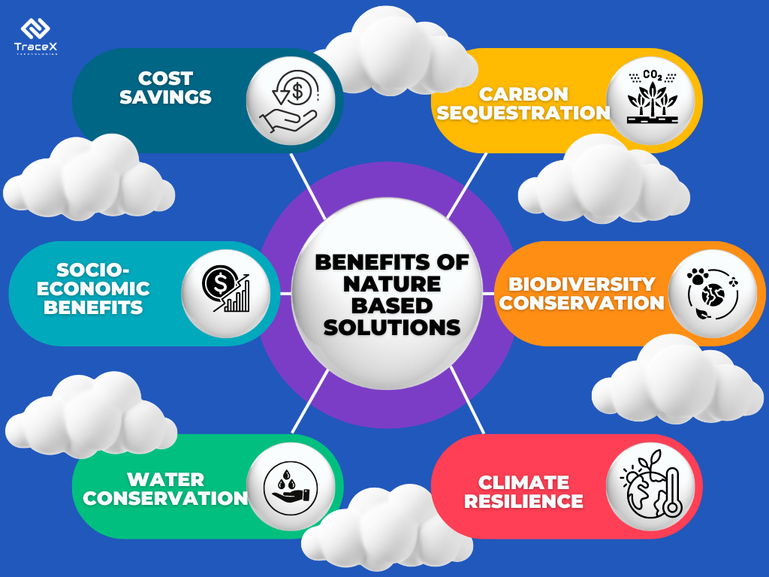
Benefits of Nature Based Solutions

Slide 45
Thank You

