Slide 1
CCP-LAW
Curricula development on Climate Change Policy and Law
Module: Environmental Risk Prevention and Management
Topic: Public Health and the Environmental
Instructor Name:
Project No of Reference: 618874-EPP-1-2020-1-VN-EPPKA2-CBHE-JP:
The European Commission's support for the production of this publication does not constitute an endorsement of the contents, which reflect the views only of the authors, and the Commission cannot be held responsible for any use which may be made of the information contained therein.

Slide 2
Aims of the Session
An introduction to the relationship between climate change and public health risks.
Ascertain how certain groups are more vulnerabile to health impacts exacerbated by climate change.
Using Covid-19 as an example, it explores how Biodiversity was positively and negatively impacted by the virus.

Slide 3
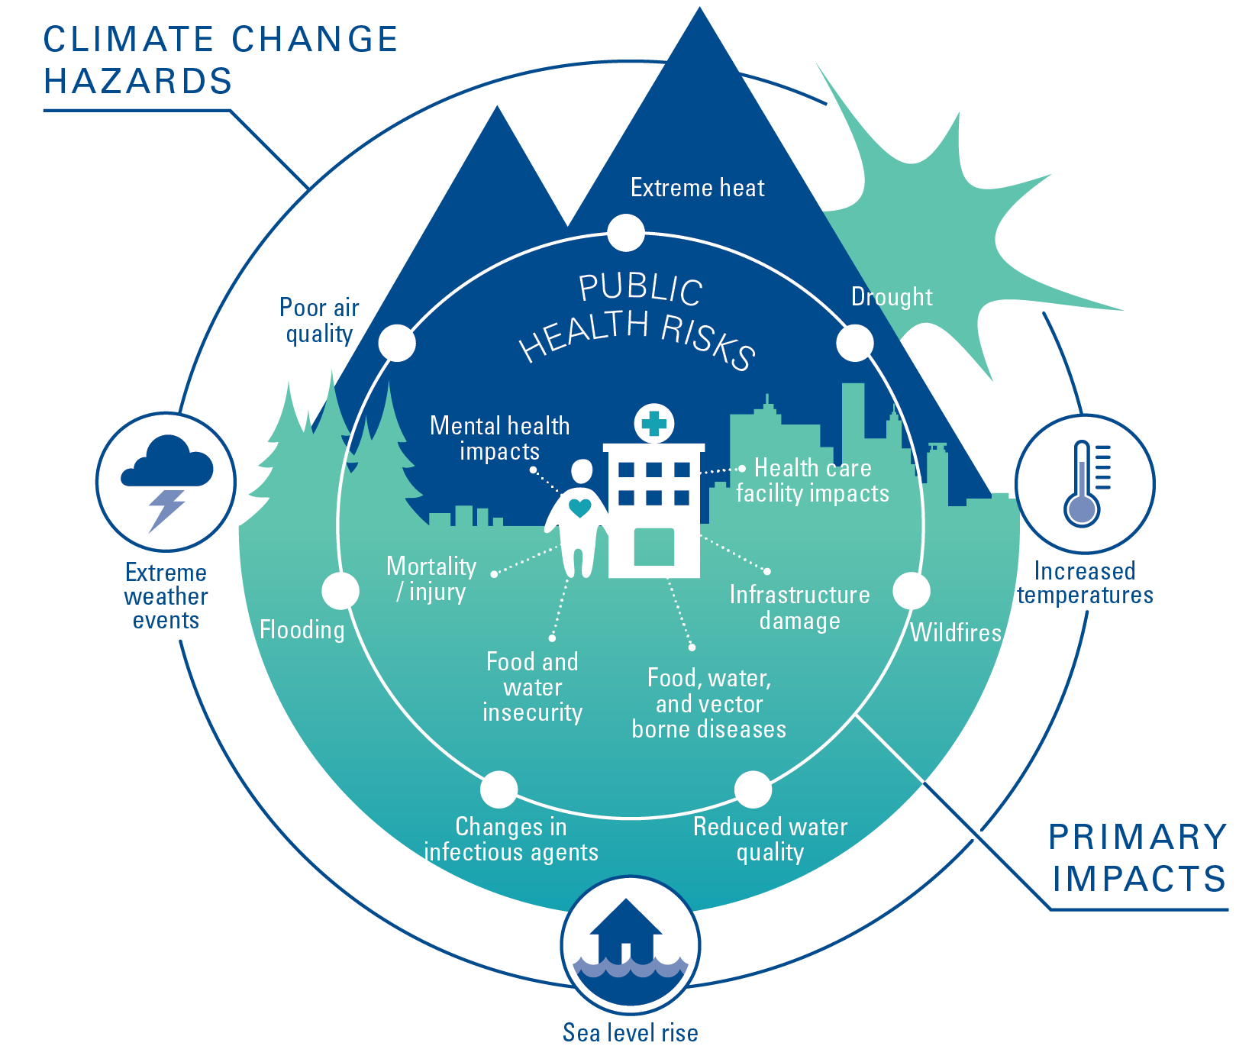
Public Health and Environmental Risks

Slide 4
The role of Climate Change in affecting Public Health

Slide 5
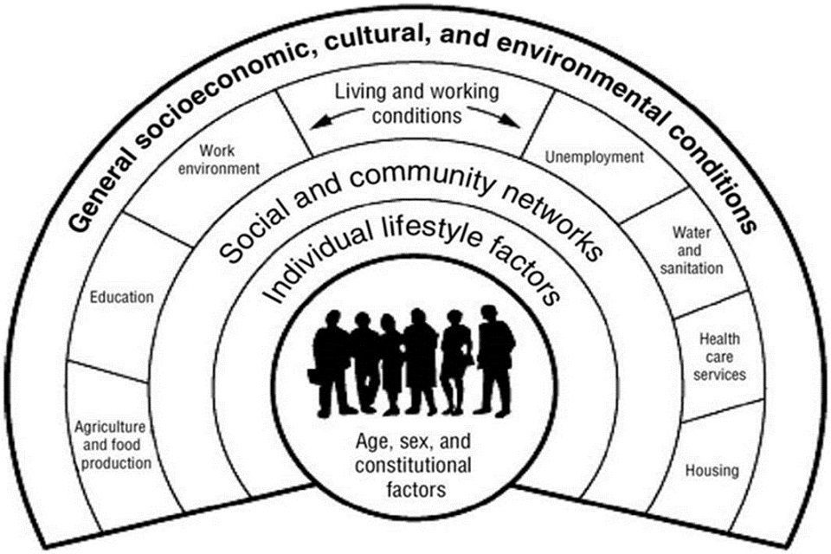
Dahlgreen and Whitehead (1991)

Slide 6
Livelihood impacts
Poor social & economic circumstances affect health throughout life. People further down the social ladder usually run at least twice the risk of serious illness & premature death as those near the top.
Disadvantage has many forms: few family assets, poorer education, insecure employment, a hazardous or dead-end job, living in poor housing…
The longer people live in stressful economic & social circumstances, the greater the physiological wear and tear they suffer, and the less likely they are to enjoy a healthy old age.
(World Health Organisation)

Slide 7
Social impacts and health
Health impacts social (and other assets)
Social (and other assets) impact(s) health
What type of factors impact health and livelihoods?

Slide 8
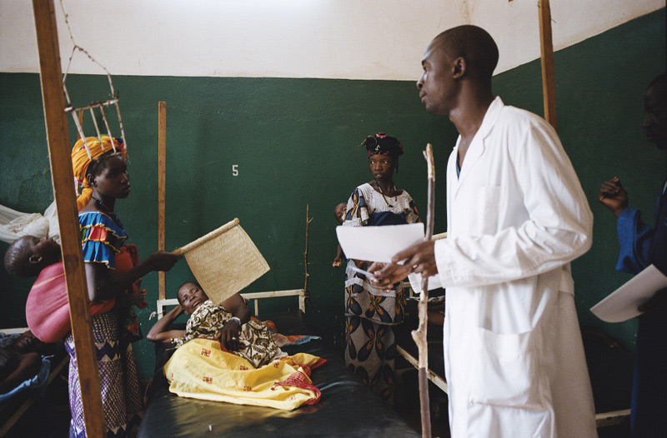
Key challenges
What are the challenges to providing health care?

Slide 9
5 As Access model – Discuss in groups (10 mins) what you think all these mean?
Availability
Accessibility
Affordability
Adequacy
Acceptability

Slide 10
Availability
The existing health services and goods meet clients' needs

Slide 11
Accessibility
The location of supply is in line with the location of clients

Slide 12
Affordability
The prices of services fit the clients' income and ability to pay

Slide 13
Adequacy
The organisation of health care meets the clients' expectations

Slide 14
Acceptability
The characteristics of the providers match with those of the clients

Slide 15
PADLET ACTIVITY – SCAVENGER HUNT (40 mins) How is Human-induced Climate Change exacerbating Global Health ? Research some global examples and provide information on the PADLET Link.
Global Health Threats Scavenger Hunt
In groups, search for information on various health threats amplified by climate change (such as heatwaves, infectious diseases, and air pollution) and share your discoveries with an attachment that provides more detail or examples.
In small groups, consider what aspects of climate change affect health.
What impacts do health crises have for the economy, society and
In terms of health, what ways are marginalised groups more greatly impacted by climate change?
Consider some global events or emergencies that have contributed to health crises.
To what extent have these events or emergencies been exacerbated by anthropogenic activity?
PADLET LINK: Global Health Threats Scavenger Hunt (padlet.com)

Slide 16
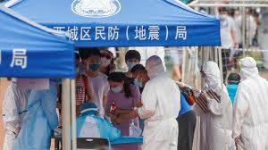
Covid-19: context
Origin
Vulnerability and social context
Vectors of infection
Timelines

Slide 17
COVID-19
Pre-COVID global context
Patient ZERO- reason for infection- vulnerability
Vectors of infection
What helped the pandemic to spread?
What might have prevented the spread?
What can we learn from the previous pandemics?
What should we do now to prevent longer infection?

Slide 18
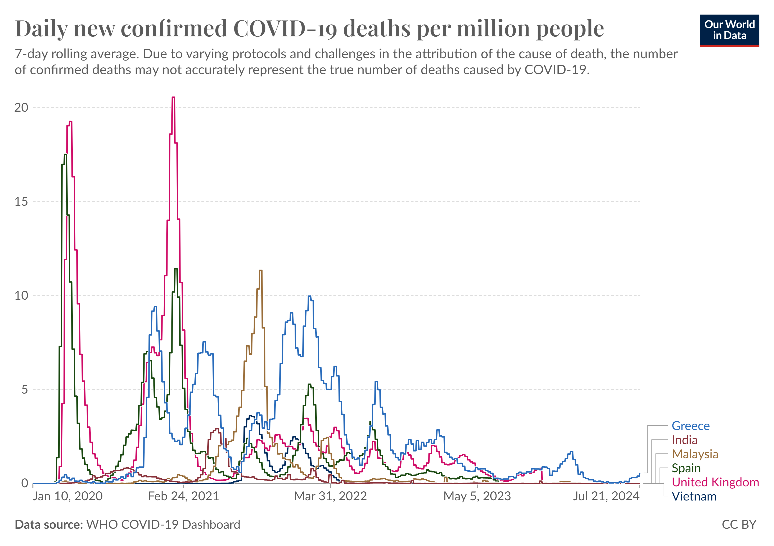

Slide 19
Covid-19 and Biodiversity
There were both benefits and impacts of the Covid-19 crisis on Biodiversity.
PPE used for managing and treating Covid-19 and for everyday living (i.e.: face masks and gloves) have increased disposable waste products.
Restrictions on travel led to a stop to ecotourism, so unsustainable and environmentally exploitative re-surfaced again in many regions of sub-Saharan Africa and Asia, such as poaching and hunting.
There was a lack of protection, security and governance afforded to the environment as governments attempts to deal with the immediate challenges of the virus.
The limits to air and car travel, however led to less Co2 emissions and improved air quality.
The pandemic itself drew attention to the origins of viruses such as Covid-19 and Ebola and the need to address inhumane living conditions for animals (including selling in markets).

Slide 20
Living Planet Index
The Living Planet Index tries to summarize the average change in population size of tens of thousands of studied animal populations. It distills this change into a single number.
What it reports is the average decline in animal population sizes since 1970. This does not tell us the:
Number of species lost;
Number of populations or individuals that have been lost;
Number or percentage of species or populations that are declining;
Number of extinctions.
All the data may not always be representative as some countries have larger and more detailed data sets due to cost, access to education and policy.
(Our Wprld in Data 2023)

Slide 21
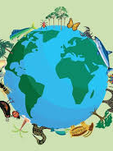
Scientific Paper Review on Covid-19 and Biodiversity (40 mins)
PADLET activity: Research Findings Share (padlet.com)
Research Findings Share
Select a recent scientific study on Covid-19's effects on biodiversity, add a post with a summary, your thoughts, and a link to the full study.
Instructions
Welcome to our activity Padlet!
Please follow the instructions below to complete the activity.
• Select a recent scientific study on Covid-19's effects on biodiversity.
• Add a post with a brief summary of the findings and your thoughts on the study's significance.
• Include a link to the full study or related resources.
• Like at least 3 other posts and comment on any you find interesting.

Slide 22
Ways to address the challenges in Global Health....

Slide 23
IFRC Recovery Programming Principles
Recovery programming is based on the following specific ways of working:
• participation
• inclusive participation
• being accountable
• doing no harm
• being timely

Slide 24
IFRC Recovery Principles continued...
Communities must be at the centre of their own recovery
When supporting community recovery, National Societies should build back better and work towards safer, more resilient and inclusive communities
Recovery starts early, and so should recovery programming
Recovery is about much more than just reconstruction
Communities can be supported to recover more quickly and effectively with integrated programmes that address different sectors together
Recovery requires close coordination with government, including local government

Slide 25
World Health Organisation (WHO) response to Climate Change Challenges
Promote actions that both reduce carbon emissions and improve health: supporting a rapid and equitable transition to a clean energy economy; ensuring that health is central to climate change mitigation policy; accelerating mitigation actions that bring the greatest health gains; and mobilizing the strength of the health community to drive policy change and build public support.
Build better, more climate-resilient and environmentally sustainable health systems: ensuring core services, environmental sustainability and climate resilience as central components of UHC and primary health care (PHC); supporting health systems to leapfrog to cheaper, more reliable and cleaner solutions, while decarbonizing high-emitting health systems; and mainstreaming climate resilience and environmental sustainability into health service investments, including the capacity of the health workforce.
Protect health from the wide range of impacts of climate change: assessing health vulnerabilities and developing health plans; integrating climate risk and implementing climate-informed surveillance and response systems for key risks, such as extreme heat and infectious disease; supporting resilience and adaptation in health-determining sectors such as water and food; and closing the financing gap for health adaptation and resilience.

Slide 26
Conclusion
Global Health is vitally important for the improved livelihood of individuals and communities.
Communities and households can be affected by health crises including pandemics due to their marginalised status. Those from a low economic background, women, children, elderly and in some cases, ethnic minorities can be more greatly impacted. This is due to access, adequacy and availability of health expertise and resources in some parts of the world, alongside cultural taboos about accessing it.
A changing climate (human induced) is now recognised as being responsible for creating and exacerbating health issues, such as respiratory issues from vehicle use and burning of fossil fuels, consumption of plastic through unsustainable fishing practices and sea pollution and poor treatment of and interaction with animals and biodiversity which can lead to the tranmission of viruses to humans.
The WHO has set about challenges in which to begin to effectively manage and monitor this but local and national policy needs to be in place to encourage and enforce changes in people's lifestyles but also protection of our natural resources which in turn should reduce the socio-economic impacts of such health issues.

Slide 27
Additional Reading
Dawkins, B., Renwick, C., Ensor, T., Shinkins, B., Jayne, D., & Meads, D. (2021). What factors affect patients’ ability to access healthcare? An overview of systematic reviews. In Tropical Medicine and International Health (Vol. 26, Issue 10, pp. 1177–1188). John Wiley and Sons Inc. https://doi.org/10.1111/tmi.13651
Ford, J. D., Zavaleta-Cortijo, C., Ainembabazi, T., Anza-Ramirez, C., Arotoma-Rojas, I., Bezerra, J., Chicmana-Zapata, V., Galappaththi, E. K., Hangula, M., Kazaana, C., Lwasa, S., Namanya, D., Nkwinti, N., Nuwagira, R., Okware, S., Osipova, M., Pickering, K., Singh, C., Berrang-Ford, L., … Wright, C. (2022). Interactions between climate and COVID-19. In The Lancet Planetary Health (Vol. 6, Issue 10, pp. e825–e833). Elsevier B.V. https://doi.org/10.1016/S2542-5196(22)00174-7
He, Y., Liu, W. J., Jia, N., Richardson, S., & Huang, C. (2023). Viral respiratory infections in a rapidly changing climate: the need to prepare for the next pandemic. In eBioMedicine (Vol. 93). Elsevier B.V. https://doi.org/10.1016/j.ebiom.2023.104593
World Health Organisation. (2024). Social determinants of Health. Accessed at Social determinants of health (who.int)

