Slide 1
CCP-LAW
Curricula development on Climate Change Policy and Law
Subject title: Study of the conservation and sustainable use of seas and marine resources in EU maritime areas
Instructor Name: PROF ABHINAV SHRIVASTAVA AND PROF. RAJ VARMA
Project No of Reference: 618874-EPP-1-2020-1-VN-EPPKA2-CBHE-JP:
The European Commission's support for the production of this publication does not constitute an endorsement of the contents, which reflect the views only of the authors, and the Commission cannot be held responsible for any use which may be made of the information contained therein.

Slide 2
INTRODUCTION
Seas and marine resources in EU maritime areas encompass vast ecosystems that play a crucial role in maintaining global biodiversity, regulating climate patterns, and sustaining human livelihoods. From the North Sea to the Mediterranean, these marine environments support a myriad of species, provide essential ecosystem services, and contribute significantly to economic activities such as fisheries, tourism, and shipping. Recognizing the importance of these marine ecosystems and the need for their sustainable management, this study delves into various aspects related to the conservation and sustainable use of seas and marine resources in EU maritime areas
.
Europe's seas and oceans are invaluable, providing essential natural resources, supporting diverse ecosystems, stabilizing climate patterns, and offering significant employment opportunities.
However, these marine environments face numerous threats, including pollution, overexploitation, climate change, and habitat destruction, endangering their delicate balance

Slide 3
IMPORTANCE OF SEAS AND MARITIME RESOURCES
The ecological significance of seas and marine resources cannot be overstated. These environments are home to diverse marine life, including fish, mammals, corals, and microorganisms, forming intricate food webs and supporting complex ecosystems.
Economically, seas and marine resources are invaluable assets, contributing billions of euros to the EU economy annually through fisheries, aquaculture, maritime transport, and tourism. Coastal regions, in particular, rely heavily on marine ecosystems for employment, recreation, and cultural heritage.
Socially, seas and marine resources are deeply intertwined with human well-being, providing food security, recreational opportunities, and cultural identity to coastal communities. Moreover, these environments play a crucial role in climate regulation, carbon sequestration, and mitigating the impacts of natural disasters such as storms and floods.

Slide 4
EU POLICIES AND FRAMEWORK
To address these challenges and promote the conservation and sustainable use of seas and marine resources, the EU has developed a comprehensive framework of policies and initiatives. At the core of this framework is the Marine Strategy Framework Directive (MSFD), which aims to achieve and maintain good environmental status (GES) of EU marine waters by 2020.
In addition to the MSFD, the EU has implemented various directives and initiatives, including the Common Fisheries Policy (CFP), the Blue Economy Strategy, the Water Framework Directive, and the Birds and Habitats Directives, to address specific issues such as fisheries management, marine pollution, and biodiversity conservation.
These policies and frameworks provide a holistic approach to marine management, integrating ecological, economic, and social considerations and promoting ecosystem-based management approaches, stakeholder engagement, and international cooperation.

Slide 5
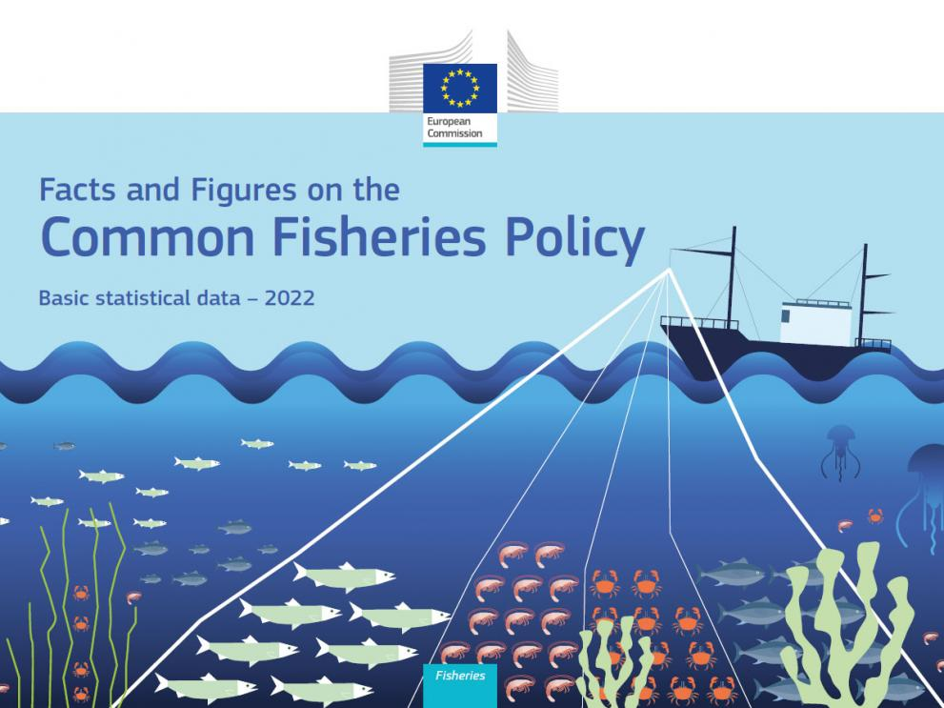
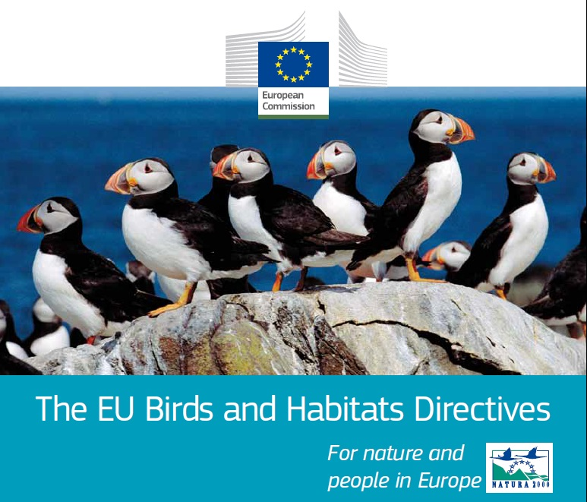

Slide 6
MARINE STRATERGY AND FRAMEWORK DIRECTIVE
The MSFD, adopted in 2008, focuses on maintaining clean, healthy, productive, and resilient marine ecosystems while promoting sustainable use of marine resources.
Member States are required to develop national marine strategies to achieve or maintain GES by setting objectives, establishing monitoring programs, and implementing measures to improve marine waters' state.
Implementation of the MSFD:
The MSFD is implemented in six-year cycles, with Member States reporting on progress and the Commission assessing and providing recommendations.
Member States coordinate with the Commission and regional sea conventions to ensure effective implementation, including public participation in environmental decision-making.

Slide 7
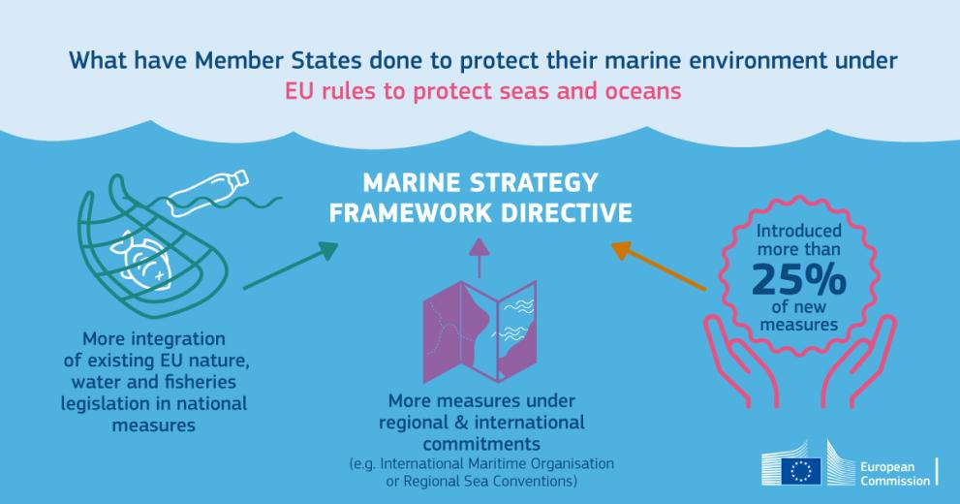

Slide 8
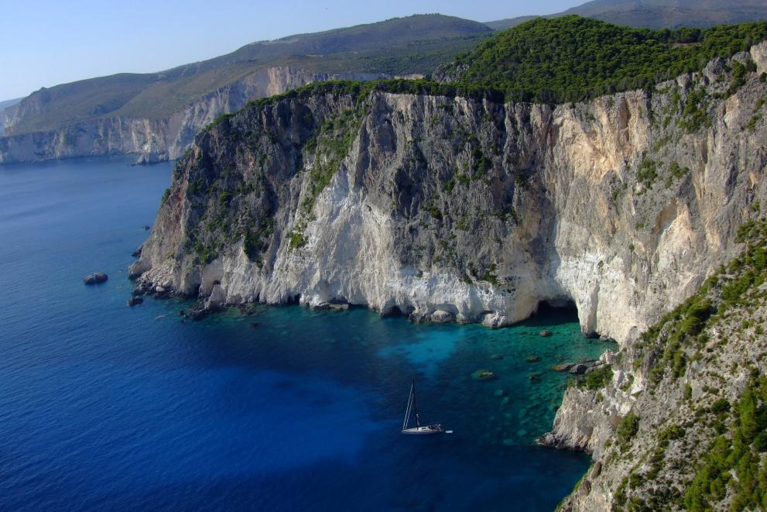
REGIONAL AND INTERNATIONAL COOPERATION
Regional cooperation through conventions like the Barcelona Convention, OSPAR, and HELCOM fosters collaboration among Member States and neighboring countries to protect marine environments.
Internationally, the EU engages in global frameworks like UNCLOS, CBD, and SDG 14 to fulfill commitments for marine protection and sustainable ocean management.

Slide 9
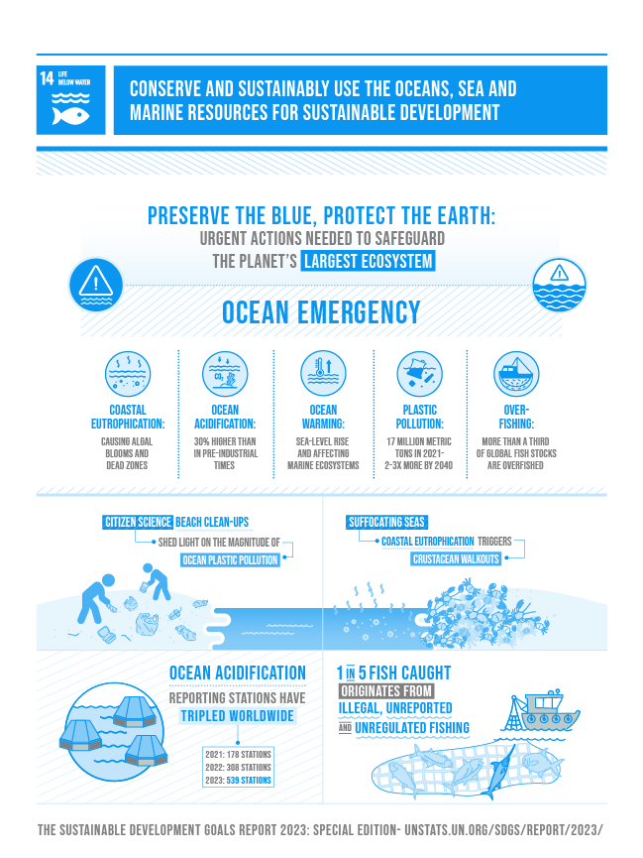
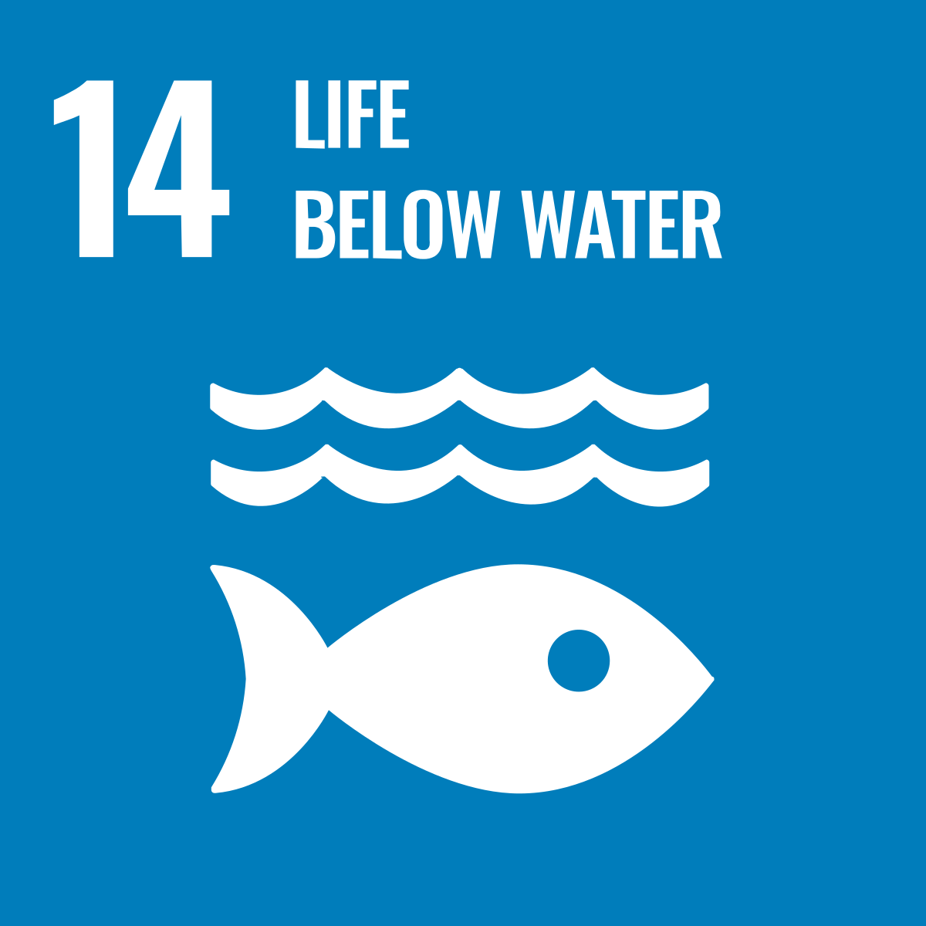

Slide 10
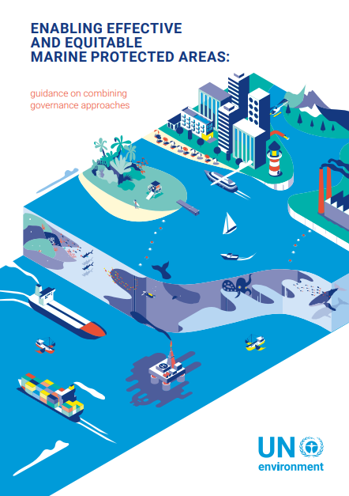
CASE STUDIES
These case studies showcase innovative approaches, collaborative partnerships, and lessons learned from practical experiences on the ground and offers valuable insights into successful initiatives and best practices for conserving and sustainably using seas and marine resources in EU maritime areas.
Examples of case studies may include successful marine protected area (MPA) management schemes, community-based fisheries management projects, restoration of degraded coastal habitats, and initiatives promoting sustainable tourism and blue economy development.
By highlighting these case studies, the presentation aims to inspire and inform policymakers, practitioners, and stakeholders about effective strategies and interventions that can be replicated and scaled up to achieve broader conservation and sustainability goals in marine environments.

Slide 11
FINDINGS
The findings of the studies reveal a complex picture of the state of seas and marine resources in EU maritime areas, reflecting both progress and persistent challenges. While efforts have been made to improve the conservation status of marine ecosystems, significant gaps and deficiencies remain, requiring urgent action.
Key findings include improvements in fish stocks in certain regions, but continued overfishing and habitat degradation in others. Marine pollution remains a significant concern, with plastic debris, chemical contaminants, and nutrient runoff threatening marine life and ecosystems.
Climate change impacts, including ocean warming, acidification, and sea-level rise, exacerbate these challenges, posing risks to marine biodiversity, habitats, and ecosystem services. Addressing these challenges requires coordinated and integrated actions across multiple sectors and stakeholders, emphasizing the need for adaptive management approaches and innovative solutions.

Slide 12
CHALLENGES FACED
Despite their significance, seas and marine resources face a myriad of challenges, threatening their sustainability and resilience. Overfishing, driven by increasing demand for seafood and inadequate fisheries management, has led to the depletion of fish stocks and ecosystem degradation.
Habitat destruction, resulting from coastal development, pollution, and destructive fishing practices, has disrupted marine ecosystems, causing loss of biodiversity and degradation of critical habitats such as coral reefs, seagrass beds, and mangroves.
Pollution, including plastic debris, chemical contaminants, and nutrient runoff, poses a significant threat to marine ecosystems, harming marine life, contaminating seafood, and degrading water quality.
Climate change exacerbates these challenges, leading to ocean warming, acidification, and extreme weather events, which impact marine biodiversity, habitats, and ecosystem functioning.

Slide 13
RECOMMENDATIONS
Based on the study findings and insights gained from case studies, a set of recommendations is proposed to enhance conservation efforts and promote sustainable use of seas and marine resources in EU maritime areas.
Recommendations may include strengthening regulatory frameworks, improving enforcement mechanisms, enhancing monitoring and surveillance capabilities, investing in research and innovation, fostering stakeholder engagement and public awareness, and promoting international cooperation and knowledge exchange.
These recommendations aim to guide policymakers, practitioners, and stakeholders in developing and implementing effective policies, strategies, and actions to address the challenges facing seas and marine resources and achieve long-term sustainability objectives.

Slide 14
CONCLUSION
The conservation and sustainable use of seas and marine resources in EU maritime areas are critical for maintaining ecosystem health, supporting human well-being, and promoting socio-economic development. While significant progress has been made in some areas, challenges remain that require urgent and concerted actions. Continued commitment to effective policies, innovative solutions, and collaborative partnerships is essential to address the complex and interconnected challenges facing marine environments. By working together, we can ensure the resilience and sustainability of seas and marine resources for current and future generations.

