Slide 1
CCP-LAW
Curricula development on Climate Change Policy and Law
Subject title: CLIMATE CHANGE DISPUTE RESOLUTION
Instructor Name: Tran Anh Tuan
Project No of Reference: 618874-EPP-1-2020-1-VN-EPPKA2-CBHE-JP:
The European Commission's support for the production of this publication does not constitute an endorsement of the contents, which reflect the views only of the authors, and the Commission cannot be held responsible for any use which may be made of the information contained therein.

Slide 2
5.1. Settlement Agreement
5. Remedies for climate change disputes
Individual essay on the subtopic 5.1.

Slide 3
5.2. Compensation for damages
5. Remedies for climate change disputes
Existing approaches:
Private law litigation: Individuals or entities can sue specific companies for climate-related damages, but proving causation remains a significant obstacle.
International mechanisms: The Warsaw International Mechanism for Loss and Damage under the UNFCCC aims to address climate impacts in developing countries, including providing financial assistance and technical support.
Notes:
"injunctive relief" refers to a court order that compels a party (usually a government or corporation) to take specific actions or stop specific actions related to their greenhouse gas emissions.
Types of injunctive relief:
Prohibitory injunction: This type of order would prohibit a party from taking certain actions, like building a new coal-fired power plant or continuing deforestation practices.
Mandatory injunction: This type of order would require a party to take specific actions, like implementing stricter emissions reduction measures or investing in renewable energy sources.

Slide 4
5.2. Compensation for damages
5. Remedies for climate change disputes
Existing approaches:
Public law litigation: Individuals or communities can sue governments for failing to adequately address climate change, seeking injunctive relief or policy changes rather than direct compensation.
Current challenges:
Limited scope: Currently, compensation claims rarely focus solely on monetary compensation for past damages. Instead, many cases aim for injunctive relief, requiring polluters to reduce emissions or adopt specific mitigation measures.
Notes:
"injunctive relief" refers to a court order that compels a party (usually a government or corporation) to take specific actions or stop specific actions related to their greenhouse gas emissions.
Types of injunctive relief:
Prohibitory injunction: This type of order would prohibit a party from taking certain actions, like building a new coal-fired power plant or continuing deforestation practices.
Mandatory injunction: This type of order would require a party to take specific actions, like implementing stricter emissions reduction measures or investing in renewable energy sources.

Slide 5
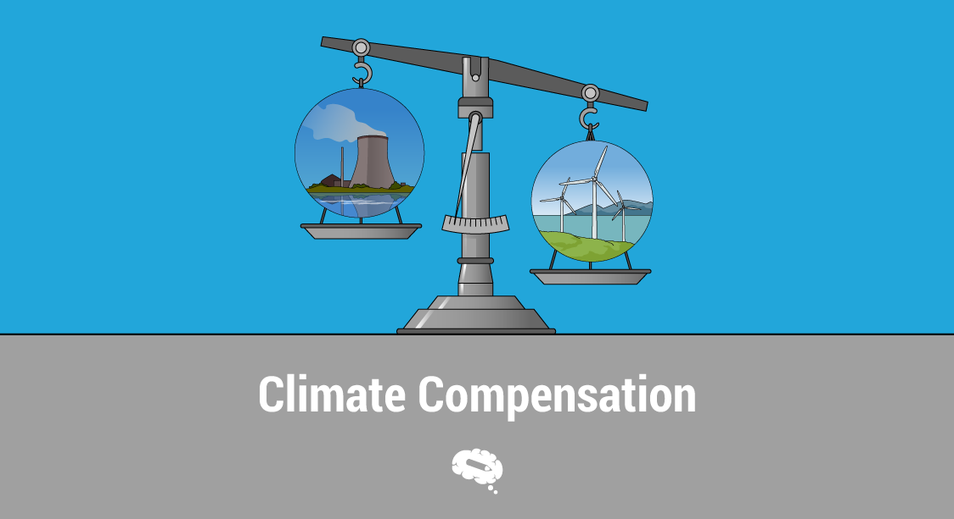
5.2. Compensation for damages
5. Remedies for climate change disputes
Current challenges:
Challenges in attribution: Attributing specific damages to individual actors' emissions is difficult due to the systemic nature of climate change. This makes it hard to prove causation and hold specific parties liable.
Legal frameworks: International laws lack clear provisions for climate-related compensation, and domestic laws are still developing. This creates legal uncertainty and hurdles for successful claims.
Notes:
"injunctive relief" refers to a court order that compels a party (usually a government or corporation) to take specific actions or stop specific actions related to their greenhouse gas emissions.
Types of injunctive relief:
Prohibitory injunction: This type of order would prohibit a party from taking certain actions, like building a new coal-fired power plant or continuing deforestation practices.
Mandatory injunction: This type of order would require a party to take specific actions, like implementing stricter emissions reduction measures or investing in renewable energy sources.

Slide 6
5.2. Compensation for damages
5. Remedies for climate change disputes
Future possibilities:
Strengthening legal frameworks: Developing clearer international and national laws on climate liability could facilitate compensation claims.
Evolving case law: Successful cases establishing legal precedents could pave the way for future claims and potentially influence corporate behavior.
Alternative mechanisms: Exploring alternative mechanisms like carbon pricing or insurance schemes could provide broader compensation solutions.
Notes:
"injunctive relief" refers to a court order that compels a party (usually a government or corporation) to take specific actions or stop specific actions related to their greenhouse gas emissions.
Types of injunctive relief:
Prohibitory injunction: This type of order would prohibit a party from taking certain actions, like building a new coal-fired power plant or continuing deforestation practices.
Mandatory injunction: This type of order would require a party to take specific actions, like implementing stricter emissions reduction measures or investing in renewable energy sources.

Slide 7
5.2. Compensation for damages
5. Remedies for climate change disputes
Important points to consider:
Compensation for damages is just one aspect of addressing climate change. Mitigation and adaptation remain crucial to prevent further harm.
Equity and justice are central concerns in compensation discussions, ensuring that vulnerable communities most affected by climate change receive fair treatment.
The debate around compensation is complex, with various stakeholders and perspectives involved.
Notes:
"injunctive relief" refers to a court order that compels a party (usually a government or corporation) to take specific actions or stop specific actions related to their greenhouse gas emissions.
Types of injunctive relief:
Prohibitory injunction: This type of order would prohibit a party from taking certain actions, like building a new coal-fired power plant or continuing deforestation practices.
Mandatory injunction: This type of order would require a party to take specific actions, like implementing stricter emissions reduction measures or investing in renewable energy sources.

Slide 8
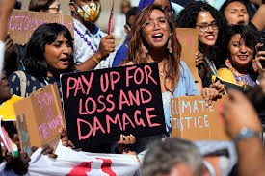
5.2. Compensation for damages
5. Remedies for climate change disputes
Key takeaways:
Compensation for damages is a complex and evolving area in the realm of climate change disputes.
Compensation for damages is a common request in climate lawsuits, but calculating appropriate amounts involves complex scientific and economic analysis.
While the issue of holding polluters accountable for climate-related harm is gaining traction, it faces numerous challenges.

Slide 9
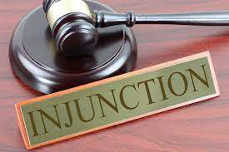
5.3. Prohibitory Order/Injunctions
5. Remedies for climate change disputes
Prohibitory orders and injunctions are court orders that restrict or prevent a party from engaging in specific actions related to greenhouse gas emissions.
Different types:
Prohibitory injunction: Directly prohibits a specific action, like building a new pipeline or engaging in a certain type of industrial activity.
Mandatory injunction: Requires a party to take specific actions, like implementing stricter emissions reduction measures or investing in renewable energy sources.
Notes:
"injunctive relief" refers to a court order that compels a party (usually a government or corporation) to take specific actions or stop specific actions related to their greenhouse gas emissions.
Types of injunctive relief:
Prohibitory injunction: This type of order would prohibit a party from taking certain actions, like building a new coal-fired power plant or continuing deforestation practices.
Mandatory injunction: This type of order would require a party to take specific actions, like implementing stricter emissions reduction measures or investing in renewable energy sources.

Slide 10
5.3. Prohibitory Order/Injunctions
5. Remedies for climate change disputes
In the context of climate change disputes, these orders are often used to:
Prevent future harm: Stop activities that would contribute to climate change, such as building new coal-fired power plants, deforestation, or extracting fossil fuels.
Protect vulnerable communities: Prevent activities that would disproportionately impact communities already suffering the effects of climate change.
Enforce existing reguvlations: Force governments or corporations to comply with environmental laws and regulations concerning emissions reduction.
Notes:
"injunctive relief" refers to a court order that compels a party (usually a government or corporation) to take specific actions or stop specific actions related to their greenhouse gas emissions.
Types of injunctive relief:
Prohibitory injunction: This type of order would prohibit a party from taking certain actions, like building a new coal-fired power plant or continuing deforestation practices.
Mandatory injunction: This type of order would require a party to take specific actions, like implementing stricter emissions reduction measures or investing in renewable energy sources.

Slide 11
5.3. Prohibitory Order/Injunctions
5. Remedies for climate change disputes
Examples:
Urgenda case (Netherlands, 2019): A court ordered the Dutch government to reduce its greenhouse gas emissions faster, citing a violation of its duty of care towards citizens.
Juliana v. United States (US, 2018): Young people sued the federal government for failing to protect their future from climate change, but the case was ultimately dismissed.
Lliu v. Shell (Netherlands, 2023): A court ordered Shell to reduce its global emissions by 45% by 2030 compared to 2019 levels.
Notes:
"injunctive relief" refers to a court order that compels a party (usually a government or corporation) to take specific actions or stop specific actions related to their greenhouse gas emissions.
Types of injunctive relief:
Prohibitory injunction: This type of order would prohibit a party from taking certain actions, like building a new coal-fired power plant or continuing deforestation practices.
Mandatory injunction: This type of order would require a party to take specific actions, like implementing stricter emissions reduction measures or investing in renewable energy sources.

Slide 12
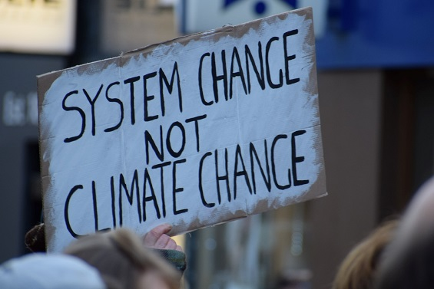
5.3. Prohibitory Order/Injunctions
5. Remedies for climate change disputes
Challenges:
Legal standing: Establishing the right to sue for a prohibitory order/injunction can be difficult, especially for individuals or small groups.
Causation: Proving that a specific party's emissions would directly cause harm can be challenging due to the complexity of climate change.
Enforcement: Obtaining and enforcing court orders against powerful governments or corporations can be time-consuming and expensive.
Notes:
"injunctive relief" refers to a court order that compels a party (usually a government or corporation) to take specific actions or stop specific actions related to their greenhouse gas emissions.
Types of injunctive relief:
Prohibitory injunction: This type of order would prohibit a party from taking certain actions, like building a new coal-fired power plant or continuing deforestation practices.
Mandatory injunction: This type of order would require a party to take specific actions, like implementing stricter emissions reduction measures or investing in renewable energy sources.

Slide 13
5.3. Prohibitory Order/Injunctions
5. Remedies for climate change disputes
Current trends:
Increasing use: Prohibitory orders/injunctions are becoming a more common tool in climate change litigation, with cases being filed around the world.
Evolving legal landscape: Courts are increasingly recognizing the urgency of climate action and the potential role of litigation in driving change.
Growing public support: Public support for holding polluters accountable and taking action on climate change is increasing, which may embolden courts to take bolder action.
Notes:
"injunctive relief" refers to a court order that compels a party (usually a government or corporation) to take specific actions or stop specific actions related to their greenhouse gas emissions.
Types of injunctive relief:
Prohibitory injunction: This type of order would prohibit a party from taking certain actions, like building a new coal-fired power plant or continuing deforestation practices.
Mandatory injunction: This type of order would require a party to take specific actions, like implementing stricter emissions reduction measures or investing in renewable energy sources.

Slide 14
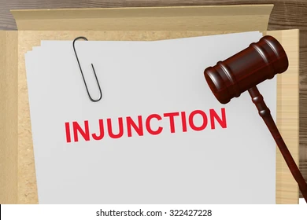
5.3. Prohibitory Order/Injunctions
5. Remedies for climate change disputes
Key takeaways:
While challenges remain, prohibitory orders/injunctions offer a potentially powerful tool for addressing climate change by preventing future harm and holding polluters accountable.
The legal landscape is evolving, and their effectiveness will likely depend on continued public support and creative legal strategies.
Injunctions allow courts to directly halt climate damaging activities and compel new policies, but they should be carefully tailored to proper judicial authority and roles.
Notes:
"injunctive relief" refers to a court order that compels a party (usually a government or corporation) to take specific actions or stop specific actions related to their greenhouse gas emissions.
Types of injunctive relief:
Prohibitory injunction: This type of order would prohibit a party from taking certain actions, like building a new coal-fired power plant or continuing deforestation practices.
Mandatory injunction: This type of order would require a party to take specific actions, like implementing stricter emissions reduction measures or investing in renewable energy sources.

Slide 15
5.4. Interim protection
5. Remedies for climate change disputes
Independent learning: review articles on the sub-topic 5.4.
Notes:
"injunctive relief" refers to a court order that compels a party (usually a government or corporation) to take specific actions or stop specific actions related to their greenhouse gas emissions.
Types of injunctive relief:
Prohibitory injunction: This type of order would prohibit a party from taking certain actions, like building a new coal-fired power plant or continuing deforestation practices.
Mandatory injunction: This type of order would require a party to take specific actions, like implementing stricter emissions reduction measures or investing in renewable energy sources.

Slide 16
5.5. Formal appology
5. Remedies for climate change disputes
Arguments for formal apologies:
Acknowledgment of harm: A formal apology can symbolize recognition of climate change's lasting damage, especially to at-risk groups and future generations.
Opening dialogue: It could act as a catalyst for open dialogue and collaboration between polluters, affected communities, and policymakers.
Moral responsibility: For some, a formal apology is seen as a moral obligation for those who have contributed significantly to causing climate change.
Notes:
"injunctive relief" refers to a court order that compels a party (usually a government or corporation) to take specific actions or stop specific actions related to their greenhouse gas emissions.
Types of injunctive relief:
Prohibitory injunction: This type of order would prohibit a party from taking certain actions, like building a new coal-fired power plant or continuing deforestation practices.
Mandatory injunction: This type of order would require a party to take specific actions, like implementing stricter emissions reduction measures or investing in renewable energy sources.

Slide 17
5.5. Formal appology
5. Remedies for climate change disputes
Challenges and limitations:
Attribution of responsibility: Attributing specific responsibility for climate change to individuals or entities is complex due to its systemic nature. Who should apologize?
Limited impact on emissions: An apology alone wouldn't directly reduce greenhouse gas emissions or address the root causes of the problem.
Notes:
"injunctive relief" refers to a court order that compels a party (usually a government or corporation) to take specific actions or stop specific actions related to their greenhouse gas emissions.
Types of injunctive relief:
Prohibitory injunction: This type of order would prohibit a party from taking certain actions, like building a new coal-fired power plant or continuing deforestation practices.
Mandatory injunction: This type of order would require a party to take specific actions, like implementing stricter emissions reduction measures or investing in renewable energy sources.

Slide 18
5.5. Formal appology
5. Remedies for climate change disputes
Challenges and limitations:
Potential for exploitation: Apologies could be seen as a way for polluters to avoid taking meaningful action or deflect responsibility.
Risk of tokenism: A poorly executed apology could be perceived as insincere or inadequate, potentially further alienating affected communities.
Notes:
"injunctive relief" refers to a court order that compels a party (usually a government or corporation) to take specific actions or stop specific actions related to their greenhouse gas emissions.
Types of injunctive relief:
Prohibitory injunction: This type of order would prohibit a party from taking certain actions, like building a new coal-fired power plant or continuing deforestation practices.
Mandatory injunction: This type of order would require a party to take specific actions, like implementing stricter emissions reduction measures or investing in renewable energy sources.

Slide 19
5.5. Formal appology
5. Remedies for climate change disputes
Current context:
Formal apologies in the context of climate change are rare, although some institutions and individuals have issued statements acknowledging their role in contributing to the problem.
Many argue that the focus should be on taking concrete action and holding polluters accountable through legal or regulatory measures.
Notes:
"injunctive relief" refers to a court order that compels a party (usually a government or corporation) to take specific actions or stop specific actions related to their greenhouse gas emissions.
Types of injunctive relief:
Prohibitory injunction: This type of order would prohibit a party from taking certain actions, like building a new coal-fired power plant or continuing deforestation practices.
Mandatory injunction: This type of order would require a party to take specific actions, like implementing stricter emissions reduction measures or investing in renewable energy sources.

Slide 20
5.5. Formal appology
5. Remedies for climate change disputes
Key takeaways:
While formal apologies have potential value in reconciliation and acknowledging harm, they are unlikely to be a sufficient remedy for climate change disputes on their own.
The focus should primarily remain on concrete actions, reparations, systemic change, and holding polluters accountable.
However, sincere apologies, accompanied by concrete steps towards addressing the problem, could play a role in fostering dialogue and rebuilding trust in the long run.
Notes:
"injunctive relief" refers to a court order that compels a party (usually a government or corporation) to take specific actions or stop specific actions related to their greenhouse gas emissions.
Types of injunctive relief:
Prohibitory injunction: This type of order would prohibit a party from taking certain actions, like building a new coal-fired power plant or continuing deforestation practices.
Mandatory injunction: This type of order would require a party to take specific actions, like implementing stricter emissions reduction measures or investing in renewable energy sources.

Slide 21
5.6. Preventive diplomacy
5. Remedies for climate change disputes
Key areas of focus:
Dialogue and cooperation: Open dialogue and cooperation among varied nations and parties build trust, find consensus, and create advantageous outcomes, preventing conflicts.
Early warning and conflict prevention: Spotting climate-related tensions such as water disputes or land competition enables early mediation to deter conflicts.
Notes:
"injunctive relief" refers to a court order that compels a party (usually a government or corporation) to take specific actions or stop specific actions related to their greenhouse gas emissions.
Types of injunctive relief:
Prohibitory injunction: This type of order would prohibit a party from taking certain actions, like building a new coal-fired power plant or continuing deforestation practices.
Mandatory injunction: This type of order would require a party to take specific actions, like implementing stricter emissions reduction measures or investing in renewable energy sources.

Slide 22
5.6. Preventive diplomacy
5. Remedies for climate change disputes
Key areas of focus:
Capacity building and knowledge sharing: Aiding developing nations with expertise, funding, and capacity building for climate issues fosters fairness and lessens grievances.
Building resilience and adaptation: Joint efforts in climate adaptation and resilience can reduce resource conflicts and curb rivalry.
Notes:
"injunctive relief" refers to a court order that compels a party (usually a government or corporation) to take specific actions or stop specific actions related to their greenhouse gas emissions.
Types of injunctive relief:
Prohibitory injunction: This type of order would prohibit a party from taking certain actions, like building a new coal-fired power plant or continuing deforestation practices.
Mandatory injunction: This type of order would require a party to take specific actions, like implementing stricter emissions reduction measures or investing in renewable energy sources.

Slide 23
5.6. Preventive diplomacy
5. Remedies for climate change disputes
Examples of preventive diplomacy in action:
The Green Climate Fund: This international fund provides financial support to developing countries for climate adaptation and mitigation projects, fostering collaboration and addressing potential sources of conflict.
Regional initiatives: Many regional organizations, like the African Union and the Association of Southeast Asian Nations, have adopted climate action plans and frameworks for dialogue and cooperation, addressing regional climate challenges and potential conflicts.
Notes:
"injunctive relief" refers to a court order that compels a party (usually a government or corporation) to take specific actions or stop specific actions related to their greenhouse gas emissions.
Types of injunctive relief:
Prohibitory injunction: This type of order would prohibit a party from taking certain actions, like building a new coal-fired power plant or continuing deforestation practices.
Mandatory injunction: This type of order would require a party to take specific actions, like implementing stricter emissions reduction measures or investing in renewable energy sources.

Slide 24
5.6. Preventive diplomacy
5. Remedies for climate change disputes
Challenges and limitations:
Political will and commitment: Effective preventive diplomacy needs ongoing commitment from all parties, despite differing agendas and goals.
Resource constraints: Limited resources may impede preventive diplomacy, especially in aiding developing nations and tackling intricate issues.
Long-term approach: Preventive diplomacy needs ongoing involvement and adjustment to changing climate effects and political shifts.
Notes:
"injunctive relief" refers to a court order that compels a party (usually a government or corporation) to take specific actions or stop specific actions related to their greenhouse gas emissions.
Types of injunctive relief:
Prohibitory injunction: This type of order would prohibit a party from taking certain actions, like building a new coal-fired power plant or continuing deforestation practices.
Mandatory injunction: This type of order would require a party to take specific actions, like implementing stricter emissions reduction measures or investing in renewable energy sources.

Slide 25
5.6. Preventive diplomacy
5. Remedies for climate change disputes
Key takeaways
While preventive diplomacy may not be a direct remedy for existing climate change disputes, it plays a crucial role in mitigating future conflicts, fostering cooperation, and promoting sustainable solutions.
By addressing the root causes of potential disagreements and building collaborative approaches, preventive diplomacy can contribute significantly to a more peaceful and just response to the global climate challenge.
Notes:
"injunctive relief" refers to a court order that compels a party (usually a government or corporation) to take specific actions or stop specific actions related to their greenhouse gas emissions.
Types of injunctive relief:
Prohibitory injunction: This type of order would prohibit a party from taking certain actions, like building a new coal-fired power plant or continuing deforestation practices.
Mandatory injunction: This type of order would require a party to take specific actions, like implementing stricter emissions reduction measures or investing in renewable energy sources.

