Slide 1
CCP-LAW
Curricula development on Climate Change Policy and Law
Subject title: The Relationship between Sustainable Development and the Common Market of the EU
Instructor Name: Abhinav Shrivastava & Raj Varma
Project No of Reference: 618874-EPP-1-2020-1-VN-EPPKA2-CBHE-JP:
The European Commission's support for the production of this publication does not constitute an endorsement of the contents, which reflect the views only of the authors, and the Commission cannot be held responsible for any use which may be made of the information contained therein.

Slide 2
Introduction
Sustainable Development: Sustainable development is described as meeting the needs of the present without compromising the ability of future generations to meet their own needs.
The European single market, also known as the European internal market or the European common market, is the single market comprising mainly the 27 member states of the European Union (EU).
The single market seeks to guarantee the free movement of goods, capital, services, and people, known collectively as the "four freedoms", through common rules and standards that all participating states are legally committed to follow.

Slide 3
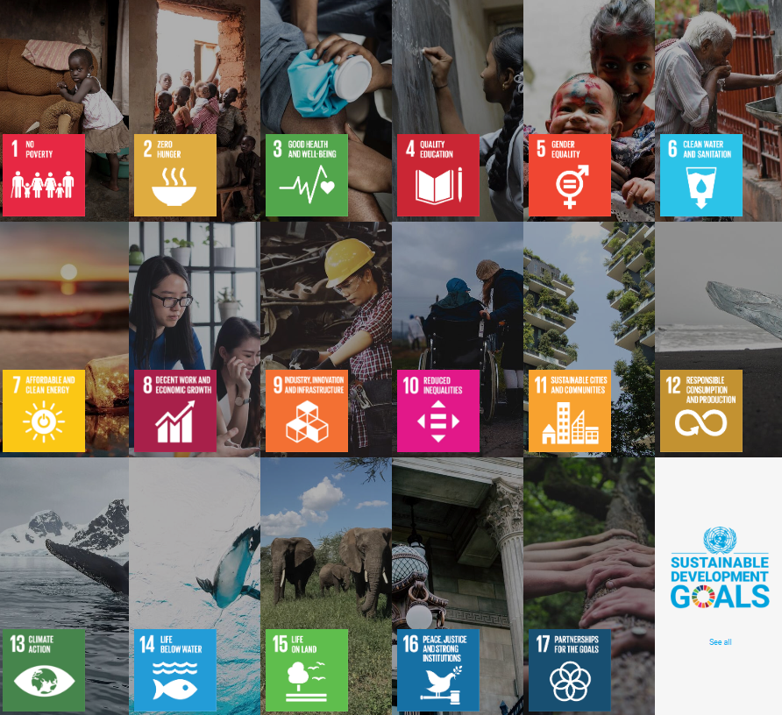
Sustainable Development Goals (SDGs)
The 2030 Agenda for Sustainable Development, adopted by all United Nations Member States in 2015, provides a shared blueprint for peace and prosperity for people and the planet, now and into the future. At its heart are the 17 Sustainable Development Goals (SDGs), which are an urgent call for action by all countries - developed and developing - in a global partnership. They recognize that ending poverty and other deprivations must go hand-in-hand with strategies that improve health and education, reduce inequality, and spur economic growth – all while tackling climate change and working to preserve our oceans and forests.

Slide 4
The elements of the Common Market
Common Market of the EU
The "Four Freedoms" of the single market are:
Free movement of goods
Free movement of capital
Freedom to establish and provide services
Free movement of people
Balancing the "Four Freedoms" with environmental protection involves harmonizing regulations, conducting EIAs, enforcing compliance, integrating environmental considerations into policies, engaging stakeholders, promoting innovation, and fostering international cooperation. Harmonization ensures consistency in environmental standards, while impact assessments guide sustainable decision-making. Effective enforcement mechanisms maintain compliance with regulations, and stakeholder engagement fosters public support. Innovation in green technologies drives economic growth with reduced environmental impacts. International cooperation addresses transboundary challenges. These efforts aim to achieve a harmonious balance between economic integration and environmental sustainability, ensuring prosperity for all.

Slide 5
Environmental Policies in the EU
EU environment policy dates back to the European Council held in Paris in 1972, at which the Heads of State or Government (in the aftermath of the first UN conference on the environment) declared the need for a Community environment policy flanking economic policies, and called for an action programme.
The Single European Act of 1987 introduced a new ‘Environment Title’, which provided the first legal basis for a common environment policy with the aims of preserving the quality of the environment, protecting human health and ensuring rational use of natural resources.
Subsequent treaty revisions strengthened the Community’s commitment to environmental protection and the role of the European Parliament in its development. The Treaty of Maastricht (1993) made the environment an official EU policy area, introduced the codecision procedure and made qualified majority voting in the Council the general rule.
The Treaty of Amsterdam (1999) established the duty to integrate environmental protection into all EU sectoral policies with a view to promoting sustainable development. ‘Combating climate change’ (2.5.2) became a specific goal with the Treaty of Lisbon (2009), as did sustainable development in relations with third countries.
The Treaty of Lisbon also granted the EU legal personality, which enables the EU to conclude international agreements. These advancements strengthened the EU’s role as a key actor on the global environmental front, leading the way with key initiatives such as the European Green Deal and the EU Climate Law.

Slide 6
Integration of Sustainability in EU Policies
RE: Articles 191 to 193 of the Treaty on the Functioning of the European Union (TFEU).
Objectives and achievements:
Sustainable consumption and production (SCP) action plan to improve the environmental performance of products throughout their life cycle, to increase consumer awareness and demand for sustainable goods and production technologies, to promote innovation in EU industry and to address international aspects, such as trade and standards.
Roadmap to a Resource Efficient Europe, 2011 proposes ways to increase resource productivity and decouple economic growth from resource use and its environmental impact
Ecolabelling and energy labelling provides crucial information that enables consumers to make informed choices. The European Ecolabel is a voluntary scheme established in 1992 to encourage businesses to market products and services that meet certain environmental criteria.

Slide 7
Integration of Sustainability in EU Policies
The Eco-design Directive ensures the technical improvement of products.
Eco-management and Audit Scheme (EMAS) is a management tool enabling companies and other organisations to evaluate, report and improve their environmental performance.
Green public procurement (GPP)is a voluntary policy within the strategic public procurement framework supporting public authorities in the purchase of goods, services and works with a reduced environmental impact. The concept of GPP has been widely recognised in recent years as a useful tool for driving the market for greener products and services and reducing the environmental impacts of public authorities’ activities.
Eco-innovation action plan (EcoAP)is the successor to the environmental technologies action plan (ETAP), aimed at boosting the development and use of environmental technologies and improving European competitiveness in this area.
Sustainable product policy: under the European Green Deal, the Commission presented a new circular economy action plan (CEAP) in March 2020, in which it announced a sustainable products initiative to make products fit for a climate-neutral, resource-efficient and circular economy, as well as reduce waste.

Slide 8
Environmental Implications of Common Market Policies
Environmental policies have become increasingly stringent in OECD countries over the past decades, albeit at varying paces across nations. These policies address critical issues such as rising air and water pollution, climate change, biodiversity loss, and waste generation. Notably, climate policies have effectively reduced emissions from industry, while having relatively minor effects on economic outcomes like employment, investment, and productivity. Well-designed environmental policies do not significantly harm the economy, but they can create winners and losers. Strategic policy packaging can help compensate affected workers and industries, fostering public support for more ambitious environmental measures.
C-165/09 - European Commission v. Portuguese Republic (2010): Portugal's failure to comply with EU environmental law regarding waste management highlights the importance of regulating environmental practices within the Common Market.

Slide 9
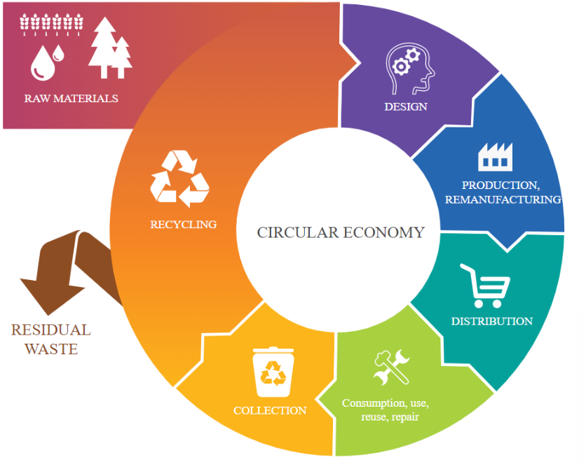
Circular Economy and Sustainable Consumption
In a circular economy, things are made and consumed in a way that minimizes our use of the world’s resources, cuts waste and reduces carbon emissions. Products are kept in use for as long as possible, through repairing, recycling and redesign – so they can be used again and again.
At the end of a product’s life, the materials used to make it are kept in the economy and reused wherever possible, the European Parliament explains.
The European Commission adopted the new circular economy action plan (CEAP) in March 2020. It is one of the main building blocks of the European Green Deal, Europe’s new agenda for sustainable growth. The EU’s transition to a circular economy will reduce pressure on natural resources and will create sustainable growth and jobs. It is also a prerequisite to achieve the EU’s 2050 climate neutrality target and to halt biodiversity loss.

Slide 10
Agriculture and Sustainable Practices
The Common Agricultural Policy (CAP) is the agricultural policy of the European Commission. It implements a system of agricultural subsidies and other programmes. It was introduced in 1962 and has since then undergone several changes to reduce the EEC budget cost (from 73% in 1985, to 37% in 2017 and consider rural development in its aims.
CAP has been divided into two 'pillars':
Agricultural production support and common organization of markets (I pillar, known otherwise earlier as the 'agricultural guarantee' section)
Rural development policy (II pillar, otherwise the 'agricultural structural policy' pillar, known earlier as the 'agricultural guidance' section).
In the European Union (EU25) 3.9% of the total utilized agricultural area was used for organic production in 2005. The countries with the highest proportion of organic land were Austria (11%) and Italy (8.4%) In 2009, the proportion of organic land in the EU grew to 4.7%.

Slide 11
Energy Transition and Climate Action
Energy is central to the European Union's transition towards climate neutrality by 2050, in line with the European Green Deal. As the biggest source of greenhouse gas emissions in the European Union (EU), the energy sector is undergoing a profound transformation on the path to a net-zero economy.
The shift to a more sustainable energy system entails switching from fossil fuels to low-carbon and renewable energy sources, improving energy efficiency in products, industry and buildings, and creating a more sustainable energy system based on clean technologies.
The EU has developed a number of policies to support the energy transition. The EU budget sets a target of 30 % climate spending, a large part of which includes energy actions such as energy efficiency and deployment of renewables, energy infrastructure and smart energy systems.
The bulk of EU energy spending is channelled through the Recovery and Resilience Facility, cohesion policy funds, the Modernisation Fund and several others. Specific instruments also exist to support a socially fair transition, notably the Just Transition Fund and the Social Climate Fund.
C-102/16 - Commission v. Austria (2018): Austria's breach of EU law regarding landfill operation underscores the EU's efforts to enforce environmental standards and promote sustainable practices within the Common Market.

Slide 12
Biodiversity Conservation
The EU’s biodiversity strategy for 2030 is a comprehensive, ambitious and long-term plan to protect nature and reverse the degradation of ecosystems. The strategy aims to put Europe's biodiversity on a path to recovery by 2030, and contains specific actions and commitments.
It is the proposal for the EU’s contribution to the upcoming international negotiations on the global post-2020 biodiversity framework. A core part of the European Green Deal, it will also support a green recovery following the Covid-19 pandemic.
C-137/14 - AGET Iraklis v. Elliniko Dimosio (2015): This case involving a dispute over landfill operation in Greece demonstrates the EU Court of Justice's role in enforcing environmental laws and ensuring member states adhere to sustainable practices.

Slide 13
Biodiversity Conservation
The biodiversity strategy aims to put Europe’s biodiversity on the path to recovery by 2030 for the benefit of people, climate and the planet.
In the post-COVID-19 context, the strategy aims to build our societies’ resilience to future threats such as
the impacts of climate change
forest fires
food insecurity
disease outbreaks - including by protecting wildlife and fighting illegal wildlife trade
The EU will enlarge existing Natura 2000 areas, with strict protection for areas of very high biodiversity and climate value.
There are over 27 000 nature sites protected by EU legislation. These form the Natura 2000 network.

Slide 14
Case Study
C-101/12 - Commission v. Spain (2013): The Commission brought proceedings against Spain arising out of the upgrading of a road that ran along the edge of (and partly through) the Doñana natural park. At the time of the road project the park had been proposed, but not yet adopted, as a site of community importance (SCI) under Article 2(1) of the Habitats Directive. The area through which the road runs is habitat for the Iberian lynx, a ‘priority species listed in Annex II to the Habitats Directive and also listed in Annex IV(a), thus requiring a system for monitoring its ‘incidental capture and killing and consequential measures under Article 12(4) The Commission complained of two breaches of the Habitats Directive. The first consisted of authorising an intervention (ie the upgrading of the road) of a kind which would seriously endanger the ecological characteristics of the site owing to (i) fragmentation of the habitat, making dispersal difficult; and (ii) the risk of road kill (contrary to Article 6, which lays down protection arrangements required for SCIs). This complaint was rejected, essentially on a failure of the evidence to establish any significant deterioration of the habitat or disturbance of the lynx as a result of the upgrading. The second complaint alleged a failure to establish a sufficient system of monitoring on the road concerned. This, too, failed on the facts, as a suitable system was found to have been adopted and that the requirements of Article 12(4) were being met

