Slide 1
CCP-LAW
Curricula development on Climate Change Policy and Law
Subject title: The Science of Climate Change: Mitigation and Adaptation
Instructor Name: Dr. Mohamad Farhan Mohamad Mohsin
Project No of Reference: 618874-EPP-1-2020-1-VN-EPPKA2-CBHE-JP:
The European Commission's support for the production of this publication does not constitute an endorsement of the contents, which reflect the views only of the authors, and the Commission cannot be held responsible for any use which may be made of the information contained therein.

Slide 2
Technological solutions to climate change
Role of Technology and Innovation
Need for Technological Change and its Process
Importance of Technological Innovation
Resource Needs for Climate Innovation

Slide 3
Technological solutions to climate change
Scenario: Historical Trends in Greenhouse Gases
Past 150 Years: Significant increase in greenhouse gases (GHGs) like CO2, CH4, N2O, and industrial GHGs.
Impact on Climate: GHGs trap heat, altering global climate, precipitation, and ocean currents.
Human Activity's Role: Major GHG emissions from human activities, primarily fossil fuel combustion.
Rising Emissions: Recent years show notable increases, especially from energy sources (85% of total GHGs).
Potential Future: Current trends may lead to substantial temperature rises by the century's end.

Slide 4
Long-Term Challenge & Impact
Technological solutions to climate change
Global Warming Impact: Expected risks to health, water supplies, agriculture, and coastal areas due to climate changes.
Persistent GHGs: Greenhouse gases remain in the atmosphere for extended periods, contributing to prolonged global warming.
Mitigation Challenges: Mitigating GHGs poses challenges due to their long-term presence, making prompt reduction difficult.
Key linkages between human activities and global climate change

Slide 5
Technological solutions to climate change
Role of Technology and Innovation
Understanding Technological Solutions
Technological solutions encompass a wide array of innovations specifically designed to mitigate and adapt to the impacts of climate change.
This section provides an inclusive overview of various technologies aimed at addressing climate challenges. It covers:
Renewable Energy Systems: Such as solar, wind, hydroelectric, and geothermal energy, offering sustainable alternatives to fossil fuels.
Carbon Capture and Storage (CCS): Technologies that capture carbon dioxide emissions from industries and store them underground, reducing greenhouse gas concentrations in the atmosphere.
Sustainable Agriculture Practices: Innovations in precision farming, agroforestry, and soil management promoting resilience against changing climatic conditions.
Smart Grids and Energy Efficiency: Technologies enhancing energy distribution, optimizing consumption, and minimizing wastage in electricity networks.

Slide 6
Technological solutions to climate change
Role of Technology and Innovation
Innovation and Advancements
Technological innovation plays a pivotal role in combatting climate change by constantly evolving and addressing emerging challenges. It involves:
Continuous Advancements: Ongoing technological advancements contribute to the refinement and development of climate-friendly solutions. These innovations often result in increased efficiency, decreased costs, and broader applicability of green technologies.
Adaptation to Climate Challenges: Innovation helps in adapting existing technologies or developing new ones to address specific climate challenges. For instance, innovations in disaster-resilient infrastructure or climate-resilient crop varieties.
Importance of Collaboration: Collaboration between research institutions, industries, governments, and communities is crucial in fostering innovation. It allows for the pooling of expertise, resources, and knowledge necessary for the development, refinement, and deployment of effective climate solutions. Open collaboration accelerates the pace of innovation and ensures the scalability and accessibility of technologies globally.

Slide 7
Technological solutions to climate change
Role of Technology and Innovation
Innovation and Advancements
Technological innovation plays a pivotal role in combatting climate change by constantly evolving and addressing emerging challenges. It involves:
Continuous Advancements: Ongoing technological advancements contribute to the refinement and development of climate-friendly solutions. These innovations often result in increased efficiency, decreased costs, and broader applicability of green technologies.
Adaptation to Climate Challenges: Innovation helps in adapting existing technologies or developing new ones to address specific climate challenges. For instance, innovations in disaster-resilient infrastructure or climate-resilient crop varieties.
Importance of Collaboration: Collaboration between research institutions, industries, governments, and communities is crucial in fostering innovation. It allows for the pooling of expertise, resources, and knowledge necessary for the development, refinement, and deployment of effective climate solutions. Open collaboration accelerates the pace of innovation and ensures the scalability and accessibility of technologies globally.

Slide 8
Technological solutions to climate change
Need for Technological Change and its Process
Importance of Technological Change
Technological shifts play a pivotal role in addressing climate change due to various essential factors:
Mitigation and Adaptation: Technologies are instrumental in mitigating greenhouse gas emissions, thus reducing their impact on the environment. Simultaneously, they aid in adapting to changing climatic conditions by offering innovative solutions.
Innovation for Sustainability: Technological advancements drive innovations that foster sustainable practices. They enable advancements in energy efficiency, renewable energy sources, waste management, and ecosystem preservation, thereby reducing environmental degradation.
Addressing Global Challenges: Technological solutions offer tangible approaches to resolve global environmental challenges. They ensure resilience against climate-related disruptions, enhance food security, promote sustainable urban development, and contribute to a harmonious coexistence with nature.

Slide 9
Technological solutions to climate change
Need for Technological Change and its Process
The adoption of new technologies to address climate challenges encompasses several essential stages and mechanisms:
Research and Development (R&D): Initiate extensive R&D efforts to conceptualize, design, and create novel technological solutions that offer climate change mitigation and adaptation benefits.
Testing and Validation: Rigorous testing, validation, and prototyping of new technologies to assess their functionality, feasibility, and performance under various environmental conditions.
Scaling Up and Commercialization: Refinement of prototypes and technologies to enable mass production, making them more accessible and cost-effective for widespread use.
Market Adoption and Policy Incentives: Implement strategies for commercial viability, market penetration, and policy incentives (such as tax credits, subsidies, or regulatory frameworks) to encourage technology adoption.
Regulatory Support and Framework: Introduction of supportive regulations and standards that facilitate the integration of innovative technologies into existing systems, ensuring safety, efficiency, and sustainability.
Public Awareness and Education: Engage in public awareness campaigns and educational programs to create a positive attitude toward technological changes, fostering acceptance and adoption.
Continuous Innovation and Collaboration: Encourage continuous improvement, feedback mechanisms, and international collaborations to enhance technology effectiveness, sustainability, and relevance.

Slide 10
Need for Technological Change and its Process
Technological solutions to climate change
Importance of Technological Change
Technological shifts play a pivotal role in addressing climate change due to various essential factors:
Mitigation and Adaptation: Technologies are instrumental in mitigating greenhouse gas emissions, thus reducing their impact on the environment. Simultaneously, they aid in adapting to changing climatic conditions by offering innovative solutions.
Innovation for Sustainability: Technological advancements drive innovations that foster sustainable practices. They enable advancements in energy efficiency, renewable energy sources, waste management, and ecosystem preservation, thereby reducing environmental degradation.
Addressing Global Challenges: Technological solutions offer tangible approaches to resolve global environmental challenges. They ensure resilience against climate-related disruptions, enhance food security, promote sustainable urban development, and contribute to a harmonious coexistence with nature.

Slide 11
Need for Technological Change & its Process
Technological solutions to climate change
The adoption of new technologies to address climate challenges encompasses several essential stages and mechanisms:
Market Adoption and Policy Incentives: Implement strategies for commercial viability, market penetration, and policy incentives (such as tax credits, subsidies, or regulatory frameworks) to encourage technology adoption.
Regulatory Support and Framework: Introduction of supportive regulations and standards that facilitate the integration of innovative technologies into existing systems, ensuring safety, efficiency, and sustainability.
Public Awareness and Education: Engage in public awareness campaigns and educational programs to create a positive attitude toward technological changes, fostering acceptance and adoption.
Continuous Innovation and Collaboration: Encourage continuous improvement, feedback mechanisms, and international collaborations to enhance technology effectiveness, sustainability, and relevance.
Research and Development (R&D): Initiate extensive R&D efforts to conceptualize, design, and create novel technological solutions that offer climate change mitigation and adaptation benefits.
Testing and Validation: Rigorous testing, validation, and prototyping of new technologies to assess their functionality, feasibility, and performance under various environmental conditions.
Scaling Up and Commercialization: Refinement of prototypes and technologies to enable mass production, making them more accessible and cost-effective for widespread use.

Slide 12
Technological solutions to climate change
Importance of Technological Innovation
Innovative Solutions
Innovation serves as a cornerstone in the development of new technologies essential for climate resilience. It plays a pivotal role in fostering solutions that address climate change challenges:
Catalyzing Advanced Technologies: Innovation acts as a catalyst for the conception and creation of advanced technologies specifically tailored to combat climate change. It facilitates breakthroughs in renewable energy, carbon capture and storage, sustainable agriculture practices, and eco-friendly infrastructure development.
Promoting Adaptive Resilience: Innovative solutions bolster adaptive resilience by devising cutting-edge strategies to anticipate and counteract the impacts of changing climatic conditions. These solutions include early warning systems, climate-smart urban planning, resilient infrastructure, and nature-based interventions.
Encouraging Cross-Sector Collaboration: Innovation thrives on collaboration across sectors, fostering interdisciplinary approaches that amalgamate expertise from science, technology, policy-making, and social sciences. This collaborative effort ensures holistic solutions to multifaceted climate challenges.
Empowering Green Economies: Innovations drive the shift towards green economies by propelling the development and integration of sustainable practices into industries. They encourage the evolution of clean energy markets, circular economies, and resource-efficient production methods.
Adopting Nature-Inspired Designs: Innovative solutions often draw inspiration from nature, leading to bio-mimicking designs that harness ecological principles to create sustainable technologies. These nature-inspired innovations offer promising avenues for mitigating environmental impact while promoting sustainability.

Slide 13
Technological solutions to climate change
Innovating the technologies.
Floating cities as an innovative response to climate change
Systemic Innovation to Radically Reduce Greenhouse Gas Emissions

Slide 14
Importance of Technological Innovation
Introduction to Climate Change Science
Government Policy and Technological Innovation:
The relationship between government policy and technological innovation in the context of climate-related technologies is a critical aspect that drives progress and facilitates adaptation to climate change challenges:
Incentivizing Research and Development (R&D): Government policies play a pivotal role in stimulating R&D efforts by offering grants, subsidies, tax incentives, and funding initiatives to research institutions, businesses, and startups engaged in developing climate-related technologies. These incentives encourage innovation and risk-taking in the pursuit of novel solutions.
Regulatory Frameworks and Standards: Governments establish regulatory frameworks and standards that guide and support the development, deployment, and adoption of climate-resilient technologies. This involves setting emissions targets, mandating energy efficiency standards, and establishing renewable energy portfolio standards to promote the uptake of sustainable technologies.

Slide 15
Importance of Technological Innovation
Introduction to Climate Change Science
Government Policy and Technological Innovation:
The relationship between government policy and technological innovation in the context of climate-related technologies is a critical aspect that drives progress and facilitates adaptation to climate change challenges:
3. Public-Private Partnerships (PPPs): Collaboration between governments, private enterprises, and academia through PPPs encourages the sharing of resources, expertise, and risks in developing climate-related technologies. Such partnerships foster innovation ecosystems and accelerate the transition toward sustainable practices.
4. Technology Transfer and Intellectual Property Rights (IPR): Governments often facilitate technology transfer mechanisms and address intellectual property rights issues to ensure fair access to climate-related technologies. This aids in disseminating innovations, especially to developing nations, fostering global collaboration in addressing climate challenges.
5. Market Mechanisms and Funding Initiatives: Policy interventions such as carbon pricing, green bonds, and venture capital investments directed towards climate innovation create a conducive market environment. These mechanisms attract investment, drive commercialization, and ensure scalability of innovative climate solutions.

Slide 16
Resource Needs for Climate Innovation
Introduction to Climate Change Science
Financial Investment: Adequate funding is vital for R&D in climate-resilient technologies. Both public and private investments are crucial for innovation and scaling up new solutions.
R&D and Skilled Human Resources: Increased support for R&D and skilled personnel is essential, not just in energy technology but also in agriculture, forestry, and manufacturing sectors.
Global Resource Allocation: Varies among nations; while countries like China invest heavily in 'green' technologies, the US faces a decline in government funding for energy R&D.
Private Sector Engagement: Private-sector investment is pivotal for developing and commercializing low-emission technologies. Governments must create incentives for private investment in emission reduction R&D.
Skilled Workforce Needs: More skilled workers, especially engineers and scientists, are necessary for climate innovation. Redirecting talent towards climate change solutions is crucial.

Slide 17
Refernce
Matos, S., Viardot, E., Sovacool, B. K., Geels, F. W., & Xiong, Y. (2022). Innovation and climate change: A review and introduction to the special issue. Technovation, 117, 102612. https://doi.org/10.1016/j.technovation.2022.102612
BBVA OpenMind. (n.d.). Innovation and climate change. BBVA OpenMind. Retrieved from https://www.bbvaopenmind.com/en/articles/innovation-and-climate-change/

Slide 18
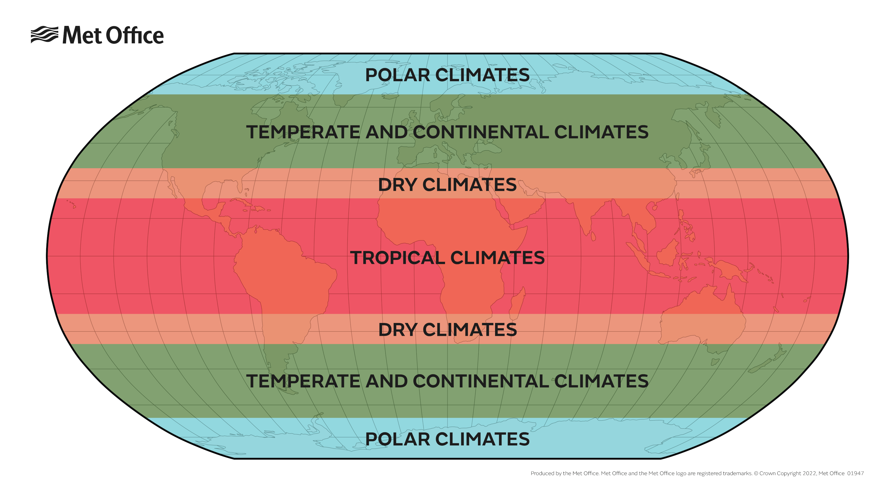
Key Climate Concepts
Introduction to Climate Change Science
Climate Zones: Geographical areas characterized by specific climate patterns determined by factors like temperature, precipitation, latitude, and altitude. They include Tropical (warm and humid), Temperate (moderate), and Polar (cold) zones, each with distinct environmental conditions.
Climate Classifications: Various classification systems exist, such as the Köppen climate classification, which categorizes climates based on temperature and precipitation patterns, resulting in symbols representing climate types globally.
https://www.metoffice.gov.uk/weather/climate/climate-explained/climate-zones

Slide 19
Climate vs. Weather
Introduction to Climate Change Science
Climate: the average weather patterns observed in a region over an extended period, typically 30 years or more.
Weather: denotes short-term atmospheric conditions that change rapidly over hours, days, or weeks and can include temperature, precipitation, wind, and humidity.
Emphasis: Distinguishing between climate and weather aids in understanding long-term trends (climate) versus immediate conditions (weather), influencing societal planning, agriculture, and disaster preparedness.

Slide 20
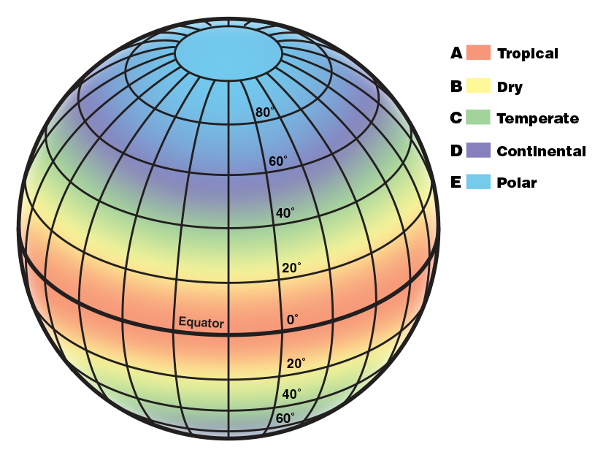
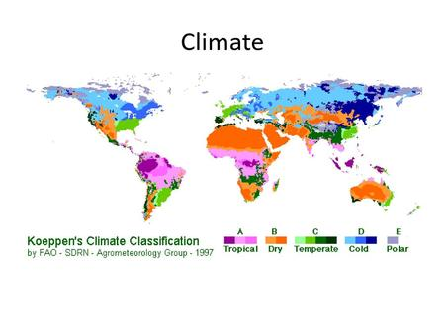
5 Climate Zones
Introduction to Climate Change Science

Slide 21
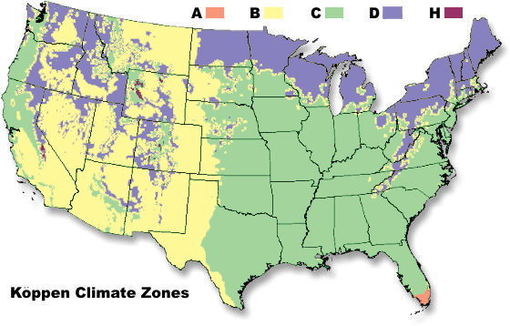
Introduction to Climate Change Science
Köppen Climate Classification
Overview: The Köppen climate classification system categorizes climates based on temperature, precipitation, and vegetation patterns. It identifies climate types using letters and symbols, facilitating the understanding and communication of climatic differences worldwide.
Classification Criteria: Köppen's system includes categories like Tropical (A), Dry (B), Temperate (C), Continental (D), and Polar (E) climates, further divided into subcategories based on specific climate characteristics.

Slide 22
Climate vs. Weather Examples
Introduction to Climate Change Science
Climate:
Visualization: Graph representing temperature averages and precipitation trends over several decades in a hypothetical region (Graph showing average temperatures and precipitation from 1950 to 2020).
Description: The graph illustrates long-term climate trends, showcasing the average temperatures and precipitation levels recorded over many years, indicating patterns and variability.
Weather :
Visualization: Weekly bar graph or icons displaying day-to-day variations in temperature and rainfall for a specific week in the same hypothetical region (Bar graph showing daily temperature fluctuations and rainfall amounts for a week in 2021).
Description: This visual representation highlights short-term variations in temperature and rainfall observed over a week, demonstrating day-to-day weather changes that differ from the long-term climate patterns depicted in the previous graph.

