Slide 1
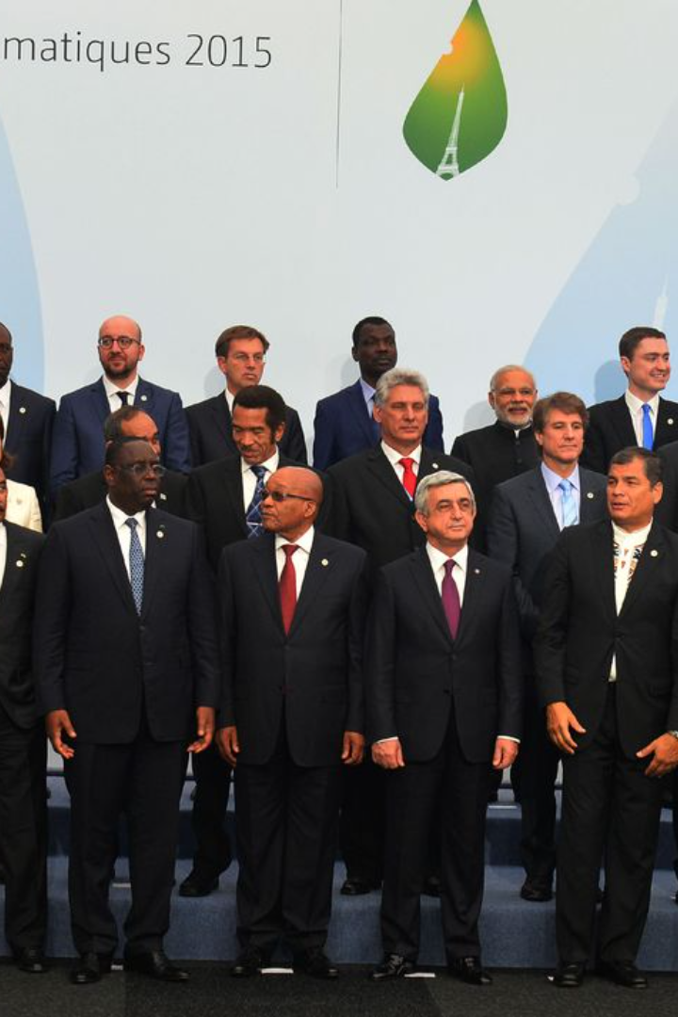
The Paris Agreement: A Commitment to a Sustainable Future
At COP 21 in Paris, on 12 December 2015, a landmark agreement was reached by Parties to the UNFCCC to combat climate change and to accelerate and intensify the actions and investments needed for a sustainable low carbon future. This agreement, known as the Paris Agreement, unites all nations in a common cause to undertake ambitious efforts to combat climate change and adapt to its effects, with enhanced support to assist developing countries. It charts a new course in the global climate effort and builds upon the existing Convention.

Slide 2
Central Goals of the Paris Agreement
1
Temperature Rise Limit
2
Adaptation Enhancement
3
Support Framework
The central aim of the Paris Agreement is to keep the global temperature rise this century well below 2 degrees Celsius above pre-industrial levels and to pursue efforts to limit the temperature increase even further to 1.5 degrees Celsius.
The agreement also aims to increase the ability of countries to deal with the impacts of climate change and make finance flows consistent with a pathway towards low GHG emissions and climate-resilient development.
To reach these ambitious goals, the agreement plans for the mobilization and provision of financial resources, a new technology framework, and enhanced capacity-building to support action by developing countries and the most vulnerable countries, in line with their own national objectives.

Slide 3
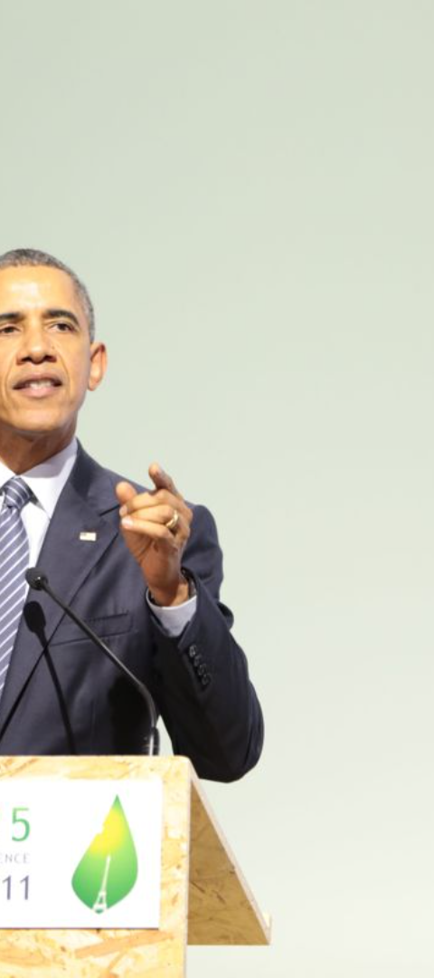
Transparency and Reporting
Nationally Determined Contributions
The Paris Agreement requires all Parties to put forward their best efforts through "nationally determined contributions" (NDCs) and to strengthen these efforts in the years ahead.
Regular Reporting
It includes requirements that all Parties report regularly on their emissions and on their implementation efforts.
Global Stocktake
There will be a global stocktake every 5 years to assess collective progress towards achieving the purpose of the agreement and to inform further individual actions by Parties.

Slide 4
Ratification and Entry into Force
1
Opening for Signature
The Paris Agreement opened for signature on 22 April 2016 – Earth Day – at UN Headquarters in New York.
2
Entry into Force
It entered into force on 4 November 2016, 30 days after the "double threshold" had been met, with ratification by 55 countries accounting for at least 55% of global emissions.
3
Ongoing Ratifications
Since then, more countries have ratified and continue to ratify the Agreement, reaching a total of 125 Parties in early 2017.

Slide 5
Operationalizing the Paris Agreement
In order to make the Paris Agreement fully operational, a work programme was launched in Paris to develop modalities, procedures and guidelines on a broad array of issues. Parties work together in the subsidiary bodies and various constituted bodies, with the first meeting of the CMA taking place in conjunction with COP 22 in Marrakesh in November 2016.

Slide 6
Key Aspects of the Paris Agreement
Long-term Temperature Goal
Global Peaking and Neutrality
Mitigation Efforts
Binding commitments are established for all Parties to prepare, communicate, and maintain NDCs and to pursue domestic measures to achieve them.
The Agreement reaffirms the goal of limiting global temperature increase to well below 2 degrees Celsius, while pursuing efforts to limit the increase to 1.5 degrees.
Parties aim to reach global peaking of GHG emissions as soon as possible to achieve a balance between emissions by sources and removals by sinks of GHGs in the second half of the century.

Slide 7
Adaptation and Loss & Damage
Adaptation
Loss and Damage
The Agreement establishes a global goal on adaptation to enhance adaptive capacity, strengthen resilience, and reduce vulnerability to climate change.
It recognizes the importance of averting, minimizing, and addressing loss and damage associated with the adverse effects of climate change.

Slide 8
z
Support Mechanisms
Finance
Technology
Capacity-Building
The Agreement reaffirms the obligations of developed countries to support developing country Parties to build clean, climate-resilient futures.
It encourages voluntary contributions by other Parties and aims for a balance between adaptation and mitigation in the provision of resources.
International cooperation on climate-safe technology development and transfer and capacity-building in the developing world are strengthened.

Slide 9
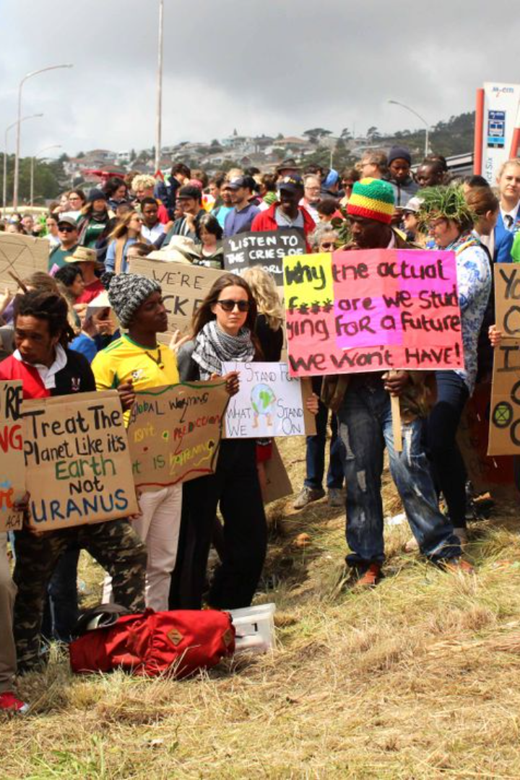
Education and Public Engagement
Climate change education, training, public awareness, public participation, and public access to information are to be enhanced under the Agreement, as outlined in Article 12.

Slide 10
Transparency, Implementation, and Compliance
The Paris Agreement relies on a robust transparency and accounting system to provide clarity on action and support by Parties. It includes a mechanism to facilitate implementation and promote compliance in a non-adversarial and non-punitive manner.

Slide 11
Global Stocktake and Pre-2020 Action
A "global stocktake" will assess collective progress toward achieving the purpose of the Agreement. Decision 1/CP.21 also sets out measures to enhance action prior to 2020, including strengthening the technical examination process and enhancement of provision of urgent finance, technology, and support.

Slide 12
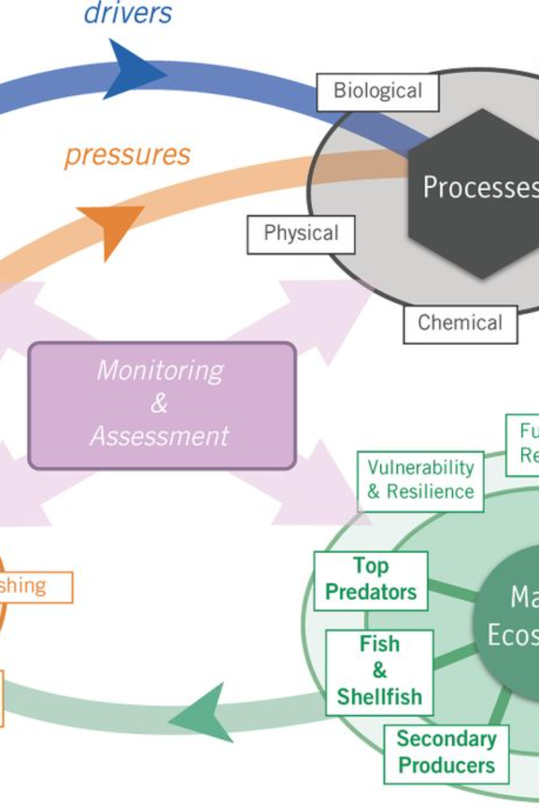
Stakeholder Engagement and Non-Party Efforts
Decision 1/CP.21 welcomes the efforts of all non-Party stakeholders to address and respond to climate change, including those of civil society, the private sector, financial institutions, cities, and other subnational authorities. These stakeholders are invited to scale up their efforts and showcase them via the Non-State Actor Zone for Climate Action platform.

Slide 13
Supporting Local Communities and Indigenous Peoples
Parties recognized the need to strengthen the knowledge, technologies, practices, and efforts of local communities and indigenous peoples, as well as the important role of providing incentives through tools such as domestic policies and carbon pricing.

Slide 14
Facilitative Dialogue and High-Level Engagement
For 2018, a facilitative dialogue is envisaged to take stock of collective progress towards the long-term emission reduction goal of Article 4. Measures to strengthen high-level engagement are also included in the decision.

Slide 15
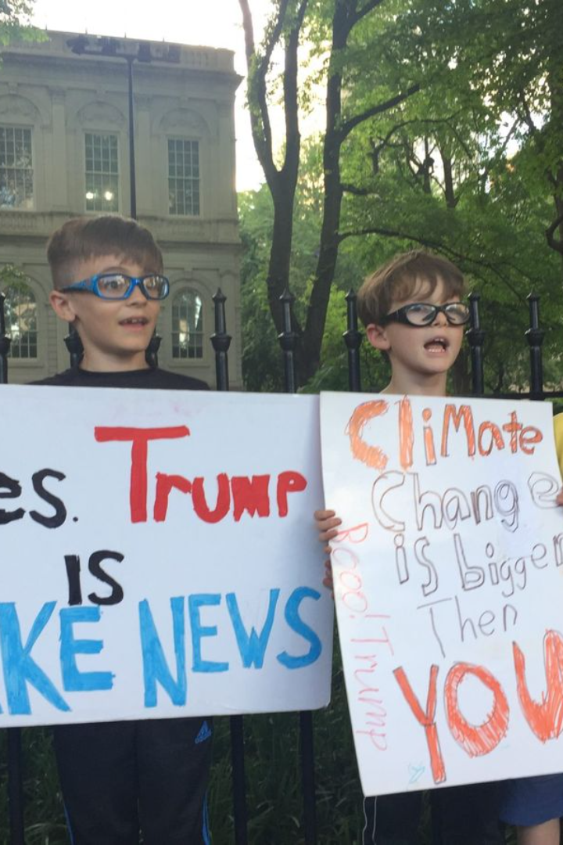
Looking Forward: The Paris Agreement's Legacy
The Paris Agreement, through its comprehensive framework and global participation, sets a precedent for future climate action. It addresses crucial areas necessary to combat climate change and paves the way for a sustainable and resilient future.

