Slide 1
CCP-LAW
Curricula development on Climate Change Policy and Law
Subject title: Climate Change Policy
Instructor Name: Dr. Rahul Nikam
Project No of Reference: 618874-EPP-1-2020-1-VN-EPPKA2-CBHE-JP:
The European Commission's support for the production of this publication does not constitute an endorsement of the contents, which reflect the views only of the authors, and the Commission cannot be held responsible for any use which may be made of the information contained therein.

Slide 2
Negotiating international cooperation: global public goods and fairness
Global public goods (GPGs) are vital to human welfare and security worldwide.
Yet often they suffer from under-provision and free-riding, and are not accessible or beneficial to everyone. They illustrate starkly problems of collective action.
Why do countries so often fail to cooperate sufficiently on peace and security issues, even when the consequences are known to harm everyone in the long term?
Any observer of world affairs will have noticed the steady proliferation of problems which defy unilateral solutions.
Are political leaders blind to the mutual gains to be reaped, and the dangers to be avoided, through collaboration?
Do they fear exploitation and ‘free riding’, that other parties cannot be trusted?
Or cannot government representatives be expected to look beyond shorter-term domestic considerations, such as the next election?

Slide 3
Negotiating international cooperation: global public goods and fairness
Negotiating global public goods: why fairness matters

Slide 4
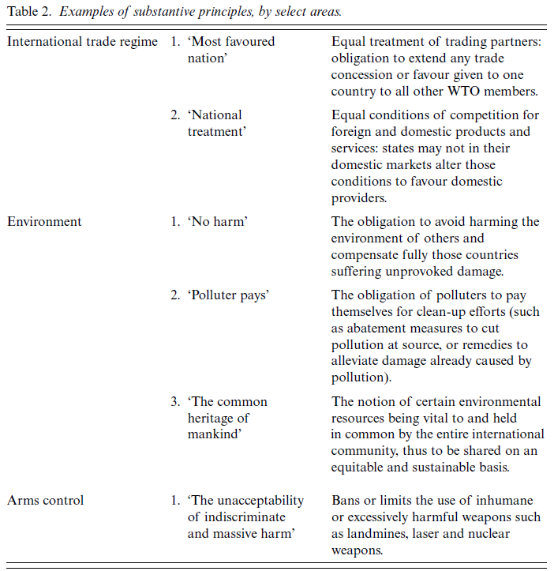
Negotiating international cooperation: global public goods and fairness
Coping with moral ambiguity: the practice of negotiation today
Moral ambiguity plagues negotiations over GPGs. We lack one overarching standard which defines justice and fairness in concrete situations. Moreover, there is no consensus on priorities among recognised principles.
Competing criteria: see table 2

Slide 5
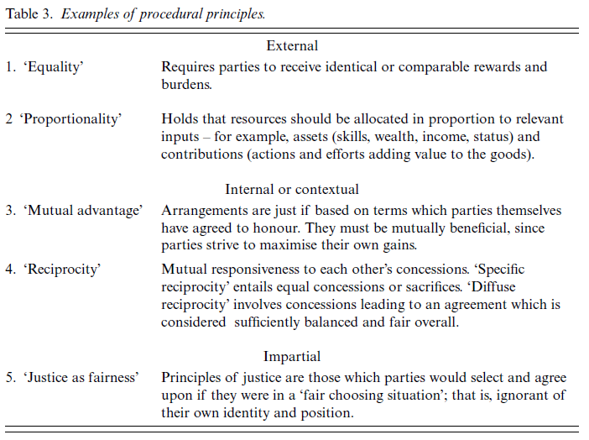
Negotiating international cooperation: global public goods and fairness

Slide 6
Negotiating international cooperation: global public goods and fairness
Widely recognised principles
Firstly, justice and fairness are rarely taken to mean identical (equal) treatment or allocations. These values require proportionality: that parties’ circumstances be taken into account.
Secondly, fairness is associated with reciprocity and net benefits for all parties: ‘The purpose of any negotiation is to produce . . . reciprocal benefits . . . All parties feel that they need a balance of concessions...that is, they require reciprocity from other parties’.
Thirdly, practitioners associate justice and fairness with impartiality. Voluntary acceptance and the absence of coercion are important. However, to them impartiality also entails balancing different principles and interests.
Finally, international negotiators widely support the obligation to comply with freely negotiated agreements. This is a well-established principle of morality and international law, although views and regulations differ on circumstances which justify breaking an agreement.

Slide 7
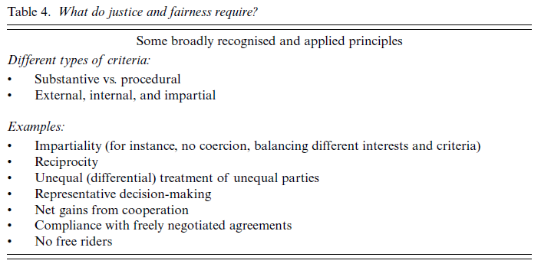
Negotiating international cooperation: global public goods and fairness

Slide 8
Negotiating international cooperation: global public goods and fairness
Making cooperation succeed: from agenda-setting to implementation
Structural issues of justice and fairness
These concern the fundamental conditions and constraints under which the negotiation process unfolds and negotiators operate. They can prejudice the talks and the outcome considerably, particularly for weaker parties. Three issues are especially important in negotiating GPGs: agenda-setting, parties, and rules.
What is a fair negotiation process?
The first, fair input or fair hearing, refers to parties and issues. Each party should have an adequate chance to put forward its case and have an input into the process, from the stage when the problem is framed and options assessed to the point when the final agreement is formulated.
Fair play means that each party can freely accept or reject proposals, without being subjected to heavy-handed coercion and threats.
Fair play also requires parties to agree on clear negotiation rules and procedures, and to respect these thereafter (unless changed subsequently by consensus). This brings us to procedural fairness, that is, the features of the methods used to arrive at an agreement.

Slide 9
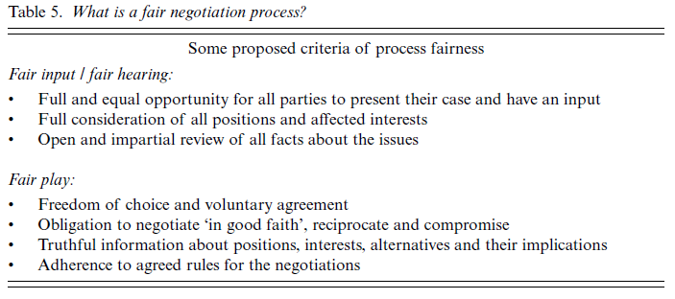
Negotiating international cooperation: global public goods and fairness

Slide 10
Negotiating international cooperation: global public goods and fairness
The justice and fairness of the outcome
This concerns, firstly, the principles guiding the distribution of benefits and burdens in an agreement.
The practice is seen as right and reasonable, not only as required on pragmatic grounds, and corresponds well
with the notion of justice as a balanced settlement of conflicting claims. For example, the 1994 Uruguay Round agreements.
But of concern is also fairness after the agreement, that is, actual implementation and compliance with its terms and principles, and the soundness of these over time with changing circumstances.
This stage often determines whether an agreement on paper will actually result in effective – and fair – cooperationon the ground.
Promoting fair negotiation practice
Like conflicts of interests, these issues can undermine the capacity of negotiation to produce acceptable and durable solutions.
The notion of justice as a balanced settlement of conflicting claims offers guidelines as to what is required in negotiations over GPGs.
Few of these ambitious criteria have been met fully in negotiations over GPGs to date. What then can be done to promote fair negotiation practice, and thereby better cooperation? By way of conclusion, we will discuss four sets of strategies.

Slide 11
Negotiating international cooperation: global public goods and fairness
The first concerns improving negotiating and decision-making methods.
Providing training, research and technical support, and policy advice to disadvantaged parties is another way to promote fairness. Some expansion of the opportunities for non-state actors to be consulted and participate in negotiations over GPGs could enhance their legitimacy and effectiveness.
The second stage at which non-state actors, alone or in cooperation with governments, could make a real difference is in the international negotiation process itself.
Finally, linkage of issues can enhance the fairness of negotiations over GPGs to the ultimate benefit of all. It allows a party or coalition of parties to exchange concessions on their supposedly lower-priority issues, which to another party may be of utmost significance, for concessions on other issues they value more.

Slide 12
Further Reading
Negotiating international cooperation: global public goods and fairness by CECILIA ALBIN https://library.fes.de/libalt/journals/swetsfulltext/16957014.pdf

