Slide 1
CCP-LAW
Curricula development on Climate Change Policy and Law
Subject title: CLIMATE CHANGE DISPUTE RESOLUTION
Instructor Name: Tran Anh Tuan
Project No of Reference: 618874-EPP-1-2020-1-VN-EPPKA2-CBHE-JP:
The European Commission's support for the production of this publication does not constitute an endorsement of the contents, which reflect the views only of the authors, and the Commission cannot be held responsible for any use which may be made of the information contained therein.

Slide 2
9.5. Debriefing, evaluating and learning from applications and simulations
Module 9. Practical applications and simulations
Debriefing
Methods:
Open-Ended Questions: Asking questions about participants' experiences, choices, challenges, and surprises helps to uncover key insights.
Collaborative Analysis: Encouraging participants to share different perspectives and interpretations of the simulation enriches the collective learning process.
Highlighting Key Concepts: Facilitators can connect the simulation outcomes with theoretical concepts, international agreements, and real-world cases related to climate change.

Slide 3
9.5. Debriefing, evaluating and learning from applications and simulations
Module 9. Practical applications and simulations
Evaluation
Methods:
Participant Feedback: Surveys and questionnaires collect valuable feedback on the realism of the simulation, engagement levels, and learning outcomes.
Observation: Facilitators can observe the dynamics during the simulation to gain insights into participant interaction, negotiation strategies, and decision-making processes.
Measuring Learning Outcomes: Pre- and post-simulation assessments can measure changes in participants' knowledge, understanding, and attitudes towards climate change and dispute resolution principles.

Slide 4
9.5. Debriefing, evaluating and learning from applications and simulations
Module 9. Practical applications and simulations
Learning into actionable knowledge and skills applicable to real-world climate change disputes.
Applications:
Negotiation Strategies: Identifying effective negotiation strategies, communication techniques, and ways to build trust that were successful within the simulation.
Understanding Complexity: Appreciating the interconnected nature of climate change, the diverse interests of stakeholders, and the challenges of finding common ground.
Identifying Gaps: Recognizing areas where additional knowledge or skill development may be needed to address real-world climate change disputes more effectively.

Slide 5
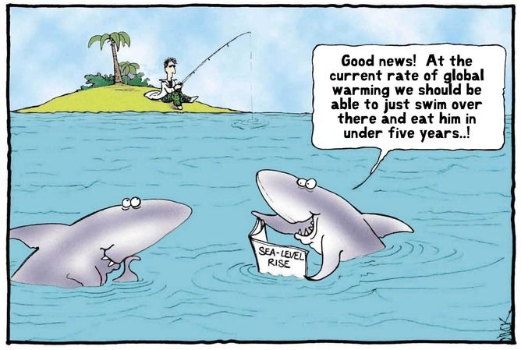
9.5. Debriefing, evaluating and learning from applications and simulations
Module 9. Practical applications and simulations
Example: Debriefing a Multi-Party Negotiation Simulation
Questions for reflection:
What were the key challenges you faced during the negotiation process?
What strategies proved effective in reaching a compromise or finding a solution?
Did your perspective on the issue change at any point during the simulation? If so, why?
How might the lessons learned from this simulation apply to real-life disputes?

Slide 6
9.5. Debriefing, evaluating and learning from applications and simulations
Module 9. Practical applications and simulations
Conclusion:
Debriefing, evaluating, and learning from simulations are crucial aspects that transform the experience into a valuable tool for climate change dispute resolution.
Debriefing, evaluation, and learning are essential for maximizing the benefits of simulations and applications in climate change dispute resolution.
By extracting insights, assessing effectiveness, and translating knowledge into action, these phases ensure that simulations continue to contribute to the development of more effective and collaborative approaches to climate challenges.

