Slide 1
CCP-LAW
Curricula development on Climate Change Policy and Law
Subject title: Climate Change Policy
Instructor Name: Dr. Rahul Nikam
Project No of Reference: 618874-EPP-1-2020-1-VN-EPPKA2-CBHE-JP:
The European Commission's support for the production of this publication does not constitute an endorsement of the contents, which reflect the views only of the authors, and the Commission cannot be held responsible for any use which may be made of the information contained therein.

Slide 2
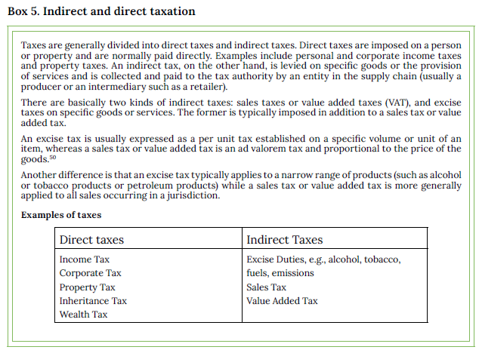
General Issues in Designing a Carbon Tax
1. A carbon tax in context with other forms of taxation
A carbon tax is a tax on carbon emissions. However, in practice, the tax base is a product, a process, or a service; thus, it is typically considered a type of indirect taxation, and more specifically an excise tax.
Therefore, a jurisdiction’s experience with indirect taxation should be the starting point for considering the implementation of a carbon tax. See Box 5 for a definition of the types of taxes.

Slide 3
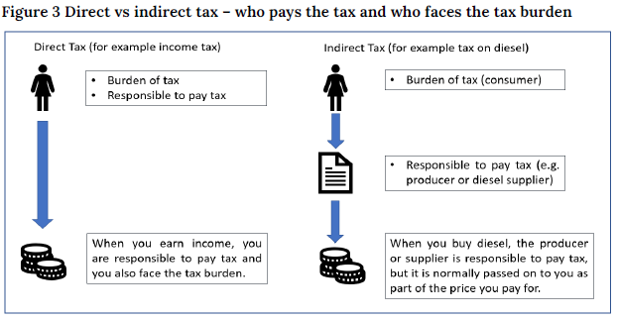
General Issues in Designing a Carbon Tax
2. Who faces the cost of a carbon tax?
A carbon tax is aimed at giving consumers an incentive to change their behaviors and consume less carbon-intensive products. Carbon tax legislation determines which legal entity will be responsible for paying the tax, which is the taxpayer. The carbon tax incentive effect will depend on whether the taxpayer can pass the cost of the carbon tax on to the consumers, who are expected to change their behaviors. However, there may be a difference between who is targeted by the tax, who is legally responsible for payment, and who bears the tax burden.

Slide 4
General Issues in Designing a Carbon Tax
3. Taxing power
3.1 Taxing power boundaries
The statutory power or authority to levy taxes varies across and within jurisdictions. It is established in rules that can take the form of constitutional arrangements, public law requirements, supra-national principles, or other legal obligations.
3.2 Existing institutional frameworks for setting and collecting taxes
Taxes are usually designed by Ministries of Finance and collected by Tax Agencies or Customs Authorities.
3.3 Distinct features of a carbon tax
A carbon tax is not to raise revenue but to change the behavior of households and firms. An effective carbon tax should incentivize the reduction of carbon emissions.

Slide 5
General Issues in Designing a Carbon Tax
When designing a carbon tax, technical expertise in environmental and energy issues is crucial for setting the tax rate and the effective design and administration of the tax, particularly in the case of the Direct Emissions Approach.
A carbon tax can also be designed using the existing excise tax administration system, particularly with the Fuel Approach.
3.4 Constitutional rules regarding taxing power
Policymakers will need to consider constitutional requirements and the confines of the fiscal system in general, as they determine carbon tax design choices.
3.5 Special considerations for jurisdictions with subnational levels
In case a jurisdiction has subnational levels, a country’s constitution or public law arrangements will likely contain rules as to which levels of the state have taxing powers, e.g., municipal level, provincial level, and/or federal level.

Slide 6
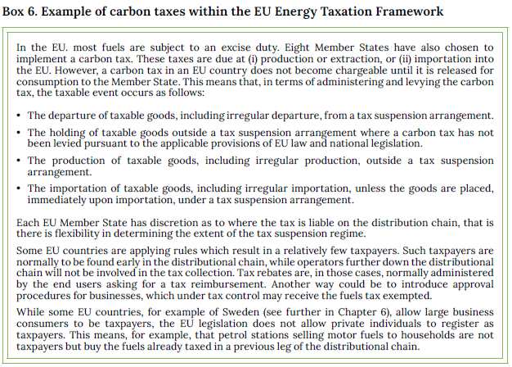
General Issues in Designing a Carbon Tax

Slide 7
General Issues in Designing a Carbon Tax
4. Scope of the carbon tax
4.1 What to tax?
The simple answer to the question of what we are going to tax is carbon emissions. Carbon is the primary element that may give rise to the release of CO2 if submitted to a combustion or other processes. Emissions of CO2 from fossil fuels and industrial processes amount to roughly two-thirds of the global greenhouse gas (GHG) emissions, as illustrated in Figure 4 below. Of these, the combustion of fossil fuels accounts for more than 80 percent.55 In this Handbook, we will principally focus on CO2 emissions from fuel combustion, although one of the approaches to carbon taxation discussed below can also accommodate taxation of other processes that generate carbon emissions as well.

Slide 8
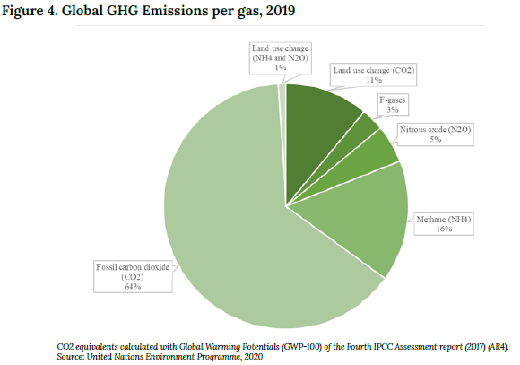
General Issues in Designing a Carbon Tax

Slide 9
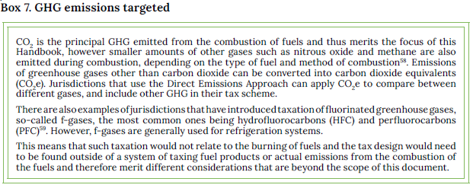
General Issues in Designing a Carbon Tax
There are two basic approaches when considering what to tax. One is a tax on the volume or weight units of the fuels giving rise to emissions when combusted; this will be referred to as the Fuel Approach, where the tax rate is based on standardized amounts of carbon content in fossil fuels. The other is a tax on emissions directly at source; this is known as the Direct Emissions Approach.

Slide 10
General Issues in Designing a Carbon Tax
5.2 Who will pay the tax?
Choosing the taxpayer and liable sectors will depend on the objective of the tax, the tax approach, and the administrative conditions in the implementing jurisdiction. In the case of the Fuel Approach, the taxpayer will depend on the fuel distribution chain which typically involves a range of agents operating at different points.
The actual payment of the tax – when and by whom – should be regulated in the carbon tax legislation. These issues are of interest to authorities set to administer the carbon tax and, consequently, to legislators considering how to design their tax legislation. The legislator’s choice depends on the possibility for the taxpayer to transfer the cost of the tax down to the fuel supply chain or the consumer.

Slide 11
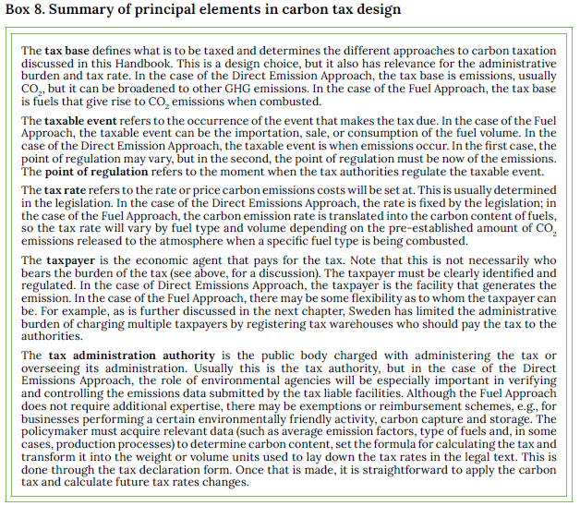
General Issues in Designing a Carbon Tax
5.3 How to tax?

Slide 12
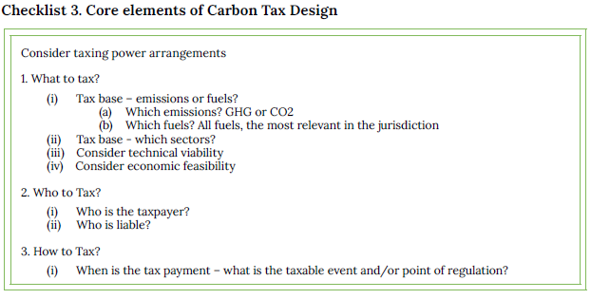
General Issues in Designing a Carbon Tax

Slide 13
Further Reading
Carbon Pricing Leadership Coalition (CPLC). (2018). “How can consumption-based carbon pricing address carbon leakage and competitiveness concerns?." Executive Briefing: Climate Strategies. https://static1.squarespace.com/static/54ff9c5ce4b0a53decccfb4c/t/5ad8d232758d46c25386e589/1524159026153/27916-CPLC-ExecBrief-CarbonPricing-v7.pdf
Rogelj, J., et al. (2018). “Mitigation Pathways Compatible with 1.5°C in the Context of Sustainable Development.” In: Global Warming of 1.5 ºC, IPCC. https://www.ipcc.ch/site/assets/uploads/sites/2/2019/05/SR15_Chapter2_Low_Res.pdf
Olivier J. G. J., and Peters J. A. H. W. (2020). “Trends in global CO2 and total greenhouse gas emissions: 2020 report.” PBL Netherlands Environmental Assessment Agency, The Hague. https://www.pbl.nl/sites/default/files/downloads/pbl-2020-trends-in-global-co2-and-total-greenhouse-gas-emissions-2019-report_4068.pdf
United Nations Environment Programme. (2020). “Emissions Gap Report 2020.” Nairobi. https://www.unep.org/emissions-gap-report-2020

Slide 14
Setting the Tax Rate
1. Introduction
We examine practical approaches to determining the tax rate, complemented by country examples. These are the Standards and Price Approach, the Revenue Target Approach, and the Benchmarking Approach. These methodologies should not be considered independently since they support an integrated decision-making process. This is because each one provides insights that can help find a tax rate in line with a desired climate policy objective.
2. Basic considerations for setting the tax rate
Implementing a carbon tax should be viewed as a learning-by-doing process. To meet the objectives of the Paris Agreement, jurisdictions should strive to implement a carbon tax as soon as possible.
The range of carbon tax rates currently implemented across the world varies from less than US$ 1 per tonne of carbon dioxide equivalent (tCO2e) to over US$ 100.
To achieve the 1.5 degrees Celsius temperature increase limit target agreed upon by the Paris Agreement, the High-Level Commission on Carbon Prices proposed a carbon price ranging from US$ 50 – 100 / tCO2e by 2030.

Slide 15
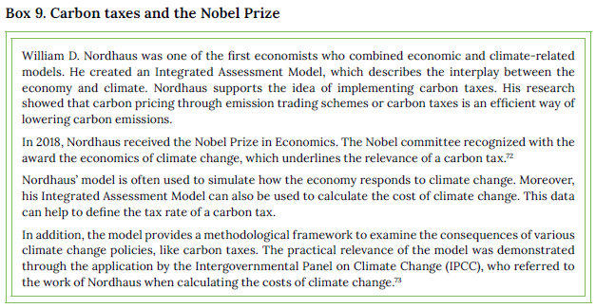
Setting the Tax Rate
3. The theoretical framework
3.1 Theory of Externalities
The theoretical framework that supports carbon taxation is based on the theory of externalities developed by Pigou.70 The idea is that carbon emitters generate an externality by imposing costs and disservices on others, without paying the full cost of the resulting damage that occurs.

Slide 16
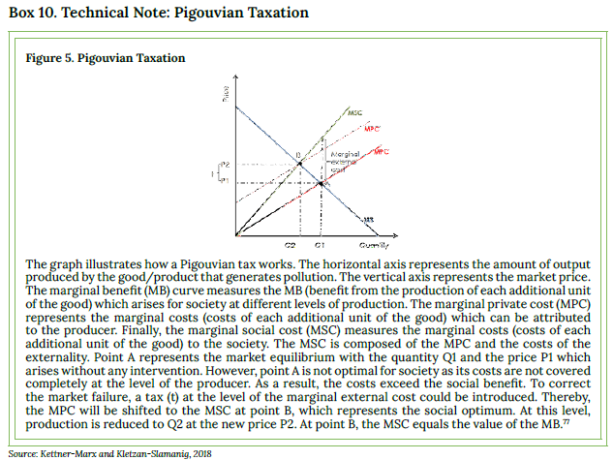
Setting the Tax Rate
3.2 Pigouvian taxation – internalizing external costs

Slide 17
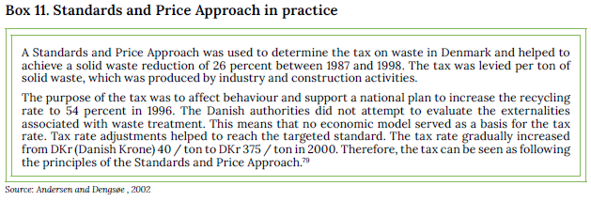
Setting the Tax Rate
4. Practical approaches to set the carbon tax rate
4.1 Standards and Price Approach – to reach a specific carbon reduction target
In practice, several approaches can be used to set a carbon tax rate. One approach is to set the tax rate corresponding to a specific carbon reduction target; this is known as the Standards and Price Approach (also known in the literature as the Baumol-Oates approach). The focus of the Standards and Price Approach is not the determination of the correct social cost of carbon, but the tax rate required to achieve a specific emission reduction target.

Slide 18
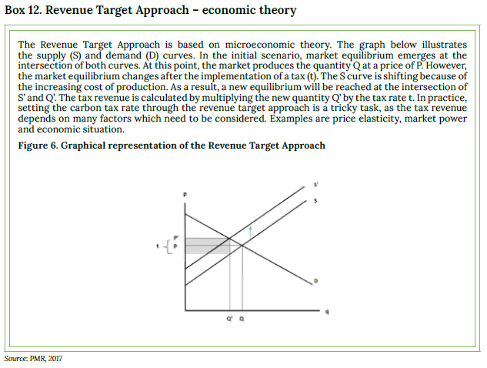
Setting the Tax Rate
4.2 Revenue Target Approach

Slide 19
Setting the Tax Rate
4.2 Revenue Target Approach

Slide 20
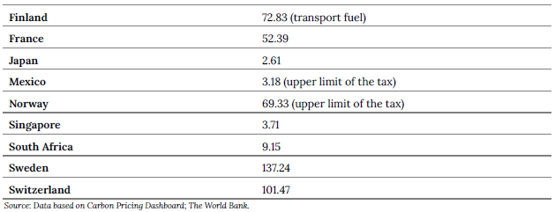
Setting the Tax Rate
4.3 Benchmarking Approach
Benchmarking comparison with carbon tax rates

Slide 21
Setting the Tax Rate
As jurisdictions have different framework conditions, policymakers should consider which is comparable to their own when choosing their tax rates. Regarding the selection of comparable jurisdictions, factors to consider include: (i) policy objective; (ii) similar economies/politics; (iii) demographic factors; (iv) energy production; (v) geographic distribution; (vi) potential for coordination, and (vii) tax system.

Slide 22
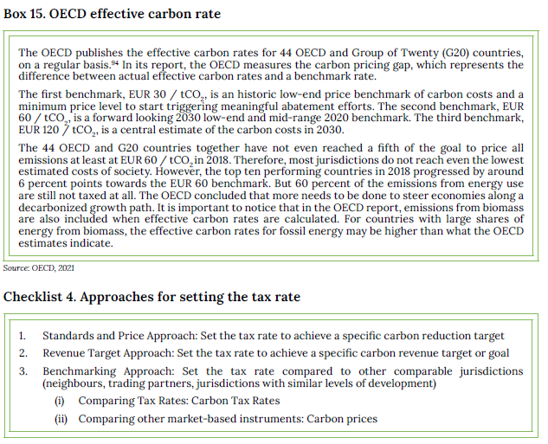
Setting the Tax Rate
Benchmarking comparison with other market-based instruments

Slide 23
Setting the Tax Rate
5. Dynamic Tax Rates
5.1 The role of politics
It can help jurisdictions create a policy strategy; however, to prevent the tax rate level from becoming subject to short-term political considerations, achieving the broadest political consensus is also important.
5.2 Tax rate trajectory
Policymakers should consider different strategies for imposing the optimum tax rate, which may also involve considering the tax rate trajectory. One strategy is to introduce an initial tax rate that remains at the same level for the initial period (“static carbon tax rate”). Another strategy is to adjust the tax rate over time to soften the impacts of the tax. In practice, dynamic tax rate strategies have been used by several jurisdictions.
To ensure compliance and limit opposition, policymakers can implement a low tax rate in its initial year and then increase the rate later (“ramp-up introduction”). If a jurisdiction has decided to apply a slow ramp-up strategy, the tax rate would be increased gradually until the tax rate reaches the desired level. Under the ramp-up strategy, it is easier to adjust and anticipate carbon taxes. The economy would have more time to invest in alternative environmentally friendly technologies and would not face major economic shocks.

Slide 24
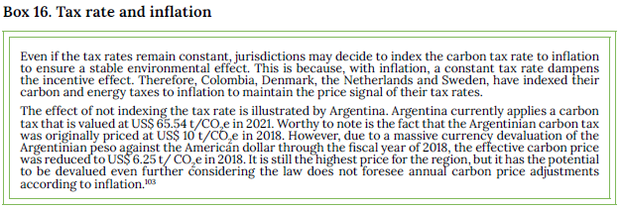
Setting the Tax Rate
5.3 Regular adjustments of the tax rate
To deal with economic change, policymakers may decide to implement predetermined adjustment formulas in the legislation. The law can include specific criteria or scenarios that trigger changes in the tax rate. One example could be that the tax rate automatically increases if specific reduction targets are not met.

Slide 25
Setting the Tax Rate
Moreover, economic factors like Gross Domestic Product (GDP) growth or changes in exchange rates could be used as triggering factors. Switzerland has implemented a reduction target in its national carbon tax. The tax rate is raised
by a predetermined formula in advance, thus avoiding a new legislative process in Parliament.
Another approach is to periodically review the carbon tax rate, for example, via a special committee. Experts can assess the impacts of the carbon tax. Past experiences and available information about future developments allow those expert committees to draft concrete proposals for tax rate changes. The composition of the panels may differ in each jurisdiction. To avoid political interests, these committees can be composed of experts or stakeholders.
Reviewing the carbon tax rate can also be part of the general political considerations. For example, Norway reviews its carbon tax rate on a yearly basis, as the Norwegian tax law requires it to be presented as part of the annual national
budget. During this process, the Norwegian carbon tax rate has increased. Also, Ireland reviews the status of their national carbon tax rate on a yearly basis considering international trends in carbon pricing

Slide 26
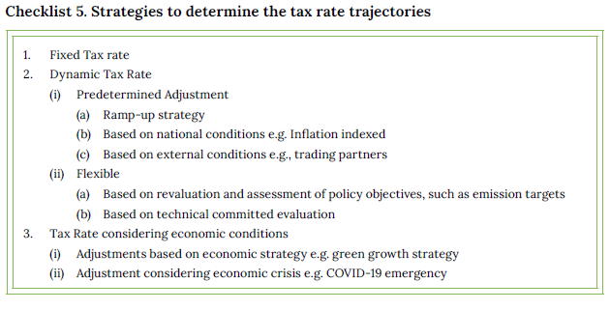
Setting the Tax Rate
6. Setting tax rates under challenging circumstances

Slide 27
Further reading
Carbon Pricing Leadership Coalition (CPLC). (2017). “Report of the High-Level Commission on Carbon Prices.” Washington, DC: World Bank. https://www.carbonpricingleadership.org/report-of-the-highlevel-commission-on-carbon-prices/
Kettner-Marx, C. and Kletzan-Slamanig, D. (2018). “Carbon Taxes from an Economic Perspective.” WIFO Working Paper, 554. https://www.econstor.eu/handle/10419/179308
OECD (2021). “Effective Carbon Rates 2021: Pricing Carbon Emissions Through Taxes and Emissions Trading.” Paris: OECD Publishing. https://doi.org/10.1787/0e8e24f5-en
World Bank Group. (2019). “State and Trends of Carbon Pricing 2019.” Washington, DC: World Bank. https://openknowledge.worldbank.org/handle/10986/31755
World Bank Group. (2021). “State and Trends of Carbon Pricing 2021.” Washington, DC: World Bank.. https://openknowledge.worldbank.org/handle/10986/35620

Slide 28
Carbon Tax Design Approaches in Practice
1. Introduction
We examines the two principal carbon tax design approaches, the Fuel Approach (which uses fuels as the tax base and sets the tax rate based on the carbon content of the fuels) and the Emissions Approach (which establishes the tax directly on emissions).
To illustrate, we draw on two specific examples. The first is the Swedish carbon tax, based on the Fuel Approach, which has had over thirty years’ experience and could be considered a benchmark of carbon tax design and implementation. The second is the relatively recent experience in Chile with a tax on carbon emissions, one of the few examples of a middle-income country implementing this approach.
The examples serve to address some of the specific questions raised by carbon tax design considering the two different approaches.

Slide 29
Carbon Tax Design Approaches in Practice
2. The Fuel Approach
2.1 Basic concept
The Fuel Approach is the predominant method of carbon taxation around the world. It involves taxing fossil fuels, primarily oil, gas, coal, and their derivative products, and setting the tax rate based on the carbon content of the fuel.
The key to this approach is that carbon emissions are closely related to the carbon content of a specific fuel; therefore, emissions from fuel combustion can be determined accurately by standardized carbon emission factors.
Therefore, once the carbon tax rate has been determined, carbon content is used to establish the specific tax rates on fuels based on average emission factors.
A jurisdiction introducing a carbon tax could thus choose to express their carbon tax rates by volume or weight units (such as litre of petrol or tonne of coal) based on the average carbon content of each fuel type.

Slide 30
Carbon Tax Design Approaches in Practice
2.2 Carbon tax rates applied to different fuels in practice
carbon tax rates on fuels, based on carbon content, can be applied by operators and authorities using volume or weight units; these are standard trade units facilitating tax administration enormously. The advantage is that the calculation of the tax revenue can be carried out by the Ministry drafting the carbon tax legislation and not left to the agencies responsible for administering and collecting the tax.
The table below presents examples of emission factors and heating values for common fuel types from the Intergovernmental Panel on Climate Change (IPCC) Emission Factor Database and the International Energy Agency (IEA) Energy Statistics Manual. The carbon content here expressed in terms of emission factors (kilogram (kg) CO2 per Gigajoule (GJ)), as well as the heating values (GJ per m3 or tonne), varies for fuels depending on their composition. Hence, specific values should be used where available to reflect national or facility-specific circumstances. See Table 3 below

Slide 31
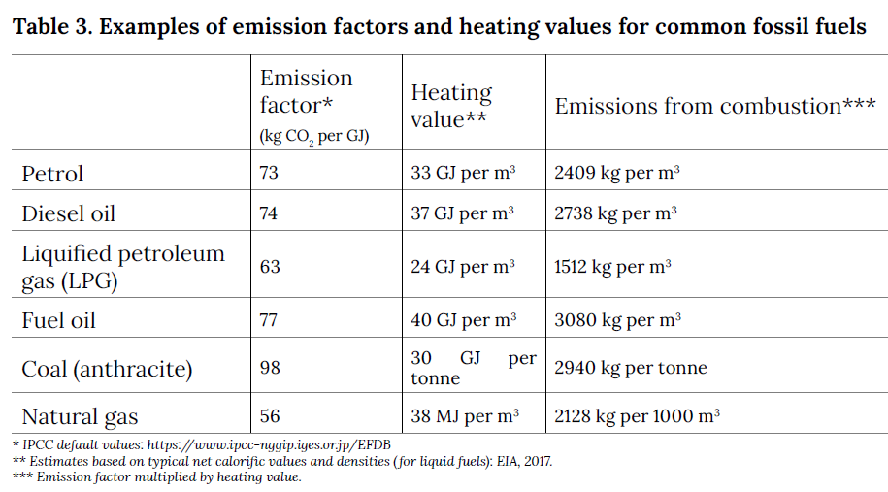
Carbon Tax Design Approaches in Practice

Slide 32
Carbon Tax Design Approaches in Practice
2.3 Point of regulation and tax payment
The point of regulation refers to when the tax is charged in the value chain.
In the case of the Fuel Approach, the tax can be levied at any point in the value chain from the extraction (in a mine or crude oil extraction site) or importation into the jurisdiction, down the value chain until consumption, depending on the institutional framework.
In many cases, the tax is paid further down the value chain since most tax schemes allow the tax payment to be deferred during part of the distributional chain. Thus, the tax is paid after some form of the suspension arrangement. An example is the one applied to excise taxes (including carbon taxes) within the European Union (EU). EU Member States have a choice of who to register as taxpayers within the regime, but the basic principle is the same for all countries (see the illustration of the Swedish scheme in Figure 7).

Slide 33
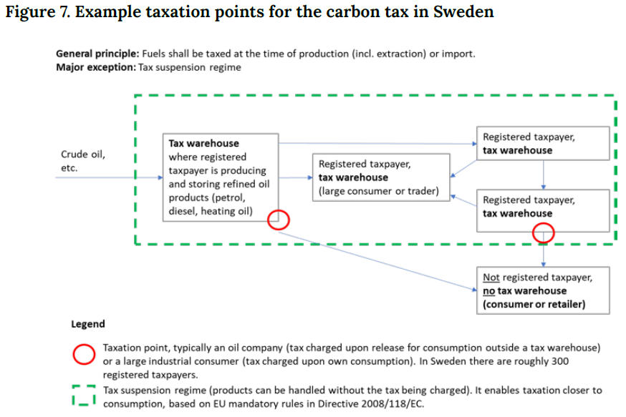
Carbon Tax Design Approaches in Practice

Slide 34
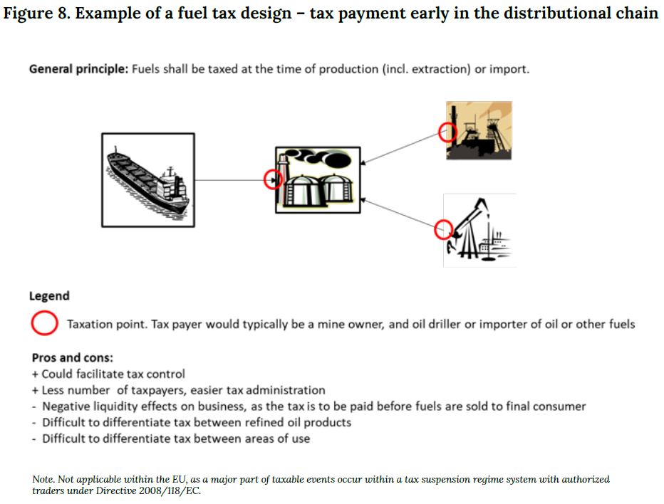
Carbon Tax Design Approaches in Practice
2.3.1 Carbon tax due early in the distributional chain

Slide 35
Carbon Tax Design Approaches in Practice
2.3.2 Carbon tax due later in the distributional chain
Many jurisdictions have taken the approach to levy taxes further down the value chain. One reason is the desire to be able to differentiate the tax depending on final fuel use or sectors. Another is to avoid cash-flow problems by allowing trading of fuels between operators before reaching the final consumer, and therefore deferring tax payment.
2.4 Using an existing fuel taxation administrative system
For example, the EU Member States that have introduced a carbon tax have generally added it to an already existing general excise tax, either as part of the general excise duty (e.g., in France) or as a separate tax (e.g., in Denmark, Finland, Norway and Sweden). In some cases, the introduction of a carbon tax was combined with a reduction in the pre-existing excise tax covering the same fuels.

Slide 36
Carbon Tax Design Approaches in Practice
2.5 Coverage of fuels by the Fuel Approach
Different jurisdictions have chosen to tax different fuel sources depending on their specific conditions. For example, in Iceland, the carbon tax base is petrol, diesel, and heating gas oil, as these are the only fossil fuels available in that country.
Outside Europe, some countries (for instance India, Mexico, the Philippines, and Zimbabwe) have chosen to tax a limited number of fuels. In the case of India and the Philippines, only coal is taxed, while Mexico taxes coal and petroleum products.
The Colombian carbon tax base consists of natural gas and other petroleum products. Zimbabwe only taxes petrol and diesel. The carbon tax in Argentina covers all major fossil fuels used as motor fuels or for heating purposes with the exemption of natural gas and LPG used for heating purposes.
In Mexico and Argentina, natural gas is considered as a transitional fossil fuel.

Slide 37
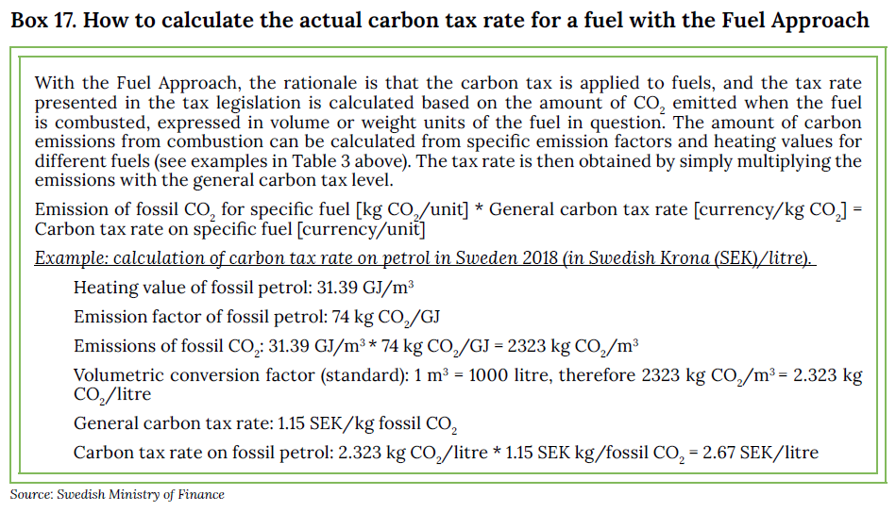
Carbon Tax Design Approaches in Practice
2.6 Methodology to calculate a carbon tax by the Fuel Approach

Slide 38
Carbon Tax Design Approaches in Practice
2.7 Tax rates are presented in the tax law in weight or volume units
2.8 Differentiation based on fuel quality
2.9 Some aspects relating to carbon content in fuels of biomass origin
Another decision facing a policymaker is whether the tax base should relate to the fossil carbon content of fuels, or to carbon emissions generated in general, which may include biomass-based fuels, for instance ethanol and biodiesel (commonly referred to as biofuels).
Some jurisdictions consider biomass-based fuels (also referred to as “bioenergy”) to be carbon neutral and therefore part of the solution towards a low-carbon economy, while other jurisdictions focus solely on a transition to other renewable energy sources such as wind and solar.
2.10 Low blends of ethanol and biodiesel into petrol and diesel
Depending on where the carbon tax is levied on the distribution chain, jurisdictions may encounter administrative problems in implementing tax exemptions, for example, adding ethanol in petrol fuel blends. However, this can be resolved with extensive bookkeeping and verifications for the different components or legal definitions of the level of a low blend to be eligible for a tax refund.

Slide 39
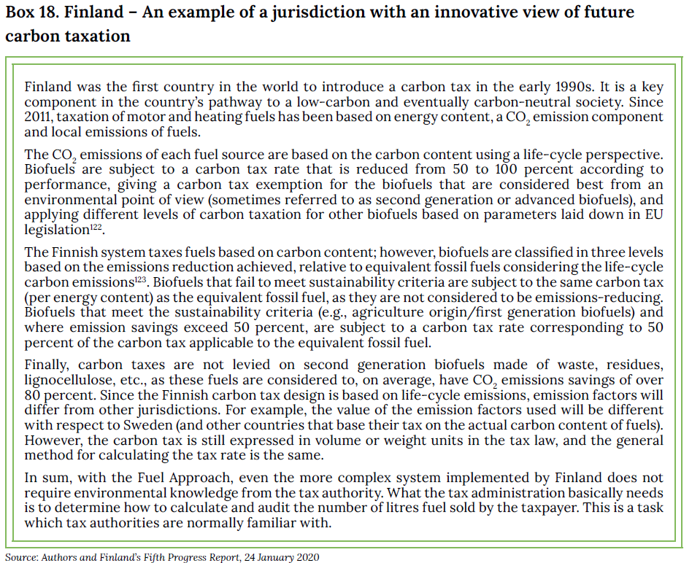
Carbon Tax Design Approaches in Practice
2.11 Taking account of the biomass part of petrol and diesel when calculating the carbon tax rate.

Slide 40
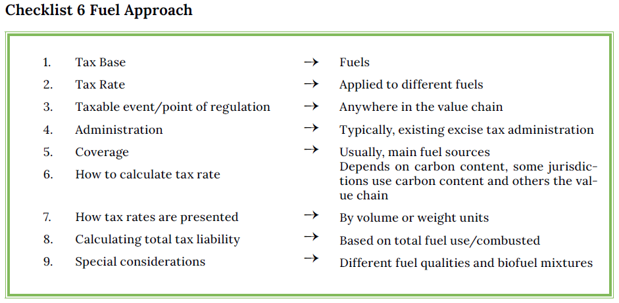
Carbon Tax Design Approaches in Practice

Slide 41
Carbon Tax Design Approaches in Practice
3. The Direct Emissions Approach
3.1 Basic concept
An alternative to the Fuel Approach is a carbon tax on measured emissions.
With this approach, known as the ‘Direct Emissions Approach’, the carbon tax targets CO2 emissions at source regardless of fuel or processes. Although the tax is usually focussed on fuel combustion, it can be applied to emissions from any source. This is an obvious advantage since the tax can extend to non-fuel emission sources and other GHG and pollution emissions. The disadvantage is that it requires a more sophisticated administrative structure to measure emissions at source and, therefore, it can only generally be applied to large facilities.
This approach relies on direct reporting of emissions from stationary installations/facilities, such as large factories, power plants, and oil refineries. This is the case in Chile and, most recently, in Singapore and South Africa.

Slide 42
Carbon Tax Design Approaches in Practice
3.2 Coverage of emissions by the Direct Emissions Approach
Although not as common as taxation of fuels, there are jurisdictions that have chosen to tax direct emissions. For example, in a 2017 tax reform, Chile introduced two new green taxes, a carbon tax and a local pollution tax targeting emissions from large facilities comprised of boilers or turbines.
Other examples include the San Francisco Bay Area carbon tax in the USA (in force since 2008) and Singapore that introduced its first carbon tax in 2019. Both these jurisdictions calculate the tax on measured emissions arising from combustion of fuels in large stationary facilities. By converting emissions from other greenhouse into CO2 equivalents (CO2e), other GHGs are also included.
A similar approach is taken by South Africa where a carbon tax came into force in 2019. The South African carbon tax126 targets CO2e emissions above a certain threshold from fuel combustion, electricity generation and industrial processes, as well as estimated fugitive emissions.

Slide 43
Carbon Tax Design Approaches in Practice
However, a MRV system will still be necessary. This requires cooperation between the national tax administration and agencies with environmental and technical capacities, to be able to control and monitor emissions and ensure tax control.
Starting in 2024, all parties to the Paris Agreement will be required to report their emissions using the guidelines of the Paris Rulebook.
3.3 Taxpayer
If a Direct Emissions Approach is chosen for the design of a new carbon tax, it would be natural to choose the taxpayer as the entity that physically generates the emissions.
3.4 Methodology to calculate the tax payment by the Direct Emissions Approach
Jurisdictions need to determine where the emissions are coming from. Therefore, defining the facility affected by the tax, or what the boundaries of the tax liability are, is crucial: Is it a spatially contained area, or does it involve broader processes that span a larger area? Is it one chimney stack or many? This not only limits coverage but also establishes the criteria of who pays the tax.

Slide 44
Carbon Tax Design Approaches in Practice
3.5 Measuring, Reporting and Verification Systems (MRV)
Both the Fuel Approach and the Direct Emissions Approach will require MRV.
However, in the case of the Fuel Approach, the MRV system is, in effect, the current excise tax institutional system. The Direct Emissions Approach, on the other hand, will require a new MRV system.
The general structure of the MRV system is composed of, at least, four components:
The registry of the facility and sources subject to the tax
The measurement, monitoring (M) or quantification of emissions
The reporting (R) mechanisms of emissions at the facility level, and
The verification (V) of those emissions.

Slide 45
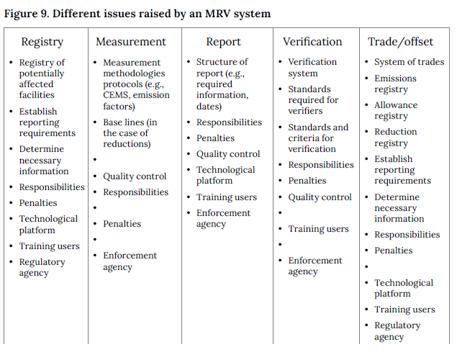
Carbon Tax Design Approaches in Practice
.

Slide 46
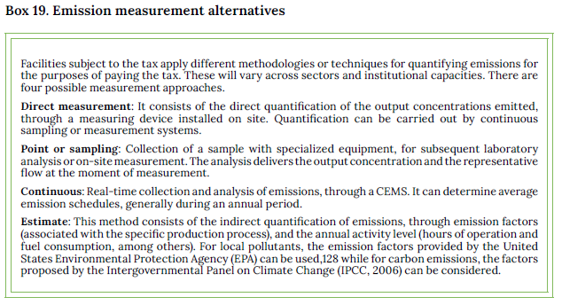
Carbon Tax Design Approaches in Practice
.

Slide 47
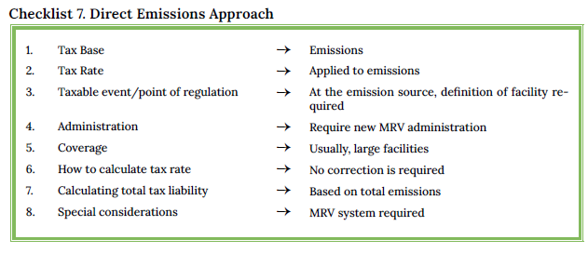
Carbon Tax Design Approaches in Practice
.

Slide 48
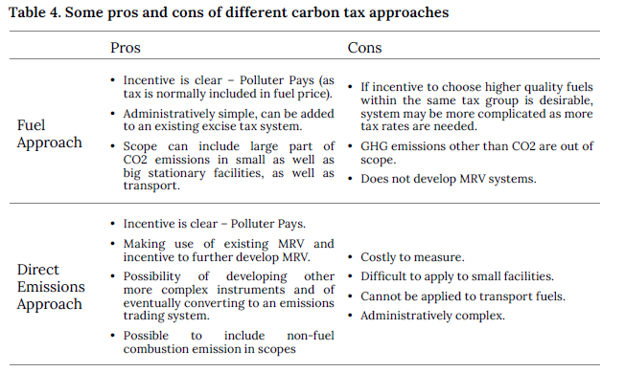
Carbon Tax Design Approaches in Practice
.

Slide 49
Further Reading
Carbon Pricing Leadership Coalition (CPLC) (2018). “How can consumption-based carbon pricing address carbon leakage and competitiveness concerns?." Executive Briefing: Climate Strategies. https://static1.squarespace.com/static/54ff9c5ce4b0a53decccfb4c/t/5ad8d232758d46c25386e589/1524159026153/27916-CPLC-ExecBrief-CarbonPricing-v7.pdf
European Commission. (2020). “Finland’s Fifth Progress Report under Article 22 of Directive 2009/28/EC.” https://ec.europa.eu/energy/sites/default/files/documents/fi_-_tr_into_eng_-_ 5th_progress_report_red_for_2017_and_2018.pdf
Pizarro, R., and Pinto, F. (2019). “Chile: green taxes, design and implementation.” In: Carbon Pricei n Latin America, Peruvian Society of Environmental Law, Peru, GIZ Publications. Trinidad, C. (ed). https://dialogopolitico.org/wp-content/uploads/dlm_uploads/2019/11/Precio_al_carbon_ en_AL.pdf
Republic of South Africa Minster of Finance (2018). “Carbon Tax Bill.” http://www.treasury.gov.za/comm_media/press/2018/2018112101%20Carbon%20Tax%20Bill%202018-B46-2018.pdf

Slide 50
Addressing Undesired Effects on Households and Firms
Introduction
The concerns over the undesired effects on firm competitiveness and carbon leakage, together with fear of unwanted distributional impacts, can constitute political obstacles for its implementation.
2. Possible adverse effects from carbon taxation
Carbon taxes may lead to price increases in goods and services, which can have negative impacts on households’ disposable income and firms’ competitiveness. Policymakers may want to avoid or mitigate these impacts. Addressing concerns over distributional effects, social equity, fairness, employment, and firm competitiveness, among others, is also important for achieving public acceptance.
2.1 Negative impacts on households
For example, the French nation-wide demonstrations organized by the “Gilets Jaunes” movement was sparked in late 2018 by, among other things, concerns over the effect of increasing carbon taxation on fuel prices and how this would affect households.
The most common way to measure distributional effects is to study the impact on different income groups.
Conventional wisdom regarding the distributional effects of taxation of energy sources has been that it is regressive, i.e., that these taxes increase the burden on low-income groups relatively more than those with higher income.

Slide 51
Addressing Undesired Effects on Households and Firms
However, more recent research suggests that taxes on energy can no longer be viewed as universally regressive; instead, the tax incidence (or the final distribution of the burden of taxation), depends on a variety of factors. These include, among others, the type of energy commodity being taxed, the social, physical, and climate characteristics of the jurisdiction, and how household income is measured.
2.2 Negative effects on firms
For firms, a carbon tax will increase the cost of carbon-intensive inputs. If the additional cost cannot be passed on to the consumers, the tax may affect competitiveness. The firm may also face increased costs from its own abatement measures. There is also the possibility that some firms may choose to avoid the tax by reducing production, since, in the short run, it is likely that mitigation options are limited by capital constraints, current technologies, and production processes.
In the long run, other types of mitigation efforts will be available, as firms have more time to raise capital, invest in Research and Development (R&D), and adopt new technologies.

Slide 52
Addressing Undesired Effects on Households and Firms
Firms that produce a homogeneous product for an international market are normally price-takers, and they will not be able to pass the additional costs from taxation on to customers. Under these circumstances, an increase in production costs risks reducing domestic firms’ market share.
2.3 Concerns over carbon leakage
It is closely related to the question of adverse competitive impacts. Carbon leakage occurs when the carbon pricing in one jurisdiction results in increased emissions in another. If this happens, in practice, the carbon pricing policy would just displace carbon emissions from one area to another.
As a carbon tax increases the cost of domestic production, foreign goods gain a competitive advantage, and, as a result, consumption may switch towards imported goods.
Carbon leakage can also occur as domestic firms choose to reduce production volumes in existing factories as a result of the tax, and that market share is taken over by foreign companies with higher carbon emissions.

Slide 53
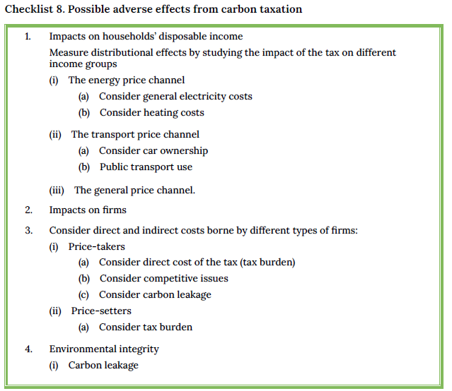
Addressing Undesired Effects on Households and Firms

Slide 54
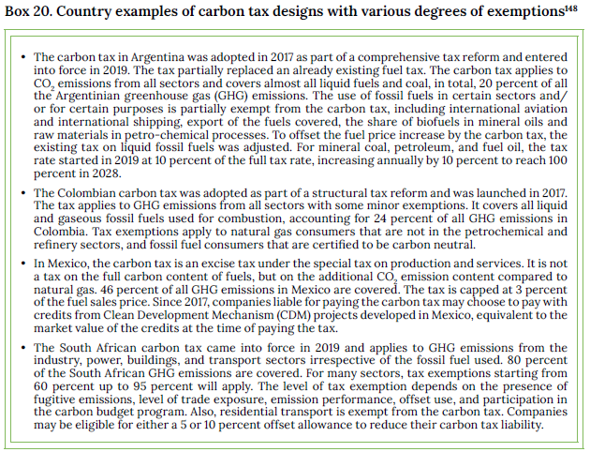
Addressing Undesired Effects on Households and Firms

Slide 55
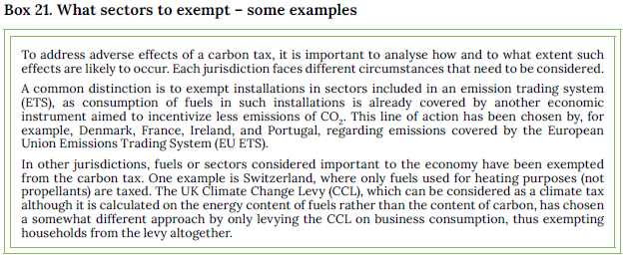
Addressing Undesired Effects on Households and Firms

Slide 56
Addressing Undesired Effects on Households and Firms

Slide 57
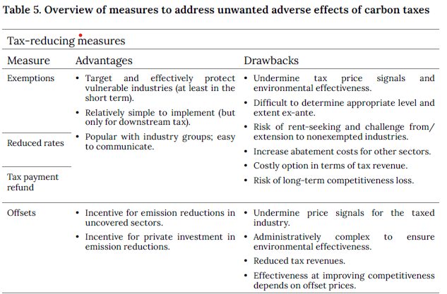
Addressing Undesired Effects on Households and Firms

Slide 58
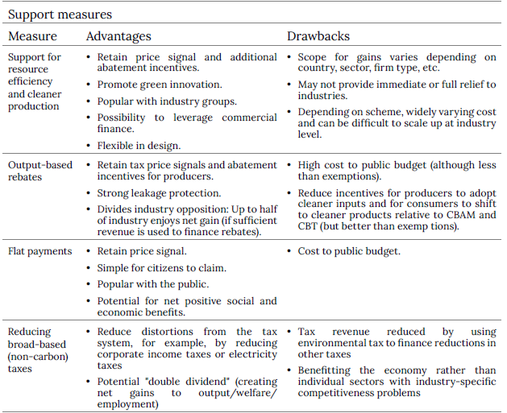
Addressing Undesired Effects on Households and Firms

Slide 59
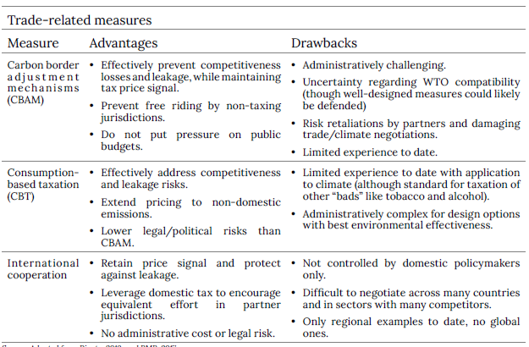
Addressing Undesired Effects on Households and Firms

Slide 60
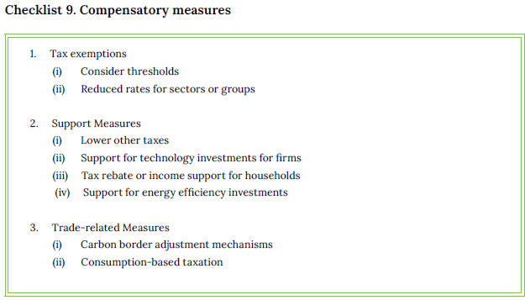
Addressing Undesired Effects on Households and Firms

Slide 61
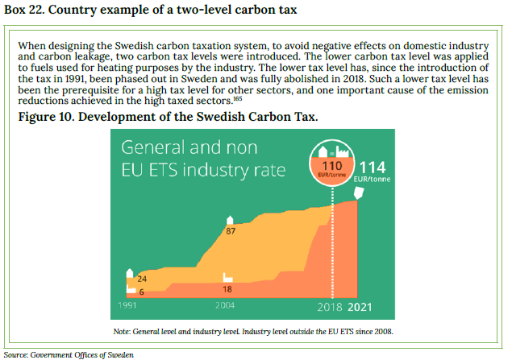
Addressing Undesired Effects on Households and Firms

Slide 62
Further reading
Carbon Pricing Leadership Coalition (CPLC). (2017). “Report of the High-Level Commission onCarbon Prices.” Washington, DC: World Bank. https://www.carbonpricingleadership.org/reportof-the-highlevel-commission-on-carbon-prices/
Cosbey, et al. (2019). “Developing Guidance for Implementing Border Carbon Adjustments: Lessons, Cautions, and Research Needs from the Literature.” Review of Environmental Economics and Policy, 13(1), 3–22. https://doi.org/10.1093/reep/rey020
European Commission. (2020). “EU Green Deal (carbon border adjustment mechanism).” https://ec.europa.eu/info/law/better-regulation/have-your-say/initiatives/12228-EU-Green-Dealcarbon-border-adjustment-mechanism-_en
European Commission. (2019). “COMMISSION STAFF WORKING DOCUMENT IMPACTASSESSMENT Accompanying the document Commission Delegated Decision Supplementing Directive 2003/87/EC of the European Parliament and of the Council concerning the determination of sectors and subsectors deemed at risk of carbon leakage for the period 2021to 2030.” Brussels: SWD(2019)22. https://ec.europa.eu/transparency/documents-register/detail?ref=SWD(2019)22&lang=en
World Bank. (2021). “World Bank Carbon Pricing Dashboard.” https://carbonpricingdashboard.worldbank.org/

