Slide 1
CCP-LAW
Curricula development on Climate Change Policy and Law
Subject title: Climate Change Policy
Instructor Name: Dr. Rahul Nikam
Project No of Reference: 618874-EPP-1-2020-1-VN-EPPKA2-CBHE-JP:
The European Commission's support for the production of this publication does not constitute an endorsement of the contents, which reflect the views only of the authors, and the Commission cannot be held responsible for any use which may be made of the information contained therein.

Slide 2
An Introduction to Policy Maker
Countries are facing dramatic impacts because of global warming.
Given the substantial costs associated with climate change, jurisdictions are increasingly adopting more ambitious and sophisticated policy instruments to support climate mitigation, especially market-based policy instruments such as carbon pricing.
Carbon pricing is more cost-efficient than other policy instruments and has co-benefits that can support additional development objectives, such as resource mobilization. Carbon taxation is a common carbon pricing instrument (CPI).

Slide 3
An Introduction to Policy Maker
2. The environmental problem: climate change and carbon emissions
The long-term stability of the climate depends on the Earth’s radiation balance.
Radiation comes from the Sun and is reflected by the Earth by emitting outgoing longwave radiation. Greenhouse gases act as insulators to longwave radiation coming from the surface.
This is known as the natural greenhouse effect and is the reason the Earth’s surface is warm enough to sustain life.
Carbon dioxide (CO2) is a naturally occurring greenhouse gas (GHG).
Through the carbon cycle, the Earth keeps a balance of CO2 in the atmosphere.
Besides natural processes, CO2 can also be produced by human activities, most notably the burning of fossil fuels. These emissions are called “anthropogenic”. Since the industrial revolution, human activities have caused a dramatic increase in carbon emissions in the atmosphere,6 which has disrupted the Earth’s natural balances.
Carbon emissions concentrate in the Earth’s atmosphere, exacerbating the natural greenhouse effect by trapping heat. This phenomenon, known as global warming, is causing the Earth to warm faster than normal.

Slide 4
An Introduction to Policy Maker
3. Carbon emissions: a global policy problem
Whenever fossil fuels are burnt, carbon emissions cannot be completely eliminated. Unlike other pollutants, CO2 cannot be effectively “filtered” before being emitted into the atmosphere – at least not with current technologies.
Currently, the only way to generate zero emissions is by using non-fossil fuel sources (for example, renewable energy sources such as wind, solar, geothermal, etc.) or reducing activities that are energy intensive such as cement, steel, and pulp production.
It is important to underscore that carbon emissions are a global problem, meaning that emissions in any part of the world contribute equally to warming the planet, and not just the location where they were generated. This is another characteristic that sets CO2 apart from other pollutants, and it poses challenges but also offers opportunities.
However, emissions can be “absorbed” by supporting natural processes, for example, by increasing forested lands. a forest outside the city absorbing emissions could theoretically balance (or “offset”) each other, resulting in net zero emissions.

Slide 5
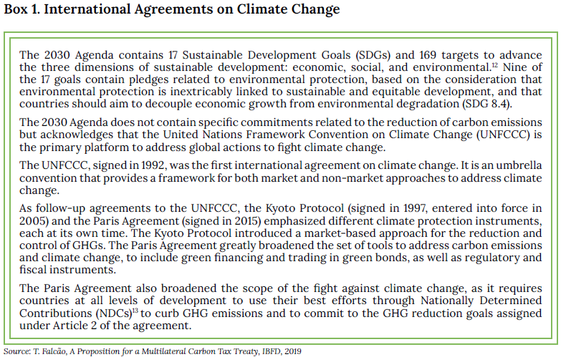
An Introduction to Policy Maker

Slide 6
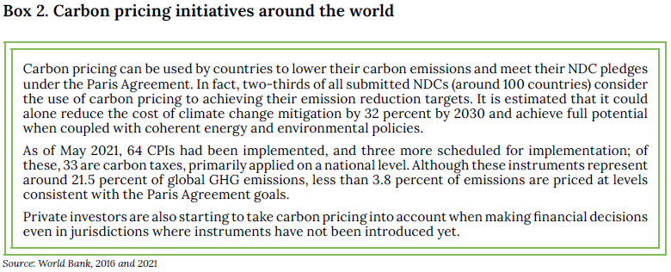
An Introduction to Policy Maker
4. Carbon pricing
4.1 Carbon emission reductions and Government policies
CPIs are policy instruments that use prices to provide incentives for economic agents to support climate mitigation. Today, they are considered fundamental to support environmental policy and climate mitigation, and their use has increased across the world. See Box 2.

Slide 7
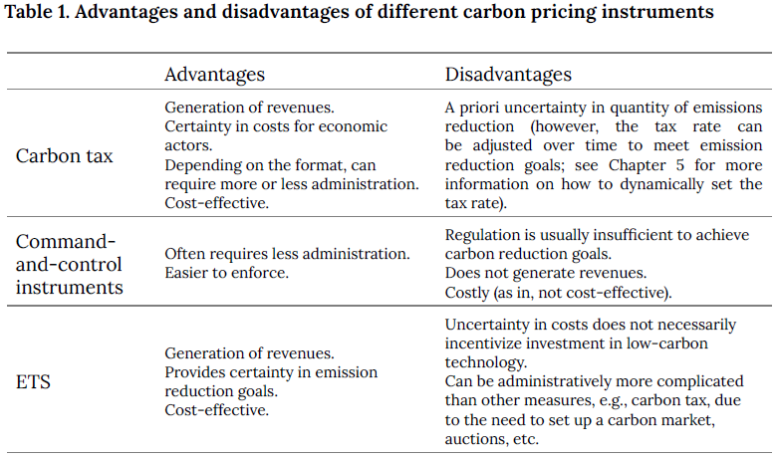
An Introduction to Policy Maker
4.2 Carbon pricing instruments

Slide 8
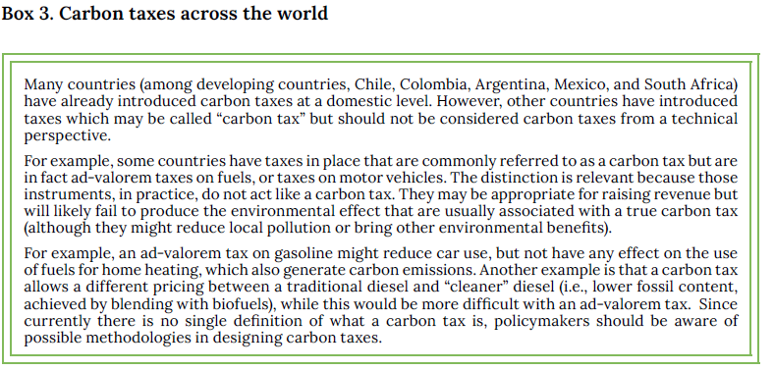
An Introduction to Policy Maker
5. A Carbon Tax
A carbon tax, as per OECD defined as a compulsory, unrequited payment to the general government, levied on carbon emissions or its proxy that can confer a reduction in corresponding carbon-based (equivalent) emissions in the atmosphere and is thus characterized as having both environmental purpose and effect.

Slide 9
An Introduction to Policy Maker
6. Motives for the introduction of a carbon tax
The primary purpose of a carbon tax is the reduction of carbon emissions (i.e., an environmental purpose). However, governments may also have additional or complementary goals while implementing these policies; for example, they may wish to also generate public revenues. Different policies provide different advantages and disadvantages. Depending on their priorities, governments may, therefore, prefer to implement one type over the other, or to combine elements of two or more policy objectives.
6.1 Fighting climate change by reducing carbon emissions (the “green” dividend)
6.2 Generation of budgetary sources
6.3 Promotion of investment in new technology

Slide 10
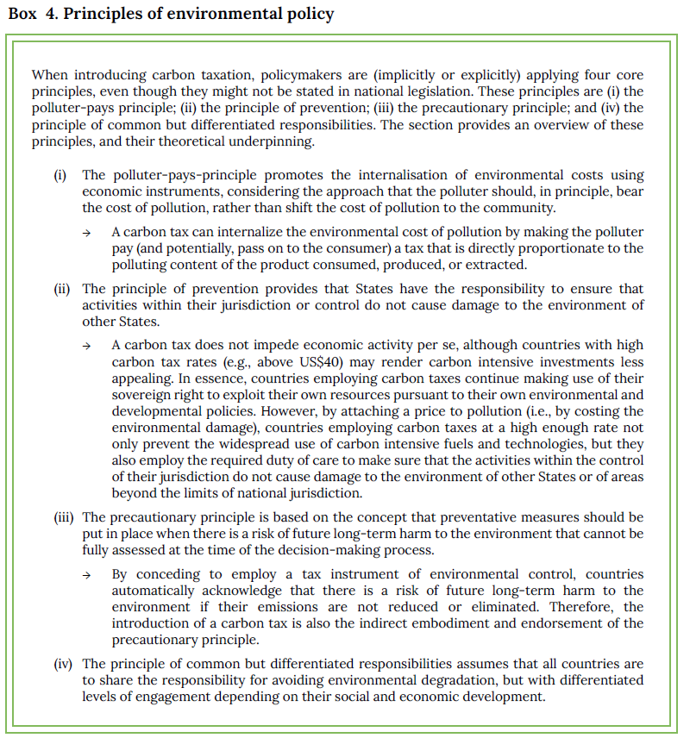
An Introduction to Policy Maker
7. Policy considerations in the introduction of a carbon tax

Slide 11
An Introduction to Policy Maker
7. Policy considerations in the introduction of a carbon tax
7.1 Certainty and predictability of the price of carbon
A carbon tax offers stable and predictable carbon prices. Economic agents are aware that they will have to pay a certain price when the triggering event occurs, i.e., when they emit above a certain level.
7.2 Administration of the carbon tax
a carbon tax is often simple and quick to implement, as well as easy to administer and collect at low costs, particularly when adopting the Fuel Approach. Generally, monitoring, reporting and verifying emissions is not simple, something that is normally required for carbon trading systems. However, carbon tax systems tend to work with a proxy (i.e., an assumed amount of carbon released when burning certain types of fossil fuels).

Slide 12
An Introduction to Policy Maker
7.3 Potential distributional implications and corrective measures
Introducing a carbon tax may have distributional effects that raise concerns, especially impacting low-income households and consumers. To mitigate these negative economic distributive effects, governments may need to consider other changes to the tax system to alleviate the tax burden of low-income citizens.
7.4 Safeguarding the competitiveness of domestic industries
In the absence of a global agreement, some countries or regions have unilaterally adopted a carbon price. A carbon price, whether in the form of a carbon tax or another instrument, forces domestic producers to partially internalize the cost of environmental damage, and therefore can raise their cost of production.
Dealing with competitive disadvantage and potential carbon leakage is important for the government to gain industry acceptance of climate policy, including carbon pricing. Moreover, some governments are
exploring carbon border adjustment mechanisms (CBAM) as a tool to deal with carbon leakage and competitiveness

Slide 13
Further reading
Further reading
2021 United Nations Handbook on Carbon Taxation for Developing Countries
https://desapublications.un.org/publications/united-nations-handbook-carbon-taxation-developing-countries

Slide 14
How to Generate Public Acceptability for Carbon Taxes
1. Introduction
A key element in implementing carbon taxes is their feasibility. Feasible policy measures are those that can be implemented and achieve their objectives efficiently. The discussion is about how the policy feasibility of carbon taxes can be increased by improving its acceptability, as well as the elements that policymakers might want to consider to increase successful policy implementation.
2. Designing a feasible carbon tax
The most relevant are the direct and indirect impacts on climate mitigation (i.e., effectiveness), implementation costs, enforcement capacity, and the side effects of implementation (i.e., cost-efficiency).
However, the effectiveness and efficiency of a carbon tax are also connected to acceptability, that is, the extent
to which the policy, once implemented, has the potential to be accepted by the public.
Only when these three components (i.e. effectiveness, cost-efficiency, and acceptability) coincide can the policy measure be considered as feasible.

Slide 15
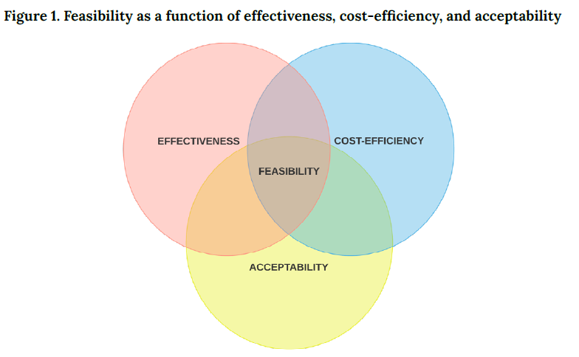
How to Generate Public Acceptability for Carbon Taxes

Slide 16
How to Generate Public Acceptability for Carbon Taxes
2.1 The importance of acceptability
It has only been implemented in a small number of jurisdictions around the world.
This can be attributed to contextual factors such as the system of government and policymaking, path dependence, economic conditions and development, quality of government, and political culture. However, research also points towards the highly politicized nature of climate policies and carbon taxes, making them sensitive to public opinion for their successful implementation.
Specifically, the limited prevalence of carbon taxes around the world reflects a lack of public acceptability, therefore making them unfeasible.
The public’s attitudes towards the tax are also important once the policy has been implemented. Sustaining public acceptance (i.e., attitudes formed once the policy is in place) over time may be crucial for effective implementation.

Slide 17
How to Generate Public Acceptability for Carbon Taxes
3. Explaining attitudes towards carbon taxes
There are reasons to believe that they constitute important drivers for carbon tax acceptability.
A major strand of research focuses on individual-level factors. A person’s core values, beliefs (e.g., about the seriousness of climate change and general risk perceptions), and personal norms (i.e., a feeling of moral obligation to act in a specific way) are relevant to their attitudes toward carbon taxation.
Inter-relational factors also determine policy attitudes. Most notably, trust in people’s voluntary compliance with policy initiatives (i.e., interpersonal trust) and in the political-administrative system responsible for implementing and enforcing policies (i.e., institutional trust) affect policy acceptability

Slide 18
How to Generate Public Acceptability for Carbon Taxes
Four interrelated policy-specific beliefs have been suggested to affect policy attitudes:
(i) Perceived distributional effects - the extent to which the consequences of a carbon tax are perceived as being fair;
(ii) Perceived impact on freedom of choice - whether implementing a carbon tax requires a change in behavior and whether behavioral substitutes are readily available;
(iii) Perceptions of policy effectiveness - the extent to which the proposed carbon tax is expected to achieve its aims, and;
(iv) Personal outcome expectancy - the perceptions of how oneself will be positively or negatively affected by implementing a carbon tax.

Slide 19
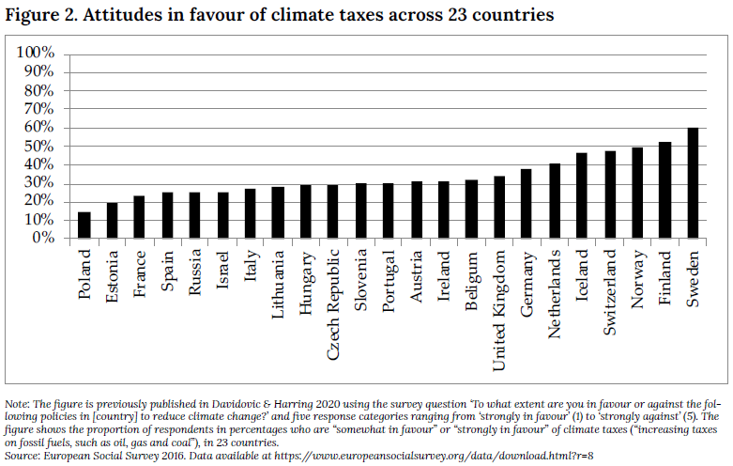
How to Generate Public Acceptability for Carbon Taxes

Slide 20
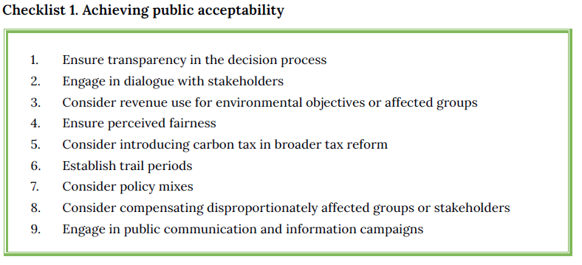
How to Generate Public Acceptability for Carbon Taxes
4. How to generate public acceptability

Slide 21
How to Generate Public Acceptability for Carbon Taxes
4.1 The role of political and institutional trust
4.2 Focus on the revenues
4.3 The importance of perceived fairness
4.4 Searching for windows of opportunity
4.5 Consider trial periods
4.6 Examples of potential policy mixes/packages
(Un)fairness in outcome
Freedom
Effectiveness
Personal outcome expectancy
4.7 Measuring acceptability in due time

Slide 22
Further Reading
Davidovic, D., and Harring, N. (2019). “Does Quality of Government and Trust Explain the Cross-National Variation in Public Support for Climate Policies?.” CeCAR Working Paper Series No. 2. http://dx.doi.org/10.2139/ssrn.3706867
Davidovic, D., and Harring, N. (2020). “Exploring the cross-national variation in public support for climate policies in Europe: The role of quality of government and trust.” Energy Research & Social Science, 70. https://doi.org/10.1016/j.erss.2020.101785
Harring, N., Jagers, S.C., and Matti, S. (2019). “The significance of political culture, economic context and instrument type for climate policy support: a cross-national study.” Climate Policy, 19(5), 636–650. https://doi.org/10.1080/14693062.2018.1547181
Jagers, S., Matti, S., and Nilsson, A. (2017). “How exposure to policy tools transforms the mechanisms behind public acceptability and acceptance—The case of the Gothenburg congestion tax.” International Journal of Sustainable Transportation, 11(2), 109–119. https://doi.org/10.1080/1 5568318.2016.1197348
Klenert, D., et al. (2018). “Making carbon pricing work for citizens.” Nature Climate Change, 8, 669–677. https://doi.org/10.1038/s41558-018-0201-2
Maestre-Andrés, S., Drews, S., and van den Bergh, J. (2019). “Perceived fairness and public acceptability of carbon pricing: a review of the literature,” Climate Policy. https://doi.org/10.1080/14693062.2019.1639490

