Slide 1
CCP-LAW
Curricula development on Climate Change Policy and Law
Subject title: CLIMATE CHANGE DISPUTE RESOLUTION
Instructor Name: Tran Anh Tuan
Project No of Reference: 618874-EPP-1-2020-1-VN-EPPKA2-CBHE-JP:
The European Commission's support for the production of this publication does not constitute an endorsement of the contents, which reflect the views only of the authors, and the Commission cannot be held responsible for any use which may be made of the information contained therein.

Slide 2
4.1. Features of Online Dispute Resolution
4. Online Dispute Resolution (ODR)
Group work on the sub-topic 4.1

Slide 3
4.2. Types of Online Dispute Resolution
4. Online Dispute Resolution (ODR)
Some of the main types of ODR:
Automated Negotiation: This involves the use of software and algorithms to facilitate negotiation and settlement between parties without third party intervention. The software can help parties calculate settlement options.
Online Mediation: A neutral third-party mediator facilitates negotiations between parties remotely through videoconferencing, chat, or messaging. The mediator helps parties communicate and find common ground.

Slide 4
4.2. Types of Online Dispute Resolution
4. Online Dispute Resolution (ODR)
Some of the main types of ODR:
Online Arbitration: Parties present their case before an arbitrator online who then makes a final and binding decision to resolve the dispute. It is typically faster and less expensive than traditional arbitration.
Online Judging: A qualified neutral third-party with judicial training makes a decision on the dispute after reviewing arguments and evidence submitted by the parties online. The judge's decision is legally binding.

Slide 5
4.2. Types of Online Dispute Resolution
4. Online Dispute Resolution (ODR)
Some of the main types of ODR:
Peer Review Panels: A dispute is presented online to a panel of peers, experts, or stakeholders selected by the parties, who review the information and make a determination. The panel could be voting-based.
Crowdsourced Dispute Resolution: The dispute is opened up to a larger crowd-based online community to gather opinions and input, which the parties then use to reach a resolution.

Slide 6
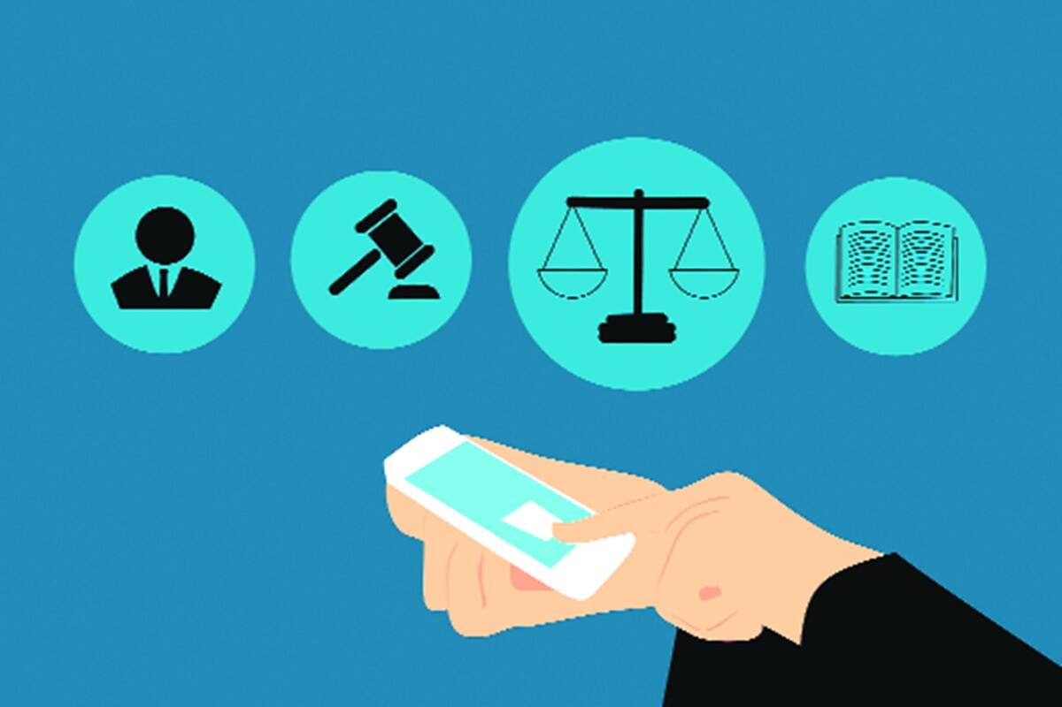
4.2. Types of Online Dispute Resolution
4. Online Dispute Resolution (ODR)
Some of the main types of ODR:
Consensus-Based Approaches: Including collaborative problem-solving, facilitated communication, and group decision-making
Hybrid Models: Combining elements of multiple ODR techniques, such as automated negotiation followed by human intervention

Slide 7
4.3. Infrastructure of Online Dispute Resolution
4. Online Dispute Resolution (ODR)
Some of the main types of ODR:
Legal framework: Relevant laws and regulations must permit ODR use for the jurisdiction, types of disputes, enforcement of resolution, limitations etc.
Internet connectivity and access: For effective Online Dispute Resolution (ODR), participants must have dependable high-speed internet for digital interactions and sharing files.

Slide 8
4.3. Infrastructure of Online Dispute Resolution
4. Online Dispute Resolution (ODR)
Some of the main types of ODR:
ODR platform software: A dedicated ODR platform is needed to host the end-to-end dispute resolution process online. This includes case management, scheduling, document sharing, video and messaging capabilities, mobile access etc.
Artificial intelligence: AI could be used to automate certain parts of the process like drafting agreements, predicting outcomes, reviewing documents, etc. This improves efficiency and consistency.

Slide 9
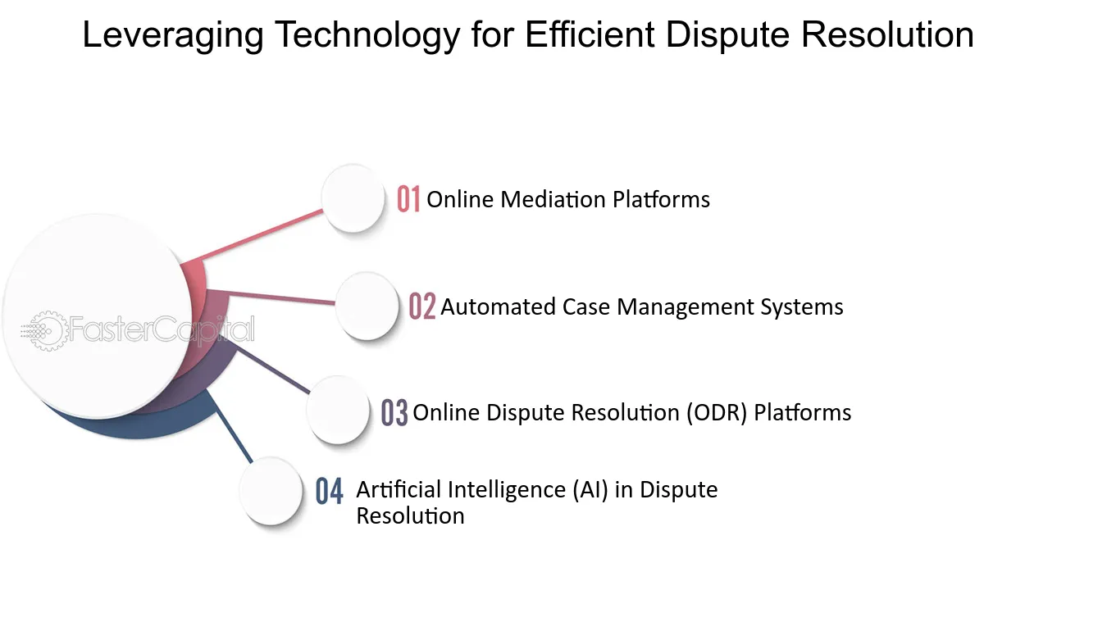
4.3. Infrastructure of Online Dispute Resolution
4. Online Dispute Resolution (ODR)
Some of the main types of ODR:
Digital signatures - Legally valid digital signatures are essential for signing binding agreements and approvals reached online. Compatible software and legal framework must support this.
Payment systems - Integrated electronic payment systems enable online payment transfers as required as part of the dispute resolution. This could include settlements, arbitration fees, etc.

Slide 10
4.3. Infrastructure of Online Dispute Resolution
4. Online Dispute Resolution (ODR)
Some of the main types of ODR:
Data security and privacy: The ODR platform and associated data storage must be secure with encryption, cybersecurity protections, access controls and privacy safeguards.
Training and support: Users of the system need training on how to use the ODR platform effectively. Technical support must be available in case users face any issues.

Slide 11
4.4. Applications of ODR for resolving climate change disputes
4. Online Dispute Resolution (ODR)
Research aspects of the sub-topic 4.4 and share notes via Zalo Group or Google Doc

Slide 12
4.5. Advantages and chalenges
4. Online Dispute Resolution (ODR)
Some key advantages and challenges of using ODR:
Advantages:
Cost-effectiveness: ODR eliminates travel and venue costs, making it cheaper than traditional in-person methods.
Accessibility: ODR platforms are accessible 24/7, allowing for dispute resolution at any time and from anywhere with internet access.
Flexibility: ODR processes often offer asynchronous communication, allowing parties to participate at their own pace and convenience.

Slide 13
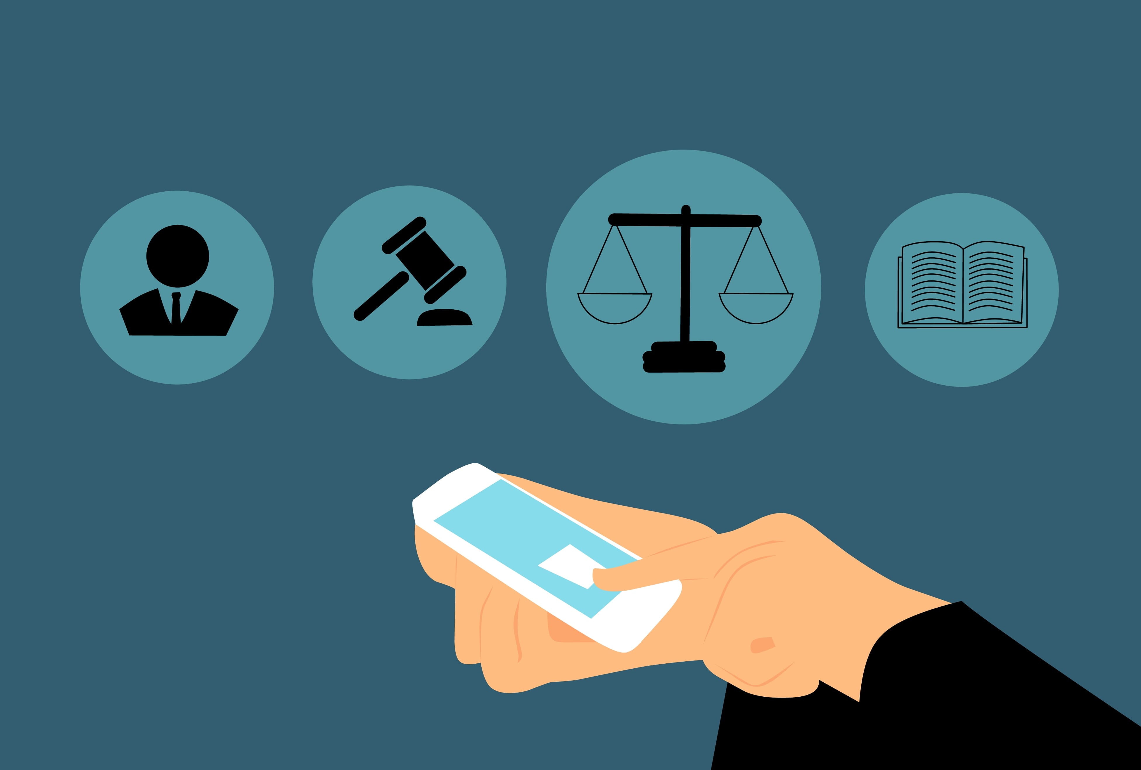
4.5. Advantages and chalenges
4. Online Dispute Resolution (ODR)
Some key advantages and challenges of using ODR:
Advantages:
Efficiency: Streamlined processes and automated features can expedite dispute resolution compared to traditional methods.
Confidentiality: Online platforms can offer greater privacy and confidentiality than public court proceedings.
Informal and less intimidating: ODR can create a less stressful and confrontational environment for parties compared to court.

Slide 14
4.5. Advantages and chalenges
4. Online Dispute Resolution (ODR)
Some key advantages and challenges of using ODR:
Advantages:
Speed: ODR systems can facilitate faster resolutions than traditional court litigation or in-person mediation. Automation like document filing speeds the process.
Data preservation: Online platforms provide a digital record of the entire process, facilitating future reference and transparency.
Wider reach: ODR can connect parties across geographical boundaries, making it suitable for international disputes.

Slide 15
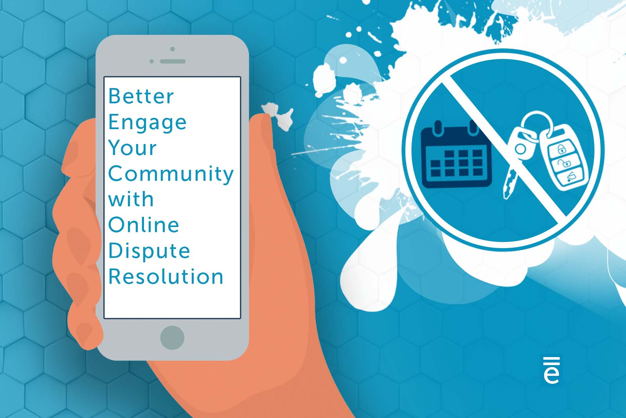
4.5. Advantages and chalenges
4. Online Dispute Resolution (ODR)
Some key advantages and challenges of using ODR:
Challenges:
Technical barriers: Unequal access to technology and digital literacy can exclude certain parties from participating.
Lack of human interaction: The absence of face-to-face interaction can hinder building trust and rapport between parties.
Limited scope: ODR may not be suitable for complex legal disputes requiring extensive evidence presentation or nuanced judgment.

Slide 16
4.5. Advantages and chalenges
4. Online Dispute Resolution (ODR)
Some key advantages and challenges of using ODR:
Challenges:
Enforcement of agreements: ODR agreements may lack the same enforceability as court judgments, requiring alternative mechanisms.
Security and privacy concerns: Data security breaches and privacy violations can be risks associated with online platforms.
Potential for bias: Algorithms used in ODR platforms could introduce biases that disadvantage certain parties.

Slide 17
4.5. Advantages and chalenges
4. Online Dispute Resolution (ODR)
Some key advantages and challenges of using ODR:
Challenges:
Limited legal expertise: ODR platforms typically don't offer legal representation, which may disadvantage some users.
Cultural differences: Cultural norms and expectations around communication and dispute resolution can pose challenges in online settings.
Unequal power: Potential for stronger parties to dominate weaker parties remains without facilitator oversight.

Slide 18
4.5. Advantages and challenges
4. Online Dispute Resolution (ODR)
Key takeaways
ODR offers several advantages over traditional dispute resolution methods, particularly in terms of cost, accessibility, and flexibility.
ODR offers a valuable alternative for resolving disputes online, but its suitability depends on the specific context and challenges.

Slide 19
4.5. Advantages and challenges
4. Online Dispute Resolution (ODR)
Key takeaways
It's crucial to consider its limitations and ensure its implementation is fair, transparent, and inclusive.
ODR should be seen as a complementary tool alongside other approaches, not a replacement for traditional dispute resolution in complex cases.

