Slide 1
CCP-LAW
Curricula development on Climate Change Policy and Law
Subject title: CLIMATE CHANGE DISPUTE RESOLUTION
Instructor Name: Tran Anh Tuan
Project No of Reference: 618874-EPP-1-2020-1-VN-EPPKA2-CBHE-JP:
The European Commission's support for the production of this publication does not constitute an endorsement of the contents, which reflect the views only of the authors, and the Commission cannot be held responsible for any use which may be made of the information contained therein.

Slide 2
8.1. The Paris Agreement (2015)
Module 8. Case studies in climate change dispute resolution
The Paris Agreement (2015)
1) Background: This Agreement is a landmark international treaty within the UNFCCC. It was adopted in 2015 after years of intense negotiations.
2) Goal: The Agreement's central goals include:
Limiting global temperature increase to below 2ºC (and preferably to 1.5ºC) compared to pre-industrial levels.
Strengthening adaptation to climate change impacts and making financial flows consistent with low-emission pathways.

Slide 3
8.1. The Paris Agreement (2015)
Module 8. Case studies in climate change dispute resolution
The Paris Agreement (2015)
3) Mechanisms:
Nationally Determined Contributions (NDCs): Each country submits its own climate action plan and commitments, called NDCs. These are reviewed every five years to encourage more ambitious goals.
Transparency Framework: Countries must regularly report their emissions and climate actions using a robust system for tracking progress.

Slide 4
8.1. The Paris Agreement (2015)
Module 8. Case studies in climate change dispute resolution
The Paris Agreement (2015)
3) Mechanisms:
Global Stocktake: Every five years, there is a formal assessment of collective progress towards achieving the Agreement's terms. This informs countries if they need to strengthen their individual commitments.
Finance: Developed countries committed to providing financial support to developing nations to help them address climate change, with a target of mobilizing $100 billion annually.

Slide 5
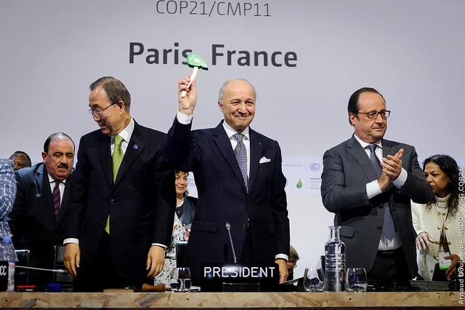
8.1. The Paris Agreement (2015)
Module 8. Case studies in climate change dispute resolution
The Paris Agreement (2015)
4) Dispute Resolution Elements:
Negotiation Process: The Agreement was the culmination of years of negotiations within the UNFCCC. These negotiations involved overcoming differences between developed and developing countries on their responsibilities and contributions.
Non-binding but Encouraging: NDCs are not legally binding, but the global stocktake and transparency framework create peer pressure and accountability mechanisms to encourage continuous ambition.

Slide 6
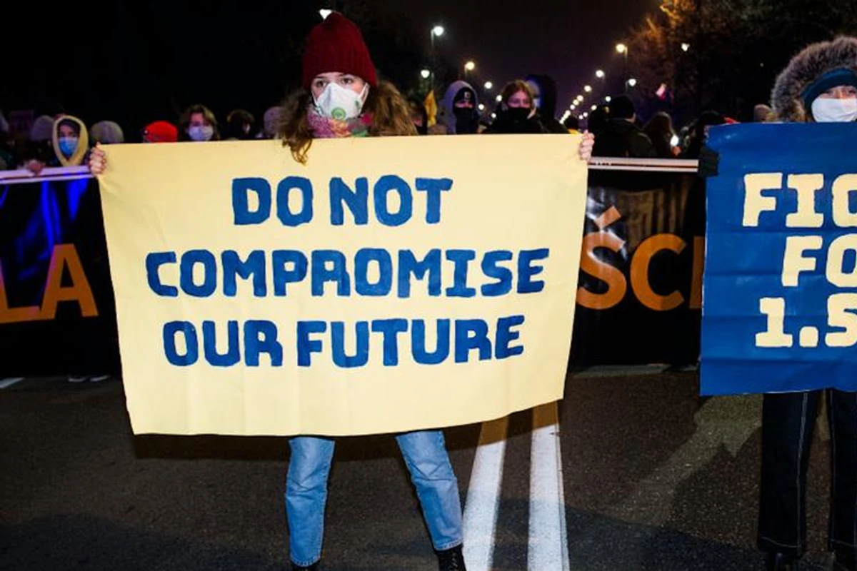
8.1. The Paris Agreement (2015)
Module 8. Case studies in climate change dispute resolution
The Paris Agreement (2015)
4) Dispute Resolution Elements:
Compromise: The Agreement reflects a balance of interests, including:
Differentiation between developed and developing countries
Flexibility for nations to determine their own contributions.
Ambition to ratchet up commitments over time to achieve the global goal.

Slide 7
8.1. The Paris Agreement (2015)
Module 8. Case studies in climate change dispute resolution
The Paris Agreement (2015)
Successes and Challenges:
Successes:
Near-universal ratification, showcasing widespread political will.
Creation of a shared framework for global action to address climate change

Slide 8
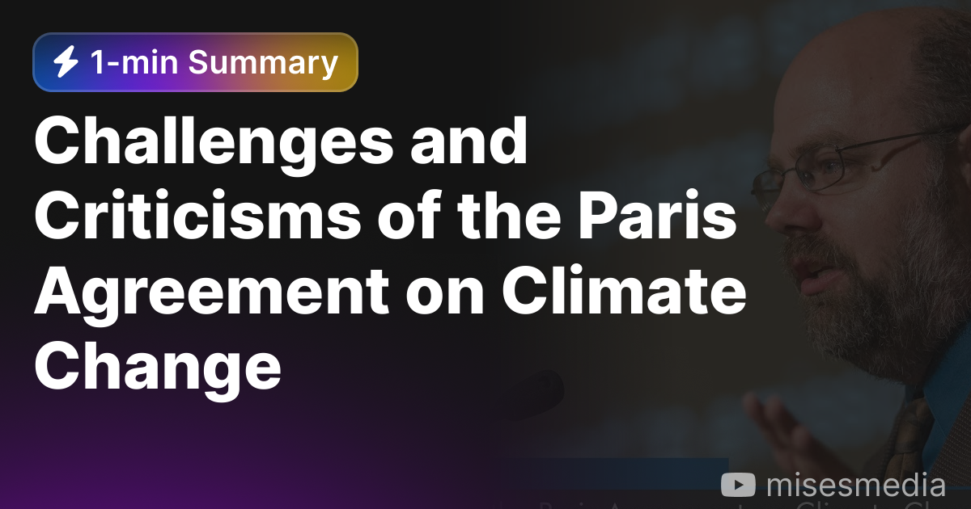
8.1. The Paris Agreement (2015)
Module 8. Case studies in climate change dispute resolution
The Paris Agreement (2015)
Successes and Challenges:
Challenges:
Existing NDCs are insufficient to meet the Agreement's temperature goals.
Delivery on climate finance pledges from developed countries has been slow.
Increasing geopolitical tensions make cooperation challenging in subsequent discussions.

Slide 9
8.1. The Paris Agreement (2015)
Module 8. Case studies in climate change dispute resolution
The Paris Agreement (2015)
Key Takeaways
The Paris Agreement highlights the importance of complex, multilateral negotiations for addressing global issues like climate change.
It demonstrates the delicate balance between achieving a universal agreement and preserving enough ambition to drive urgent action.
While not a perfect solution, it provides a foundation and process for ongoing improvement.

Slide 10
8.2. Nation-state accountability
Module 8. Case studies in climate change dispute resolution
Definition:
Nation-state accountability refers to the principle that countries bear responsibility for the environmental harm they cause, including the greenhouse gas emissions that contribute to climate change.
Types of Responsibility:
Responsibility for Transboundary Harm: Climate change impacts don't respect borders. A crucial question is whether countries are responsible for the damage caused to other nations by their emissions.

Slide 11
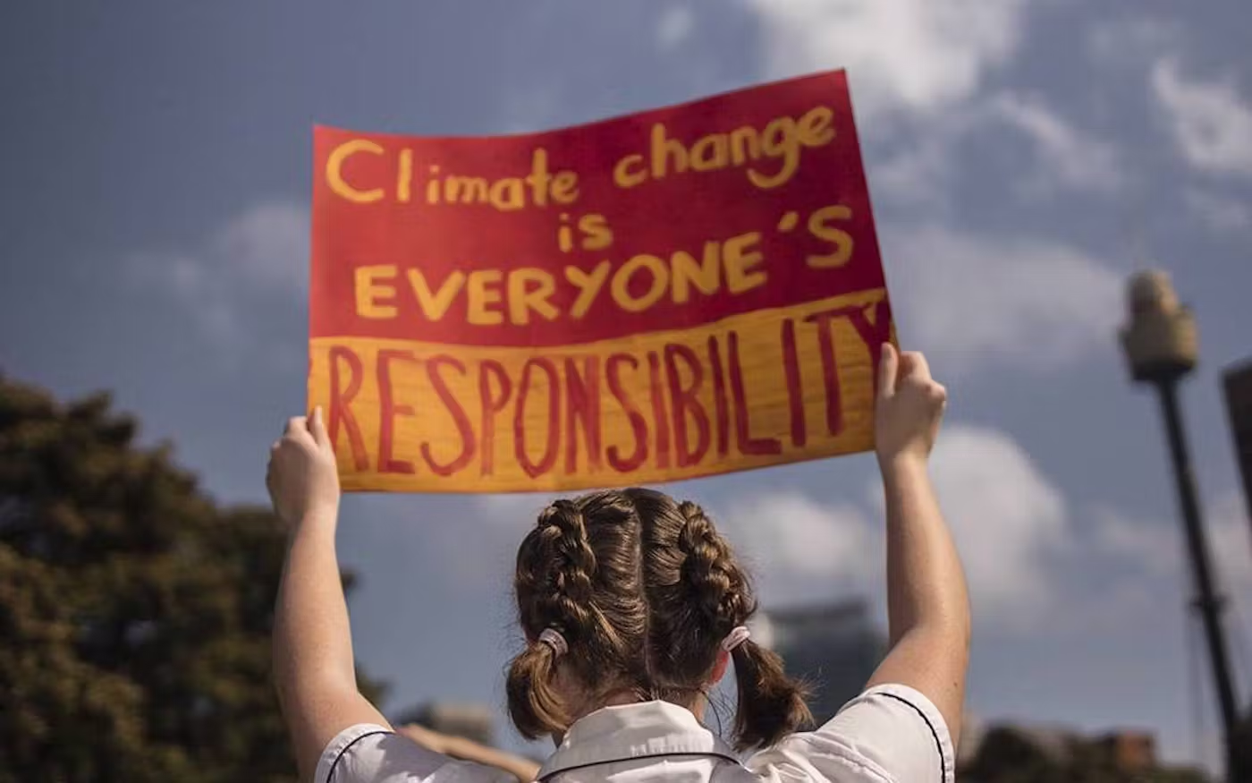
8.2. Nation-state accountability
Module 8. Case studies in climate change dispute resolution
Types of Responsibility:
Historical Responsibility: Developed nations have contributed the majority of historical GHG emissions leading to the current climate crisis. Developing countries argue this creates a moral obligation to take greater action now and provide support for adaptation.
Current Responsibility: Current high emitters face a responsibility to reduce their emissions based on their ongoing contribution to the problem.

Slide 12
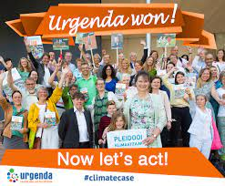
8.2. Nation-state accountability
Module 8. Case studies in climate change dispute resolution
Case Study: The Urgenda Foundation v. The Netherlands (2019)
Background:
The Netherlands, despite being a relatively small country, ranks as one of the world's highest per capita GHG emitters due to its reliance on fossil fuels and intensive agriculture.
This case, brought to court by the Urgenda Foundation, a Dutch environmental non-profit organization, challenged the government's lack of ambition in tackling climate change.

Slide 13
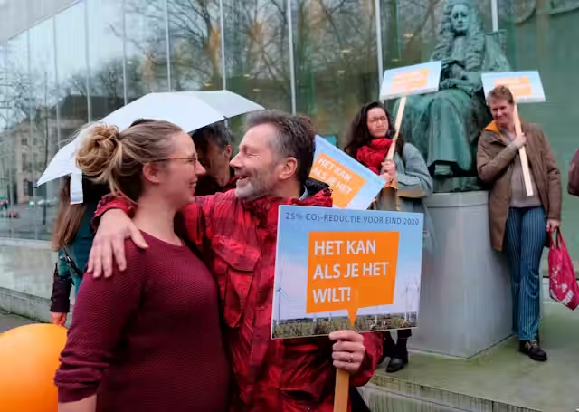
8.2. Nation-state accountability
Module 8. Case studies in climate change dispute resolution
Case Study: The Urgenda Foundation v. The Netherlands (2019)
Claim:
The Urgenda Foundation argued that the Dutch government had a legal duty of care to protect its citizens from the harmful effects of climate change. They claimed that the government's insufficient National Action Plan, aiming for a 25% reduction in emissions by 2020 compared to 1990, was inadequate to meet the urgency of the climate crisis.

Slide 14
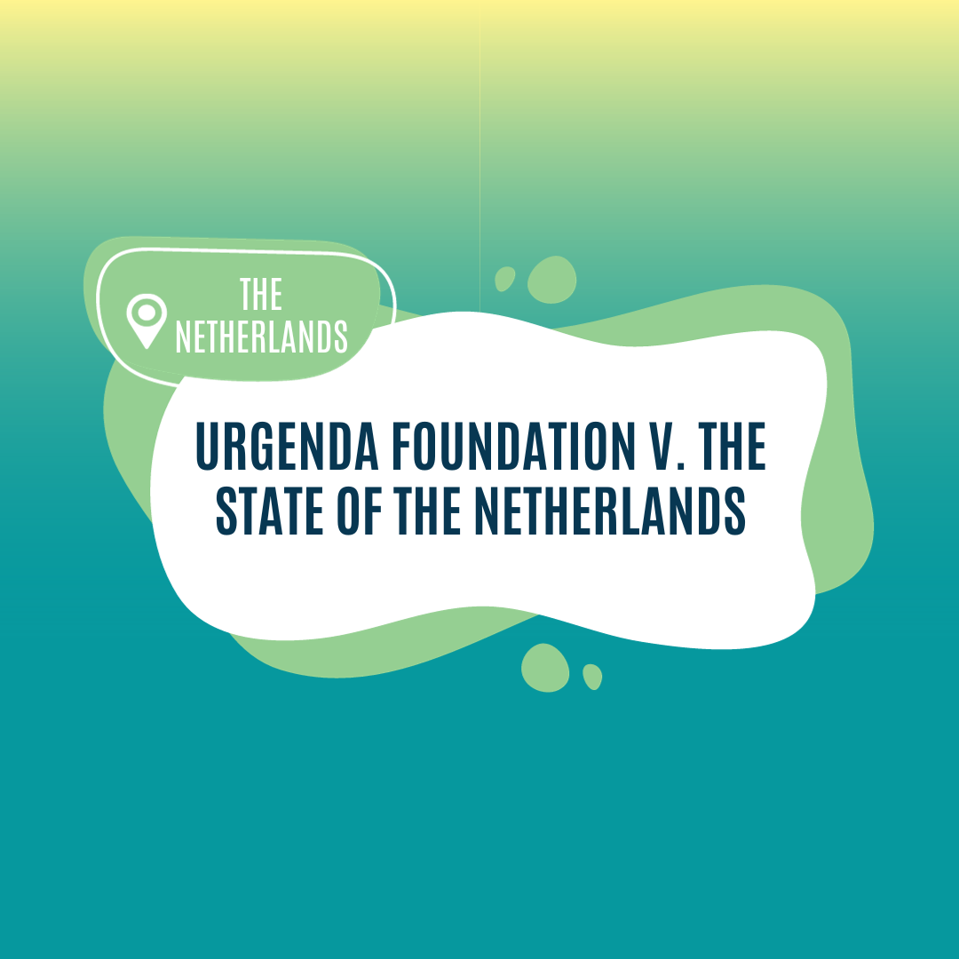
8.2. Nation-state accountability
Module 8. Case studies in climate change dispute resolution
Legal Basis:
The Urgenda Foundation based their case on two legal arguments:
Duty of Care: The Dutch government has a legal duty to protect its citizens from foreseeable harm, including the significant risks posed by climate change. This duty exists under Dutch tort law and the European Convention on Human Rights.
Unwritten Standard of Care: Even in the absence of specific legislation, government action must meet an unwritten standard of care that is reasonable and proportionate to the risks involved.

Slide 15
8.2. Nation-state accountability
Module 8. Case studies in climate change dispute resolution
Case Study: The Urgenda Foundation v. The Netherlands (2019)
Court Decision:
In a landmark ruling in 2019, the District Court of The Hague sided with the Urgenda Foundation.
The court found that the Dutch government had a legal duty of care to its citizens and that its current climate action plan was insufficient to meet the required standard of care.
The court ordered the government to reduce greenhouse gas emissions by at least 25% compared to 1990 levels by the end of 2020.

Slide 16
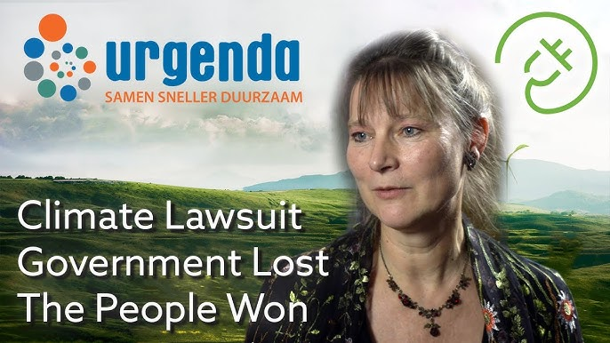
8.2. Nation-state accountability
Module 8. Case studies in climate change dispute resolution
Case Study: The Urgenda Foundation v. The Netherlands (2019)
Significance:
The Urgenda decision is considered a landmark case in climate change litigation.
It demonstrates the potential for domestic courts to hold governments accountable for inadequate climate action based on existing legal principles.
The ruling has had a ripple effect, inspiring similar legal challenges around the world and pushing governments to reassess their climate targets.

Slide 17
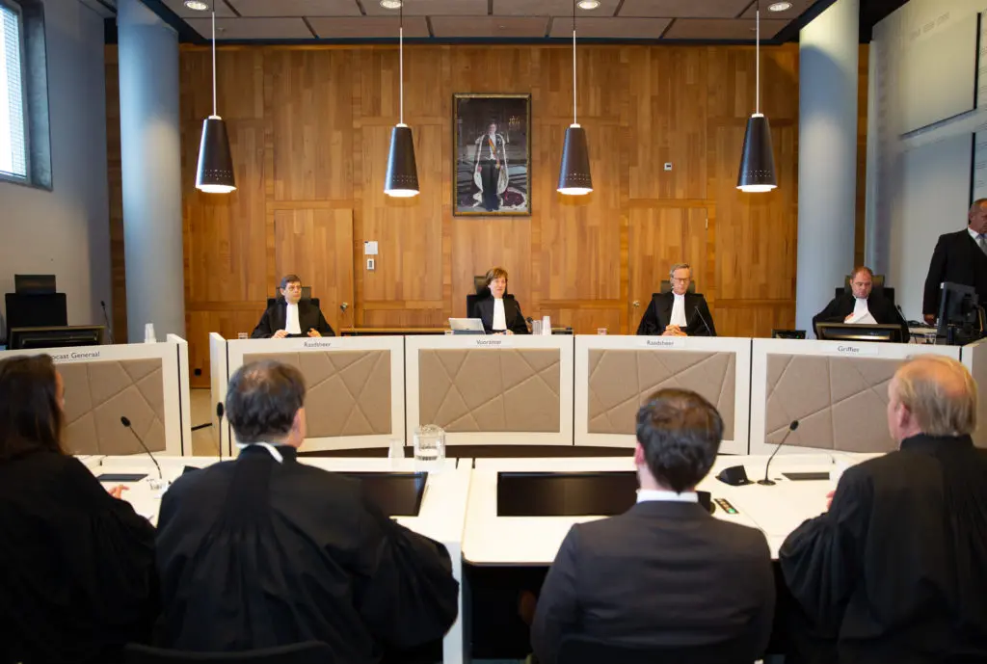
8.2. Nation-state accountability
Module 8. Case studies in climate change dispute resolution
Challenges and Limitations:
Legal Uncertainty: The boundaries of the "duty of care" principle remain somewhat uncertain, and future rulings may not be consistent.
Limited Scope: The Urgenda case only applies to the specific context of the Netherlands and its legal framework. It doesn't set a universal legal precedent for other countries.
Enforcement: While the court ordered specific action, enforcing it might be complex and time-consuming.

Slide 18
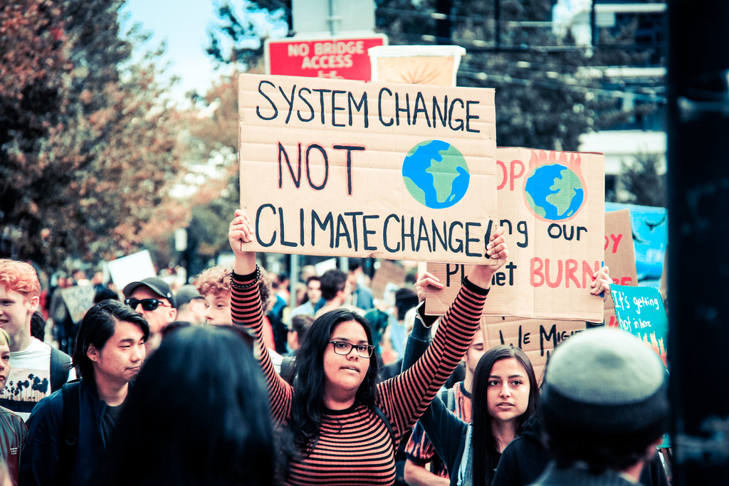
8.2. Nation-state accountability
Module 8. Case studies in climate change dispute resolution
Key Takeaways:
The Urgenda case demonstrates the evolving legal landscape regarding nation-state accountability for climate change.
While the case has limitations, it serves as a powerful example of how individuals and organizations can use existing legal frameworks to hold governments accountable for their actions and advocate for more ambitious climate action.
The case also highlights the ongoing debate and challenges surrounding nation-state accountability in the fight against climate change.

Slide 19
8.3. Municipal and local action
Module 8. Case studies in climate change dispute resolution
Case Study: The City of Vancouver, Canada - Greenest City Action Plan
Background
Challenge: Cities around the world are significant contributors to greenhouse gas emissions but are also on the frontlines of climate change impacts. They face the dual challenge of reducing their own carbon footprint and adapting to the changes already underway.

Slide 20
8.3. Municipal and local action
Module 8. Case studies in climate change dispute resolution
Case Study: The City of Vancouver, Canada - Greenest City Action Plan
Background
Vancouver's Approach: Vancouver, a coastal city in British Columbia, has been recognized as a leader in municipal climate action. Its Greenest City Action Plan (GCAP), launched in 2010, sets ambitious targets across energy use, transportation, waste reduction, ecosystem health, and more.

Slide 21
8.3. Municipal and local action
Module 8. Case studies in climate change dispute resolution
Key Elements of the Plan
The GCAP sets out ten long-term goals, with specific targets and deadlines, accompanied by detailed action plans for implementation:
Example Goals:
Zero emissions from new buildings by 2030
All trips in the city by foot, bike, or transit by 2040
Zero waste going to landfills or incinerators

Slide 22
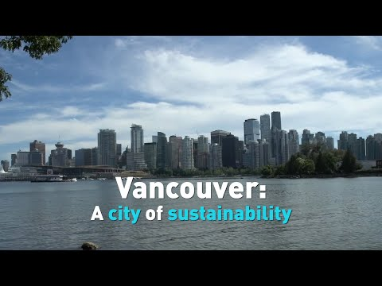
8.3. Municipal and local action
Module 8. Case studies in climate change dispute resolution
Key Elements of the Plan
Implementation: The GCAP relies on a mix of strategies:
Regulation (e.g., building codes, zoning bylaws)
Incentives (e.g., subsidies for electric vehicles, grants for green renovations)
Infrastructure investment (e.g., expanded bike lanes, electric bus fleet)
Public awareness and engagement campaigns

Slide 23
8.3. Municipal and local action
Module 8. Case studies in climate change dispute resolution
Dispute Resolution Mechanisms
Implementing ambitious climate plans at the local level inevitably leads to disputes and requires mechanisms for resolution:
Public consultations: Extensive engagement with residents and businesses was integral to developing the GCAP and continues on specific initiatives, ensuring diverse voices are heard.
Tradeoffs and Negotiation: Not all actions are universally popular. For example, expanding bike lanes might lead to conflicts with parking needs. City leadership must mediate these interests.

Slide 24
8.3. Municipal and local action
Module 8. Case studies in climate change dispute resolution
Dispute Resolution Mechanisms
Technical Committees: For certain areas, such as energy efficiency in buildings, technical committees involving experts and stakeholders work together to develop detailed technical solutions that meet standards and are widely supported.
Legal Challenges: Cities don't have full authority over all relevant areas. Regulations may sometimes be challenged by higher levels of government or industry, leading to court battles.

Slide 25
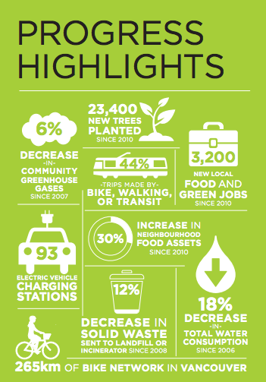
8.3. Municipal and local action
Module 8. Case studies in climate change dispute resolution
Outcomes and Successes
Reduced Emissions: Progress has been made towards emission reduction targets, though some goals remain challenging.
Leadership and Innovation: Vancouver has become a model for other cities, demonstrating innovative solutions in urban transportation, green buildings, and waste management.
Public Buy-in: While there's always room for improvement, widespread public support has been crucial for the plan's success.

Slide 26
8.3. Municipal and local action
Module 8. Case studies in climate change dispute resolution
Challenges and Limitations
Cost: Implementing ambitious climate plans can be expensive, putting pressure on municipal budgets.
Jurisdictional Limits: Cities can't control everything (e.g., fossil fuel supply is regulated by higher levels of government). This limits ultimate impact.
Maintaining Momentum: Sustaining long-term action and ensuring accountability, particularly through shifts in political leadership, is vital.

Slide 27
8.3. Municipal and local action
Module 8. Case studies in climate change dispute resolution
Key Takeaways
Cities are Important Players: Municipal governments have significant leverage in addressing climate change and demonstrate innovation.
Planning is Essential: Detailed, goal-oriented plans like the GCAP are critical for effective implementation.
Dispute Resolution is Built-in: Climate action is not always smooth. Mechanisms for consultation, negotiation, and technical solutions are necessary.

Slide 28
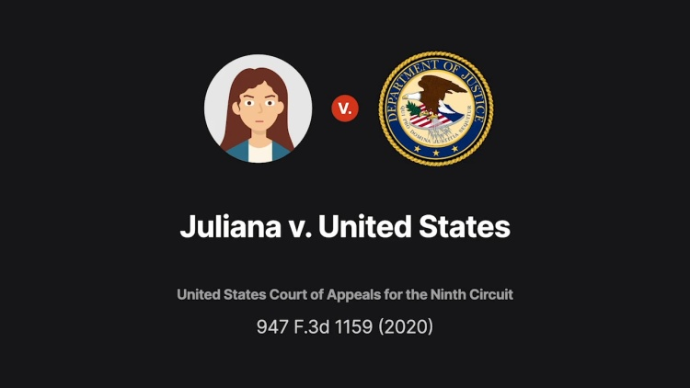
8.4. Corporate responsibility
Module 8. Case studies in climate change dispute resolution
Case Study: Juliana v. United States (2020)
Background:
Juliana v. United States, originally filed in 2015, is a landmark case in the United States regarding climate change and the rights of future generations.
Twenty-one young plaintiffs, represented by their legal guardians, sued the US government, arguing that its actions and policies regarding climate change violate their constitutional right to life, liberty, and property.

Slide 29
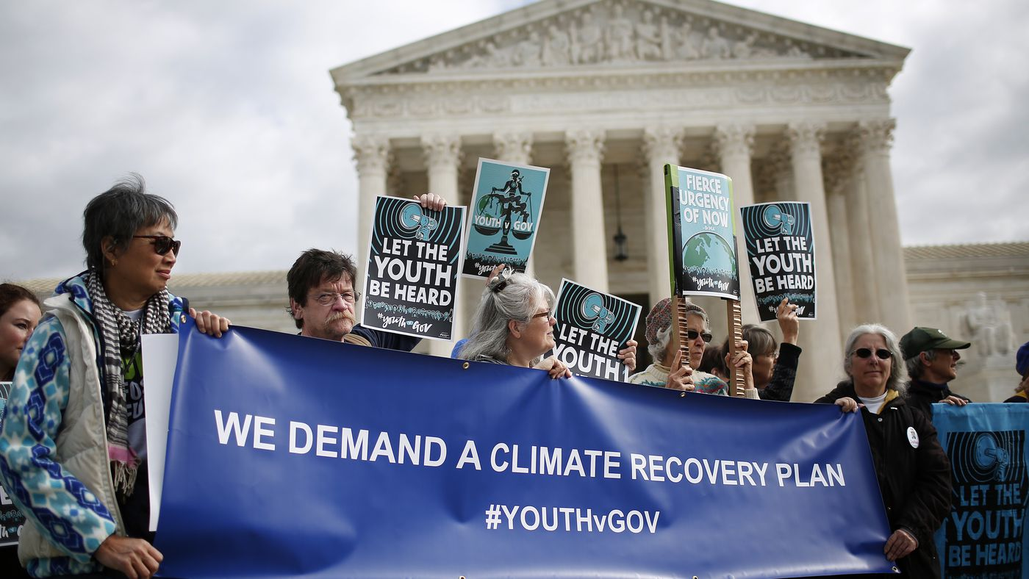
8.4. Corporate responsibility
Module 8. Case studies in climate change dispute resolution
Case Study: Juliana v. United States (2020)
Claims:
The plaintiffs claimed the federal government has known about the dangers of climate change for decades but failed to take sufficient action, jeopardizing their future and violating their constitutional rights. They argued the government's actions amount to a "system of exploitation" that prioritizes short-term economic benefits over long-term environmental health, disproportionately harming future generations.

Slide 30
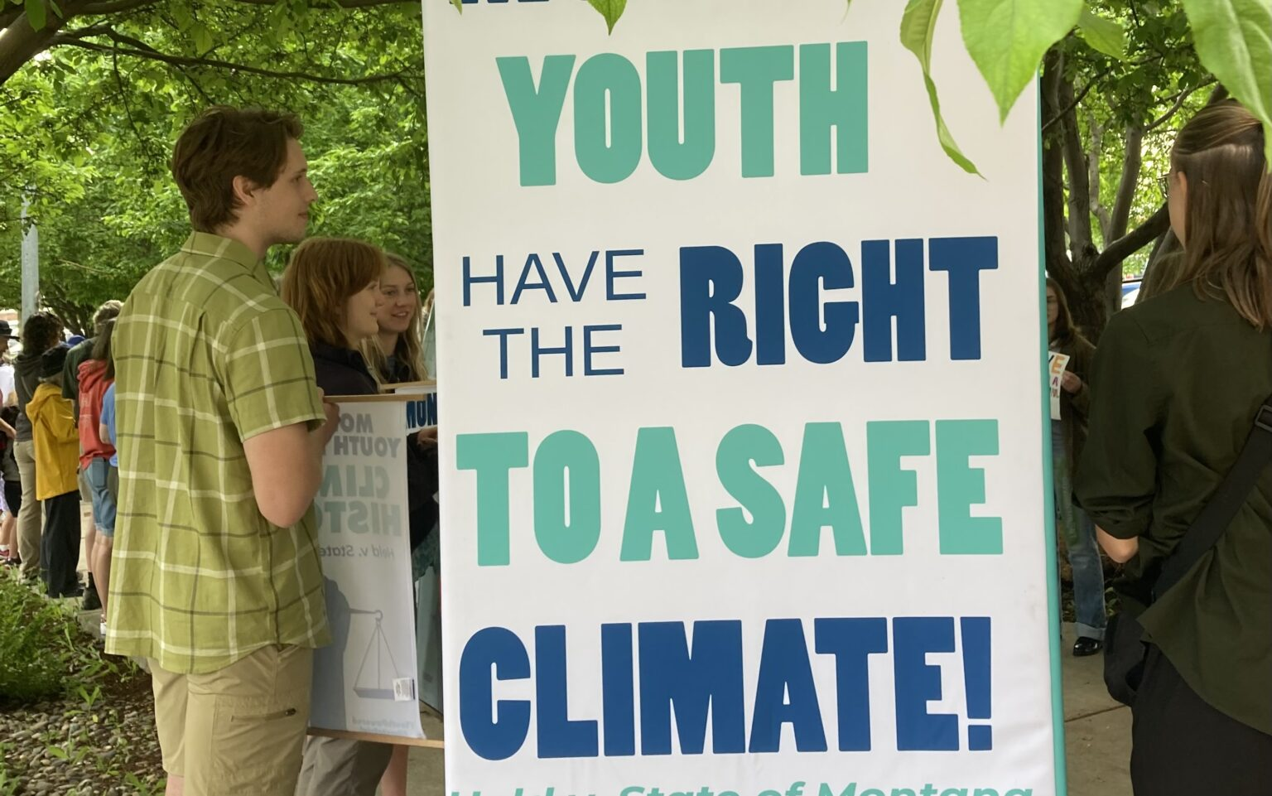
8.4. Corporate responsibility
Module 8. Case studies in climate change dispute resolution
Case Study: Juliana v. United States (2020)
Legal Basis:
The lawsuit relied on a novel legal approach, utilizing the public trust doctrine and the Fifth Amendment's Due Process Clause.
The public trust doctrine posits the government holds certain resources, like the atmosphere, in trust for the benefit of present and future generations.
The Due Process Clause prohibits the government from depriving individuals of life, liberty, or property without due process of law.

Slide 31
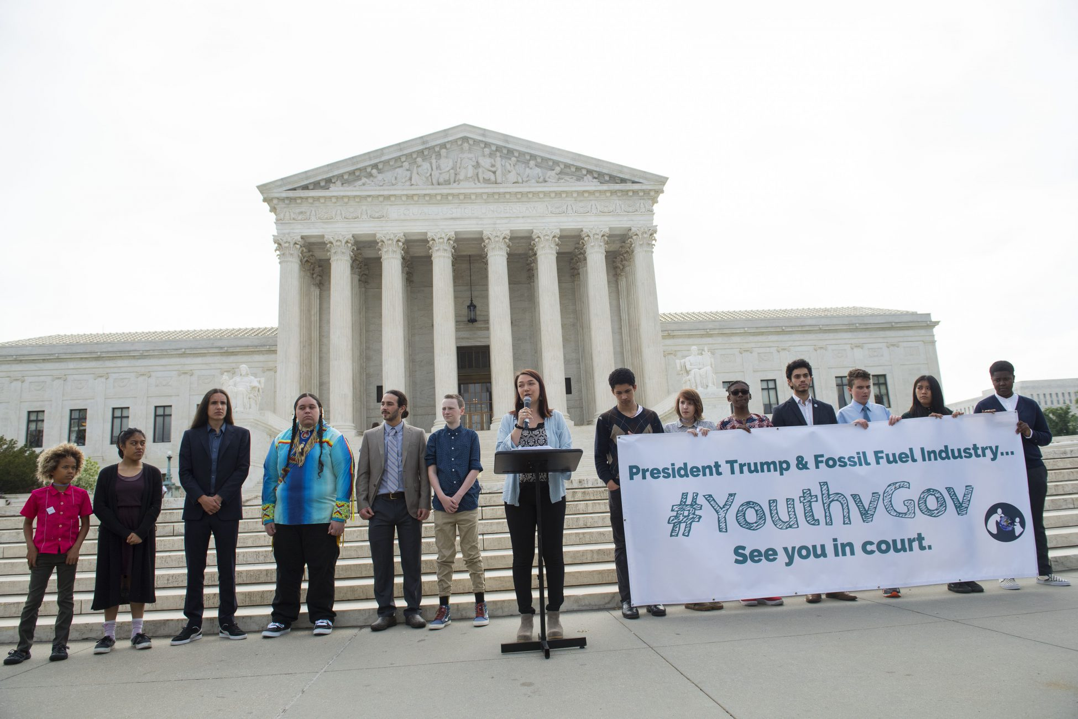
8.4. Corporate responsibility
Module 8. Case studies in climate change dispute resolution
Case Study: Juliana v. United States (2020)
Court Decision:
In 2020, the U.S. Court of Appeals for the Ninth Circuit dismissed the case, ruling that the plaintiffs lacked standing, meaning they couldn't demonstrate their specific injuries caused by the government's actions. The court also questioned whether the judiciary has the authority to order specific remedies regarding complex policy issues like climate change.

Slide 32
8.4. Corporate responsibility
Module 8. Case studies in climate change dispute resolution
Significance:
Despite the dismissal, the Juliana case remains significant for several reasons:
Raising Awareness: It brought widespread public attention to the concept of intergenerational equity and the potential legal avenues to address climate change.
Inspiring Similar Actions: The case inspired similar lawsuits around the world, including in Pakistan and Colombia, where courts have recognized the rights of future generations regarding environmental protection.
Shifting the Debate: The case has broadened the discourse on climate change by moving beyond solely environmental concerns and framing it as a matter of fundamental rights, potentially influencing future legal strategies.

Slide 33
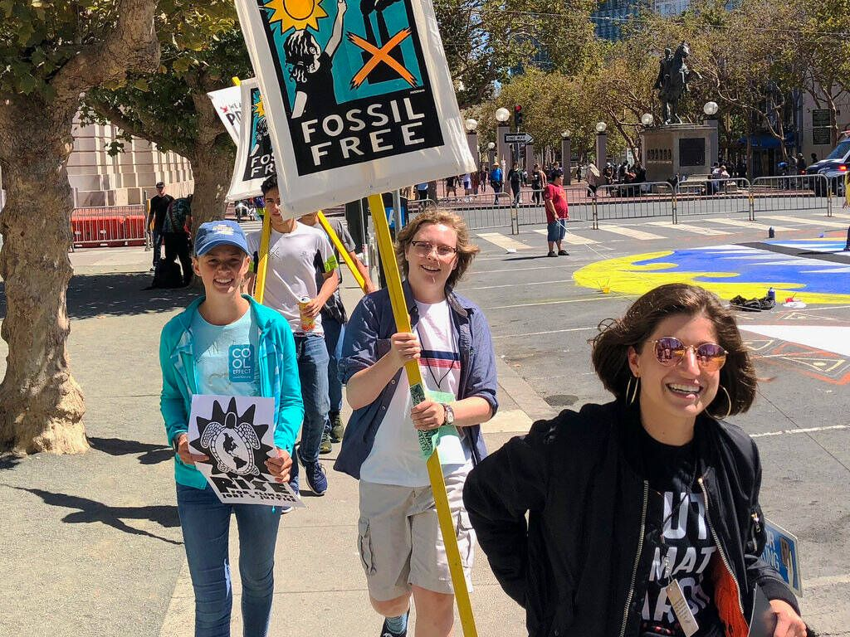
8.4. Corporate responsibility
Module 8. Case studies in climate change dispute resolution
Challenges and Limitations:
The dismissal highlights the legal hurdles and complexities of climate litigation, particularly in the US context due to limitations on judicial review and the principle of separation of powers.
Additionally, proving causation and quantifying specific harm to individual plaintiffs based on government policies remains challenging.

Slide 34
8.4. Corporate responsibility
Module 8. Case studies in climate change dispute resolution
Key takeaways
The Juliana case, while unsuccessful in achieving its initial objective, has been pivotal in raising awareness, inspiring similar actions globally, and influencing the legal discourse surrounding climate change and intergenerational equity.
It serves as a reminder of the ongoing fight for climate justice and the search for effective legal pathways to ensure the well-being of future generations in the face of climate change.

Slide 35
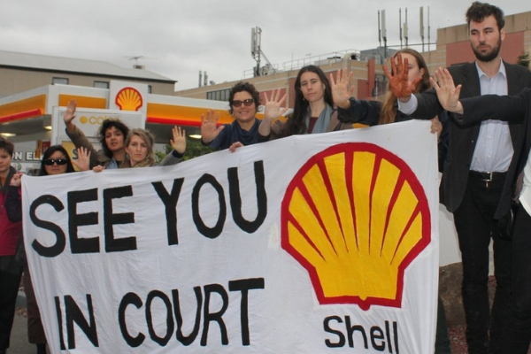
8.4. Corporate responsibility
Module 8. Case studies in climate change dispute resolution
Case study: Royal Dutch Shell and Climate Change
Background:
Royal Dutch Shell is a multinational oil and gas company and one of the largest corporations in the world. It has faced increasing pressure from shareholders, activists and governments regarding its contribution to climate change through fossil fuel extraction and production.
In 2018, a group of institutional investors filed a resolution directing Shell to set concrete emissions reduction targets in line with the Paris Agreement goals. This sparked a dispute over Shell's responsibility and role in climate change mitigation.

Slide 36
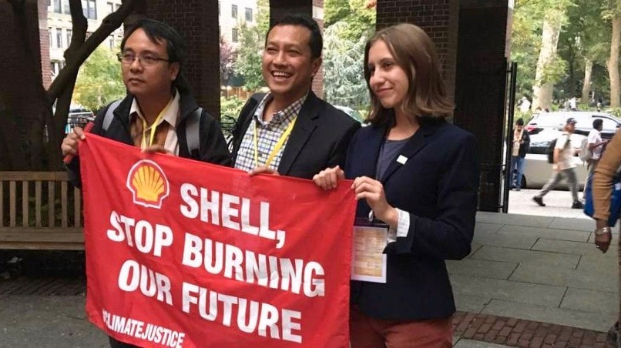
8.4. Corporate responsibility
Module 8. Case studies in climate change dispute resolution
Case study: Royal Dutch Shell and Climate Change
Resolution Process:
An independent third party was brought in to mediate discussions between Shell and the critical shareholders.
Several meetings were held and additional shareholders joined the pressure on Shell.
Eventually a resolution was reached, with Shell agreeing to set short-term targets to reduce its carbon footprint and link executive pay to emissions reductions.

Slide 37
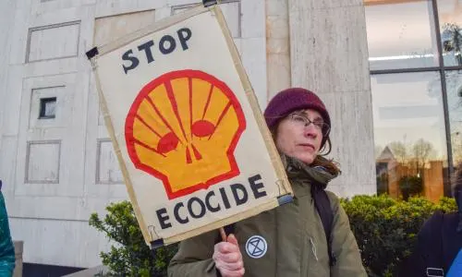
8.4. Corporate responsibility
Module 8. Case studies in climate change dispute resolution
Case study: Royal Dutch Shell and Climate Change
Outcome:
In 2020, Shell announced one of the most ambitious climate strategies for industry. It aims to reduce emissions intensity by 20% by 2030 and achieve net zero emissions by 2050.
Executive pay is now tied to meeting carbon reduction targets through an energy transition plan. This gives directors financial incentive to prioritize climate action.
While activists say Shell still isn't doing enough, the dispute resolution process led to real change in Shell's business strategy.

Slide 38
8.4. Corporate responsibility
Module 8. Case studies in climate change dispute resolution
Key takeaways
Shareholder activism, like the resolution that pushed Shell, can make companies set stronger climate goals.
Third-party mediation, like in the Shell case, fosters dialogue and helps corporations reach agreements with stakeholders.
Tying executive pay to sustainability, like Shell's bonus on emissions, incentivizes climate action.

