Slide 1
CCP-LAW
Curricula development on Climate Change Policy and Law
Subject title: Climate Change Policy
Instructor Name: Dr. Rahul Nikam
Project No of Reference: 618874-EPP-1-2020-1-VN-EPPKA2-CBHE-JP:
The European Commission's support for the production of this publication does not constitute an endorsement of the contents, which reflect the views only of the authors, and the Commission cannot be held responsible for any use which may be made of the information contained therein.

Slide 2
Summary of relevant knowledge in the IPCC Third Assessment Report
The scope assigned to Working Group II was limited to the impacts of climate change on sectors and regions and to issues of vulnerability and adaptation.
While Working Group III (WGIII) was commissioned to assess the technological, economic, social, and political aspects of mitigation.
There was little room to consider the direct relationships between these two domains.
The attempt to establish the foundations of the TAR Synthesis Report (IPCC, 2001a) in the final chapters of WGII and WGIII did not shed light on the inter-relationships between adaptation and mitigation.
Nonetheless, the TAR presented new concepts for addressing inter-relationships between adaptation and mitigation.

Slide 3
Summary of relevant knowledge in the IPCC Third Assessment Report
As the TAR pointed out: "one country can easily display high adaptive capacity and low mitigative capacity simultaneously (or vice versa)" (IPCC, 2001b; see also Yohe, 2001)
In a wealthy nation, damages of climate change may fall on a small but influential social group and the costs of adaptation can be distributed across the entire population through the tax system.
The TAR discussed inter-relationships between adaptation and mitigation at two levels: at the aggregated, global, and national levels, and in the context of economic sectors and specific projects.
The WGII report pointed out that "adaptation is a necessary strategy at all scales to complement climate change mitigation efforts" (IPCC, 2001c), but also elaborates on the complex relationships between the two domains at various levels.

Slide 4
Summary of relevant knowledge in the IPCC Third Assessment Report
The WGIII TAR noted, that one has to bear in mind the intergenerational trade-offs.
The WGIII TAR outlined the iterative process in which nations balance their own mitigation burden against their own adaptation and damage costs. "The need for, extent and costs of adaptation measures in any region will be determined by the magnitude and nature of the regional climate change driven by shifts in global climate.
Both mitigation costs and net damages, in turn, depend on some crucial baseline assumptions: economic development and baseline emissions largely determine emissions reduction costs, while development and institutions influence vulnerability and adaptive capacity" (IPCC, 2001b).
The WGII TAR in Chapter 8 mentioned energy end-use efficiency in buildings having both adaptation and mitigation benefits, as improved insulation and equipment efficiency can reduce the vulnerability of structures to extreme temperature episodes and emissions

Slide 5
Summary of relevant knowledge in the IPCC Third Assessment Report
The WGII TAR drew attention to a link between adaptation and mitigation in the Kyoto Protocol that establishes a surcharge (`set-aside') on mitigation activities implemented as Clean Development Mechanism (CDM) projects.
Investments in mitigation may have consequences for adaptation, and investments in adaptation may have consequences for the emission of greenhouse gases.
At the highest level of aggregation, adaptation, and mitigation are both policy substitutes and policy complements and may compete for finite resources.
However, this need not be the case: both adaptation and mitigation may be considered in a policy process without invoking trade-offs, often in the context of broader considerations of sustainable development.

Slide 6
Summary of relevant knowledge in the IPCC Third Assessment Report
The climate-policy decision tree can be represented as points at which decisions are made, and the reduction of uncertainty in the outcomes (if any) in a wide range of possible decisions and outcomes.
The first decision node represents some of today's investment options. How much should we invest in mitigation, and how much in adaptation? How much should be invested in research? Once we act, we have an opportunity to learn and make mid-course corrections.
The outcomes include types of learning that will occur between now and the next set of decisions. The outcomes are uncertain; the uncertainty may not be resolved but there will be new information that may influence future actions. Hence the expression: "act, then learn, and then act again"

Slide 7
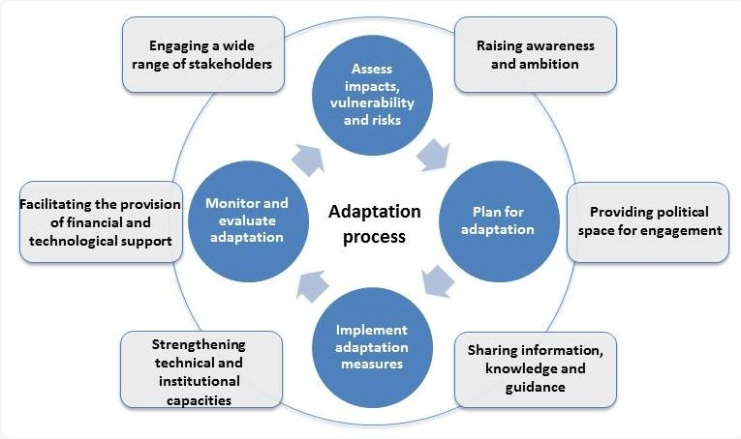
Summary of relevant knowledge in the IPCC Third Assessment Report
How to undertake adaptation?

Slide 8
Glasgow–Sharm el-Sheikh work program on the global goal of adaptation (2022-2023)
The Paris Agreement and the global goal of adaptation referred to in Article 7, paragraph 1, Also recalling Articles 2 and 7 of the Paris Agreement, Recognizing the importance of the global goal of adaptation for effective implementation of the Paris Agreement, Also recognizing that additional work is needed about the global goal on adaptation.
Recognizing that combining various approaches to reviewing overall progress made in achieving the global goal of adaptation, including qualitative and quantitative approaches, can generate a more holistic picture of adaptation progress and help to balance the strengths and weaknesses of the different approaches

Slide 9
Glasgow–Sharm el-Sheikh work program on the global goal of adaptation (2022-2023)
Adaptation action should follow a country-driven, gender-responsive, participatory, and fully transparent approach, taking into consideration vulnerable groups, communities, and ecosystems, and should be based on and guided by the best available science and, as appropriate, traditional knowledge, knowledge of Indigenous peoples and local knowledge systems to integrate adaptation into relevant socioeconomic and environmental policies and actions, where appropriate.
A comprehensive two-year Glasgow–Sharm el-Sheikh work program on the global goal of adaptation.
implementation of the work program will start immediately after the third session of the Conference of the Parties serves as the meeting of the Parties to the Paris Agreement;
The work program will be carried out jointly by the Subsidiary Body for Scientific and Technological Advice and the Subsidiary Body for Implementation;

Slide 10
Glasgow–Sharm el-Sheikh work program on the global goal of adaptation (2022-2023)
Invites the subsidiary bodies to carry out the work program with contributions from the current and incoming Presidencies of the Conference of the Parties, the Adaptation Committee, Working Group II of the Intergovernmental Panel on Climate Change, as appropriate, and other relevant constituted bodies and experts;
The objectives of the work program should be to, inter alia-
(a) Enable the full and sustained implementation of the Paris Agreement, towards achieving the global goal of adaptation, to enhance adaptation action and support;
(b) Enhance understanding of the global goal of adaptation, including the methodologies, indicators, data and metrics, needs, and support needed for assessing progress towards it;
(c) Contribute to reviewing the overall progress made in achieving the global goal of adaptation as part of the global stocktake referred to in Article 7, paragraph 14, and Article 14 of the Paris Agreement to inform the first and subsequent global stock takes;

Slide 11
Glasgow–Sharm el-Sheikh work program on the global goal of adaptation (2022-2023)
(d) Enhance national planning and implementation of adaptation actions through the process to formulate and implement national adaptation plans and nationally determined contributions and adaptation communications;
(e) Enable Parties to better communicate their adaptation priorities, implementation and support needs, plans, and actions, including adaptation communications and nationally determined contributions;
(f) Facilitate the establishment of robust, nationally appropriate systems for monitoring and evaluating adaptation actions;
(g) Strengthen implementation of adaptation actions in vulnerable developing countries;
(h) Enhance understanding of how communication and reporting instruments established under the Convention and the Paris Agreement related to adaptation can complement each other to avoid duplication of efforts;

Slide 12
Least Developed Countries Expert Group (LEG)
Since 2001, the Least Developed Countries Expert Group (LEG) was established to provide technical guidance and support to the LDCs on the process of formulating and implementing national adaptation plans (NAPs). The LEG is mandated to provide technical guidance and advice on accessing funding from the Green Climate Fund for the formulation and implementation of NAPs and its work program through various activities to share best practices and lessons learned.
The LEG implements its work program through a variety of modalities including technical guidance to the countries, technical guidelines, technical papers, training activities, workshops, expert meetings, NAP Expos, case studies, capturing and sharing of experiences, best practices, and lessons learned, NAP Central, monitoring of progress, effectiveness, and gaps, collaboration with other bodies, programs and organizations, and promotion of coherence and synergy.

Slide 13
Least Developed Countries Expert Group (LEG)
NAP Central is a portal developed under the guidance of the LEG, aiming to facilitate access to data, information, and knowledge relevant to NAPs.
LDC Portal contains information that is of specific interest to LDCs and their work on NAPs, including databases of relevance to both LDCs and non-LDCs alike, and sources of funding.

Slide 14
Further Reading
https://unfccc.int/topics/adaptation-and-resilience/the-big-picture/introduction#The-Least-Developed-Countries-Expert-Group-LEG
https://unfccc.int/sites/default/files/resource/sbi2024_12.pdf

Slide 15
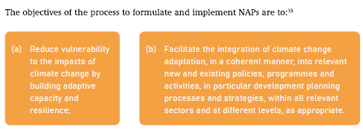
National Adaptation Plans (NAPs)
OVERVIEW OF THE PROCESS TO FORMULATE AND IMPLEMENT NATIONAL ADAPTATION PLANS

Slide 16
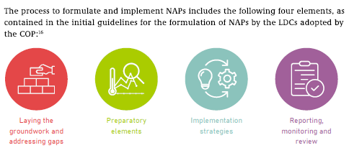
National Adaptation Plans (NAPs)

Slide 17
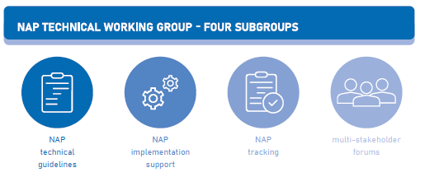
National Adaptation Plans (NAPs)

Slide 18
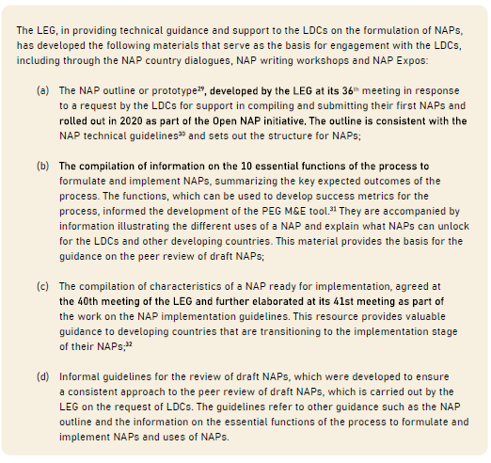
National Adaptation Plans (NAPs)

Slide 19
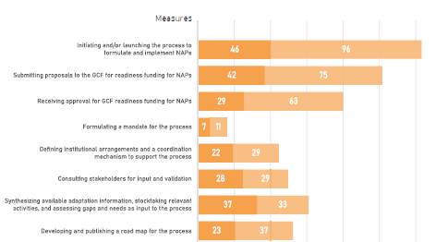
National Adaptation Plans (NAPs)
2. PROGRESS OF DEVELOPING COUNTRY PARTIES IN THE PROCESS TO FORMULATE AND IMPLEMENT
NATIONAL ADAPTATION PLANS, INCLUDING GAPS AND NEEDS

Slide 20
National Adaptation Plans (NAPs)
2. PROGRESS OF DEVELOPING COUNTRY PARTIES IN THE PROCESS TO FORMULATE AND IMPLEMENT
NATIONAL ADAPTATION PLANS, INCLUDING GAPS AND NEEDS

Slide 21
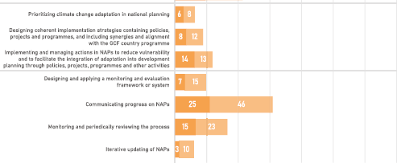
National Adaptation Plans (NAPs)
2. PROGRESS OF DEVELOPING COUNTRY PARTIES IN THE PROCESS TO FORMULATE AND IMPLEMENT
NATIONAL ADAPTATION PLANS, INCLUDING GAPS AND NEEDS

Slide 22
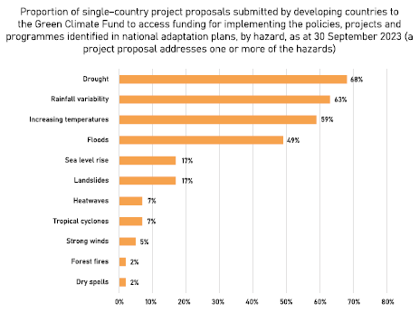
National Adaptation Plans (NAPs)
3. PROGRESS IN IMPLEMENTING POLICIES, PROJECTS ABD PROGRAMS IDENTIFIED IN NATIONAL ADAPTATION PLANS

Slide 23
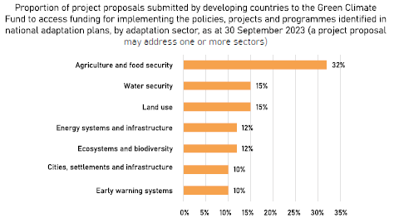
National Adaptation Plans (NAPs)
3. PROGRESS IN IMPLEMENTING POLICIES, PROJECTS ABD PROGRAMS IDENTIFIED IN NATIONAL ADAPTATION PLANS

Slide 24
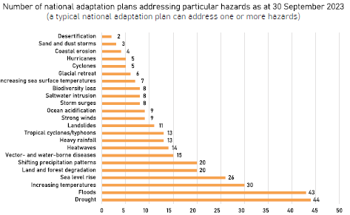
National Adaptation Plans (NAPs)
3. PROGRESS IN IMPLEMENTING POLICIES, PROJECTS ABD PROGRAMS IDENTIFIED IN NATIONAL ADAPTATION PLANS

Slide 25
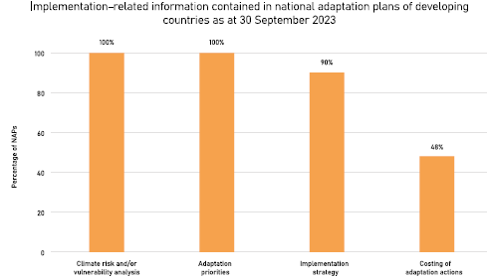
National Adaptation Plans (NAPs)
4 Implementation strategies and resource mobilization

Slide 26
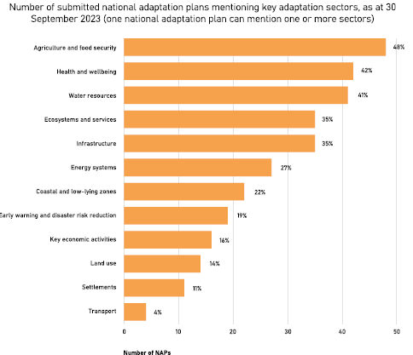
National Adaptation Plans (NAPs)
5 Key sectors for adaptation actions

Slide 27
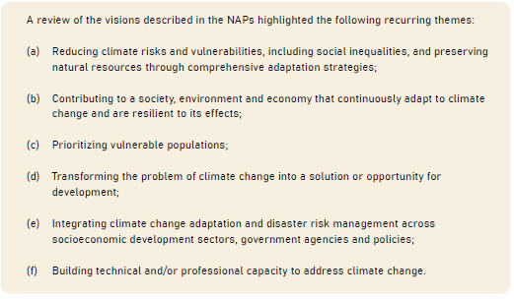
National Adaptation Plans (NAPs)
6 Overview of visions and goals

Slide 28
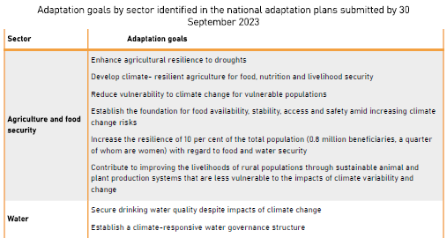
National Adaptation Plans (NAPs)

Slide 29
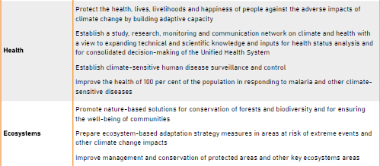
National Adaptation Plans (NAPs)

Slide 30
National Adaptation Plans (NAPs)

Slide 31
National Adaptation Plans (NAPs)
PROGRESS IN ADDRESSING THE GUIDING PRINCIPLES OF THE PROCESS TO FORMULATE AND
IMPLEMENT NATIONAL ADAPTATION PLANS
Marinating an effective and interactive process to formulate and implement NAPs
Applying the best available science
Multi-stakeholder engagement including consideration of traditional and Indigenous peoples’ knowledge
Gender considerations

Slide 32
Further Reading
United nations –National Action Plan
https://unfccc.int/topics/adaptation-and-resilience/workstreams/national-adaptation-plans
UNFCCC LDC EXPERT GROUP-NATIONAL ADAPTATION PLANS 2021
https://unfccc.int/sites/default/files/resource/UNFCCC-NAP2021-Progress-report.pdf
Guidelines for National Adaptation Plans (NAPs)
https://unfccc.int/topics/adaptation-and-resilience/resources/guidelines-for-national-adaptation-plans-naps

