Slide 1
CCP-LAW
Curricula development on Climate Change Policy and Law
Subject title: Climate Change Policy
Instructor Name: Dr. Rahul Nikam
Project No of Reference: 618874-EPP-1-2020-1-VN-EPPKA2-CBHE-JP:
The European Commission's support for the production of this publication does not constitute an endorsement of the contents, which reflect the views only of the authors, and the Commission cannot be held responsible for any use which may be made of the information contained therein.

Slide 2
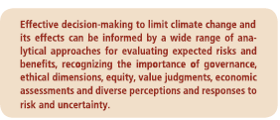
Future Pathways for Adaptation, Mitigation, and Sustainable Development
Strategic responses to climate change involve consideration of climate-related risks along with the risks & co-benefits of adaptation & mitigation action.
(WGII, SPM A-3, SPM C, Glossary, WGIII SPM.2, 4.1, 5.1, Glossary)

Slide 3
Future Pathways for Adaptation, Mitigation, and Sustainable Development (SD)
1. Foundations of decision-making about climate change
SD & equity provide a basis for assessing climate policies. Limiting the effects of climate change is necessary to achieve SD & equity including poverty eradication. (WGII 2.2, 2.3, 13.3, 13.4, 17.3, 20.2, 20.5, WGIII SPM.2, 3.3, 3.10, 4.1.2, 4.2, 4.3, 4.5, 4.6, 4.8)
Effective mitigation will not be achieved if individual agents advance their own interests independently. (WGII 20.3.1, WGIII SPM.2, TS1, 1.2, 2.6, 3.2, 4.2, 13.2, 13.3)
Decision-making about climate change involves valuation and mediation among diverse values and may be aided by the analytic methods of several normative disciplines. (WGII 2.2, 2.3, WGIII SPM.2, Box TS.2, 2.4,2.5,2.6,3.2-3.6, 3.9.4)

Slide 4
Future Pathways for Adaptation, Mitigation, and Sustainable Development (SD)
Analytical methods of valuation cannot identify a single best balance between mitigation, adaptation and residual climate impacts. (WGII 1.1.4, 2.3, 2.4, 17.3, 19.6, 19.7, WGII 2.5, 2.6, 3.4, 3.7, Box 3-9)
Effective decision-making and risk management in the complex environment of climate change may be iterative: strategies can often be adjusted as new information and understanding develop during implementation. (WG II SPM A-3, SPM C-2, 2.1-2.4, 3.6, q4.1-14.3, 15.2-15.4, 17.1-17.3, 17.5, 20.2, 20.3, 20.6, WGIII SPM.2, 2.4, 2.5,5.5, 16.4)

Slide 5
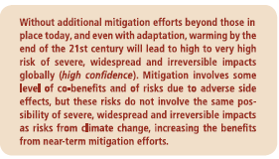
Future Pathways for Adaptation (A), Mitigation (M), and Sustainable Development (SD)
2. Climate change risks reduced by adaptation and mitigation
The risks of climate change, A & M differ in nature, timescale, magnitude and persistence (high confidence) (WGI SPM E.8, 12.4, 12.5.2, 13.5, WGII 4.2, 17.2, 19.6, WGIII Ts. 3.1.4, Table TS.4, Table TS.5, table YS.6, Table TS.7, Table TS.8, 2.5, 6.6)

Slide 6
Future Pathways for Adaptation (A), Mitigation (M), and Sustainable Development (SD)
M & A are complementary approaches for reducing risks of Climate change impacts. They interact with one another & reduce risks over different timescales (high- confidence) (WGI 11.3, 12.4, WGII SPM A-3, SPM B-2, SPMC-2, 1.1.4, 2.5, 16.3-16.3, 17.3, 19.2, 20.2.3, 20.3, 20.6)
Without additional mitigation efforts beyond those in place today, and even with adaptation, warming by the end of the 21st century will lead to a high to very high risk of severe, widespread, and irreversible impacts globally (WGII SPM B-1, SPM C-2, WGIII SPM.3)
substantial cuts in GHG emissions over the next few decades can substantially reduce risks of climate change by limiting warming in the 2nd half of the 21st century and beyond (high-confidence).

Slide 7
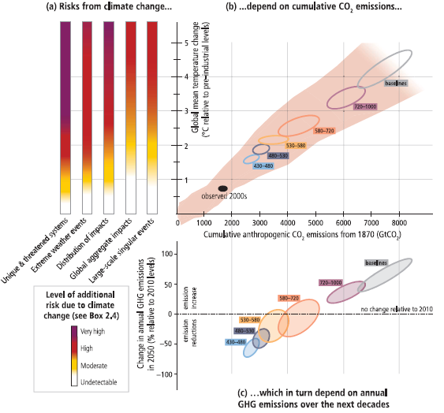
Future Pathways for Adaptation (A), Mitigation (M), and Sustainable Development (SD)

Slide 8
Future Pathways for Adaptation (A), Mitigation (M), and Sustainable Development (SD)
Previous Slide figure 3.1.

Slide 9
Future Pathways for Adaptation (A), Mitigation (M), and Sustainable Development (SD)
Mitigation involves some level of co-benefits and risks, but these risks do not involve the same possibility of severe, widespread, and irreversible impacts as risks from climate change (high confidence) (WGIII SPM 4.2, SPM 4.2, TS. 3.1.4, Table TS.4 Table TS.5, Table TS.7, Table TS.8, 6.6)
Inertia in the economic and climate systems and the possibility of irreversible impacts from climate change increase the benefits of near-term mitigation efforts (high confidence). (WGI SPM E-8, WG II SPM B-2, 2.1, 19.7, 20.3, WGIII 4.2.1, 3.6, 6.4, 6.6, 6.9)

Slide 10
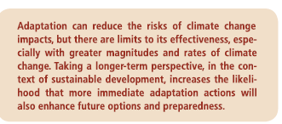
Future Pathways for Adaptation (A), Mitigation (M), and Sustainable Development (SD)
3. Characteristics of adaptation pathways
Adaptation can contribute to the well-being of current and future populations, the security of assists and the maintains of ecosystem goods, functions and services now and in the future . Adaptation is place and context specific, with no single approach for reducing risks appropriate across all settings.

Slide 11
Future Pathways for Adaptation (A), Mitigation (M), and Sustainable Development (SD)
Adaptation planning and implementation at all levels of governance are contingent on societal values, objectives and risk perceptions. (WGII SPM C-1)
Adaptation planning and implementation can be enhanced through complementary actions across levels, from induvial to governments. (WG II SPM C-1)
A 1st step towards adaptation to future climate change is reducing vulnerability and exposure to present climate variability, but some near-term responses to climate change may also limit future choice. (WGII SPM C-1)
Numerous interacting constraints can impede adaptation planning and implementation. (WG II SPM C-1)
Greater rates and magnitude of climate change increase the likelihood of exceeding adaptation limits. (WG II SPM C-2, TS)

Slide 12
Future Pathways for Adaptation (A), Mitigation (M), and Sustainable Development (SD)
Transformation in economic, social, technological and political decisions and action can enhance adaptation and promote sustainable development.
Building adaptive capacity is crucial for effective selection and implementation of adaptation options (robust evidence, high agreement.) (WG II 8.2, 12.3, 14.1-3, 16.2, 16.3, 16.5, 16.8)
Significant co-benefits, synergies and trade-offs exist between M&A and among different adaption responses; interactions occur both within and across regions. (WG II SPM C-1)

Slide 13
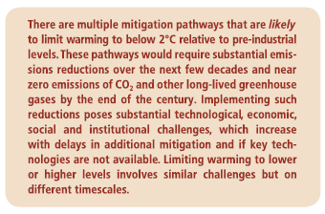
Future Pathways for Adaptation (A), Mitigation (M), and Sustainable Development (SD)
4. Characteristics of mitigation pathways
Without additional efforts to reduce GHC emissions beyond those in place today, global emission growth is expected to persist driven by growth in global population and economic activities. (WG III SPM.3, SPM 4.1, TS.2.2, TS3.1, 6.3)

Slide 14
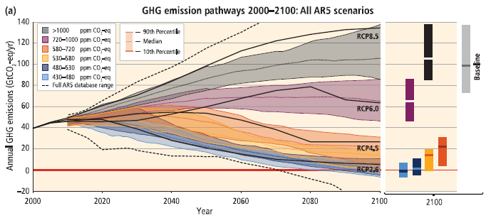
Future Pathways for Adaptation (A), Mitigation (M), and Sustainable Development (SD)
Many different combinations of technological, behavioural and policy options can be used to reduce emissions and limit temperature change. (WG III SPM 4.2, TS 3.1, 6.1, 6.2, 6.3, Annex II)

Slide 15
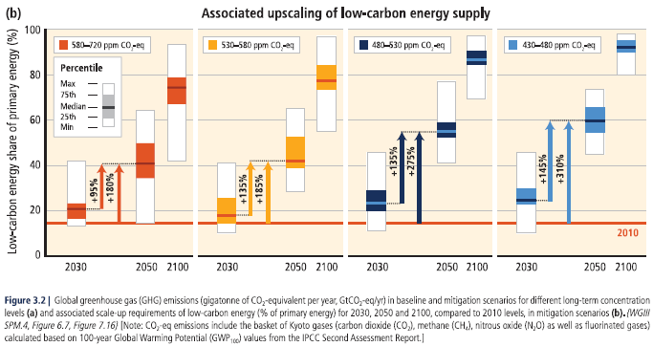
Future Pathways for Adaptation (A), Mitigation (M), and Sustainable Development (SD)

Slide 16
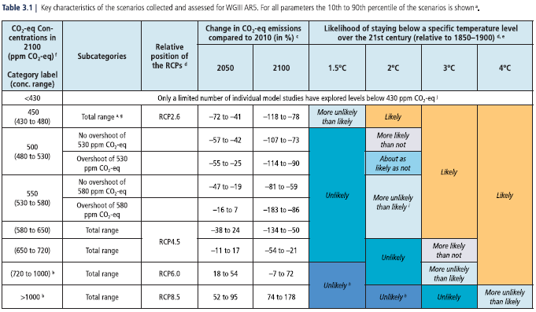
Future Pathways for Adaptation (A), Mitigation (M), and Sustainable Development (SD)

Slide 17
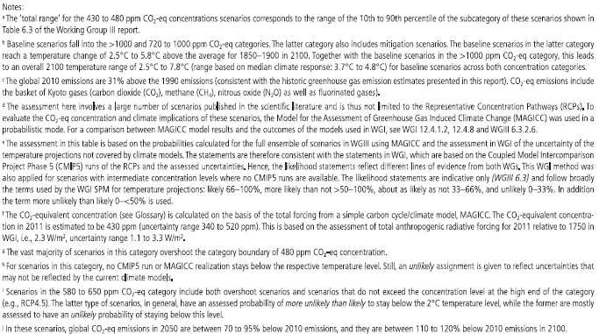
Future Pathways for Adaptation (A), Mitigation (M), and Sustainable Development (SD)

Slide 18
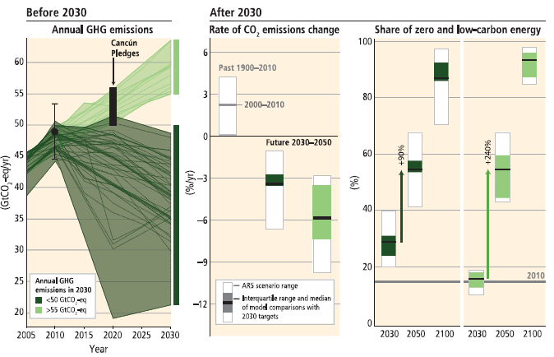
Future Pathways for Adaptation (A), Mitigation (M), and Sustainable Development (SD)

Slide 19
Future Pathways for Adaptation (A), Mitigation (M), and Sustainable Development (SD)

Slide 20
Future Pathways for Adaptation (A), Mitigation (M), and Sustainable Development (SD)
5. Interaction among mitigation, adaptation, and sustainable development
Climate change is a threat to equitable and sustainable development. Adaptation, Mitigation, and sustainable development. (WG II SPM B-2, 2.5 10.9, 13.1-13.3, 20.1, 20.2, 20.6, WGIII SPM.2, 4.2)
Aligning climate policy with sustainable development requires attention to both A&M. (WGII 2.5, 8.4, 9.3, 13.3-13.4, 20.2-20.4, 21.4, 25.9, 26.8, WGIII SPM .2, 4.8, 6.6)
Both A & M can bring substantial co-benefits (WGII SPM C-1, SPM. 4.1)
Strategies and actions can be pursued now that will move towards climate-resilient pathways for sustainable development, while at the same time helping to improve livelihoods, social and economic well-being, and effective environmental management. (WGII SPM C-2, 20.2, 20.6.2)

Slide 21
Further Reading
Climate Change 2014 Synthesis Report https://ar5-syr.ipcc.ch/ipcc/ipcc/resources/pdf/IPCC_SynthesisReport.pdf

