Slide 1
CCP-LAW
Curricula development on Climate Change Policy and Law
Module: Environmental Risk Prevention and Management
Topic: Introduction to the Terminology associated with Risk and a focus on Natural Hazards
Instructor Name:
Project No of Reference: 618874-EPP-1-2020-1-VN-EPPKA2-CBHE-JP:
The European Commission's support for the production of this publication does not constitute an endorsement of the contents, which reflect the views only of the authors, and the Commission cannot be held responsible for any use which may be made of the information contained therein.

Slide 2
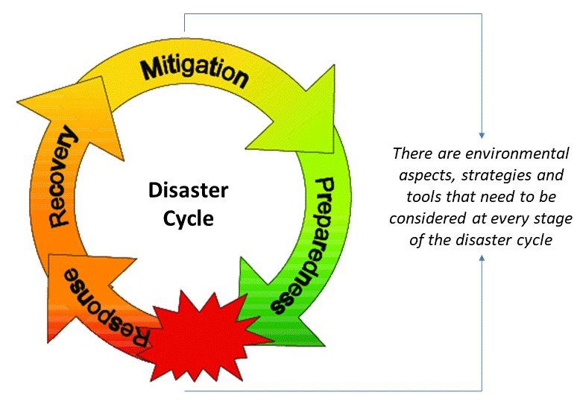
Session 1: Introduction to Terminology associated with Environmental Risk and Hazards

Slide 3
Aims of the Session
Consider the environmental challenges that exist today and how these are perpetuated by human activity and a changing climate.
Introduce the terminology related to risk and vulnerability in relation to hazards and environmental challenges.
Review the disaster management cycle as a means of understanding how to managing and reducing risks of hazards.

Slide 4
Environment as a Social Construction
When exploring the relationship between society and nature – research had previously tended to focus on NATURE as being the determinant. Lack of proper integration of nature with social and economic systems.
The Environment itself as a SOCIAL CONSTRUCTION.
Ryden (1993, 37–38) adds that ‘‘a place ...takes in the meanings which people assign to that landscape through the process of living in it.’’
A sense of place is not intrinsic to the physical setting itself, but resides in human interpretations of the setting, which are constructed through experience with it. Spaces become ‘‘places’’ as they become imbued with meaning through lived experience (Tuan 1977).
Hazards that exist within the environment feature because of people's interactions with the natural world either directly or indirectly.

Slide 5
Nature and Society
Cannon (1994) states that nature presents humankind with a set of opportunities and risks which vary greatly in their spatial distribution.
1. Opportunities include the way in which people utilize nature for production (raw materials etc.), to service their livelihoods (absorbing or recycling waste products).
2. The risks inherent in nature consist of a wide range of hazards that can put a constraint on production (e.g.: frosts affecting agriculture) and on other aspects of livelihoods and safety (e.g.: floods, earthquakes).

Slide 6
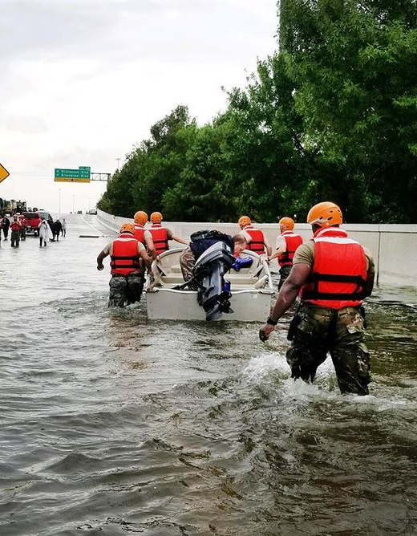
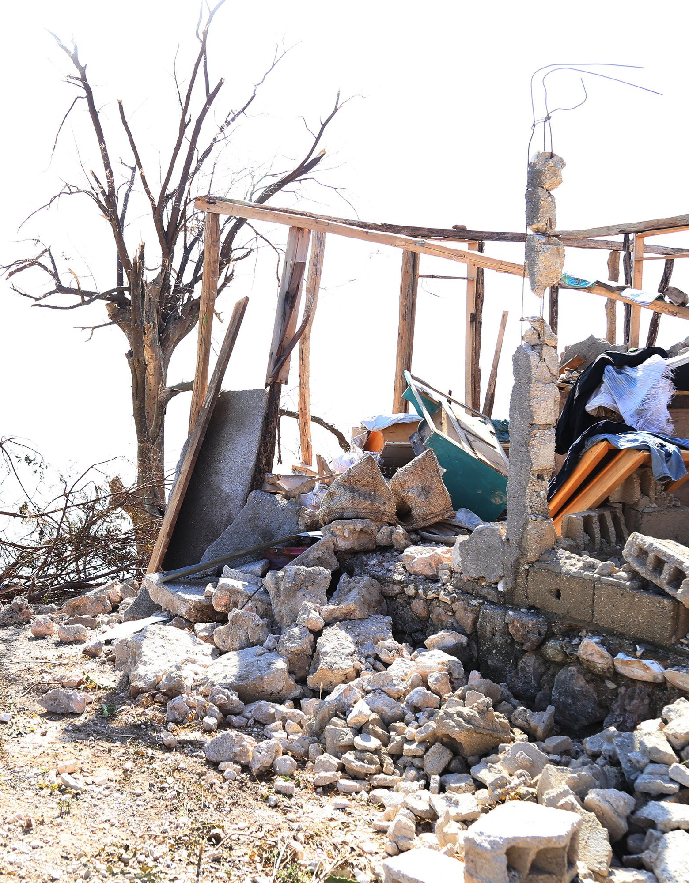
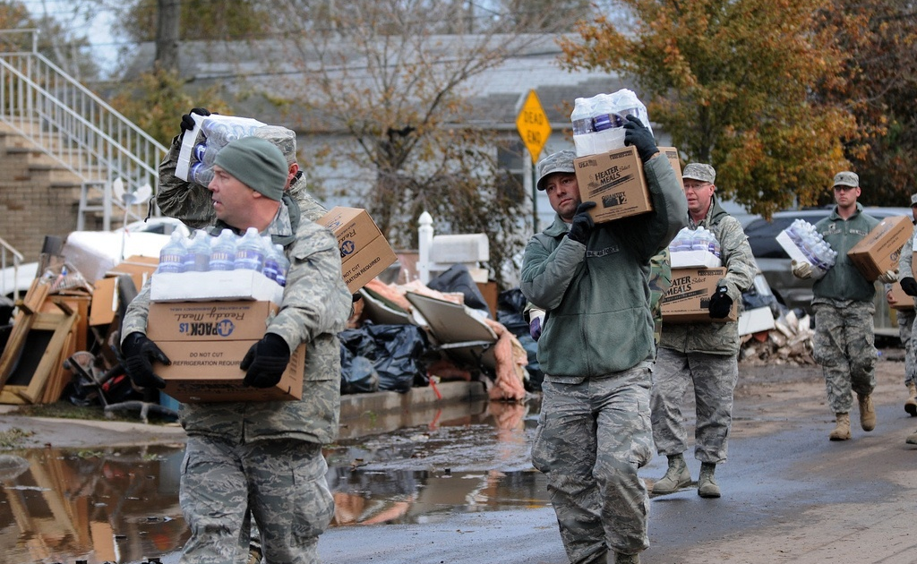
Natural Hazards and Risk
As a result of a changing climate and how people are responding to it, we are witnessing an increase in the frequency and magnitude of disaster events caused by natural hazards.

Slide 7
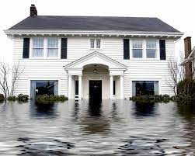
Natural Hazards and Risk
In this research, the term risk follows the definition by the Office of the United Nations Disaster Relief Coordinator (UNDRO) and “refers to the expected losses from a particular hazard to a specified element at risk in a particular future time period. Loss may be estimated in terms of human lives, or buildings destroyed or in financial terms.”
(Cardona, 2005; Burton, 1978).

Slide 8
Class Discussion (10 minutes): Hazards and Disasters as Risk
What is the difference between a hazard and a disaster?
Are all natural hazards considered disasters?
Can you name any modern disaster events nationally and/or internationally?
What do you know about these events?
What are the risks associated with disasters?
What strategies can be put in place to best reduce the impact of disasters?

Slide 9
Types of Natural Hazards
Natural hazards (geophysical, hydrological, climatological, meteorological etc.)
Hurricanes
Flooding
Earthquakes
Heatwaves
Volcanic Eruptions
Tornado
Tsunamis
Landslides

Slide 10
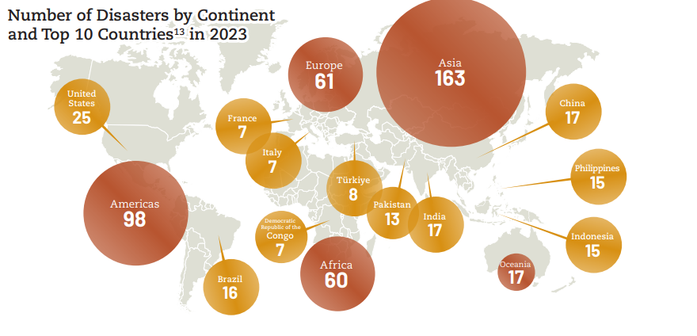

Slide 11
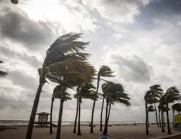
‘Natural’ Disasters
A Focus on the ‘Naturalness’
Lack of Human responsibility
Unstoppable, uncontrollable phenomenon
Unpredictable?
Terrifying, powerful, frightening
‘Out of worldly’ force

Slide 12
Causes of Disasters
The denial of the naturalness of disasters is in no way a denial of natural process.
You cannot overlook the fact that there is a degree of ‘nature’ within disaster events.
Earthquakes, tsunamis, blizzards, droughts and hurricanes are certainly events of nature that require a knowledge of geophysics, physical geography or climatology to comprehend.
Whether a natural event is a disaster or not depends ultimately, however, on its location and the social, political, cultural and economic issues occurring there.
See Neil Smith’s (2006) discussion ‘There is no such thing as a natural disaster’ - http://understandingkatrina.ssrc.org/Smith/

Slide 13
There is nothing 'natural' about disasters: Ted Talk
Watch the following Ted Talk by Rohini Swaminathan
V - Multi - Placeholder (youtube.com)
What are the key points she is making?
Do you agree?

Slide 14
Risk….not always a choice
Migration to hazard prone or environmentally vulnerable areas has been predominantly due to an increase in the world population, with some countries being pushed to their limits spatially (Turnbull et al. 2013). Limited available and adequate land space to build on has led to unsuitable development occurring in many regions (Bernstein 1992).
This has principally been the case within densely populated countries like Bangladesh which has incurred rapid urbanisation (Martin 2010; Paul & Dutt. 2010) and large urban areas such as Vancouver (Andrey & Jones 2008).

Slide 15
Why risk living in a hazardous area?
/
Living in areas of tectonic risk?
Ignorance of the risks and / or underestimation of risk
Inertia; always lived there, roots
Nowhere else to go / lack of alternatives
Choice e.g.: Economic opportunities like tourism, farming, mining, geothermal power
There are more people living
in potentially hazardous areas than
you might expect.
Does this constitute vulnerability?
Notes:
Note for teachers: It may be worthwhile to unravel with students each of these reasons and perhaps, if necessary, to challenge stereotypes and prejudice.

Slide 16
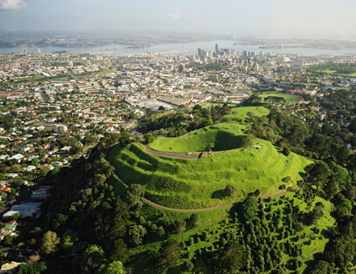
Living in ‘Risky’ areas
Becker et al. (2010) shows that Auckland, New Zealand which developed on what was active volcanic land, has harnessed these previous risks to create economic benefits for those living there, like the use of hot springs for tourism ventures (Becker et al. 2010) which provides jobs.
In a small number of cases, locations like Calabasas City and in Los Angeles have recently become popular destinations for higher socio-economic groups including celebrities (Las Virgenes-Malibu Council of Governments 2013). Many have moved due to its lucrative status and scenic views (Las Virgenes-Malibu Council of Governments 2013) regardless of the known risks from earthquakes and landslides (Wisner et al. 2013).

Slide 17
Measuring Disaster Risk
Will be discussed in more detail in Session 2

Slide 18
Introduction to the Disaster Management Cycle What is the difference between each of the following stages?

Slide 19
Introducing the Stages
Mitigation - Minimizing the effects of disaster. Examples: building codes and zoning; vulnerability analyses; public education.
Preparedness - Planning how to respond. Examples: preparedness plans; emergency exercises/training; warning systems.
Response - Efforts to minimize the hazards created by a disaster. Examples: search and rescue; emergency relief .
Recovery - Returning the community to normal. Examples: temporary housing; grants; medical care.

Slide 20
Activity (40 minutes): Disaster Management Cycle
Using the disaster case studies provided, identify the mitigation, preparation, response and recovery approaches within place.
Cyclone Biparjoy: India, Pakistan evacuate more than 170,000 - BBC News
Vietnam flooding: More than 100 dead after weeks of bad weather | CNN
Malaysia landslide: Death toll rises to 23 | CNN
What We Know About the Earthquake in Turkey and Syria - The New York Times (nytimes.com)

Slide 21
Conclusion
Humans and Nature are inextricably connected and in the period of the Anthropocene, we are witnessing a greater prevalence of hazards and potential risks because of people's intrusion on the environment.
Natural hazards have been well-documented in the literature and models have been designed to measure, monitor and manage the impacts of such events.
Risk is a combination of the hazard type itself and the vulnerability and resilience of that community or individual to that hazard.

Slide 22
For the next session...
Read the following paper:
Gunjyal N, Rani S, Asgari Lajayer B, Senapathi V, Astatkie T. A review of the effects of environmental hazards on humans, their remediation for sustainable development, and risk assessment. Environ Monit Assess. 2023 Jun 1;195(6):795
Consider what environmental risk is and the various types of environmental hazards currently affecting a changing climate and the social, economic and ecological impacts of these hazards.

Slide 23
Additional Reading
Dominey-Howes, D. (2018) ‘Hazards and Disasters in the Anthropocene: Some Critical Reflections for the Future’. Geoscience Letters [online] 5 (1). available from <https://doi.org/10.1186/s40562-018-0107
Gibb, C. (2018) ‘A Critical Analysis of Vulnerability’. International Journal of Disaster Risk Reduction [online] 28 (August 2017), 327–334. available from https://doi.org/10.1016/j.ijdrr.2017.11.007
Kelman, I. (2007) ‘Understanding Vulnerability to Understand Disasters’. Panel Contribution to the Population-Environment Forum [online] 1–14.
Parsons, M and Lykins, M D. (2022) Cultural worldviews and the perception of natural hazard risk in Australia, Environmental Hazards 22 (1) 29-51 Available from https://doi.org/10.1080/17477891.2022.2050668
Wisner, B., Blaikie, P., Cannon, T., and Davis, I. (2016) At Risk: Natural Hazards, People’s Vulnerability and Disasters. Second Edi. ed. by Wisner, B., Blaikie, P., Cannon, T., and Davis, I. New York: Routledge

