Slide 1
CCP-LAW
Curricula development on Climate Change Policy and Law
Subject title: CLIMATE CHANGE DISPUTE RESOLUTION
Instructor Name: Tran Anh Tuan
Project No of Reference: 618874-EPP-1-2020-1-VN-EPPKA2-CBHE-JP:
The European Commission's support for the production of this publication does not constitute an endorsement of the contents, which reflect the views only of the authors, and the Commission cannot be held responsible for any use which may be made of the information contained therein.

Slide 2
2.1. The principle of common but differentiated responsibilities
2. JUSTICE AND EQUITY IN CLIMATE DISPUTE RESOLUTION
What is Common But Differentiated Responsibilities (CBDR)?
The principle was formalized in the 1992 United Nations Framework Convention on Climate Change (UNFCCC)
A central principle in addressing global challenges, particularly environmental issues.
Emphasizes shared responsibility for a healthy planet while recognizing different levels of responsibility.

Slide 3
2.2. Climate compensation
2. JUSTICE AND EQUITY IN CLIMATE DISPUTE RESOLUTION
2.3. Addressing loss and damage from climate change impacts
Independent learning: review articles and book chapters on the sub-topics 2.2 and 2.3.

Slide 4
2. JUSTICE AND EQUITY IN CLIMATE DISPUTE RESOLUTION
Environmental Justice Considerations
Recognition of Responsibility: Developed nations, as major historical emitters, bear a greater responsibility for causing climate-related loss and damage. This underscores the "polluter pays principle."
Equitable Compensation: A key issue is determining fair and equitable compensation mechanisms to assist vulnerable nations in coping with loss and damage they did little to cause.

Slide 5
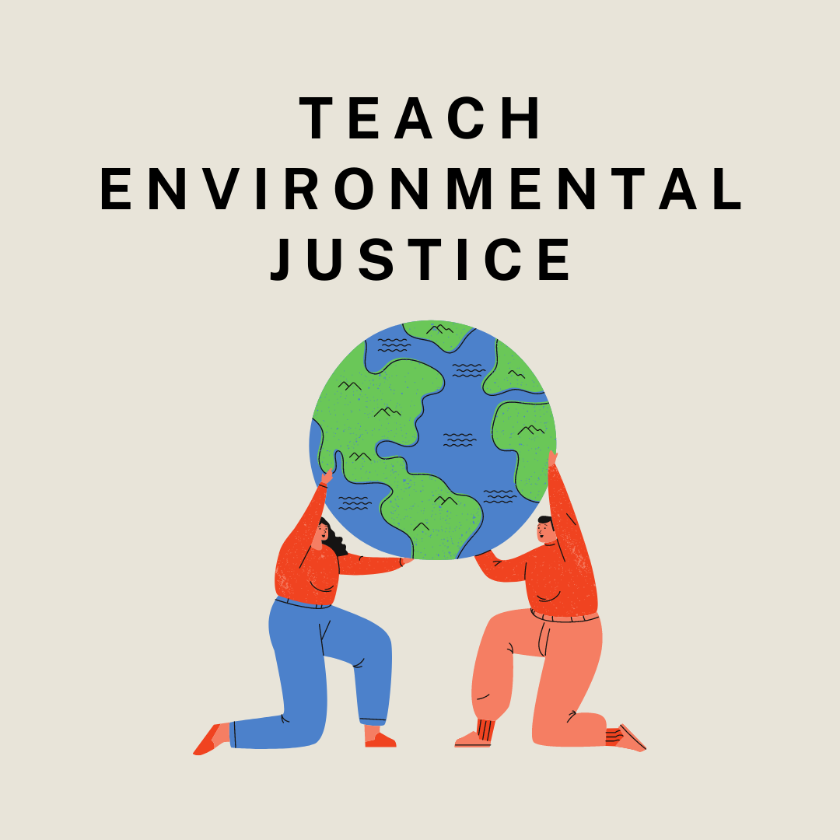
2.3. Addressing loss and damage from climate change impacts
2. JUSTICE AND EQUITY IN CLIMATE DISPUTE RESOLUTION
Environmental Justice Considerations:
Prioritizing the Most Vulnerable: Climate dispute resolution must center the needs of the most climate-vulnerable communities, often marginalized and lacking resources to fully address the impacts.
Beyond Financial Aid: Environmental justice demands addressing loss and damage holistically. It includes technological support for adaptation, capacity building for climate resilience, and addressing non-economic losses.

Slide 6
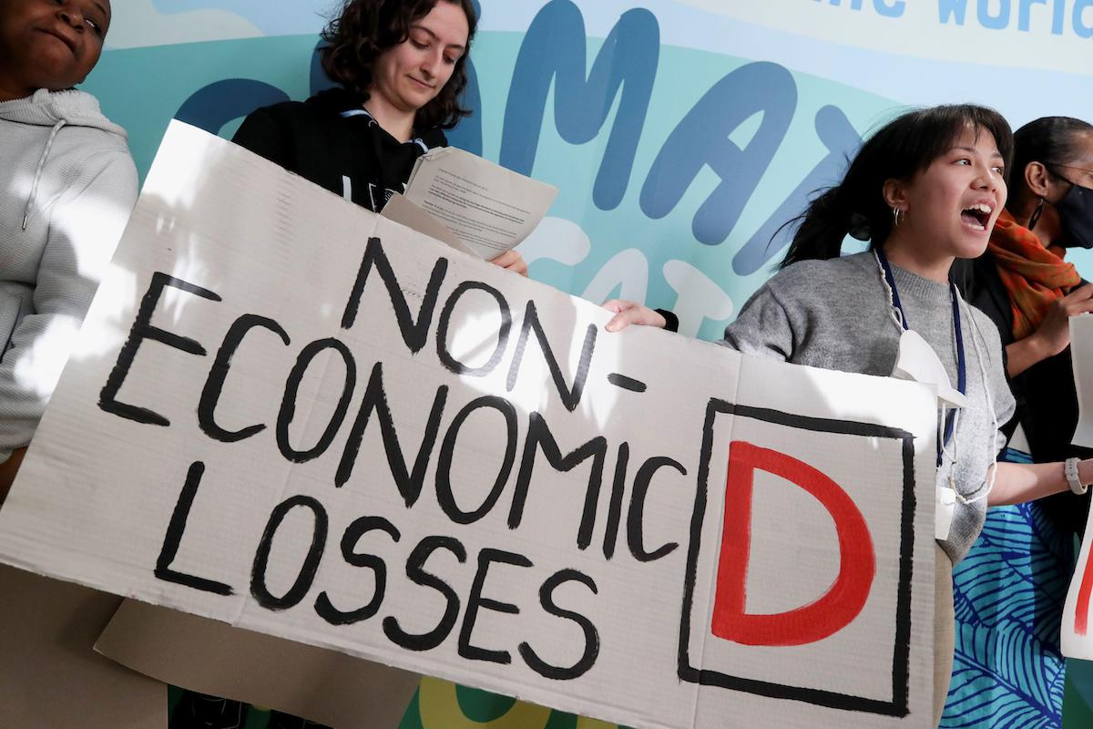
2.3. Addressing loss and damage from climate change impacts
2. JUSTICE AND EQUITY IN CLIMATE DISPUTE RESOLUTION
Types of Loss and Damage:
Economic Loss: Climate change can damage infrastructure, disrupt livelihoods, and lead to economic losses, particularly in sectors like agriculture and tourism.
Non-Economic Loss: Loss of land, cultural heritage, and traditional ways of life can have devastating social and cultural impacts, particularly for indigenous communities and those with deep connections to their environment.

Slide 7
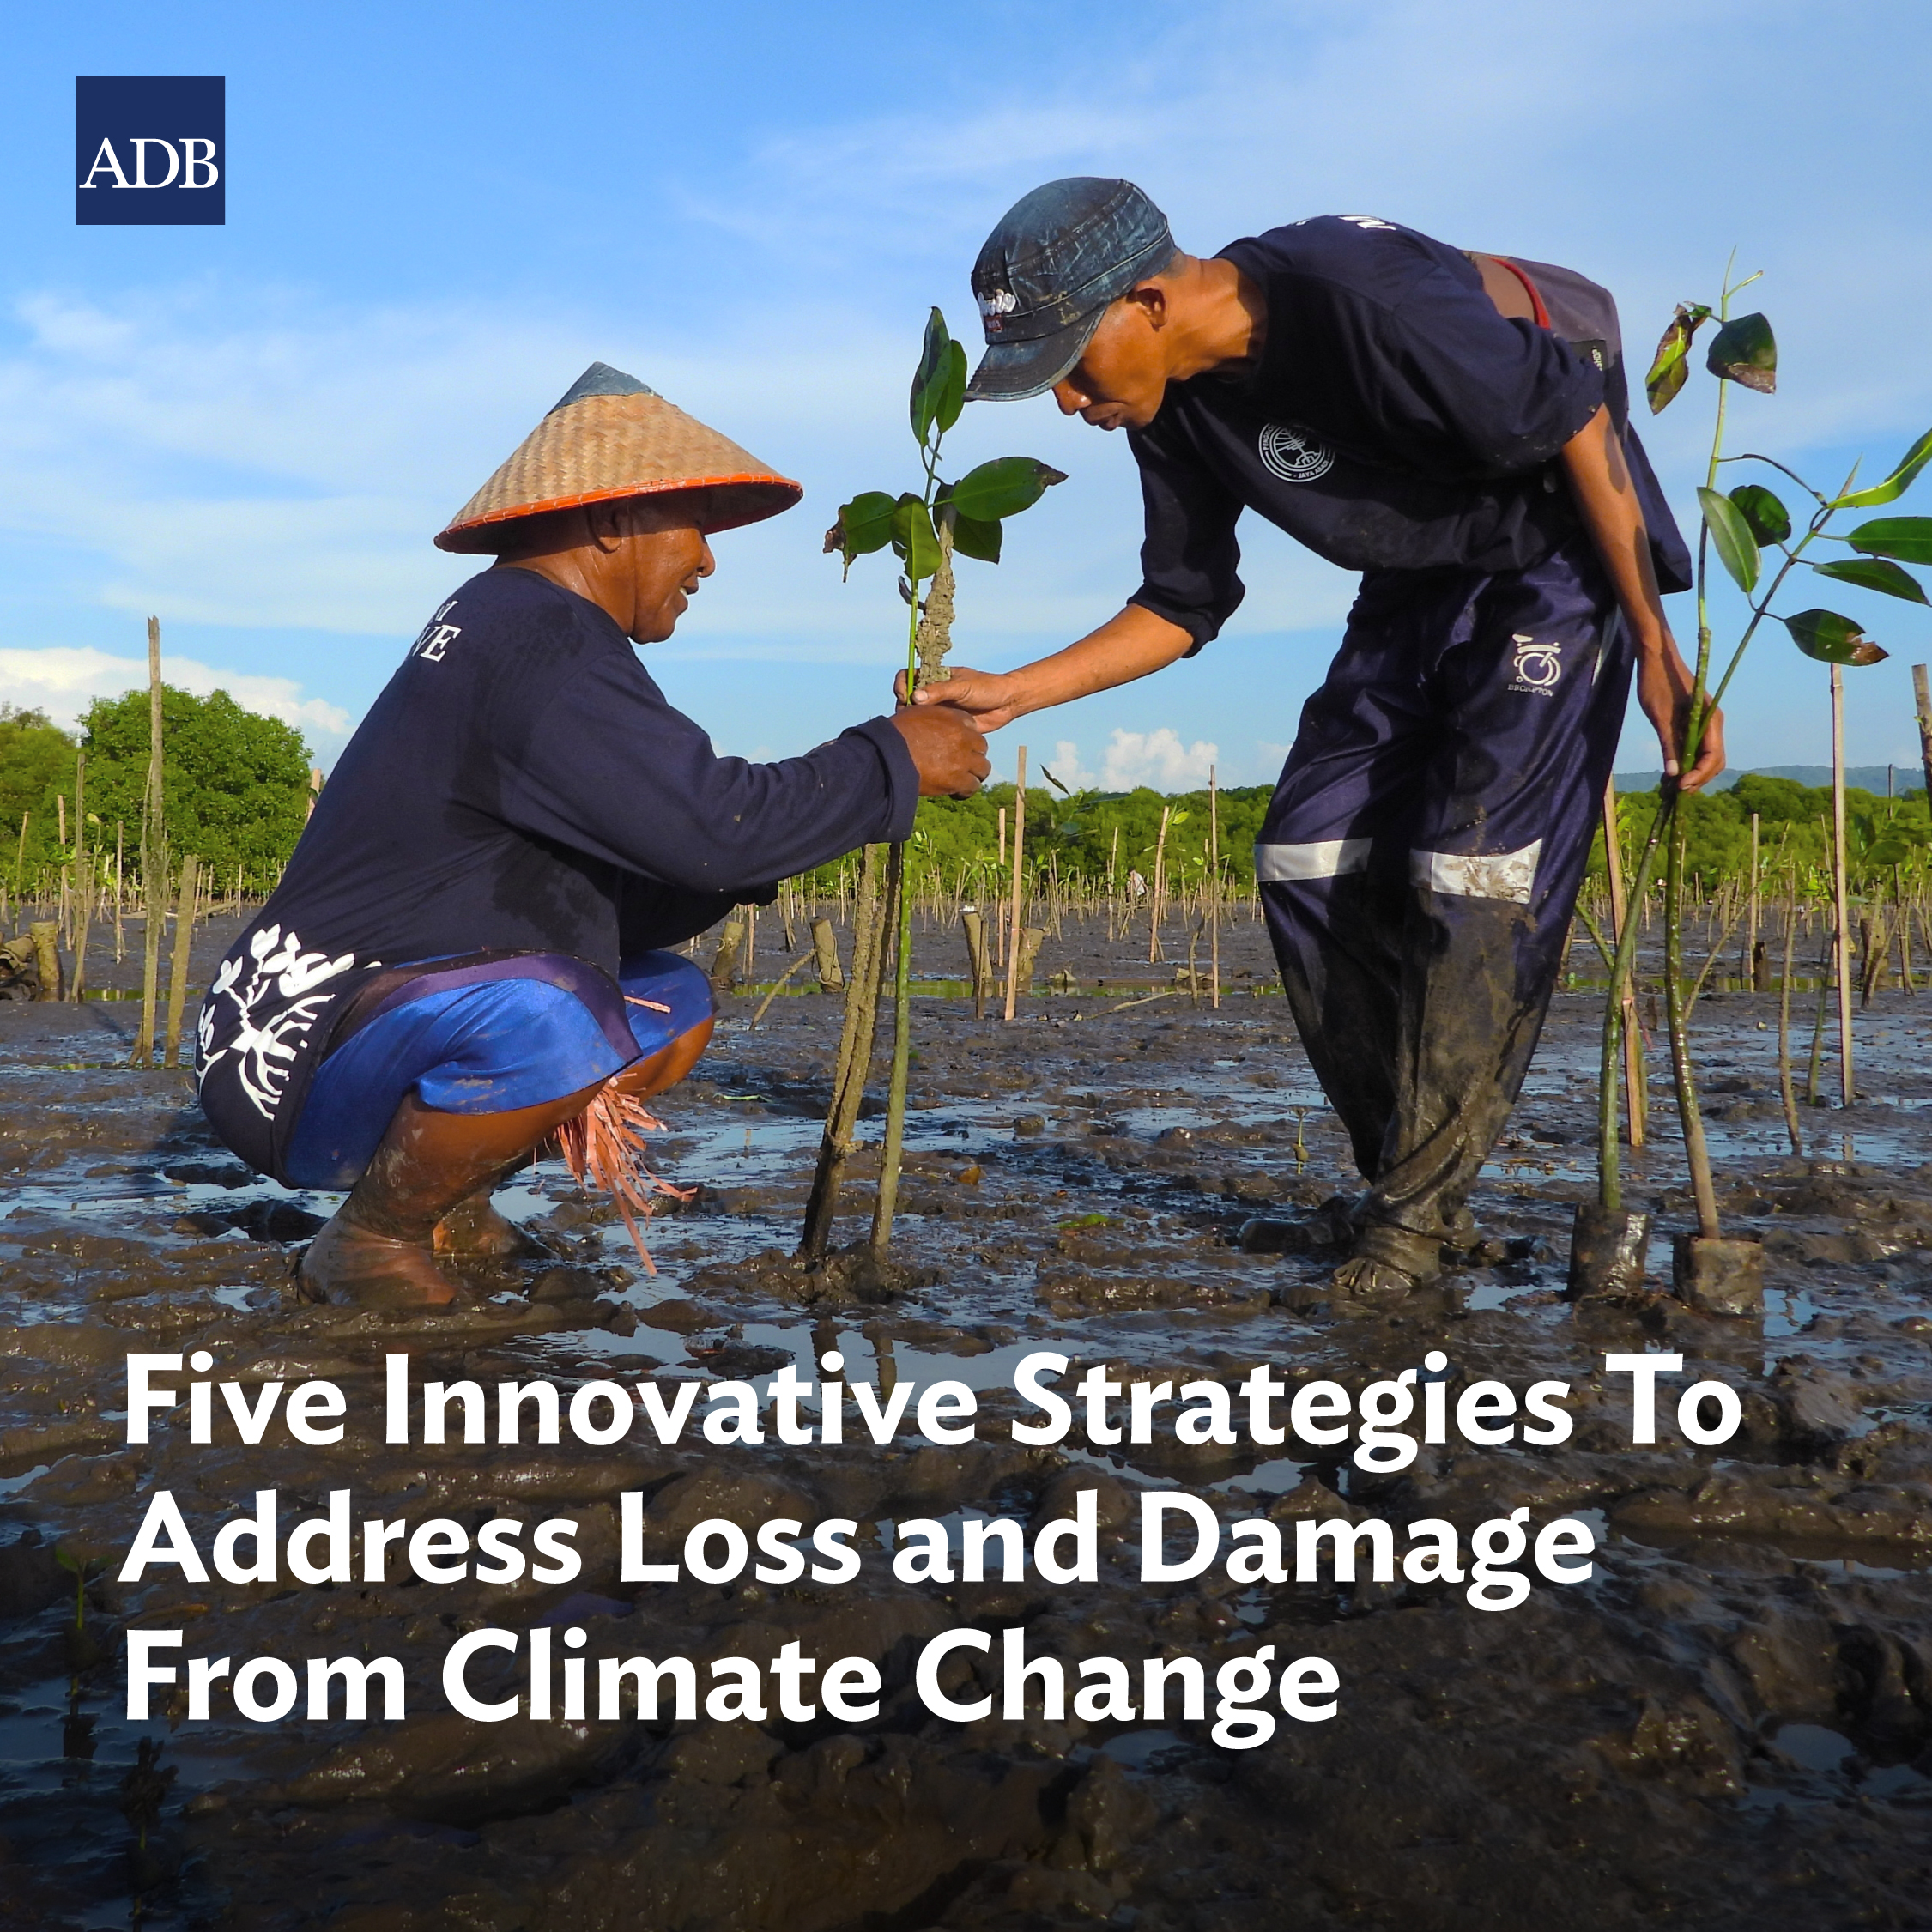
2.3. Addressing loss and damage from climate change impacts
2. JUSTICE AND EQUITY IN CLIMATE DISPUTE RESOLUTION
Addressing Loss and Damage:
Financial Support: Developed countries should provide financial assistance to help vulnerable communities cope with the loss and damage they experience. This could include funding for adaptation measures, disaster relief, and loss compensation.
Capacity Building: Building the capacity of vulnerable communities to adapt to climate change is essential. This includes providing training, resources, and technology to help them manage risks and build resilience.

Slide 8
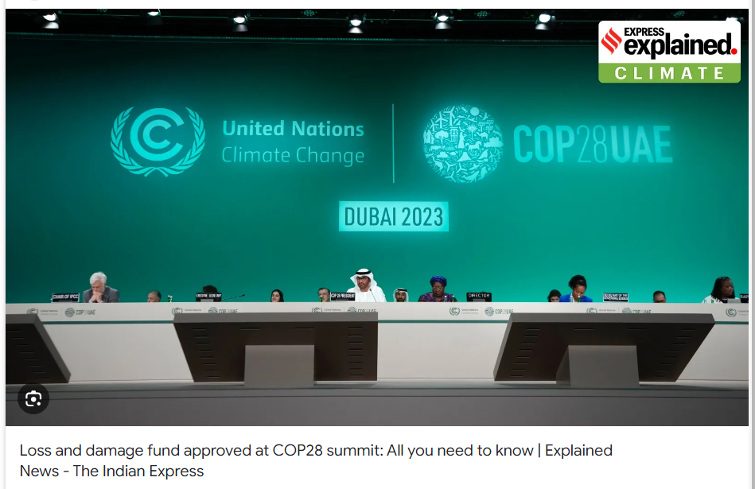
2.3. Addressing loss and damage from climate change impacts
2. JUSTICE AND EQUITY IN CLIMATE DISPUTE RESOLUTION
Addressing Loss and Damage:
Establishing a dedicated Loss and Damage funding mechanism: This will create a reliable source of finance specifically for addressing loss and damage.
Participatory frameworks: Include affected communities in decision-making surrounding loss and damage, ensuring their voices are heard.
Innovative compensation schemes: Explore mechanisms beyond traditional aid, such as levies on fossil fuel industries or debt-for-climate swaps.

Slide 9
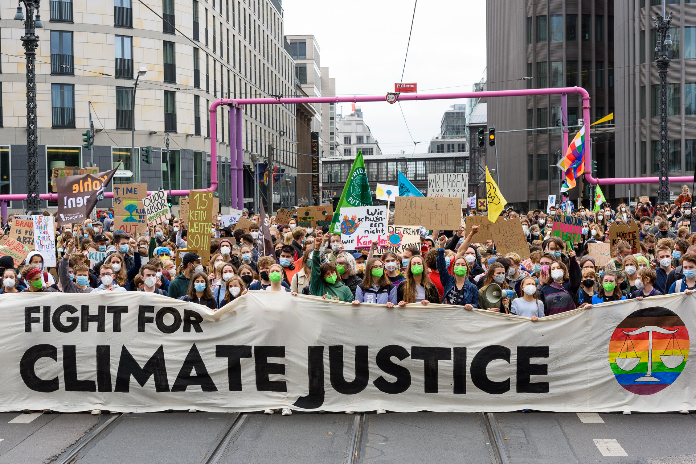
2.4. Ethical and social considerations in climate dispute resolution
2. JUSTICE AND EQUITY IN CLIMATE DISPUTE RESOLUTION
Ethical and Social Dimensions of Climate Disputes:
Climate Injustice: Climate change amplifies existing inequalities. Wealthy nations with high emissions often have greater resources to adapt, while poorer countries with minimal contributions suffer the worst impacts.
Intergenerational Equity: Today's decisions regarding emissions and mitigation profoundly impact future generations. Dispute resolution must consider the rights and well-being of those yet to be born.

Slide 10
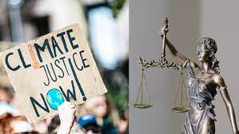
2.4. Ethical and social considerations in climate dispute resolution
2. JUSTICE AND EQUITY IN CLIMATE DISPUTE RESOLUTION
Ethical and Social Dimensions of Climate Disputes:
Distributive Justice: How should the costs and burdens of climate action be distributed fairly? Should high emitters bear more responsibility? Should the most vulnerable receive more support?
Procedural Justice: Ensuring marginalized communities and developing nations have a voice in international climate negotiations and dispute resolution mechanisms is crucial for procedural fairness and just outcomes.

Slide 11
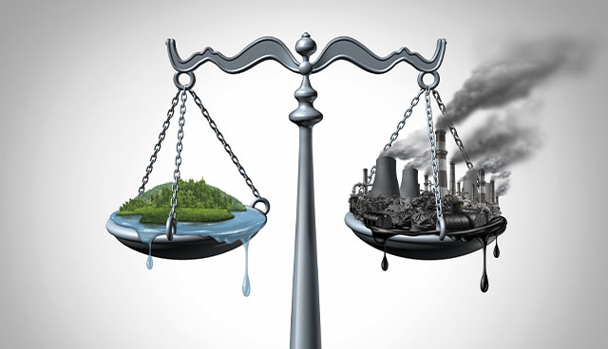
2.4. Ethical and social considerations in climate dispute resolution
2. JUSTICE AND EQUITY IN CLIMATE DISPUTE RESOLUTION
Key Ethical and Social Considerations:
Recognition of Differential Impacts and Responsibilities: Acknowledging that climate change has disproportionate impacts and that historical emitters have a greater responsibility is the foundation for ethical dispute resolution.
Equity-Based Decision Making: Prioritizing the needs of the most vulnerable – nations, communities, and individuals – must be central to decision-making processes to address historical and ongoing climate injustices.

Slide 12
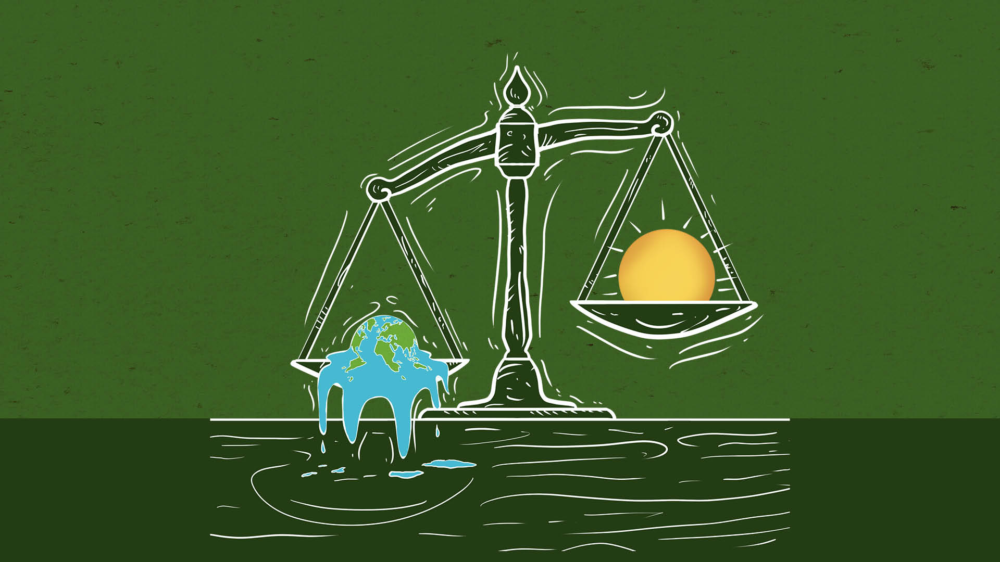
2.4. Ethical and social considerations in climate dispute resolution
2. JUSTICE AND EQUITY IN CLIMATE DISPUTE RESOLUTION
Key Ethical and Social Considerations:
Fair Burden Sharing: Determining how the costs of climate mitigation, adaptation, and loss & damage should be shared requires ethical considerations of fairness within and across generations.
Compensation and Reparations: There's an ethical argument for developed nations, as major historical emitters, to compensate or provide reparations to nations facing the most severe impacts of climate change.

Slide 13
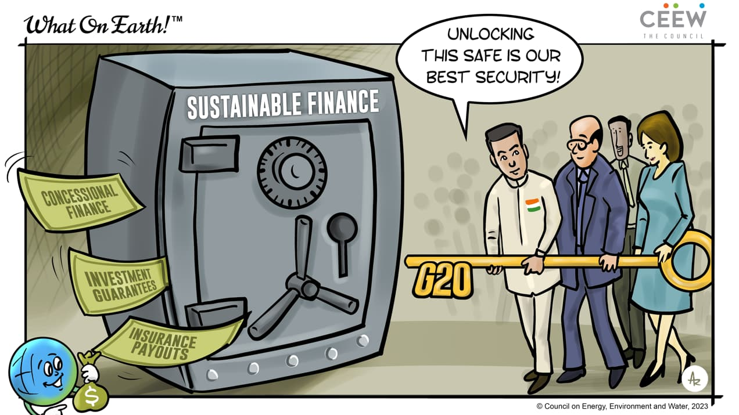
2.4. Ethical and social considerations in climate dispute resolution
2. JUSTICE AND EQUITY IN CLIMATE DISPUTE RESOLUTION
The Imperative for Just Climate Solutions
Ethical and social factors are critical in resolving climate disputes to form a fair and balanced response to the climate crisis, even with existing challenges.
Neglecting fairness in climate change deepens existing problems, hindering solutions and global unity.
Prioritizing the vulnerable, honoring past contributions, and sharing decision-making can ensure a just response to climate change.

Slide 14
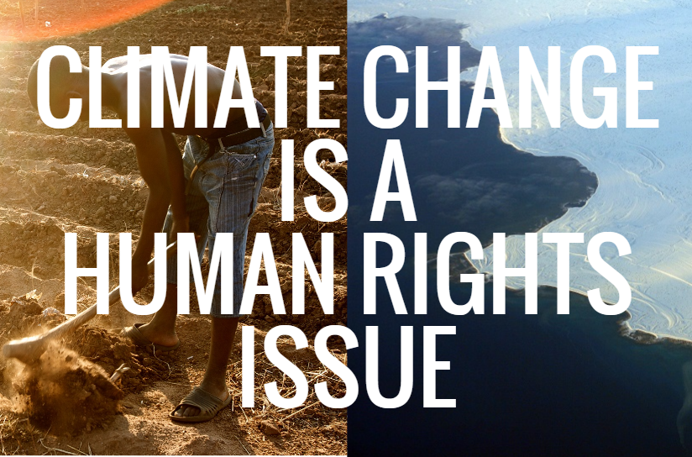
2.5. Climate justice and human rights
2. JUSTICE AND EQUITY IN CLIMATE DISPUTE RESOLUTION
Individual assigment on climate justice and human rights

