Slide 1
CCP-LAW
Curricula development on Climate Change Policy and Law
Subject: Corporate Governance and Climate Change
Topic 3:Governance, Risk Management and Internal Controls Instructor Name: …
Project No of Reference: 618874-EPP-1-2020-1-VN-EPPKA2-CBHE-JP:
The European Commission's support for the production of this publication does not constitute an endorsement of the contents, which reflect the views only of the authors, and the Commission cannot be held responsible for any use which may be made of the information contained therein.

Slide 2
In this topic, we will cover…
Climate change risks and opportunities
Relationship between governance, risk and control
Risk management and internal control process
Development of risk management system

Slide 3
Climate Change Risks and Opportunities

Slide 4
RISKS
Risk is the possibility of an event or condition that can have a negative impact on the achievement of objectives.
Key Elements
Risk Identification: Recognizing potential threats.
Risk Assessment: Evaluating the likelihood and impact.
Risk Mitigation: Developing strategies to manage and minimize

Slide 5
RISKS
Operational
Physical
Financial
Market
Compliance
Regulatory
Reputational

Slide 6
RISKS – 1.Financial Risk
Increased Operating Costs: Climate change can lead to higher costs for energy, raw materials, and insurance premiums as companies need to adapt to new environmental conditions.
Asset Devaluation: Properties and infrastructure in areas prone to extreme weather events or rising sea levels may lose value, affecting a corporation’s balance sheet.
Market and Credit Risks: Financial markets may become more volatile, and credit risks can increase for companies heavily exposed to climate-related impacts.

Slide 7
RISKS – 2. Operational Risk
Supply Chain Disruptions: Extreme weather events and resource scarcity can disrupt supply chains, causing delays and increased costs in production and logistics.
Resource Scarcity: Access to essential resources such as water and raw materials may become limited, affecting production capabilities.

Slide 8
RISKS – 3.Physical Risk
Extreme Weather Events: More frequent and severe weather events (e.g., hurricanes, floods, droughts) can cause direct damage to physical assets and infrastructure.
Long-Term Environmental Changes: Gradual changes such as rising temperatures and changing precipitation patterns can affect agriculture, water availability, and overall business operations.

Slide 9
RISKS – 4. Regulatory Risk
Stricter Regulations: Governments worldwide are implementing stricter regulations to mitigate climate change, which can increase compliance costs and require significant changes in business operations.
Carbon Pricing: Implementation of carbon taxes or cap-and-trade systems can affect the profitability of businesses reliant on fossil fuels.
Reporting Requirements: Corporations may face increased demands for transparency in reporting their environmental impact and sustainability efforts.

Slide 10
RISKS – 5. Compliance Risk
Litigation Risks: Companies may face lawsuits related to environmental damage, failure to comply with regulations, or insufficient disclosure of climate risks.
Regulatory Fines and Penalties: Non-compliance with evolving environmental regulations can result in significant fines and penalties.

Slide 11
RISKS – 6. Reputational Risk
Stakeholder Perceptions
Public Perception
Media Scrutiny
Corporations face growing scrutiny from shareholders, consumers, and the public over their environmental and social impact. Negative perceptions can damage brand reputation and erode customer loyalty.
Consumers, investors, and other stakeholders are increasingly concerned about environmental responsibility. Negative publicity related to environmental practices can harm a corporation's brand image.
Greater attention from the media on corporate environmental performance can impact public perception and trust.

Slide 12
RISKS – 7. Market Risk
Changing Consumer Preferences: There is a growing market for environmentally friendly products and services. Companies that fail to adapt may lose market share to more sustainable competitors.
Competitive Pressure: Businesses need to innovate and incorporate sustainability to stay competitive in a rapidly changing market landscape.
Market Access: Companies that do not meet environmental standards may face restrictions in certain markets or be excluded from investment opportunities.

Slide 13
OPPORTUNITIES
Investment in Renewable Energy
Opportunities
Innovation in Sustainable Products
Market Differentiation

Slide 14
OPPORTUNITIES – 1. Innovation in Sustainable Products
Developing New Markets: By creating innovative, sustainable products, companies can tap into new markets that are increasingly demanding eco-friendly solutions. This can lead to significant growth opportunities and expansion into previously untapped segments.
Revenue Streams: Sustainable products often attract higher margins and loyal customer bases, leading to diversified and more stable revenue streams.
Regulatory Advantage: Companies that innovate with sustainability in mind can stay ahead of regulatory changes and avoid potential fines or sanctions related to environmental impacts.
Example: A company producing biodegradable packaging can reduce plastic waste and appeal to environmentally conscious consumers and businesses, gaining a competitive edge.

Slide 15
OPPORTUNITIES – 2. Investment in Renewable Energy
Cost Reduction: Transitioning to renewable energy sources such as solar, wind, or hydro power can significantly reduce energy costs in the long term, despite the initial investment. Renewable energy sources often have lower operating and maintenance costs compared to fossil fuels.
Energy Independence: Investing in renewable energy can reduce reliance on external energy providers and insulate the company from energy price volatility.
Sustainability Goals: Using renewable energy helps companies meet sustainability goals, reducing their carbon footprint and enhancing their reputation as responsible corporate citizens.
Example: A manufacturing company installing solar panels can generate its own electricity, reduce energy bills, and contribute to a cleaner environment.

Slide 16
OPPORTUNITIES – 3. Market Differentiation
Brand Loyalty: Companies that prioritize environmental performance and sustainability can build stronger relationships with eco-conscious consumers. This loyalty can translate into repeat business and long-term customer retention.
Competitive Advantage: Differentiating products and services through sustainable practices can set a company apart from its competitors, attracting customers who prioritize environmental impact in their purchasing decisions.
Reputation Enhancement: A strong commitment to sustainability can enhance a company's reputation, making it more attractive to investors, partners, and top talent. This can also lead to positive media coverage and improved stakeholder relations.
Example: A fashion brand using organic and recycled materials can attract a niche market of consumers who are willing to pay a premium for sustainable products, thereby increasing its market share and profitability.

Slide 17
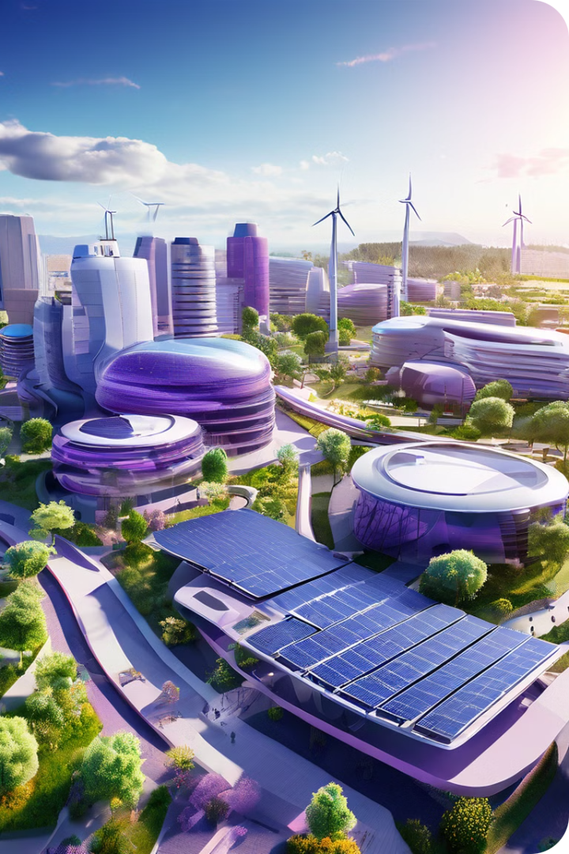
Conclusion and Call to Action
In conclusion, climate change presents both significant risks and valuable opportunities for corporations. By proactively addressing these challenges, organizations can strengthen their resilience, capture new markets, and contribute to a sustainable future.

