Slide 1
CCP-LAW
Curricula development on Climate Change Policy and Law
Subject title: CLIMATE CHANGE DISPUTE LITIGATION
Instructor Name: Nguyễn Thị Hồng Trinh
Project No of Reference: 618874-EPP-1-2020-1-VN-EPPKA2-CBHE-JP:
The European Commission's support for the production of this publication does not constitute an endorsement of the contents, which reflect the views only of the authors, and the Commission cannot be held responsible for any use which may be made of the information contained therein.

Slide 2
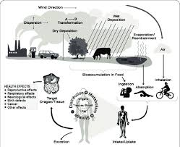
5.1. Introduction: Setting the Context
5. CLIMATE CHANGE LITIGATION AND HUMAN RIGHTS
The interconnectedness of climate change and human rights
Introduction to the Interconnectedness
Climate change is not only an environmental issue but also a profound human rights issue, affecting the most fundamental rights such as health, access to water, food, and secure living conditions.

Slide 3
5.1. Introduction: Setting the Context
5. CLIMATE CHANGE LITIGATION AND HUMAN RIGHTS
The interconnectedness of climate change and human rights
Health Rights at Risk
Climate change impacts health rights by increasing the prevalence of diseases, creating new health risks, and compromising access to clean air and water.

Slide 4
5.1. Introduction: Setting the Context
5. CLIMATE CHANGE LITIGATION AND HUMAN RIGHTS
The interconnectedness of climate change and human rights
Threats to Water and Food Security
Changes in precipitation patterns and temperatures affect water availability and agricultural productivity, leading to challenges in food security and safe drinking water.

Slide 5
5.1. Introduction: Setting the Context
5. CLIMATE CHANGE LITIGATION AND HUMAN RIGHTS
The interconnectedness of climate change and human rights
Vulnerable Populations
Climate change disproportionately affects vulnerable groups, including children, the elderly, indigenous peoples, and residents of developing countries.

Slide 6
5.1. Introduction: Setting the Context
5. CLIMATE CHANGE LITIGATION AND HUMAN RIGHTS
The interconnectedness of climate change and human rights
Climate Migration
Severe weather events and changing environmental conditions force people to migrate, affecting their right to live in their chosen community and maintain cultural ties.

Slide 7
5.1. Introduction: Setting the Context
5. CLIMATE CHANGE LITIGATION AND HUMAN RIGHTS
The interconnectedness of climate change and human rights
Legal Frameworks Evolving
Evolving legal frameworks that address the linkage between human rights and climate change, including key international treaties and national laws.

Slide 8
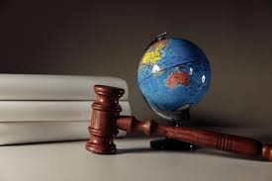
5.1. Introduction: Setting the Context
5. CLIMATE CHANGE LITIGATION AND HUMAN RIGHTS
b) How litigation has evolved as a tool for human rights advocacy in the climate context
Litigation has increasingly become a pivotal tool in the fight against climate change, merging the fields of environmental protection and human rights. This presentation explores how legal actions are used to enforce human rights in the context of the global climate crisis.

Slide 9
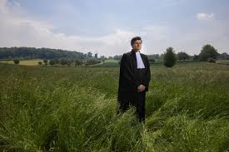
5.1. Introduction: Setting the Context
5. CLIMATE CHANGE LITIGATION AND HUMAN RIGHTS
b) How litigation has evolved as a tool for human rights advocacy in the climate context
Early Cases and Pioneers
The roots of climate litigation can be traced back to early environmental lawsuits that set precedents for today's cases. Pioneers in this field challenged large polluters and government inactions, laying the groundwork for integrating human rights into environmental litigation.

Slide 10
5.1. Introduction: Setting the Context
5. CLIMATE CHANGE LITIGATION AND HUMAN RIGHTS
b) How litigation has evolved as a tool for human rights advocacy in the climate context
Legal Grounds for Climate Litigation
Legal theories and statutes that have been used to link climate change to human rights, such as public trust doctrine and international human rights law.

Slide 11
5.1. Introduction: Setting the Context
5. CLIMATE CHANGE LITIGATION AND HUMAN RIGHTS
b) How litigation has evolved as a tool for human rights advocacy in the climate context
Notable Global Cases
Examples of significant cases from around the world where courts have ruled on climate issues based on human rights considerations, such as the Urgenda case in the Netherlands and Juliana v. United States.

Slide 12
5.1. Introduction: Setting the Context
5. CLIMATE CHANGE LITIGATION AND HUMAN RIGHTS
b) How litigation has evolved as a tool for human rights advocacy in the climate context
Impact on Policy and Public Awareness
These legal battles have influenced public policy and raised awareness about the link between human rights and climate change.

