Slide 1
CCP-LAW
Curricula development on Climate Change Policy and Law
Subject title: Topic 7_Waste Reduction Strategies and Circular Economy
Instructor Name: Filio Petridou_ PEDMEDE
Project No of Reference: 618874-EPP-1-2020-1-VN-EPPKA2-CBHE-JP:
The European Commission's support for the production of this publication does not constitute an endorsement of the contents, which reflect the views only of the authors, and the Commission cannot be held responsible for any use which may be made of the information contained therein.

Slide 2
Contents
1. The role of waste reduction strategies in achieving circular economy…….……….
2. The principles of waste hierarchy and extended producer responsibility...………..
3. Waste reduction application policies and practices in partner countries………….
4. Case studies on successful waste reduction strategies and circular economy practices….………………………………………………………………………………………....
Reference List……………………………………………………………………………….………

Slide 3
1. The role of waste reduction strategies in achieving circular economy
Waste management refers to the process of collection, transporting, recovery (including sorting) and disposal of waste in a safe and environmentally friendly way. It involves Reducing, Reusing and Recycling waste, as much as, possible to conserve natural resources and support in addressing the effects of climate change.
Waste reduction consists a flagship priority in the waste management process, intertwined with the circular economy model of development, which is:
“A sustainable economic model in which products and materials are designed in such a way that they can be reused, remanufactured, recycled or recovered and thus remain in the economy as long as possible together with the resources from which they are made” (United Nations, 2019)

Slide 4
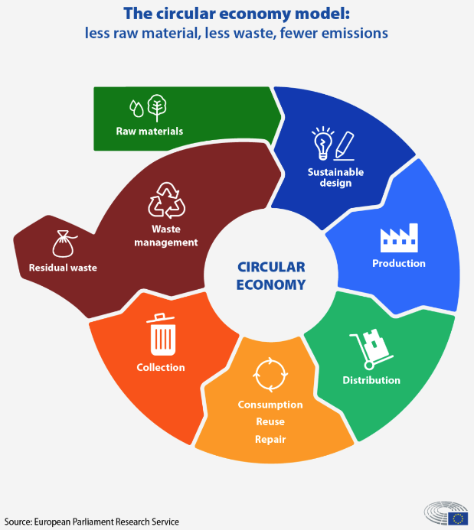
Circular Economy
Title
In a circular economy, materials re-enter the economy at the end of their use. It refers to a paradigm shift from the linear ‘take – make –consume – throw away’ system, towards a circular system of ‘Repair – Reuse – Recycle’.
A circular system implies reducing waste to a minimum. When a product reaches the end of its life, its materials are kept within the economy wherever possible through recycling.

Slide 5
Types of most common Wastes
Construction and demolition waste
Food waste
Industrial waste
Plastics
Agricultural waste
Health waste
Hazardous chemical waste
Electrical and electronic waste (e-waste)
Textiles
End-of-life vehicles and waste from mechanics’ garages
Definition:
Waste is the unintended by-product of consumption and production.

Slide 6
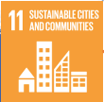
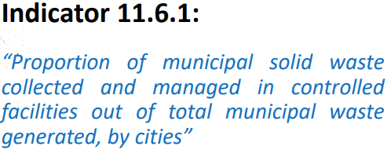
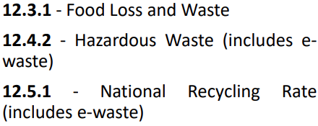
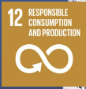
1. The role of waste reduction strategies in achieving circular economy
In the framework of Circular Economy, waste reduction strategies contribute to the mitigation of climate change and the attainment of UN Sustainable Development Goals. In particular:

Slide 7
2. The principles of waste hierarchy and extended producer responsibility
According to the UN Global Waste Management Outlook 2024, every year across the globe more than two billion tones of municipal solid waste (MSW) is generated, whereas some 2.7 billion people do not have their waste collected: 2 billion in rural areas and 700,000 in urban areas. In 2019, a record 53.6 million metric tones (Mt) of electronic waste was generated worldwide.
For reversing these trends, waste reduction and circular management is an imperative and a number of strategies and methods have been devised to support in their optimum attainment, such as:
Waste Hierarchy Strategy
Reuse and recycling
Waste-to-energy, also known as incineration with energy recovery
Sanitary landfll
Waste segregation
Biological reprocessing (composting)
Beginning in Europe in 2008 and since then applied globally (through the United Nations Environment Program, 2011) both as a conceptual framework, as well as, a comprehensive strategy, Waste Hierarchy establishes an order of preference for managing and disposing waste.

Slide 8
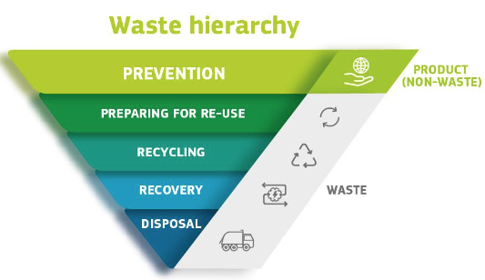
Waste Hierarchy Strategy
2. The principles of waste hierarchy and extended producer responsibility
The Waste Framework Directive (Directive 98/2008/EC, article 4) introduced a five-step waste hierarchy instead of the traditional waste management approach consisting of three R’s (Reduce, Reuse, Recycle), where prevention / reduction is the best option, followed by re-use, recycling and other forms of recovery, with disposal such as landfill as the last resort.
It requires that waste should be managed:
without endangering human health and harming the environment
without risk to water, air, soil, plants or animals
without causing a nuisance through noise or odours
and without adversely affecting the countryside or places of special interest

Slide 9
2. The principles of waste hierarchy and extended producer responsibility
Waste Hierarchy is a strategy (WHS) based on circular economy principles. It ensures that from the start, materials are being designed to reduce overall waste. Additionally, the waste hierarchy prepares for a product’s end-of-life so that materials can re-enter the cycle by means of re-use, recycling, and recovery. According to the WHS, each phase in the waste management process is ranked according to its environmental impact and resource efficiency and include:
• Prevention / Reduction: measures taken before a substance, material or product has become waste.
• Re-use: operations by which products or components that are not waste are used again or the same purpose for which they were conceived.
• Preparing for re-use: checking, cleaning or repairing products or components of products so that they can be re-used without any other pre-processing.
• Recycling: recovery operations where waste materials are reprocessed into products, materials or substances for both the original and other purposes. This includes composting but not energy recovery or processing of waste for use as fuels.
• Recovery: operations where the principal result is waste serving a useful purpose by replacing other materials which would otherwise have been used to fulfil a particular function, in the plant or wider economy.
• Disposal: landfill and incineration without energy recovery.

Slide 10
3. Waste reduction application policies and practices in partner countries (Vietnam)
National Strategy for Integrated Solid Waste Management up to 2025
Main goals of the plan include:
To collect and treat up to environmental standards 100% of daily life solid waste in urban centers, 90% of which will be recycled, reused, recovered energy or used for organic fertilizer production.
To collect and treat 90% of construction solid waste in urban areas. 60% of which will be recovered for reuse or recycling.
To collect and treat up to environmental standards 90% of solid waste from rural residential areas and 100% of solid waste from craft villages.
National Action Plan for Management of Marine Plastic Litter by 2030
Vietnam aims for a 50% reduction in marine plastic litter by 2025, increasing to 75% by 2030.
It has made a political commitment, in order to, manage and reduce plastic waste, including ocean plastic waste (Resolution No. 36-NQ /TW of October 22, 2018, of the Eighth Conference of the Party Central Committee XII), setting the goal of “Preventing, controlling, and significantly reducing pollution of the marine environment; becoming a regional leader in minimizing ocean plastic waste.” The plan was launched in 2020.

Slide 11
3. Waste reduction application policies and practices in partner countries (Spain)
State program for waste prevention 2014-2020
Total waste prevention program, which was structured around four strategic orientations:
Reduction of the waste generation in Spain
Reuse and extension of the useful life of products
Reduction of the content of harmful substances in materials and products, and
Reduction of the adverse impacts on human health and the environment of the waste generated.
In 2016 Spain became the first European country to set a separate and binding national re-use target by adopting a State Waste Management Framework Plan (PEMAR) 2016-2022
Law 7/2022 on waste and contaminated soils for a circular economy
This law includes, among others:
The adoption of measures to prevent the generation of waste by competent authorities
The promotion and support of sustainable and circular production and consumption models
The promotion of the reduction of hazardous substances in materials and products in accordance with established harmonized EU legislation
The adoption of the ‘Waste Hierarchy’ (art. 8)

Slide 12
3. Waste reduction application policies and practices in partner countries (Malaysia 1)
The 12th Malaysia Plan (2021-2025)
Since the 1990’s Malaysia has implemented 12 four-year-long national plans, so called ‘Malaysia Plans” in order to transform into a developed country. The 12th Malaysia Plan (2021-2025) incorporates the country's waste reduction strategy and the principle of 3R’s. The Plan emphasizes the need of transitioning from a linear to a circular economy and includes directions for introducing integrated waste management facilities, controlling waste imports and exports, minimizing single-use plastics and packaging materials. It has also set a 40% recycling rate target by 2025.
National Strategic Plan for Solid Waste Management 2019-2030
The first national SWM plan was introduced in 2005, however the Malaysian government re-introduced a strategy for waste management for the period 2019-2030 aiming at lower waste generation, boosting recycling rates and enhance waste management facilities across the country.
Malaysia’s Roadmap Towards Zero Single-Use Plastics 2018-2030
In order to, address plastics waste and pollution Malaysia has adopted a Roadmap in cooperation with stakeholders such as NGOs, academia, industry, retailers, federal agencies and state governments and introduced a strategy “Towards zero single-use plastics for a cleaner and healthier environment in Malaysia by 2030”.

Slide 13
3. Waste reduction application policies and practices in partner countries (Malaysia 2)
Malaysia Circular Plastics Economy Roadmap 2020-2030
The great increase in plastics waste generation, together with the low rate or recycling, where only 24% of plastics (from four main resins (PET, PP, LDPE/LLDPE and HDPE)) introduced to the market in 2019 were recycled, has led Malaysia to engage a circular approach to plastics waste management and adopt the ‘Circular Plastics Economy Roadmap’ for the period 2020-2030. The main objectives of the plan are:
1. To sustainably address plastic pollution in Malaysia, ensuring economic development, environmental protection and societal wellbeing.
2. To provide guidance and promote sustainable business practices in ensuring plastics circularity and sustainability through circular economy approach.
3. To harmonize actions along plastic value chain through adoption of life cycle approach.
Achieving a circular economy for plastics ensures that problematic and unnecessary plastics are phased out up-front, and that plastics at the end of life-cycles are designed to be reused, recycled, or disposed of in a clean and sanitary way

Slide 14
3. Waste reduction application policies and practices in partner countries (Greece)
Νational Waste Management Plan (NWMP) 2020-2030
In order to, improve waste management and reduction and get closer to the European waste indicators, Greece has renewed its waste management plan of 2015 and devised a new ‘National Waste Management Plan’ for the period 2020-2030.
Among the main objectives of the plan include:
1. The reduction of the amount of waste being buried in landfills to below 10% by 2030. 2. The implementation of the separate collection for waste and bio-waste materials. The separate collection of biological waste has become mandatory as of 31st December 2022. 3. The development of a network for the collection of organic waste (coffee bin) by the end of 2022. 4. The recovery of energy from the treatment of organic waste (biomass) and also the production of secondary materials (compost). 5. The construction and operation of Waste Treatment Plants and Bio-Waste Treatment Plants.
New Action Plan for Circular Economy 2019-2021
The new plan replaces the 2018-2019 ‘National Business Plan for the Circular Economy’ included in the “National Strategy for the Circular Economy” established in 2018. It includes among others 71 actions for the period 2021-2025 of which:
46 concern horizontal aspects of circular economy, such as consumption, production and waste management
25 concern the application of circular economy principles in waste materials, such as electronic, plastic, construction etc

Slide 15
3. Waste reduction application policies and practices in partner countries (India 1)
Waste management and reduction
The Ministry of Environment, Forest and Climate Change has introduced a number of waste management rules in order to, address India’s increased waste production:
Solid Waste Management Rules, 2016,
Plastic Waste Management Rules, 2016, amended in 2018, 2021 and 2022
Bio-medical Waste Management Rules, 2016,
Construction and Demolition Waste Management Rules, 2016,
Hazardous and other wastes (Management and Transboundary Movement) Rules, 2016,
E-waste Management Rules, 2022,
Battery Waste Management Rules, 2022.
India is the fifth-highest generator of plastic waste in the world. In 2022, India banned single-use plastic (SUPs) items that have low utility but are often littered, harming land and marine ecosystems. It had also stipulated mandatory targets on ‘extended producer responsibility (EPR), recycling of plastic packaging waste, reuse of rigid plastic packaging and use of recycled plastic content.
In 2014, the Indian government launched the ‘Swachh Bharat Abhiyaan’ (Clean India Mission) program, aiming to make India cleaner and free from open defecation and litter. The mission included provisions for plastic waste management, such as promoting waste segregation at the source and setting up plastic waste management systems.

Slide 16
3. Waste reduction application policies and practices in partner countries (India 2)
Waste to Energy Program
India introduced in 2022 a Waste to Energy Program, which is separated in three (3) sub-programs:
Waste to Energy
Biomass Program
Biogas Program
The main objective of the program is to support the setting up of Waste to Energy projects for generation of Biogas/ BioCNG/ Power/ producer or syngas from urban, industrial and agricultural wastes/residues.
Waste to Wealth Mission
Waste to Wealth Mission is an initiative organized by the Office of the Principal Scientific Advisor to the Government of India aiming at identifying, validating and deploying technologies for waste management, adoption of circular economy practices, clean energy generation and recycling
The Mission has taken several initiatives in different areas of waste management, including technology demonstrations in multiple waste management domains, community engagement and development of an online portal, which act as a reference point for all stakeholders including urban local bodies, government departments, technology companies, investors and citizens.
Mission Circular Economy 2021 - Circular Economy Cell (CE Cell)
This government Unit was initiated by NITI Aayog (government think-tank) in September 2022, as a dedicated agency to work in the field of Circular Economy. 10 sectoral Circular Economy action plans were developed for 10 waste categories: Li-ion batteries; E-waste; Toxic and hazardous industrial waste; Scrap metal (ferrous and non-ferrous); Tyre and Rubber; End of Life Vehicles; Gypsum, Used Oil, Municipal solid waste and Solar Panels. On average, about 50.72% of the waste collected in India is minimized, recycled, and reused (Gour &Singh, 2022:10)

Slide 17
3. Waste reduction application policies and practices in partner countries (United Kingdom 1)
Our waste, our resources: a strategy for England
In December 2018, the UK government published ‘Our waste, our resources: a strategy for England (the Strategy)’, setting out government’s aim towards establishing a circular economy model for waste management, where products are used again or for longer through reuse, repair and recycling. It contains 5 strategic ambitions:
1. To work towards all plastic packaging placed on the market being recyclable, reusable or compostable by 2025
2. To work towards eliminating food waste to landfill by 2030
3. To eliminate avoidable15 plastic waste over the lifetime of the 25 Year Environment Plan
4. To double resource productivity16 by 2050 and
5. To eliminate avoidable waste of all kinds by 2050.
It also includes important milestones, such as:
1. 50% recycling rate for household waste by 2020 and
2. 65% recycling rate for municipal solid waste by 2035.

Slide 18
3. Waste reduction application policies and practices in partner countries (United Kingdom 2)
Waste prevention program for England 2021
It embeds the strategic principle – ‘to prevent waste from occurring in the first place and manage it better, when it does’ and is applied to 7 sectors of waste arisings:
Construction
Textiles
Furniture
Electronics
Vehicles
Plastic and packaging
Good
Routemap for Zero Avoidable Waste in Construction 2021
It adopts the principles of the waste hierarchy and life cycle assessment and include baseline targets, such as:
Zero avoidable waste (ZAW) in the construction sector by 2050
By 2040 eliminate all but hazardous C&D waste entering landfill
By 2040 reduce soil to landfill by 75% based on a 2020 level and by 2050 this should be zero unless required for landfill operation purposes.

Slide 19
4. Case studies on successful waste reduction strategies and circular economy practices (1)
The Zero Waste town of Kamikatsu in Tokushima Prefecture Japan (1)
In 2003, the Japanese Municipality of Kamikatsu declared its intention to become a Zero-Waste Town. Twenty years later, in 2023, and by putting into practice the 3Rs - “reduce, reuse, and recycle” the town has reached an impressive 80% recycling rate by sorting trash into 45 categories, with used items displayed like a store at the Zero Waste Center, when the national rate of Japan is at 20%.
As the town does not operate its trash collection service, the residents take their garbage themselves to the town’s single waste-collection center, where they then separate it into the various categories. Meanwhile, they compost kitchen waste and food scraps at home. With the town having devised such a waste system, the residents have gained a keen awareness of the need to reduce waste completely.

Slide 20
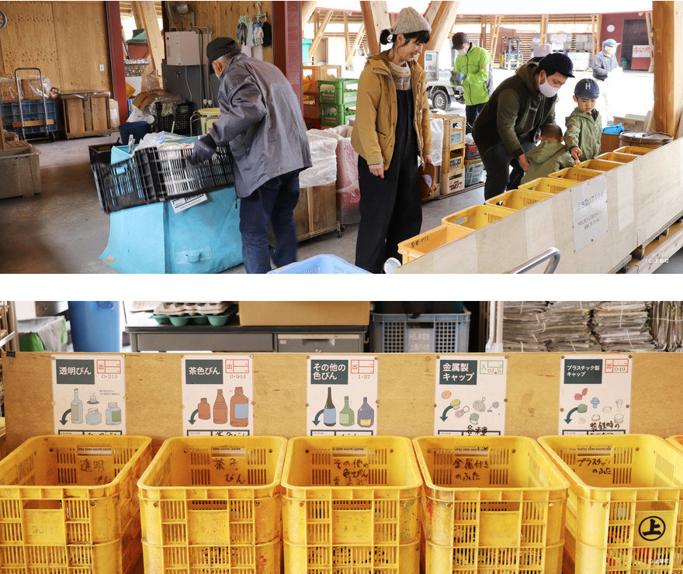
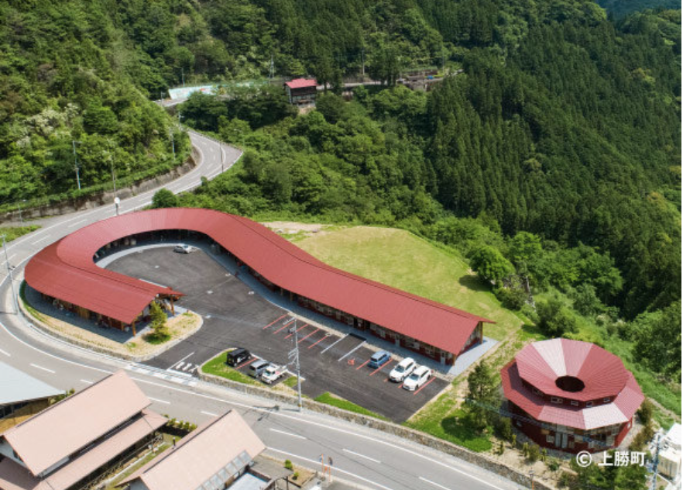
4. Case studies on successful waste reduction strategies and circular economy practices (1)
The Zero Waste town of Kamikatsu in Tokushima Prefecture Japan (2)
Looking down from above, an intriguing pair of buildings appears in the shape of a question mark. The Zero Waste Center (left), comprises a garbage collection facility, a learning center and public hall, a collaborative laboratory and a hotel.

Slide 21
4. Case studies on successful waste reduction strategies and circular economy practices (2)
Sweden: Transforming Waste to Energy (1)
Sweden is often described as the world’s greenest country. Within a few decades, the country has completely revolutionized waste management, drastically increasing its recycling rate and investing in technologies to turn its waste into energy.
Circular Economy has been the main strategy for Sweden’s transition
Sweden has the highest renewable energy usage in the European Union – with approximately 56% of the energy coming from renewable sources such as hydroelectric, wind, and nuclear power – but it also has some of the world’s lowest carbon emissions thanks to a shift to electric transportation, as well as extensive investments in smart technologies and urban farming. On average, nearly 60% of the world’s waste ends up in landfills. Yet in Sweden, it accounts for just 1%.

Slide 22
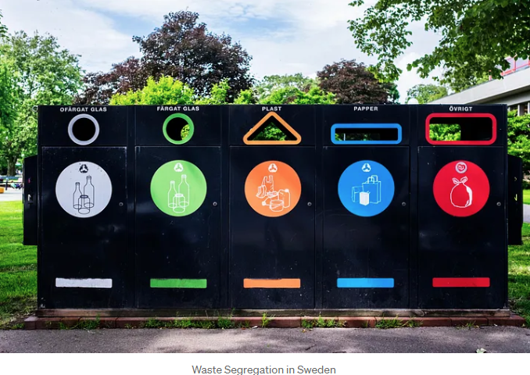
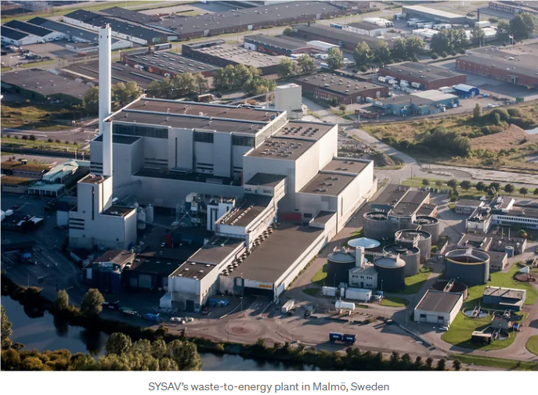
4. Case studies on successful waste reduction strategies and circular economy practices (2)
Sweden: Transforming Waste to Energy (2)

Slide 23
Reference List (1)
Gour Anunay A. and Singh S.K. (2022) “Solid Waste Management in India: A State-of-the-Art Review”, in Environmental Engineering Research, 28(4), https://doi.org/10.4491/eer.2022.249
Greece (2018) “Action Plan on Circular Economy”, https://circulareconomy.europa.eu/platform/en/strategies/greeces-action-plan-circular-economy
Greece “Circular Economy Implementation in Greece”, https://circulargreece.gr/el/
India “Waste to Wealth Mission”, https://www.wastetowealth.gov.in/policies , https://www.psa.gov.in/waste-to-wealth
India “Waste to Energy Program”, https://cdnbbsr.s3waas.gov.in/s3716e1b8c6cd17b771da77391355749f3/uploads/2022/12/2022122763-1.pdf,
https://mnre.gov.in/waste-to-energy/
Karishma Chaudhary / Prem Vrat, (2017) “Overview and Critical Analysis of National Law on Electronic Waste Management (India)”, in Environmental Policy and Law, 47(5-6), pp. 181-188.
Malaysia, “Malaysia’s Roadmap Towards Zero Single-Use Plastics 2018-2030”, https://www.pmo.gov.my/ms/2019/07/pelan-hala-tuju-malaysia-ke-arah-sifar-penggunaan-plastik-sekali-guna-2018-2030/
Ng, K.S., Yeoh, L., Iacovidou, E., Wan Ab Karim Ghani, W.A., Yamaguchi, A. (2023) “Towards Sustainable Municipal Solid Waste Management in Malaysia”, University of Oxford and Brunel University London. Funded by the UK Natural Environment Research Council (NE/R012938/1).

Slide 24
Reference List (2)
Shakil, Nurul & Azhar, Nur & Othman, Norashida (2023) “Solid Waste Management in Malaysia: An overview” in Information Management and Business Review”, vol. 15, pp. 86-93.
Spain (2022) “Law 7/2022 on waste and contaminated soils for a circular economy”, https://www.boe.es/eli/es/l/2022/04/08/7
Spain, “State program for waste prevention 2014-2020”,
https://www.eea.europa.eu/themes/waste/waste-prevention/countries/2021-waste-prevention-country-profiles/spain-waste-prevention-country-profile-2021
https://www.miteco.gob.es/en/calidad-y-evaluacion-ambiental/planes-y-estrategias/planes-y-programas.html
United Kingdom (2018) “Our waste, our resources: a strategy for England”, https://assets.publishing.service.gov.uk/media/5c18f11740f0b60bbee0d827/resources-waste-strategy-dec-2018.pdf
United Kingdom (2021) “Waste prevention program for England”, https://www.gov.uk/government/publications/waste-prevention-programme-for-england-maximising-resources-minimising-waste/the-waste-prevention-programme-for-england-maximising-resources-minimising-waste
United Kingdom (2021) “Routemap for Zero Avoidable Waste in Construction”, https://www.constructionleadershipcouncil.co.uk/wp-content/uploads/2021/07/ZAW-Interactive-Routemap-FINAL.pdf
United Nations Environment Programme (2024) “Beyond an age of Waste. Turning rubbish into a resource”, https://www.unep.org/news-and-stories/press-release/world-must-move-beyond-waste-era-and-turn-rubbish-resource-un-report

Slide 25
Reference List (3)
United Nations Environment Programme (2010) “Waste and Climate Change - Global Trends and Strategy Framework”, https://wedocs.unep.org/20.500.11822/8648
Vietnam (2018) “National Action Plan for Management of Marine Plastic Litter by 2030”, https://www.undp.org/vietnam/publications/national-action-plan-management-marine-plastic-litter-2030
https://www.oecd.org/ocean/topics/ocean-pollution/marine-plastics-pollution-Viet-Nam.pdf
Vietnam (2017) “National strategy for integrated solid waste management to 2025, vision to 2050”, https://asemconnectvietnam.gov.vn/default.aspx?ZID1=14&ID8=14639&ID1=2

