Slide 1
CCP-LAW
Curricula development on Climate Change Policy and Law
Subject title: EU Green Deal and a climate neutral continent
Instructor Name: PROF. ABHINAV SHRIVASTAVA & PROF. RAJ VARMA
Project No of Reference: 618874-EPP-1-2020-1-VN-EPPKA2-CBHE-JP:
The European Commission's support for the production of this publication does not constitute an endorsement of the contents, which reflect the views only of the authors, and the Commission cannot be held responsible for any use which may be made of the information contained therein.

Slide 2
THE EU GREEN DEAL
The EU Green Deal is a comprehensive strategy aimed at making the European Union a climate-neutral continent by 2050. It outlines a bold vision to transform Europe's economy and society to address the pressing challenges of climate change and environmental degradation.

Slide 3
Addressing Climate Change: The Urgency
Overwhelming Scientific Consensus: The overwhelming scientific evidence confirms that human-induced climate change is a pressing global issue requiring immediate action.
Accelerating Impacts: The pace and severity of climate change impacts, from rising sea levels to extreme weather events, are intensifying rapidly, threatening lives and livelihoods worldwide.
Narrowing Window of Opportunity: The window of opportunity to mitigate the worst effects of climate change is rapidly closing, necessitating swift and coordinated global efforts.
Intergenerational Responsibility: Taking decisive action on climate change is a moral imperative to protect the planet for current and future generations

Slide 4
EU's Commitment to Climate Neutrality
Net Zero Emissions Emissions by 2050: The EU has set an ambitious target of achieving climate neutrality by 2050, meaning the EU will strive to balance greenhouse gas emissions with removals through natural and technological solutions.
Binding Interim Targets: To stay on track, the EU has also established binding intermediate goals, including a 55% reduction in emissions by 2030 compared to 1990 levels.
Comprehensive Policy Framework: The EU Green Deal outlines a comprehensive set of policies and regulations to drive the transition to a climate-neutral economy, covering areas like energy, transport, industry, and agriculture.
Global Leadership: By pursuing ambitious climate action, the EU aims to position itself as a global leader in the fight against climate change and inspire other regions to take similar decisive steps.

Slide 5
Key Pillars of the EU Green Deal
1. Climate Action: Reducing greenhouse gas emissions and transitioning to clean energy sources to mitigate climate change.
2. Sustainable Industry: Promoting sustainable production and consumption practices, circular economy, and innovation in green technologies.
3. Biodiversity Protection: Preserving and restoring natural ecosystems, habitats, and wildlife to safeguard the planet's biodiversity.
4. Sustainable Mobility: Developing environmentally-friendly transportation solutions, including electric vehicles, public transit, and multimodal systems.

Slide 6
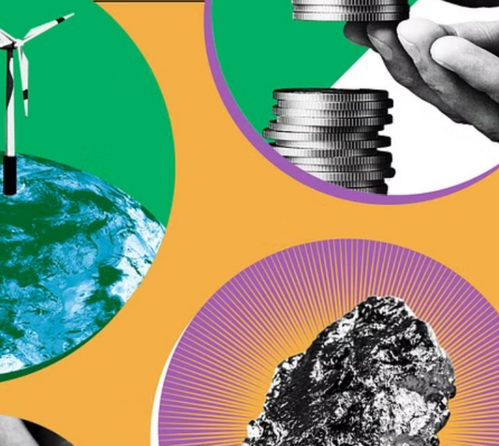
Renewable Energy Transition
The EU Green Deal aims to accelerate the shift towards renewable energy sources to meet its climate neutrality goals. This includes a significant increase in wind, solar, and other clean energy generation across the continent. Key initiatives focus on expanding grid infrastructure, incentivizing renewable investment, and enabling a just transition away from fossil fuels.

Slide 7
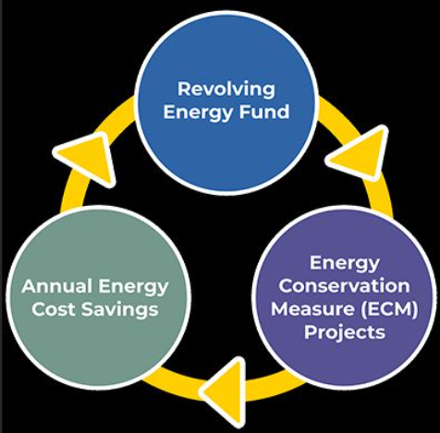
Energy Efficiency Measures
The EU Green Deal prioritizes improving energy efficiency across
buildings, industry, and transportation. This includes upgrading building
insulation, deploying energy-efficient appliances and lighting, and
implementing smart energy management systems to reduce overall
energy consumption.
Targeted policies and incentives will help transform the EU's building
stock, making homes and businesses more energy-efficient and lowering
energy bills for citizens and businesses.

Slide 8
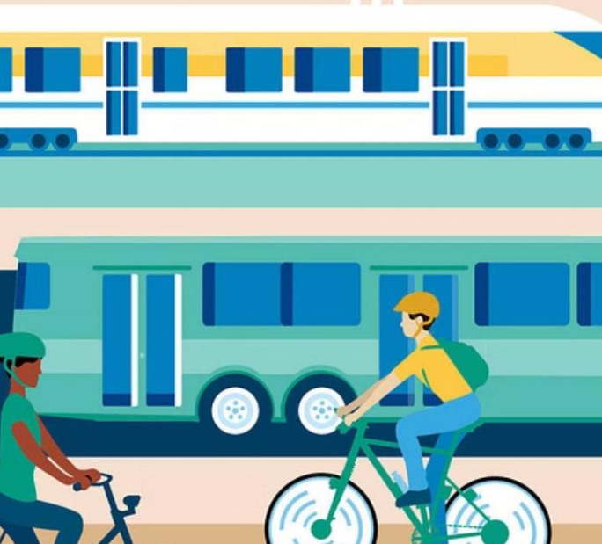
Sustainable Transport Solutions
The EU Green Deal aims to transform Europe's transportation sector to
reduce emissions and promote sustainable mobility. This includes
investments in electric vehicles, public transit, high-speed rail, and active
transportation infrastructure like bike lanes and pedestrian paths.
Policies will also incentivize cleaner fuels, improve efficiency standards,
and support the development of green technologies like hydrogen powered trucks and buses.

Slide 9
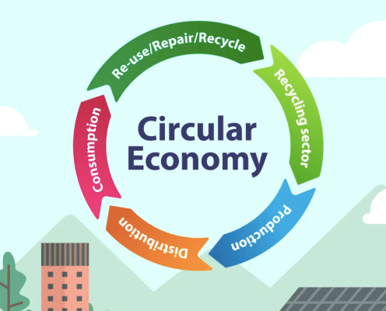
Circular Economy Initiatives
EU Green Deal aims to transform the EU into a modern, resource efficient and competitive economy, where waste is minimized and resources are kept in use for as long as possible. Key circular economy initiatives include promoting product repair, reuse, and recycling, as well as innovative waste management solutions.
The goal is to reduce the EU's environmental footprint and dependence on raw materials, while creating new economic opportunities and green jobs in the process. This shift towards a circular model is a critical component of the EU's path to climate neutrality.

Slide 10
Biodiversity Protection
Safeguarding the rich tapestry of life on Earth is a core pillar of the EU
Green Deal. Comprehensive measures aim to halt and reverse the
alarming decline in biodiversity across the continent through habitat
restoration, species conservation, and sustainable ecosystem
management.
By protecting and restoring natural ecosystems, the EU aims to foster
resilience, enhance carbon sequestration, and support the provision of
vital services that underpin human well-being and a thriving economy.

Slide 11
Sustainable Agriculture Practices
The EU Green Deal emphasizes the importance of transforming EU's food system to become more sustainable and environmentally-friendly. This includes promoting organic farming, precision agriculture, agroforestry, and other practices that reduce emissions, conserve biodiversity, and ensure long-term soil health. Farmers are encouraged to adopt integrated pest management, reduce chemical fertilizer and pesticide use, and implement climate-smart techniques to adapt to changing weather patterns. Sustainable livestock management and manure handling also play a crucial role in lowering the environmental impact of the agricultural sector

Slide 12
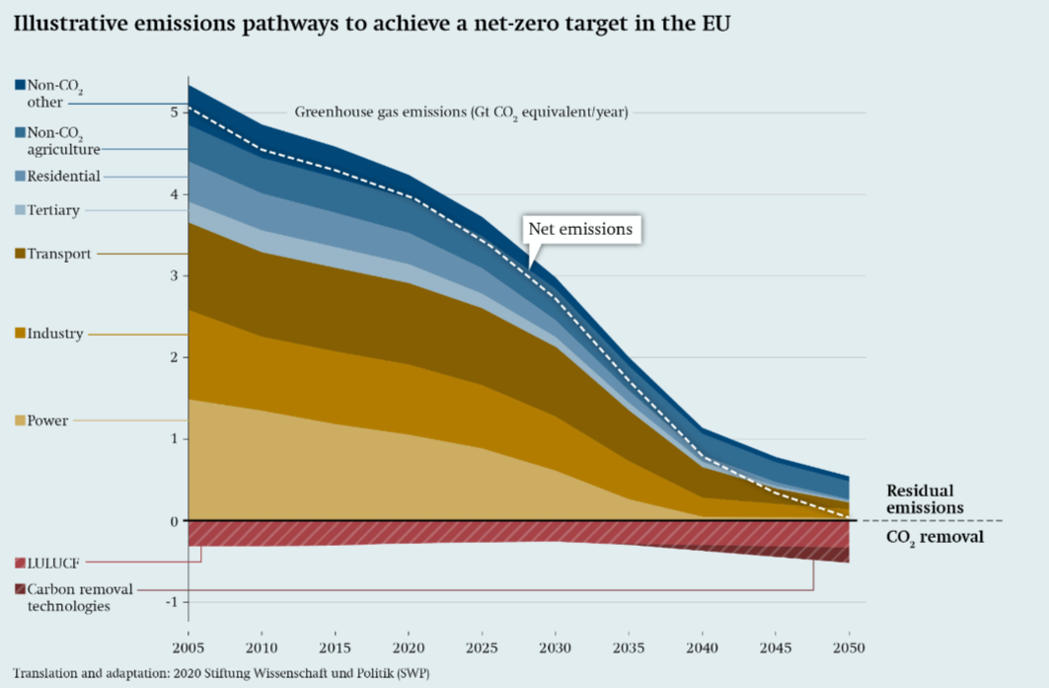
Emissions Reduction Targets
Net Zero Emissions by 2050
The EU has set a binding target to achieve climate neutrality by 2050, meaning net-zero greenhouse gas emissions across all sectors of the economy.
Interim 2030 Targets
The EU has increased its 2030 emissions reduction target from 40% to at least 55% below 1990 levels as an important milestone towards climate neutrality.
Sectoral Roadmaps
Each major economic sector has its own emissions reduction roadmap, with tailored policies and initiatives to drive decarbonization in areas like energy, transportation, and industry.

Slide 13
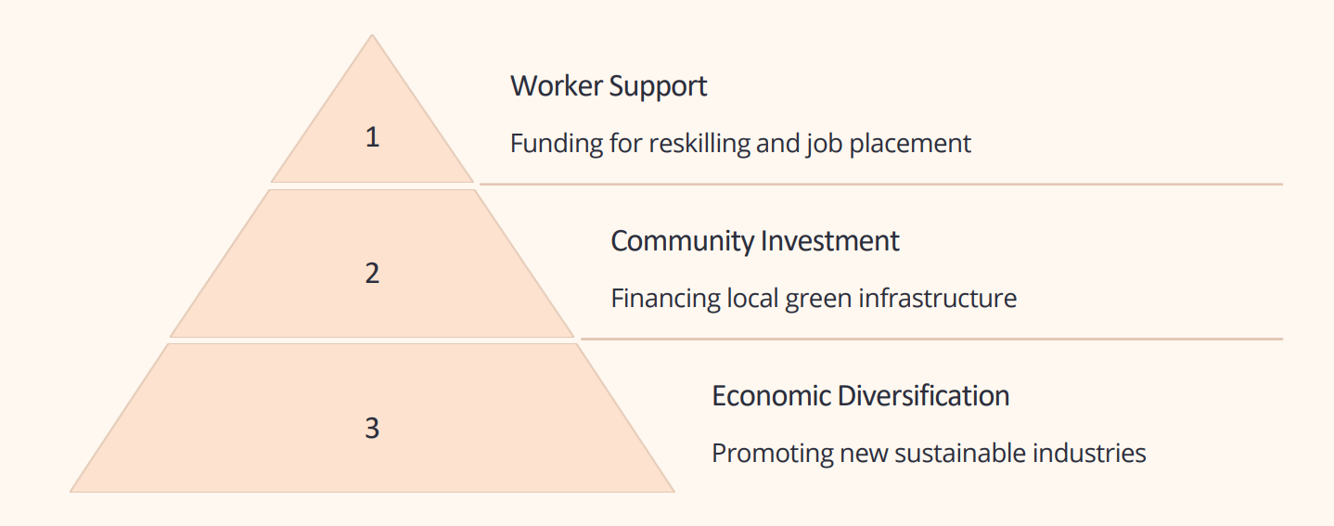
Just Transition Mechanism
The Just Transition Mechanism is a key part of the EU Green Deal, ensuring a fair and inclusive transition to a climate-neutral economy. It provides financial and practical support to workers and communities impacted by the shift away from fossil fuels, helping them adapt and thrive in the new green economy.

Slide 14
Financing the Green Deal
Achieving the ambitious goals of the EU Green Deal will require significant financial resources. The European Union has committed to mobilizing at least €1 trillion in sustainable investments over the next decade to support the transition to a climate-neutral economy.
1 Trillion €: Mobilized for sustainable investments over the next decade
30% of EU budget: Dedicated to climate action and environmental protection
The EU's budget, the Just Transition Mechanism, and the InvestEU program will be key financing sources. Additionally, leveraging private sector investments through innovative financial instruments and incentives will be crucial to meeting the funding needs

Slide 15
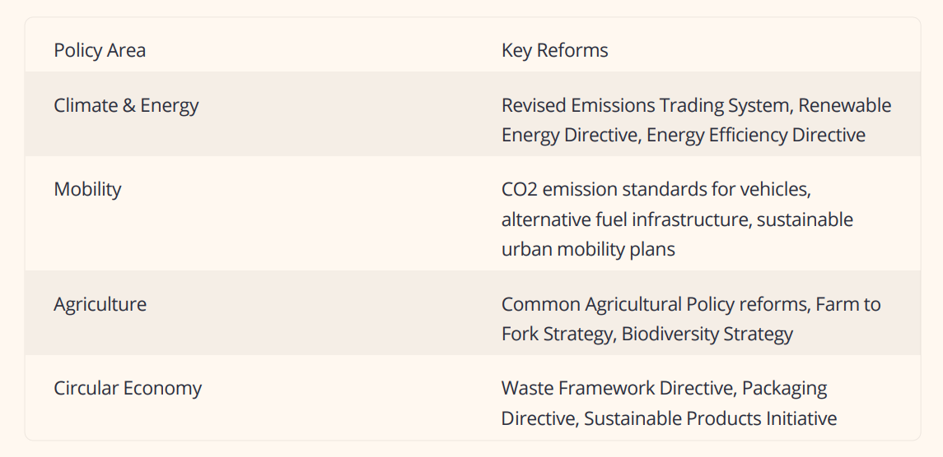
Regulatory and Policy Reforms
The EU Green Deal has paved the way for comprehensive regulatory and policy reforms to drive the transition to a climate-neutral economy. Key initiatives include strengthening emissions trading, implementing more stringent energy efficiency standards, and revising regulations on renewable energy, transport, and agriculture.
These reforms aim to create a coherent policy framework, provide regulatory certainty, and drive investment in green technologies and solutions across key economic sectors.

Slide 16
International Cooperation
Global Collaboration: The EU is working closely with international partners to coordinate climate action and drive sustainable development worldwide.
Multilateral Agreements: The EU is a key player in major global climate agreements like the Paris Agreement, pushing for ambitious targets and collective progress.
Knowledge Sharing: The EU shares best practices, technologies, and expertise with other countries to accelerate the global transition to a green economy.
Climate Finance: The EU provides financial and technical assistance to help developing countries mitigate and adapt to climate change impacts.

Slide 17
Citizen Engagement and Awareness
Climate Rallies and and Protests Citizens are taking to the streets in growing numbers to demand urgent action on climate change, raising awareness and pressuring policymakers.
Household Sustainability Families are adopting eco-friendly habits like recycling, reducing waste, and using renewable energy to lower their carbon footprint.
Climate Education Schools are incorporating climate change lessons into their curricula, empowering the next generation to understand the crisis and become agents of change.
Digital Activism Citizens are leveraging social media and online platforms to raise awareness, organize campaigns, and hold governments and corporations accountable for climate action.

Slide 18
Monitoring and Evaluation
Continuous Tracking Regular monitoring of key performance indicators to assess the progress and impact of the EU Green Deal initiatives.
Transparency and Accountability Publicly reporting on the achievements and challenges to ensure transparency and build trust with citizens and stakeholders.
3. Data-Driven Evaluation Rigorous evaluation of the policies, programs, and projects to measure their effectiveness and inform future decision-making. .

Slide 19
Challenges and Barriers
1. Policy Barriers Conflicting regulations and lack of coordination
2. Economic Hurdles High upfront costs and limited funding
3. Technological Gaps Limitations in clean energy and efficiency solutions
4. Public Acceptance Resistance to change and lack of awareness
Implementing the EU Green Deal faces various challenges, including policy barriers, economic hurdles, technological gaps, and public acceptance issues. Overcoming these obstacles will require coordinated efforts, increased funding, innovative solutions, and extensive public engagement to achieve the ambitious climate goals.

Slide 20
Sectoral Transformation Strategies
To achieve the ambitious goals of the EU Green Deal, comprehensive transformation strategies are required across key economic sectors. These involve:
• Energy Sector: Accelerating the transition to renewable energy sources, improving grid infrastructure, and phasing out fossil fuels.
• Transport Sector: Promoting sustainable mobility options, electrifying vehicles, and developing low-emission freight and aviation solutions.
• Industry Sector: Driving circular economy principles, increasing energy and resource efficiency, and supporting low-carbon technology innovation

Slide 21
Innovation and Technology
The EU Green Deal leverages innovation and technology to drive the transition to a sustainable, low carbon economy. Investments in clean energy research, smart grid infrastructure, and green mobility solutions are key to achieving climate neutrality. Novel technologies like carbon capture, energy storage, and sustainable materials are critical enablers.

Slide 22
Green Jobs and Skills Development
The EU Green Deal emphasizes the creation of new "green jobs" across various sectors, from renewable energy to sustainable transportation and circular economy. These jobs require specialized skills and training to meet the rapidly evolving demands of a decarbonized economy. Upskilling and reskilling programs are crucial to ensure workers are equipped with the necessary competencies to thrive in the green transition. Investments in vocational training, apprenticeships, and higher education programs focused on green technologies, sustainability, and environmental management will be key to developing the workforce needed to implement the EU's climate and environmental objectives. This green skills pipeline will empower citizens to actively participate in the low-carbon transformation and benefit from the economic opportunities it presents.

Slide 23
Adaptation and Resilience Measures
As the climate continues to change, the EU is implementing measures to help communities adapt and build resilience. This includes investing in infrastructure upgrades, developing early warning systems, and promoting nature-based solutions that protect against extreme weather events. The goal is to safeguard lives, livelihoods, and vital resources. Coastal regions, for example, are adopting living shorelines and wetland restoration projects to mitigate the impacts of sea level rise and storm surges. Inland areas are reforesting to improve water management and prevent soil erosion during droughts and floods. These resilience measures help communities withstand climate impacts and bounce back faster.

Slide 24
EU Leadership in Global Climate Action
The EU is at the forefront of global efforts to combat climate change, leveraging its economic and diplomatic influence to drive ambitious climate policies worldwide. As a global leader, the EU is spearheading international cooperation, sharing best practices, and mobilizing resources to support developing nations in their climate mitigation and adaptation efforts.

