Slide 1
CCP-LAW
Curricula development on Climate Change Policy and Law
Subject title: Introduction to EU Renewable Energy Law
Instructor Name: PROF ABHINAV SHRIVASTAVA AND PROF RAJ VARMA
Project No of Reference: 618874-EPP-1-2020-1-VN-EPPKA2-CBHE-JP:
The European Commission's support for the production of this publication does not constitute an endorsement of the contents, which reflect the views only of the authors, and the Commission cannot be held responsible for any use which may be made of the information contained therein.

Slide 2
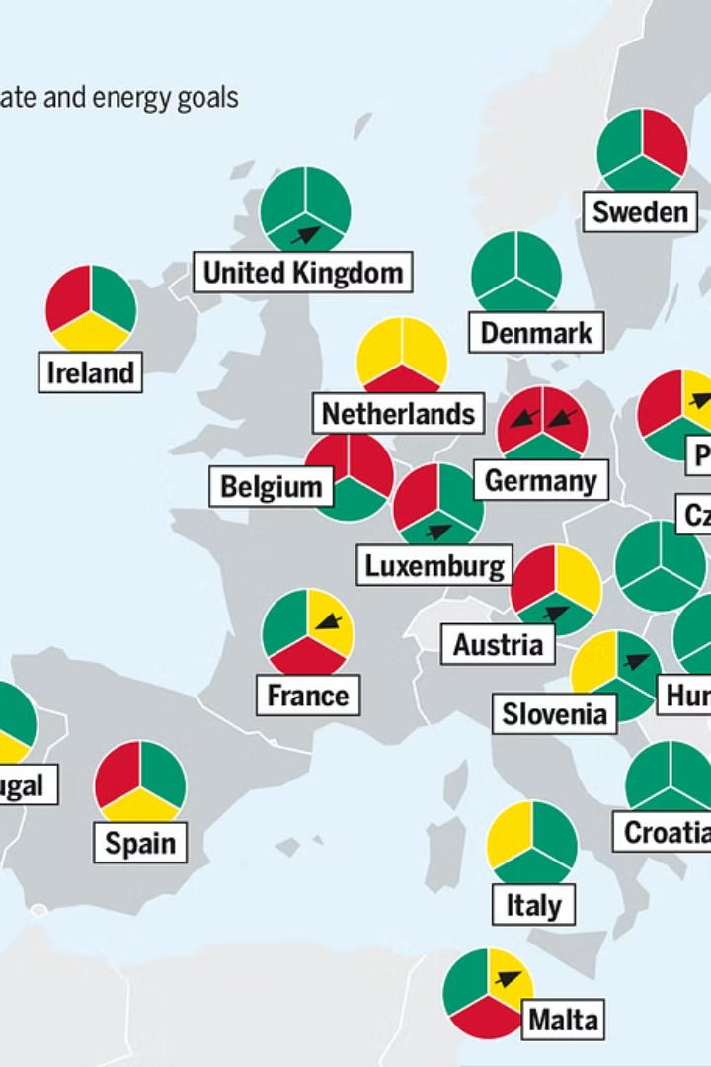
Introduction
The European Union has implemented comprehensive legislation to promote the adoption of renewable energy sources across its member states. This regulatory framework aims to transform the EU's energy landscape and contribute to its ambitious climate and sustainability goals.

Slide 3
Objectives of the EU's renewable energy policy
Text……
DECARBONIZATION
Reduce greenhouse gas emissions and transition to a low-carbon economy.
Energy Security
Decrease EU's reliance on imported fossil fuels and promote domestic renewable energy sources.
Competitiveness
Spur innovation, create green jobs, and position the EU as a global leader in renewable technologies.
Sustainability
Promote sustainable, environmentally-friendly energy production and consumption practices across the EU.

Slide 4
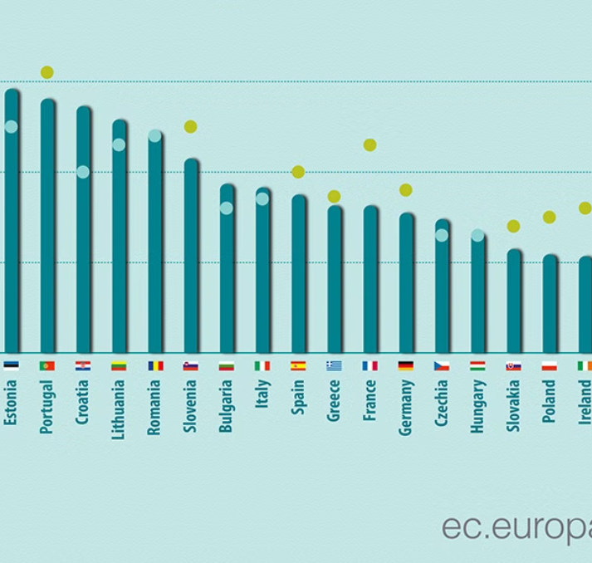
Key Directives and Regulations
1. The Renewable Energy Directive (RED) establishes a binding target for the EU to reach at least 32% of its total energy consumption from renewable sources by 2030.
2. The Energy Performance of Buildings Directive (EPBD) requires member states to set minimum energy performance standards for new and renovated buildings, promoting the use of renewable energy in buildings.
3. The Energy Efficiency Directive (EED) sets energy efficiency targets and requires member states to implement policies to achieve those targets, including the use of renewable energy.

Slide 5
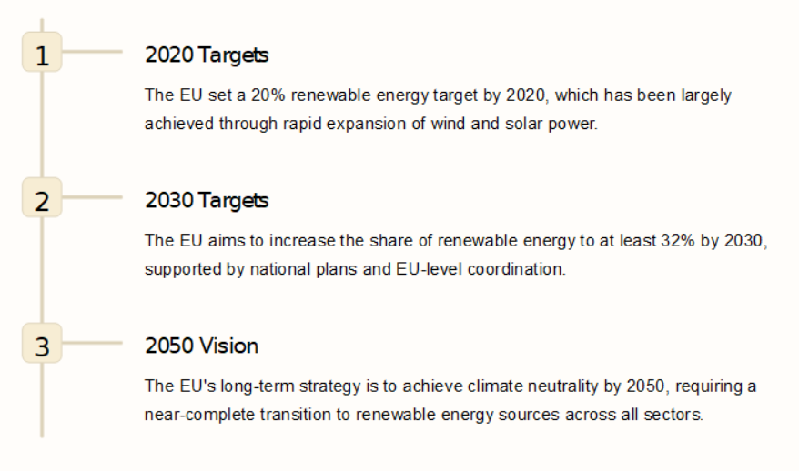
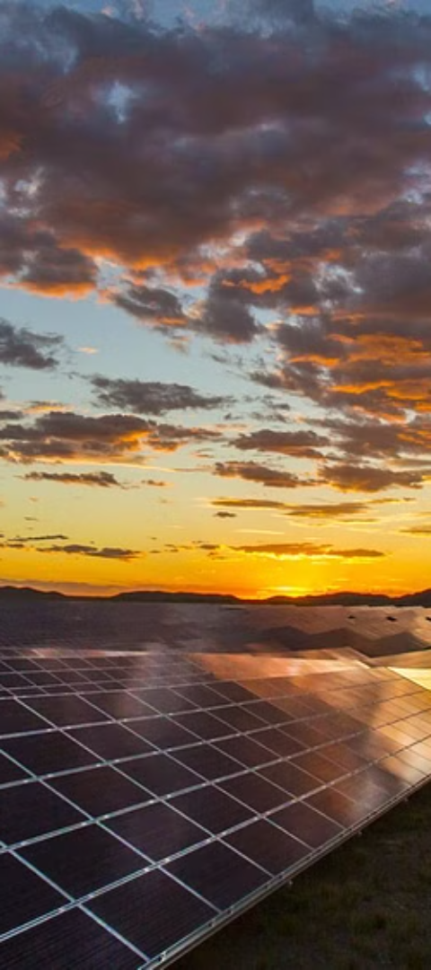
Targets and timelines for renewable energy adoption

Slide 6
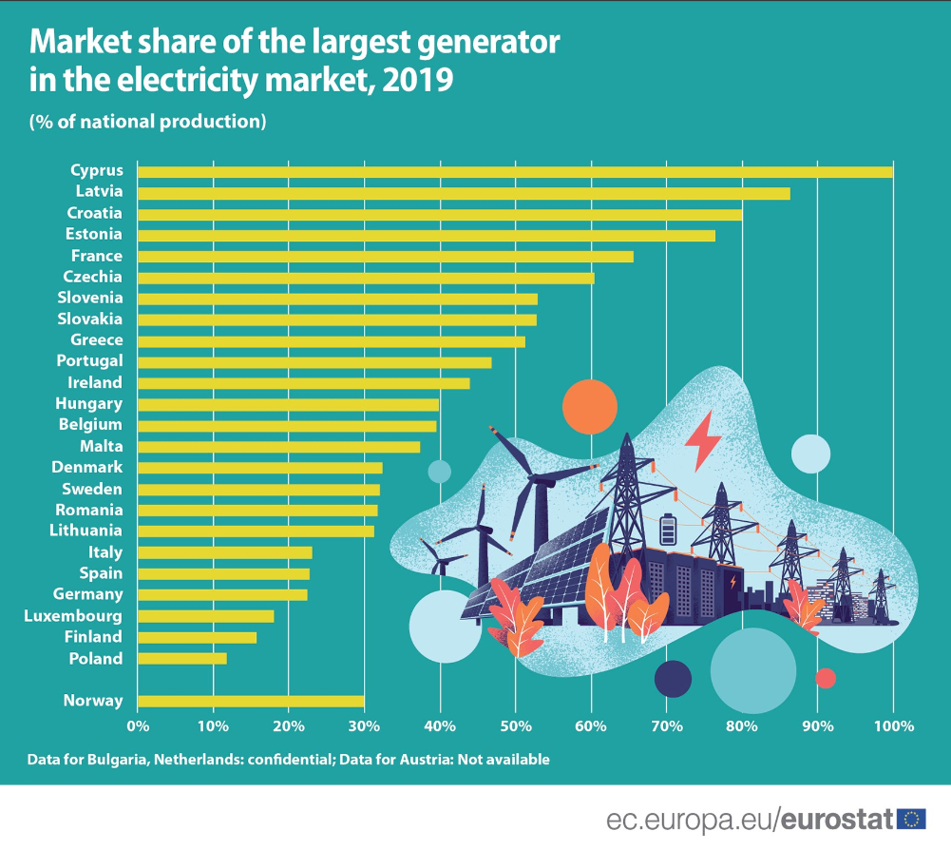
Challenges in the European Internal Energy Market
The transition to renewable energy in the EU faces significant challenges in the internal energy market. Integrating large-scale renewable generation into the grid, balancing intermittent supply, and harmonizing national support schemes are key hurdles to overcome.
Regulatory barriers, ensuring fair competition, and financing renewable projects also pose obstacles to a seamless internal energy market. Addressing these issues is crucial for the EU to meet its ambitious renewable energy targets.

Slide 7
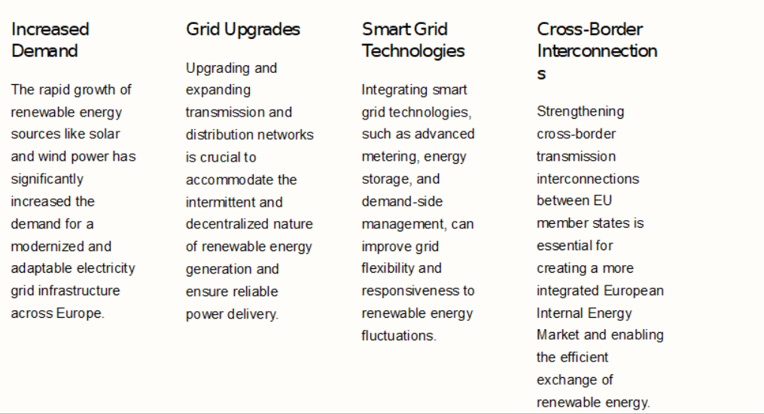
Grid Integration and Infrastructure Requirements

Slide 8
Challenges in the European Internal Energy Market
The transition to renewable energy in the EU faces significant challenges in the internal energy market. Integrating large-scale renewable generation into the grid, balancing intermittent supply, and harmonizing national support schemes are key hurdles to overcome.
Regulatory barriers, ensuring fair competition, and financing renewable projects also pose obstacles to a seamless internal energy market. Addressing these issues is crucial for the EU to meet its ambitious renewable energy targets.

Slide 9
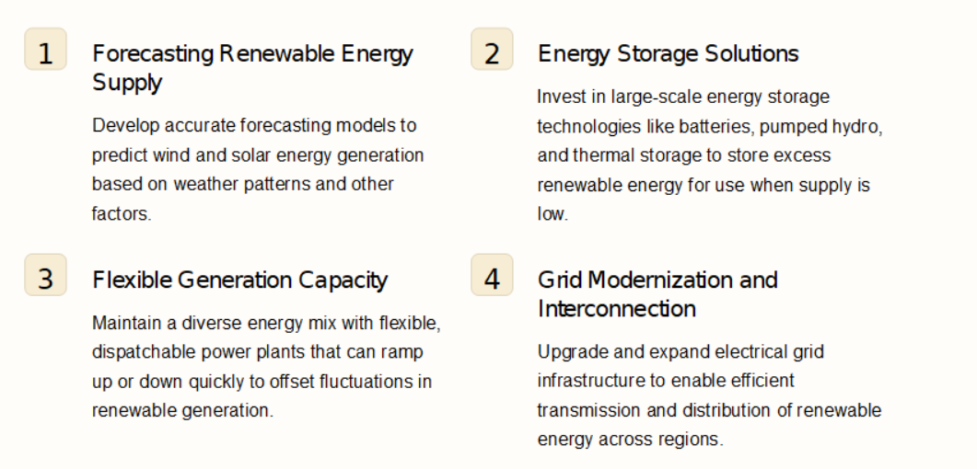
Balancing Intermittent Renewable Generation

Slide 10
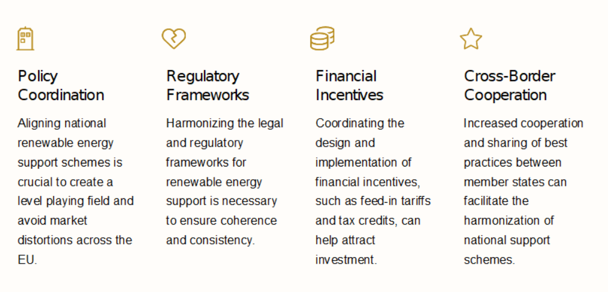
Harmonizing National Support Schemes

Slide 11
Addressing Regulatory Barriers
Regulatory barriers, such as complicated permitting processes and inconsistent policies across EU member states, can hinder the widespread adoption of renewable energy. Harmonizing regulations and streamlining approval procedures are crucial to facilitate grid integration and enable fair market access for renewable energy providers.
Addressing these regulatory challenges will require close collaboration between EU institutions, national governments, and industry stakeholders. Establishing common standards and best practices can help reduce administrative burdens and create a more supportive environment for renewable energy investments.

Slide 12
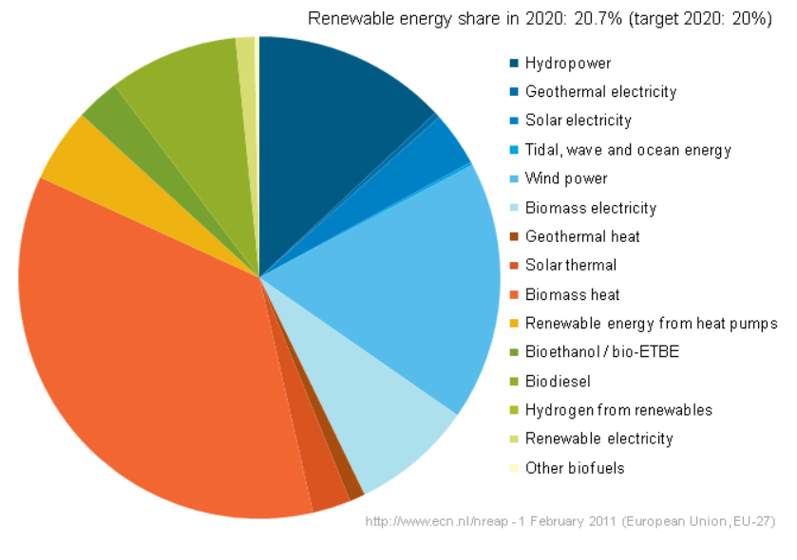
Ensuring fair competition and market access
1. Level Playing Field
Promote policies that ensure all energy providers, including renewable players, have equal opportunities to compete and access the market.
2. Transparent Regulations
Establish clear, consistent, and transparent rules for renewable energy integration to avoid market distortions and discriminatory practices.
3. Reduce Barriers
Identify and address regulatory barriers that limit market access and participation for renewable energy producers and suppliers.

Slide 13
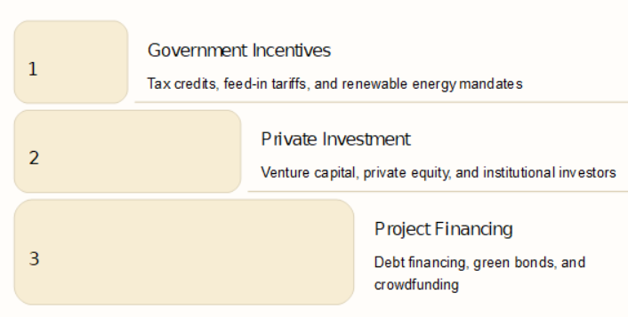
Financing renewable energy projects
Financing is critical to the widespread adoption of renewable energy. Governments provide various incentives like tax credits and feed-in tariffs to stimulate private investment. Private investors, including venture capitalists and institutional funds, are increasingly turning to renewable energy projects. Project-level financing, including debt, bonds, and crowdfunding, is also expanding to meet the capital needs of renewable energy infrastructure.

Slide 14
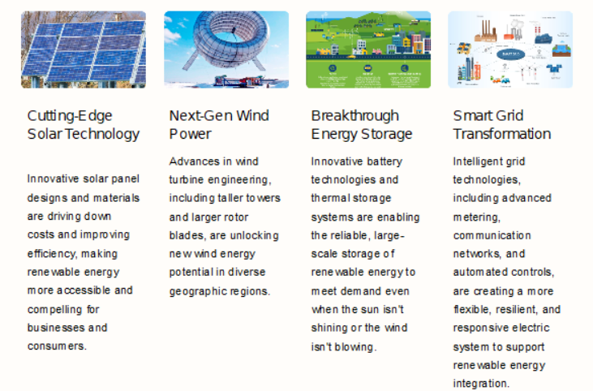
Promoting Innovation and Technological Advancements

Slide 15
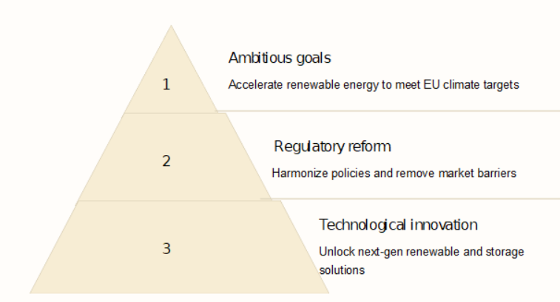
Conclusion and future outlook
As the EU pushes towards its ambitious renewable energy goals, continued regulatory reform and technological innovation will be crucial. Harmonizing policies, removing market barriers, and unlocking advanced renewable and storage technologies will be key to realizing a truly integrated European energy market powered by clean, sustainable energy.

