Slide 1
CCP-LAW
Curricula development on Climate Change Policy and Law
Subject title: CLIMATE CHANGE DISPUTE LITIGATION
Instructor Name: Nguyễn Thị Hồng Trinh
Project No of Reference: 618874-EPP-1-2020-1-VN-EPPKA2-CBHE-JP:
The European Commission's support for the production of this publication does not constitute an endorsement of the contents, which reflect the views only of the authors, and the Commission cannot be held responsible for any use which may be made of the information contained therein.

Slide 2
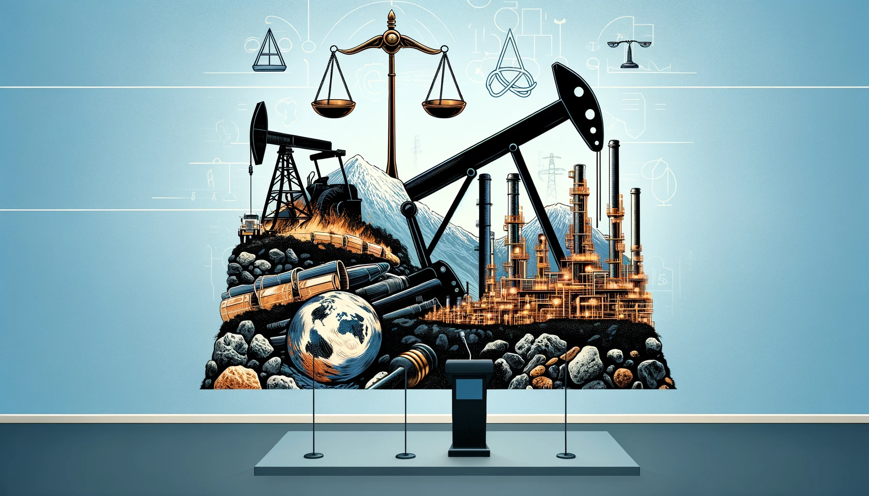
2.3. Defendants
2. PARTIES IN CLIMATE CHANGE LITIGATION
Introduction to Defendants in Climate Change Litigation
Overview of common defendants in climate change litigation.
The role of large corporations, particularly fossil fuel companies.
Governments and public authorities as defendants.
Increasing litigation targeting a wide range of sectors beyond energy.

Slide 3
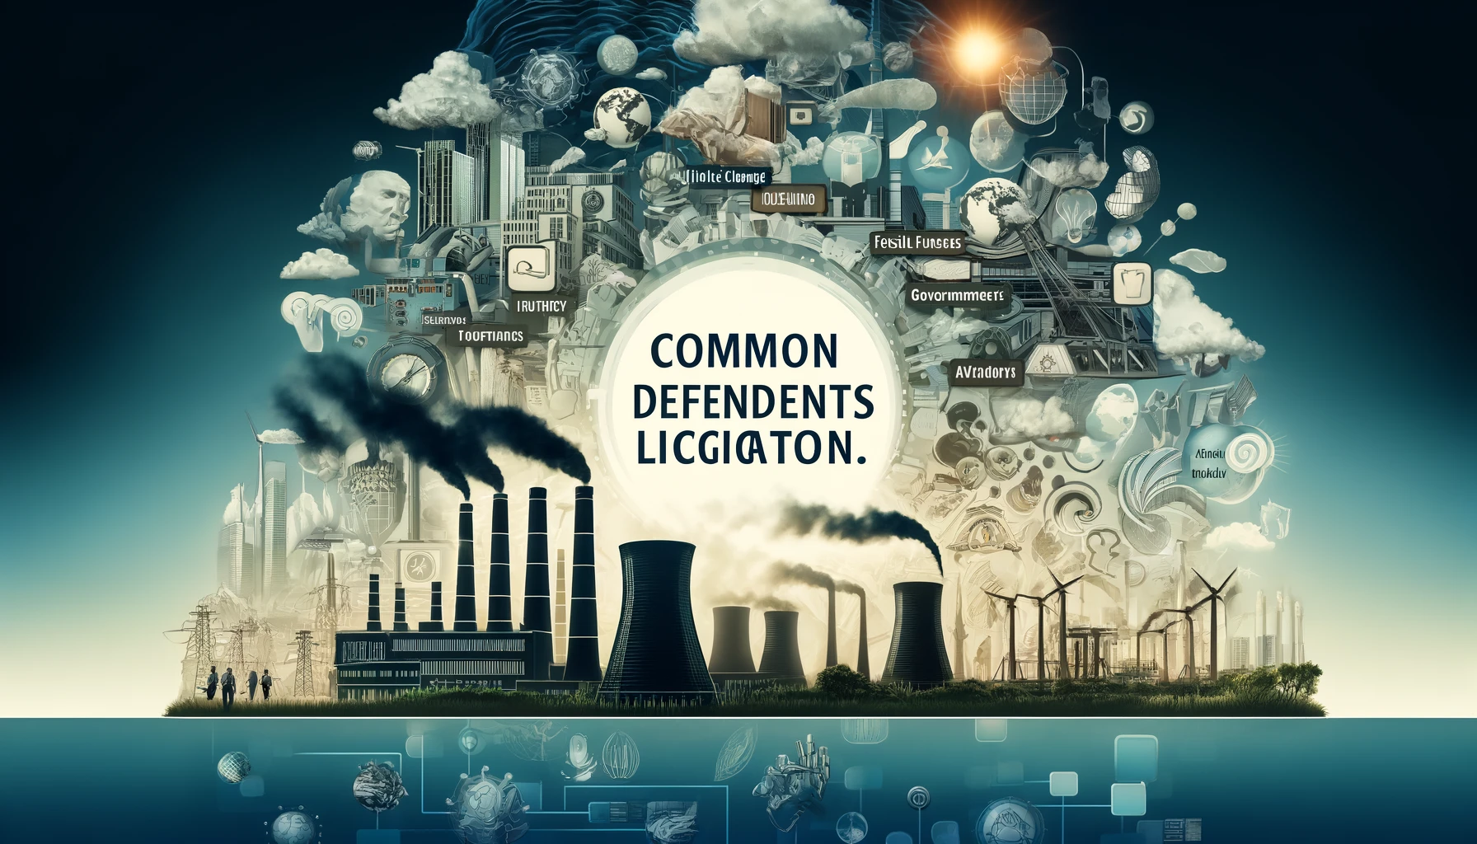
2.3. Defendants
2. PARTIES IN CLIMATE CHANGE LITIGATION
Fossil Fuel Companies as Defendants
Predominant targets due to their significant GHG emissions.
Litigation based on misinformation and denial campaigns about climate change.
Cases seeking compensation for environmental harm and adaptation costs.
Challenges in attributing specific damages to individual companies.

Slide 4
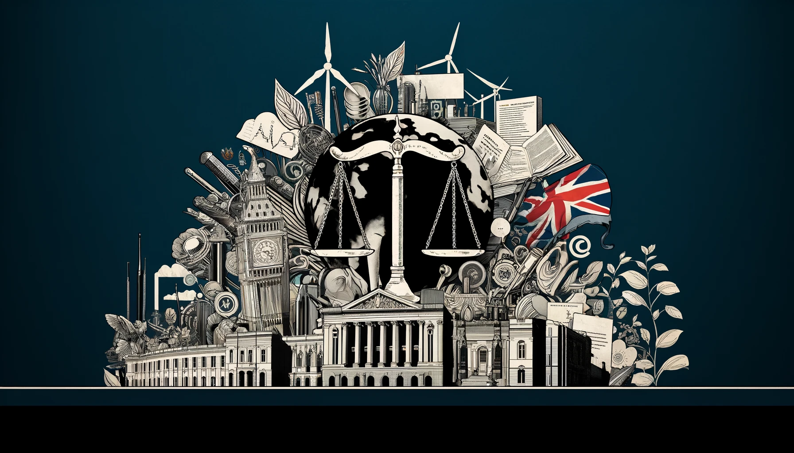
2.3. Defendants
2. PARTIES IN CLIMATE CHANGE LITIGATION
Governments as Defendants
Litigation aimed at compelling stronger climate action and policy changes.
Cases challenging insufficient national emission reduction targets.
Suits related to failure to adapt to climate impacts, violating human rights.
Importance of constitutional and international law in these cases.

Slide 5
2.3. Defendants
2. PARTIES IN CLIMATE CHANGE LITIGATION
Corporations Outside the Energy Sector
Expanding scope to include automotive, agriculture, and finance sectors.
Liability for indirect emissions and contribution to climate change.
Shareholder and investor lawsuits for failing to disclose climate risks.
The evolving landscape of corporate responsibility and environmental stewardship.

Slide 6
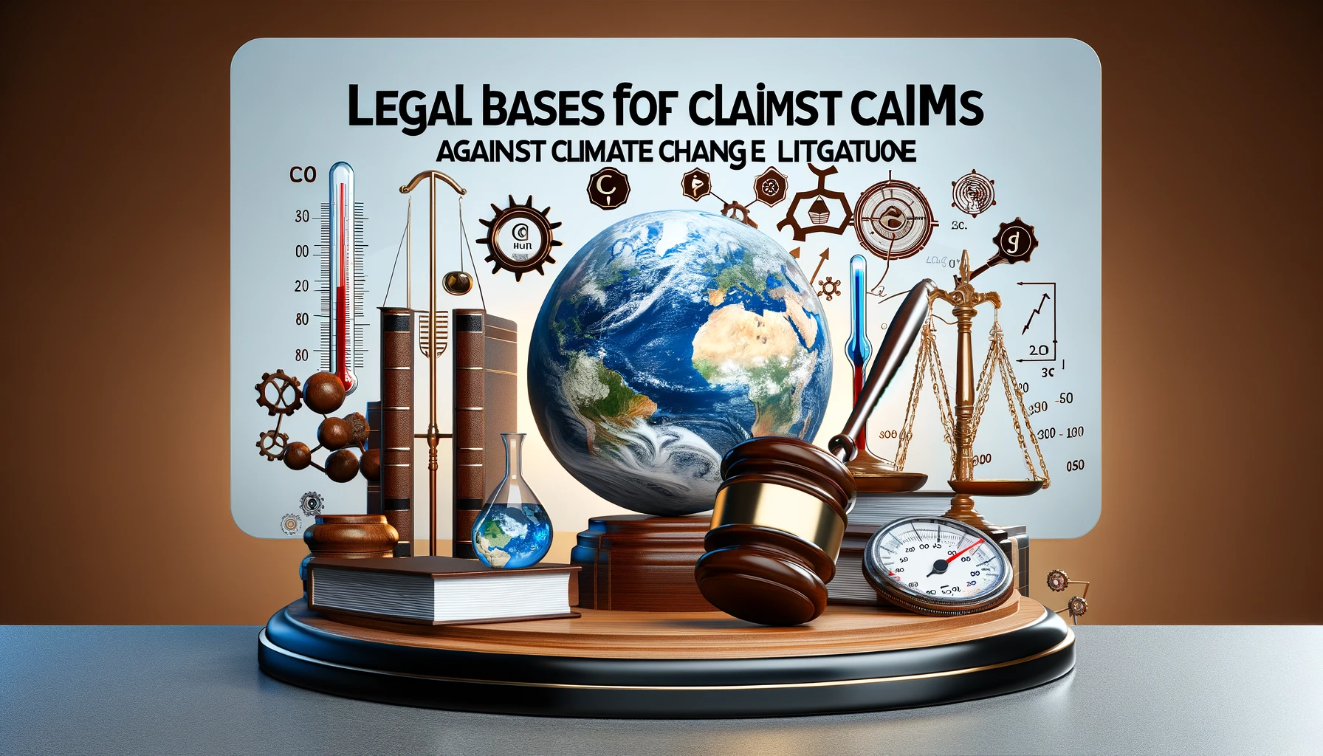
2.3. Defendants
2. PARTIES IN CLIMATE CHANGE LITIGATION
Legal Bases for Claims Against Defendants
Tort law claims, including negligence, nuisance, and trespass.
Statutory claims under environmental and human rights laws.
The innovative use of public trust doctrine.
Corporate disclosure laws and financial regulations.

Slide 7
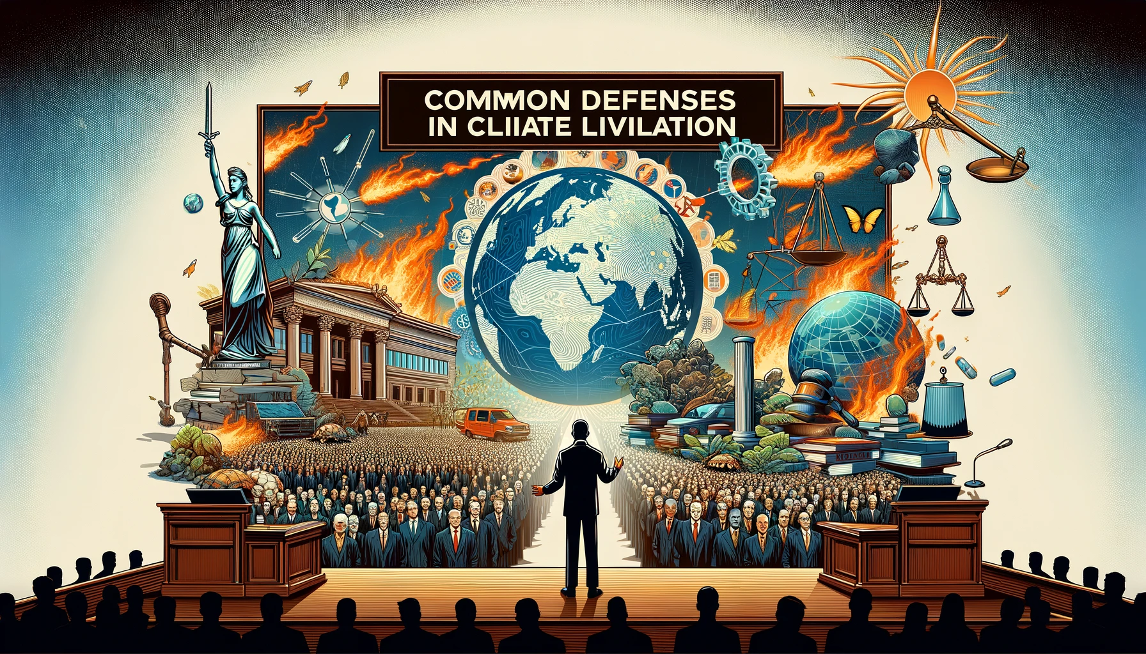
2.3. Defendants
2. PARTIES IN CLIMATE CHANGE LITIGATION
Common Defenses in Climate Litigation
Questioning the causation between defendant’s actions and specific climate harms.
Arguing global problem requires collective action, beyond one entity’s responsibility.
Invoking the political question doctrine to argue climate policy is a legislative matter.
Asserting compliance with existing environmental regulations and standards.

Slide 8
2.3. Defendants
2. PARTIES IN CLIMATE CHANGE LITIGATION
Impact of Litigation on Defendants
Financial implications including potential for significant damages.
Reputational damage and public relations impacts.
Influence on corporate and governmental policies on climate.
Increasing pressure to transition to sustainable practices.

Slide 9
2.3. Defendants
2. PARTIES IN CLIMATE CHANGE LITIGATION
Notable Cases and Precedents
Overview of landmark cases and their outcomes.
Discussion of cases that have set important precedents.
Impact of legal victories for plaintiffs on broader climate litigation landscape.
Examples of how specific rulings have influenced defendant behaviors.

