Slide 1
CCP-LAW
Curricula development on Climate Change Policy and Law
Subject title: Climate Change Policy
Instructor Name: Dr. Rahul Nikam
Project No of Reference: 618874-EPP-1-2020-1-VN-EPPKA2-CBHE-JP:
The European Commission's support for the production of this publication does not constitute an endorsement of the contents, which reflect the views only of the authors, and the Commission cannot be held responsible for any use which may be made of the information contained therein.

Slide 2
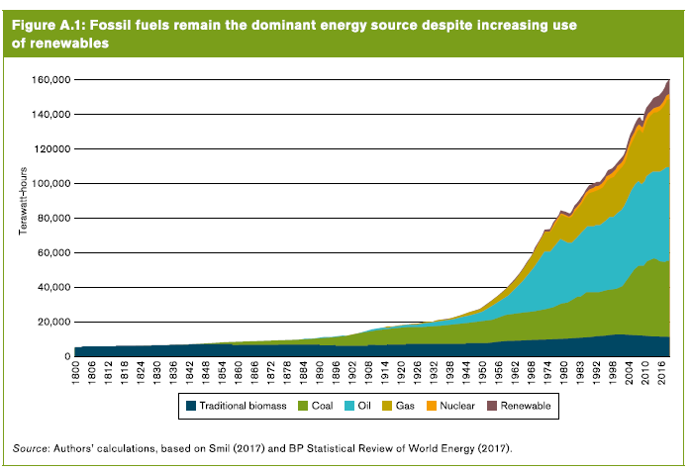
The Role of trade in Adapting to climate change and the trade implications of a low-carbon economy
The next great transformation Technological cooperation, competition, and cross-fertilization do not just spur innovation; they also encourage needed technological diffusion.
2. Harnessing the transformative power of trade.

Slide 3
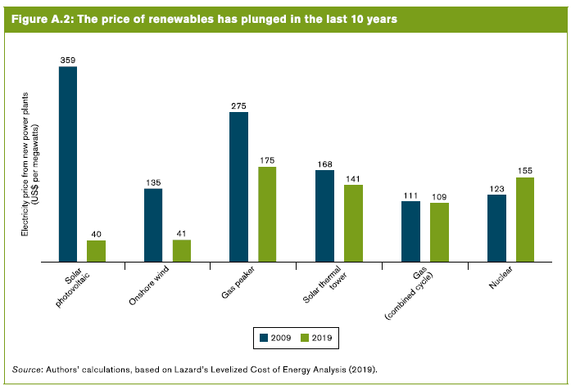
The Role of trade in Adapting to climate change and the trade implications of a low-carbon economy

Slide 4
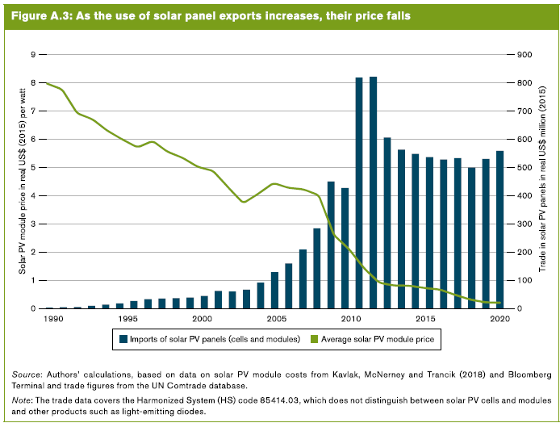
The Role of trade in Adapting to climate change and the trade implications of a low-carbon economy

Slide 5
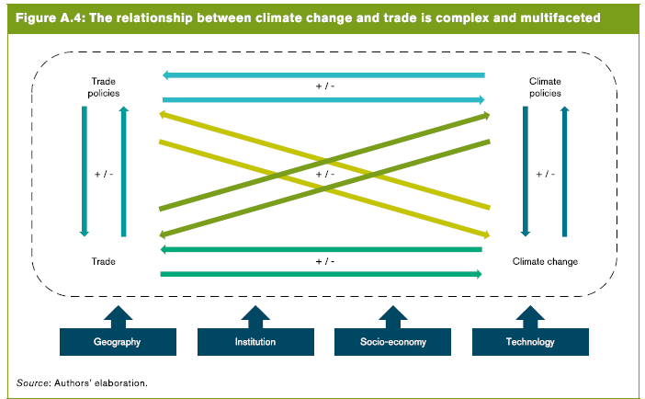
The Role of trade in Adapting to climate change and the trade implications of a low-carbon economy

Slide 6
The Role of trade in Adapting to climate change and the trade implications of a low-carbon economy
B. The role of trade in adapting to climate change
Why does climate change adaptation matter?
The Climate change has severe effects on people and the economy
The impacts of climate change on trade are heterogeneous across regions and sectors
i. Climate change will alter patterns of comparative advantage, leaving some economies at a disadvantage
ii. Climate change is likely to increase trade costs unevenly across regions
iii. Trade in agriculture and tourism are particularly vulnerable to climate change
iv. Manufacturing sectors are exposed to climate-indued global value chain disruptions

Slide 7
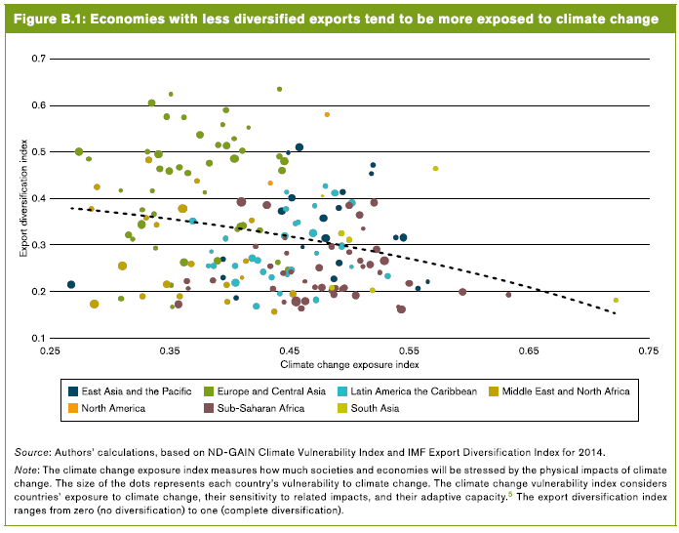
The Role of trade in Adapting to climate change and the trade implications of a low-carbon economy

Slide 8
The Role of trade in Adapting to climate change and the trade implications of a low-carbon economy
3. International trade and trade policy can support climate change adaptation strategies.
Trade can support climate change adaptation actions through economic growth
Trade can enhance economic resilience to climate change shocks
Trade can contribute to improving food security arising from changing comparative advantages
Trade can facilitate the acquisition and development of technologies that can contribute to climate change adaptation
Trade policies can be integrated into climate change adaptation strategies

Slide 9
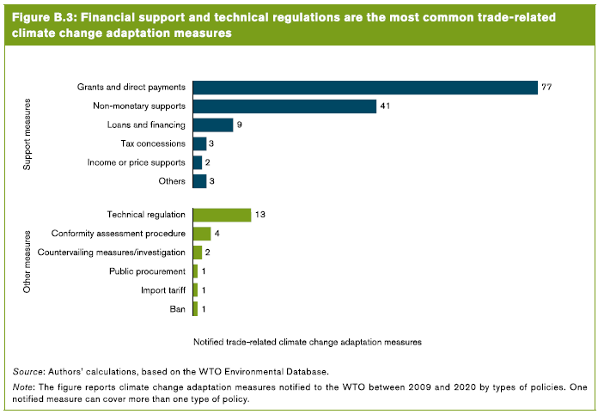
The Role of trade in Adapting to climate change and the trade implications of a low-carbon economy

Slide 10
The Role of trade in Adapting to climate change and the trade implications of a low-carbon economy
4. International cooperation is essential to assist countries in adapting to climate change
climate change adaptation is cross-cutting
It can help increase the ambition and viability of climate adaptation strategies
Predictability, dialogue, and coordination are key to increasing climate resilience of supply chains
Well-functioning markets are important to address climate-related food security challenges
More trade-related technical assistance and capacity building for climate change adaptation is needed

Slide 11
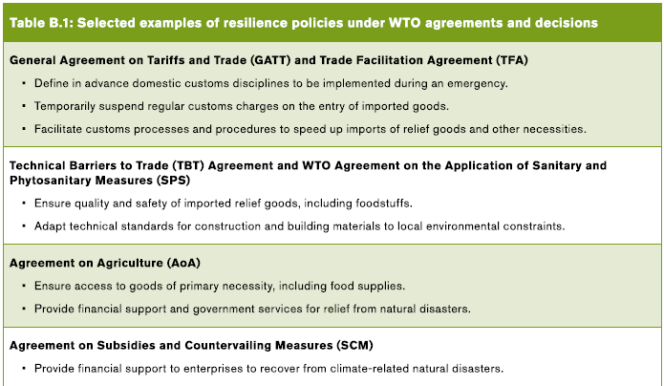
The Role of trade in Adapting to climate change and the trade implications of a low-carbon economy

Slide 12
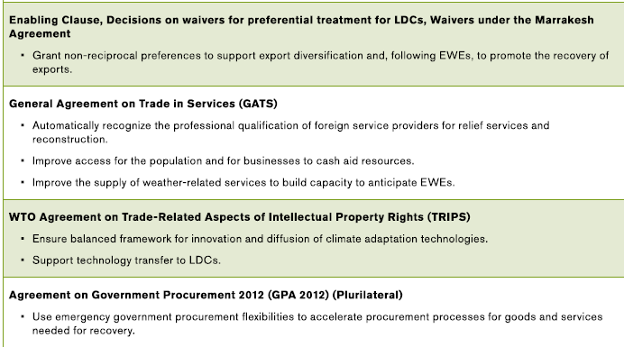
The Role of trade in Adapting to climate change and the trade implications of a low-carbon economy

Slide 13
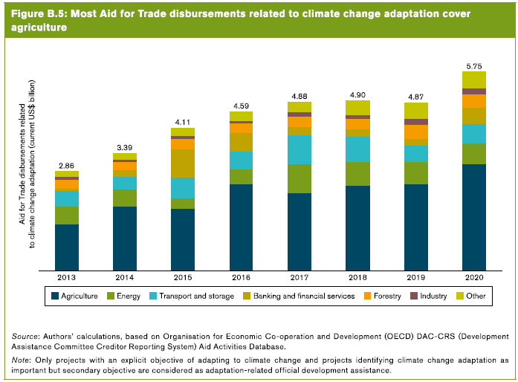
The Role of trade in Adapting to climate change and the trade implications of a low-carbon economy

Slide 14
The Role of trade in Adapting to climate change and the trade implications of a low-carbon economy
C. The trade implications of a low-carbon economy
Achieving a low-carbon economy is imperative but faces challenges
a. Different strategies can support the transition to a low-carbon economy
b. Ambitious climate change mitigation policies are essential
c. Climate change mitigation policies are multifaceted
i. Command –and- control instruments
ii. Market-based instruments
iii. Information instruments
iv. Voluntary agreements

Slide 15
The Role of trade in Adapting to climate change and the trade implications of a low-carbon economy
d. Addressing the distributional & political implications of ambitious climate change mitigation policies is essential
e. Well-functioning financial markets are essential to support the transition to a low-carbon economy
2. A low-carbon economy would change trade patterns and provide new trading opportunities
The transition to a low-carbon economy provides opportunities to support a more sustainable and equitable development
International trade in low-carbon technologies and renewable energy can support a low-carbon transition
A low-carbon economy would impact trade patterns

Slide 16
The Role of trade in Adapting to climate change and the trade implications of a low-carbon economy
A low-carbon economy could spur regional trade in renewable electricity
The low-carbon would shift production and trade patterns, affecting regions differently
d. Some climate change mitigation policies may have trade implications

Slide 17
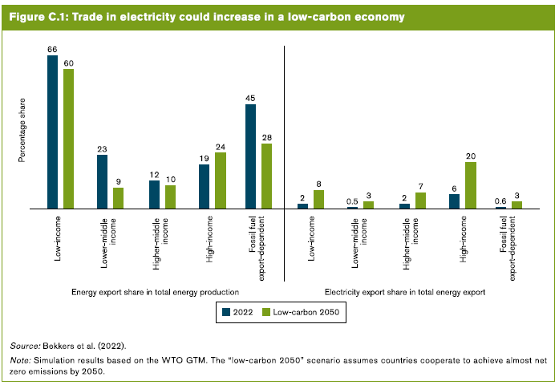
The Role of trade in Adapting to climate change and the trade implications of a low-carbon economy

Slide 18
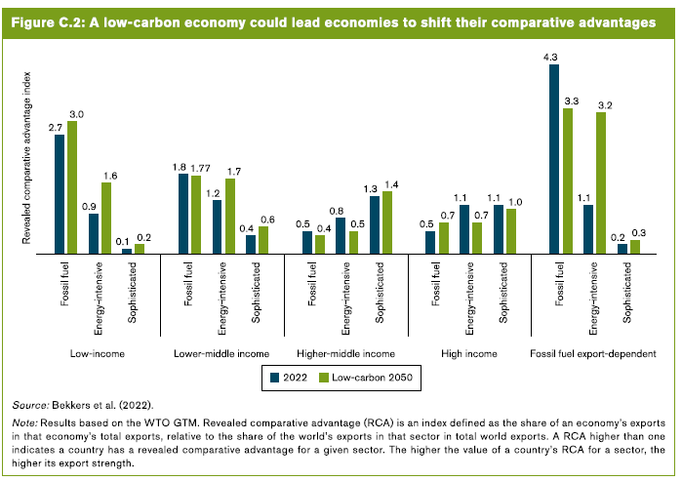
The Role of trade in Adapting to climate change and the trade implications of a low-carbon economy

Slide 19
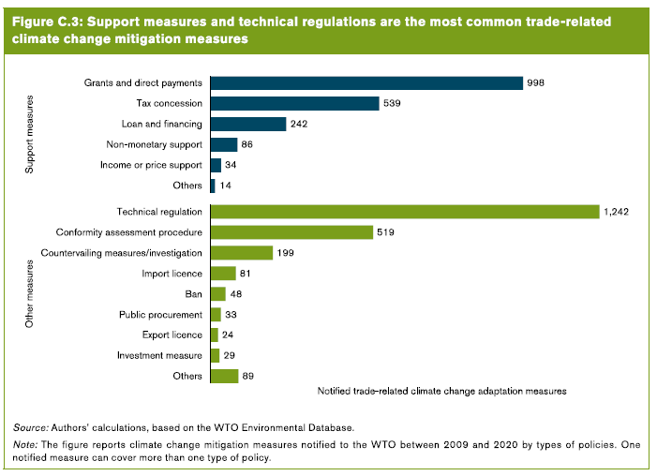
The Role of trade in Adapting to climate change and the trade implications of a low-carbon economy

Slide 20
The Role of trade in Adapting to climate change and the trade implications of a low-carbon economy
3. International cooperation is essential to achieve a low-carbon economy
Greater international cooperation is needed to support a just low-carbon
International cooperation on climate adaptation is broad and diverse
International cooperation on trade can support and enhance climate change mitigation actions.
WTO rules help to prevent protectionism and to promote efficient and effective trade-related climate policies
Transparency and dialogue support coherent and fit-for-purpose climate change policies
Aid for trade can play an important role in supporting a just transition to a low-carbon economy

Slide 21
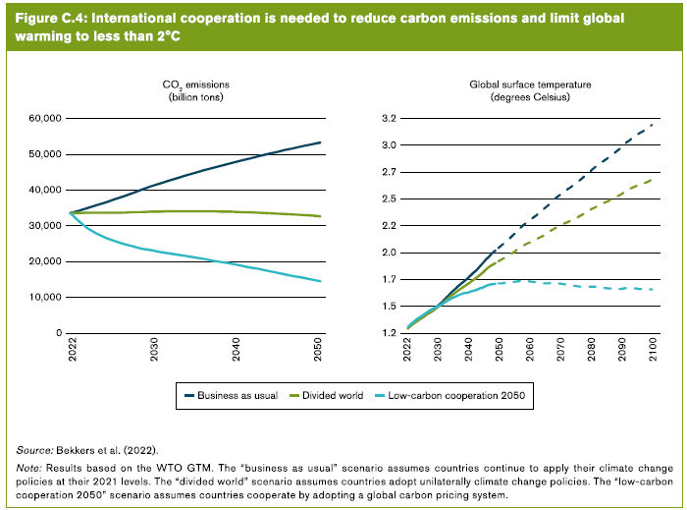
The Role of trade in Adapting to climate change and the trade implications of a low-carbon economy

Slide 22
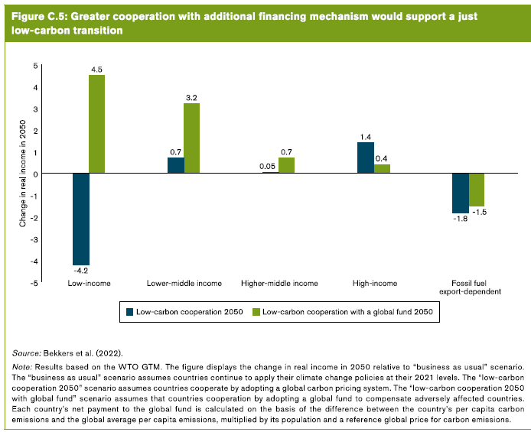
The Role of trade in Adapting to climate change and the trade implications of a low-carbon economy

Slide 23
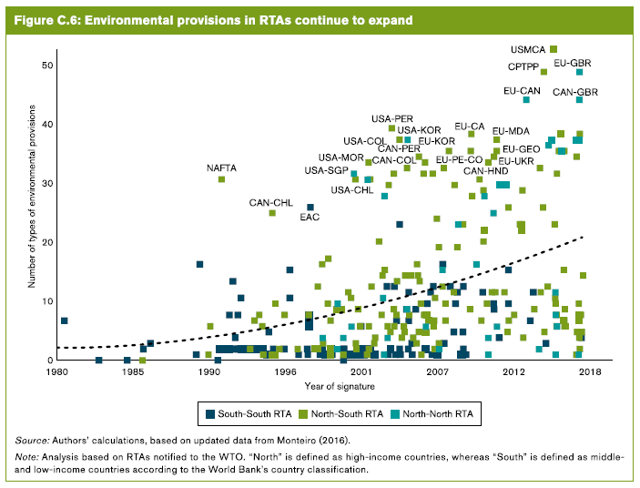
The Role of trade in Adapting to climate change and the trade implications of a low-carbon economy

Slide 24
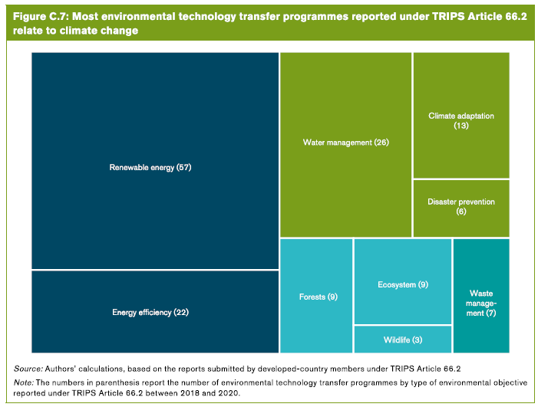
The Role of trade in Adapting to climate change and the trade implications of a low-carbon economy

Slide 25
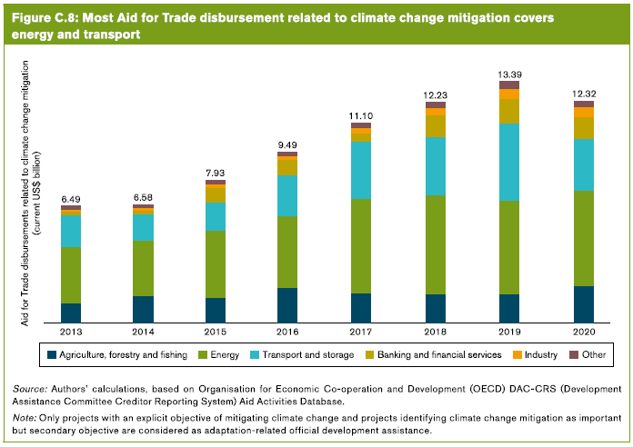
The Role of trade in Adapting to climate change and the trade implications of a low-carbon economy

Slide 26
Further Reading
Trade and climate change https://www.wto.org/english/tratop_e/envir_e/climate_intro_e.htm
World Trade Report 2022 Climate change and international trade https://www.wto.org/english/res_e/publications_e/wtr22_e.htm

