Slide 1
CCP-LAW
Curricula development on Climate Change Policy and Law
Subject title: The Science of Climate Change: Mitigation and Adaptation
Instructor Name: Dr. Abhishek Gupta
Project No of Reference: 618874-EPP-1-2020-1-VN-EPPKA2-CBHE-JP:
The European Commission's support for the production of this publication does not constitute an endorsement of the contents, which reflect the views only of the authors, and the Commission cannot be held responsible for any use which may be made of the information contained therein.

Slide 2
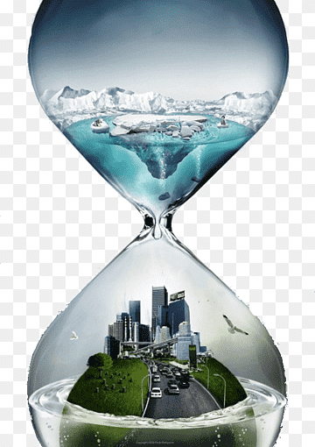
Climate Change Mitigations

Slide 3
Climate Change: The State of the Science

Slide 4
Can we avoid Climate Change?
No
Can we reduce Climate Change
Yes

Slide 5
Introduction
Climate change refers to significant changes in global temperatures and weather patterns over an extended period, primarily due to human activities such as burning fossil fuels, deforestation, and industrial processes.
Causes of Climate Change:
Greenhouse Gas Emissions: Carbon dioxide (CO2), methane (CH4), and other gases trap heat in the atmosphere, leading to a warming effect known as the greenhouse effect.
Deforestation: Reduced forest cover decreases the Earth's capacity to absorb CO2, contributing to higher atmospheric concentrations.
Industrial Activities: Manufacturing processes, agriculture, and transportation release greenhouse gases into the atmosphere.
Impacts of Climate Change:
Environmental: Rising temperatures, melting glaciers, sea-level rise, shifts in ecosystems and biodiversity.
Social and Economic: Increased frequency of extreme weather events (e.g., storms, droughts), threats to food security, water scarcity, and health risks.

Slide 6
Importance of Mitigation
Why Mitigation is Crucial:
Limiting Global Temperature Rise: Mitigation efforts aim to reduce greenhouse gas emissions to limit global warming to manageable levels (e.g., below 2°C compared to pre-industrial levels).
Protecting Vulnerable Communities: Especially crucial for vulnerable populations in low-lying coastal areas, small island nations, and regions prone to extreme weather events.
Benefits of Reducing Greenhouse Gas Emissions:
Environmental Benefits: Preserving biodiversity, protecting ecosystems, and reducing pollution.
Economic Benefits: Stimulating innovation in clean technologies, reducing long-term costs associated with climate impacts and adaptation.

Slide 7
Goals of Climate Change Mitigation
Long-term Objectives:
Limiting Global Warming: The primary goal of mitigation is to limit global temperature rise to well below 2°C compared to pre-industrial levels, ideally aiming for 1.5°C. This target is set to avoid the most catastrophic impacts of climate change.
Achieving Carbon Neutrality: Many countries and organizations aim to achieve net-zero greenhouse gas emissions by mid-century or sooner. This involves balancing any remaining emissions with carbon removal or offsetting measures.
Global Targets and Agreements:
Paris Agreement: Signed in 2015, the Paris Agreement sets a framework for global action to limit warming well below 2°C, aiming for 1.5°C. It includes commitments from countries to submit Nationally Determined Contributions (NDCs) outlining their targets and actions.
UN Sustainable Development Goals (SDGs): Mitigation efforts also contribute to several SDGs, including affordable and clean energy (SDG 7), climate action (SDG 13), and sustainable cities and communities (SDG 11).

Slide 8
Goals of Climate Change Mitigation
Key Strategies:
Transition to Renewable Energy: Increasing the share of renewable energy sources such as wind, solar, hydroelectric, and geothermal power to reduce reliance on fossil fuels.
Energy Efficiency: Improving energy efficiency across sectors, including buildings, transportation, and industry, to reduce overall energy demand and emissions.
Land Use and Forest Management: Enhancing carbon sinks through sustainable land use practices, afforestation, reforestation, and reducing deforestation rates.
Monitoring and Evaluation:
Tracking Progress: Regular monitoring and reporting of emissions data and progress towards mitigation targets are essential for assessing effectiveness and adjusting strategies as needed.
Review Mechanisms: Reviewing and updating mitigation strategies based on scientific evidence and changing circumstances to ensure alignment with long-term goals.

Slide 9
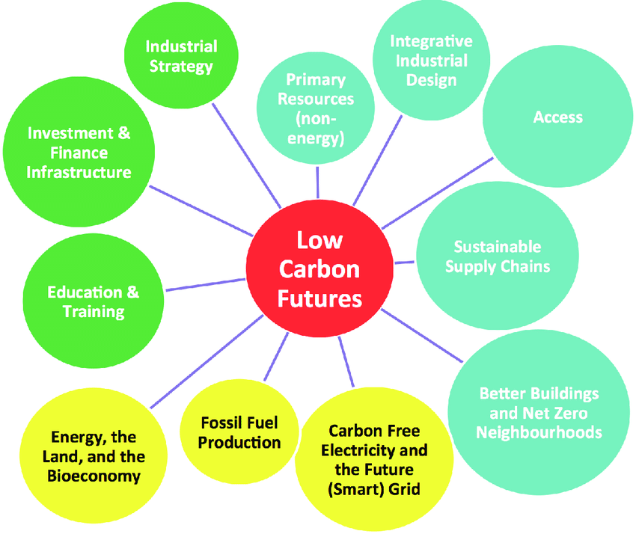
Climate Change Mitigation Strategies

Slide 10
Carbon Credit System
Carbon Credits: Carbon credits represent a unit of greenhouse gas (GHG) emissions reduced, avoided, or removed from the atmosphere. They are a key component of emissions trading schemes and carbon pricing mechanisms.
Purpose: The carbon credit system aims to create financial incentives for businesses and governments to reduce their carbon footprints. By assigning a monetary value to carbon emissions, it encourages investments in cleaner technologies and practices.
How Carbon Credits Work:
Issuance: Carbon credits are issued based on verified emissions reductions or removals. Projects that generate carbon credits include renewable energy installations, reforestation projects, and energy efficiency improvements.
Trading: Carbon credits can be traded on carbon markets. Buyers purchase credits to offset their own emissions, while sellers (project developers) benefit financially from selling credits generated by their projects.
Types of Credits: There are different types of carbon credits, including Certified Emission Reductions (CERs) under the CDM and Verified Emission Reductions (VERs) from voluntary carbon markets.

Slide 11
Clean Development Mechanism (CDM)
Clean Development Mechanism (CDM)
Purpose: The CDM is a project-based mechanism under the Kyoto Protocol (now integrated into the Paris Agreement) that allows developed countries to invest in emission reduction projects in developing countries.
Goals: It aims to promote sustainable development in developing countries while helping developed countries meet their emission reduction targets cost-effectively.
Operational Framework:
Establishment: The CDM was established under the Kyoto Protocol, which came into force in 2005. It allows developed countries (Annex I countries) to invest in emission reduction projects in developing countries (Non-Annex I countries) as a way to meet their emission reduction targets.
Executive Board: Overseen by the CDM Executive Board (EB), which is responsible for assessing and approving CDM projects, verifying emission reductions, and issuing Certified Emission Reductions (CERs).

Slide 12
Clean Development Mechanism (CDM)
Examples of CDM Projects:
Renewable Energy: Projects include wind farms, solar power installations, and biomass energy projects that replace fossil fuel-based energy sources.
Energy Efficiency: Improvements in industrial processes, transportation systems, and building technologies to reduce energy consumption and emissions.
Forestry and Land Use: Afforestation, reforestation, and forest conservation projects that enhance carbon sinks and biodiversity conservation.
Benefits and Challenges:
Benefits: Provides financial and technological support for sustainable development in developing countries. Facilitates knowledge transfer and capacity building.
Challenges: Administrative complexity, additionality requirements (ensuring projects would not have occurred without CDM incentives), and evolving market dynamics.

Slide 14
Carbon Trading
Carbon trading, also known as emissions trading, is a market-based approach to controlling pollution by providing economic incentives for achieving reductions in the emissions of greenhouse gases (GHGs).
Cap-and-Trade Systems: Under cap-and-trade systems, a cap is set on the total amount of emissions allowed, and emission permits or allowances are distributed or auctioned among entities covered by the system.
Trading Mechanism: Entities can trade these permits or credits, allowing those who can reduce emissions more cheaply to sell excess permits to those who face higher costs.
Key Markets and Participants:
Regional and National Markets: Examples include the European Union Emissions Trading System (EU ETS), California's Cap-and-Trade Program, and China's national ETS.
Participants: Companies in energy-intensive industries (e.g., power generation, cement production), aviation sector, and other regulated entities required to comply with emission reduction targets.

Slide 15
Carbon Trading
Benefits of Carbon Trading:
Cost-effectiveness: Allows emissions reductions to occur where costs are lowest, maximizing overall economic efficiency.
Flexibility: Provides flexibility for companies to choose how and when to reduce emissions, encouraging innovation in clean technologies.
Scalability: Can be scaled up to cover larger geographical areas and sectors, potentially leading to significant global emission reductions.

Slide 16
Clean Technologies
Clean technology, also known as cleantech, refers to products, services, and processes that use renewable materials and energy sources, reduce waste, and minimize environmental impact.
Examples: Includes renewable energy technologies (solar, wind, hydro, geothermal), energy-efficient technologies (LED lighting, efficient appliances), and technologies for waste management and water purification.
Benefits and Importance:
Environmental Benefits: Reduces greenhouse gas emissions, minimizes air and water pollution, conserves natural resources, and protects biodiversity.
Economic Benefits: Stimulates economic growth and job creation in the clean energy sector, reduces energy costs over the long term, and enhances energy security.
Social Benefits: Improves public health by reducing exposure to pollutants and creating sustainable communities.

Slide 17
Clean Technologies
Role in Mitigation Strategies:
Integration into Policies: Governments integrate clean technology into national and regional policies to achieve emission reduction targets (e.g., renewable energy targets, energy efficiency standards).
Innovation and Research: Supports research and development (R&D) efforts to improve efficiency and reduce costs of clean technologies, driving technological advancements.
Challenges:
Cost and Financing: Initial costs and financing for clean technology deployment can be barriers, though costs have been decreasing over time.
Regulatory and Market Uncertainty: Policy changes and fluctuations in energy prices and carbon markets can impact investment decisions and market adoption.

Slide 18
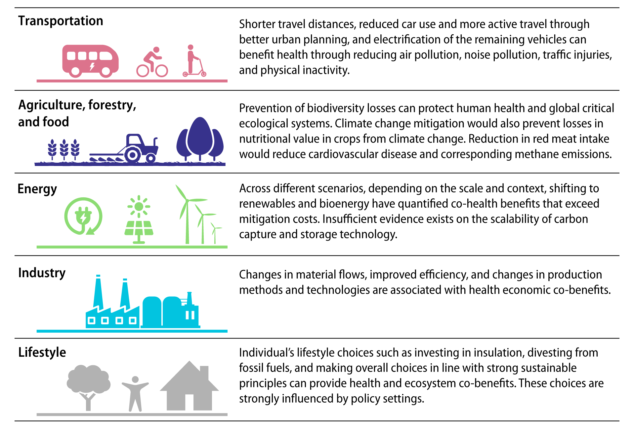
Mitigation Technologies for different sector

Slide 19
Strategic Frameworks for Mitigation
Purpose: Strategic frameworks provide guidance and structure for countries and regions to implement effective climate change mitigation measures.
Examples: Include Nationally Determined Contributions (NDCs), Long-Term Low-Emission Development Strategies (LT-LEDS), and sectoral policies addressing specific industries (e.g., transportation, agriculture).
Nationally Determined Contributions (NDCs):
Definition: NDCs are national climate action plans submitted by countries under the Paris Agreement, outlining their commitments to reduce greenhouse gas emissions and adapt to climate change impacts.
Components: Typically include emission reduction targets, policies and measures to achieve targets, adaptation strategies, and support needs for implementation.

Slide 20
Strategic Frameworks for Mitigation
Long-Term Low-Emission Development Strategies (LT-LEDS):
Purpose: LT-LEDS provide a pathway for countries to achieve long-term emission reduction goals, often aligned with national development priorities and sustainable development objectives.
Scope: Includes scenarios for decarbonizing key sectors, identifying investment needs, technological innovations, and policy interventions required over several decades.
Sectoral and Regional Strategies:
Examples: Policies targeting specific sectors such as energy, transportation, industry, and agriculture to promote low-carbon technologies, energy efficiency, and sustainable practices.
Integration: Strategies are integrated with broader economic and development plans to ensure coherence and maximize co-benefits across sectors.

Slide 21
Policy Approaches for Low Carbon Development
Overview of Policy Approaches:
Market-Based Instruments: Such as carbon pricing mechanisms (carbon taxes, emissions trading systems) to internalize the cost of carbon emissions and incentivize low-carbon investments.
Regulatory Measures: Standards, regulations, and incentives to promote energy efficiency, renewable energy deployment, and sustainable land use practices.
Examples of Effective Policies:
Renewable Energy Targets: Setting ambitious targets for renewable energy deployment (e.g., percentage of electricity generation from renewables by a certain year).
Energy Efficiency Standards: Mandating efficiency standards for appliances, buildings, and vehicles to reduce energy consumption and emissions.
Subsidies and Incentives: Financial incentives, grants, and subsidies for clean technology adoption and innovation, promoting investment in sustainable development.

Slide 22
Policy Approaches for Low Carbon Development
Integrated Approaches:
Cross-Sectoral Integration: Ensuring policies are coordinated across sectors (energy, transportation, agriculture) to achieve synergies and avoid trade-offs.
Public-Private Partnerships: Collaborative efforts between governments, businesses, and civil society to drive innovation, investment, and implementation of low-carbon solutions.
Evaluation and Adjustment:
Monitoring and Evaluation: Regular assessment of policy effectiveness, including emissions reductions achieved, costs incurred, and social and economic impacts.
Policy Flexibility: Flexibility to adjust policies based on evolving scientific knowledge, technological advancements, and changing socio-economic conditions.

Slide 23
International Initiatives
Paris Agreement
Adopted in 2015 under the United Nations Framework Convention on Climate Change (UNFCCC).
Aim: Limit global warming to well below 2°C above pre-industrial levels, and pursue efforts to limit the temperature increase to 1.5°C.
Key Provisions:
Nationally Determined Contributions (NDCs): Each country sets its own targets.
Global stocktake every five years to assess collective progress.
Climate finance: Developed countries to assist developing countries.

Slide 24
Goals and Achievements of the Paris Agreement
Goals:
Enhance adaptive capacity, resilience, and low-emission development.
Foster climate resilience and low greenhouse gas emissions development.
Achievements:
Ratification by 197 countries.
Enhanced climate commitments and updates in NDCs by several countries.
Increased focus on climate finance and support for vulnerable nations.
Challenges:
Varied levels of ambition and commitment.
Financial and technological support for developing nations.
Balancing economic growth with emission reductions.

Slide 25
National Initiatives
United States:
Clean Power Plan: Targeting reductions in carbon emissions from power plants.
Biden Administration’s climate policies: Rejoining the Paris Agreement, net-zero emissions by 2050.
China:
Carbon neutrality by 2060.
Large-scale renewable energy projects and investments.
European Union:
European Green Deal: Climate neutrality by 2050.
Emissions Trading System (ETS): Cap-and-trade system to reduce industrial emissions.

Slide 26
Success Stories and Challenges
Success Stories:
Germany:
Energiewende: Transition to renewable energy, significant reductions in greenhouse gas emissions.
Costa Rica:
Nearly 100% renewable electricity generation.
India:
Rapid expansion of solar energy capacity.
Challenges:
United States:
Political shifts impacting climate policy continuity.
China:
Balancing economic growth with emission reductions.
Developing Nations:
Limited financial and technological resources.
Vulnerability to climate impacts despite low emissions.

Slide 27
Case Study 1
Germany's Energiewende
Germany's Energiewende (Energy Transition) is one of the most ambitious national climate policies in the world, aiming to shift from fossil fuels to renewable energy.
Objectives:
Achieve at least an 80-95% reduction in greenhouse gas emissions by 2050 compared to 1990 levels.
Increase the share of renewable energy in electricity consumption to 65% by 2030.
Key Strategies:
Renewable Energy Sources Act (EEG): Provides financial incentives for renewable energy production.
Phase-out of Nuclear Power: Gradual shutdown of nuclear power plants, replaced by renewable sources.
Expansion of the Grid: Upgrading and expanding the electricity grid to accommodate renewable energy.
Energy Efficiency: Programs to increase energy efficiency in buildings and industries.

Slide 28
Case Study 1
Germany's Energiewende
Achievements:
As of 2020, around 45% of Germany's electricity comes from renewable sources.
Significant reduction in CO₂ emissions, contributing to EU targets.
Challenges:
High costs and economic impact on energy-intensive industries.
Public opposition to infrastructure projects like new power lines.
Ensuring a stable and reliable energy supply during the transition.

Slide 29
Case Study 2
Costa Rica's Renewable Energy Success
Costa Rica is renowned for its commitment to environmental sustainability and renewable energy, aiming to become carbon neutral by 2050.
Objectives:
Achieve 100% renewable energy generation.
Reduce carbon footprint across all sectors, including transportation and agriculture.
Key Strategies:
Investment in Hydropower: Major reliance on hydropower, supplemented by geothermal, wind, and solar power.
Environmental Conservation: Extensive national parks and protected areas, covering about 25% of the country.
Public Transportation: Initiatives to modernize and electrify public transportation systems.
Legislation: Laws promoting renewable energy and setting emission reduction targets.

Slide 30
Case Study 2
Costa Rica's Renewable Energy Success
Achievements:
In 2019, Costa Rica ran on 99.62% renewable energy for the entire year.
Significant reductions in fossil fuel dependency and greenhouse gas emissions.
International recognition for environmental leadership.
Challenges:
Hydropower dependency makes the country vulnerable to climate variability (e.g., droughts).
Financial and technical challenges in expanding other renewable sources.
Addressing emissions in sectors like transportation and agriculture.

Slide 31
Financing Climate Change Mitigation
Sources of Funding:
Public Funding: Government budgets, international climate funds (e.g., Green Climate Fund), and development assistance from bilateral and multilateral agencies (e.g., World Bank).
Private Sector Investments: Venture capital, private equity, and corporate investments in renewable energy projects, clean technologies, and climate-resilient infrastructure.
Carbon Markets: Revenue from carbon pricing mechanisms such as carbon credits and emissions trading systems, which incentivize emission reductions.
Challenges in Financing Mitigation Projects:
Financial Barriers: High upfront costs for clean technology adoption and infrastructure development.
Risk Perception: Uncertainty in returns on investments, especially in emerging markets and technologies.
Policy and Regulatory Uncertainty: Changes in government policies, lack of supportive regulatory frameworks, and inconsistent carbon pricing mechanisms.
Access to Finance: Limited access to affordable financing options for developing countries and small-scale projects.

Slide 32
Innovations in Mitigation Technologies
Emerging Technologies:
Renewable Energy: Advancements in solar photovoltaics (PV), wind turbines, and energy storage technologies to enhance efficiency and cost-effectiveness.
Carbon Capture and Storage (CCS): Techniques to capture carbon dioxide emissions from industrial processes and power generation, followed by transportation and storage underground.
Electric Vehicles (EVs) and Sustainable Transport: Development of electric vehicles, hydrogen fuel cells, and infrastructure for zero-emission transportation.
Smart Grids and Energy Management Systems: Integration of digital technologies to optimize energy distribution, improve grid reliability, and reduce energy consumption.

Slide 33
Innovations in Mitigation Technologies
Potential Impact on Mitigation Efforts:
Cost Reduction: Lowering the cost of clean technologies and making them competitive with fossil fuels.
Scalability: Scaling up deployment of renewable energy and low-carbon technologies to meet global energy demand.
Emission Reductions: Achieving deeper cuts in greenhouse gas emissions across sectors such as energy, transportation, industry, and buildings.
Adaptation Benefits: Enhancing resilience to climate impacts through innovative solutions in water management, agriculture, and urban planning.

Slide 34
Public Awareness and Engagement
Importance of Public Support:
Policy Implementation: Public support is crucial for governments to implement ambitious climate policies and regulations.
Behavior Change: Individuals and communities play a role in reducing carbon footprints through energy conservation, sustainable consumption, and advocacy for climate action.
Social Acceptance: Public awareness fosters acceptance of renewable energy projects and carbon pricing mechanisms, enabling their successful implementation.

Slide 35
Public Awareness and Engagement
Strategies for Increasing Awareness:
Education and Outreach: School curricula, public campaigns, and workshops to educate individuals about climate science, impacts, and mitigation strategies.
Media and Communication: Leveraging traditional and digital media platforms to disseminate information on climate change, local impacts, and solutions.
Community Engagement: Encouraging community participation in local climate initiatives, grassroots organizations, and climate action networks.
Partnerships: Collaborating with civil society organizations, businesses, and academia to amplify messages and mobilize collective action.

Slide 36
Challenges in Climate Change Mitigation
Barriers to Effective Mitigation:
Political Will: Resistance from vested interests, short-term political cycles, and competing policy priorities.
Economic Considerations: Costs of transitioning to low-carbon technologies, economic impacts on industries reliant on fossil fuels, and financial barriers.
Technological Limitations: Development and deployment challenges of emerging technologies like carbon capture and storage (CCS) and sustainable aviation fuels.
Social and Behavioral Factors: Resistance to change, lack of awareness, and societal norms that perpetuate high-carbon lifestyles.

Slide 37
Challenges in Climate Change Mitigation
Global vs. Local Challenges:
Global Coordination: Negotiating international agreements, addressing equity concerns, and ensuring accountability in emission reduction commitments.
Local Implementation: Tailoring mitigation strategies to regional contexts, addressing local vulnerabilities to climate impacts, and building resilience.
Capacity Building: Strengthening institutional capacity, enhancing technical expertise, and securing funding for climate projects in developing countries.
Adaptation Needs: Balancing mitigation efforts with adaptation measures to manage climate risks and protect vulnerable communities.

Slide 38
Future Trends in Mitigation
Predictions and Projections:
Emission Reduction Targets: Increasing ambition to align with scientific recommendations, potentially revising NDCs under the Paris Agreement.
Technological Innovations: Advancements in renewable energy technologies (e.g., solar, wind, storage), carbon capture and storage (CCS), and sustainable transport solutions (e.g., electric vehicles).
Policy Developments: Expansion of carbon pricing mechanisms, integration of climate risk assessments into financial regulations, and adoption of circular economy principles.
Potential Advancements in Policy and Technology:
Policy Frameworks: Strengthening international cooperation, enhancing transparency in climate reporting, and promoting climate-smart agriculture and forestry practices.
Technology Deployment: Scaling up deployment of clean technologies, fostering innovation in low-carbon solutions, and enhancing resilience through nature-based solutions (e.g., reforestation, ecosystem restoration).

Slide 39
Thank You

