Slide 1
CCP-LAW
Curricula development on Climate Change Policy and Law
Subject title: Climate Change and Human Rights
Instructor Name: Dr. Albert Lladó Martínez
Project No of Reference: 618874-EPP-1-2020-1-VN-EPPKA2-CBHE-JP:
The European Commission's support for the production of this publication does not constitute an endorsement of the contents, which reflect the views only of the authors, and the Commission cannot be held responsible for any use which may be made of the information contained therein.

Slide 2
Topic 1. The Progressive Recognition of Human Rights Obligations Relating to the Climate Change
OVERVIEW
TOPIC 1.1 Overview of the impacts of climate change on human rights and the incorporation of corresponding human rights obligations into climate action.

Slide 3
INTRODUCTION
Climate change directly affects human rights. One of the consequences of climate change is the proliferation of natural disasters such as hurricanes, rising sea levels, floods and droughts, which deprive millions of people of their livelihoods. This reality directly affects the enjoyment of their most basic rights: the rights to food, water and sanitation, decent housing, health, personal security, in short, the right to a dignified life.

Slide 4
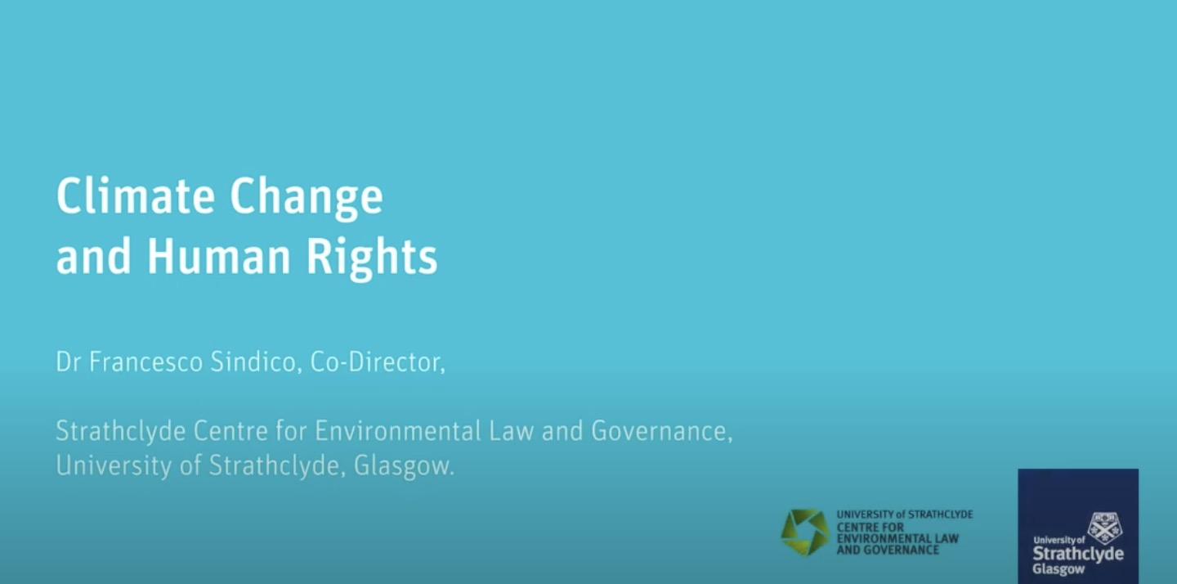
INTRODUCTION
VIDEO (2 min.):
Climate Change and Human Rights
by Dr Francesco Sindico
Co-Director, Strathclyde Center for Environmental Law and Governance,
University of Strathclyde, Glasgow.
https://youtu.be/YKQn1YCOxTo?si=5ctTJElZBLCVrXJr

Slide 5
Topic 1.1 Overview of the impacts of
climate change on human rights
Human rights are indeed affected by climate change, and there is hard evidence of the damage in many cases:
RIGHT TO LIFE
RIGHT TO HEALTH
RIGHT TO WATER AND SANITATION
RIGHT TO FOOD
RIGHT TO ADEQUATE HOUSING
RIGHT TO SELF-DETERMINATION
RIGHT TO DEVELOPMENT
CLIMATE REFUGEES AND MIGRATION
RIGHT TO EDUCATION

Slide 6
OVERVIEW OF THE IMPACTS OF CLIMATE CHANGE ON HUMAN RIGHTS
RIGHT TO LIFE (1/2)
Increased Mortality: Climate change exacerbates extreme weather events such as heatwaves, floods, and storms, leading to increased deaths and injuries. According to the World Health Organization (WHO), climate change could cause an additional 250,000 deaths per year between 2030 and 2050 due to heat stress, malnutrition, and diseases like malaria.

Slide 7
OVERVIEW OF THE IMPACTS OF CLIMATE CHANGE ON HUMAN RIGHTS
RIGHT TO LIFE (2/2)
Natural Disasters: Rising sea levels, stronger storms, and more frequent floods increase mortality risks, particularly in vulnerable coastal regions and small island states. In 2019 alone, 24.9 million people were displaced due to disasters related to climate change.

Slide 8
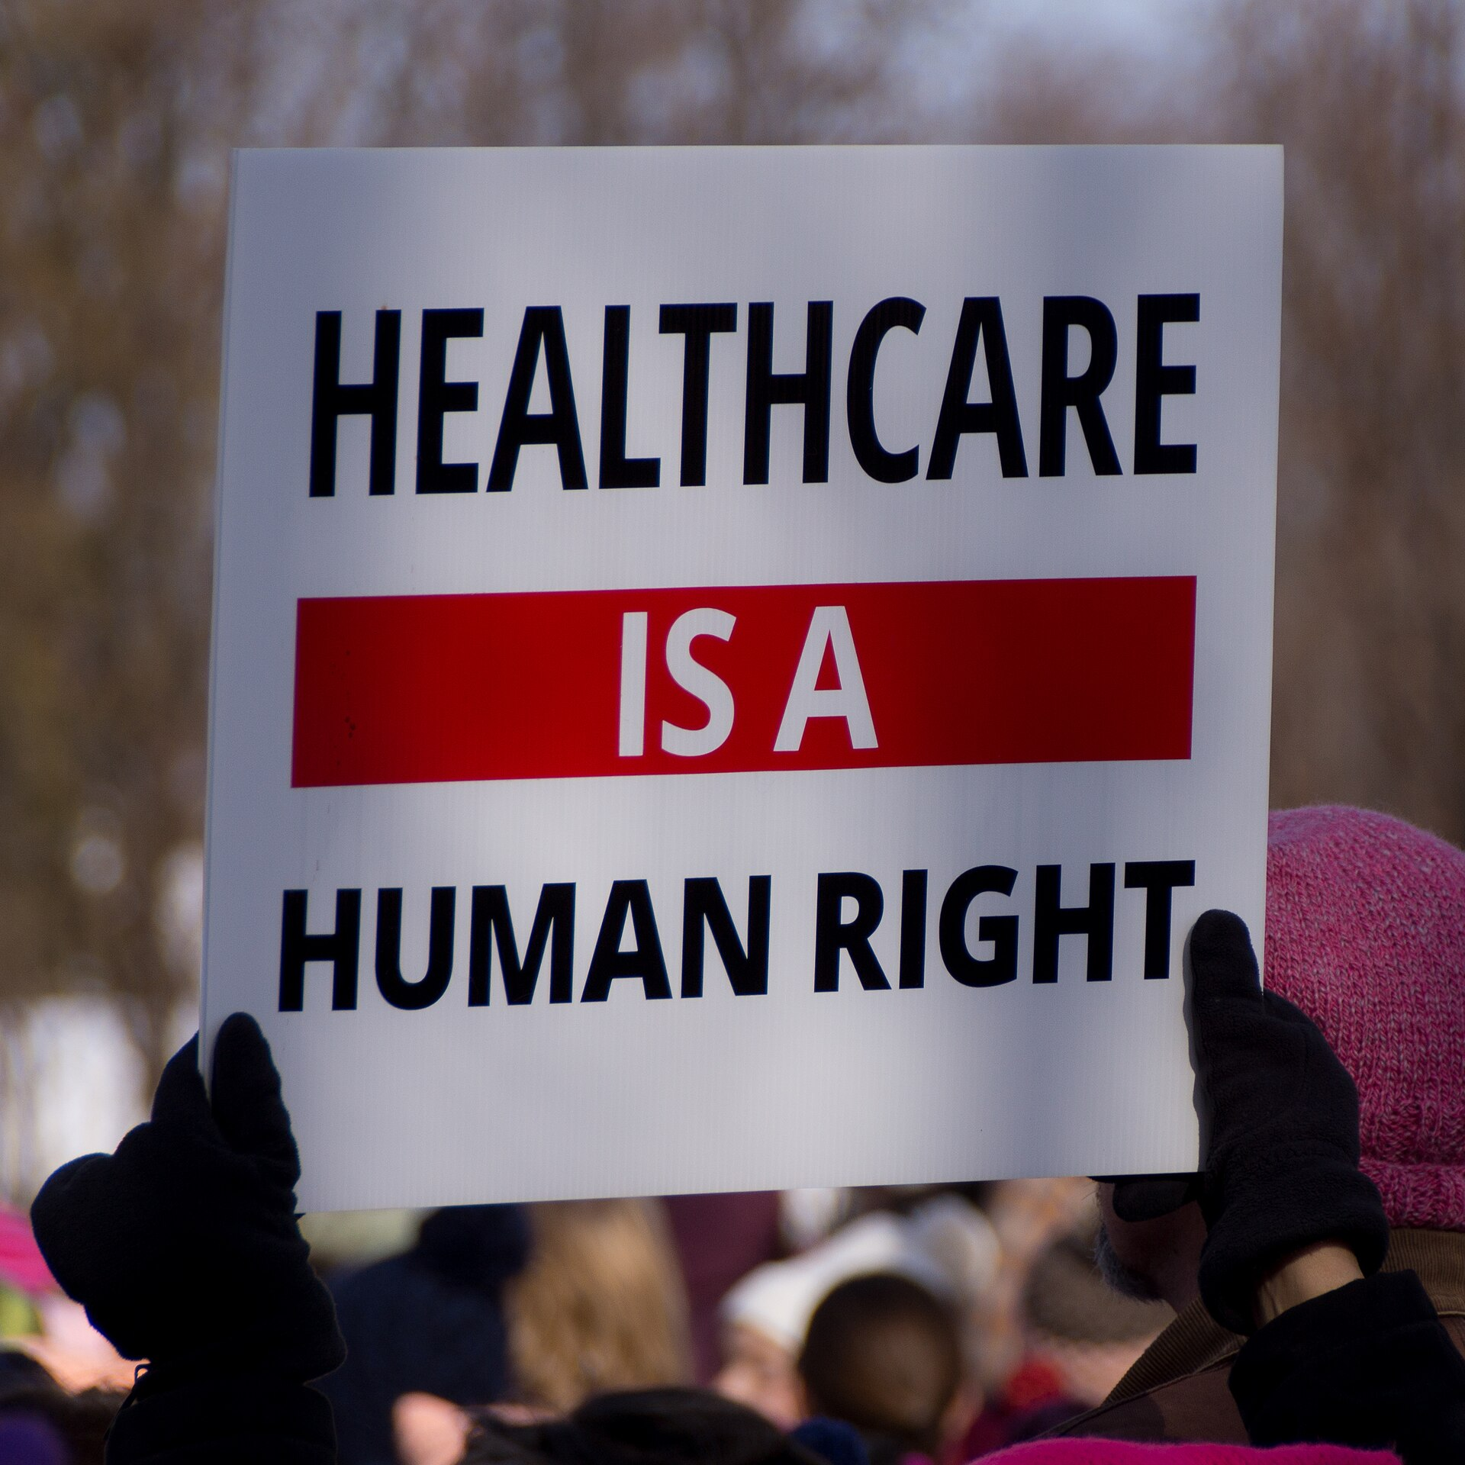
OVERVIEW OF THE IMPACTS OF CLIMATE CHANGE ON HUMAN RIGHTS
RIGHT TO HEALTH (1/2)
Heat-related Illnesses: Rising temperatures contribute to heat-related illnesses and deaths, especially among the elderly, the very young, and those with pre-existing health conditions. The Lancet’s “Countdown on Health and Climate Change” reported that in 2019, more than 300,000 deaths were directly attributable to heatwaves.

Slide 9
OVERVIEW OF THE IMPACTS OF CLIMATE CHANGE ON HUMAN RIGHTS
RIGHT TO HEALTH (2/2)
Spread of Diseases: Climate change expands the habitat of disease vectors like mosquitoes, increasing the spread of diseases such as malaria and dengue fever. The WHO warns that climate-sensitive diseases could spread to new regions as temperatures and humidity rise.

Slide 10
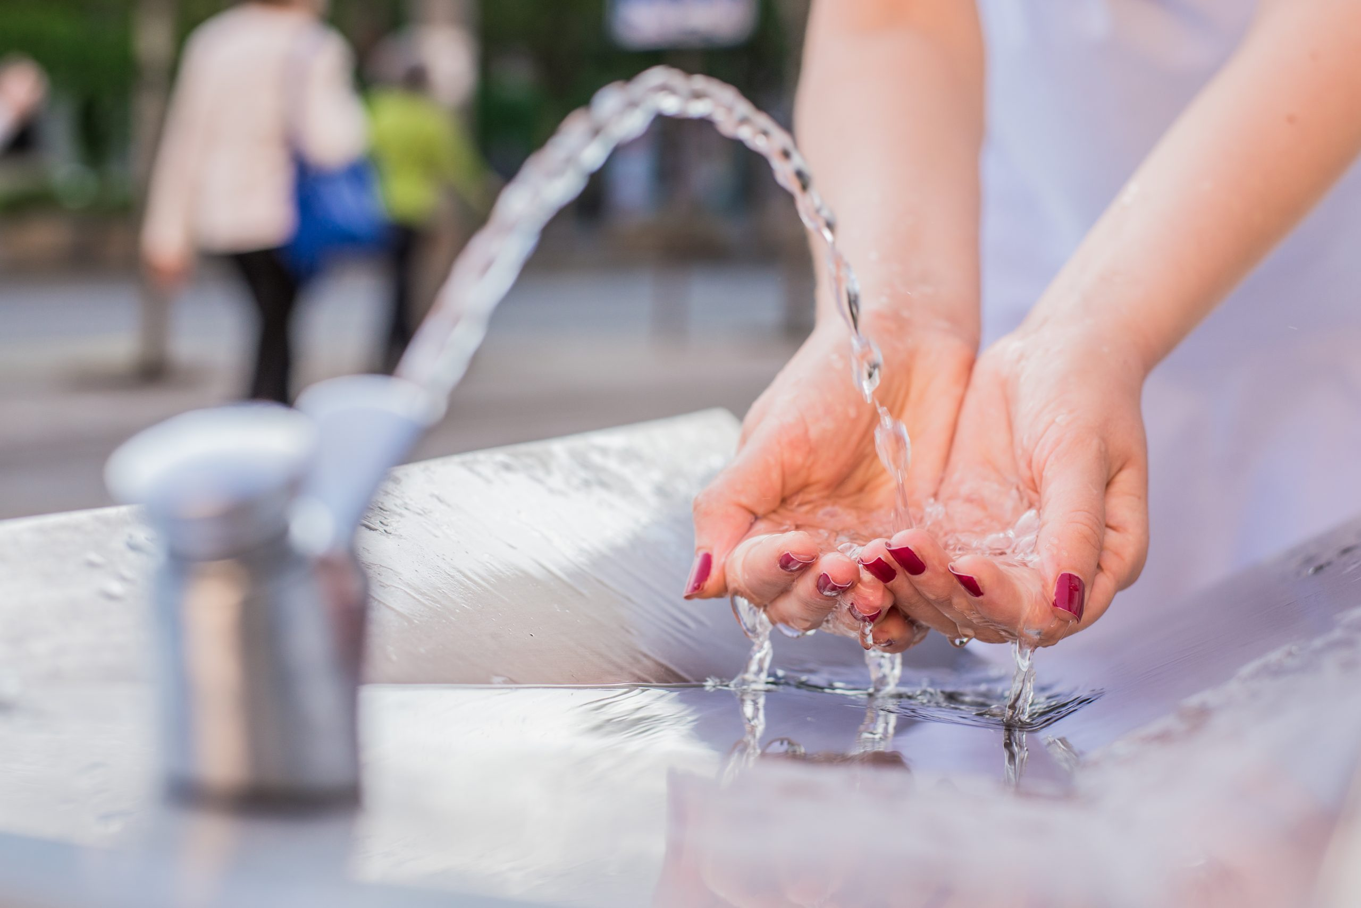
OVERVIEW OF THE IMPACTS OF CLIMATE CHANGE ON HUMAN RIGHTS
RIGHT TO WATER AND SANITATION
Water Scarcity: Global warming leads to prolonged droughts and freshwater shortages. The UN estimates that by 2050, more than 5 billion people could face water shortages due to climate impacts, particularly in Africa, Asia, and Latin America .
Water Contamination: Flooding and extreme weather events can contaminate water supplies with pollutants and pathogens, directly impacting public health and access to clean water.

Slide 11
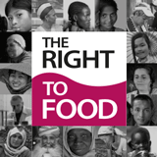
OVERVIEW OF THE IMPACTS OF CLIMATE CHANGE ON HUMAN RIGHTS
RIGHT TO FOOD (1/2)
Agricultural Decline: Climate change reduces agricultural productivity by increasing temperatures, changing rainfall patterns, and leading to droughts or floods. The Food and Agriculture Organization (FAO) reports that global crop yields could decline by 10-25% by 2050, severely threatening food security in developing countries.

Slide 12
OVERVIEW OF THE IMPACTS OF CLIMATE CHANGE ON HUMAN RIGHTS
RIGHT TO FOOD (2/2)
Hunger and Malnutrition: The World Food Programme estimates that climate change could push an additional 100 million people into extreme hunger by 2030, with children and women particularly vulnerable to malnutrition.

Slide 13
OVERVIEW OF THE IMPACTS OF CLIMATE CHANGE ON HUMAN RIGHTS
RIGHT TO ADEQUATE HOUSING (1/2)
Climate Displacement: Rising sea levels and extreme weather events are already forcing millions from their homes, creating "climate refugees". The Internal Displacement Monitoring Centre reported that 23.9 million people were displaced by weather-related disasters in 2019 alone.

Slide 14
OVERVIEW OF THE IMPACTS OF CLIMATE CHANGE ON HUMAN RIGHTS
RIGHT TO ADEQUATE HOUSING (2/2)
Housing Damage: Coastal erosion, desertification, and stronger storms threaten to destroy homes, particularly in informal settlements or developing regions where housing infrastructure is weak.

Slide 15
OVERVIEW OF THE IMPACTS OF CLIMATE CHANGE ON HUMAN RIGHTS
RIGHT TO SELF-DETERMINATION (1/2)
Impact on Indigenous Peoples: Climate change disproportionately affects indigenous communities, especially those relying on natural ecosystems for livelihoods. Rising temperatures and environmental degradation threaten their right to preserve their land and culture.

Slide 16
OVERVIEW OF THE IMPACTS OF CLIMATE CHANGE ON HUMAN RIGHTS
RIGHT TO SELF-DETERMINATION (2/2)
Loss of Livelihoods: Farmers, herders, and fishers are increasingly unable to sustain their traditional ways of life due to changes in weather patterns, undermining their economic and cultural rights.

Slide 17
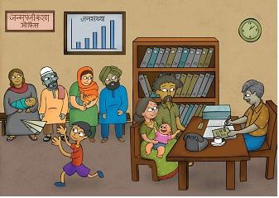
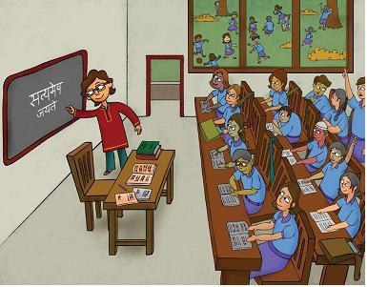
OVERVIEW OF THE IMPACTS OF CLIMATE CHANGE ON HUMAN RIGHTS
RIGHT TO DEVELOPMENT (1/2)
Economic Inequality: Climate change exacerbates inequalities between developed and developing countries. Developing nations, which contribute the least to global emissions, are bearing the brunt of climate impacts, further limiting their right to sustainable development.
Vulnerable Populations: The poorest populations, particularly women and children, are the most affected by the environmental and economic impacts of climate change, trapping them in cycles of poverty.

Slide 18
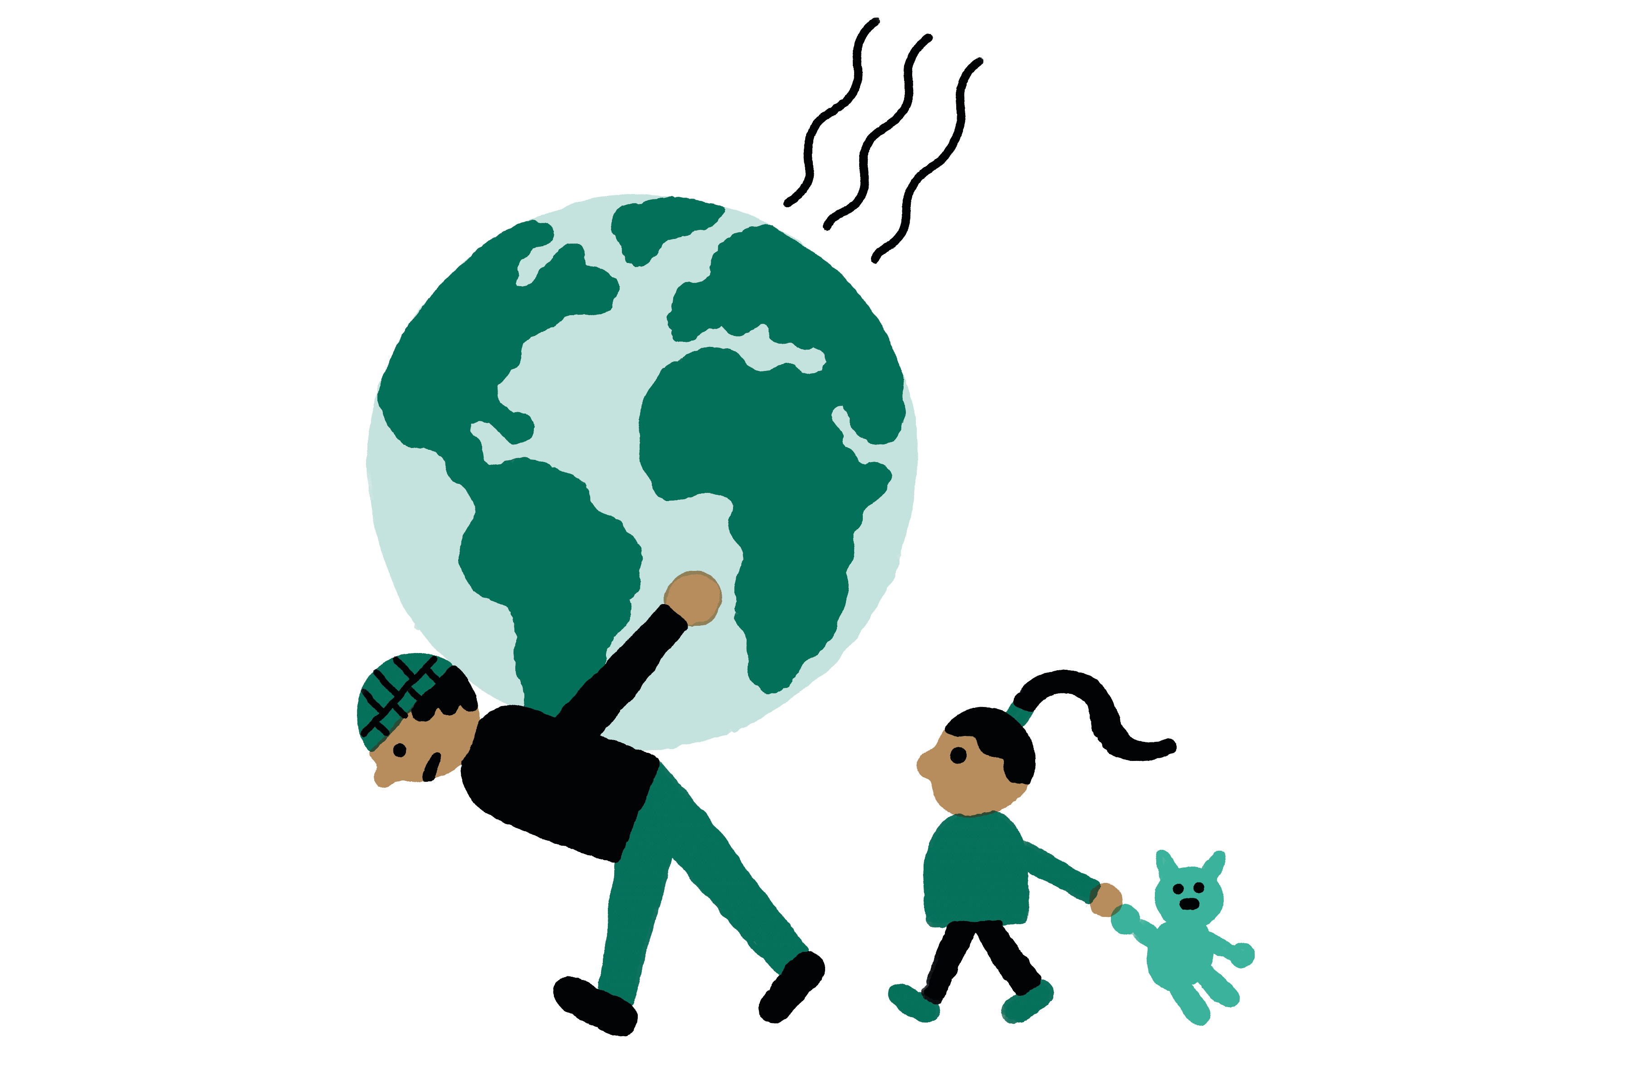
OVERVIEW OF THE IMPACTS OF CLIMATE CHANGE ON HUMAN RIGHTS
CLIMATE REFUGEES AND MIGRATION
Displacement Crisis: Climate-induced displacement is expected to rise sharply. By 2050, the World Bank estimates that climate change could force up to 143 million people to migrate within their countries in Sub-Saharan Africa, South Asia, and Latin America.

Slide 19
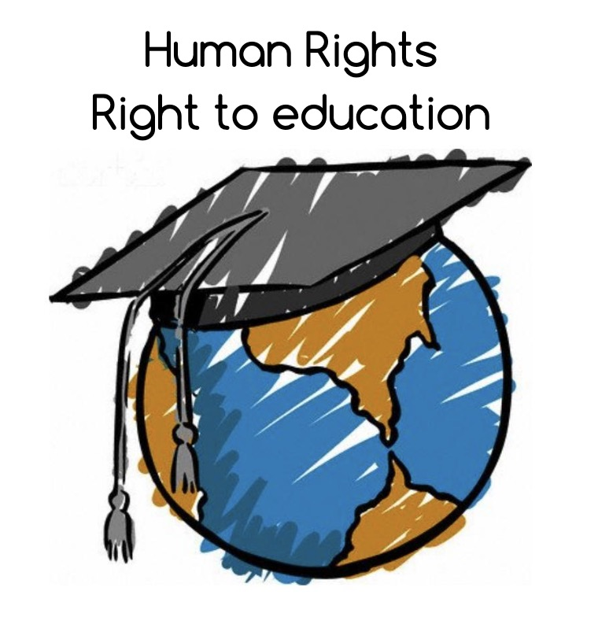
OVERVIEW OF THE IMPACTS OF CLIMATE CHANGE ON HUMAN RIGHTS
RIGHT TO EDUCATION
Educational Disruption: Climate disasters, such as floods or droughts, can disrupt schooling by damaging infrastructure, displacing students and teachers, or pushing children into labor to support their families. Access to education, especially for girls, is severely impacted in climate-vulnerable areas.

Slide 20
OVERVIEW OF THE IMPACTS OF CLIMATE CHANGE ON HUMAN RIGHTS
Key Takeaways 1: Climate Change and Human Rights
1. Climate Change Directly Impacts Human Rights:
- Climate change is linked to extreme weather events, including rising sea levels, heatwaves, droughts, and floods, which jeopardize fundamental human rights.
- These rights include the right to life, health, food, water and sanitation, adequate housing, and even self-determination for vulnerable populations.

Slide 21
OVERVIEW OF THE IMPACTS OF CLIMATE CHANGE ON HUMAN RIGHTS
Key Takeaways 1: Climate Change and Human Rights
2. Vulnerable Populations:
- The most vulnerable populations, especially in developing countries, indigenous communities, and small island states, face the most severe consequences of climate change, exacerbating economic inequality.
- Climate refugees are on the rise, with millions displaced annually due to weather-related disasters. By 2050, up to 143 million people could be displaced internally due to climate impacts.

Slide 22
OVERVIEW OF THE IMPACTS OF CLIMATE CHANGE ON HUMAN RIGHTS
Key takeaways 2: Integrating Human Rights in Climate Action
1. The Need for Rights-Based Climate Policies:
- Climate policies must integrate human rights considerations, ensuring that vulnerable populations are protected and have access to sustainable development.
- International cooperation is crucial in addressing these inequalities and ensuring a just transition to low-carbon economies.

Slide 23
OVERVIEW OF THE IMPACTS OF CLIMATE CHANGE ON HUMAN RIGHTS
Key takeaways 2: Integrating Human Rights in Climate Action
2. Urgency of Action:
Global climate action needs to accelerate to meet international obligations like the Paris Agreement.
Without immediate and coordinated global efforts, climate change will continue to erode basic human rights, leading to significant displacement, poverty, and inequality.

