Slide 1
CCP-LAW
Curricula development on Climate Change Policy and Law
Module 9: Climate Change and Sustainable development
Subject title: Corporate sustainability strategies and frameworks
Instructor Name: Regina Kalodiki
Project No of Reference: 618874-EPP-1-2020-1-VN-EPPKA2-CBHE-JP:
The European Commission's support for the production of this publication does not constitute an endorsement of the contents, which reflect the views only of the authors, and the Commission cannot be held responsible for any use which may be made of the information contained therein.

Slide 2
Content
Content
Corporate Sustainability Defined
Environmental Sustainability
Social Sustainability
Corporate sustainability within the economic context
Sustainable Business Models

Slide 3
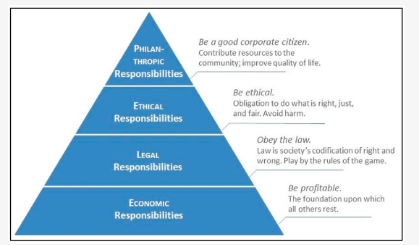
Corporate Sustainability Defined
Corporate Social Responsibility:
CSR gained force during the 1970 as a business model that helps a company be socially accountable to itself, its stakeholders, and the public.
According to Carroll’s statement (1979):
“the social responsibility of business encompasses
the economic, legal, ethical, and discretionary
expectations that society has of organizations at a given
point in time”
Carroll proposed dividing CSR into four tiers of
responsibilities which were ordered according to priority
from bottom to top for socially responsible behaviour or
activity. His categories of activity ascended from the
foundations of economic obligation, to legal, through
ethical to philanthropic obligations at the apex.
CSR addresses the ethical obligations of businesses
towards society and the environment in the present and
focuses on immediate social and environmental needs or
responding to specific events or issues
Carrolls’s CSR Pyramid
Notes:
Costa AJ, Curi D, Bandeira AM, Ferreira A, Tomé B, Joaquim C, Santos C, Góis C, Meira D, Azevedo G, et al. Literature Review and Theoretical Framework of the Evolution and Interconnectedness of Corporate Sustainability Constructs. Sustainability. 2022; 14(8):4413. https://doi.org/10.3390/su14084413
Sheehy B, Farneti F. Corporate Social Responsibility, Sustainability, Sustainable Development and Corporate Sustainability: What Is the Difference, and Does It Matter? Sustainability. 2021; 13(11):5965. https://doi.org/10.3390/su13115965

Slide 4
Corporate Sustainability Defined
Corporate sustainability
Corporate sustainability goes beyond CSR by incorporating a broader perspective that includes economic, social, and environmental dimensions. It aims to create long-term value for all stakeholders by balancing financial performance with environmental stewardship and social responsibility.
Background:
During the 1990s, discussions arose regarding Sustainable Development (SD), leading to calls from governments, non-governmental organizations, and civil society for companies to endorse SD principles. This placed "Corporate Social Responsibility" (CSR), the "environment", and the "bottom line" at the heart of the corporate sustainability concept.
Elkington's (1997) argued that companies should seek, in addition to financial results, social and environmental results from their activities, and, only in this way, ensure the sustainability (in the sense of continuity) of their businesses.
"triple bottom line (TBL) . "The triple bottom line (or otherwise noted as TBL or 3BL) is an accounting framework with three parts: social, environmental (or ecological) and economic.
Notes:
Costa AJ, Curi D, Bandeira AM, Ferreira A, Tomé B, Joaquim C, Santos C, Góis C, Meira D, Azevedo G, et al. Literature Review and Theoretical Framework of the Evolution and Interconnectedness of Corporate Sustainability Constructs. Sustainability. 2022; 14(8):4413. https://doi.org/10.3390/su14084413
Sheehy B, Farneti F. Corporate Social Responsibility, Sustainability, Sustainable Development and Corporate Sustainability: What Is the Difference, and Does It Matter? Sustainability. 2021; 13(11):5965. https://doi.org/10.3390/su13115965

Slide 5
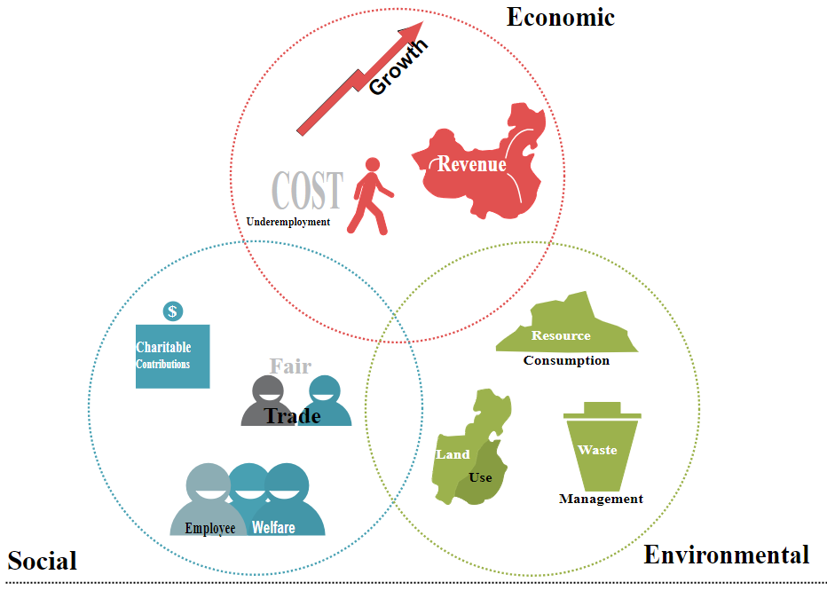
Corporate Sustainability Defined
Triple Bottom lines ( the three pillars of sustainability):
In traditional business accounting and common usage, the "bottom line“
refers to either the "profit" or "loss", which is usually recorded at the very
bottom line on a statement of revenue and expenses.
The triple bottom line consists of social equity, economic, and
environmental factors.
The phrase, "people, planet, and profit" to describe the triple bottom line and
the goal of sustainability was coined by John Elkington 1994 and was later
used as the title of the Anglo-Dutch oil company Shell's first sustainability
Report ( 1997)
These pillars represent the key dimensions that organizations need to
consider to ensure sustainable practices and long-term success.
The environmental pillar (planet) emphasizes environmental stewardship,
resource conservation, and minimizing ecological impact.
The social pillar ( people) addresses social responsibility, community
engagement, and human rights considerations.
The economic pillar (profit) focuses on financial performance, efficiency, and
profitability.
While there is no universally agreed definition of CS, many see
it as the private sector’s way of integrating the economic,
social and environmental imperatives of their business.
Graphic describing the three types of bottom lines
licensed under the Creative
Commons Attribution-Share Alike 4.0 International license.
Notes:
Hassis, S. M., Othman, M., & Saleh, Y. (2023). The impact of total quality management on corporate sustainability in the manufacturing sector: corporate social responsibility as a mediator. The TQM Journal, 35(8), 2572-2597. https://doi.org/10.1108/tqm-08-2022-0259

Slide 6
Corporate Sustainability Defined
Definition of corporate sustainability
This definition aligns with the broader concept of sustainable development, which emphasizes meeting present needs while ensuring the ability of future generations to meet their own needs.
Definition:
Corporate sustainability represents a strategic approach that goes beyond short-term profit goals to consider the long-term impact of organizational activities on society and the environment.
Corporate sustainability is an organizational approach that aims to meet the needs of both current and future stakeholders without compromising the ability to continue meeting these needs in the long term (World Commission on Environment and Development (WCED); Izzo et al., 2020)
Corporate Sustainability is a business approach that creates long-term shareholder value by embracing opportunities and managing risks deriving from economic, environmental, and social developments.” – Dow Jones Sustainability Index
Notes:
Sheehy B, Farneti F. Corporate Social Responsibility, Sustainability, Sustainable Development and Corporate Sustainability: What Is the Difference, and Does It Matter? Sustainability. 2021; 13(11):5965. https://doi.org/10.3390/su13115965

Slide 7
Corporate Sustainability Defined
Importance of integrating sustainability into corporate strategies
CS practices can lead to financial advantages, enhanced reputation, improved stakeholder relationships, and long-term sustainability
Enhanced reputation: Adopting sustainable practices can enhance a company's reputation and brand image, leading to increased customer loyalty, trust, and goodwill. Consumers, investors, employees, and other stakeholders are increasingly prioritizing sustainability and are more likely to support and engage with companies that demonstrate a commitment to environmental and social responsibility. In particular for companies with a high-value retail brand, the positive image effects of CR can be a decisive actor for future market development.
Cost Savings and Efficiency: Sustainable practices often lead to cost savings and operational efficiencies by reducing resource consumption, waste generation, and energy usage. Through initiatives such as energy efficiency improvements, waste reduction, and sustainable supply chain management, companies can lower their operating costs and improve their overall financial performance. (Reference: Epstein, M. J., & Roy, M. J. (2001).
Innovation and learning: Engaging in stakeholder dialogues makes companies more sensitive to their operating environment and often results in enhanced capacities for risk management, anticipation of challenges and ultimately, introducing viable process and product improvements.
Improvements in productivity and quality: Greater efficiency and better management encouraged by CSR can help companies to improve the quality and productivity of their output.
Improved corporate value and competitiveness in the capital market, by attracting investors and enhancing the company's standing
Notes:
https://downloads.unido.org/ot/38/92/3892640/84703_Background_Paper__LAC_Roundtable.pdf
Pujiati, D. and Averina, M. (2022). Determinants of firm value in indonesia: financial factors or non finan-cial factors?. International Journal of Multidisciplinary: Applied Business and Education Research, 3(2), 162-169. https://doi.org/10.11594/ijmaber.03.02.04

Slide 8
Corporate Sustainability Defined
Challenges of Corporate sustainability
Complexity and Integration: Corporate sustainability involves addressing interconnected environmental, social, and economic challenges, which can be complex and require interdisciplinary collaboration and expertise. Complexities are also associated with incorporating sustainability into corporate reporting
Resource Constraints: Implementing sustainable practices often requires significant financial and human resources, which may pose challenges for smaller businesses or those with limited budgets. Bekele, Bosona, Nordmark, Gebresenbet and Ljungberg (2012), who assessed the sustainability of the food company Konsum Värmland in Sweden. They found that the main challenges for sustainability initiatives were the higher cost of more environmentally friendly products, the high cost of logistics and emissions, the seasonal nature of local products and the high cost of investment.
Short-Term vs. Long-Term Orientation: Balancing short-term financial goals with long-term sustainability objectives can be difficult for businesses, especially when sustainability initiatives may not provide immediate returns
Lack of Awareness and Education: Limited understanding of sustainability issues among stakeholders, including employees, customers, investors, and suppliers, can hinder support for sustainability initiatives. A case was presented by Parisi (2013), who studied 405 large European companies and found weak alignment and commitment among middle- and top-level managers with regard to sustainable management. Education could be crucial in the implementation of sustainability
Regulatory Uncertainty: Inconsistent or evolving regulations related to sustainability can create uncertainty for businesses, impacting investment decisions and strategic planning.
Notes:
CARLOS ARMANDO;;JACOBO-HERNANDEZ;MIGUEL ÁNGEL JAIMES-VALDEZ;SERGIO OCHOA-JIMÉNEZ Benefits, challenges and opportunities of corporate sustainability; Management
2021 Vol. 25, No. 1; DOI: 10.2478/manment-2019-0059

Slide 9
Corporate Sustainability Defined
Video: Corporate sustainability

Slide 10
Environmental Sustainability
Environmental impacts of corporate activities
Climate Change: Corporate activities contribute to climate change through the emission of greenhouse gases, deforestation, and land-use changes. Understanding the contribution of businesses to climate change helps identify measures to reduce emissions and adapt to the impacts of climate change
Resource Consumption: Businesses consume natural resources such as water, energy, raw materials, and land in their operations. Understanding the quantity and sources of resource consumption helps identify opportunities for conservation and efficiency improvements.
Emissions and Pollution: Corporate activities can result in emissions of greenhouse gases (e.g., carbon dioxide, methane), air pollutants (e.g., sulfur dioxide, nitrogen oxides), and water pollutants (e.g., chemicals, heavy metals). Assessing these emissions helps quantify the environmental impact and identify measures to mitigate pollution.
Waste Generation: Businesses generate various types of waste, including solid waste, wastewater, and hazardous materials. Understanding the volume, composition, and disposal methods of waste generated helps identify opportunities for waste reduction, recycling, and proper disposal.
Biodiversity Loss and Habitat Destruction: Some corporate activities, such as deforestation, urbanization, and land development, can lead to habitat destruction and loss of biodiversity. Assessing the impacts on ecosystems and wildlife helps identify measures to minimize habitat destruction and preserve biodiversity.
Water Use and Quality: Businesses use water for various purposes, including manufacturing, agriculture, and cooling. Understanding water use patterns and assessing the quality of water discharged helps identify opportunities for water conservation and pollution prevention.
Land Use and Land Degradation: Corporate activities such as agriculture, mining, and urban development can lead to land degradation, soil erosion, and loss of natural habitats. Assessing land use patterns and soil quality helps identify measures to minimize land degradation and promote sustainable land management practices.

Slide 11
Environmental Sustainability
How to reduce the Environmental Impact?
The environmental pillar can be attained through environmental management systems ( EMS), which can vary from more reactive to more proactive actions. Reactive actions are associated with pollution control or compliance and refer to "end-of-pipe" measures. Proactive actions prevent pollution by reducing or eliminating waste through innovative processes or technologies applied throughout the production process and by analyzing the product life cycle, shifting the focus of a company’s processes to its products, to reduce the impact from "cradle to grave". Environmental factors relate to corporate environmental policies to reduce for example carbon footprint, energy consumption, and waste generation
1.Reducing Carbon Footprint:
Transition to Renewable Energy: Invest in renewable energy
sources such as solar, wind, or hydroelectric power to reduce
reliance on fossil fuels and decrease greenhouse gas emissions.
Energy Efficiency Improvements: Implement energy-saving technologies
and practices such as LED lighting, energy-efficient appliances, and building
insulation to reduce energy consumption and carbon emissions.
Green Transportation: Encourage the use of public transportation,
carpooling, cycling, and electric vehicles (EVs) for employee commuting
and business travel to reduce emissions from transportation.
Carbon Offsetting: Offset unavoidable emissions by investing in projects
that reduce or capture carbon dioxide, such as afforestation, reforestation,
or renewable energy projects.
Environmental strategies
1.Reducing carbon footprint: Implementing eco- friendly practices to minimize environmental impact and combat climate change
2.Reducing Energy Consumption:
Educate and engage employees in energy-saving practices; Investment in Energy-Efficient Technologies
3. Reducing Waste Generation: Implement recycling and composting Programs and waste audits
Notes:
Pariag-Maraye, N., Ansaram, K., & Devi, R. N. (2017). Environmental management systems and financial performance: the case of listed companies in mauritius. Theoretical Economics Letters, 07(07), 2054-2069. https://doi.org/10.4236/tel.2017.77139

Slide 12
Environmental Sustainability
2.Reducing Energy Consumption:
Energy Audits: Conduct regular energy audits to identify inefficiencies and opportunities for energy savings in buildings, manufacturing processes, and operations.
Employee Engagement: Educate and engage employees in energy-saving practices such as turning off lights and equipment when not in use, optimizing heating and cooling systems, and using energy-efficient appliances.
Investment in Energy-Efficient Technologies: Upgrade equipment and machinery to newer, more energy-efficient models and invest in smart technologies for monitoring and controlling energy usage. The concept of Net Zero Energy Buildings (NZEB) and strategies like retrofitting existing buildings with NZEB principles can significantly contribute to lowering energy demand and promoting on-site renewable energy generation (El-Sherif et al., 2020).
Demand-Side Management: Implement demand-side management strategies to shift energy usage to off-peak hours, reducing strain on the grid and minimizing the need for additional energy generation.
3.Reducing Waste Generation:
Source Reduction: Minimize waste generation at the source by optimizing processes, reducing packaging, and designing products for durability, repairability, and recyclability.
Recycling and Composting Programs: Implement comprehensive recycling and composting programs to divert waste from landfills and recover valuable resources.
Waste Audits: Conduct waste audits to identify opportunities for waste reduction, reuse, and recycling throughout the supply chain and operational processes.
Notes:
El-Sherif, M. O., Mohamed, A., & Fatouh, M. (2020). Implementing the net zero energy building “nzeb” strategies on an existing administration building in egypt. Engineering Research Journal, 168(0), 146-171. https://doi.org/10.21608/erj.2020.142640
Rachmawati, F. and Wilujeng, S. A. (2023). Swot analysis to determine waste management strategy in tenggilis mejoyo district, surabaya city. IOP Conference Series: Earth and Environmental Science, 1263(1), 012064. https://doi.org/10.1088/1755-1315/1263/1/012064
Pariag-Maraye, N., Ansaram, K., & Devi, R. N. (2017). Environmental management systems and financial performance: the case of listed companies in mauritius. Theoretical Economics Letters, 07(07), 2054-2069. https://doi.org/10.4236/tel.2017.77139

Slide 13
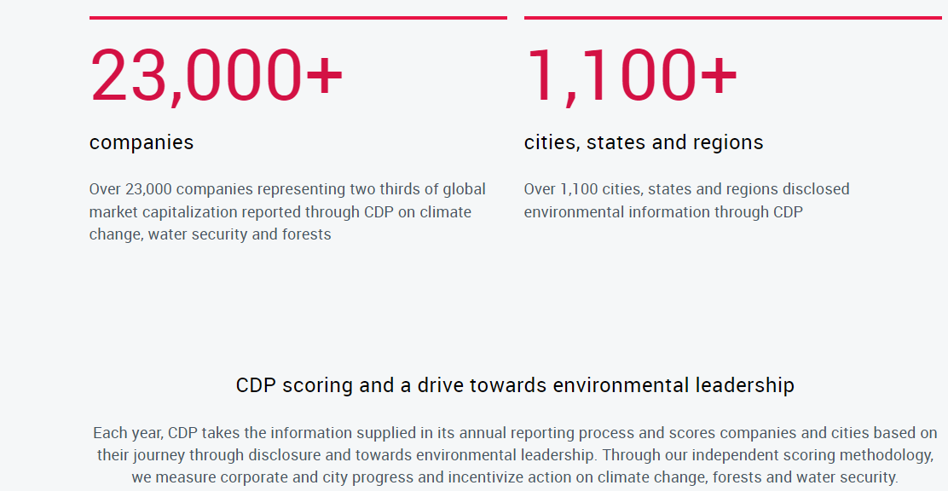
Environmental Sustainability
Understand the Corporate Environmental Pillar
Case Study: The Carbon Disclosure Project (CDP) collects data on corporate greenhouse gas emissions and provides insights into emission reduction strategies. CDP is an internationally recognized nonprofit organization that operates a global disclosure system for environmental data. Its core mission revolves around collecting and distributing vital information concerning companies' carbon emissions, climate strategies, and environmental risks and opportunities. Engaging with CDP enables companies to unlock numerous advantages. These encompass gaining invaluable insights into their environmental performance, pinpointing areas ripe for enhancement, and benchmarking against industry counterparts.
Companies like Unilever have demonstrated significant reductions in carbon emissions through initiatives such as renewable energy adoption and energy efficiency improvements see: https://www.unilever.com/planet-and-society/climate-action/strategy-and-goals/
Source: https://www.cdp.net/en/info/about-us/what-we-do
Notes:
https://www.cdp.net/en/info/about-us

Slide 14
Environmental Sustainability
Environmental impact
Carbon Disclosure Project (CDP) Introduction
Notes:
https://www.cdp.net/en/info/about-us

Slide 15
Environmental Sustainability
Understand the Environmental pillar.
The case of Google (data from Google’s 2023 Environnemental Report)
Enhanced and launched new sustainability product features, such as eco-friendly routing in Maps, which is estimated to have helped prevent more than 1.2 million metric tons of carbon emissions from launch through 2022—equivalent to taking approximately 250,000 fuel-based cars off the road for a year
Expanded the availability of Google Earth Engine—which provides access to reliable, up-to date insights on how our planet is changing—to include businesses and governments worldwide as an enterprise-grade service through Google Cloud.
Opened the new Bay View campus, which is all-electric, net water-positive, restores over 17 acres of high-value nature, and incorporates the leading principles of circular design.
Signed 20 more renewable energy agreements, bringing our total to more than 80 agreements totaling approximately 10 GW of clean energy generation capacity—we estimate we’ll spend approximately $10 billion to purchase clean energy through 2040.
Notes:
https://www.cdp.net/en/info/about-us

Slide 16
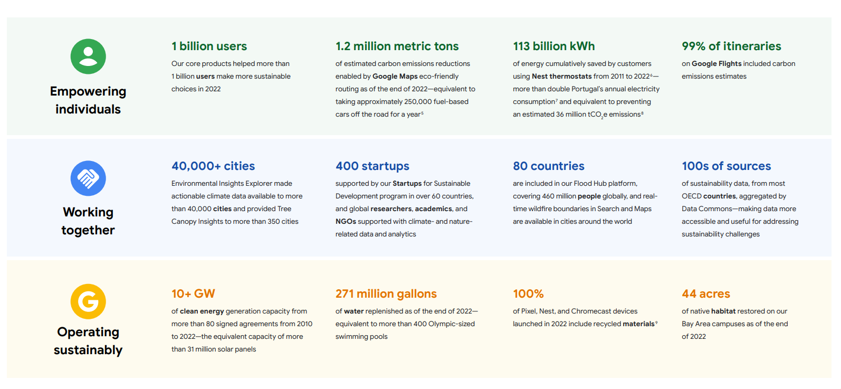
Environmental Sustainability
Understand the Environmental pillar.
The case of Google (data from Google’s 2023 Environnemental Report- HIGHLIGHTS
Notes:
https://www.cdp.net/en/info/about-us

Slide 17
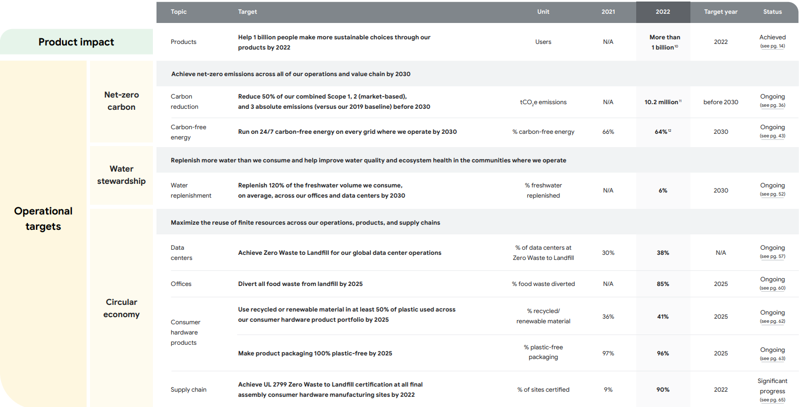
Environmental Sustainability
Understand the Environmental pillar: The case of Google
Notes:
https://www.cdp.net/en/info/about-us

Slide 18
Social Sustainability
The social pillar in Corporate Sustainability emphasizes fair business practices for employees and the community and can be achieved through corporate social responsibility, which requires companies to embrace the economic, legal, ethical, and discretionary expectations of all stakeholders and not just financial shareholders. For example community management, and stakeholder engagement, workforce well being; diversity and inclusion are important. Is the most neglected pillar among the 3Ps of sustainability.
Examples of CSR initiatives include:
1. Stakeholder engagement:
Engaging with stakeholders allows companies to gain
insights into their expectations, concerns, and priorities related to social and environmental
issues. This understanding helps companies tailor their CSR strategies and initiatives to
better meet stakeholder needs. Stakeholder engagement promotes accountability and
transparency in CSR practices. By openly communicating with stakeholders about CSR goals,
progress, and performance, companies demonstrate their commitment to responsible business
practices and accountability for their
social and environmental impacts.
2. Community Engagement:
By working collaboratively with local communities, companies can create shared value,
enhance their social license to operate, and contribute to the well-being of society as a whole.
This can include volunteering, charitable giving, or partnerships with local nonprofits.
Social Responsibility
1.Stakeholder engagement :
understanding and addressing the needs, concerns, and expectations of various stakeholders affected by a company's operations
2.Community engagement
Engaging with local communities to support social development and address societal needs
3.Workforce well-being
Prioritizing employee health, safety and fair labor practices for a sustainable and inclusive workplace
Notes:
Sutisna, N., Herdiansyah, H., & Sanjatmiko, P. (2022). Environment conservation responsibility in community development. IOP Conference Series: Earth and Environmental Science, 1041(1), 012042. https://doi.org/10.1088/1755-1315/1041/1/012042
Khaled, M., Shaban, I. A., Karam, A., Hussain, M., Zahran, I., & Hussein, M. (2022). An analysis of research trends in the sustainability of production planning. Energies, 15(2), 483. https://doi.org/10.3390/en15020483
Utomo, D., Karsidi, R., Nurhaeni, I. D. A., & Kartono, D. T. (2021). The empowerment of tourism community through corporate social responsibility (csr) program. Iapa Proceedings Conference, 203. https://doi.org/10.30589/proceedings.2021.528

Slide 19
Social Sustainability
3. Work- Force Well Being
Research indicates that employee perceptions of CSR have a positive impact on organizational commitment, job satisfaction, work meaningfulness, and perceived organizational support
Key strategies:
Health and Safety: Companies should prioritize the health and safety of their employees by providing a safe working environment, implementing health and safety policies and procedures, and ensuring compliance with relevant regulations. This includes measures to prevent workplace accidents, occupational illnesses, and exposure to hazards.
Work-Life Balance: Promoting work-life balance is essential for employee well-being. Companies can offer flexible work arrangements, paid time off, parental leave, and wellness programs to support employees in managing their personal and professional lives.
Diversity and Inclusion: Embracing diversity and fostering an inclusive workplace culture are key components of CSR. Companies should promote diversity and inclusion initiatives, such as equal employment opportunities, diversity training, and affinity groups, to ensure that all employees feel valued, respected, and empowered to contribute their unique perspectives and talents.
Employee Development and Training: Investing in employee development and training enhances workforce well-being by providing opportunities for professional growth, skill enhancement, and career advancement. Companies can offer training programs, mentoring, coaching, and tuition reimbursement to support employee learning and development.
Employee Engagement and Satisfaction: Engaging employees in decision-making processes, recognizing their contributions, and soliciting feedback fosters a positive work environment and enhances employee satisfaction and morale. Companies can conduct employee surveys, focus groups, and town hall meetings to gather feedback and address employee concerns.
Ethical Business Practices: Upholding fair labor practices is essential for CSR. Companies should ensure compliance with labor laws and regulations, provide fair wages and benefits, prohibit discrimination and harassment, and promote ethical employment practices throughout their supply chain.
Mental Health and Well-being: Addressing mental health issues and promoting well-being in the workplace is increasingly recognized as a critical aspect of CSR. Companies can offer employee assistance programs (EAPs), mental health resources, counseling services, and stress management initiatives to support employees' mental and emotional well-being.
Notes:
Glavas A, Kelley K. The Effects of Perceived Corporate Social Responsibility on Employee Attitudes. Business Ethics Quarterly. 2014;24(2):165-202. doi:10.5840/beq20143206

Slide 20
Social Sustainability
Corporate social responsibility (CSR) initiatives and programs:
Microsoft's Accessibility Initiatives:
Case Study: Microsoft has implemented various initiatives to improve accessibility for people with disabilities, both internally and externally. This includes creating innovative technology solutions, changing hiring practices with the Autism Hiring Program, growing the employee community and partnering with others to help create new opportunities for the many talented people with disabilities. Microsoft will also empower software developers by embedding accessibility tools, prompts and AI-driven automation so that accessibility is included at the start of the development cycle. It also embraces a team-centric and company-wide training offered to all employees. Topics such as disability education, etiquette, and inclusive best practices are just part of our training efforts.
IKEA's Social and Environmental Responsibility:
Case Study: IKEA, a global furniture retailer, has integrated social and environmental responsibility into its business model. They have focused on sourcing sustainable materials, reducing energy consumption, and promoting fair labor practices throughout their supply chain. Further, IKEA's ethical labor policies are a significant area where the company has shown its commitment to social responsibility. The business has a robust code of conduct that outlines its demands for suppliers, including criteria for fair pay, secure working conditions, and adherence to employees' rights. In order to make sure that its code of conduct is being followed, IKEA also regularly checks the facilities of its suppliers. A team of auditors from the firm visits the facilities of its suppliers to evaluate their adherence to the code of conduct and spot any areas for improvement.
Additionally, a study on the influence of CSR on financial performance, specifically focusing on IKEA, found that data collected from IKEA's financial statements from 2009 to 2019 supports the positive impact of CSR on financial performance ("The Influence of Corporate Social Responsibility on Financial Performance: The Case of IKEA", 2021).
Notes:
https://www.microsoft.com/en-us/accessibility/approach
Satinder Dhiman Joan Marques, (2011),"The role and need of offering workshops and courses on workplace spirituality", Journal of Management Development, Vol. 30 Iss 9 pp. 816 - 835 Permanent link to this document:

Slide 21
Corporate sustainability within the economic context
Why corporate sustainability is vital within the economic context:
1.Long term profitability: Sustainable practices often lead to
increased efficiency and cost savings. For example, energy efficiency
measures can reduce utility expenses, waste reduction initiatives can
lower disposal costs, and sustainable supply chain practices can
improve resource utilization and reduce procurement expenses.
2.Risk Management:
Corporate sustainability helps mitigate risks associated with environmental,
social, and governance (ESG) factors. Companies that proactively address ESG
risks, such as regulatory non-compliance, supply chain disruptions, reputational
damage, and climate-related impacts, are better positioned to withstand shocks
and uncertainties.
3. Brand Reputation
Embracing sustainability can differentiate a company in the marketplace and
enhance its brand reputation. Consumers, investors, and other stakeholders
increasingly favor companies that demonstrate environmental and social
responsibility. Building a positive sustainability reputation can attract customers,
investors, and top talent, contributing to long-term competitiveness and profitability.
4.Regulatory Compliance:
Corporate sustainability helps companies stay ahead of evolving regulatory requirements
and compliance obligations. By proactively addressing environmental and social risks, companies
can minimize legal and regulatory liabilities, avoid fines and penalties, and maintain license to operate in various jurisdictions.
Economic viability
Long term profitability
Investing in sustainable practices to ensure long term financial success and resilience in the market
Risk Management
Identifying and mitigating risks associated with ES and governance factors for sustainable business growth
Brand reputation and Stakeholders trust
Building trust with stakeholders by demonstrating a commitment to ethical and sustainable business practices can attract customers, investors, and top talent, contributing to long-term competitiveness and profitability
Notes:
Sheehy B, Farneti F. Corporate Social Responsibility, Sustainability, Sustainable Development and Corporate Sustainability: What Is the Difference, and Does It Matter? Sustainability. 2021; 13(11):5965. https://doi.org/10.3390/su13115965

Slide 22
Sustainable Business models
Sustainable business models encompass a variety of approaches that integrate environmental, social, and economic considerations to create long-term value. Some examples of sustainable business models include:
Circular Economy Model: This model focuses on minimizing waste and maximizing the use of resources by promoting recycling, reusing, and remanufacturing products to create a closed-loop system that reduces environmental impact.
Example:
Interface, Inc. is a global manufacturer of modular carpet tiles and flooring systems. In the late 1990s, Interface's founder, Ray Anderson, made a commitment to sustainability and embarked on a mission to transform the company into a model of environmental stewardship. Interface embraced the circular economy principles, aiming to eliminate waste, reduce resource consumption, and create products with a net positive impact on the environment.
In 2003, they began offering carbon neutral flooring by offsetting the full life cycle of greenhouse gas emissions for carpet tiles across North and South America.​​
Each year they divert millions of pounds of used (or post-consumer) carpet from landfills, historically feeding compatible materials through the Cool Blue™ system and now the CQuest™ backing line.
Results:
The company has achieved substantial reductions in greenhouse gas emissions, water usage, and waste generation, while increasing the use of recycled materials in its products.
Notes:
Nosratabadi S, Mosavi A, Shamshirband S, Kazimieras Zavadskas E, Rakotonirainy A, Chau KW. Sustainable Business Models: A Review. Sustainability. 2019; 11(6):1663. https://doi.org/10.3390/su11061663
https://www.interface.com/US/en-US.html
Heisel, Felix and Hebel, Dirk E.. "A Circular Approach in Flooring". Building Better - Less - Different: Circular Construction and Circular Economy: Fundamentals, Case Studies, Strategies, Berlin, Boston: Birkhäuser, 2022, pp. 134-137. https://doi.org/10.1515/9783035626353-028

Slide 23
Sustainable Business models
Video: Interface and Recycled PVB - From windscreens to carpet

Slide 24
Sustainable Business models
2. Sharing Economy Model: Companies operating under this model facilitate the sharing or renting of goods and services, promoting resource efficiency and reducing overall consumption.
Companies operating within sharing economies share four common characteristics:
They operate as digital platforms facilitating offline transactions between users.
They enable peer-to-peer transactions, involving mostly ordinary citizens or micro-entrepreneurs rather than large businesses or corporations, both as suppliers and consumers.
They prioritize temporary access over ownership, allowing users to utilize resources or services for a limited duration.
They provide access to previously unused physical or human resources, such as empty rooms, parked cars, available seats, barbecues, as well as individuals' skills, talents, or time.
Example: Airbnb
Founded in 2008 by Brian Chesky, Joe Gebbia, and Nathan Blecharczyk, Airbnb is a peer-to-peer online marketplace that connects travelers with hosts who have accommodations to rent. The platform allows individuals to list their homes, apartments, or spare rooms for short-term rentals, providing travelers with unique and affordable lodging options in destinations around the world.
Key Features of Airbnb's Sharing Economy Model:
Peer-to-Peer Marketplace: Airbnb operates as a two-sided marketplace, connecting hosts (property owners) with guests (travelers) seeking accommodations.
Underutilized Space Utilization: Airbnb leverages the sharing economy concept by enabling hosts to monetize their underutilized space, such as spare bedrooms, vacation homes, or second properties
Community and Trust:
Airbnb emphasizes community and trust-building as core principles of its platform. Hosts and guests create profiles with photos, personal descriptions, and verified information to establish trust and credibility.
Success and Impact:
Global Reach and Scale: Airbnb has achieved global reach and scale, operating in over 220 countries and regions and offering millions of listings worldwide.
Economic Opportunity :Airbnb has created economic opportunities for hosts by enabling them to earn income from their properties.
Environmental Benefits: Airbnb promotes sustainable travel by maximizing the use of existing infrastructure and underutilized space, rather than building new accommodations.
Notes:
Boar A, Bastida R, Marimon F. A Systematic Literature Review. Relationships between the Sharing Economy, Sustainability and Sustainable Development Goals. Sustainability. 2020; 12(17):6744. https://doi.org/10.3390/su12176744
https://truust.io/blog/sharing-economy-sustainability-business-models/
Curtis, Steven & Mont, Oksana. (2020). Sharing economy business models for sustainability. Journal of Cleaner Production. 266. 121519. 10.1016/j.jclepro.2020.121519.

Slide 25
Sustainable Business models
Sharing economy business model and environmental sustainability:
Reducing Inefficiency: Sharing economy platforms often emphasize efficiency and resource optimization, which can lead to a reduction in inefficiencies and wasteful practices, thereby promoting environmental sustainability
Reducing Carbon Footprint: Many sharing economy platforms position themselves as environmentally friendly by emphasizing the reduction of carbon footprint, particularly through practices that promote resource sharing and reuse
Resource Efficiency: The sharing economy promotes the efficient use of resources by enabling multiple users to access and utilize the same resources, leading to reduced consumption and waste generation
Reduction of Negative Environmental Externalities: Sharing economy platforms contribute to the reduction of negative environmental externalities by transforming traditional production and consumption systems, leading to more sustainable resource management practices (Schmeleva, 2020).
These insights highlight how the sharing economy model can have positive environmental impacts by promoting resource efficiency, reducing waste, and contributing to more sustainable consumption and production practices.
Notes:
Boar A, Bastida R, Marimon F. A Systematic Literature Review. Relationships between the Sharing Economy, Sustainability and Sustainable Development Goals. Sustainability. 2020; 12(17):6744. https://doi.org/10.3390/su12176744
Wirtz, J., So, K. K. F., Mody, M., Liu, S. Q., & Chun, H. E. H. (2019). Platforms in the peer-to-peer sharing economy. Journal of Service Management, 30(4), 452-483. https://doi.org/10.1108/josm-11-2018-0369

Slide 26
Sustainable Business models
3. B-Corporation Model: B-Corporations are certified entities that meet rigorous social and environmental performance standards, demonstrating a commitment to balancing profit with purpose.
Purpose-driven Business: B Corps are businesses that prioritize purpose alongside profit, aiming to create positive impacts on society and the environment. This model emphasizes a "triple bottom line" approach, considering people, planet, and profit equally important.
Certification Process: To become a B Corp, companies must undergo a rigorous assessment conducted by B Lab, a nonprofit organization. The assessment evaluates a company's performance across various areas, including governance, workers, community, environment, and customers.
Transparency and Accountability: B Corps are required to be transparent about their social and environmental performance by publishing an annual "B Impact Report." This report provides detailed information about the company's practices and performance in relation to the B Corp standards. B Corps also undergo recertification every few years to maintain their status.
Community of Practice: B Corps form a global community of businesses committed to using the power of business to solve social and environmental challenges. This community provides networking opportunities, knowledge sharing, and collaboration to support the growth and impact of B Corps worldwide.
Consumer Trust and Market Differentiation: The B Corp certification can enhance consumer trust and loyalty by signaling a company's commitment to ethical business practices and social responsibility. It can also differentiate B Corps in the marketplace, attracting socially conscious consumers and investors.
Notes:
https://bcorporation.net/about-b-corps
https://bcorporation.net/become-a-b-corp/how-to-become-a-b-corp
https://bcorporation.net/b-impact-report
https://bcorporation.net/bcorp-the-bcorp-declaration-of-interdependence

