Slide 1
CCP-LAW
Curricula development on Climate Change Policy and Law
Subject title: Introduction to the EU Emissions Trading Scheme (EU ETS)
Instructor Name: Abhinav Shrivastava & Raj Varma
Project No of Reference: 618874-EPP-1-2020-1-VN-EPPKA2-CBHE-JP:
The European Commission's support for the production of this publication does not constitute an endorsement of the contents, which reflect the views only of the authors, and the Commission cannot be held responsible for any use which may be made of the information contained therein.

Slide 2
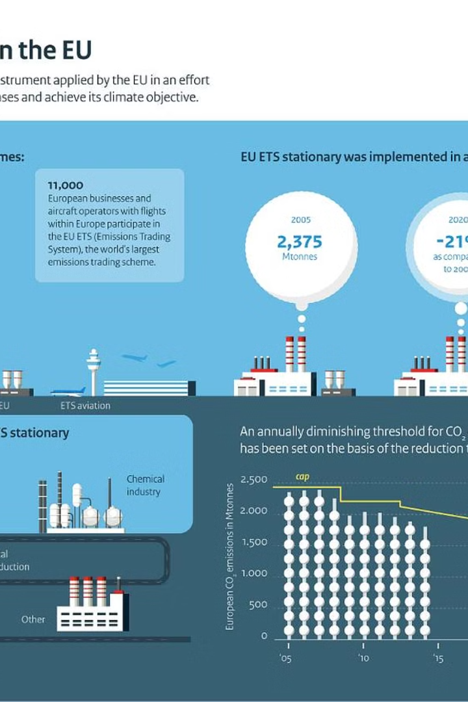
INTRODUCTION TO EU EMISSIONS TRADING SCHEME
The EU Emissions Trading Scheme (EU ETS) is the world's largest carbon market, a cornerstone of the European Union's policy to combat climate change. It sets a cap on greenhouse gas emissions and allows companies to buy and sell emission allowances.

Slide 3
OVERVIEW
The EU Emissions Trading Scheme (EU ETS) is the world's largest carbon market, a cornerstone of the European Union's policy to combat climate change. It sets a cap on greenhouse gas emissions and allows companies to buy and sell emission allowances.
Largest Emissions Trading System
The EU Emissions Trading System (EU ETS) is the world's largest carbon market, covering over 11,000 power plants and industrial facilities across Europe.
Cap-and-Trade Mechanism
The EU ETS operates on a cap-and-trade principle, setting a limit on the total amount of greenhouse gases that can be emitted by the covered sectors.
Driving Emissions Reductions
By putting a price on carbon, the EU ETS provides a financial incentive for companies to invest in clean technologies and reduce their emissions.

Slide 4
OBJECTIVES AND KEY FEATURES
The primary objective of the EU Emissions Trading Scheme (EU ETS) is to reduce greenhouse gas emissions in a cost-effective and economically efficient manner.
A key feature is the cap-and-trade system, where a cap is set on the total amount of certain greenhouse gases that can be emitted by participating entities.
The scheme allocates emissions allowances to these entities, which they can trade if they emit less or need to purchase more to cover their emissions.

Slide 5
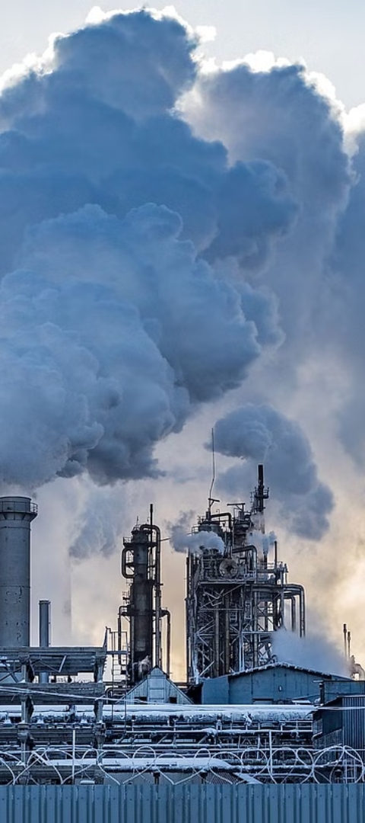
SECTORS AND ACTIVITIES COVERED BY THE EU ETS
1. Power and Heat Generation: The EU ETS covers emissions from power plants and industrial facilities that generate heat and electricity.
2. Energy-Intensive Industries: like steel, cement, glass, and chemicals are included in the EU ETS due to their high levels of greenhouse gas emissions.
3. Aviation: Flights within the European Economic Area are subject to the EU ETS, which aims to reduce emissions from the aviation industry.

Slide 6
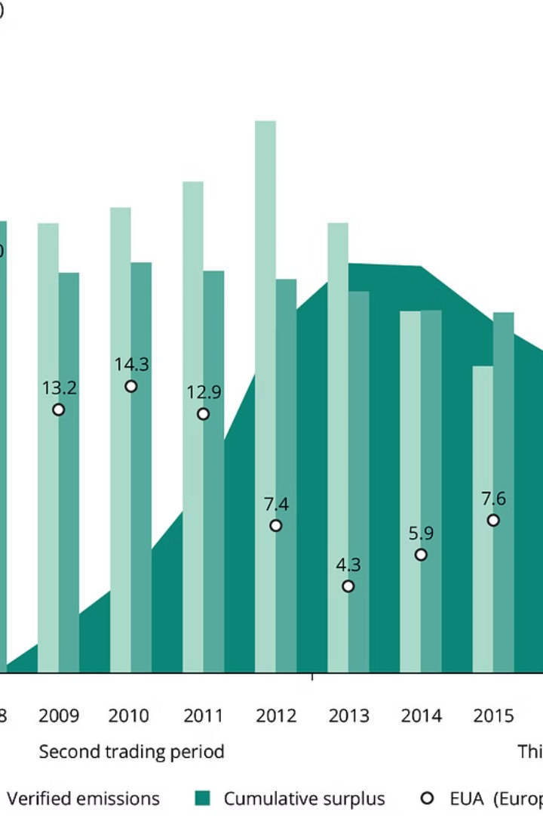
ALLOWANCE ALLOCATION AND TRADING
The EU Emissions Trading Scheme (EU ETS) allocates greenhouse gas emissions allowances to regulated entities, which they can then trade on the carbon market. Allowances are distributed either through free allocation or auctioning, with the aim of incentivizing emissions reductions.
Companies can buy, sell, or bank their allowances, creating a price signal for carbon and a financial incentive to cut emissions. The trading of allowances allows for the most cost-effective emissions reductions to occur across the EU.

Slide 7
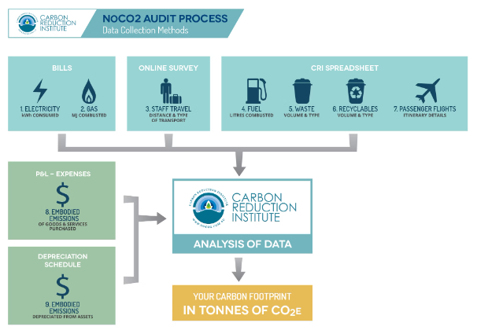
MONITORING, REPORTING AND VERIFICATION
The EU Emissions Trading System (EU ETS) requires rigorous monitoring, reporting, and verification (MRV) of greenhouse gas emissions to ensure the integrity and effectiveness of the system. Participating companies must monitor their emissions in accordance with strict guidelines and submit annual emission reports that are independently verified by accredited third-party auditors. This robust MRV process helps to guarantee the accuracy of emissions data and enables effective enforcement of the system's rules and regulations.

Slide 8
COMPLIANCE AND ENFORCEMENT IN THE EU ETS
Reporting and Verification: Emitters must report their annual greenhouse gas emissions and have them independently verified by accredited verifiers.
Penalty for Non-Compliance: Companies that fail to surrender sufficient allowances face financial penalties of €100 per ton of CO2 emitted without a permit.
Enforcement Mechanisms: National authorities can impose additional sanctions, such as suspending an operator's ability to participate in the ETS, for persistent non-compliance.
Monitoring and Oversight: The European Commission oversees the implementation of the ETS and can initiate infringement procedures against member states for non-compliance.

Slide 9
ROLE OF THE EU ETS IN REDUCING GREENHOUSE GAS EMISSIONS
Driving Emissions Reductions: The EU ETS is a cornerstone of the EU's climate policy, putting a price on carbon emissions and providing a financial incentive for companies to reduce their greenhouse gas output.
Emissions Cap and Trade: By setting a steadily declining emissions cap and allowing companies to trade emissions allowances, the EU ETS encourages cost-effective emissions reductions across covered sectors.
Technological Innovation: The EU ETS incentivizes companies to invest in clean technologies and low-carbon solutions to comply with the scheme's requirements and reduce their compliance costs.
Driving Sectoral Transformation: As a market-based mechanism, the EU ETS helps drive gradual, sector-wide transitions towards decarbonization by making high-emitting activities more expensive relative to low-carbon alternatives.

Slide 10
CHALLENGES AND LIMITATIONS OF THE EU ETS
.
The EU ETS faces several challenges, including the complex design and implementation, uneven impact across sectors, and difficulty in setting effective carbon prices. Limitations include the potential for carbon leakage, exclusion of certain industries, and the need for continuous policy refinement. Ensuring the scheme's integrity and effectiveness while addressing the concerns of affected stakeholders remains an ongoing challenge for policymakers. Reforms to the EU ETS are necessary to enhance its impact and align it with the EU's ambitious climate goals under the Green Deal

Slide 11
EU GREEN DEAL AND ITS CONNECTION TO THE EU ETS
Integration: The EU Green Deal aims to integrate the EU ETS into a comprehensive set of policies to achieve climate neutrality by 2050.
Emissions Reductions: Strengthening the EU ETS is a key pillar of the EU Green Deal, with the goal of deeper emissions cuts across the economy.
Energy Transition: The EU ETS is vital to incentivizing the shift to clean energy sources and technologies under the EU Green Deal.

Slide 12
KEY ELEMENTS OF THE EU GREEN DEAL
Climate Action
Achieving climate neutrality by 2050
Clean Energy
Transition to renewable and efficient energy
Sustainable Industry
Promoting circular economy and green technologies
The EU Green Deal is a comprehensive plan to transform the EU into a modern, resource-efficient, and competitive economy. Its key elements include ambitious climate action targets, a transition to clean and renewable energy, and the promotion of sustainable industrial practices. These interconnected goals aim to make Europe the first climate-neutral continent by 2050.

Slide 13
ALIGNMENT OF THE EU ETS WITH THE EU GREEN DEAL
Emissions Reduction
Aligning the EU ETS carbon pricing with the EU Green Deal's emissions reduction targets
Renewable Energy
Incentivizing investment in renewable energy through the ETS allowance structure
Circular Economy
Promoting a transition to a more circular economy through the ETS
The EU ETS is a critical policy instrument for achieving the emissions reduction goals set forth in the EU Green Deal. Reforms are being considered to better align the ETS with the Green Deal's more ambitious climate targets, including strengthening the carbon price signal and expanding the sectors covered. This will help drive investments in renewable energy, energy efficiency, and a circular economy.

Slide 14
POTENTIAL REFORMS OF THE EU ETS UNDER THE EU GREEN DEAL
Expanding Emissions Coverage: Proposals to expand the EU ETS to include more sectors, such as buildings and transportation, to broaden its impact on greenhouse gas reductions.
2) Tightening Emissions Caps: Discussions around lowering the overall emissions cap under the EU ETS to drive deeper cuts in carbon pollution and align with the EU's more ambitious climate targets
3)Strengthening Carbon Pricing: Considerations to increase the price of carbon allowances to provide stronger economic incentives for businesses to invest in clean technologies and reduce emissions.

Slide 15
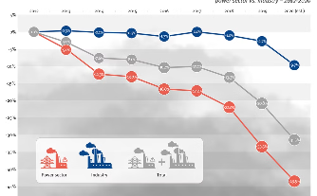
IMPACT OF THE EU GREEN DEAL ON THE EU ETS
Alignment with Green Deal Goals
Strengthening the Carbon Market
Accelerating Clean Energy Transition
The EU Green Deal aims to make Europe the first climate-neutral continent by 2050. Reforms to the EU ETS are a key part of this strategy, ensuring the carbon market aligns with and supports the Green Deal's ambitious emissions reduction targets.
The Green Deal is expected to drive reforms to the EU ETS, such as lowering the emissions cap, increasing the rate of emissions reductions, and introducing a carbon border adjustment mechanism. These changes will bolster the ETS as the EU's primary tool for cost-effectively cutting greenhouse gas emissions.
The Green Deal's focus on expanding renewable energy, improving energy efficiency, and decarbonizing key industries will reshape the landscape in which the EU ETS operates, creating new incentives and challenges for the carbon market.

Slide 16
SYNERGIES BETWEEN EU ETS AND OTHER EU GREEN DEAL INITIATIVES
The EU Emissions Trading System (EU ETS) is closely aligned with other initiatives under the EU Green Deal, creating synergies to drive comprehensive climate action. The EU ETS works in tandem with policies like the Renewable Energy Directive and the Energy Efficiency Directive to incentivize decarbonization across multiple sectors.
EU Green Deal Initiative
Synergy with the EU ETS
Renewable Energy Directive
The EU ETS encourages the shift to renewable energy by pricing carbon emissions, making renewable sources more competitive.
The EU ETS complements energy efficiency measures by ensuring that emissions reductions achieved through efficiency are reflected in lower carbon allowance demand.
Energy Efficiency Directive
Effort Sharing Regulation
The EU ETS and Effort Sharing Regulation work together to drive emissions cuts across the entire economy, including sectors not covered by the ETS.
By aligning the EU ETS with these complementary policies, the EU is creating a comprehensive framework to accelerate the transition to a low-carbon, sustainable economy.

Slide 17
OUTLOOK OF THE FUTURE OF THE EU ETS AND THE EU GREEN DEAL
As the EU continues to strengthen its climate ambitions through the EU Green Deal, the EU ETS will likely undergo significant reforms to support these goals. Potential changes include expanding the sectors covered, adjusting the emissions cap, and increasing the price of carbon to drive deeper emissions reductions. The future of the EU ETS and the EU Green Deal will be closely intertwined, with the trading system serving as a key policy instrument to achieve the EU's ambitious decarbonization targets. Ongoing monitoring, evaluation, and adaptations will be necessary to ensure the continued effectiveness of the EU ETS in supporting the broader objectives of the EU Green Deal.
—
2030
EU Climate Targets
The EU aims to reduce greenhouse gas emissions by at least 55% below 1990 levels by 2030 as part of the EU Green Deal.
—
2050
Climate Neutrality
The EU's long-term goal is to achieve climate neutrality by 2050, with the EU ETS playing a key role in this transition.
—
Innovation Fund
€55B
The EU has allocated €55 billion to the Innovation Fund to support low-carbon technologies and projects, further aligning the EU ETS with the EU Green Deal.

