Slide 1
CCP-LAW
Curricula development on Climate Change Policy and Law
Subject title: Climate Change Policy
Instructor Name: Dr. Rahul Nikam
Project No of Reference: 618874-EPP-1-2020-1-VN-EPPKA2-CBHE-JP:
The European Commission's support for the production of this publication does not constitute an endorsement of the contents, which reflect the views only of the authors, and the Commission cannot be held responsible for any use which may be made of the information contained therein.

Slide 2
The Role of Planification in Climate Change
Understanding climate change impact on cities

Slide 3
The Role of Planification in Climate Change
Understanding climate change impact on cities

Slide 4
The Role of Planification in Climate Change
Understanding climate change impact on cities

Slide 5
The Role of Planification in Climate Change
Why some Places are more Vulnerable to Risks/ Disasters than Others?
The following will explain the relation between those three factors and its definitions in details.

Slide 6
The Role of Planification in Climate Change
Why some Places are more Vulnerable to Risks/ Disasters than Others? The following will explain the relation between those three factors and its definitions in details.
Exposure: The nature and degree to which a system (People, property, or other elements present in hazard zones) is exposed to Disaster or significant climatic variations and subject to potential losses today and in the future for the city/region.
Sensitivity: The degree to which exposed people, places, institutions and sectors are impacted, either positively or negatively, by disaster today and the degree to which they could be impacted in the future. The sensitivity analysis is based on the socio-economic and physical realities, which represent the underlying causes for disaster impact.
Adaptive capacity: The degree to which people, places, institutions and sectors are able to adapt to disaster impacts. Adaptive capacity typically is indicated by socio-economic and environmental factors and local realities that enable a city or community to adjust its system in view of current and future risks. It may also include factors and conditions that leverage new climate conditions to become new opportunities

Slide 7
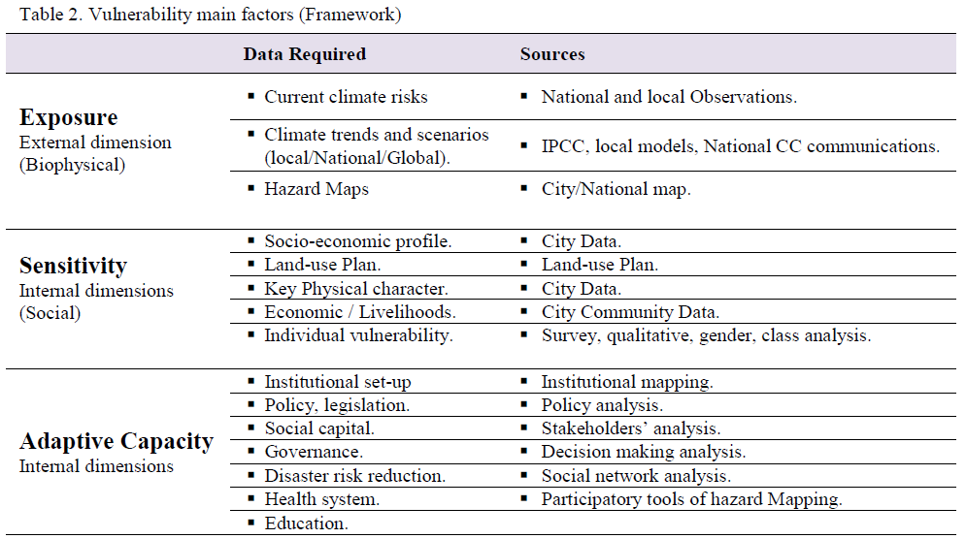
The Role of Planification in Climate Change

Slide 8
The Role of Planification in Climate Change

Slide 9
The Role of Planification in Climate Change
Planning for Climate Change (A step forward to livability)
The importance of having Climate Change Action Plans is to translate - often vague - strategies for adaption and mitigation into concrete actions. Which mainly based on vulnerability assessment, mitigation and adaptation assessment and consider the (financial) constraints of the particular city. However many cities can apply no-regrets policies that work within the existing system. These can then be scaled-up when necessary. Such a future-proof approach prevents maladaptation and ensures appropriate action can be taken when certain changes in the conditions are reached.
Cities should mainstream adaptation/mitigation actions across all sectors of urban development; crucially this must occur in urban development and land-use planning. Importantly to make sure that, climate change mitigation and adaptation should not be treated as two separate goals. Planning priority should be given to actions that contribute to both adaptation and mitigation and its co-benefits and mainstream those actions with the development local/strategic plans.

Slide 10
The Role of Planification in Climate Change
How to deal with climate change? (What is the climate change management?)
Three main strategies
No Regrets Strategies: Provides benefits now with or without climate change,
Low Regrets Strategies: Provide climate change benefits for little additional cost or risk,
Win-win or Co-benefit Strategies: Reduce climate change impacts while providing other environmental, social, or economic benefits.
Adaptation (Short Term Strategy): Preparing for the system changes, reducing vulnerability by understanding climate hazards, reducing exposure and sensitivity. Adaptation addresses the consequences of climate change, such as heavy rainfall, flooding, or extreme temperatures. These are issues already affecting societies, independent of their role in causing climate change.

Slide 11
The Role of Planification in Climate Change
Reactive adaptation, which involves a deliberate response to a climatic shock or impact, in order to recover and prevent similar impacts in the future. One of its major disadvantages is running the risk of being short-sighted by focusing on the crisis at hand. In many cases it is used for unexpected consequences that may happen out of planed/designed confronting scenario.
Anticipatory or proactive adaptation, which involves planned action, in advance of climate change, to prepare for and minimize its potential impacts (taking steps to reduce the risks associated with climate change for individuals, communities and ecosystems), Proactive planning is often more effective and less costly than reactive planning, and can provide benefits today.

Slide 12
The Role of Planification in Climate Change
The main facts about adaptation are that:
Lack of (financial resources, certainty of cost, institutional oversight, information, flexibility, access to new technology) and also Social barriers are the main Barriers to adaptation.
Adapting to climate change is not a one-time activity.
There is no “one-size-fits-all” approach to managing climate change impacts (it depends always on other factors per each region and city).
Much can be gained from addressing non-climate stresses that contribute to climate vulnerability and risks.
Proactive, long-term Strategies are cheaper than reactive, short-term ones.
The Main Objective for any Adaptation Strategy are (Reduce exposure, decreasing sensitivity and increasing adaptive capacity).
Mitigation (Long term strategy): It is about reduction of GHG emissions by type of GHG, source, location

Slide 13
The Role of Planification in Climate Change

Slide 14
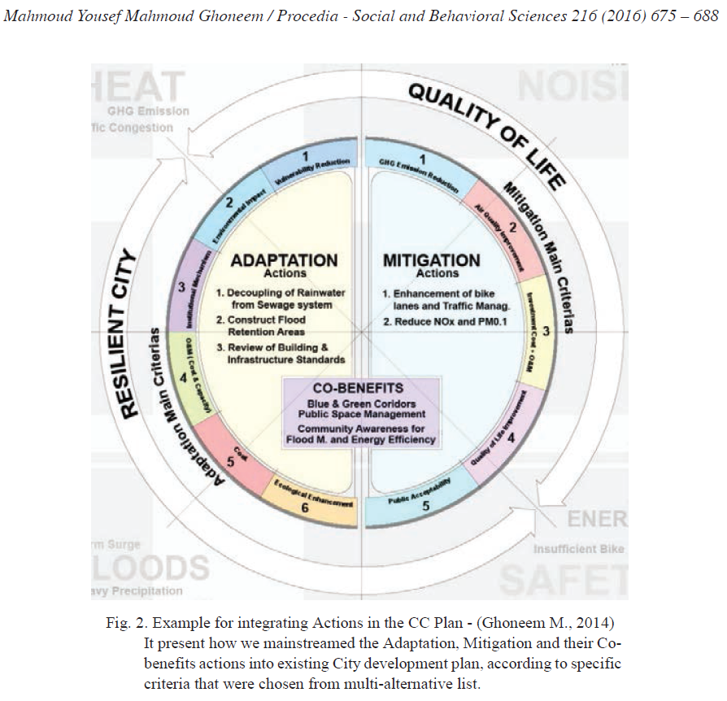
The Role of Planification in Climate Change

Slide 15
The Role of Planification in Climate Change
Cities and climate change Initiatives

Slide 16
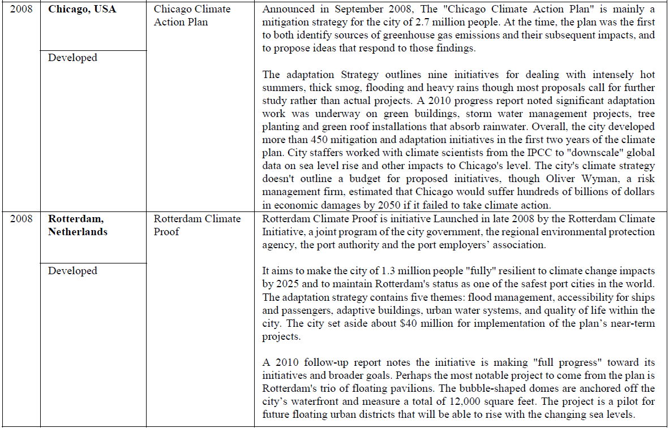
The Role of Planification in Climate Change
Cities and climate change Initiatives

Slide 17
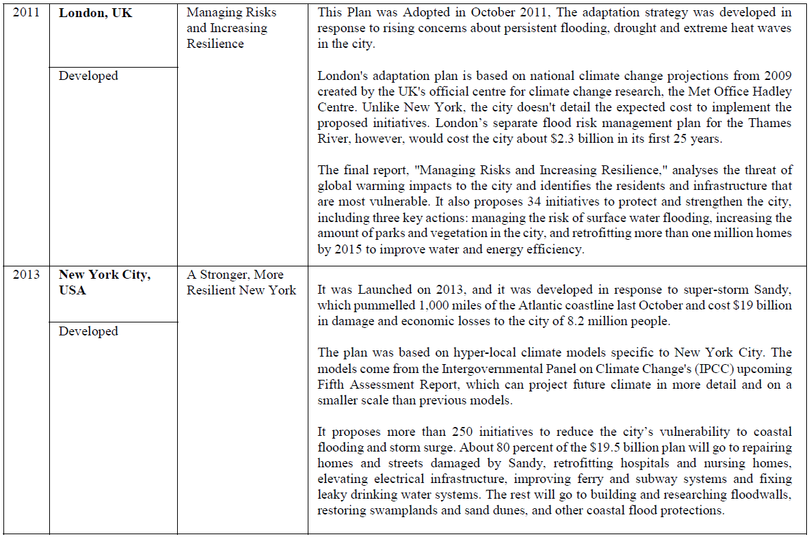
The Role of Planification in Climate Change
Cities and climate change Initiatives

Slide 18
The Role of Planification in Climate Change
Cities and climate change Initiatives

Slide 19
How to Plan for Climate Change Action Plan? Its development plan and its methodology are as follow in its most plans.
The Role of Planification in Climate Change
The Development Plan:
Data Collection and Scenario Elaboration.
Risk and Vulnerability Assessment (Cultural Heritage, Soil Consumption, Mobility Infrastructure, Heat Wave,
Water Security) - Sensitivity, impacts and vulnerability.
Participatory Process (Thematic session, Focus Group, one-to-one Meeting, Training and Educational Activities).
Local Adaptation Plan.
The Methodology when Making the CC Action Plan:
Scope of the Plan
Vulnerability Assessment/GHGs emission assessment.
Adaptation Plan (Actions & Impacts).
Mitigation Plan (Actions & Impacts).
Resilience Plan.
Implementation Plan.

Slide 20
The Role of Planification in Climate Change
What are the main challenges that the developing countries faces in planning for climate change?
Procedure to identify the challenges and opportunities in the multilevel governance is a must to make efficient steps towards increasing resilience, such as:
A national framework: the national level should provide a framework to fund local adaptive needs.
Capacity building for local government practitioners is essential.
Enforcing adaptation plans can be difficulty for local governments such as no-build zones in floodplains, especially in rapidly urbanizing Areas.
Political changes can stop progress in local governments.
Dispersed governance at the local level makes it difficult to make decisions with a global vision.

Slide 21
Further Reading
1 Alber, G., and K. Kern. 2008. “Governing Climate Change in Cities: Modes of Urban Climate Governance in Multi-Level Systems.” OECD International Conference, Competitive Cities and Climate Change, 2nd Annual Meeting of the OECD Roundtable Strategy for Urban Development, Milan, October 9–10. http://www.oecd.org/document/32/0,3343,en_21571361_41059646_41440096_1_1_1_1,00.html.
2 Arefi, Mahyar (2011) Design for Resilient Cities, reflections from a studio. In: Banerjee, Tidib & Loukaitou-Sideris (ed) (2011) Companion to Urban Design. Routledge, Abingdon. (p. 674-685).
3 Hamin, Elisabeth M & Gurran, Nicole (2009) Urban form and climate change: Balancing adaption and mitigation in the U.S and Australia. In: Habitat International, 33:3 p. 238-245
4 UNEP (2007) liveable Cities; The Benefits of Urban Environmental Planning, Local Governments for Sustainability, Washington, D.C.
5 United Nations Framework Convention on Climate Change (UNFCCC) 2007, CLIMATE CHANGE: IMPACTS, VULNERABILITIES AND ADAPTATION IN DEVELOPING COUNTRIES.

