Slide 1
CCP-LAW
Curricula development on Climate Change Policy and Law
Subject title: Climate Change Policy
Instructor Name: Dr. Rahul Nikam
Project No of Reference: 618874-EPP-1-2020-1-VN-EPPKA2-CBHE-JP:
The European Commission's support for the production of this publication does not constitute an endorsement of the contents, which reflect the views only of the authors, and the Commission cannot be held responsible for any use which may be made of the information contained therein.

Slide 2
Planning for Climate Change: a strategic, values-based approach
Adapting to new conditions brought by climate change will be challenging and will demand strategic
and creative thinking from planners and others & following are the four key planning themes
1. Strategic 2. Values-based 3. Participatory 4. Integrated
Climate change adaptation and mitigation
Adaptation is a process through which communities prepare to cope with an uncertain future climate.
Improving the adaptive capacity (awareness, knowledge, skills and resources) of planning institutions and stakeholders.
Addressing and managing the socio-economic impacts of climate change, particularly their effect on vulnerable populations (e.g. managing rural-urban migration, supporting economic resilience, improving local food security issues, upgrading emergency response systems).

Slide 3
Planning for Climate Change: a strategic, values-based approach, Aligning Climate and Development
Climate change adaptation and mitigation
Enhancing the opportunity for coordination and cooperation between and amongst climate stakeholders at the city-level and between the local, regional, state and national governments.
Mainstreaming climate change adaptation (and mitigation) into existing city plans, policies, programmes and planning processes
Adaptation
city with more adaptive capacity is also a more resilient city, able to better withstand, manage and reduce climate change vulnerabilities. Climate change resilience is often defined as the capacity of people, organizations and systems to prepare for, respond to, recover from and thrive in the face of hazards, and to adjust to continual change.

Slide 4
Planning for Climate Change: a strategic, values-based approach, Aligning Climate and Development
Climate change adaptation and mitigation
Mitigation
Help to reduce the rate or magnitude of climate change by helping to reduce human-generated greenhouse gas emissions.
cities must be leaders in mitigating climate change, reducing greenhouse gases used in energy systems (e.g. the energy used for transportation, electricity, heating, industrial processes, and waste disposal) and containing urban areas to minimize land clearing.
Supporting and leading more sustainable, compact urban design
Encouraging and facilitating new green building technologies and development
Improving transport networks with options that both reduce urban traffic congestion and support greener modes of transport
Encouraging new technologies and development for the treatment of liquid and solid wastes
Supporting sustainable energy production and distribution systems
Supporting the conservation and rehabilitation of ecosystems for the mitigation services they provide

Slide 5
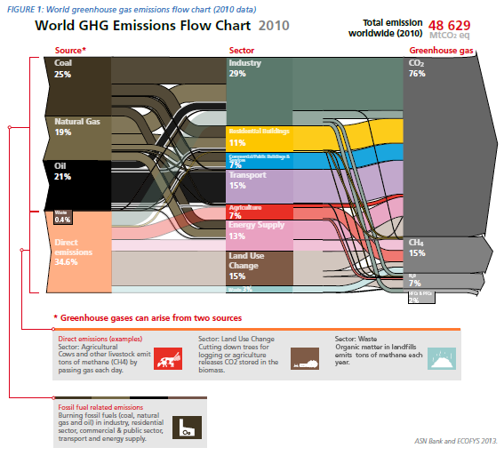
Planning for Climate Change: a strategic, values-based approach, Aligning Climate and Development

Slide 6
Planning for Climate Change: a strategic, values-based approach
At the World Planners Congress in Vancouver, Canada in 2006, a position paper on urban planning was released called the Vancouver Declaration
Sustainability
Planning with partners
Access to land
Cultural variation:
Integrated
Subsidiarity
Appropriate tools
Integrated with budgets
Market responsive
Pro-poor and inclusive

Slide 7
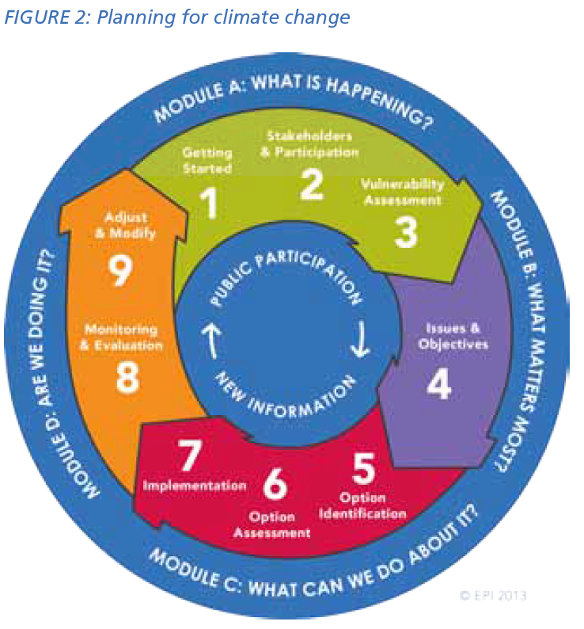
Planning for Climate Change: a strategic, values-based approach
The planning framework
Fundamentally, good city planning practices are, by their nature, also climate smart planning practices.
This is because most climate change planning actions are consistent with planners’ responsibilities, including:
Minimizing risk
Improving infrastructure
Protecting ecosystems
Improving disaster risk reduction
Supporting local economic development

Slide 8
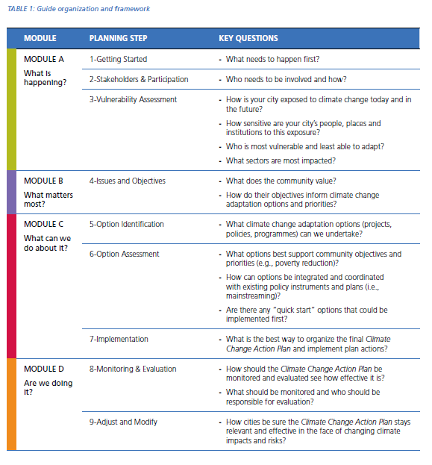
Planning for Climate Change: a strategic, values-based approach, Aligning Climate and Development

Slide 9
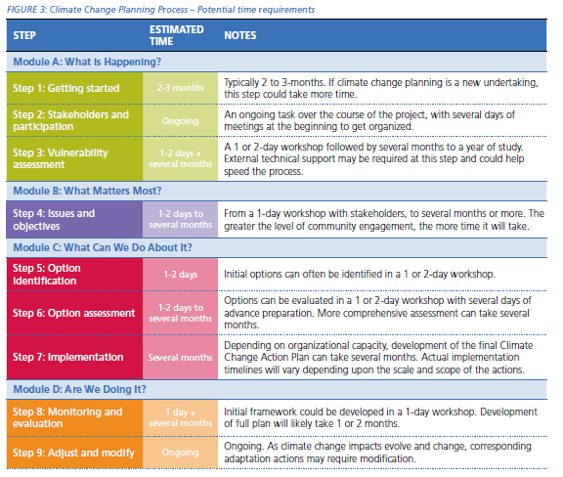
Planning for Climate Change: a strategic, values-based approach, Aligning Climate and Development
Time requirements of climate change planning

Slide 10
Further Reading
CITIES AND CLIMATE CHANGE INITIATIVE TOOL SERIES, United Nations Human Settlements Programme (UN-Habitat), 2014
https://www.uncclearn.org/wp-content/uploads/library/planning_for_climate_change.pdf

Slide 11
Planning for Climate Change: Aligning Climate and Development
COUNTRY CLIMATE AND DEVELOPMENT DIAGNOSTICS, PLANNING, AND POLICIES
Climate Risks and Macroeconomic Policies
Physical risks derive both from gradual changes in temperature, precipitation, and seasonal patterns that can affect crops and labor productivity, and from sudden-onset impacts, such as extreme weather events (droughts, forest fires, hurricanes, floods), which are becoming more frequent and severe and can directly affect consumption, investment, and trade.
Transition risks result from the adjustment of asset prices in response to climate policies and technological changes during the transition to a low-carbon economy. Countries face transition challenges in managing the potential negative impacts of domestic and international mitigation policies on equity, labor markets, or external competitiveness. The introduction of global carbon prices and other mitigation efforts has adverse impacts on exporters of fossil fuels and high-carbon activities.

Slide 12
Planning for Climate Change: Aligning Climate and Development
COUNTRY CLIMATE AND DEVELOPMENT DIAGNOSTICS, PLANNING, AND POLICIES
Climate Risks and Macroeconomic Policies
Mainstreaming climate considerations in key macroeconomic work and macro-projections via the development of national-level macro-models with a climate lens, to assess the impact of climate shocks and climate policies on macroeconomic outcomes and fiscal sustainability;
Designing climate strategies that are fiscally sustainable by introducing tailored and politically viable environmental tax reforms that use revenues to maximize development co-benefits; and
Linking environmental tax reforms with public investment in adaptation and measures to maintain fiscal space and ease borrowing constraints.

Slide 13
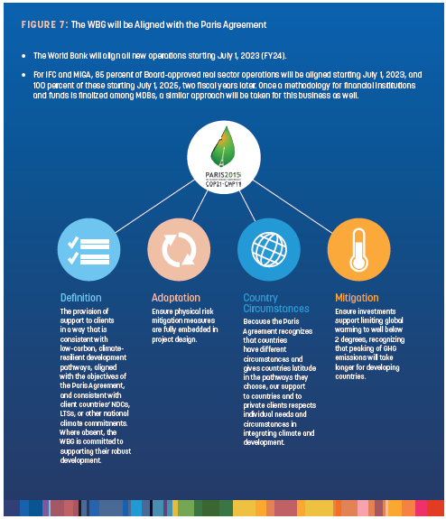
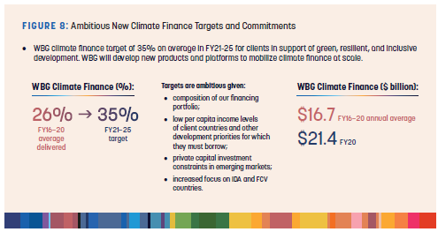
Planning for Climate Change: Aligning Climate and Development
World Bank Group (WBG)

Slide 14
Further Reading
World Bank Group Climate Change Action Plan 2021–2025: Supporting Green, Resilient, and Inclusive Development
https://openknowledge.worldbank.org/entities/publication/ee8a5cd7-ed72-542d-918b-d72e07f96c79

