Slide 1
CCP-LAW
Curricula development on Climate Change Policy and Law
Subject title: Climate Justice: Mitigation and Adaptation
Instructor Name: Dr. Shashikala Gurpur, Dr. Sujata Arya
Project No of Reference: 618874-EPP-1-2020-1-VN-EPPKA2-CBHE-JP:
The European Commission's support for the production of this publication does not constitute an endorsement of the contents, which reflect the views only of the authors, and the Commission cannot be held responsible for any use which may be made of the information contained therein.

Slide 2
Mitigation and Adaptation
Mitigation and adaptation are two complementary ways people can respond to climate change—one of the most complex challenges the world faces today. Mitigation is action to reduce greenhouse gas emissions and limit the amount of warming our planet will experience. Adaptation is action to help people adjust to the current and future effects of climate change.¹ These two prongs of climate action work together to protect people from the harms of climate change: one to make future climate change as mild and manageable as possible, and the other to deal with the climate change we fail to prevent.

Slide 3
Mitigation and Adaptation
Mitigation: Focus on greenhouse gases
Mitigation centers on the root cause of climate change: the heat-trapping greenhouse gases humans are adding to the atmosphere faster than our planet can absorb them. These can be addressed by reducing the sources of greenhouse gas emissions, or enhancing “sinks” of greenhouse gases that remove them from the atmosphere. Reducing sources: Almost three-quarters of humans’ greenhouse gas emissions come from burning fossil fuels like coal, oil and natural gas, so mitigation often focuses on replacing those fuels with other sources of energy, like renewables and nuclear power. Mitigation can also tackle other sources of greenhouse gases: protecting forests from being cut down, for instance, or collecting methane from landfills. Enhancing sinks: Other forms of mitigation, like growing new forests and designing and building “direct air capture” systems, work by taking greenhouse gases out of the atmosphere—sometimes called “carbon removal.” These approaches are challenging to do at a very large scale, and they do not eliminate the need to drastically lower our emissions. Still, authorities like the Intergovernmental Panel on Climate Change agree that some carbon removal will be needed to head off the worst climate change scenarios.
Adaptation: Focus on climate impacts
Successful worldwide mitigation efforts will eventually halt the accumulation of greenhouse gases in the atmosphere, gradually ceasing global warming.
However, the world will still face the consequences of a warmer climate, including altered weather patterns and "locked in" changes like sea level rise, which may persist for centuries.
Adaptation strategies will vary regionally, encompassing infrastructure enhancements such as improved storm drainage systems, natural solutions like wetland restoration for hurricane resilience, and behavioral and policy shifts like cultivating more resilient crops. Proactive adaptation involves fortifying systems to withstand current and future climate challenges.
For instance, in Bangladesh's vulnerable coastal areas, proactive measures like building embankments, flood-control structures, and economic development initiatives are being pursued in anticipation of rising sea levels.
Regions that fail to take proactive steps will resort to reactive adaptation, rebuilding after climate-related disasters have already struck, displacing communities, and disrupting livelihoods.

Slide 4
Paris Agreement
International Approach
The Paris Agreement is a binding international treaty on climate change adopted by 196 Parties at COP21, on 12 December 2015 and entered into force on 4 November 2016.
Its goal is to limit global warming to well below 2 degrees, preferably to 1.5 degrees Celsius, compared to pre-industrial levels.
To achieve long-term goals, countries aim to reach global peaking of greenhouse emissions as soon as possible to achieve a climate neutral world by mid-century.
The Paris Agreement provides a framework for financial, technical and capacity building support to those countries who need it.

Slide 5
COP26 and Enhanced Commitments
Held in Glasgow, Scotland the COP26 resulted in the Glasgow Climate Pact, negotiated through consensus of the representatives of the 197 attending parties, providing for enhanced global commitments to prevent the predicted rise in temperature which was set to reach nearly +3°C by the end of the century.
India also made major strides at COP26, declaring its net-zero target of 2070.
Adoption of the Glasgow Breakthrough Agenda and the Commitment for the Phasing Down of Coal Consumption further cemented the commitment to develop clean energy resources and sustainable technological solutions.

Slide 6
COP 28 and Way Forward
International Approach
COP 28 is historic in its recognition for the first time of the need for rapid and drastic reductions in greenhouse gas emissions and the “transition away” from fossil fuels. It actually points to a future without fossil fuels, which is very ambitious politically. In addition, the recommendation for tripling renewable energy capacity and doubling energy efficiency capacity is crucial and very welcome. However, for COP28 to be truly seen as a step forward, action should be taken immediately, and a lot of work needs to be done. In fact, the ultimate cost for continued inaction will be the general decrease of our quality of life, and tragically, the loss of life.

Slide 7
COP28 Key Outcomes
Global Stocktake Text: The Global Stocktake (GST) is a periodic review mechanism established under the Paris Agreement in 2015. The text proposes eight steps to keep the global temperature rise within the ambit of 1.5 degrees Celsius. It calls for tripling renewable energy capacity globally and doubling the global average annual rate of energy efficiency improvements by 2030. It calls for substantially reducing non-CO2 emissions, including, in particular, methane emissions globally by 2030.
Transitioning Away from Fossil Fuels :COP28 calls for transitioning away from fossil fuels in energy systems, in a just, orderly, and equitable manner, accelerating action in this critical decade, to achieve net zero by 2050.
Global Goal on Adaptation (GGA): Global adaptation goal focuses on enhancing adaptive capabilities, and minimizing vulnerability for sustainable development.At COP28, this text calls for a doubling in adaptation finance and plans for assessments and monitoring of adaptation needs in the coming years.
Climate Finance: The United Nations Conference on Trade and Development (UNCTAD) estimates that wealthy nations owe developing countries USD 500 billion in 2025 under the New Collective Quantified Goal (NCQG) for climate finance. The goal is to set a new collective quantified goal before 2025. The goal will start from a floor of USD 100 billion per year. This includes USD 250 billion for mitigation, USD 100 billion for adaptation, and USD 150 billion for loss and damage.

Slide 8
COP28 Key Outcomes
Loss and Damage Fund :
Member countries reached an agreement to operationalize the Loss and Damage (L&D) fund aimed at compensating countries grappling with climate change impacts.
A specific percentage is earmarked for Least Developed Countries and Small Island Developing States.
The World Bank will oversee the loss and damage fund in the beginning.
Global Renewables and Energy Efficiency Pledge:
The Pledge stipulates that signatories commit to work together to triple the world’s installed renewable energy generation capacity to at least 11,000 GW by 2030.
It also calls for collectively double the global average annual rate of energy efficiency improvements from around 2% to over 4% every year until 2030.
The Global Cooling Pledge for COP 28:
It includes 66 national government signatories committed to working together to reduce cooling-related emissions across all sectors by at least 68% globally relative to 2022 levels by 2050.

Slide 9
International Approaches to Climate Change Governance
Intended Nationally Determined Contributions (INDCs)
In their NDCs, countries communicate actions they will take to reduce their Greenhouse Gas emissions in order to reach the goals of the Paris Agreement. Countries also communicate in the NDCs actions they will take to build resilience to adapt to the impacts of rising temperatures
However, due to their nature as low-cost solutions, INDCs tend to grossly underestimated cost considering the ambitious targets, failing to consider geographical limand resultant transmission costs, which would eat up investments in other parts of the economy.
To better frame the efforts towards the long-term goal, the Paris Agreement invited countries to formulate and submit by 2020 long-term low greenhouse gas emission development strategies (LT-LEDS).
LT-LEDS provide the long-term horizon to the NDCs. Unlike NDCs, they are not mandatory. Nevertheless, they place the NDCs into the context of countries’ long-term planning and development priorities, providing a vision and direction for future development. and direction for future development.
Global Pledges Post-2020
Global Methane Pledge - The pledge was first announced in September by the US and EU, and is essentially an agreement to reduce global methane emissions. One of the central aims of this agreement is to cut down methane emissions by up to 30% from 2020 levels by the year 2030. China, Russia and India - have not signed up, while Australia has said it will not back the pledge. The rationale behind India not signing the pledge is that the country still requires methane to carry essential industrial and developmental activities and a complete ban of methane will hamper the progress of becoming an industrialised and developed country.
Deforestation Pledge - More than 100 national leaders pledged to halt and reverse deforestation and land degradation by the end of the decade. The agreement vastly expands a commitment made by 40 countries as part of the 2014 New York Declaration of Forests, and promises more resources. Major finacial pledges include USD 19 billion and 14 billion Euros in public and private funds to invest in protecting and restoring forests.

Slide 10
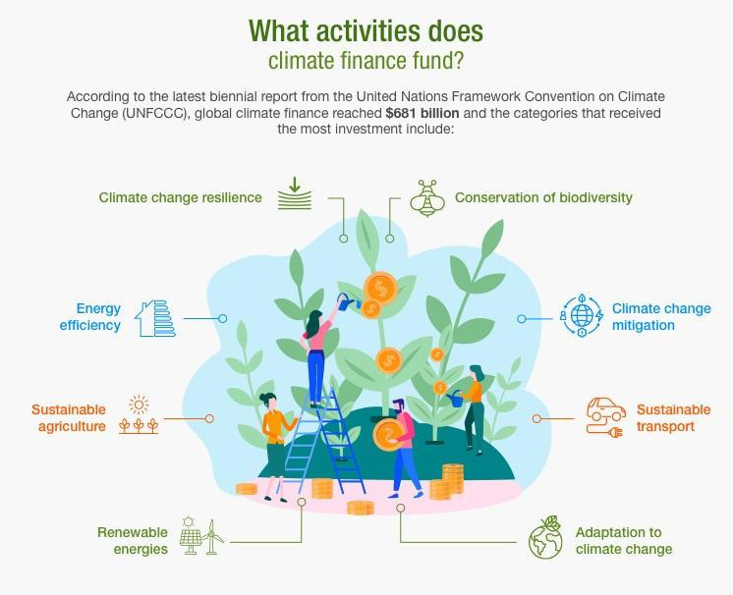
Climate Financing and Other Innovative Approaches to Tackle Climate Change.
India noted that climate finance cannot continue at the levels decided in 2009 ($100 billion), and emphasised that it should be at least $1 trillion to meet the goals of addressing climate change.

Slide 11
Climate Financing
To help finance the same, the following recommendations with regards to Multilateral Development Banks (MDBs) need to see implementation:
Under India’s G20 watch, the governing boards of the MDBs must adopt the G20 working party recommendations on capital adequacy, especially the call to shift from ultra-risk-averse ratios while preserving existing capital and ratings;
The IMF Board must allow the MDBs to hold special drawing rights (SDRs) as part of their capital, and current SDR holders should rechannel less than one-fifth of the over $500 billion of unused SDRs; and,
A Global Climate Mitigation Trust needs to be established, backed by a new $650 billion issuance of SDRs, activating a fraction of the value of $12.7 trillion of reserves set aside for a rainy day by the central banks of IMF members. With the UNFCCC’s Green Climate Fund as one of the trustees, countries would rechannel their unused SDRs to the trust, which would use them as quality collateral to borrow cheaply in the capital markets. These borrowed funds would then be on-lent or invested in an auction won by the sponsors of projects that have the biggest and the fastest impact on global warming anywhere in the world.

Slide 12
Dismantling Fossil Fuel Regimes
A study using a Computable General Equilibrium (CGE) model focuses specifically on ancillary benefits of limiting carbon dioxide emissions. Ancillary benefits are defined in terms of reduced mortality and morbidity due to reduced particulate concentrations and are estimated at 334 lives saved per million tonnes of carbon abated.
CO2 cuts would result in a decreased demand for fossil fuel, whereafter developing countries can benefit from the Clean Development Mechanism (CDM);
Policies that remove price distortions (namely, marginal cost pricing and elimination of subsidy to producers) combined with freer imports of high quality coal, could reduce carbon emissions, and lower coal consumption could allow states to focus more on social welfare too; and,
Dismantling of the Administered Price Mechanism (APM) for petroleum products would facilitate the reduction of the energy intensity of economies around the globe through continued economic reforms and the use of tried and tested methods such as emissions trading for local pollutants (as shown by the sulphur dioxide trading programme) would more effectively aid climate change mitigation.

Slide 13
Conclusion
“Vidya dadati vinayam” is an ancient Sanskrit phrase which literally translates as "Knowledge leads to Happiness".
India is an important piece in the global climate puzzle. It houses close to twenty percent of the world’s population, 2.4% of the world’s land area, 7%–8% of all recorded species, including over 45,000 species of plants and 91,000 species of animals. Over 650 million Indian people depend on climate-sensitive sectors like agriculture and forestry for their livelihood. The minimum and maximum temperatures are projected to increase by two to four degrees Celsius during the 2050s in the northern part of the country and by over four degrees Celsius in the southern part of the country.
Therefore, addressing Climate Change with the right knowledge is key at this juncture in time. The future of our planet rests in the hands of the present generation, and action must therefore be taken before it is too late to address these pressing problems.

