Slide 1
Economics of Renewable and Non-Renewable Resources

Slide 2
Renewable vs Non-Renewable Resources
Renewable Resources: naturally replenished
Non-Renewable Resources: finite and depleting

Slide 3
Sustainability of Renewable Resources
Definition: meeting present needs without compromising future generations
Benefits: reduced greenhouse gas emissions, energy independence
Challenges: land use conflicts, intermittency of some sources

Slide 4
Exploitation of Renewable Resources
Optimum Level: harvesting without depleting or damaging
Risks: over-harvesting can lead to resource depletion
Strategies: sustainable farming, controlled extraction

Slide 5
Non-Renewable Resources Overview
Definition: limited and cannot be replaced within a human lifetime
Types: fossil fuels , minerals
Economic Importance: major energy sources, raw materials for industries

Slide 6
Challenges of Non-Renewable Exploitation
Environmental Impacts: pollution, habitat destruction, oil spills
Economic Implications: price volatility, supply chain disruptions
Geopolitical Tensions: resource wars, trade disputes

Slide 7
Circular Economy Paradigm
Definition: regenerative system aiming to reduce waste
Principles: design out waste, keep products in use, regenerate natural systems
Transition: shift from 'take-make-dispose' to 'reduce-reuse-recycle'

Slide 8
Opportunities in Circular Economy
Role of Businesses: promoting sustainability, innovation, stakeholder engagement
Benefits: cost savings from waste reduction, new revenue streams
Challenges: initial investment, cultural and operational shifts

Slide 9
Task
You will present your assigned case studies

Slide 10
Case Study 1 - Local Circular Economy Initiative
Case Study: City's Waste-to-Energy Plant

Slide 11
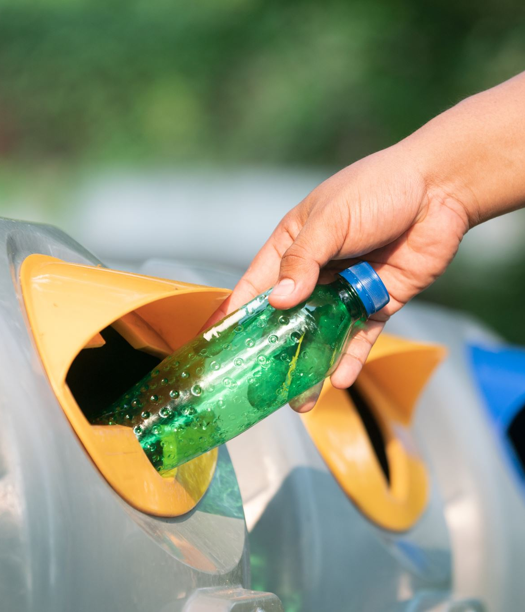
Case Study 2 - Local Circular Economy Initiative
Case Study: Community-Based Recycling Programme

Slide 12
The Way Forward
Balancing Act: optimizing renewable and non-renewable use
Circular Economy: a sustainable model for the future
Corporate Leadership: driving change towards sustainability

