Slide 1
CCP-LAW
Curricula development on Climate Change Policy and Law
Subject title: CLIMATE CHANGE DISPUTE RESOLUTION
Instructor Name: Tran Anh Tuan
Project No of Reference: 618874-EPP-1-2020-1-VN-EPPKA2-CBHE-JP:
The European Commission's support for the production of this publication does not constitute an endorsement of the contents, which reflect the views only of the authors, and the Commission cannot be held responsible for any use which may be made of the information contained therein.

Slide 2
1.1. Nature and causes of climate change disputes
1. CLIMATE CHANGE AS A SOURCE OF DISPUTE
1.1.1. Dispute vs. Conflict
- Dispute refers to a disagreement or difference of opinion between two or more parties.
- Conflict is a more intense form of disagreement that can involve violence or the threat of violence.
- Disputes can be easily resolved by dealing with the specific issue at hand and coming to a final determination.
- Conflicts, unlike Disputes, cannot be easily resolved and the possibility of resolving them is very remote. Thus, Disputes may stem from a Conflict.

Slide 3
1.1. Nature and causes of climate change disputes
1. CLIMATE CHANGE AS A SOURCE OF DISPUTE
1.1.2. Features of climate change disputes
- Transboundary nature: Climate impacts like water scarcity or mass migration cross borders, involving multiple countries and requiring collective regional or global solutions.
- Increased instability: Climate change effects are exacerbating existing ethnic, social and political tensions, which increase civil unrest, insurgencies, crime, etc.
- Complex causality: Climate change alone does not directly cause conflict. It interacts with economic, political, demographic and social drivers to increase conflict risks.

Slide 4
1.1. Nature and causes of climate change disputes
1. CLIMATE CHANGE AS A SOURCE OF DISPUTE
1.1.2. Features of climate change disputes
- Unpredictability: The conflict impacts of climate change are hard to predict precisely, can take unexpected turns, and have cascading effects
- Interrelation: Conflicts and disputes is complex and often interlinked.
- Asymmetric impacts: Poorer, marginalized and vulnerable groups tend to be hit hardest by climate change, widening inequalities.

Slide 5
1.1. Nature and causes of climate change disputes
1. CLIMATE CHANGE AS A SOURCE OF DISPUTE
1.1.3. Causes of climate change disputes
1) Competition for limited resources
- Changes in climate patterns can lead to resource scarcity. As resources become scarcer, competition for them increases, leading to conflicts over access and use. For example:
* Water scarcity heightens tensions between communities, industries, and agriculture. For example, regions dependent on shared water bodies may face disputes over water allocation.
* Food security causes disputes over access to and control of food resources.

Slide 6
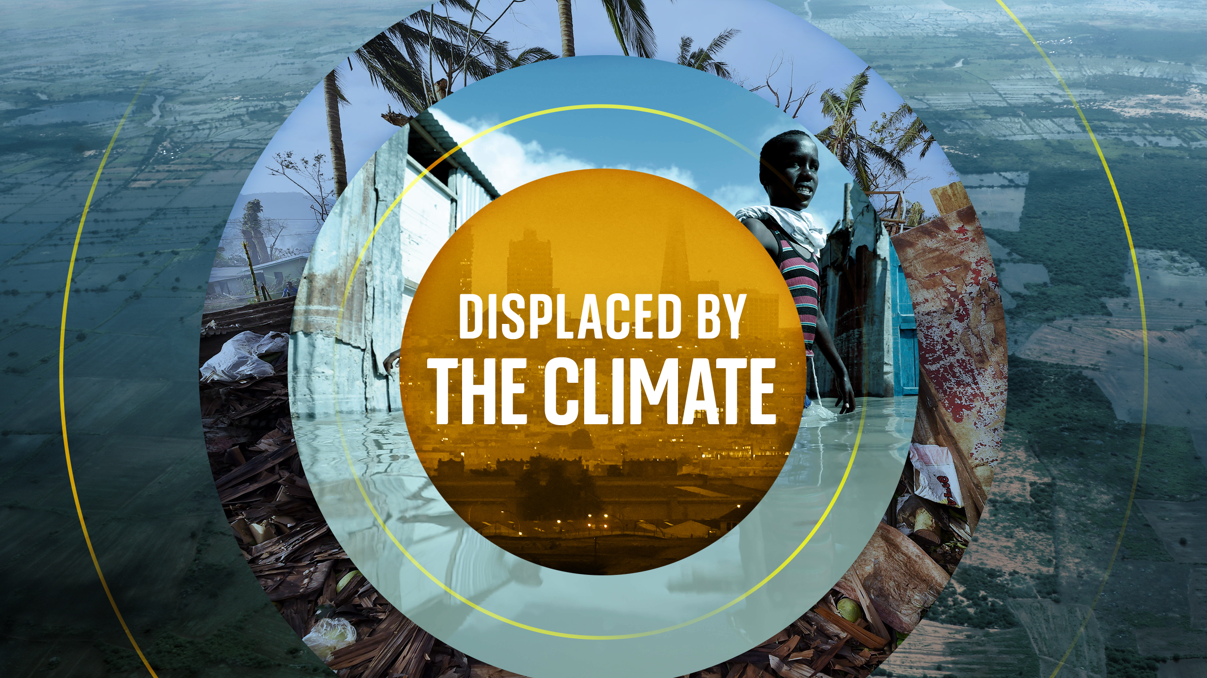
1.1. Nature and causes of climate change disputes
1. CLIMATE CHANGE AS A SOURCE OF DISPUTE
1.1.3. Causes of climate change disputes
2) Displacement and migration
- Increased frequency and intensity of extreme weather events, such as hurricanes, floods, and droughts, can lead to the displacement of communities.
- This displacement can trigger conflicts over resources, land, and jobs in both the areas of origin and the areas of migration.

Slide 7
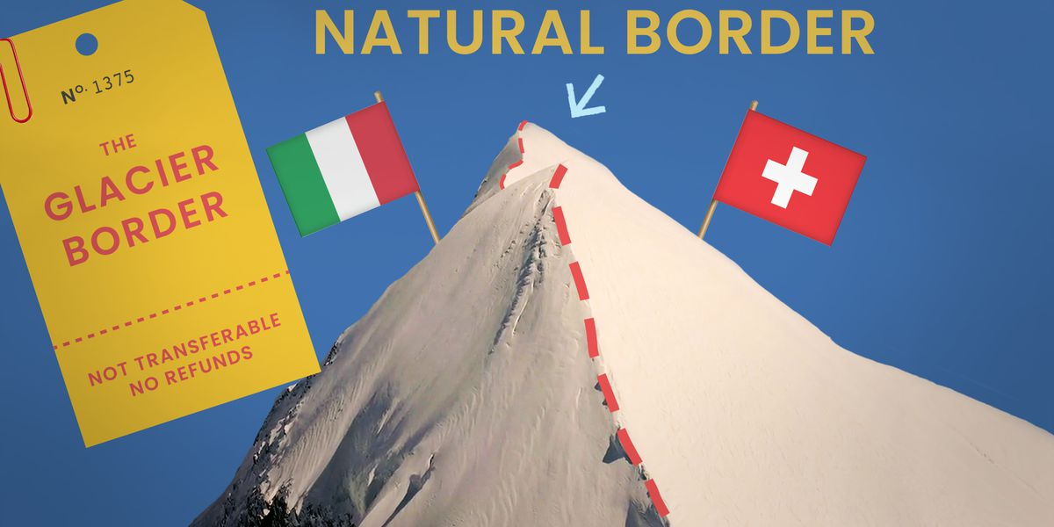
1.1. Nature and causes of climate change disputes
1. CLIMATE CHANGE AS A SOURCE OF DISPUTE
1.1.3. Causes of climate change disputes
3) Territorial disputes
- Rising sea levels threaten low-lying coastal areas and island nations can lead to disputes over territorial boundaries and maritime rights.
- For instance, there are concerns about the potential for increased tensions in regions like the South China Sea, where several countries have overlapping maritime claims.

Slide 8
1.1. Nature and causes of climate change disputes
1. CLIMATE CHANGE AS A SOURCE OF DISPUTE
1.1.3. Causes of climate change disputes
4) Loss and damage compensation
- Disputes arise over who bears responsibility for climate change-related damages and the extent of liability.
- Developing countries often seek compensation from developed nations for loss and damage caused by historical emissions of GHGs.

Slide 9
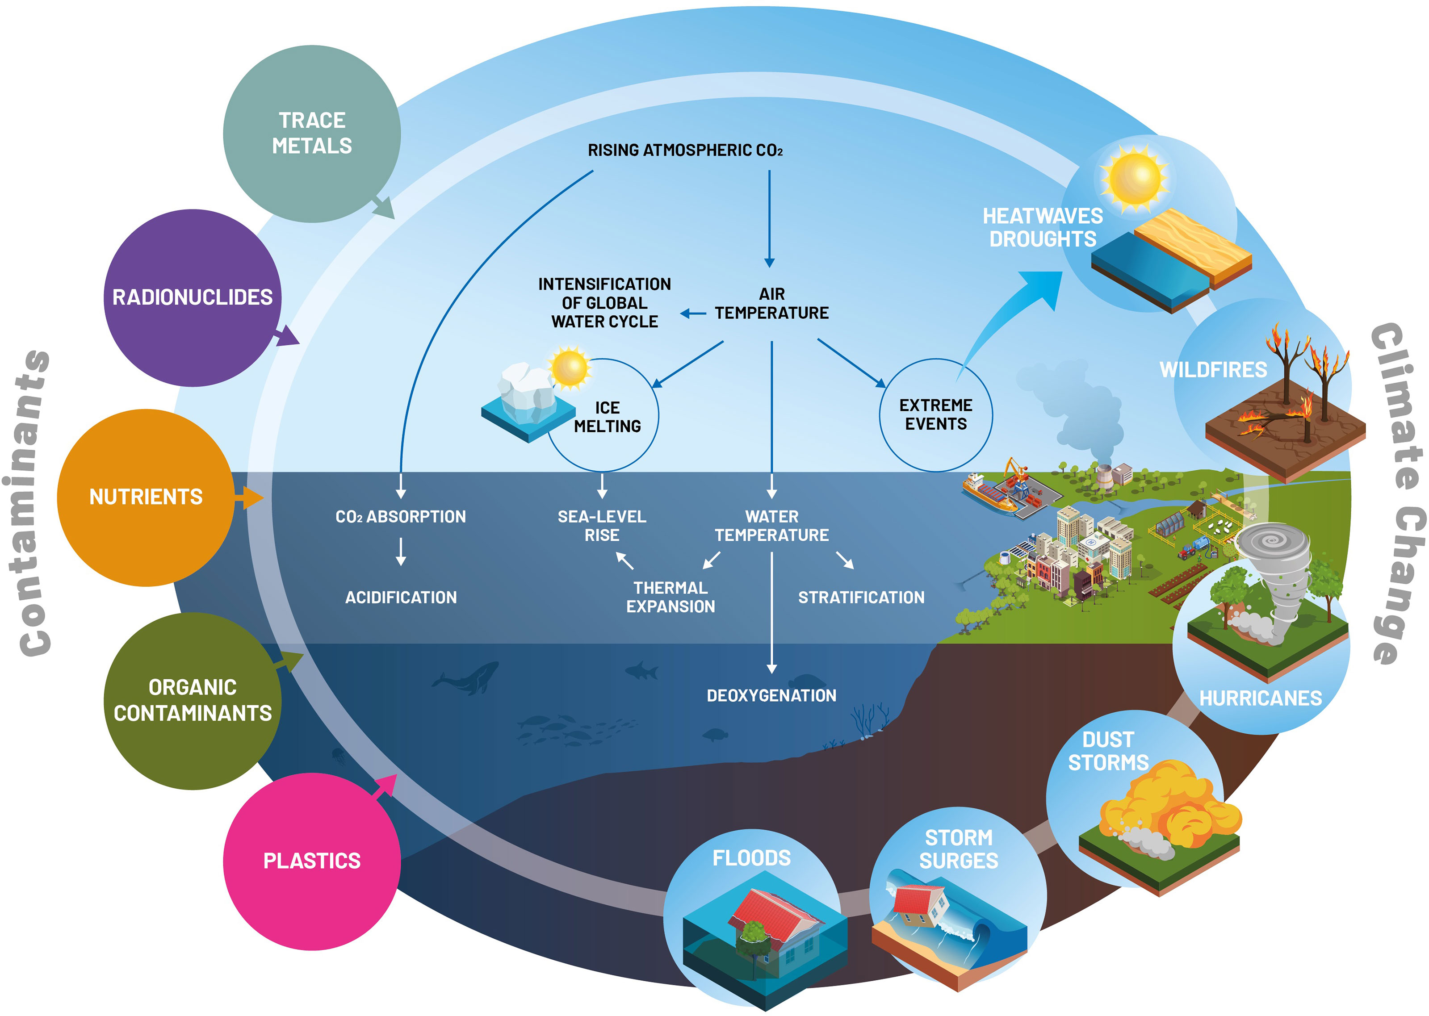
1.1. Nature and causes of climate change disputes
1. CLIMATE CHANGE AS A SOURCE OF DISPUTE
1.1.3. Causes of climate change disputes
5) Cross-border pollution
- Climate change exacerbates environmental issues, such as air and water pollution.
- Cross-border pollution can lead to disputes between neighboring countries over the origin and control of pollutants.
6) Indigenous rights and land conflicts
- Climate change can threaten the livelihoods and cultural heritage of indigenous communities, leading to conflicts over land rights and conservation efforts.

Slide 10
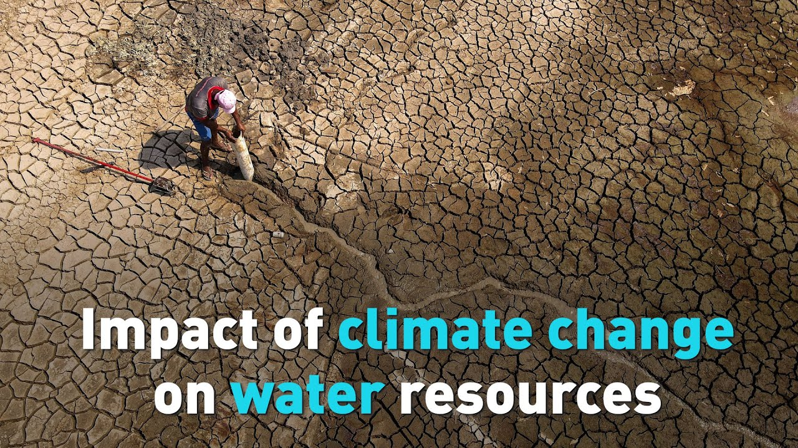
1.2. Areas / sectors where disputes would arise
1. CLIMATE CHANGE AS A SOURCE OF DISPUTE
- Water Resources: Disputes over the allocation and management of water resources are likely to increase, particularly in arid regions or places where water sources cross national borders.
- Agriculture: Competition for land use between agriculture and other needs, such as urban expansion or biofuel production would be more tense.
- Fisheries: As ocean temperatures change, fish populations migrate, potentially leading to disputes over fishing rights and international water boundaries.

Slide 11
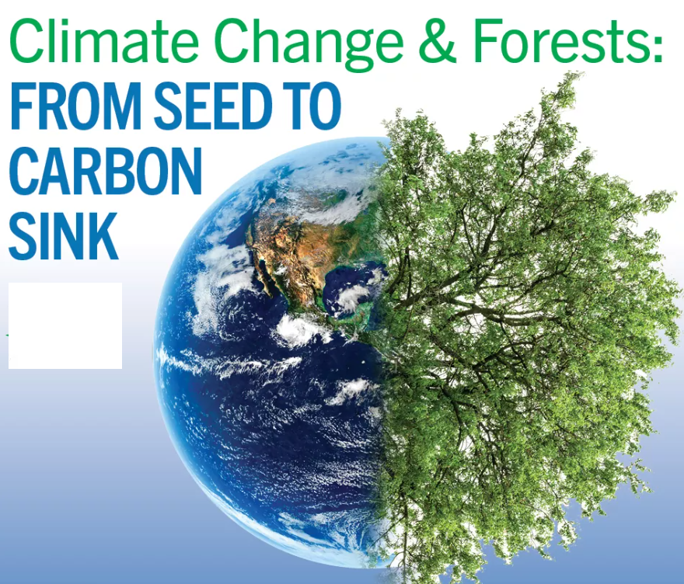
1.2. Areas / sectors where disputes would arise
1. CLIMATE CHANGE AS A SOURCE OF DISPUTE
- Energy: Conflicts may arise over the transition from fossil fuels to renewable energy sources, including disputes over land for wind or solar farms and tensions between countries with different energy transition policies.
- Forestry: Deforestation and forest degradation contribute to climate change and can lead to conflicts over land rights, conservation efforts, and the use of forest resources.
- Public Health: As climate change impacts the spread of diseases and puts pressure on health systems, disputes may arise over resource allocation and health policy responses.

Slide 12
1.2. Areas / sectors where disputes would arise
1. CLIMATE CHANGE AS A SOURCE OF DISPUTE
- Energy: Conflicts may arise over the transition from fossil fuels to renewable energy sources, including disputes over land for wind or solar farms and tensions between countries with different energy transition policies.
- Forestry: Deforestation and forest degradation contribute to climate change and can lead to conflicts over land rights, conservation efforts, and the use of forest resources.
- Public Health: As climate change impacts the spread of diseases and puts pressure on health systems, disputes may arise over resource allocation and health policy responses.

Slide 13
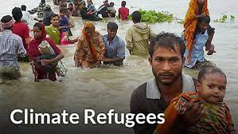
1.2. Areas / sectors where disputes would arise
1. CLIMATE CHANGE AS A SOURCE OF DISPUTE
- Transportation: Roads, railways, ports and airports that rely on shared infrastructure are vulnerable to climate disruption. Damage can isolate regions within countries and hurt trade relations.
- Climate refugees: Rising sea levels, extreme weather events, and changes in agricultural productivity may force populations to migrate leading to conflicts over migration policies, resource competition, and tensions.
- International relations: Climate change can strain international relations, particularly regarding the responsibilities and commitments of different nations to mitigate and adapt to climate change.

Slide 14
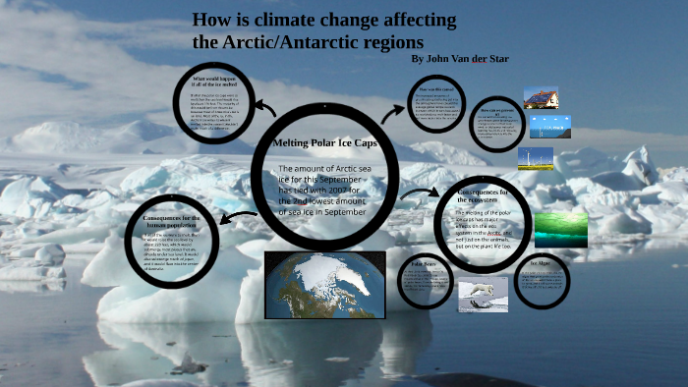
1.2. Areas / sectors where disputes would arise
1. CLIMATE CHANGE AS A SOURCE OF DISPUTE
- Border regions: Climate impacts often cross borders, requiring cooperative transboundary management of resources like rivers or adaptation projects. Failure can cause disputes between neighboring states.
- Arctic and antarctic regions: Receding Arctic ice opens up new maritime trade routes and makes oil/gas and mineral deposits newly accessible. This leads to military buildup and sovereignty disputes between the U.S., Russia, Canada, etc.

Slide 15
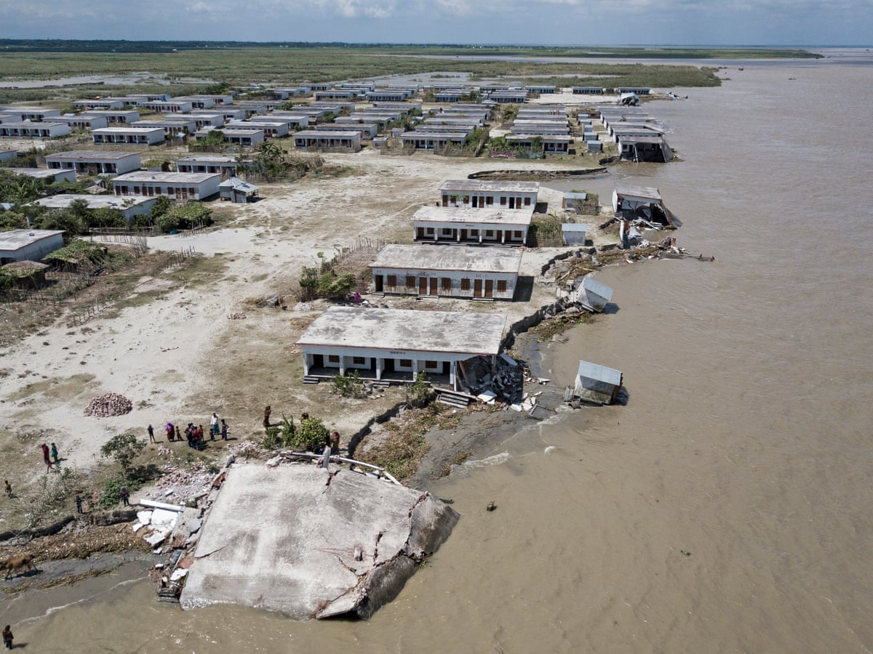
1.2. Areas / sectors where disputes would arise
1. CLIMATE CHANGE AS A SOURCE OF DISPUTE
- Resource extraction: Melting ice in the polar regions opens up new opportunities for resource extraction (e.g., oil, minerals) leading to territorial disputes and competition for these resources among nations.
- Coastal regions: Rising sea levels are making coastal lands and islands uninhabitable, and increased storms are destabilizing coastal infrastructure and housing. Migration and relocation disputes arise from this displacement.
- Urban areas: Inward climate migration strains resources like housing and jobs in cities. Shortages and unemployment breed criminal violence and identity-based tensions between migrant and local groups.

Slide 16
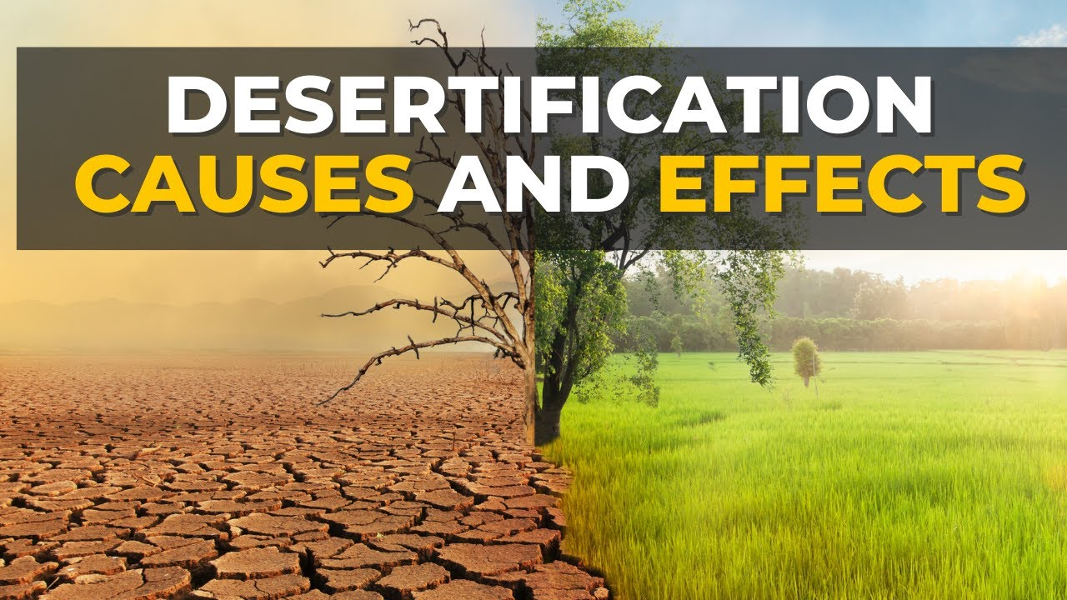
1.2. Areas / sectors where disputes would arise
1. CLIMATE CHANGE AS A SOURCE OF DISPUTE
Some specific examples of climate change disputes and conflicts that have already arisen:
- In Syria, the ongoing civil war has been exacerbated by climate change-induced droughts, which have led to crop failures and mass displacement.
- In the Sahel region of Africa, climate change-induced desertification and water scarcity have led to increased conflict between farmers and herders.

Slide 17
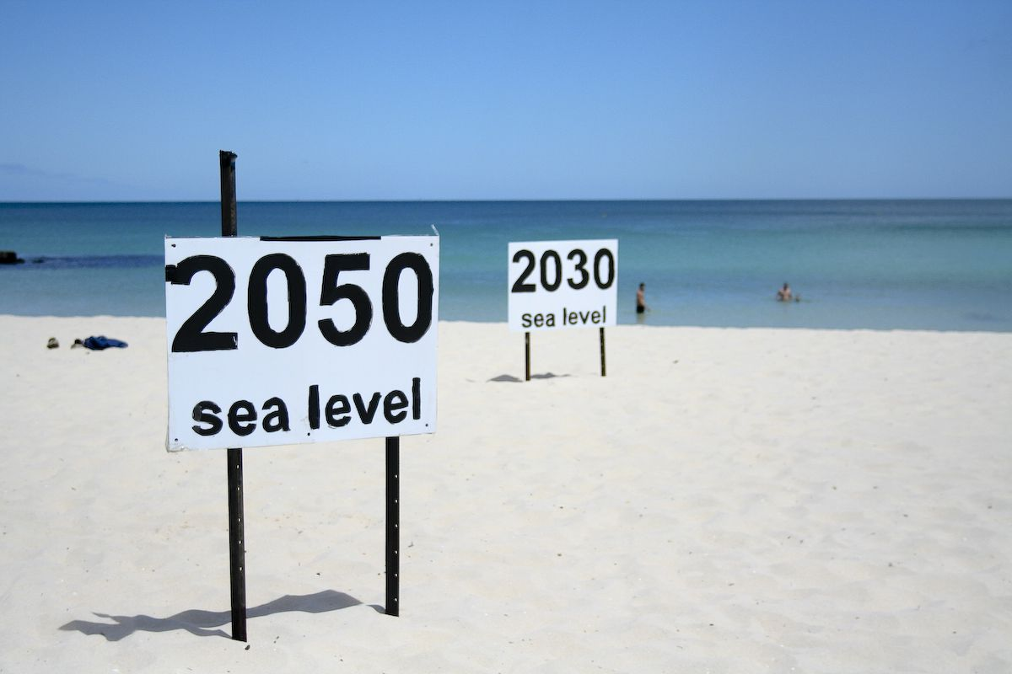
1.2. Areas / sectors where disputes would arise
1. CLIMATE CHANGE AS A SOURCE OF DISPUTE
Some specific examples of climate change disputes and conflicts that have already arisen:
- In the South Pacific, rising sea levels are threatening to displace entire communities, which could lead to conflict over land and resources.
- In the United States, there has been conflict over the construction of pipelines and other infrastructure projects that could exacerbate climate change.

Slide 18
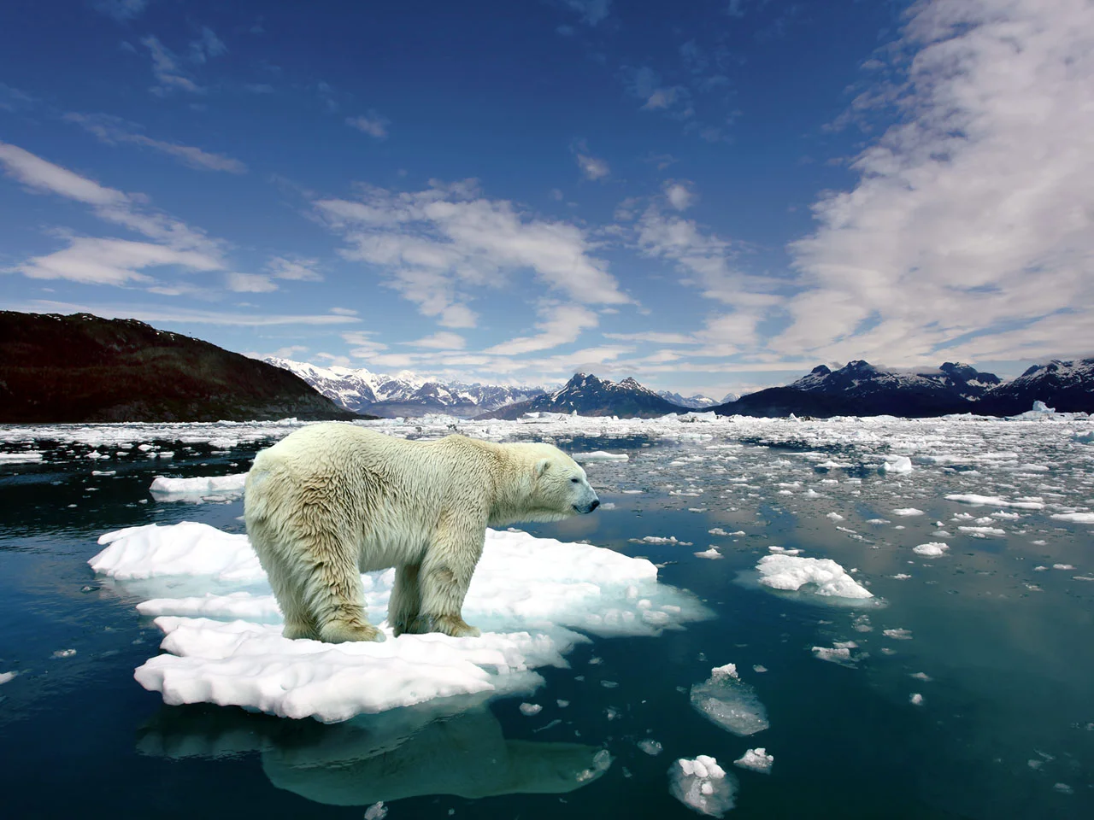
1.3. Rise in disputes and conflicts
1. CLIMATE CHANGE AS A SOURCE OF DISPUTE
1.4. Key stakeholders and their interests in climate change disputes
Independent learning: review articles and book chapters on the sub-topics 1.3 and 1.4.

Slide 19
1.5. Emerging issues in climate change dispute resolution
1. CLIMATE CHANGE AS A SOURCE OF DISPUTE
1) Climate refugees
- There is no global framework governing support or resettlement options for populations displaced by climate impacts.
2) Role of carbon markets & offsets
- Controversies exist around using carbon markets and offsets to meet emissions reductions commitments both nationally and for corporations.

Slide 20
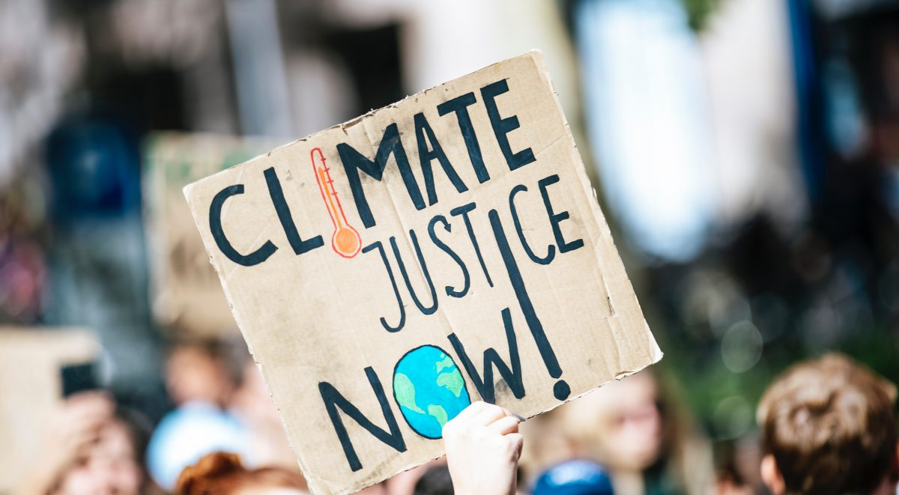
1.5. Emerging issues in climate change dispute resolution
1. CLIMATE CHANGE AS A SOURCE OF DISPUTE
3) Climate justice
- Achieving consensus on the principles of climate justice and translating them into actionable policies is challenging.
- Disputes may arise regarding the fair allocation of responsibilities, especially between developed and developing nations.

Slide 21
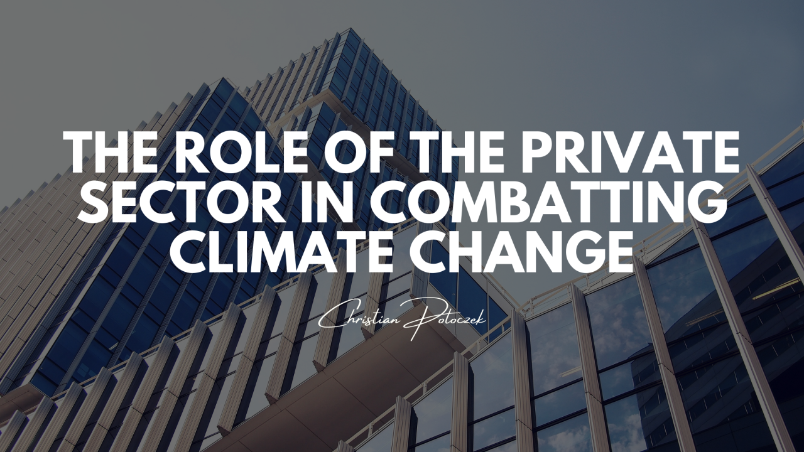
1.5. Emerging issues in climate change dispute resolution
1. CLIMATE CHANGE AS A SOURCE OF DISPUTE
4) Private sector accountability
Establishing mechanisms for holding private entities accountable for their environmental impact, ensuring transparency in reporting, and addressing disputes related to greenwashing and false claims are ongoing challenges.
5) Loss and damage compensation
Poorer vulnerable nations are seeking loss and damage financing from rich historical emitters, but lack formal legal basis to pursue climate damages compensation. This remains a huge dispute in international negotiations.

Slide 22
1.5. Emerging issues in climate change dispute resolution
1. CLIMATE CHANGE AS A SOURCE OF DISPUTE
6) Technological Innovation and Transfer
- Striking a balance between incentivizing innovation through intellectual property protection and ensuring widespread access to green technologies is a complex issue.
- Negotiating technology transfer agreements that benefit both developed and developing nations can be challenging.

Slide 23
1.5. Emerging issues in climate change dispute resolution
1. CLIMATE CHANGE AS A SOURCE OF DISPUTE
8) Green finance and investment
- Disputes may arise over the allocation of funds, the measurement of green impact, and the effectiveness of financial instruments.
- Developing standards for green finance, ensuring transparency in reporting, and addressing disputes over the allocation and utilization of funds are key challenges in the context of climate change.

Slide 24
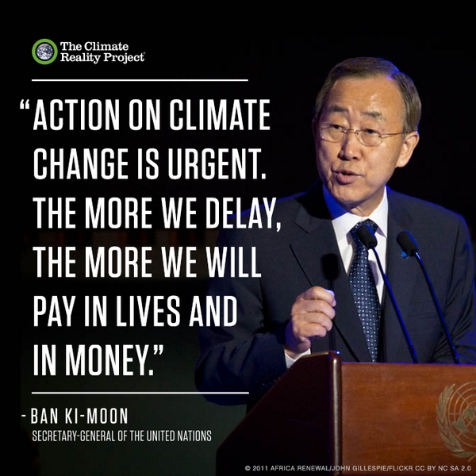
1.5. Emerging issues in climate change dispute resolution
1. CLIMATE CHANGE AS A SOURCE OF DISPUTE
Addressing these issues requires innovative thinking and collaboration from various stakeholders. Some promising approaches include:
- Developing specialized dispute resolution mechanisms for climate change.
- Promoting access to justice and legal aid for climate-related claims.
- Engaging in dialogue and mediation to find collaborative solutions.
- Building capacity and expertise in climate law and dispute resolution…

