Slide 1
CCP-LAW
Curricula development on Climate Change Policy and Law
Subject: Corporate Governance and Climate Change
Topic 8: Corporate Disclosure of Climate Change
Instructor Name: …
Project No of Reference: 618874-EPP-1-2020-1-VN-EPPKA2-CBHE-JP:
The European Commission's support for the production of this publication does not constitute an endorsement of the contents, which reflect the views only of the authors, and the Commission cannot be held responsible for any use which may be made of the information contained therein.

Slide 2
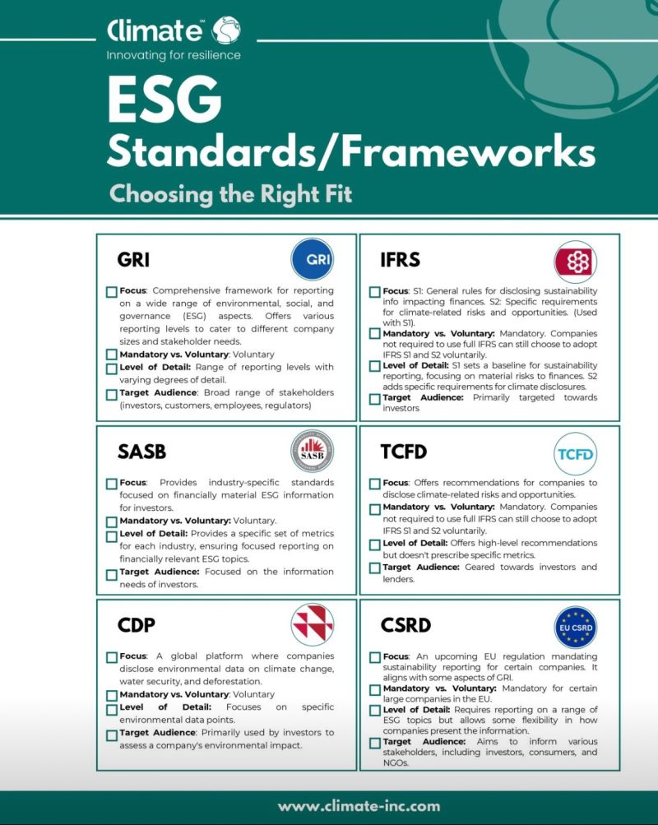
In this topic, we will cover…
Key global reporting frameworks
National reporting frameworks
Case studies of effective climate reporting

Slide 3
Why Disclose?
Climate Change & Corporate Transparency: Why Does it Matter?
Climate change poses financial risks to companies (extreme weather, regulation, resource scarcity).
Investors need info to assess these risks and make informed decisions.
Disclosure promotes accountability and helps companies manage climate impacts.

Slide 4
The Disclosure Landscape
Navigating the Disclosure Maze: Frameworks and Regulations
Voluntary frameworks like TCFD (Task Force on Climate-Related Financial Disclosures) are widely adopted.
Mandatory regulations are emerging in some regions (EU Non-Financial Reporting Directive).
Disclosures typically cover:
Governance - Board oversight of climate issues
Strategy - How climate change affects business strategy
Risk Management - Identifying and managing climate-related risks
Metrics & Targets - Greenhouse gas emissions, progress on climate goals

Slide 5
The Road Ahead
The Future of Corporate Climate Disclosure
Debate on scope of disclosure (e.g., requiring Scope 3 emissions - entire value chain)
Increased focus on scenario analysis - how companies will fare under different climate futures
Potential for standardized reporting formats for better comparability

Slide 6
Key global reporting frameworks

Slide 7
1. CDP (formerly Carbon Disclosure Project):
Focus: Investor-driven platform for companies to report environmental data, primarily climate change.
Strengths:
Global reach with thousands of companies participating.
Provides a platform for direct communication with sustainability-focused investors.
Standardizes data collection, allowing for comparison across companies.
CDP acts as a bridge between companies and investors on climate issues. Companies submit a questionnaire on their emissions, climate strategies, and governance. This information is then made publicly available, empowering investors to assess climate risks and opportunities within their portfolios.

Slide 8
2. Climate Disclosure Standards Board (CDSB):
Focus: Framework for reporting environmental and climate information aligned with financial reporting.
Strengths:
Integrates climate disclosure with mainstream financial reporting practices.
Provides decision-useful information for investors familiar with financial statements.
Offers industry-specific guidance for tailored disclosures.
CDSB promotes consistency and comparability between climate disclosure and financial data. This allows investors to analyze climate risks alongside traditional financial metrics, facilitating informed investment decisions. Like SASB, CDSB offers industry-specific guidance, ensuring climate disclosures are relevant to the specific risks and opportunities faced by a company within its sector.

Slide 9
3. Science Based Targets initiative (SBTi):
Focus: Setting ambitious emissions reduction targets aligned with climate science.
Strengths:
Provides a framework for companies to set science-based targets for emissions reduction.
Contributes to achieving the goals of the Paris Agreement.
Offers validation and recognition for companies with ambitious climate goals.
SBTi goes beyond just reporting emissions. It helps companies establish science-based targets that align with limiting global warming to well below 2°C, as outlined in the Paris Agreement. Participating companies gain access to resources and methodologies to develop and implement these targets, demonstrating their commitment to climate action.

Slide 10
4. Task Force on Climate-Related Financial Disclosures (TCFDv2):
Focus: Updated recommendations for companies to disclose climate-related financial risks and opportunities.
Strengths:
Builds on the original TCFD framework, incorporating scenario analysis.
Provides a robust framework for assessing financial implications of climate change.
Encourages companies to consider different climate futures in their strategies.
TCFDv2 expands on the original framework by introducing scenario analysis. This requires companies to assess the potential impact of different climate scenarios (e.g., a disorderly transition to a low-carbon economy) on their business. This forward-looking approach helps companies identify and manage climate-related risks more effectively.

Slide 11
5. Regional Regulations (EU CSRD, etc.):
Focus: Mandatory sustainability reporting requirements emerging in different regions.
Strengths:
Enhances transparency and comparability of climate disclosures.
Holds companies accountable for their environmental impacts.
Creates a level playing field for businesses operating within a specific region.
A growing number of regions are implementing mandatory sustainability reporting regulations. Notably, the EU Corporate Sustainability Reporting Directive (CSRD) requires large companies to disclose information on a range of sustainability factors, including climate change. These regulations establish minimum standards for climate disclosure, ensuring greater consistency and comparability across companies within a region.

Slide 12
National reporting frameworks

Slide 13
United States - SEC Climate Disclosure Rule
Purpose: The SEC’s climate disclosure rule mandates that publicly traded companies disclose climate-related risks and their potential impacts on business operations. This ensures that investors have access to consistent, comparable, and reliable information about the climate-related risks and opportunities facing companies.
Focus: Key areas of disclosure include:
Governance: How the board and management oversee and manage climate-related risks.
Strategy: The impact of climate-related risks and opportunities on the company’s business, strategy, and financial planning.
Risk Management: Processes for identifying, assessing, and managing climate-related risks.
Metrics and Targets: Specific metrics and targets used to assess and manage climate-related risks and opportunities.
Features:
Aligns with TCFD Recommendations: The rule aligns closely with TCFD’s framework, ensuring consistency and comparability of disclosures.
Mandatory Disclosure: Applies to all public companies, enhancing transparency and accountability.

Slide 14
European Union - Non-Financial Reporting Directive (NFRD)
Purpose: The NFRD requires large companies to disclose non-financial information, focusing on environmental, social, and governance issues. The aim is to increase transparency and accountability in corporate reporting and help stakeholders understand the company’s impact on society.
Focus: Areas of disclosure include:
Environmental Protection: Information on greenhouse gas emissions, energy use, water consumption, and biodiversity impacts.
Social Responsibility: Disclosures on labor practices, human rights, and social impacts.
Governance: Corporate governance structures, anti-corruption measures, and board diversity.
Features:
Scope: Applies to large public-interest entities, such as listed companies, banks, and insurance companies.
Detailed Reporting Requirements: Companies must provide detailed information on policies, risks, and outcomes related to non-financial aspects.

Slide 15
European Union - Corporate Sustainability Reporting Directive (CSRD)
Purpose: The CSRD enhances and extends the scope of the NFRD, aiming to provide more comprehensive and detailed sustainability information. This directive seeks to ensure that stakeholders have access to high-quality, comparable, and reliable sustainability information.
Focus: Covers all significant sustainability areas, including environmental, social, and governance aspects.
Features:
Broader Scope: Applies to a wider range of companies, including SMEs, enhancing the breadth of sustainability reporting.
Assurance Requirements: Requires third-party assurance for sustainability disclosures, ensuring the reliability and credibility of the information.
Alignment with EU Taxonomy: Aligns with the EU taxonomy for sustainable activities, providing a standardized framework for sustainability reporting.

Slide 16
Australia - National Greenhouse and Energy Reporting (NGER) Scheme
Purpose: The NGER Scheme establishes a national framework for reporting greenhouse gas emissions, energy production, and energy consumption by corporations in Australia. It aims to provide robust data to inform policy-making and improve transparency.
Focus: Companies must report on their greenhouse gas emissions, energy production, and energy consumption data.
Features:
Mandatory Reporting: Applies to corporations that meet specific thresholds, ensuring comprehensive coverage of large emitters.
Public Transparency: Data is published annually, promoting transparency and accountability in corporate environmental performance.

Slide 17
United Kingdom - Streamlined Energy and Carbon Reporting (SECR)
Purpose: SECR requires large UK companies to report on their energy use, carbon emissions, and energy efficiency actions. This initiative aims to enhance transparency and encourage businesses to improve their energy efficiency.
Focus: Includes detailed reporting on:
Energy Consumption: Total energy use from gas, electricity, and transport.
Greenhouse Gas Emissions: Direct (Scope 1) and indirect (Scope 2) emissions.
Energy Efficiency Actions: Measures taken to improve energy efficiency during the reporting period.
Features:
Applicability: Applies to quoted companies, large unquoted companies, and large LLPs, ensuring broad coverage of significant businesses.
Detailed Disclosure: Companies must provide detailed information on energy use and carbon emissions in their annual reports, promoting transparency and accountability.
Alignment with Other Frameworks: SECR aligns with other international frameworks such as TCFD and GRI, facilitating consistency in reporting practices.

Slide 18
Greece - National Climate Change Adaptation Strategy (NCCAS)
Purpose: The National Climate Change Adaptation Strategy (NCCAS) provides a comprehensive framework for adapting to climate change impacts in Greece. It sets out the country’s approach to managing climate risks and building resilience.
Focus:
Adaptation Measures: Implementation of sector-specific adaptation measures in agriculture, water resources, coastal areas, and urban planning.
Research and Monitoring: Encourages research, monitoring, and data collection to improve understanding of climate impacts.
Features:
Regional Adaptation Plans: Development of regional plans to address specific local vulnerabilities.
Stakeholder Engagement: Involvement of local authorities, civil society, and private sector in adaptation planning.

Slide 19
Greece - Climate Change Law
Purpose: Greece’s Climate Change Law establishes a legal framework for reducing greenhouse gas emissions and enhancing climate resilience.
Focus:
Emissions Reduction Targets: Sets national targets for reducing greenhouse gas emissions.
Climate Action Plans: Requires the development of national and regional climate action plans.
Features:
Reporting Requirements: Mandates regular reporting on emissions and progress towards targets.
Compliance Mechanisms: Introduces mechanisms for ensuring compliance with climate goals.

Slide 20
Malaysia - Climate Change Policy Framework
Purpose: Malaysia’s Climate Change Policy Framework outlines the country’s approach to addressing climate change through mitigation and adaptation strategies.
Focus:
Mitigation Strategies: Measures to reduce greenhouse gas emissions, such as promoting renewable energy and energy efficiency.
Adaptation Measures: Strategies to enhance resilience to climate impacts in vulnerable sectors.
Features:
Nationally Determined Contributions (NDCs): Commitments under the Paris Agreement to reduce emissions and enhance adaptation efforts.
Public Awareness Campaigns: Initiatives to raise awareness and educate the public about climate change.

Slide 21
Malaysia - Green Technology Master Plan (GTMP)
Purpose: The GTMP aims to mainstream green technology in Malaysia’s development plans to drive sustainable growth.
Focus:
Green Technology Adoption: Promotes the adoption of green technologies in energy, transport, building, water, and waste management.
Economic Growth: Leverages green technology to spur economic growth and job creation.
Features:
Investment Incentives: Provides financial incentives for businesses to invest in green technologies.
Capacity Building: Initiatives to build capacity and expertise in green technology sectors.

Slide 22
India - National Action Plan on Climate Change (NAPCC)
Purpose: The NAPCC outlines India’s strategy for addressing climate change through eight national missions.
Focus:
Solar Mission: Promotes the development and use of solar energy.
Enhanced Energy Efficiency Mission: Aims to improve energy efficiency across sectors.
Features:
Adaptation Programs: Includes programs to enhance resilience in agriculture, water resources, and forestry.
Research and Development: Encourages research and development in climate science and technology.

Slide 23
India - Perform, Achieve and Trade (PAT) Scheme
Purpose: The PAT Scheme is an initiative under the National Mission for Enhanced Energy Efficiency to promote energy efficiency in energy-intensive industries.
Focus:
Energy Savings Certificates: Industry sectors are given targets for reducing their energy consumption.
Trading System: Companies that exceed their targets can trade energy savings certificates with those that fall short.
Features:
Monitoring and Verification: Rigorous monitoring and verification system to ensure compliance.
Incentives for Efficiency: Financial incentives for industries that achieve significant energy savings.

Slide 24
Vietnam - National Climate Change Strategy
Purpose: The National Climate Change Strategy sets out Vietnam’s long-term vision and actions for addressing climate change.
Focus:
Mitigation and Adaptation: Balances efforts between reducing greenhouse gas emissions and adapting to climate impacts.
Sustainable Development: Integrates climate change actions with national development goals.
Features:
Sectoral Action Plans: Detailed action plans for key sectors such as agriculture, energy, and transportation.
International Cooperation: Emphasizes the importance of international cooperation and support in addressing climate challenges.

Slide 25
Vietnam - Green Growth Strategy
Purpose: The Green Growth Strategy aims to promote sustainable economic growth while reducing greenhouse gas emissions.
Focus:
Low-Carbon Economy: Encourages the development of a low-carbon economy through efficient use of resources.
Green Investment: Promotes investment in green technologies and industries.
Features:
Policy Measures: Includes a mix of regulatory and financial measures to support green growth.
Public-Private Partnerships: Encourages collaboration between the public and private sectors in green initiatives.

