Slide 1
CCP-LAW
Curricula development on Climate Change Policy and Law
Subject title: Climate Change Policy
Instructor Name: Dr. Rahul Nikam
Project No of Reference: 618874-EPP-1-2020-1-VN-EPPKA2-CBHE-JP:
The European Commission's support for the production of this publication does not constitute an endorsement of the contents, which reflect the views only of the authors, and the Commission cannot be held responsible for any use which may be made of the information contained therein.

Slide 2
Planning for Climate Change: The planning cycle
It is important to remember that the planning process is flexible and non-linear and is designed for a range of situations and realities. It is anticipated cities will:
Be at different stages of climate change planning
Be using the guide for different purposes (e.g. one city may use it to support the development of a city-level Climate Change Action Plan, while another city may use it to support only one planning step
Have different planning structures, processes
Have different resources and capacities

Slide 3
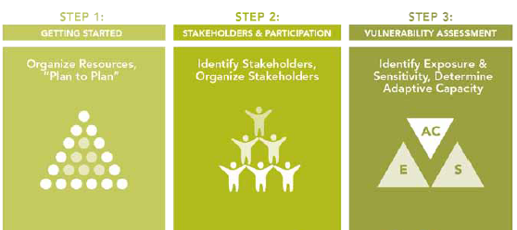
Planning for Climate Change: The planning cycle
Module A
Step 1 Are we ready to undertake a climate change planning process?
Step 2 Who needs to be involved at the city and in the community and how can they be engaged?
Step 3 How is climate change affecting the city and who is most vulnerable to these changes?
The graphic illustrates this module’s three planning steps and major planning tasks.

Slide 4
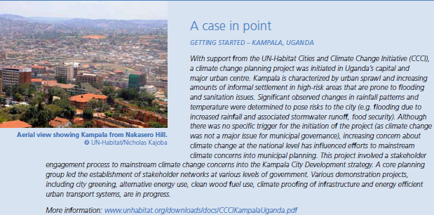
Module A- What is happening?
Planning for Climate Change: The planning cycle
Step 1: Getting started
This planning step involves the following five tasks:
Task 1.1: Frame the challenge
Task 1.2: Get organized
Task 1.3: Form a core planning team
Task 1.4: Determine organizational capacity
Task 1.5: Plan the planning process

Slide 5
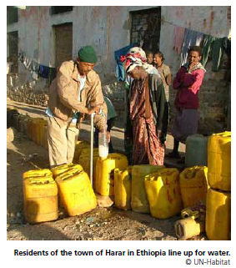
Module A
Planning for Climate Change: The planning cycle
Step 2: Stakeholders and participation
Task 2.1: Identify stakeholders
Task 2.2: Establish a stakeholder advisory group
Task 2.3: Establish a stakeholder advisory group procedures
Task 2.4: Determine the level of the broader community engagement

Slide 6
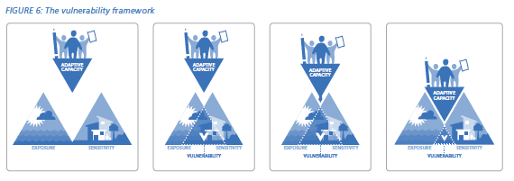
Module A
Planning for Climate Change: The planning cycle
Step 3: Vulnerability assessment
Task 3.1: Exposure analysis
Task 3.2: Sensitivity analysis
Task 3.3: Adaptive capacity analysis
Task 3.4: Summary vulnerability assessment
Task 3.5: Preliminary adaption options identification

Slide 7
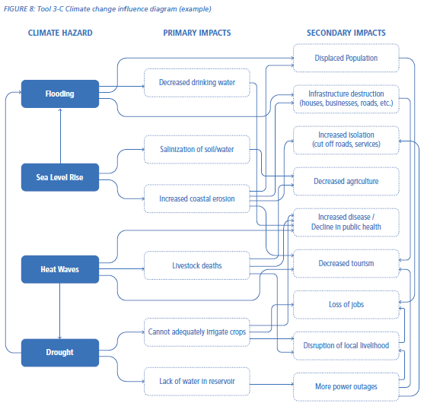
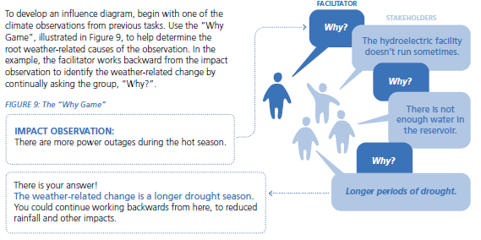
Planning for Climate Change: The planning cycle
Module A

Slide 8
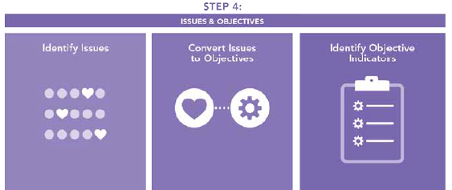
Module B- What matters most?
Planning for Climate Change: The planning cycle
STEP 4
What community and local stakeholder issues must be considered in addition to any existing city objectives when selecting and prioritizing climate change options, and how can they be identified?
Task 4.1: Identify and organize issues
Task 4.2: Restate issues as objectives
Task 4.3: Assess the relevance of objectives to climate change
Task 4.4: Identify gaps in objectives
Task 4.5: Develop indicators for objectives

Slide 9
Planning for Climate Change: The planning cycle
Module B
A values-focused approach vs. an alternatives-focused approach
Most approaches to planning and decision-making focus on determining what alternatives are available to solve a problem rather than why it is a problem in the first place. This type of thinking is referred to as an alternatives-focused approach, and it tends to be reactive. In contrast, a values-focused approach is more proactive. It emphasizes deciding what is important to people (what are the local community’s and stakeholder’s interests and objectives?) and then determines how best to achieve those objectives. Such an approach not only allows a better understanding of the climate change issues confronting the city but can also lead to the development of better, more creative climate change adaptation options or actions.
Why a values-focused approach?
Facts and values
Multiple perspectives
Holistic
Local knowledge
Participatory
Flexible

Slide 10
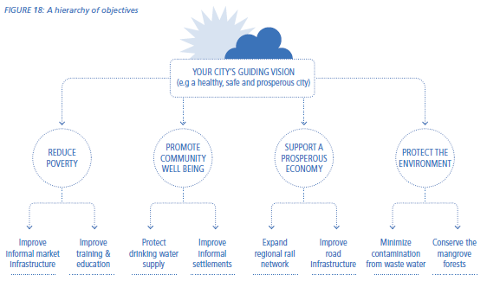
Planning for Climate Change: The planning cycle
Module B
Task 4.2: Restate issues as objectives

Slide 11
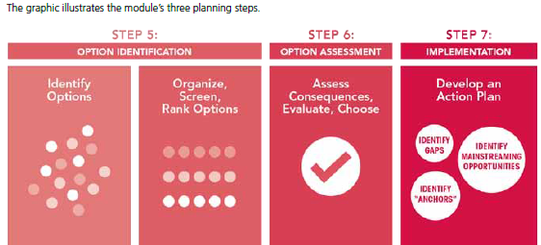
Planning for Climate Change: The planning cycle
Module C- WHAT CAN WE DO ABOUT IT?
STEP 5 What options are there to respond to climate change in our city?
STEP 6 How to assess, screen, and choose the best options to ensure resources, time, and capacity are used most effectively and efficiently?
STEP 7 How can we best implement the prioritized climate change options and assemble a Climate Change Action Plan?
After completing Module C, planners, and stakeholders will have:
Identified, screened, assessed, and prioritized climate change adaptation actions (i.e. projects, policies, programs, actions) according to local objectives and vulnerabilities;
Developed a stand-alone Climate Change Action Plan with a clear implementation framework; and/or
Mainstreamed/integrated climate actions into existing policy instruments, plans, and programs (where practical and feasible).

Slide 12
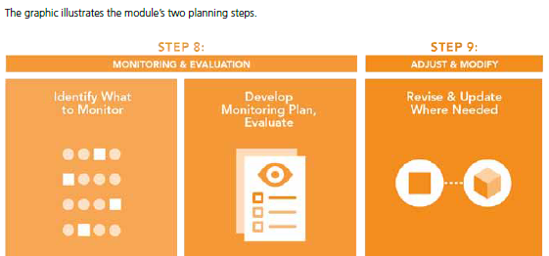
Module D- ARE WE DOING IT?
Planning for Climate Change: The planning cycle
Step 8: How can the progress of the Climate Change Action Plan be tracked to ensure it is having the anticipated impact, and that stakeholders are doing what they agreed to do?
Step 9: How should new information be incorporated into the Climate Change Action Plan or other needed changes be made?
After completing Module D, planners and stakeholders will have:
A clear understanding of what monitoring and evaluation are and why they are critical to the successful implementation of a Climate Change Action Plan
Developed a monitoring and evaluation program for the Climate Change Action Plan to monitor implementation progress, evaluate actions against plan objectives (i.e. is it making a difference?), and share results with stakeholders
Developed a clear timeline for formal Climate Change Action Plan reviews

Slide 13
Further reading
Further reading
World Bank Group Climate Change Action Plan 2021–2025: Supporting Green, Resilient, and Inclusive Development
https://openknowledge.worldbank.org/entities/publication/ee8a5cd7-ed72-542d-918b-d72e07f96c79

Slide 14
Prioritizing Key Systems Transitions
Five key systems—energy; agriculture, food, water, and land; cities; transport; and manufacturing—
together generate over 90 percent of global GHG gas emissions.
They must be transformed to address climate change, achieve a resilient and low-carbon future, and support natural capital and biodiversity. These systems face significant climate change impacts as well, making adaptation action critical across all five. They are also critical to achieving development goals.
ENERGY
The energy sector produces three-quarters of global GHG emissions, and coal combustion alone is responsible for nearly a third. Achieving SDG 7—access to affordable, reliable, sustainable, and modern energy for all by 2030—is seen as crucial to achieving many other SDGs
Scale Up Clean Energy Systems
Green hydrogen
Power System Planning
Fossil Fuel Subsidy Reform
Energy Efficiency
A Just Transition Away from Coal

Slide 15
Prioritizing Key Systems Transitions
AGRICULTURE, FOOD, WATER, AND LAND
Climate-Smart Agriculture
IFC will focus on three strategic themes: (i) helping to improve productivity while reducing input use and GHG emissions per ton of output, especially through precision farming and regenerative or conservation agriculture; (ii) making livestock production more sustainable while increasing productivity; and (iii) reducing postharvest losses in supply chains globally
Food Loss and Waste
Nature-Based Solutions
Water
Carbon Sinks
Blue Economy
De-Risking Private Investment
CITIES
Planning for Low-Carbon and Resilient Cities
Green Buildings
Integrated Waste Management and Circular Economy

Slide 16
Prioritizing Key Systems Transitions
TRANSPORT
Mobility and Access
Logistics and Freight
Resilient Transport Systems
MANUFACTURING
Base materials are inherently GHG-intensive, but they currently have no technically and economically viable substitutes that can offer similar functions at scale.
The Bank is looking to maximize its climate impact through the Circular Economy for Private Sector Development Program (CEPSD)
Achieving SDG 12— sustainable consumption and production patterns—via resource efficiency, low-carbon solutions, and circularity. Digitalization of industries will greatly affect production efficiency and enable the viability of circular economy solutions

Slide 17
Further reading
World Bank Group Climate Change Action Plan 2021–2025: Supporting Green, Resilient, and Inclusive Development
https://openknowledge.worldbank.org/entities/publication/ee8a5cd7-ed72-542d-918b-d72e07f96c79

