Slide 1
CCP-LAW
Curricula development on Climate Change Policy and Law
Subject title: Introduction to the UNFCCC and its role in EU’s transition to a low carbon economy
Instructor Name: PROF ABHINAV SHRIVASTAVA AND Dr. RAJ VARMA
Project No of Reference: 618874-EPP-1-2020-1-VN-EPPKA2-CBHE-JP:
The European Commission's support for the production of this publication does not constitute an endorsement of the contents, which reflect the views only of the authors, and the Commission cannot be held responsible for any use which may be made of the information contained therein.

Slide 2
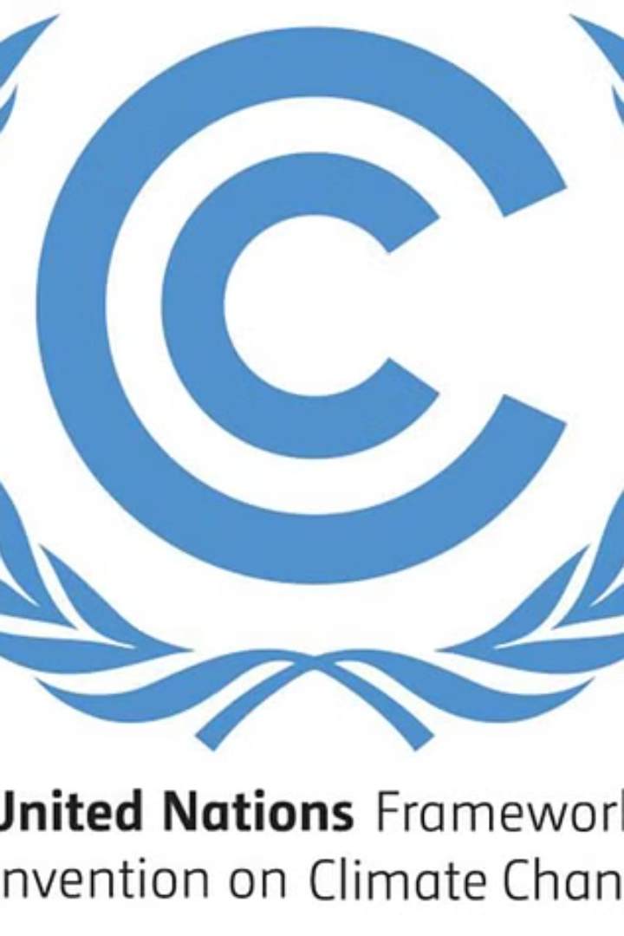
Introduction
The United Nations Framework Convention on Climate Change (UNFCCC) is an international environmental treaty that aims to stabilize greenhouse gas concentrations in the atmosphere to prevent dangerous human-induced interference with the climate system.

Slide 3
Overview of the UNFCCC
Global Treaty
Membership and Governance
The United Nations Framework Convention on Climate Change (UNFCCC) is a global treaty established in 1992 to address the threat of climate change.
The UNFCCC has near-universal membership, with 197 countries as Parties, and is overseen by a Conference of the Parties (COP) that meets annually.
Objective and Principles
Scientific Basis
The UNFCCC's objective is to stabilize greenhouse gas concentrations in the atmosphere at a level that prevents dangerous human interference with the climate system.
The UNFCCC is guided by the latest climate science, as provided by the Intergovernmental Panel on Climate Change (IPCC).

Slide 4
Key objectives of the UNFCCC
Stabilize greenhouse gas concentrations in the atmosphere at a level that would prevent dangerous human-induced interference with the climate system
Ensure sustainable development and adapt to the impacts of climate change
Promote the equitable implementation of the Convention through the principle of common but differentiated responsibilities and respective capabilities

Slide 5
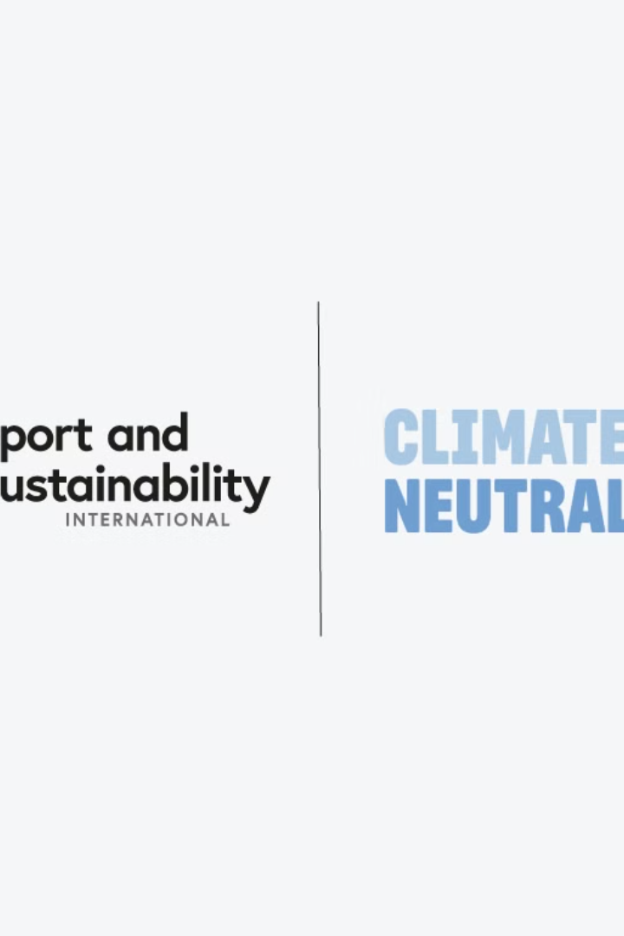
UNFCCC's Role in Global Climate Action
The UNFCCC plays a crucial role in driving global efforts to address climate change. It provides a framework for countries to cooperate, share knowledge, and coordinate actions to reduce greenhouse gas emissions and adapt to the impacts of climate change.
By facilitating international negotiations and agreements, the UNFCCC has been instrumental in mobilizing countries to take concrete steps towards a low-carbon future, such as setting emissions reduction targets and implementing policies to promote renewable energy and energy efficiency.

Slide 6
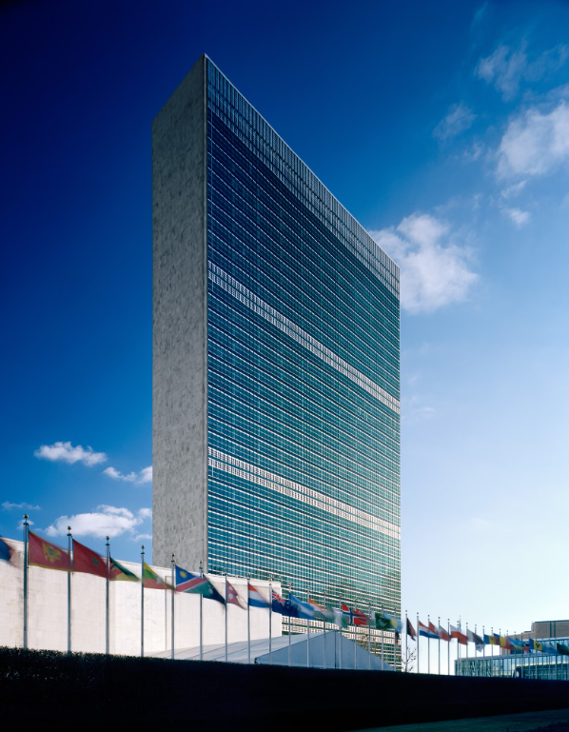
UNFCCC's Structure and Governance
The UNFCCC has a complex structure with several governing bodies and mechanisms to facilitate global climate action. At the heart of its governance is the Conference of the Parties (COP), which brings together representatives from 197 member countries.
The COP is supported by subsidiary bodies that provide scientific and technical advice, as well as financial mechanisms to assist developing countries in their climate efforts.

Slide 7
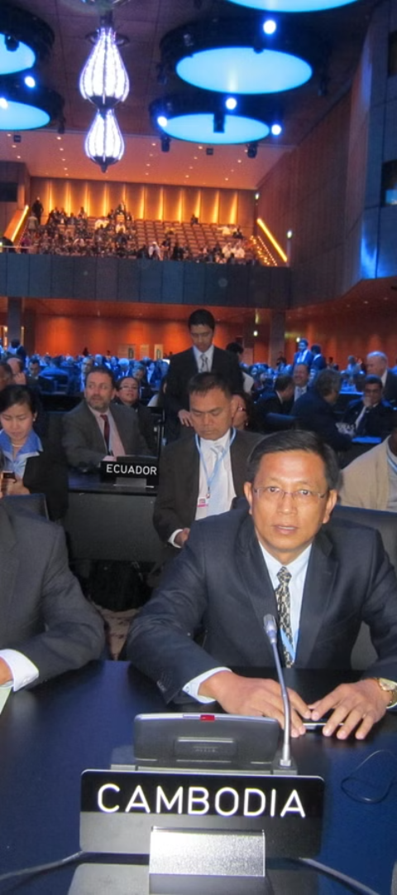
UNFCCC's Decision-Making Process
1
Conference of the Parties (COP)
The annual meeting of all countries that have ratified the UNFCCC, where major decisions are made through consensus-based negotiations.
2
Subsidiary Bodies
Two permanent subsidiary bodies provide advice on scientific, technological, and implementation matters to guide the COP's decisions.
3
Secretariat
The UNFCCC Secretariat coordinates the global climate change negotiations and supports the implementation of the Convention.

Slide 8
UNFCCC's Kyoto Protocol
1
Adoption of the Kyoto Protocol
2
Binding Emission Reduction Targets
The Kyoto Protocol was adopted in 1997 as a legally binding agreement under the UNFCCC, requiring developed countries to reduce their greenhouse gas emissions.
The protocol set binding emissions reduction targets for developed countries, with the goal of reducing overall emissions by at least 5% below 1990 levels by 2008-2012.
3
Flexible Mechanisms
4
Criticism and Withdrawal
The protocol introduced flexible mechanisms like emissions trading, the clean development mechanism, and joint implementation to help countries meet their targets.
The protocol faced criticism and the withdrawal of the US, but it represented an important milestone in global climate cooperation.

Slide 9
UNFCCC's Paris Agreement
Legally Binding
1
The Paris Agreement is a legally binding international treaty
Global Commitment
2
Commits nearly all countries to take action on climate change
Emissions Reductions
3
Aims to limit global warming to well below 2°C above pre-industrial levels
The Paris Agreement, adopted in 2015, is the central pillar of the UNFCCC's efforts to address climate change globally. It established a framework for all countries to voluntarily set emissions reduction targets and report on their progress. The agreement is legally binding, marking a historic global commitment to tackling the climate crisis.

Slide 10
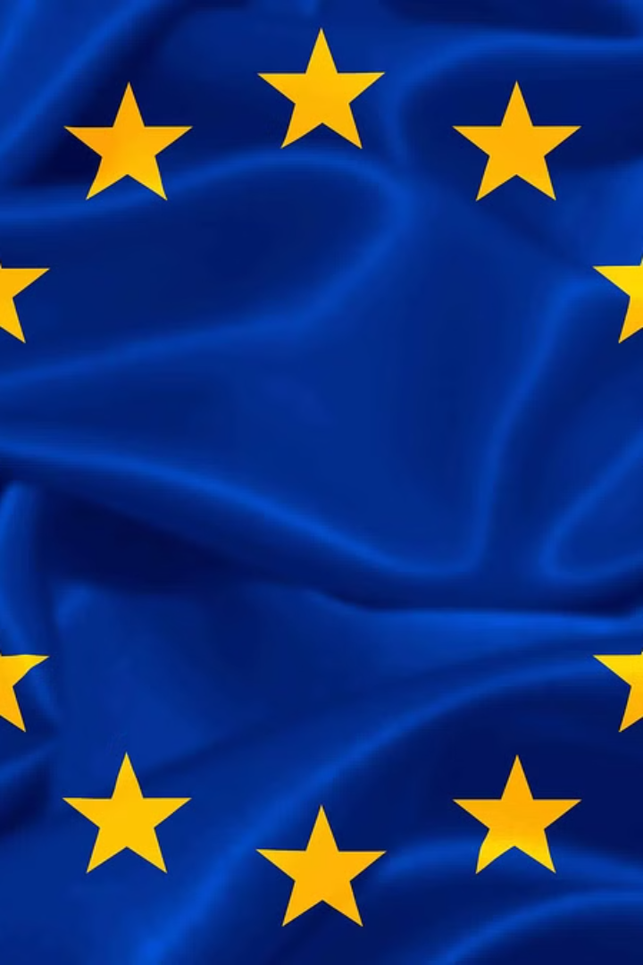
EU's Commitment to the UNFCCC
The European Union (EU) has been a strong supporter and active participant in the United Nations Framework Convention on Climate Change (UNFCCC) since its inception. As a regional economic integration organization, the EU plays a crucial role in global climate action.
The EU has pledged to take ambitious steps to reduce greenhouse gas emissions and transition towards a low-carbon economy, in line with the UNFCCC's goals and targets.

Slide 11
EU's Climate and Energy Policies
Ambitious Goals
Energy Efficiency
Emissions Trading
Renewable Energy
The EU has set ambitious targets to reduce greenhouse gas emissions and increase renewable energy production by 2030.
The EU's energy efficiency directive aims to improve buildings, appliances, and industrial processes to use less energy.
The EU Emissions Trading System (EU ETS) is the world's largest carbon market, capping emissions from key industries.
The EU has policies to increase wind, solar, and other renewable energy sources to replace fossil fuels.

Slide 12
EU's transition to a low-carbon economy
1
Policy Frameworks
Comprehensive climate and energy policies
2
Emissions Reduction
Binding emissions targets and carbon pricing
3
Renewable Energy
Ambitious renewable energy targets and investments
Energy Efficiency
4
Stringent energy efficiency standards and programs
The European Union has embarked on an ambitious transition towards a low-carbon economy, driven by its commitment to the UNFCCC and its own climate and energy policies. This multi-faceted effort encompasses robust policy frameworks, binding emissions reductions targets, the expansion of renewable energy, and a focus on improving energy efficiency across the continent.

Slide 13
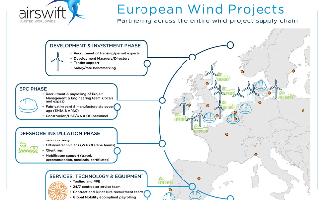
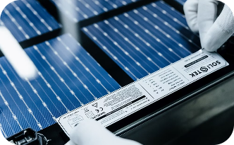
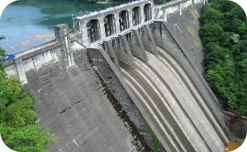
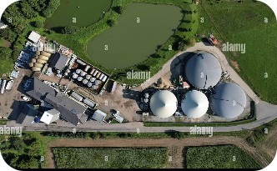
Renewable energy in the EU
Wind Power
Solar Energy
Hydropower
Bioenergy
The EU is a global leader in wind energy, with over 170 GW of installed wind capacity, meeting nearly 15% of Europe's electricity demand.
Solar photovoltaic capacity in the EU has grown exponentially, with over 130 GW installed, making the union a major player in the global solar market.
Hydroelectric power has long been a mainstay of the EU's renewable energy mix, with over 120 GW of installed capacity, largely from plants in Nordic and Alpine countries.
The EU is also a leader in bioenergy, with over 50 GW of installed capacity, generating power and heat from sustainable biomass and waste sources.

Slide 14
Energy Efficiency in the EU
Building Upgrades
The EU has set strict energy efficiency standards for new buildings and is investing heavily in retrofitting existing structures to improve insulation and reduce energy consumption.
Industrial Modernization
EU policies are driving industrial facilities to adopt the latest energy-efficient technologies and processes, cutting waste and emissions across key sectors.
Transportation Transformation
From electric vehicles to high-speed rail, the EU is revolutionizing its transportation systems to maximize energy efficiency and reduce reliance on fossil fuels.

Slide 15
EU's emissions trading system
The EU's emissions trading system (EU ETS) is a cornerstone of the EU's climate policy. It is the world's largest carbon market, covering around 40% of the EU's greenhouse gas emissions. The EU ETS aims to reduce emissions cost-effectively by setting a cap on the total amount of certain greenhouse gases that can be emitted.
Under the EU ETS, companies receive or buy emission allowances, which they can trade as needed. This creates a price for carbon and provides an incentive for companies to invest in clean technologies and reduce their emissions.
Sector Coverage
Power generation, energy-intensive industries, aviation
Cap on Emissions
Reduced by 2.2% annually to reach climate targets
Allowance Trading
Companies can buy, sell, and bank allowances to meet their obligations
Compliance Mechanism
Companies must surrender allowances equal to their annual emissions

Slide 16
Challenges in the EU's low-carbon transition
$1T
—
Cost
Transition cost
Transforming the EU's energy infrastructure to low-carbon will require over $1 trillion in investment.
2030
—
Emissions target
2030 emissions goal
The EU aims to reduce greenhouse gas emissions by at least 55% by 2030, an ambitious target requiring extensive changes.
40%
—
Energy mix
Renewable energy share
Reaching the EU's goal of 40% renewable energy by 2030 will be a major challenge, requiring rapid deployment of wind, solar and other clean sources.

Slide 17
Opportunities in the EU's low-carbon transition
Renewable Energy Investment
Energy Efficiency Upgrades
Green Infrastructure
Clean Tech Job Creation
Increased investment in renewable sources like solar, wind, and hydropower presents significant economic opportunities for the EU to generate clean energy and create green jobs.
Improving energy efficiency in buildings, transportation, and industry can lower energy costs, reduce emissions, and spur innovation in sustainable technologies.
Investing in green infrastructure like public transit, smart grids, and carbon capture technology can modernize the EU's economy and make it more environmentally resilient.
The transition to a low-carbon economy will create new job opportunities in renewable energy, energy efficiency, electric vehicles, and other emerging clean technologies.

Slide 18
Conclusion: UNFCCC's impact on the EU's low-carbon future
The UNFCCC has been a driving force behind the EU's ambitious transition to a low-carbon economy. By setting global targets and frameworks, the UNFCCC has galvanized the EU to enact comprehensive climate and energy policies that have transformed its energy landscape. The UNFCCC's influence has been crucial in accelerating the EU's shift to renewable energy, improving energy efficiency, and establishing an effective emissions trading system.
As the world looks to the future, the EU's continued commitment to the UNFCCC and its decarbonization goals will be vital in shaping a sustainable, low-carbon global economy. The path ahead may be challenging, but the EU's leadership and the UNFCCC's guidance will be instrumental in overcoming obstacles and seizing the opportunities presented by the low-carbon transition.

