Slide 1
CCP-LAW
Curricula development on Climate Change Policy and Law
Subject title: Climate Change and Human Rights
Instructor Name: Dr. Albert Lladó Martínez
Project No of Reference: 618874-EPP-1-2020-1-VN-EPPKA2-CBHE-JP:
The European Commission's support for the production of this publication does not constitute an endorsement of the contents, which reflect the views only of the authors, and the Commission cannot be held responsible for any use which may be made of the information contained therein.

Slide 2
Topic 3. Right to Development and Climate Change in Focus
OVERVIEW
TOPIC 3.1 Key elements and principles of right to development and international climate law and policies
TOPIC 3.2 Key actors who operate the right to development in climate action and the role of international cooperation

Slide 3
Topic 3. Right to Development and Climate Change in Focus
Topic 3.1
The 2030 Agenda for Sustainable Development (preamble):
(The Sustainable Development Goals) “seek to build on the Millennium Development Goals and complete what these did not achieve. They seek to realize the human rights of all and to achieve gender equality and the empowerment of all women and girls. They are integrated and indivisible and balance the three dimensions of sustainable development: the economic, social and environmental.”

Slide 4
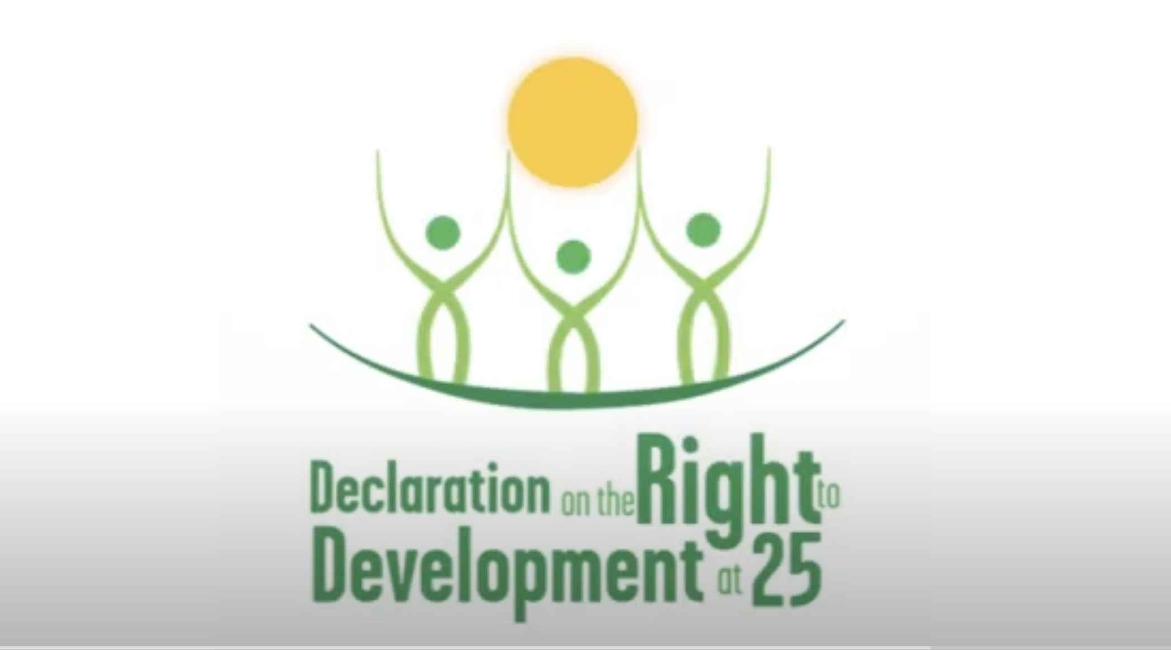
Topic 3. Right to Development and Climate Change in Focus
Video (3 min) – UN: The Right to Development
Topic 3.1
https://youtu.be/0hxhZd-zPP0?si=5FQzJU6TKqdQw_Q0

Slide 5
Topic 3. Right to Development and Climate Change in Focus
The Paris Agreement
Topic 3.1
The Paris Agreement aims to create a balance between the right to development and the need to combat climate change by promoting differentiated responsibilities, financial and technological support, and encouraging sustainable development pathways that align with global climate goals.

Slide 6
Topic 3. Right to Development and Climate Change in Focus
The Paris Agreement: Right to Development (1/4)
Topic 3.1
Recognition of Differentiated Responsibilities:
The Paris Agreement acknowledges the principle of "common but differentiated responsibilities" (CBDR), meaning that while all countries are responsible for climate action, the obligations vary based on their individual capacities and development levels. This aims to ensuree that developing countries can pursue economic growth while adapting to climate goals.

Slide 7
Topic 3. Right to Development and Climate Change in Focus
The Paris Agreement: on the Right to Development (2/4)
Topic 3.1
Nationally Determined Contributions (NDCs):
Countries are required to outline their NDCs, detailing how they will reduce greenhouse gas emissions and adapt to climate change. This mechanism respects each nation's right to pursue development while contributing to global climate goals. Developing countries are encouraged to increase their efforts based on their capacity, allowing them to balance development needs with environmental responsibilities.

Slide 8
Topic 3. Right to Development and Climate Change in Focus
The Paris Agreement: on the Right to Development (3/4)
Topic 3.1
Long-Term Development Strategies:
The agreement encourages nations to develop “long-term low greenhouse gas emission development strategies” (LT-LEDS). These strategies are non-binding but allow countries to align climate actions with their development priorities, ensuring that economic growth is not sacrificed for climate goals.

Slide 9
Topic 3. Right to Development and Climate Change in Focus
The Paris Agreement: on the Right to Development (4/4)
Topic 3.1
Financial Support:
The Paris Agreement emphasizes that developed countries should lead in providing financial support to developing nations. This support is vital for these countries to build climate resilience and adopt low-carbon technologies without undermining their development ambitions. There is a strong focus on “climate finance” to support both mitigation and adaptation efforts in vulnerable regions.

Slide 10
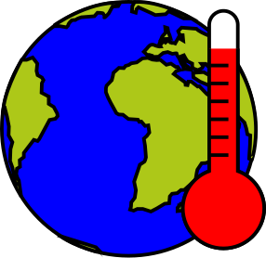
Topic 3. Right to Development and Climate Change in Focus
The Paris Agreement: on Climate Change (1/3)
Topic 3.1
Limiting Global Temperature Increase
The core goal of the Paris Agreement is to keep the global temperature rise well below 2°C and to pursue efforts to limit it to 1.5°C. This is critical to preventing severe climate impacts that disproportionately affect developing nations, which are often less equipped to deal with such effects.

Slide 11
Topic 3. Right to Development and Climate Change in Focus
The Paris Agreement: on Climate Change (2/3)
Topic 3.1
Mitigation and Adaptation:
The agreement promotes actions aimed at both “mitigation” (reducing emissions) and “adaptation” (dealing with climate impacts). It recognizes that adaptation is a global challenge with local, national, and international dimensions, which ties directly to development needs, particularly in countries that are most vulnerable to climate risks.

Slide 12
Topic 3. Right to Development and Climate Change in Focus
The Paris Agreement: on Climate Change (3/3)
Topic 3.1
Technology Transfer and Capacity Building:
The agreement encourages “technology transfer” to developing countries, allowing them to grow their economies using low-carbon technologies. It also stresses “capacity building”, helping these nations build the necessary infrastructure and human capital to tackle climate change while fostering development.

Slide 13
Topic 3. Right to Development and Climate Change in Focus
Key actors on the right to development in climate action and the role of international cooperation
Topic 3.2
This topic stresses the importance of collaboration among national governments, international organizations, the private sector, and civil society in ensuring that climate action supports the right to development.
This key actors outline the need for significant financial support, technology transfer, and capacity building to assist developing nations in adapting to climate change without compromising their development. Moreover, international cooperation is essential in providing funds, fostering technology transfers, and ensuring that climate action does not exacerbate inequalities but instead promotes sustainable and equitable development for all.

Slide 14
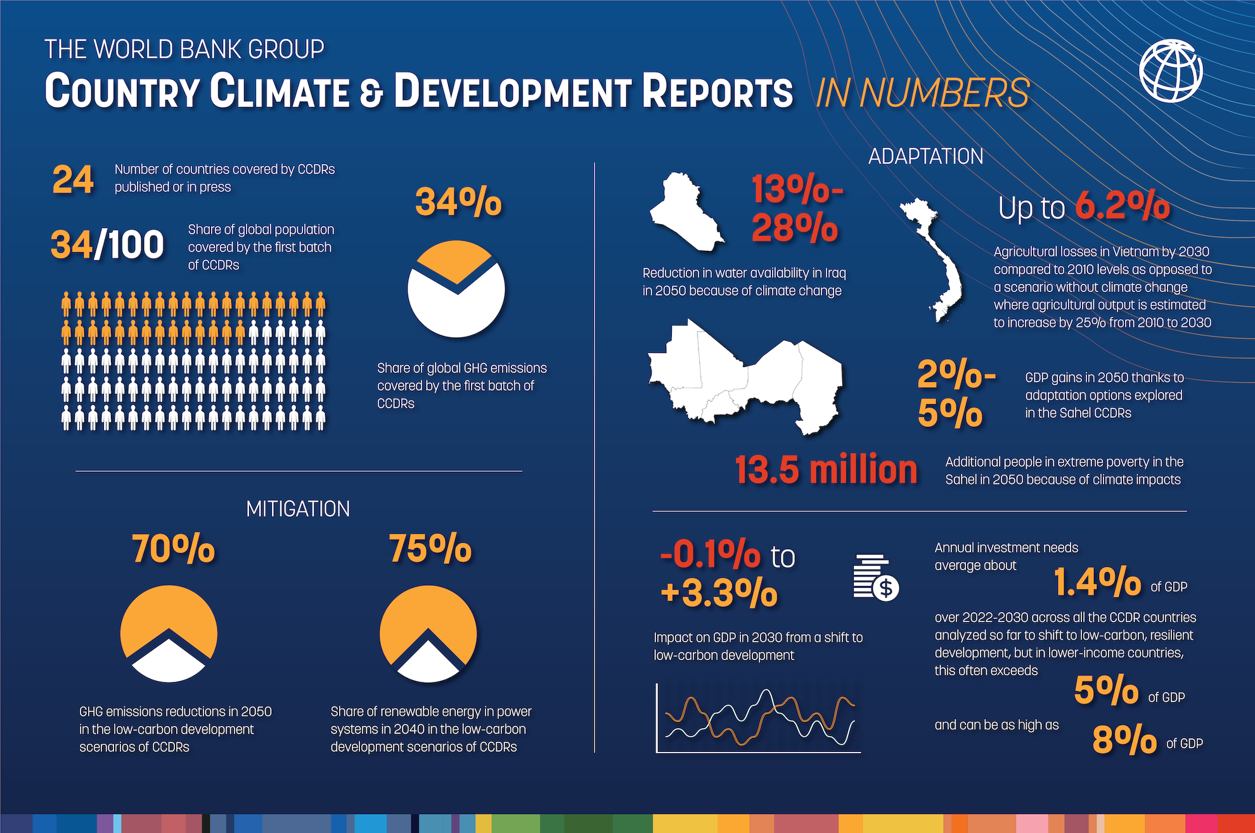
Topic 3. Right to Development and Climate Change in Focus
Key Actors in Climate Action and the Right to Development
Topic 3.2
1. Governments:
National governments are central to ensuring that development aligns with climate action while promoting human rights, including the right to development. They must integrate climate mitigation and adaptation strategies into national development plans.
World Bank: Infographic - Country Climate and Development Reports in Numbers

Slide 15
Topic 3. Right to Development and Climate Change in Focus
Key Actors in Climate Action and the Right to Development
Topic 3.2
Governments are also tasked with addressing vulnerable populations, ensuring their participation in decision-making processes, particularly when it comes to development projects and climate policies​.
Environmental safeguards must be enforced by governments to ensure development projects adhere to human rights standards​

Slide 16
Topic 3. Right to Development and Climate Change in Focus
Key Actors in Climate Action and the Right to Development
Topic 3.2
2. International Organizations:
The UNFCCC and its Paris Agreement are key to addressing the interplay between climate change and the right to development. These frameworks require that international efforts respect human rights, support sustainable development, and ensure that developing countries are partners in global mitigation efforts​.
The Green Climate Fund and other multilateral mechanisms provide crucial financial and technical support to developing countries. These mechanisms are essential for enabling developing countries to adapt to climate change and mitigate its impacts without undermining their development prospects​.

Slide 17
Topic 3. Right to Development and Climate Change in Focus
Key Actors in Climate Action and the Right to Development
Topic 3.2
3. Civil Society and NGOs:
Civil society plays an important role in ensuring that climate action is both inclusive and just. They advocate for climate justice and help raise awareness among marginalized communities about their rights under international agreements like the Paris Agreement​.
NGOs also facilitate data collection and the monitoring of development projects, ensuring that communities most affected by climate change are heard and their interests are considered in national and international policies.

Slide 18
Topic 3. Right to Development and Climate Change in Focus
Key Actors in Climate Action and the Right to Development
Topic 3.2
4. Private Sector:
Businesses are increasingly being encouraged to adopt green technologies and contribute to climate goals by reducing their environmental impact. Involvement of the private sector must align with sustainable development principles, and businesses must also respect human rights in their operations​.

Slide 19
Topic 3. Right to Development and Climate Change in Focus
The Role of International Cooperation
Topic 3.2
1. Financial Support and Climate Finance:
International cooperation is pivotal in providing financial resources for climate adaptation and mitigation in developing countries. This includes ensuring adequate climate finance flows through mechanisms such as the before seen Green Climate Fund and other multilateral institutions​.

Slide 20
Topic 3. Right to Development and Climate Change in Focus
The Role of International Cooperation
Topic 3.2
Developed countries bear a historical responsibility to assist developing nations by contributing to adaptation funds, fostering technology transfers, and ensuring that climate finance is used effectively to support the right to development​.

Slide 21
Topic 3. Right to Development and Climate Change in Focus
The Role of International Cooperation
Topic 3.2
2. Technology Transfer and Capacity Building:
Technology transfer is critical in helping developing countries adopt low-carbon technologies without hindering their development goals. The policy brief highlights the need for capacity building in developing countries to enhance their ability to implement climate mitigation and adaptation strategies​.
A coordinated effort to strengthen global capacity-building efforts should involve both the North-South and South-South exchanges, where developed nations provide the necessary technology and expertise​.

Slide 22
Topic 3. Right to Development and Climate Change in Focus
The Role of International Cooperation
Topic 3.2
3. Loss and Damage:
The reports underline the increasing relevance of loss and damage caused by climate change, which disproportionately affects developing countries. The UN’s Warsaw International Mechanism and the Paris Agreement’s Article 8 are examples of frameworks where international cooperation is needed to provide compensation and support to countries suffering irreversible climate damage​.
The UN’s Santiago Network is highlighted as an operational tool to ensure that resources for loss and damage reach the most vulnerable populations​.

Slide 23
Topic 3. Right to Development and Climate Change in Focus
The Role of International Cooperation
Topic 3.2
4. Equity and Global Participation:
Climate action must be equitable, respecting the principle of common but differentiated responsibilities. This principle underlines the need for international cooperation to address the disproportionate impact of climate change on poorer and vulnerable nations while allowing them to continue pursuing their development goals​.

Slide 24
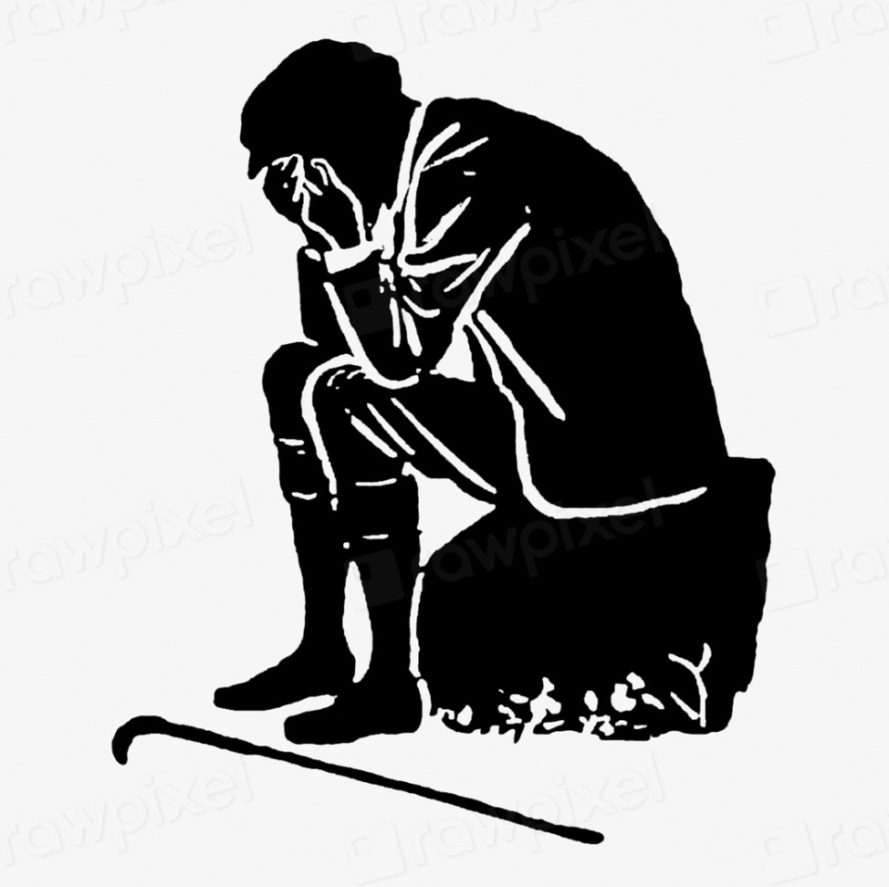
Topic 3. Right to Development and Climate Change in Focus
The Role of International Cooperation
Topic 3.2
Governments and international institutions are encouraged to create more inclusive frameworks that ensure the participation of marginalized communities, including women, indigenous peoples, and those living in extreme poverty, in climate policy design​.

Slide 25
Topic 3. Right to Development and Climate Change in Focus
Recent decisions of the European Court of Human Rights
on the responsibility of governments for addressing climate change with alignment with human rights
Verein KlimaSeniorinnen Schweiz and Others v. Switzerland (Application no. 53600/20)
The ECHR ruling in this case establishes that Switzerland failed in its positive obligations under human rights law by not implementing adequate climate change mitigation and adaptation measures. The Court found that this inaction violated Article 8 (private and family life), holding that the State has a duty to protect individuals from the adverse effects of climate change. Although individual applicants did not meet the victim status criteria, the association representing vulnerable populations was recognized as having standing. The judgment reinforces the idea that States are responsible for addressing climate change in ways that align with their human rights obligations.

Slide 26
Topic 3. Right to Development and Climate Change in Focus
Recent decisions of the European Court of Human Rights
on the responsibility of governments for addressing climate change with alignment with human rights
Carême v. France (Application no. 7189/21) – Decision of 09/04/2024
The ECHR declared the application inadmissible, primarily on the grounds of lack of victim status. The Court held that the applicant did not demonstrate a sufficiently concrete and imminent risk to his personal life, family, or property from climate change. Additionally, the applicant’s legal standing as a former mayor did not provide grounds to represent the municipality of Grande-Synthe in this case, as the municipality’s interests had been addressed through other domestic legal actions.

Slide 27
Topic 3. Right to Development and Climate Change in Focus
Key takeaways: Elements of the Right to Development and Climate Change
1. The Paris Agreement:
Aims to balance the right to development with the need for global climate action through differentiated responsibilities.
Encourages Nationally Determined Contributions (NDCs) and long-term development strategies that align economic growth with climate goals.
Emphasizes financial support from developed to developing nations to enable sustainable development without sacrificing climate action.

Slide 28
Topic 3. Right to Development and Climate Change in Focus
Key takeaways: Elements of the Right to Development and Climate Change
2. Mitigation and Adaptation:
The Paris Agreement targets limiting global temperature rise to 1.5°C and stresses both mitigation (emission reduction) and adaptation (addressing impacts) to protect vulnerable countries.
Promotes technology transfer and capacity building to support developing countries in climate-resilient growth.

Slide 29
Topic 3. Right to Development and Climate Change in Focus
Key takeaways: Main actors and international cooperation
1. Governments and International Organizations:
Governments must integrate climate mitigation and adaptation strategies into national development plans.
UNFCCC, the Paris Agreement, and the Green Climate Fund are pivotal in supporting developing nations through financial and technical assistance.
2. Civil Society and Private Sector:
NGOs and civil society advocate for climate justice and ensure the inclusion of vulnerable populations in climate policies.
The private sector plays a critical role in adopting green technologies and aligning their operations with sustainable development goals.

Slide 30
Topic 3. Right to Development and Climate Change in Focus
Key takeaways: Main actors and international cooperation
3. International Cooperation:
Cooperation is vital for providing financial resources, technology transfer, and addressing loss and damage in vulnerable regions.
Equity in climate action must be prioritized, ensuring that marginalized communities participate in climate policy decisions.

