Slide 1
CCP-LAW
Curricula development on Climate Change Policy and Law
Subject title: Climate Change Policy
Instructor Name: Dr. Rahul Nikam
Project No of Reference: 618874-EPP-1-2020-1-VN-EPPKA2-CBHE-JP:
The European Commission's support for the production of this publication does not constitute an endorsement of the contents, which reflect the views only of the authors, and the Commission cannot be held responsible for any use which may be made of the information contained therein.

Slide 2
From Design to Administration: Practical Application of a Carbon Tax
1. Introduction
A functional administration is required to ensure that the carbon tax legislation is effective and serves as an operational instrument to reach a country’s intended goals. These administrative provisions may involve several institutional levels depending on the jurisdiction, and they are likely to be decided on during various steps in the implementation process.
2. General issues in tax administration
The principal role of the administration of a carbon tax, as well as any other tax, is to guarantee that the revenue is collected in line with the provisions laid down by the legislation. The administration of a carbon tax is mainly affected by the design choice of whether to tax direct emissions or fuels

Slide 3
From Design to Administration: Practical Application of a Carbon Tax
The major elements of how to administer a carbon tax should be laid down by the legislation. Most jurisdictions use an act (law or statute) passed by a national parliament or similar body. However, the decision-making levels that regulate the details of administration may vary across jurisdictions. Once the legislation establishing the tax has been enacted, secondary legal acts, sectoral regulations, newsletters, or other administrative provisions are often used to facilitate day-today management. When setting these rules, attention should be paid to generating the necessary information for enabling their continuous improvement.

Slide 4
From Design to Administration: Practical Application of a Carbon Tax
3. General issues in carbon tax administration
3.1 Institutions and their responsibilities
At an early stage in the design process, policymakers should decide on the public agency responsible for administering the carbon tax and subsequently allocating the necessary funds to cover the administrative costs (e.g., sufficient human resources and adequate technologies).
Administration agencies/ administrative authorities.

Slide 5
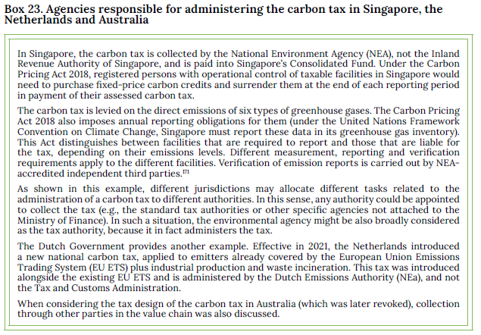
From Design to Administration: Practical Application of a Carbon Tax

Slide 6
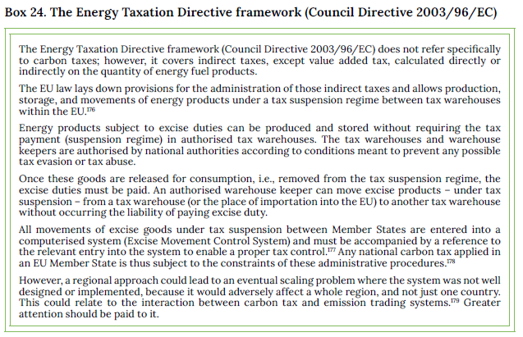
From Design to Administration: Practical Application of a Carbon Tax

Slide 7
From Design to Administration: Practical Application of a Carbon Tax
3.2 Stakeholders and public engagement
Administering consultations prior to enactment
Given the nature of carbon taxation, public consultations should engage a broad group of stakeholders. These should range from potential agencies given the task of administering the tax, tax authorities, other relevant agencies, as well as business organizations, trade and consumer organisations representing their members who are likely to face the tax burden, and tax advisors or accountants. Environmental and technical experts may also be relevant. For example, in Sweden and France.
Information campaigns and post-enactment administration

Slide 8
From Design to Administration: Practical Application of a Carbon Tax
3.3 Transition period considerations
Policymakers must allow a reasonable time period between the enactment of a new carbon tax and the date when the legislation will come into force. For example, Chile chose three years.
Sweden’s tax on the sulphur content in fuels was approved by Parliament in 1990 and came into effect in 1993. By then, fuel producers had already lowered the sulphur content below the taxable level in most of the volumes of fuels sold.

Slide 9
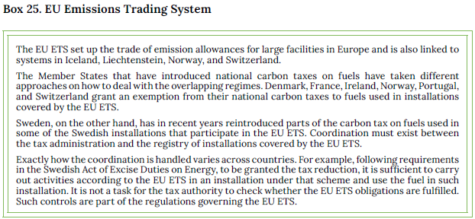
From Design to Administration: Practical Application of a Carbon Tax
3.4 Coordination with overlapping policy instruments
Overlapping policy instruments such as fuel taxes, energy contracts and Emission Trading Systems (ETS).

Slide 10
From Design to Administration: Practical Application of a Carbon Tax
4. Core features of the carbon tax
Taxable event (occurrence of what chargeable events should make the tax due, e.g., extraction, sale or consumption of fuel volumes or actual emissions).
• Taxpayer (who should pay the tax to the public authorities?).
• Tax base and tax rate(s) (what is to be taxed and by which amount?).
• Public body to administer the tax or oversee its administration.
• Tax declaration period (timeframe to provide data or file the return).
• Information to be given in the tax declaration (concerning the taxpayer or other third parties).

Slide 11
From Design to Administration: Practical Application of a Carbon Tax
• Administration of possible tax exemptions or other reductions (fiscal benefits) that the taxpayer may apply in the carbon tax declaration.
• Administration of reducing the facility’s tax burden if other market features such as crediting, or emission offsetting schemes are applied. Such features reduce the facility´ s tax burden by reducing emissions in third party facilities. Typically, these schemes are based on some form of compensation or payment to both tax and/or non-tax liable entities and require some emissions’ reduction verification system by the authority.
• Control mechanisms and tax enforcement regime (penalties in carbon taxation do not present any speciality and usually can be referred to the general applicable regime).

Slide 12
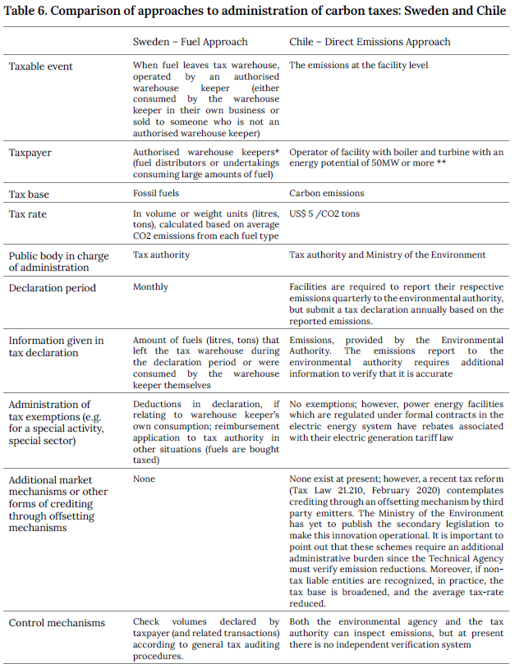
From Design to Administration: Practical Application of a Carbon Tax

Slide 13
From Design to Administration: Practical Application of a Carbon Tax

Slide 14
From Design to Administration: Practical Application of a Carbon Tax
5. Considerations regarding detailed administrative regulations to manage the carbon tax
Administrative regulations required include the following:
• Criteria for registering taxpayers and the associated timeframe for registration.
• Various forms, such as tax returns (declarations) and book-keeping.
• Information that taxpayers need to include in each declaration.
• Tax exemptions and reimbursements.
• Period to file the tax return.
• Securing the payment of the tax due.
• Liability thresholds.
• Control mechanisms and emissions reporting.
• Compliance and enforcement mechanisms.

Slide 15
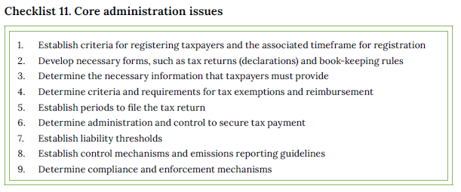
From Design to Administration: Practical Application of a Carbon Tax

Slide 16
Further Reading
Adame Martínez, F. (2019). “Los tributos ambientales en España” (Environmental taxes in Spain), Chapter 23, in Cubero Truyo, A.; Masbernat, P. (dirs.): Protección del medio ambiente. Fiscalidad y otras medidas del derecho al desarrollo, Thomson Reuters Aranzadi, Cizur Menor, 2019, pp. 322-327 and 354-355.
KPMG. (2019). “Carbon Tax: A Burning Issue.” https://assets.kpmg/content/dam/kpmg/xx/pdf/2019/02/tnf-south-africa-feb25-2019.pdf
Marcu, A., et al. (2018). “2018 State of the EU ETS Report.” ERCST, Wegener Center, NomismaEnergia, I4CE and Ecoact. https://www.i4ce.org/wp-core/wp-content/uploads/2018/04/20180416-2018-State-of-EU-ETS-Report-Final-all-logos_-1.pdf

Slide 17
Further Reading
Pizarro, R., Pinto, F., & Ainzúa, S. (2017). "Institutional Infrastructure for Chile’s Green Taxes; Creationand Implementation of a Measurement, Reporting and Verification (MRV) System; Capacity-building for the implementation of Chile’s Green Tax.” Chile’s Green Tax, Ministerio de MedioAmbiente. https://www.4echile.cl/mercado-global-del-carbono-chile/
Rocamora, A. (2017). ‘The Rise of Carbon Taxation in France: From Environmental Protection to Low-Carbon Transition.” IGES Working Paper. https://www.iges.or.jp/en/publication_documents/pub/workingpaper/en/5983/The_Rise_of_Carbon_Taxation_in_France_Rocamora_May_2017.pdf

Slide 18
Revenue Use
1. Introduction
Carbon taxes may raise significant revenues. Therefore, governments, particularly in developing countries with low tax-to-Gross Domestic Product (GDP) ratios, may want to consider carbon taxes as a source for domestic resource mobilization in addition to their role as an environmental policy instrument.
2. Options for revenue use
2.1 Compensation for vulnerable industries
Carbon taxes increase costs, particularly in energy-intensive industries; this can trigger carbon leakage (production moving to places with lower carbon costs) and reduce the ability of firms to compete internationally.
Two mechanisms can be used to address competitiveness concerns. First, revenue-recycling measures. This implies direct financial transfers to companies based on output, or financial support for efficiency improvements. Second, measures that reduce tax rates and/or targeted tax exemptions; however, they may result in the loss of revenues and reduced environmental effectiveness.
Two design principles should be considered. First, compensations should only benefit companies (or facilities) that are highly exposed to international trade and face significant cost increases because of the carbon tax. Second, compensations should be designed in a way that maintains the incentive to reduce carbon emissions.

Slide 19
Revenue Use
Instead of using tax exemptions or transfers, governments can also address the leakage and competitiveness concerns with measures such as tariffs on imports of highly traded emission-intensive commodities, which are known as Carbon Border Adjustment Mechanisms (CBAM).
2.2 Compensation for households
Governments may choose to use parts of the revenue for compensating some (usually low-income) households for the price increase. mechanisms for compensating households should be limited to those that need support without compromising the incentive of the tax to change consumption. Also, households can be shielded from rising energy prices either through targeted transfers (revenue-recycling) or through reduced rates or exemptions (forgone revenues). Governments can choose to implement targeted transfers as a redistributive mechanism. Targeted transfers can take the form of cash transfers or near-cash transfers. If a cash transfer system already exists, where beneficiaries are known and coincide with households that should receive compensation for increased energy prices, transfers from carbon tax revenues can be distributed by piggybacking on these systems.
Sometimes, broad or universal cash transfers are used to compensate households after the introduction of a carbon tax (this was the case, for example, in Switzerland and British Columbia), or after the removal of fuel subsidies (for example, Iran in 2010).

Slide 20
Revenue Use
2.3 Environmental spending
There are examples of governments using revenues to finance environment related programmes and projects, including promoting or subsidizing the use of renewable energies and low-carbon technologies, the conservation and protection of biodiversity, waste and water management, and other green programmes. Carbon tax revenues can also be used to fund energy efficiency and savings measures.
countries should aim at “filling-the-gap” policies
2.4 Tax shifts
The use of revenues from carbon or other environmental taxes to reduce other taxes is often referred to as a green tax shift or an environmental fiscal reform.

Slide 21
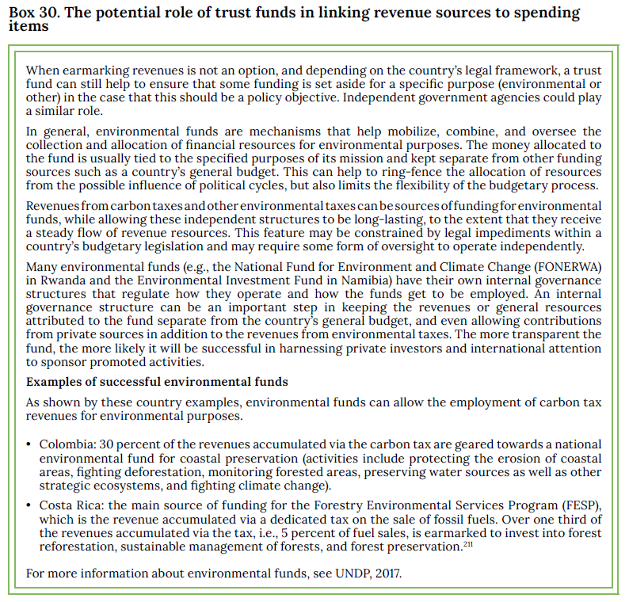
Revenue Use
3. Administrative systems to commit tax revenues

Slide 22
Revenue Use
4. Transparency and communication
When carbon taxes are introduced as part of a policy package, and revenues are used to compensate vulnerable industries, or households, or for environmental purposes, the perception of fairness and effectiveness of revenue use becomes an important factor for the public acceptability.
The labelling of a carbon tax can also be an important part of the communication strategy. A ‘fee-and-dividend’ renaming (with lump-sum payments) has been found to be an effective labelling strategy when the credibility of revenuers cycling for households and firms is chosen to increase political acceptance.

Slide 23
Further Reading
World Bank Group. (2015–2021). “State and Trends of Carbon Pricing report 2015-2021.” Washington, DC: World Bank. https://openknowledge.worldbank.org/handle/10986/13334
Vogt-Schilb, A., et al. (2019). “Cash transfers for pro - poor carbon taxes in Latin America and the Caribbean.” Nature Sustainability, 2, 941–948. https://doi.org/10.1038/s41893-019-0385-0
OECD. (2021). “Taxing Energy Use for Sustainable Development: Opportunities for energy tax and subsidy reform in selected developing and emerging economies.” https://www.oecd.org/tax/tax-policy/taxing-energy-use-for-sustainable-development.pdf
International Monetary Fund (IMF) (2019). “Fiscal Monitor: How to Monitor Climate Change.” https://www.imf.org/en/Publications/FM/Issues/2019/09/12/fiscal-monitor-october-2019

Slide 24
Interactions Between the Carbon Tax and Other Instruments
Introduction
A carbon tax is not introduced in a policy vacuum. Policies and regulations already in place may have relevant interactions with the tax and can enhance or inhibit its effectiveness, or even prompt additional administrative requirements for implementation.
2. Carbon Tax to be considered in context
The effectiveness of will not only depend on its design and implementation, but also on how the proposed carbon tax interacts with other related policies and instruments. Examples of such instruments include energy or fuel taxes, emission trading systems (ETS) and fossil fuel subsidies, as well as regulatory measures, such as renewable portfolio standards (RPS).
3. Assessing the interaction
To provide policymakers with a meaningful framework of how to assess interactions, this chapter will focus on the main types of interactions; for this, the terminology and conceptual framework developed by the World Bank is considered, where relevant types of policies are defined as:
• Complementary, in the sense that the various policies enhance each other’s performance.
• Overlapping, in that they run parallel to each other, with similar objectives.
• Countervailing, in which case they give rise to adverse or contradictory effects.

Slide 25
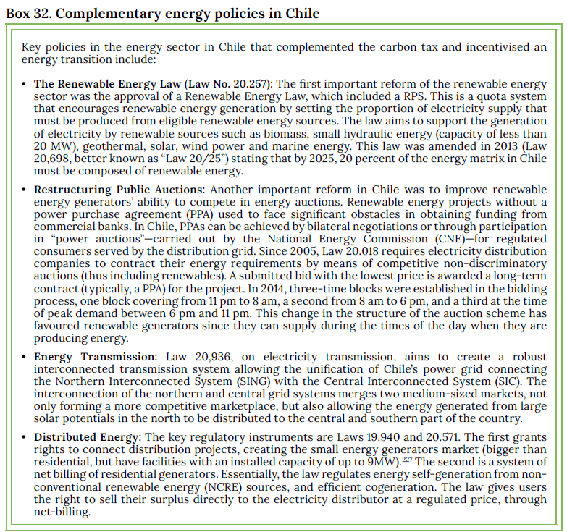
Interactions Between the Carbon Tax and Other Instruments
3.1 Complementary policies

Slide 26
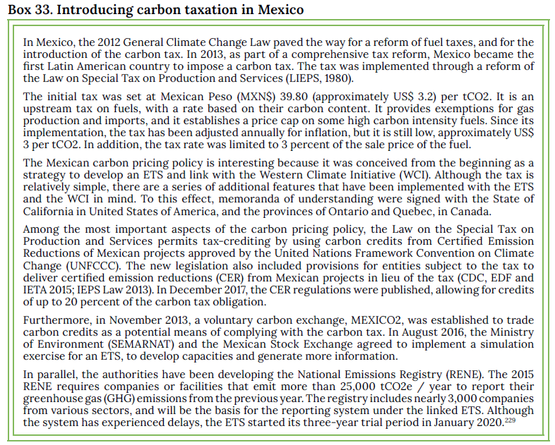
Interactions Between the Carbon Tax and Other Instruments
3.2 Overlapping policies

Slide 27
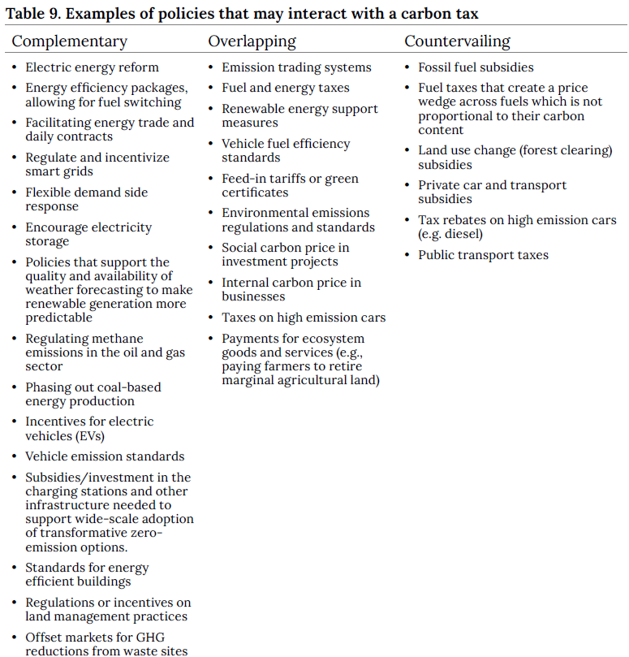
Interactions Between the Carbon Tax and Other Instruments
4. Policies and instruments interacting with a carbon tax

Slide 28
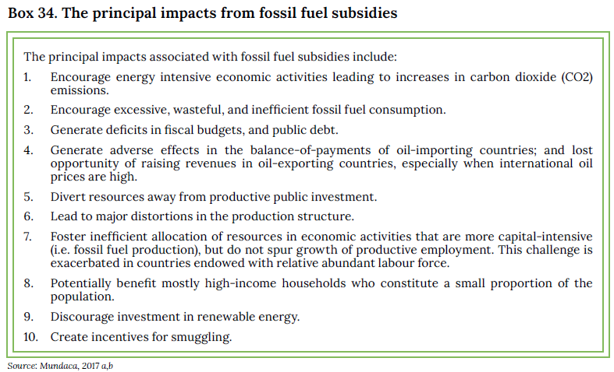
Interactions Between the Carbon Tax and Other Instruments
4.1 Carbon tax as one of the carbon pricing mechanisms
A carbon price is a powerful mechanism to reduce carbon emissions. There are several instruments that can put an explicit or implicit price on carbon emissions. Explicit carbon pricing includes carbon taxation, emissions trading, carbon crediting, and, under certain conditions, results-based climate financing. On the other hand, implicit carbon pricing influences the price of carbon in a more indirect way, through policies such as fuel taxation, energy efficiency standards, fossil fuel subsidy removal and incentives for low carbon technologies.
4.2 Fossil fuel subsidies

Slide 29
Interactions Between the Carbon Tax and Other Instruments
5. Addressing interactions
When considering the interaction in design, it can be addressed by:
Adjusting the design of the carbon tax before introduction. For example, the scope, taxable base, or rate of the carbon tax can be adjusted to avoid overlapping policies.
Adjusting the design and/or implementation of the other policies. For example, fossil fuel subsidies can be reduced in scope or phased out to avoid the countervailing interactions.
Introducing complementary policies to address aspects of a carbon tax that might make it less sustainable, e.g. introducing social measures that address the potentially regressive nature of a carbon tax.
Incorporating the carbon tax into other policies, by creating a hybrid tax or other pricing system.

Slide 30
Further Reading
Flues, F., & Van Dender, K. (2020). "Carbon pricing design: Effectiveness, efficiency and feasibility:An investment perspective." OECD Taxation Working Papers, 48. Paris: OECD Publishing.https://doi.org/10.1787/91ad6a1e-en
ICAP. (2020). “Mexico.” ICAP Carbon Action Partnership ETS Detailed Information. https://icapcarbonaction.com/en/?option=com_etsmap&task=export&format=pdf&layout=list&systems[]=59
OECD. (2019). “Taxing Energy Use in 2019: Using Taxes for Climate Action”. https://www.oecd-ilibrary.org/sites/058ca239-en/1/1/1/index.html?itemId=/content/publication/058ca239-en&_csp_=733ba7b0813af580090c8c6aac25027b&itemIGO=oecd&itemContentType=-Book
OECD. (2019). “Taxing Energy Use 2019: Country Note – Argentina.” https://www.oecd.org/tax/tax-policy/taxing-energy-use-argentina.pdf

