Slide 1
CCP-LAW
Curricula development on Climate Change Policy and Law
Subject title: Climate Change Policy
Instructor Name: Dr. Rahul Nikam
Project No of Reference: 618874-EPP-1-2020-1-VN-EPPKA2-CBHE-JP:
The European Commission's support for the production of this publication does not constitute an endorsement of the contents, which reflect the views only of the authors, and the Commission cannot be held responsible for any use which may be made of the information contained therein.

Slide 2
Carbon pricing - international trade and the decarbonization of international trade
Carbon pricing & international trade
Carbon pricing can be an important instrument for reducing carbon emissions
Carbon pricing schemes proliferate but cover only a modest share of emissions
Pricing carbon globally could contribute significantly to the low-carbon transition
Promoting carbon pricing globally faces major challenges
Free-rider problem
Fair burden-sharing
Technical challenges in global carbon pricing
Uncoordinated carbon pricing policies could undermine climate action and lead to trade tensions.
It can lead to carbon leakage, loss of competitiveness, and burdensome costs

Slide 3
Carbon pricing - international trade and the decarbonization of international trade
Differences in carbon prices are likely to lead to limited carbon leakage
Competitiveness losses in emission-intensive trade-exposed sectors could be substantial
Unconditional carbon pricing schemes increase administrative and compliance costs
b. The absence of coordinated climate action could lead to the adoption of border carbon adjustment mechanisms
Economic argument favoring border carbon adjustment
Economic arguments against border carbon adjustments
Adopting BCA involves a host of design questions
3. Greater international cooperation is required to advance ambitious carbon pricing policies
International cooperation on carbon pricing is slowly taking shape
International trade cooperation can contribute to supporting carbon pricing action

Slide 4
Carbon pricing - international trade and the decarbonization of international trade
c. WTO disciplines help to prevent protectionism and to promote well-designed carbon pricing
d. The needs of all countries, and developing countries in particular, must be part of discussions on carbon pricing

Slide 5
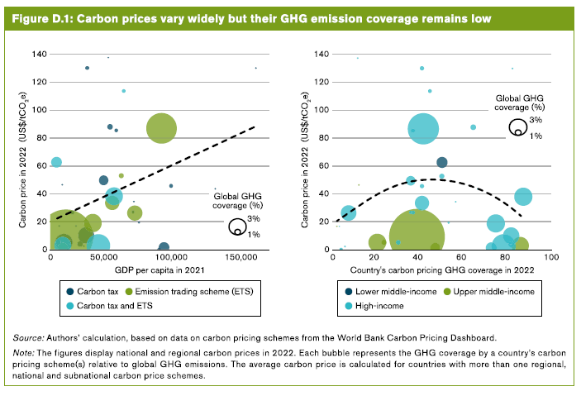
Carbon pricing - international trade and the decarbonization of international trade

Slide 6
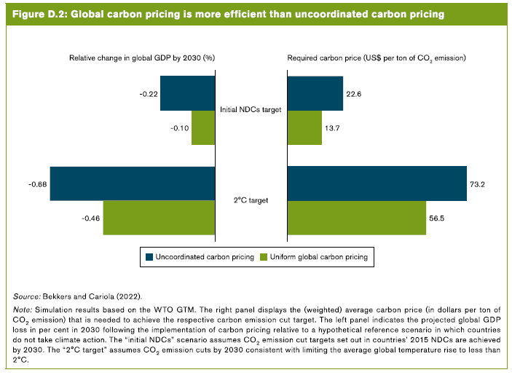
Carbon pricing - international trade and the decarbonization of international trade

Slide 7
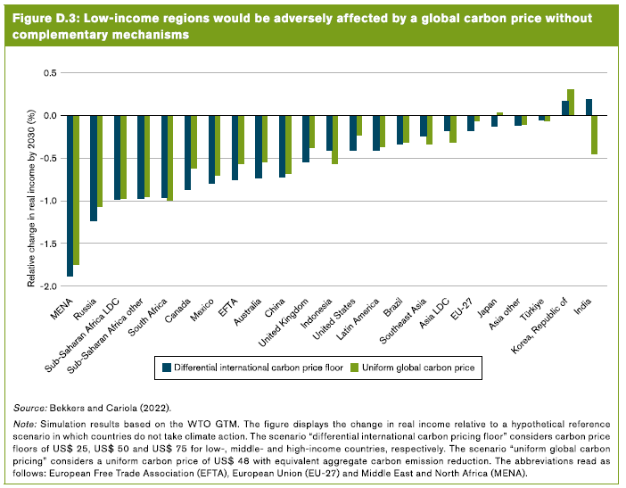
Carbon pricing - international trade and the decarbonization of international trade

Slide 8
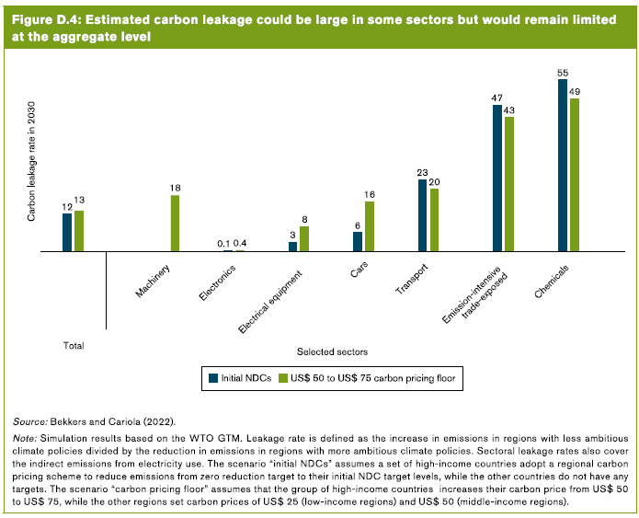
Carbon pricing - international trade and the decarbonization of international trade

Slide 9
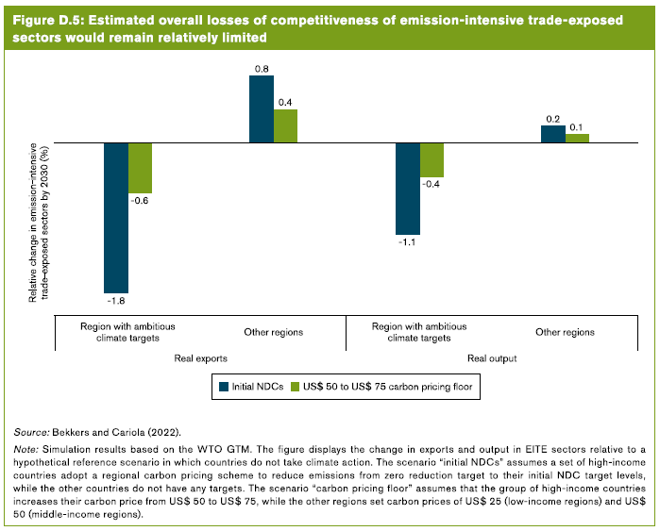
Carbon pricing - international trade and the decarbonization of international trade

Slide 10
Further Reading
Trade and climate change https://www.wto.org/english/tratop_e/envir_e/climate_intro_e.htm
World Trade Report 2022 Climate change and international trade https://www.wto.org/english/res_e/publications_e/wtr22_e.htm

